Slide 1
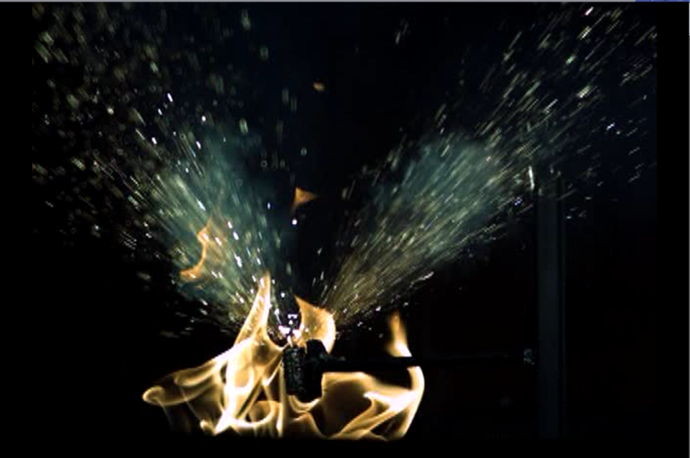
Hazards Produced by Lithium Batteries in Thermal Runaway in Aircraft Cargo Compartments

Slide 2
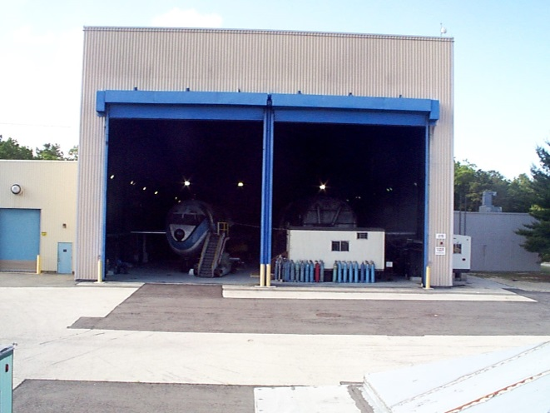
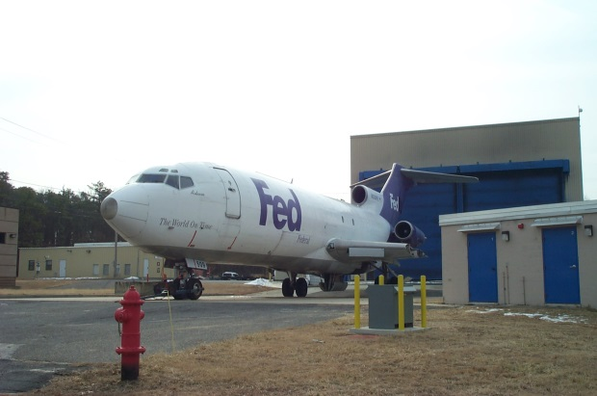
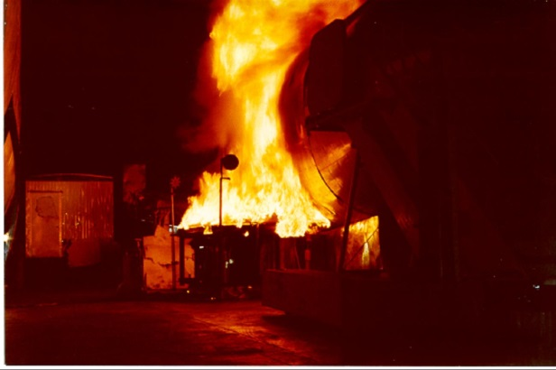
FAA William J. Hughes Technical Center
Fire Safety Branch
Atlantic City Airport, NJ
The Fire Safety Branch operates extensive testing facilities at the Technical Center. It is responsible for conducting the FAA research and testing on aircraft fire safety related issues.
This presentation documents recent test results on the fire hazards of the air transport of bulk shipments of lithium-ion batteries.

Slide 3
Outline
Introduction
Thermal Runaway Propagation
Fire Hardened Container Test
Analysis of Flammable Gases in a 21.7 Liter Sphere
Effectiveness of Halon 1301 in a 10.8 m³ Pressure Vessel.
Impact of Vent Gas Ignition on Pressure Relief Panels in a 737 Cargo Compartment
Thermal Runaway in a Single Large Format Cell
Summary of Findings

Slide 4
Introduction
Thermal Runaway Causes a Rapid Internal Pressure Rise Within a Cell
Consequences Depends on Battery Chemistry, Design, State of Charge, and Surrounding Environment, and May Include One or More of the Following Effects
  Contents Will be Expelled or Vented as Flame, Smoke, Toxic Gases, and Flammable Gases.
  Battery May Burn
  Battery May Explode
  Battery May Become a Projectile
In a Bulk Package of Batteries, a Single Cell in Thermal Runaway Will Cause Thermal Runaway to Propagate to the Remaining Batteries
Package to Package Propagation Can Also Occur

Slide 5
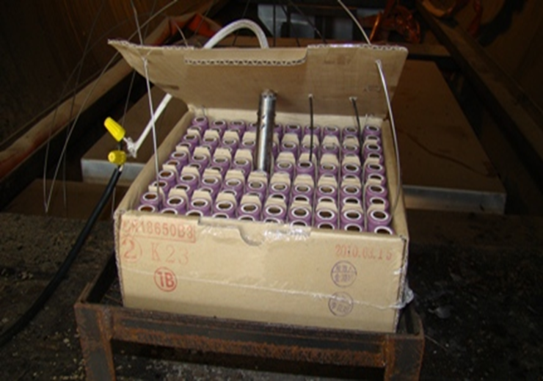
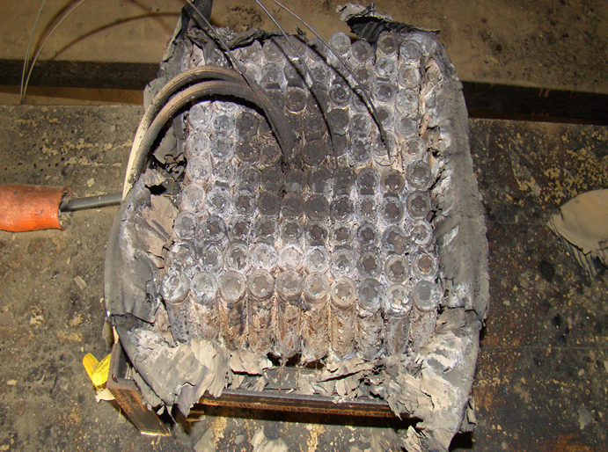
Thermal Runaway Propagation
A single cell in thermal runaway generates sufficient heat to induce thermal runaway in adjacent cells. This results in the propagation of thermal runaway through the entire package, and from package to package.
Current packaging does not impede the propagation of thermal runaway.
Halon 1301 is not effective in stopping thermal runaway propagation.

Slide 6
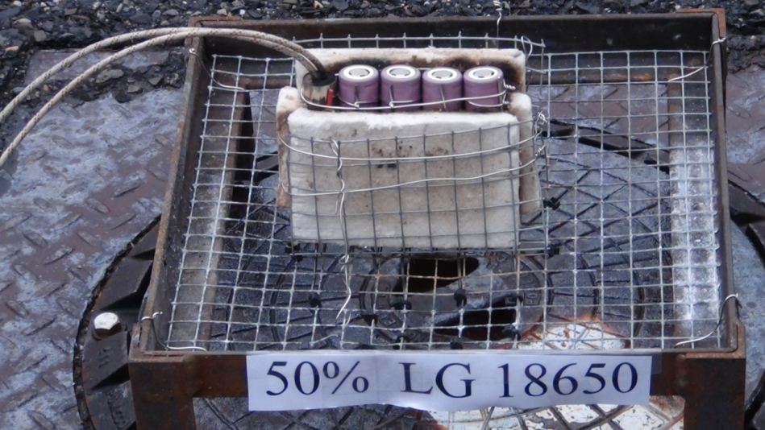
Effect of State of Charge on Thermal Runaway Propagation
Testing has shown that a low state of charge can affect propagation.
  Variables include cell chemistry, energy density, and cell design.
Cells are currently shipped at about 50% SOC or greater, where they readily propagate.
For the most common chemistry and energy density, a SOC of 30% has been shown to limit propagation.

Slide 7
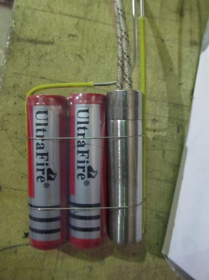
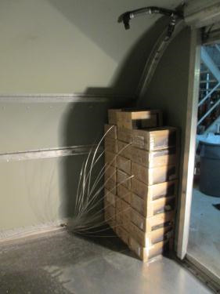
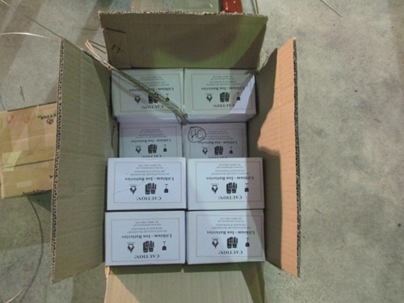
5000 Lithium-ion 18650 Batteries in a Fire Resistant Container (FRC) with an Internal Fire Suppression System
5000 batteries placed against front wall of FRC
8 Batteries per box. Compliant with ICAO Section 2 packaging requirements. Hazardous material declaration not required
Thermal runaway initiated by a cartridge heater attached to batteries

Slide 8
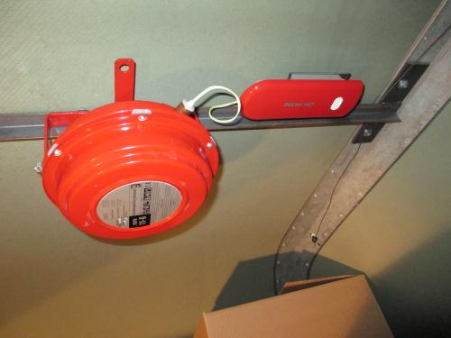
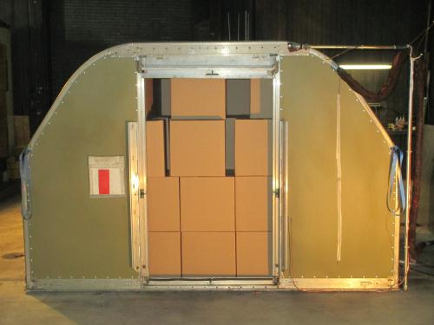
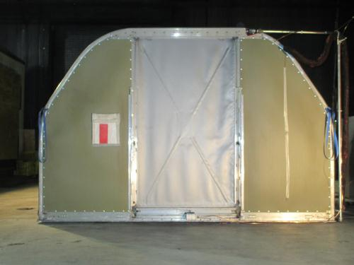
5000 Lithium-ion 18650 Batteries in a Fire Resistant Container (FRC) with an Internal Fire Suppression System
Fire suppression system installed on ceiling of FRC
Remaining free space inside FRC loaded with cardboard boxes filled with shredded paper.

Slide 9

Ignition of Flammable Gases Vented from Batteries in Thermal Runaway

Slide 10
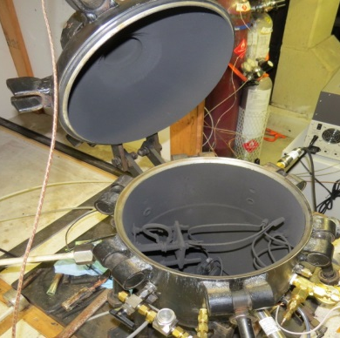
Vented Gas Analysis from Lithium-ion Cells
Tests were performed in a 21.7L combustion sphere to determine vent gas composition and quantity.
  Volume of vented gases measured from pressure rise calculations
Pressure Transducer (1Hz, 0-15psia)
Clamp-style cell holder (for cell and cartridge heater)
Spark Igniter
Gas collection port for sample bag.
Pressure Transducer (500Hz, 0-100psia)

Slide 11
Testing Demonstrating the Increase in Vent Gas Volume with Increased State of Charge (SOC)
Tests conducted at 10 psia. (Typical pressure inside fuselage at cruise altitude)

Slide 12
Vented Gas Composition
Based on FAA test results and other published data, the following composition and proportions of vented gases was selected to represent a standardized fuel for further testing.
  30.1% CO₂
  27.6% H₂
  22.9% CO
  6.37% CH₄
  4.48% C₃H₆
  2.21% C₂H₄
  1.57% C₄H₁₀
  1.17% C₂H₆
  .56% C₄H₈
  .268% C₃H₈

Slide 13
Vented Gas Composition
The pressure rise from the ignition of the selected gas composition was compared to the pressure rise from the ignition of vented gas from actual 18650 batteries in thermal runaway.
  Max pressure from actual gas at altitude: 70.1 psia
  Max pressure from bottled gas at altitude: 71.4 psia

Slide 14
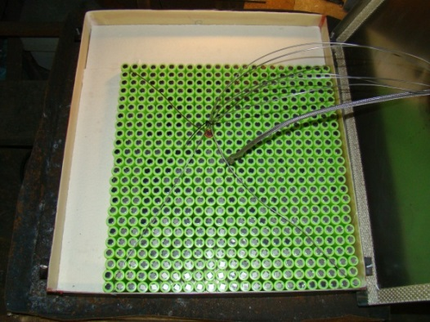
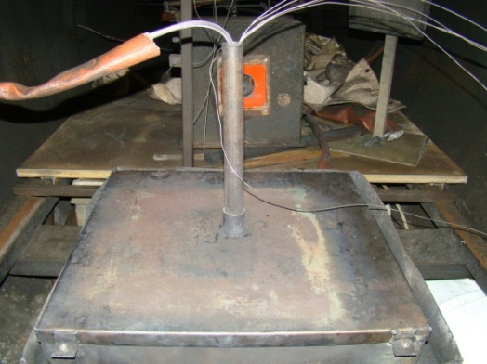
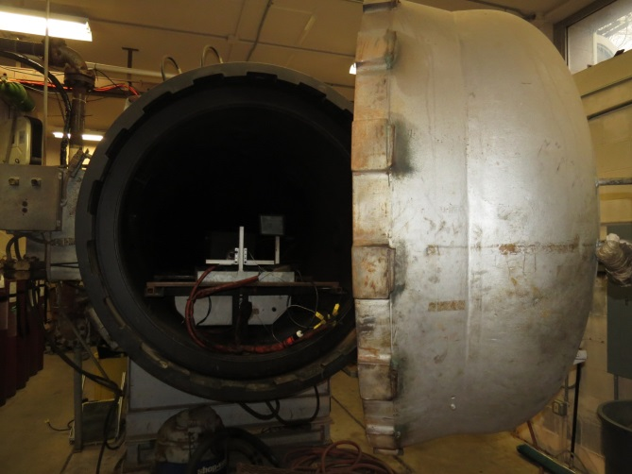
Halon Tests
Tests were performed in a 10.8m³ chamber to evaluate the effectiveness of Halon 1301 in suppressing the ignition of vented gases.
Thermal runaway was initiated with a cartridge heater
Halon was discharged into the chamber
Sparking electrodes were activated
Pressure rise was recorded.

Slide 15
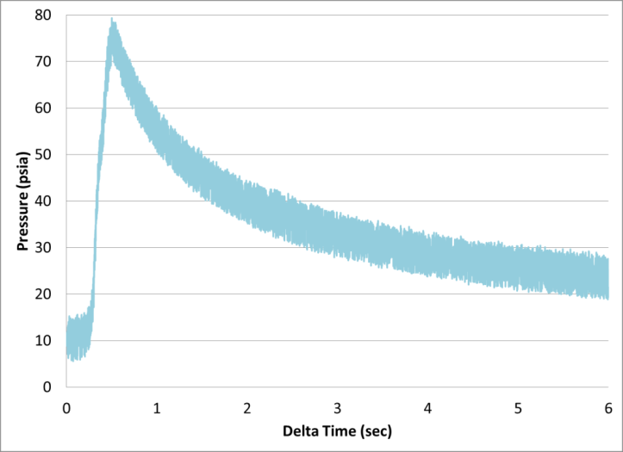
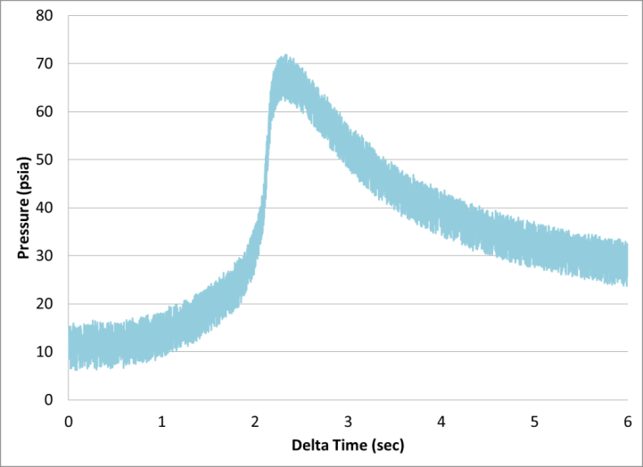
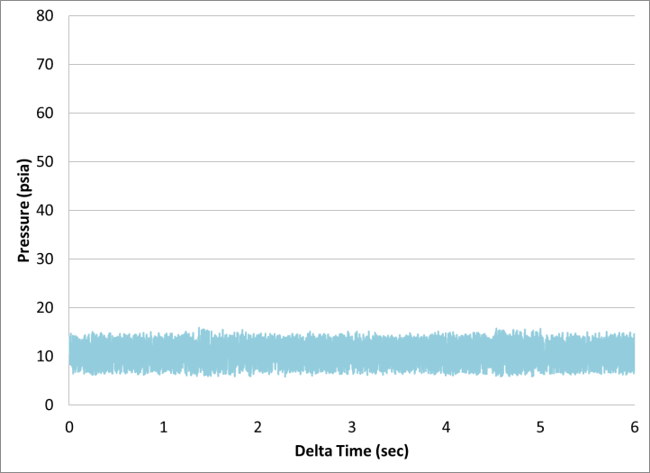
Testing Demonstrating that the 5% Design Concentration of Halon 1301 is Insufficient to Suppress the Flammable Gas Explosion
No suppression
5.3% Halon
10.4% Halon
Note: The Class C cargo compartments in passenger aircraft are designed to provide an initial concentration of 5% Halon and maintain a concentration above 3% in an empty compartment.

Slide 16
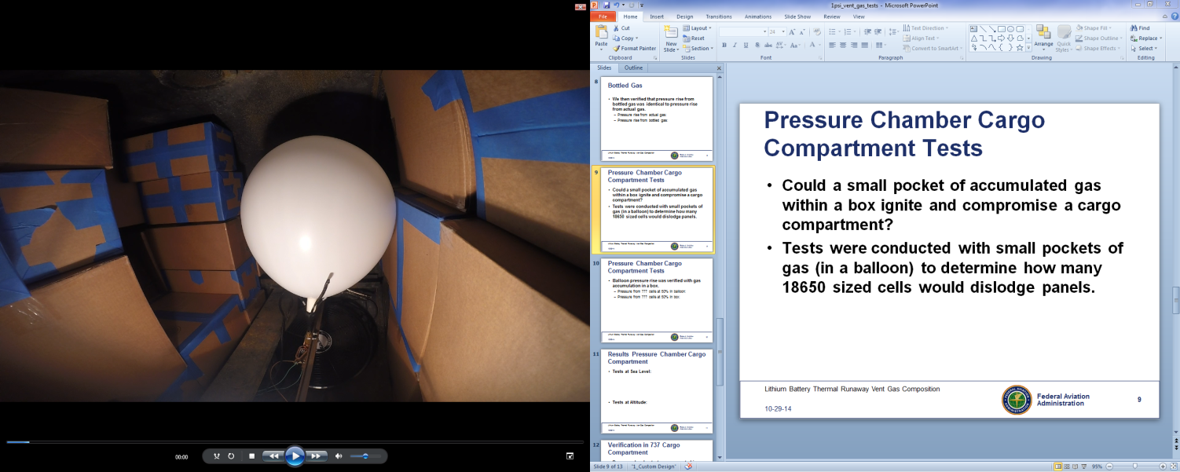
Pressure Chamber Cargo Compartment Tests
Tests were conducted with small quantities of gas (in a balloon) to determine how many 18650 sized cells would compromise the fire suppression system capability in a Class C cargo compartment.
The tests measured the resulting pressure rise in the chamber from the ignition of vented gases representing different quantities of 18650 cells.

Slide 17
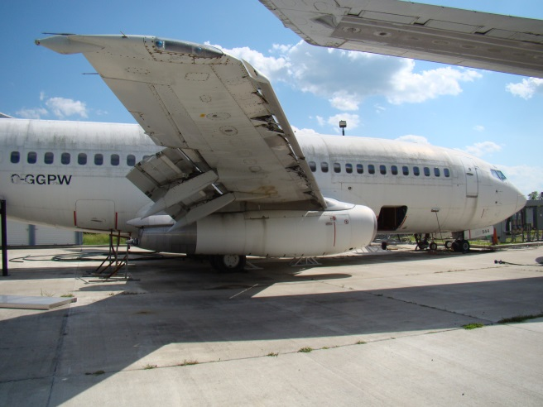
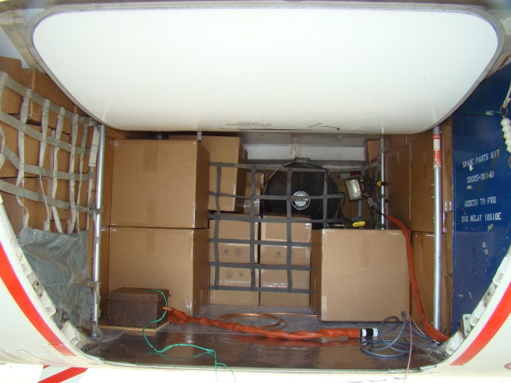
Verification in 737 Cargo Compartment
Tests were repeated in the forward cargo compartment of a 737 with 70% loading.
  Total volume of compartment (documented): 370ft³
  Volume of boxes based on 70% loading: 259ft³

Slide 18
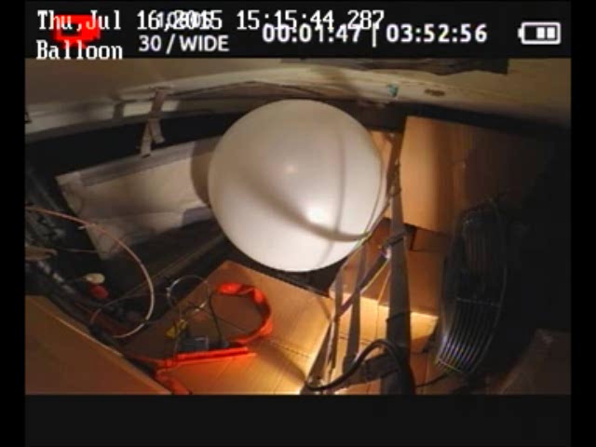
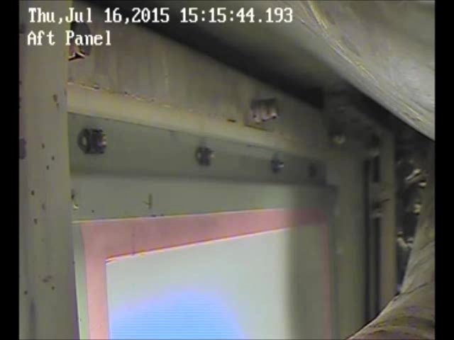
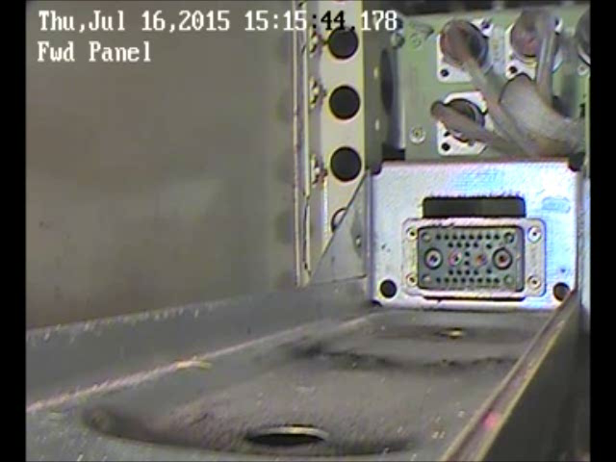
737 Cargo Compartment Results
20 cells at 50% SOC
6.44 cells at 100% SOC
1.2 psi peak pressure
Additional panel behind door (not shown) and panel on sidewall (not shown) were also compromised.

Slide 19
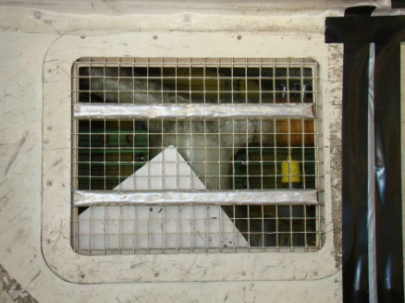
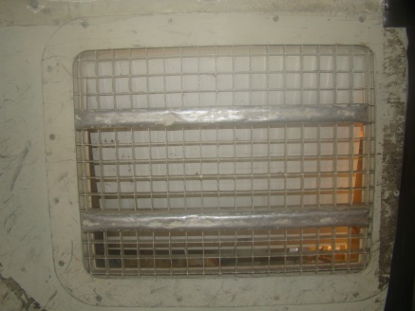
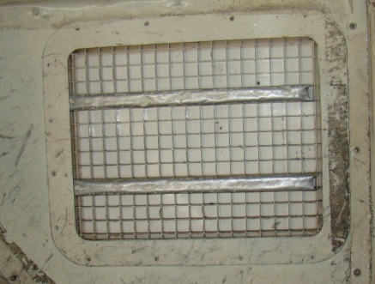
737 Cargo Compartment Results

Slide 20
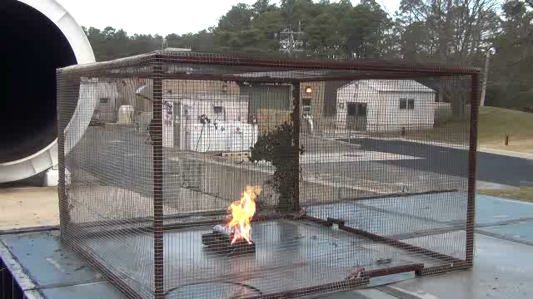
Large format cell

Slide 21
Summary of Results
A bulk shipment of Lithium ion batteries in thermal runaway may cause an explosion in a fire hardened container capable of extinguishing or suppressing non-Lithium battery cargo fires
Lithium ion batteries in thermal runaway can produce large quantities of flammable gases, including hydrogen, hydrocarbons, and carbon monoxide
The production of flammable gases from a Lithium ion battery increases with state-of-charge, particularly at or above 50%
The design concentration of Halon 1301 extinguishing agent (5%) in a passenger airplane cargo compartment (Class C) is incapable of preventing an explosion caused by the ignition of flammable gases produced by Lithium ion batteries in thermal runaway

Slide 22
Summary of Results (continued)
The ignition of flammable gases produced by a small number of Lithium ion batteries in thermal runaway (less than 10, depending on state-of-charge), can cause an over pressure in a passenger airplane cargo compartment with a 70% load factor, that will dislodge pressure release panels designed to activate between 0.5-1.0 psi, which would compromise the fire protection capabilities of the cargo compartment.
Preliminary testing of large format lithium-ion batteries (typically used in electric vehicles) indicate an increase in fire severity proportional to the increased battery size and capacity. Additional testing is needed to characterize this hazard.

Slide 23
FAA Technical Center Lithium Battery Test Reports and Presentations can be found on the Fire Safety Branch Website at:
https://www.fire.tc.faa.gov/systems/Lithium-Batteries

