Slide 1
UN Battery Classification Test Method Development

Slide 2
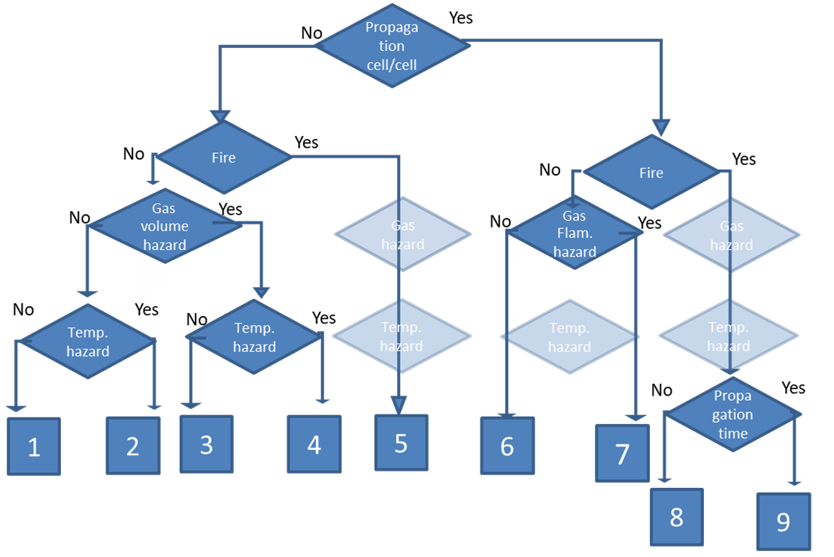
Introduction
Currently all lithium batteries are classified for shipping as either lithium-ion or lithium metal
All lithium-ion or lithium metal batteries are not created equal
New classifications reflect actual hazards:
Propagation
Fire
Gas Hazard
Temperature Hazard

Slide 3
Lithium Battery Classification
By Default, no testing will be required, all hazards would be considered worst case with common chemistry
Purpose of this testing is to determine worst case as well as developing test methods for individual batteries to be classified on their own
Gas Volume Test (all gas emitted is assumed to be toxic)
Propagation Test
Flammability and temperature hazard determined in one of these tests
If a battery shipper/seller can prove their battery is inherently safer, then they may be able to ship with fewer restrictions

Slide 4
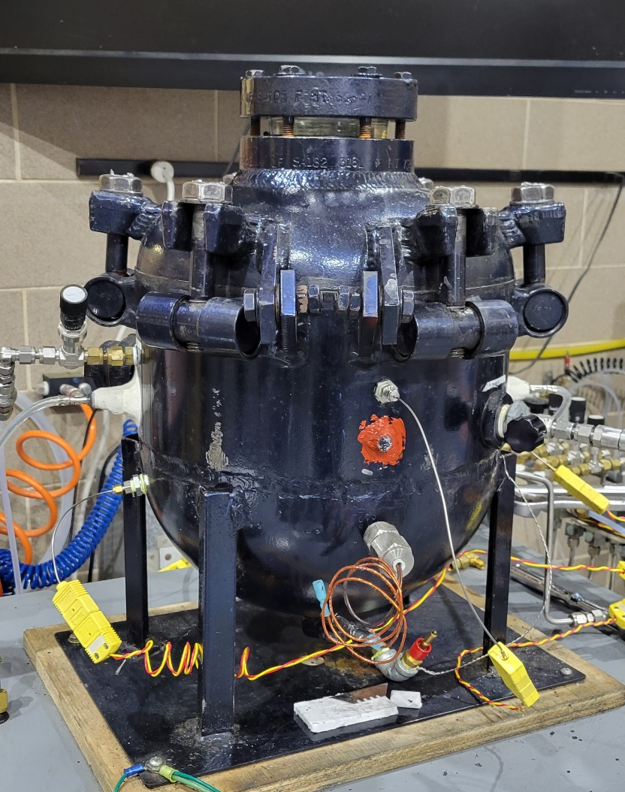
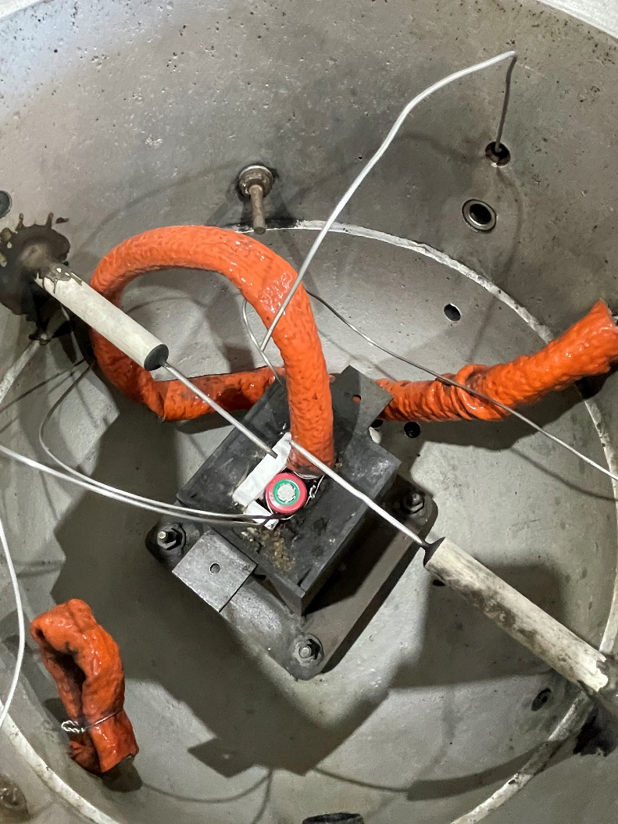
Battery Gas Volume Measurements
Single cell placed in 21.7L pressure vessel and heated until thermal runaway
Instrumented with pressure transducers and thermocouples for heater, battery, and ambient air
Chamber is evacuated with vacuum pump, then filled with nitrogen at atmospheric pressure
Battery gas volume is calculated from temperature and pressure measurements
All cells at 100% SOC

Slide 5
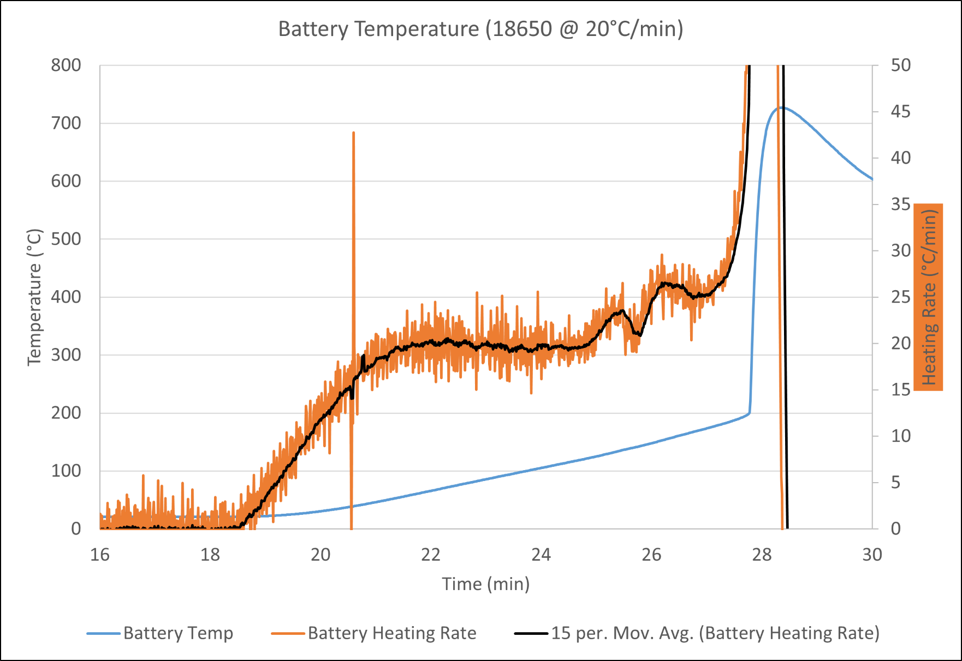
Battery Gas Volume Measurements
Heating rate controlled with temperature controller
Cells heated at rates of 5°C, 10°C, and 20°C per minute
Example shows an 18650 cell heated at 20°C/min

Slide 6
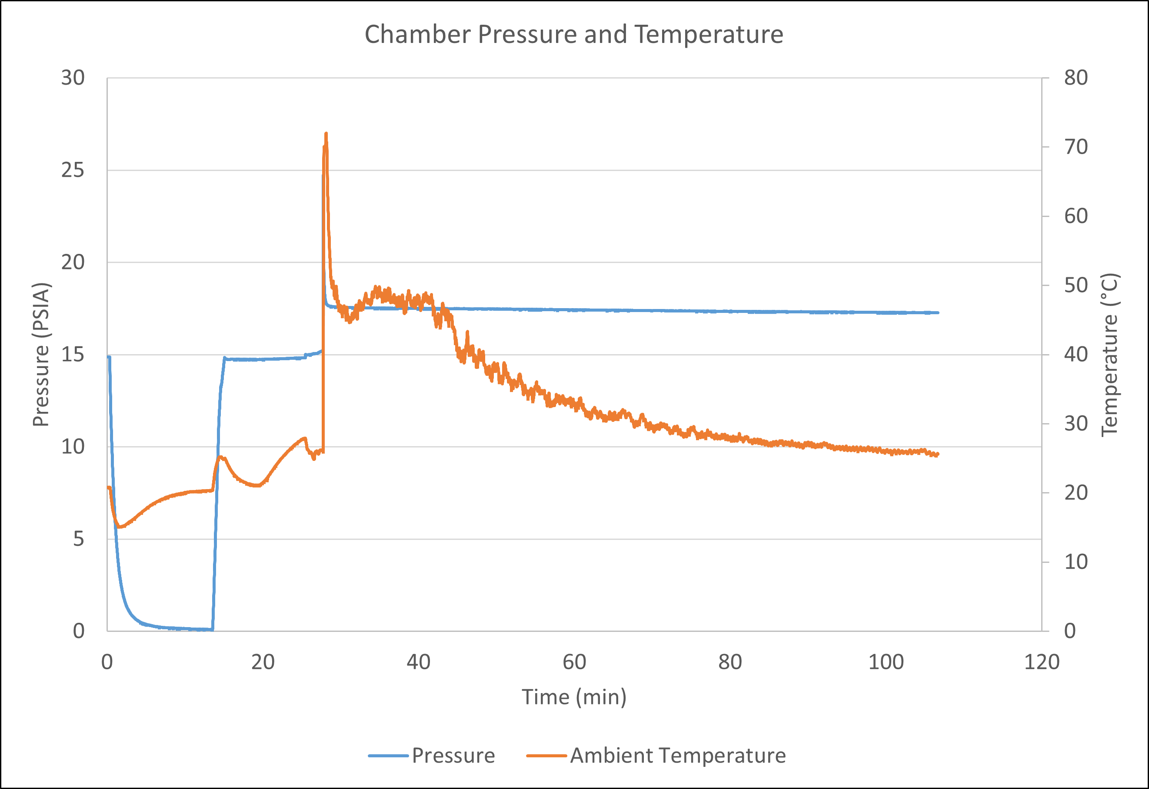
Battery Gas Volume Measurements
Chamber pressure and temperature data from same test
Calculated amount of gas (in moles) using ideal gas law
Converted to liters of gas at NIST normal temperature and pressure (NTP: 20°C and 1 atm)
This test produced 3.39L of gas
Final pressure and temperature
Initial pressure and temperature

Slide 7
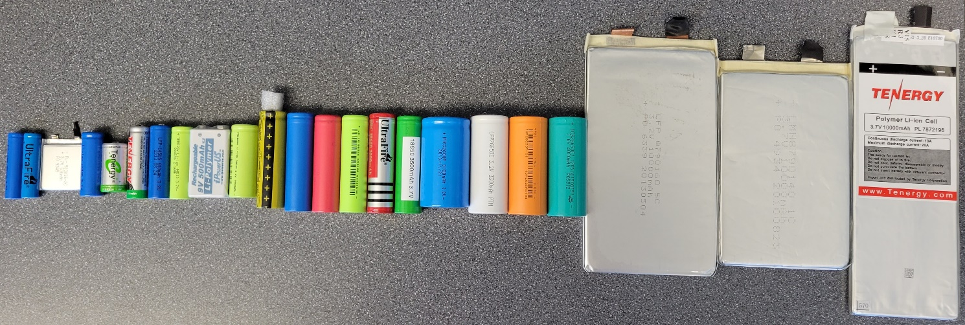
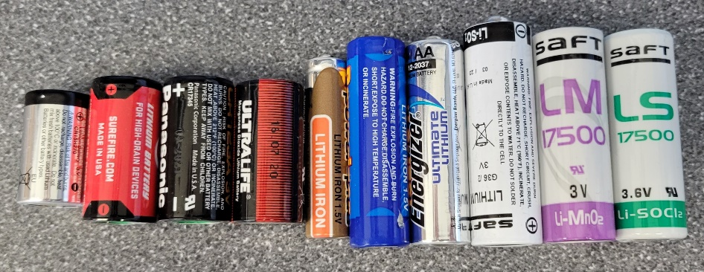
Battery Gas Volume Measurements
Tested 26 lithium-ion cells
Size from AAA to large pouches
LCO, NMC, LFP, LTO, LMN chemistries
Tested 11 lithium metal cells
Button cells up to 17500
LiFeS₂, LiMnO_{2,} LiSOCl₂, LiSO₂ chemistries
Lithium-ion batteries tested
Lithium metal batteries tested

Slide 8
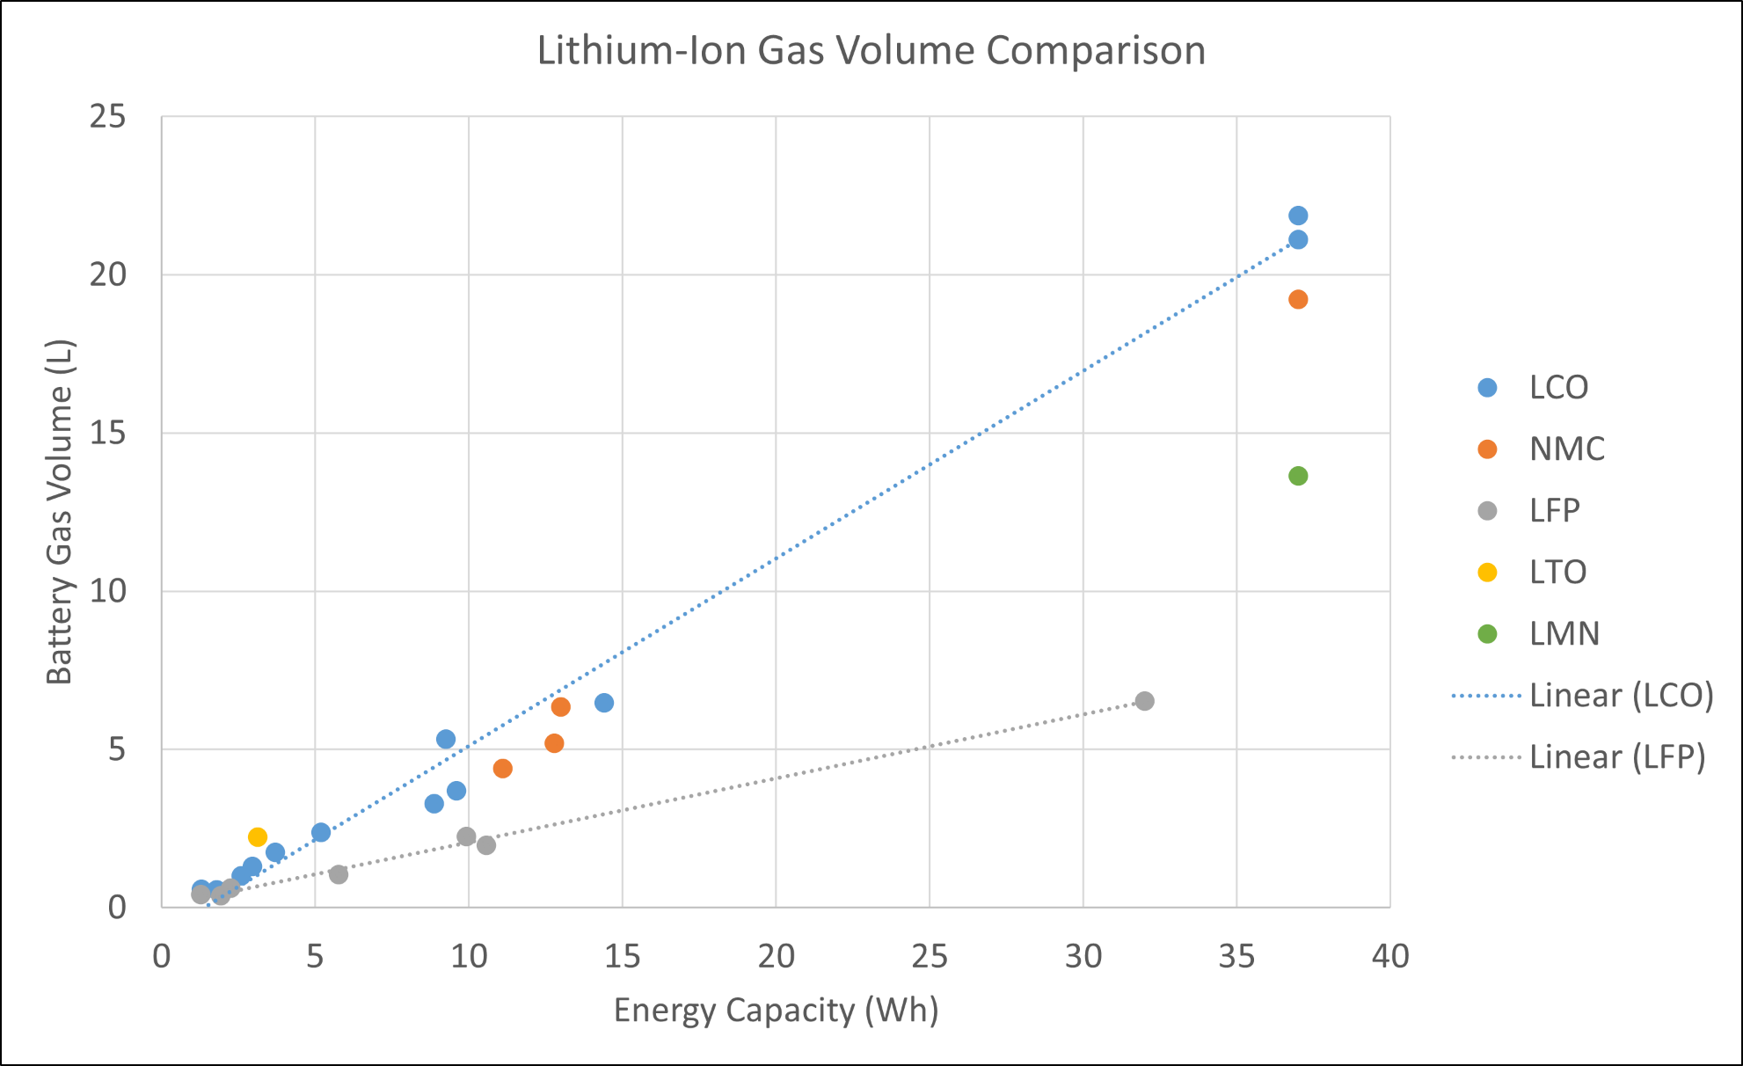
Battery Gas Volume Measurements

Slide 9
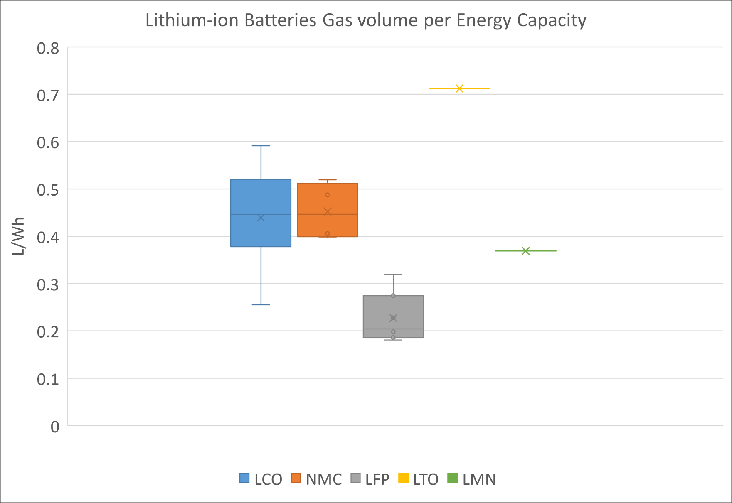
Battery Gas Volume Measurements
Highest was LTO 18650 at 0.71 L/Wh
Highest LCO was 10,000 mAh pouch cell at 0.59 L/Wh
Highest LFP was AA at 0.32 L/Wh

Slide 10
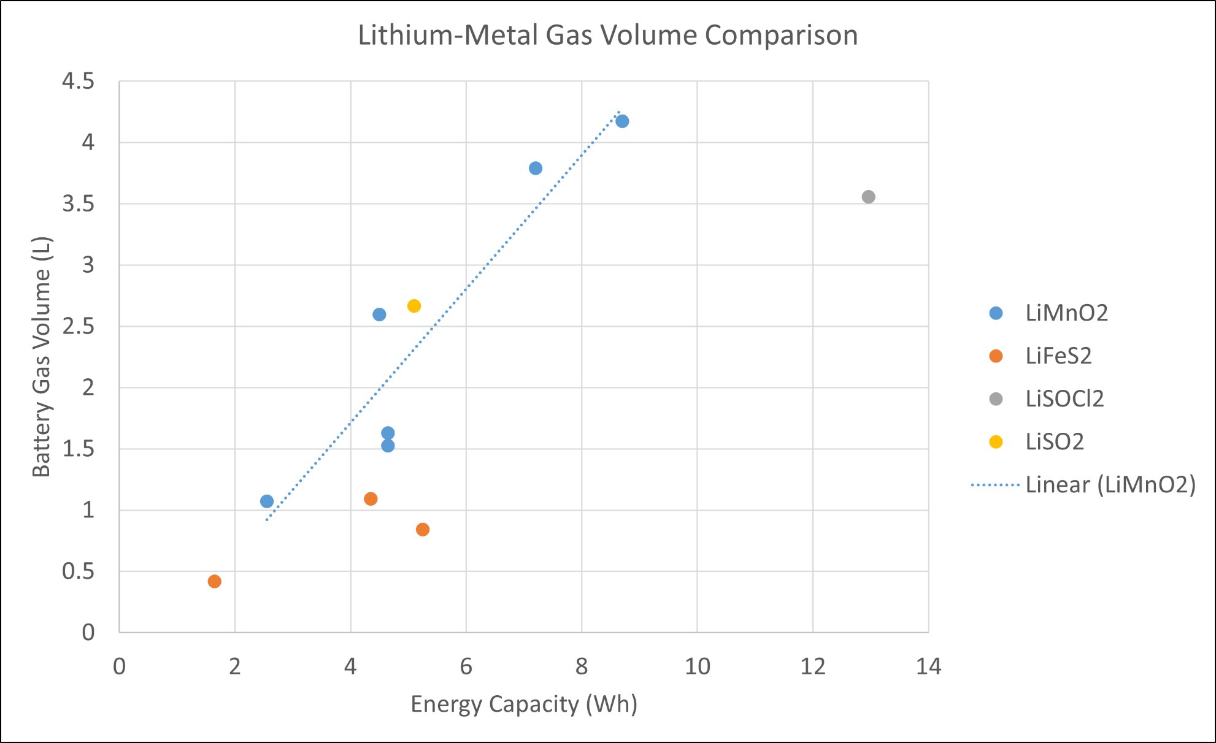
Battery Gas Volume Measurements

Slide 11
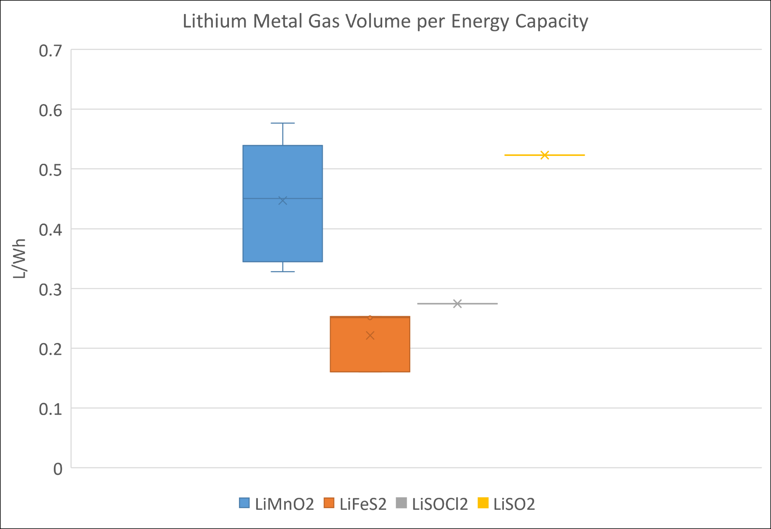
Battery Gas Volume Measurements
Highest was LiMnO2 CR123A at 0.58L/Wh
Need larger sample size of other cells

Slide 12
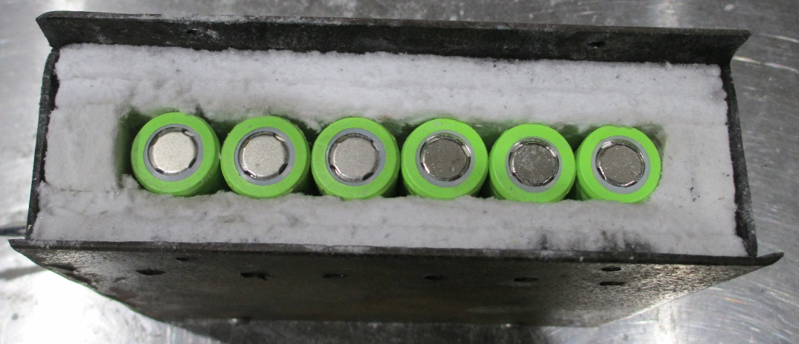
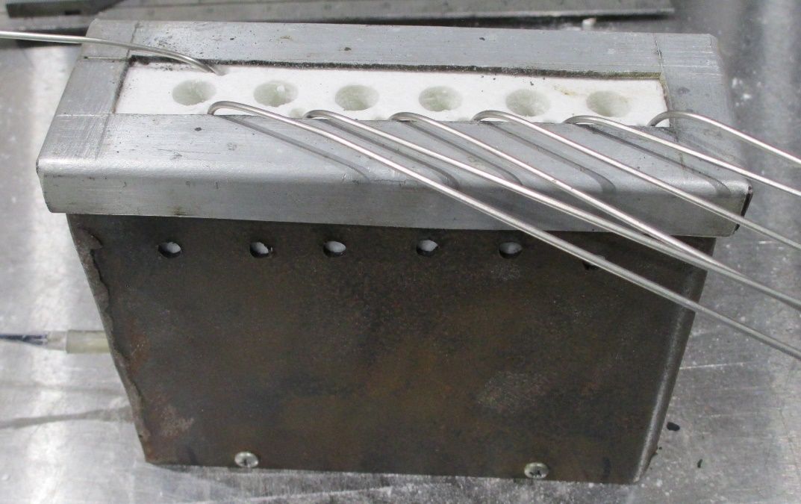
Battery Propagation Testing
6 cells placed in a line in an insulated box to determine if thermal runaway will propagate down the line
Cell #1 heated at 20°C/min until thermal runaway occurs, then heater is turned off
Thermocouple placed on each cell to measure temperature
Top of box is vented to allow gas to escape
Spark ignitor placed 3 inches above the box
To determine if gas is flammable
Ignitor turned off after first cell goes into thermal runaway
All cells at 100% SOC
Tested 20 Li-ions and 16 Li metals so far

Slide 13
Notes:
Video starts 12:15 after start of test

Slide 14
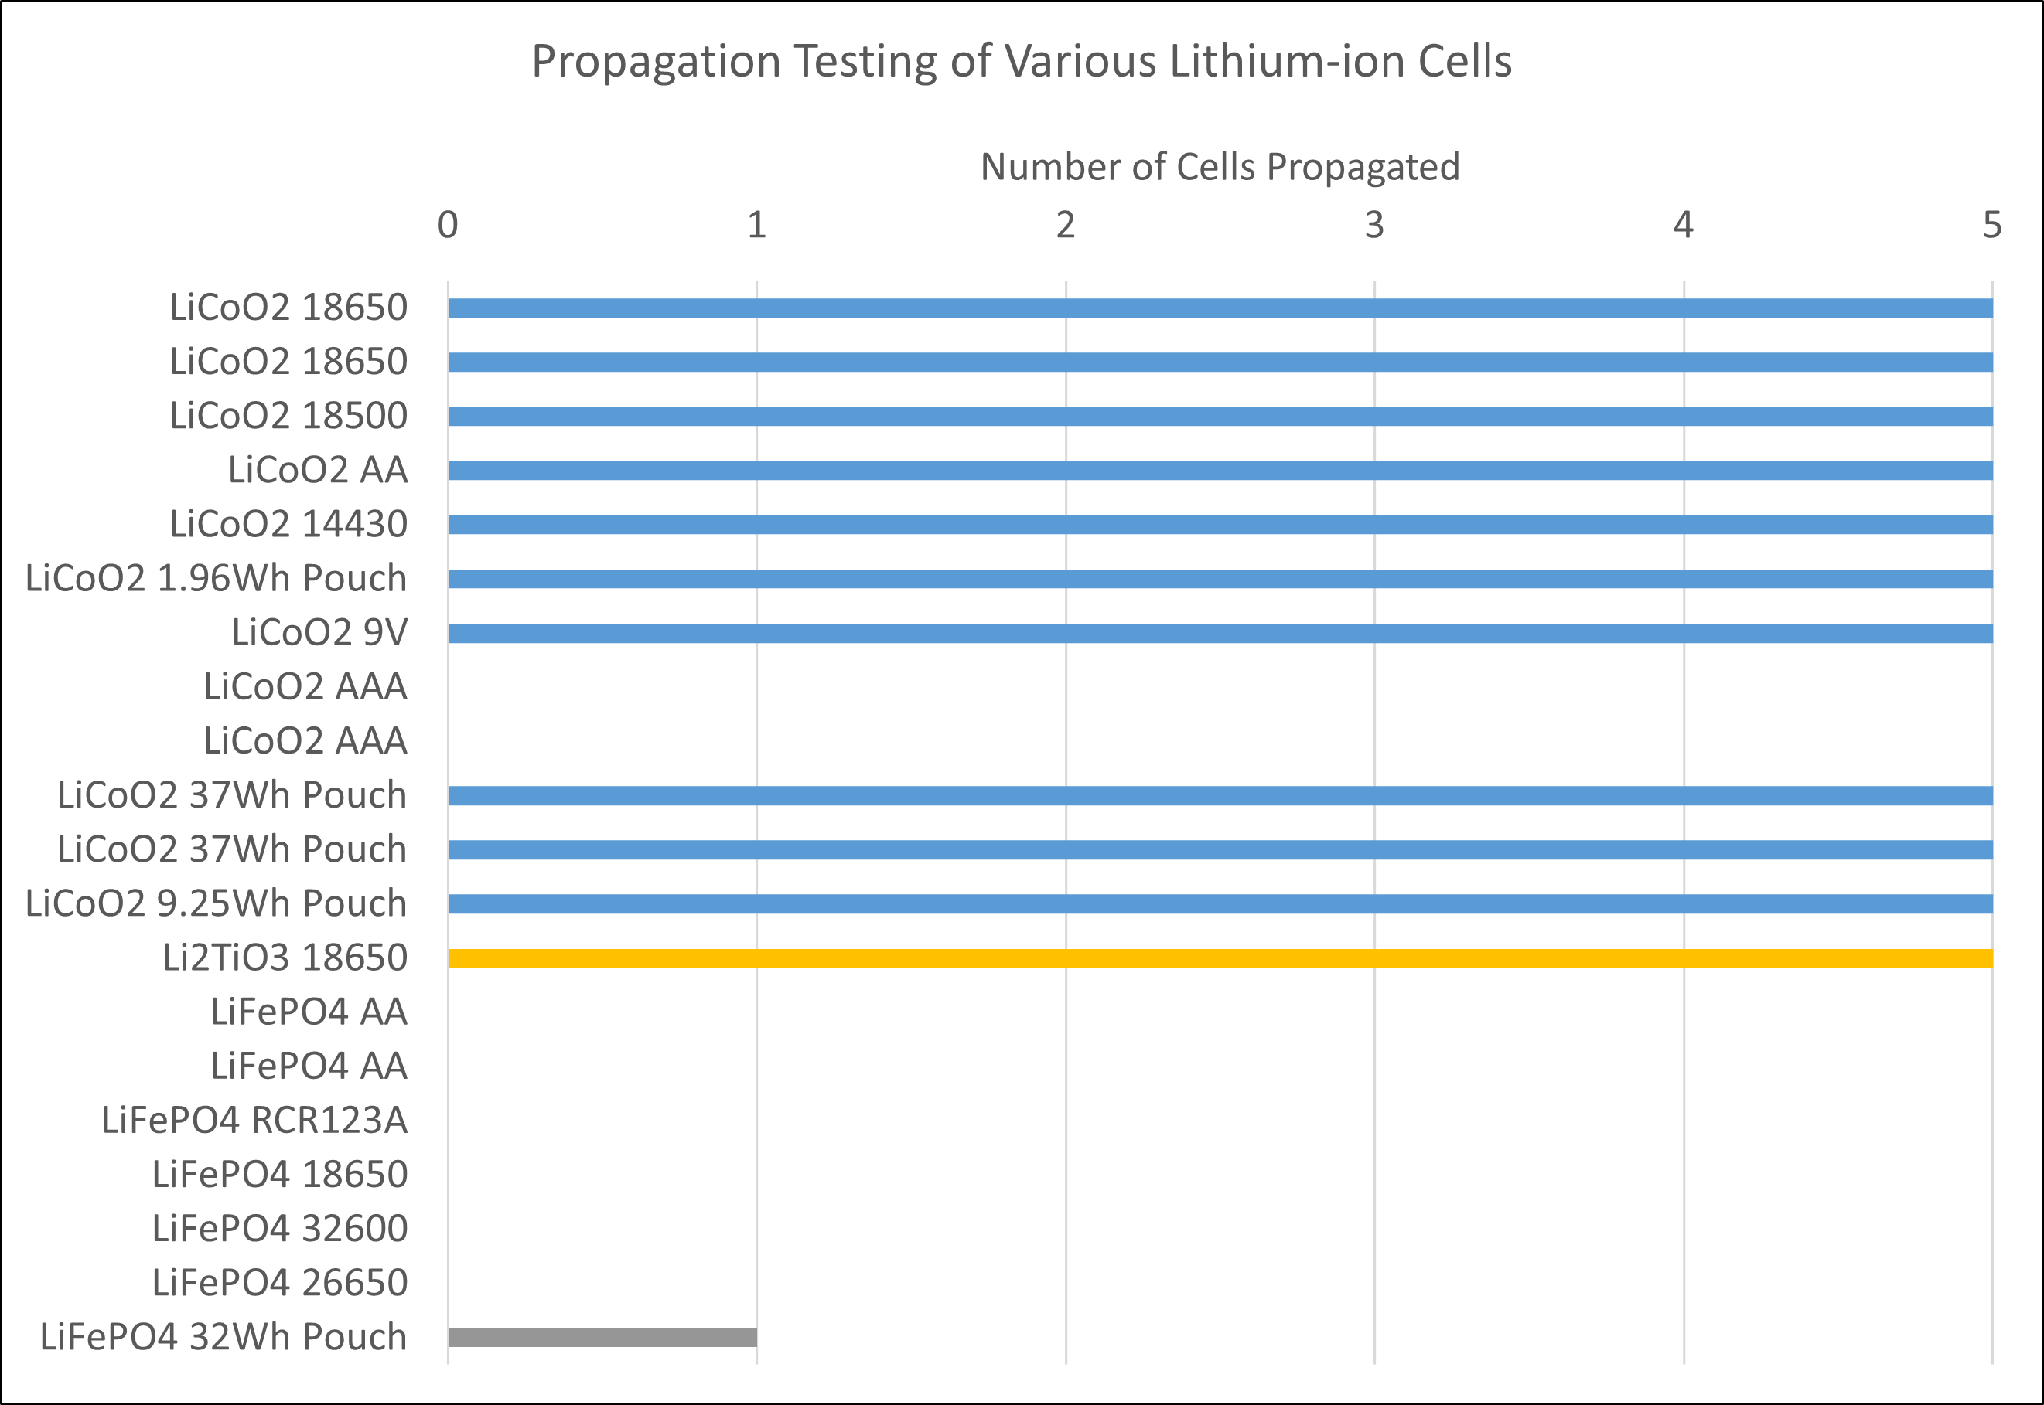
Battery Propagation Testing
All LCO cells propagated except AAA size
No LFP cells fully propagated
All cells produced flammable gas

Slide 15
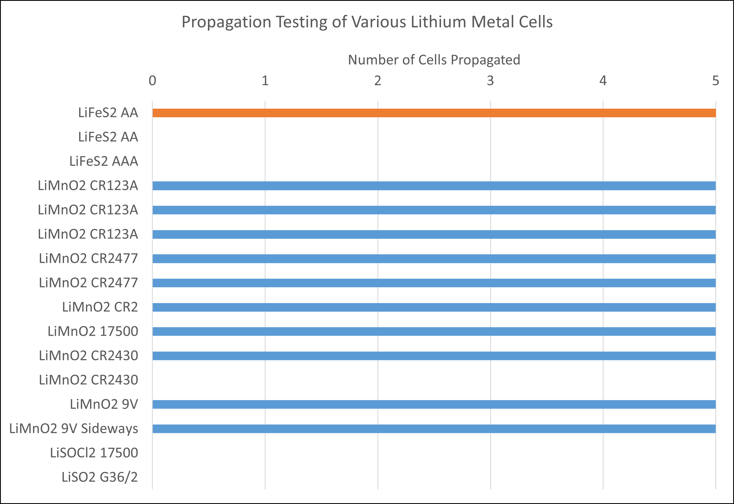
Battery Propagation Testing
LiFeS₂ propagated at AA size for one brand, not AAA
All cells produced flammable gas except LiSO2
Small CR2430 button cell propagated (0.855 Wh)

Slide 16
Speed of Propagation
Calculated from the diameter (or length) of the cell and the time it takes to propagate from cell 1 to cell 6
$Speed=\frac{Diameter × 5}{Time (1→6)}$
Diameter

Slide 17
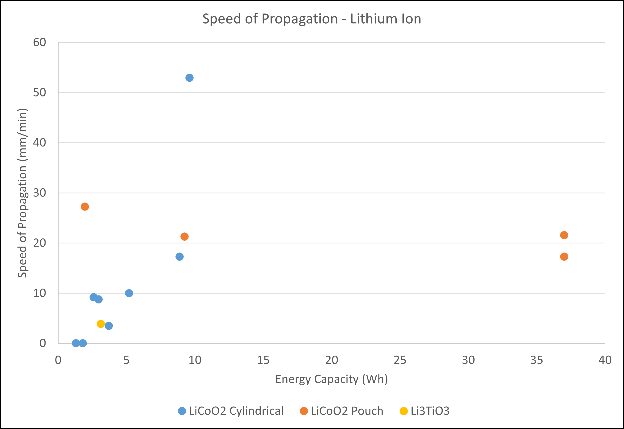
Speed of Propagation
Cylindrical cells increased as size and energy capacity increased
Pouch cells stayed relatively constant regardless of size

Slide 18
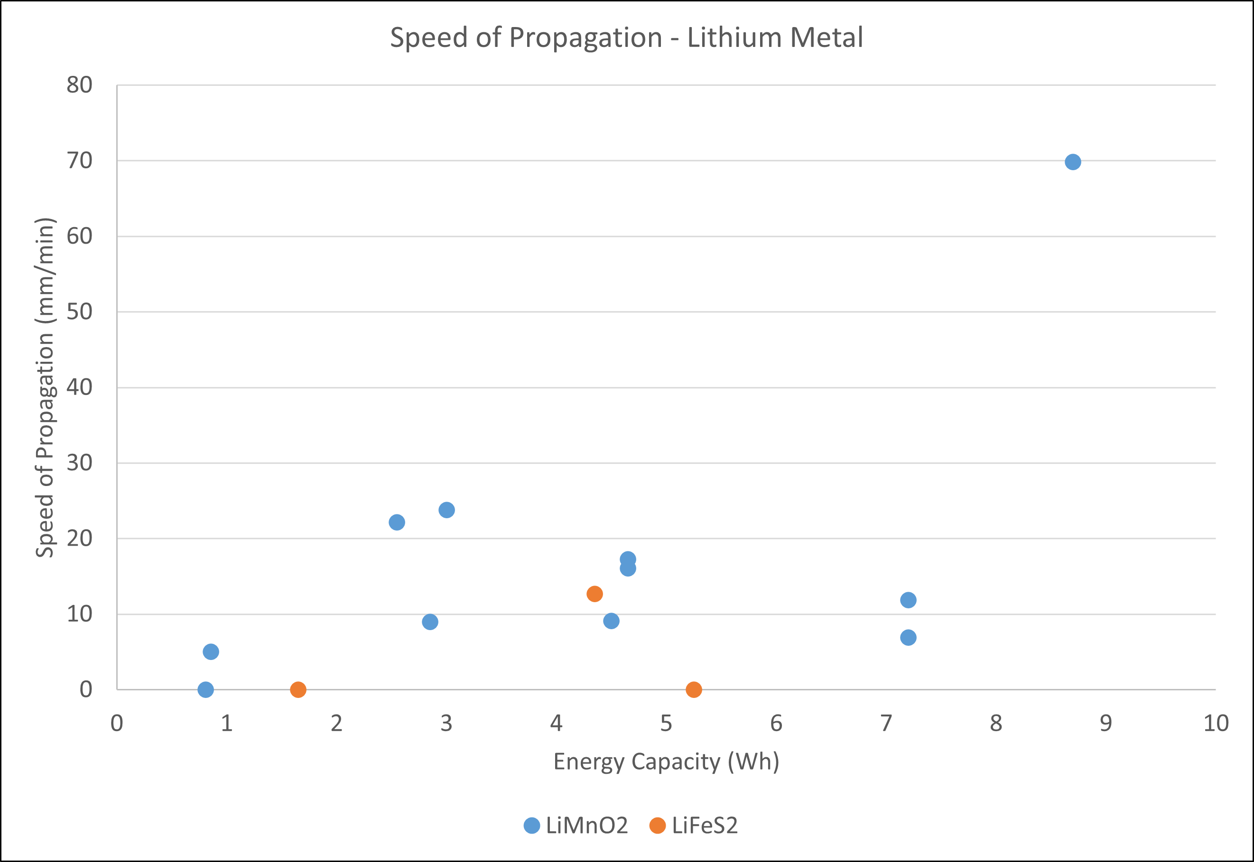
Speed of Propagation
LiMnO2 cells propagation speed seemed to increase with size as well, but all these cells tested were very small
Need to test larger cells to confirm

Slide 19
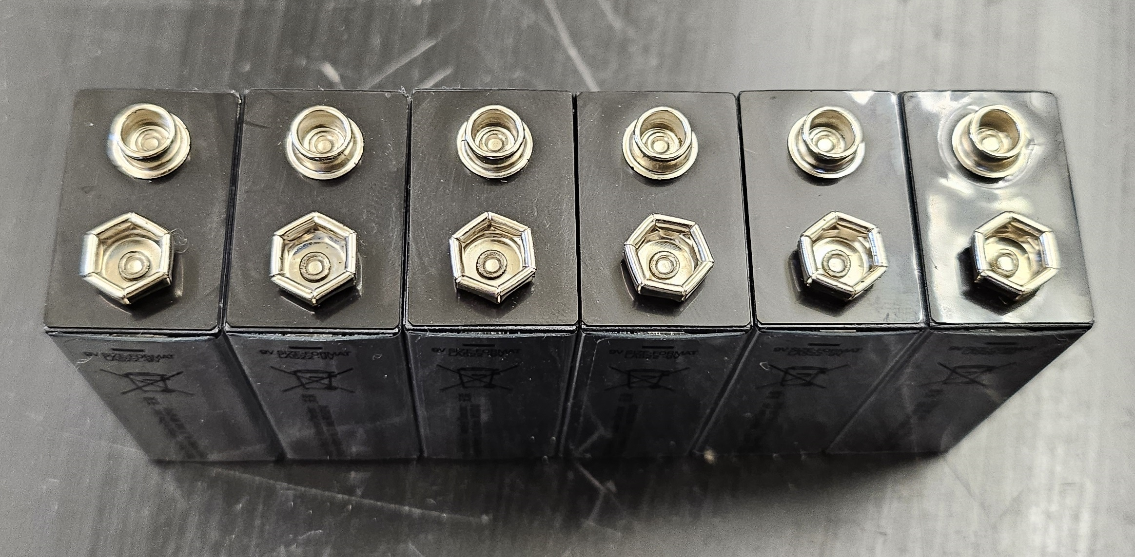
Speed of Propagation
16mm
Tested LiMnO2 9V batteries in two orientations
9V batteries are 26mm x 16mm
Took 695s to propagate in 16mm direction and 658s in 26mm direction
Speed increased from 6.91 mm/min to 11.85 mm/min
26mm

Slide 20
Conclusion and Future Work
Battery gas volume increases with battery capacity in lithium-ion and lithium metal cells
Different chemistries produce different L/Wh measurements
Battery propagation test works well for testing propagation and flammability
Ignitor placed above cell #1 always ignited flammable gases
Cells must be secured in box
Propagation speed increased with cell capacity in cylindrical cells
Future work is to simplify decision tree and conduct any further testing necessary to support the changes

Slide 21
Questions?
Contact:
Steven Rehn
Federal Aviation Administration
William J. Hughes Technical Center
Fire Safety Branch, Bldg. 203
Atlantic City Int’l Airport, NJ 08405
(609) 485-5587
steven.rehn@faa.gov

