Slide 1
Hydrogen Flame Characteristics
International Aircraft Systems Fire Protection Forum Meeting
John Kurtanidze
Oct. 17-18, 2023

Slide 2
Introduction
Interest in hydrogen propulsion for commercial aircraft
Hydrogen is abundant, source of renewable energy
Can power electric aircraft via hydrogen fuel-cells
  Produces no noise pollution
Can be burned in traditional jet engines
  Produces no CO2 emissions
  Non-toxic combustion products
Byproduct of using hydrogen is water
  Water can be recycled w/i aircraft for other purposes
Notes:
So, as you all may know, there’s a growing interest in h2 propulsion for commercial aircraft.
Hydrogen fuel is readily used in spacecraft propulsion, so there’s discussion now on how to apply hydrogen to aircraft.
On that front, Hydrogen propulsion can have many benefits …

Slide 3
Challenges
Challenges with Hydrogen:
  Easy to ignite and explosive (MIE: 0.019mJ; flammability limit 4-75% by volume of air)
  Hard to detect a leak (odorless, makes little sound)
  Can auto-ignite (T=1040F or 560C for air)
  Dangerous in confined spaces
  Difficult to store
  Hydrogen embrittlement
  Can permeate through metals
Challenges with Hydrogen Flames:
  Invisible in daylight
  Has very low quenching limit

Slide 4
Project Objective
Experimentally imitate tiny hydrogen leak ignition
Study hydrogen flame characteristics
  Heat flux
  Temperature
  Flame Length
Note the effects of:
  Leak size and shape
  Standard flow rate (SFR)
  Nozzle exit-plate spacing

Slide 5
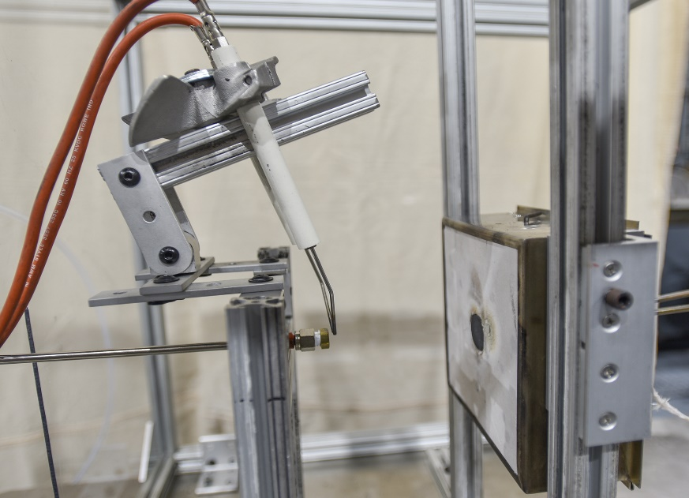
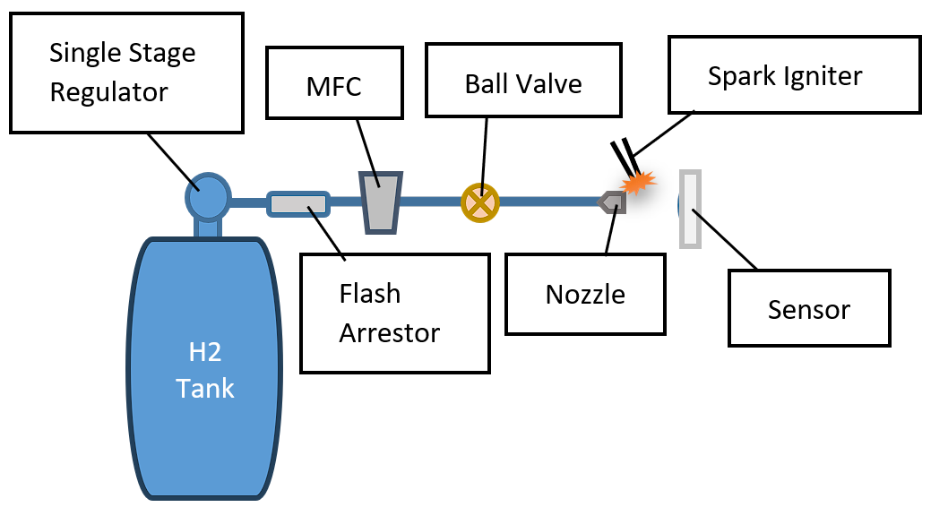
Experimental Setup
Custom hydrogen burner
Igniter
Sensor
Nozzle

Slide 6

Nozzles
Circular
vs.
Slot
#1
#2
#3
#4
#5

Slide 7
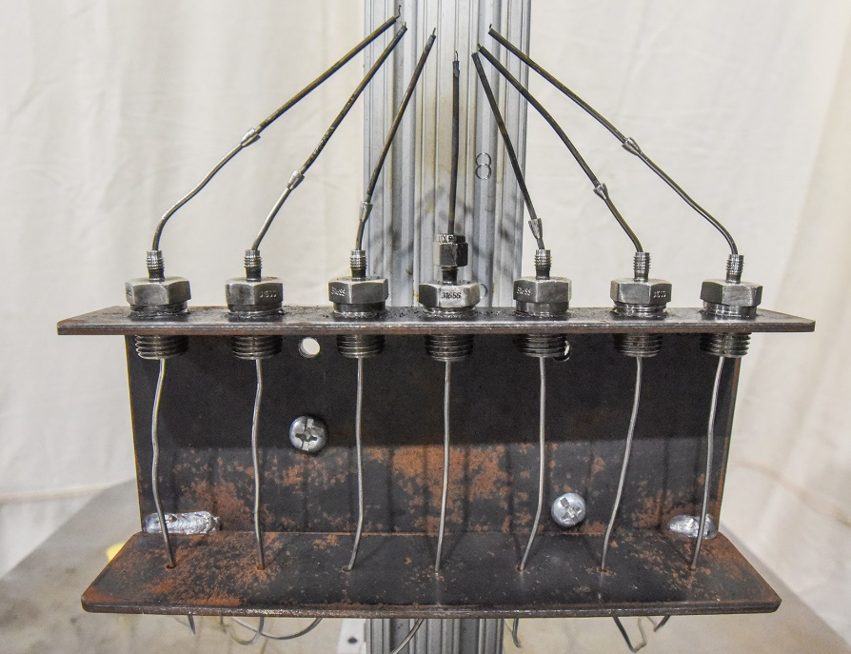
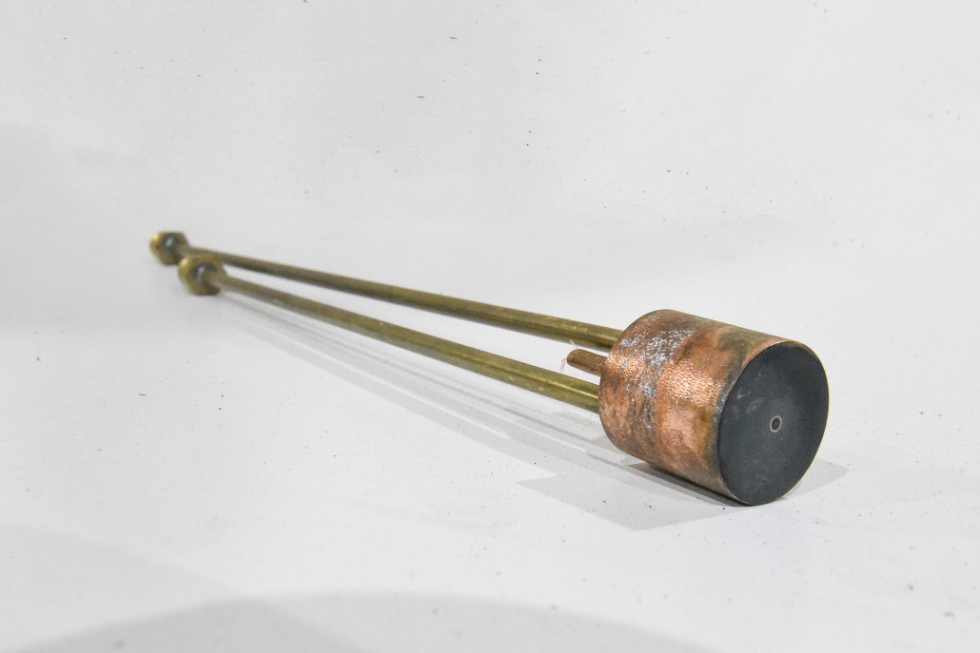
Sensors
K-Type Thermocouple Rake Heat Flux Gauge
(TCs spaced 1/8’’(~3mm) apart) (Water-Cooled Gardon Gauge)
7
6
5
4
3
2
1

Slide 8
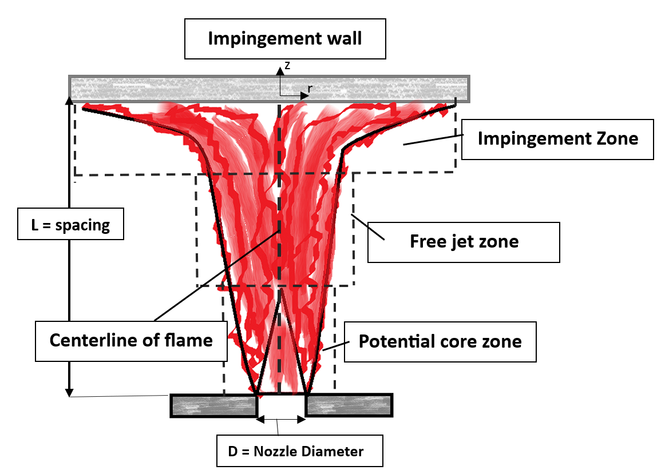
Experimental Method
Parameters varied:
  Nozzle orifice size
    D = 0.4-1.7mm
  Standard flow rate (SFR)
    M = 1-5SLPM
  Nozzle exit-plate spacing
    L = 1-4in (25-100mm)
Re #: 110-2400; Fr #: 55-10200

Slide 9
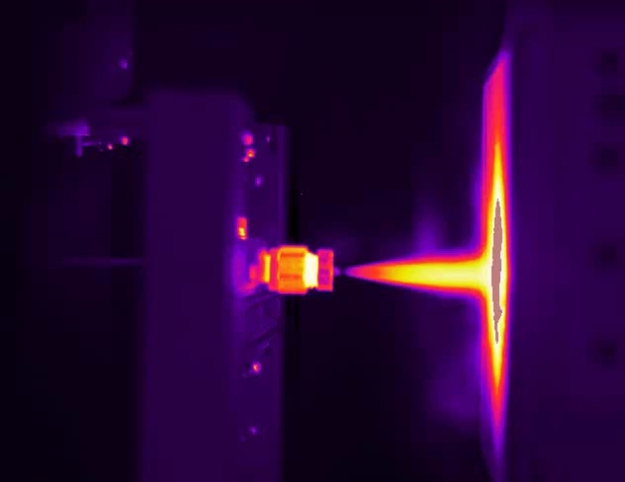
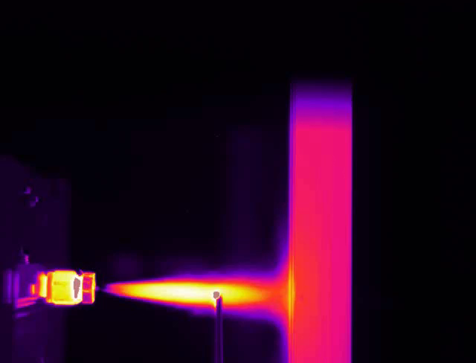
Experimental Method (videos)
Heat Flux Test Temperature Test

Slide 10
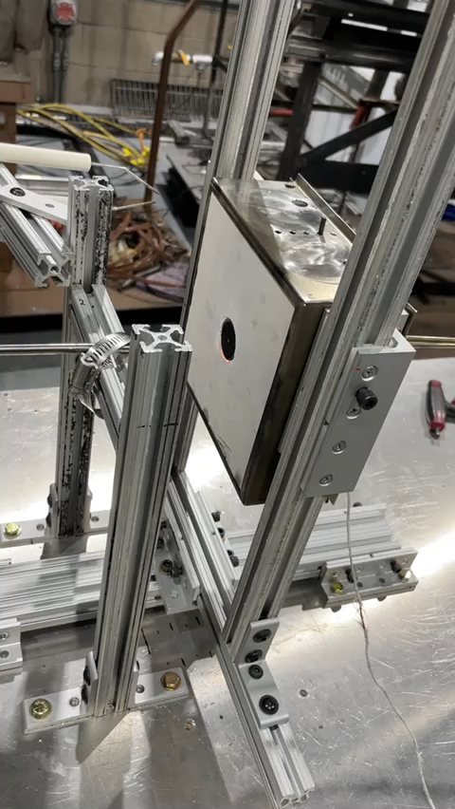
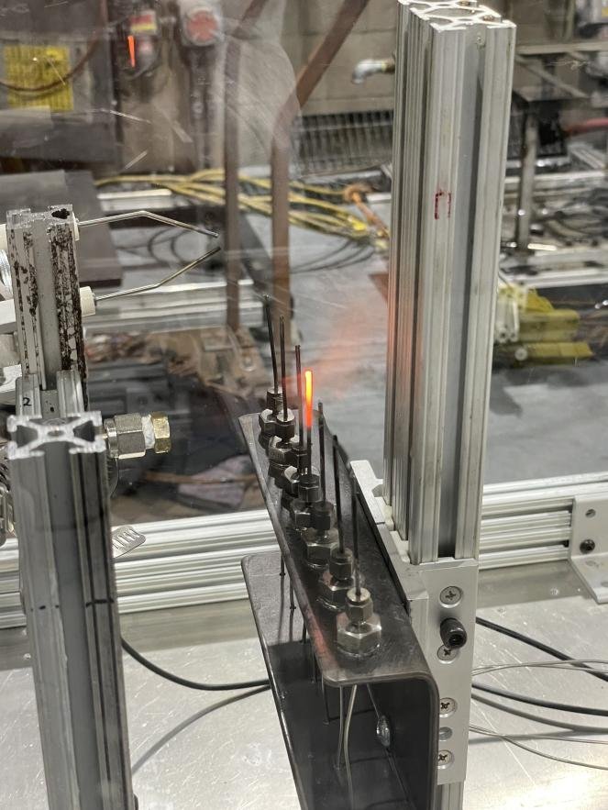
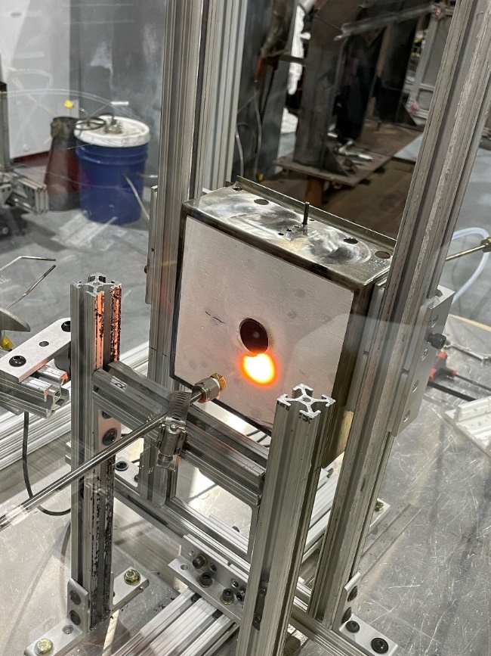
Hydrogen Flame Invisibility Examples

Slide 11
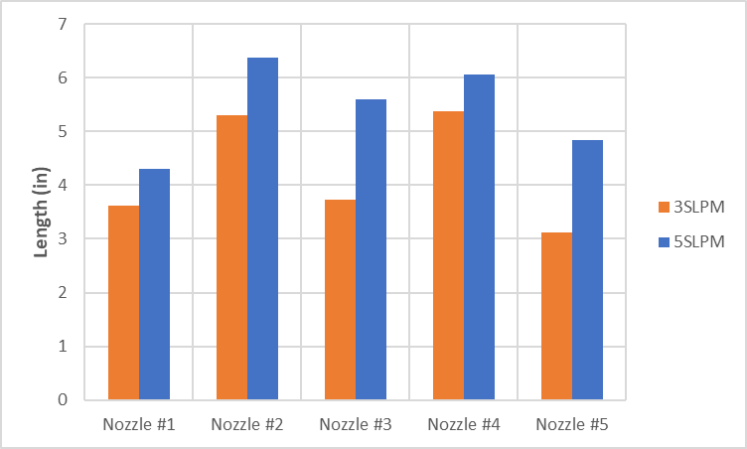
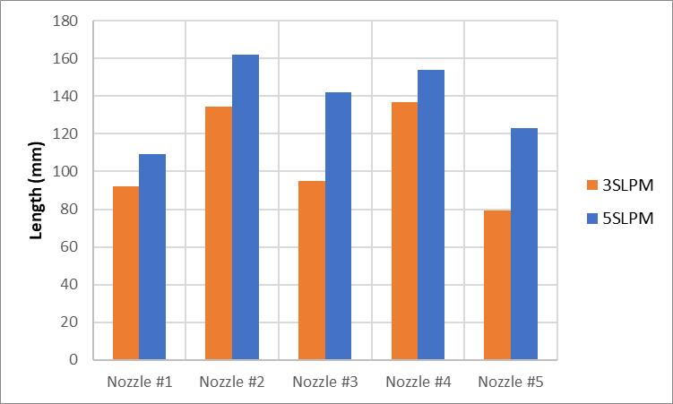
Flame Length
Takeaway: Length increases with SFR; More buoyant → shorter flame; Leak Shape has little influence
Notes:
Leak size affected how buoyant a flame would be
Generally, the bigger the leak, the more buoyant the flame
The more buoyant flames were also shorter

Slide 12
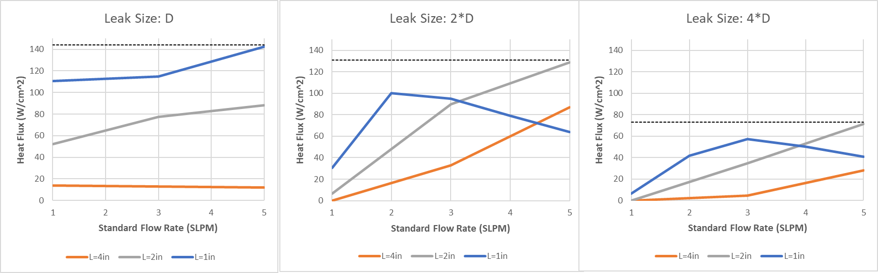
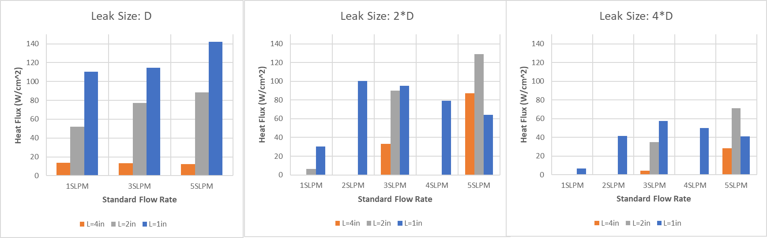
Flame Heat Flux
Decrease in Spacing→ Increase in Heat Flux
Bigger leak→ Lower Heat flux
D=0.4mm

Slide 13
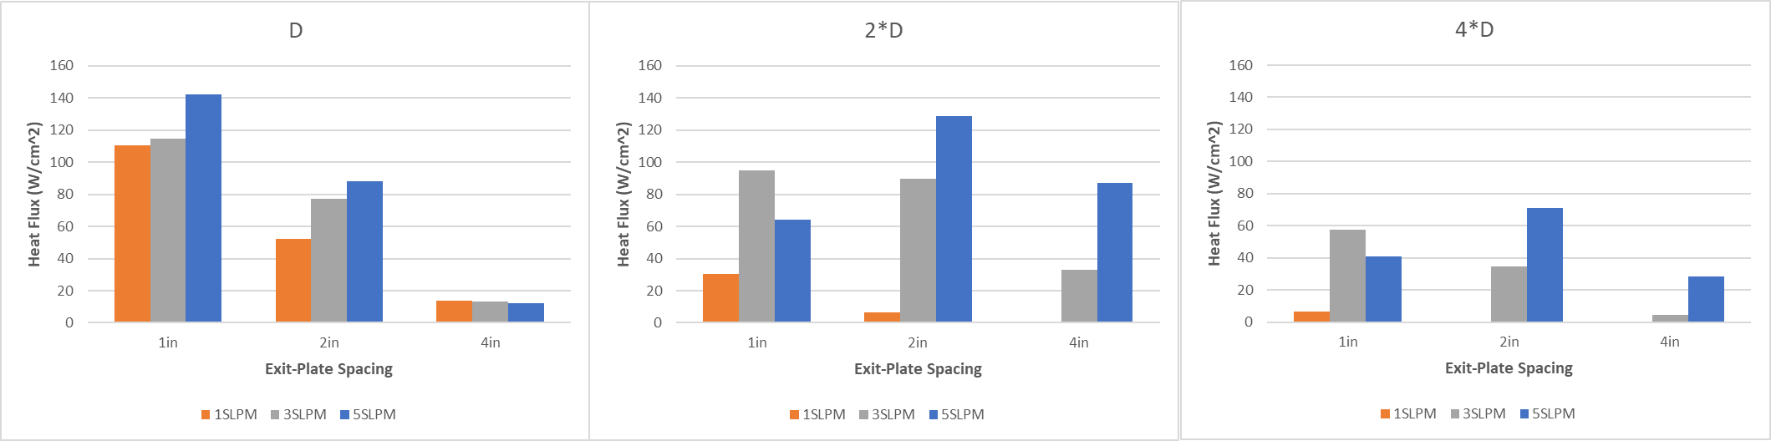
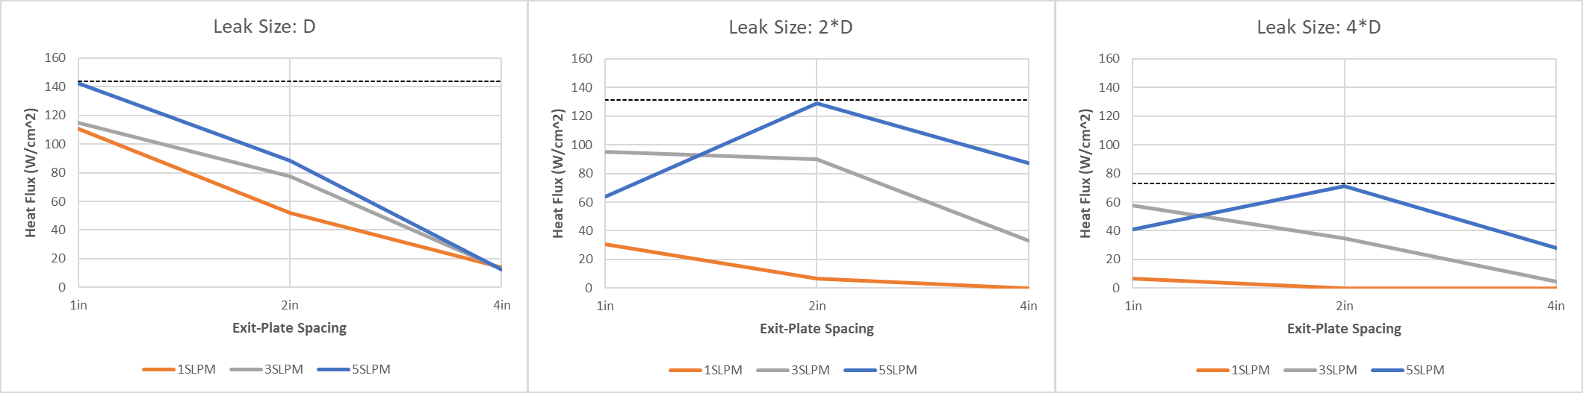
Flame Heat Flux (cont.)
Increase in SFR→ Increase in Heat Flux
Takeaway: Unburned H2 gas zone is more pronounced at high SFR and bigger leaks, therefore lower heat flux
D=0.4mm

Slide 14
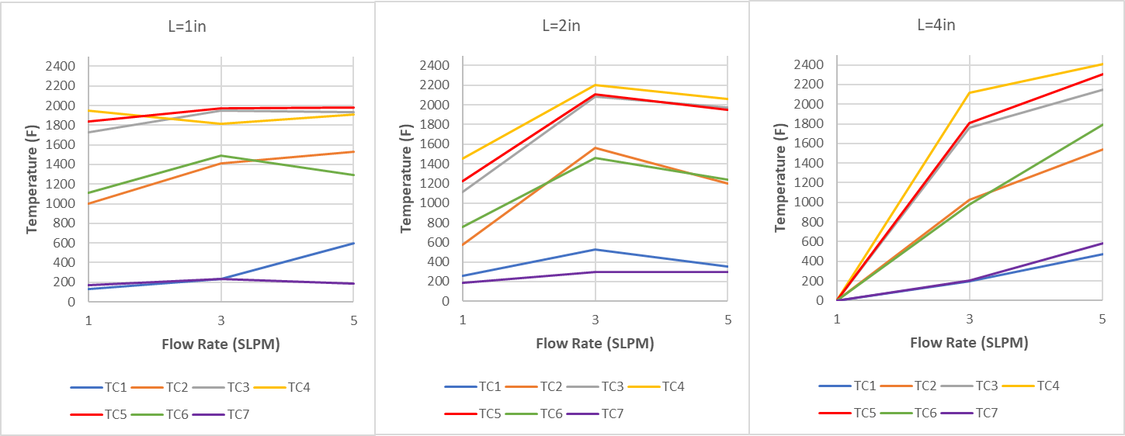
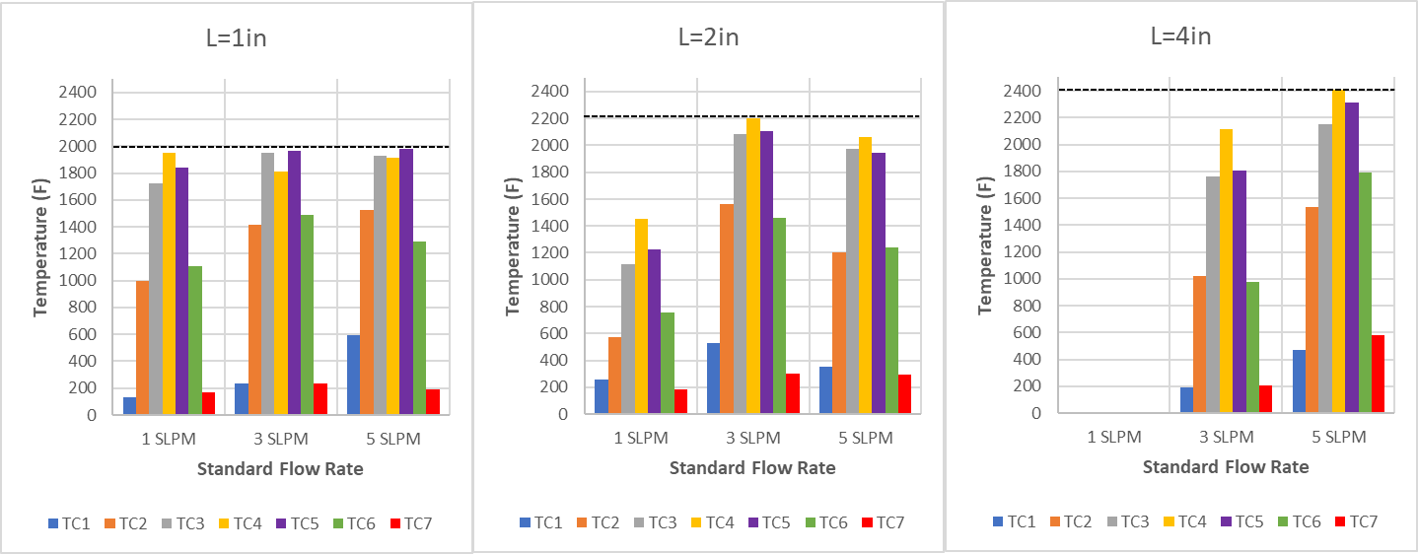
Flame Temperature
Increase in Spacing→ Increase in Temperature
Increase in SFR→ Increase in Temperature
Takeaway: Temperature increases along the z-axis and reduces radially away from the centerline
D=0.8mm

Slide 15
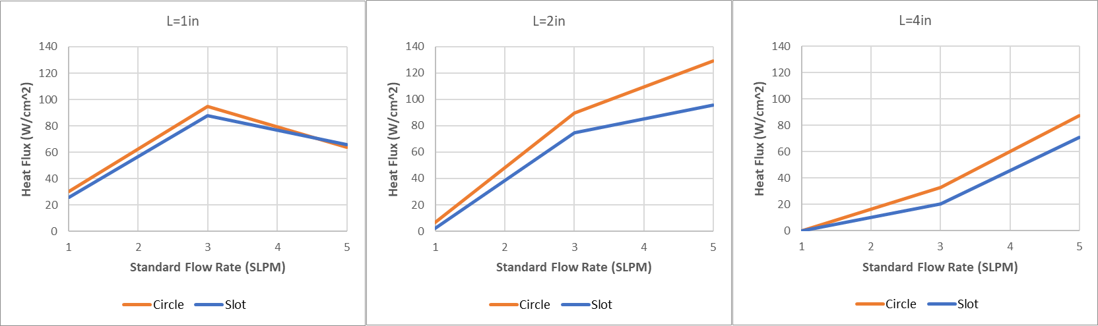
Circular vs. Slot Nozzles
Flames from circular nozzles output higher heat flux than flames from slot nozzles
Takeaway: Shape of a leak has little influence on flame characteristics. SFR and leak size are the major determining factors

Slide 16
Summary
H2 flame consists of 1) Potential core zone, 2) Free jet zone, 3) Impingement zone
SFR is the most influential factor for H2 flame; higher SFR → More intense flame
Leak size is closely correlated with SFR, i.e., the bigger the leak is, the higher the SFR must be to produce high heat flux and temperature
Increasing Leak Size for the same SFR produces lower heat flux and temperature due to lowered flame velocity and lowered intensity
The closer the impingement surface → Higher the heat flux unless the potential core zone of a flame is impinging on the surface
Potential core zone is more pronounced/exposed for bigger leaks and higher SFR
Increasing Leak Size→ lower flame velocity → shorter flame → lower heat flux and temperature
Increase in SFR → Increase in Flame Length up to ~6.5in (~165mm)
Leak Size does not have as much influence as SFR has for flame length
Leak shape has little influence on flame characteristics; what matters is the volume of gas being released and ignited
Flame Temperature increases along the z-axis and reduces radially away from the centerline
Flame temperature can vary b/w 200-2400F; Flame heat flux can vary b/w 10-140 W/cm^2

Slide 17
Future Work?
Can continue this experiment to test:
  Vertical burner over horizontal
  Bigger orifices
  Higher flow rate flames
  Burn-through tests for various materials
  More applicable sensors for heat flux & temperature measurement

Slide 18
Thank You.
Any Questions?

