Slide 1
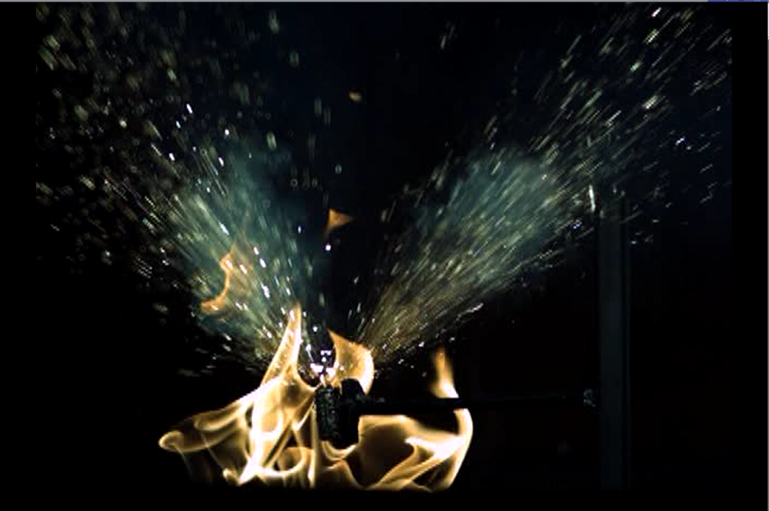
The aircraft hazards of flammable gasses produced by lithium batteries in thermal runaway
Fall Systems Meeting
FAA Fire Safety
10/2015

Slide 2
Background
Lithium-metal and lithium-ion cells contain flammable electrolytes which react during thermal runaway and release flammable gasses.
The unburnt gasses can accumulate and result in an explosive environment.

Slide 3
Background (gas composition)
Tests were conducted to determine gas compositions and volumes for various states-of-charge and various chemistries.
Tests conducted at cabin pressure at altitude (10psia)

Slide 4
Background (combustion)
Tests were conducted at altitude to determine the pressure rise generated by combustion of battery gasses.

Slide 5
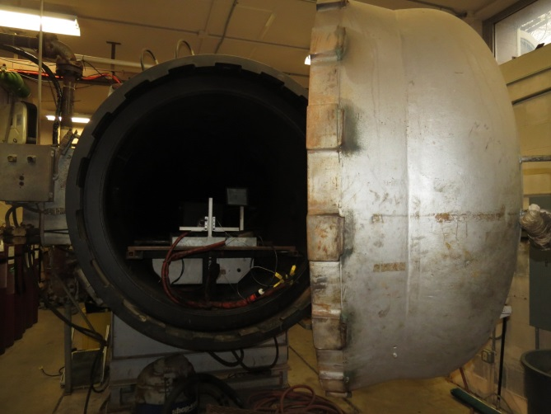
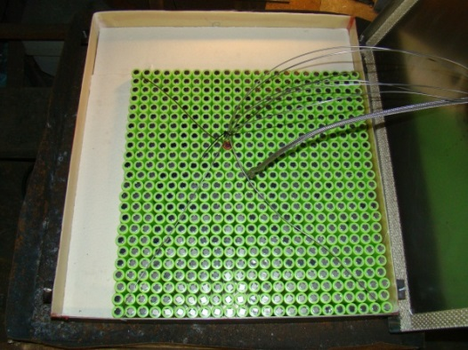
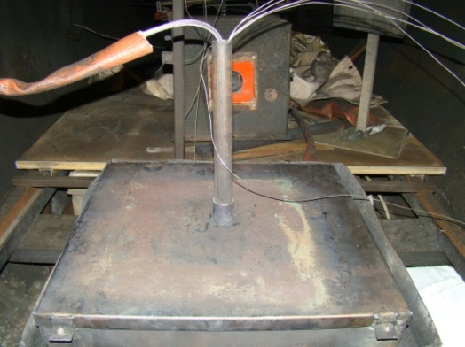
Background (halon effectiveness)
Tests were performed in a 10.8m³ chamber to evaluate the effectiveness of Halon 1301 with vent gasses.
  Runaway was initiated => Halon was introduced => Spark was activated => Pressure was recorded

Slide 6
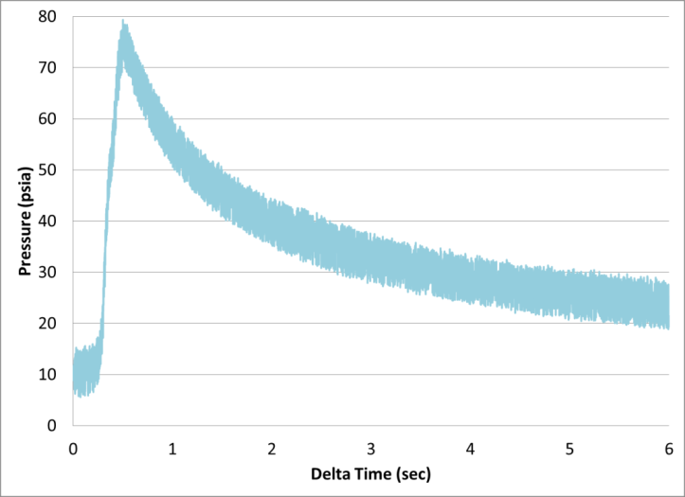
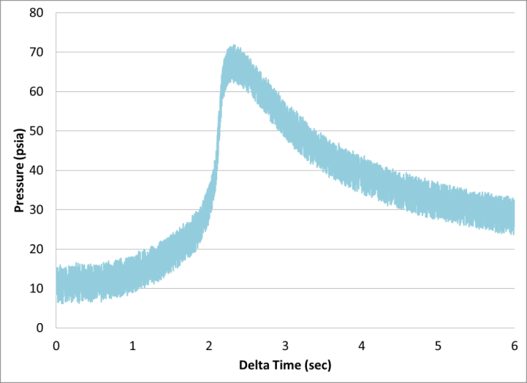
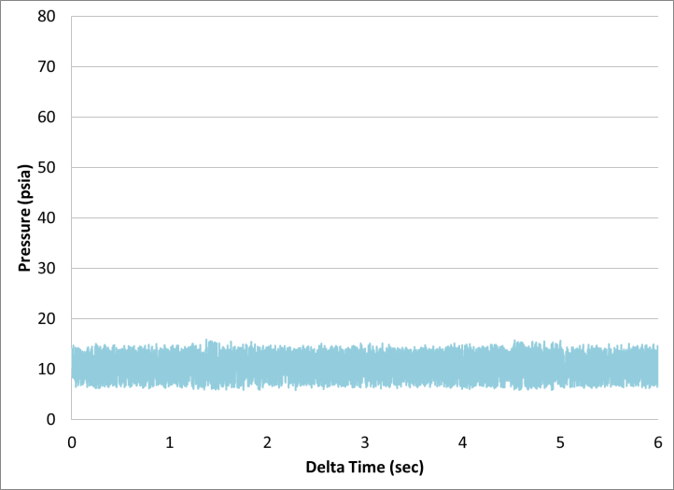
Background (halon effectiveness)
Test without suppression
Test with 5.28% Halon
Test with 10.43% Halon

Slide 7
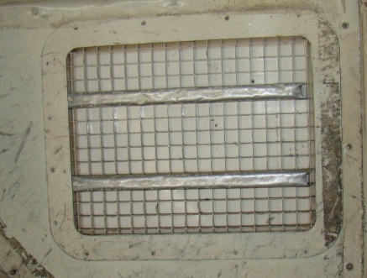
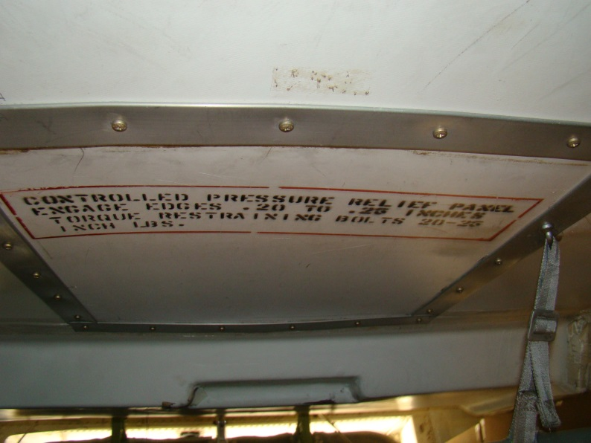
Balloon Tests
Class C cargo compartments are equipped with pressure relief panels that become dislodged during a pressure event.

Slide 8
Introduction
Could a small collection of battery gasses accumulate within a package and combust to dislodge the panels?
  If the panels became dislodged then the halon system would lose effectiveness.
Quantitative tests were first performed in a pressure chamber followed by verification tests in a 737.

Slide 9
Bottled Gas
Rather than collect Li-Ion vent gasses for subsequent tests, a bottle of mixed gas was purchased that matched the composition from previous analysis.
  30.1% CO₂
  27.6% H₂
  22.9% CO
  6.37% CH₄
  4.48% C₃H₆
  2.21% C₂H₄
  1.57% C₄H₁₀
  1.17% C₂H₆
  .56% C₄H₈
  .268% C₃H₈

Slide 10
Bottled Gas
We then verified that pressure rise from bottled gas was identical to pressure rise from actual gas.
  Max pressure from actual gas at altitude: 70.1 psia
  Max pressure from bottled gas at altitude: 71.4 psia

Slide 11
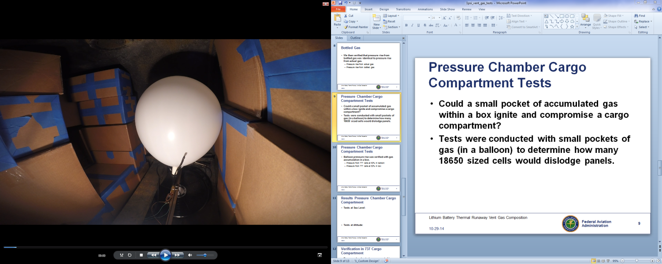
Setup (quantitative tests)
Tests were conducted in a 10.8m³ chamber with small pockets of gas (in a balloon) to determine how many 18650 sized cells would compromise fire suppression in a cargo compartment.

Slide 12
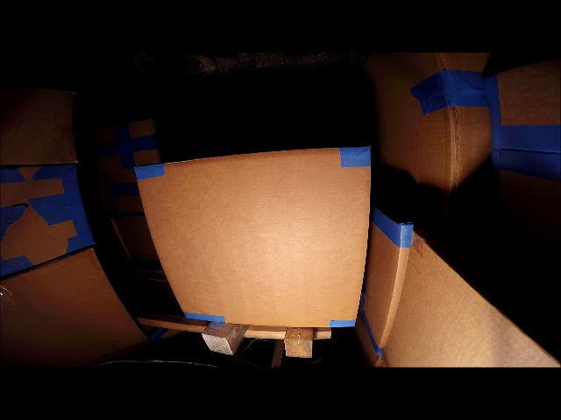
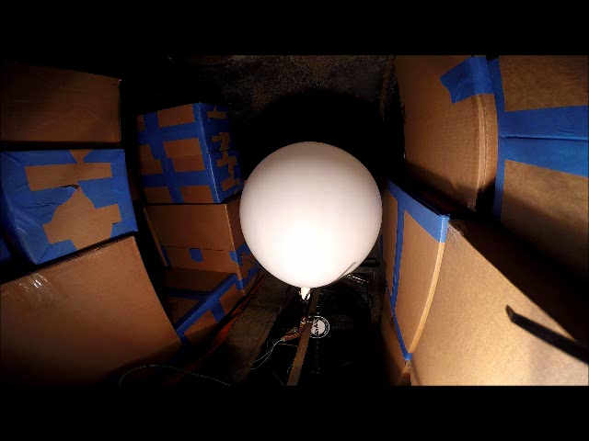
Pressure Chamber Cargo Compartment Tests
Balloon pressure rise was verified with gas accumulation in a box.
  Pressure from volume of gas corresponding to 5 cells at 50% SOC in balloon: .85 psi
  Pressure from volume of gas corresponding to 5 cells at 50% SOC in box: .97 psi

Slide 13
Results Pressure Chamber Cargo Compartment
Tests at Sea Level:
Tests at Altitude:

Slide 14
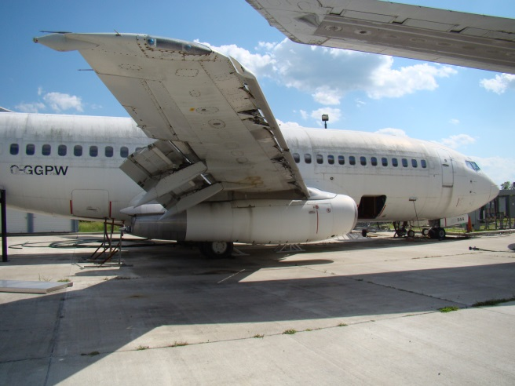
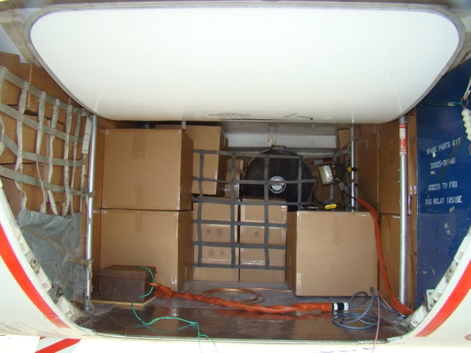
Setup (verification tests)
Pressure chamber tests were repeated in fwd. cargo compartment of 737 with 70% loading.
  Total volume of compartment (documented): 370ft³
  Volume of boxes based on 70% loading: 259ft³

Slide 15
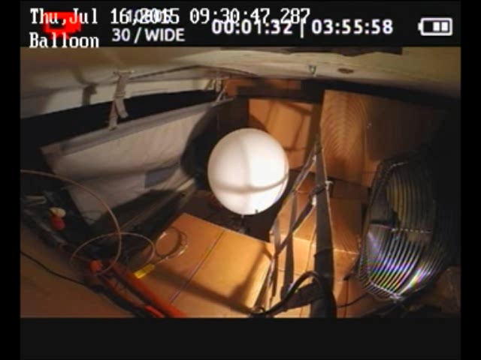
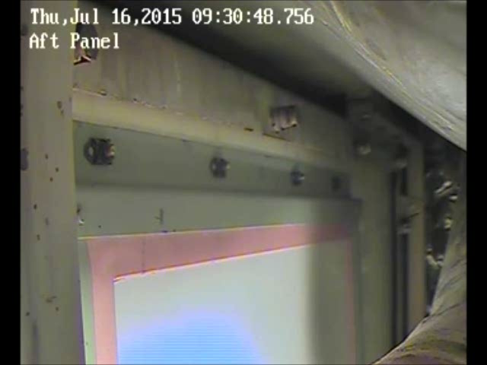
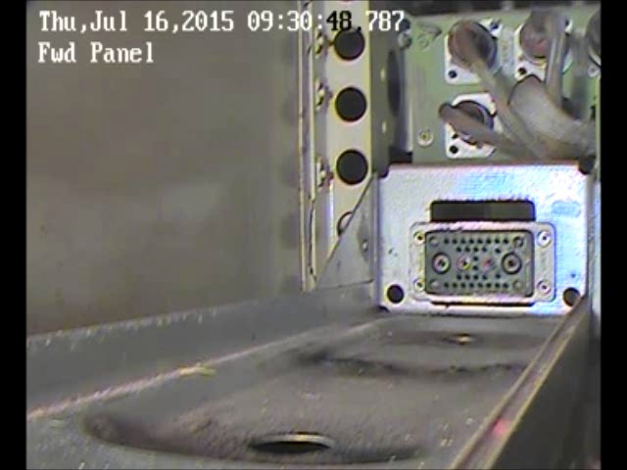
737 Cargo Compartment Results
5 cells at 50% SOC
1.61 cells at 100% SOC
.252 psi peak pressure

Slide 16
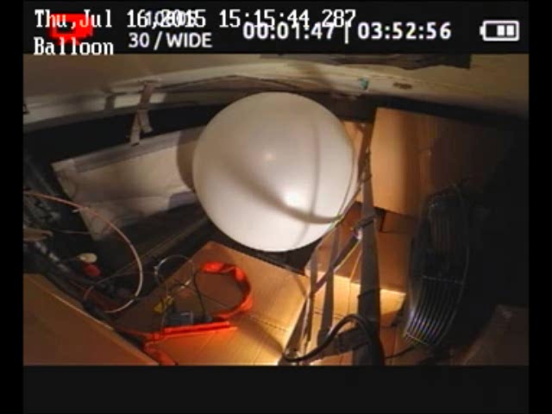


737 Cargo Compartment Results
20 cells at 50% SOC
6.44 cells at 100% SOC
1.22 psi peak pressure
Additional panel behind door (not shown) and panel on sidewall (not shown) were also compromised.

Slide 17
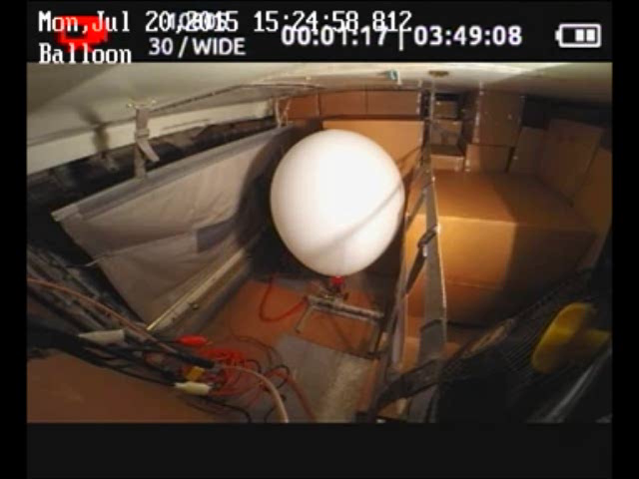
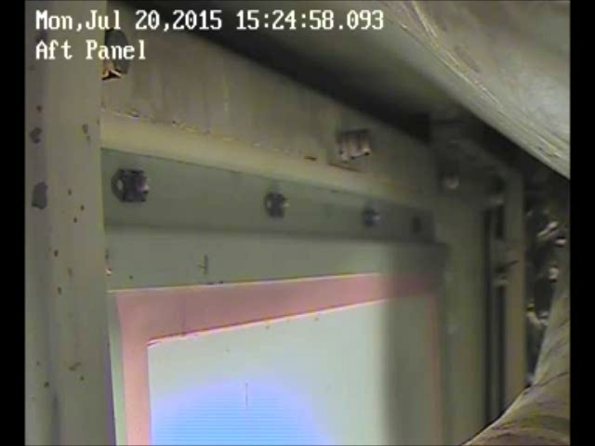
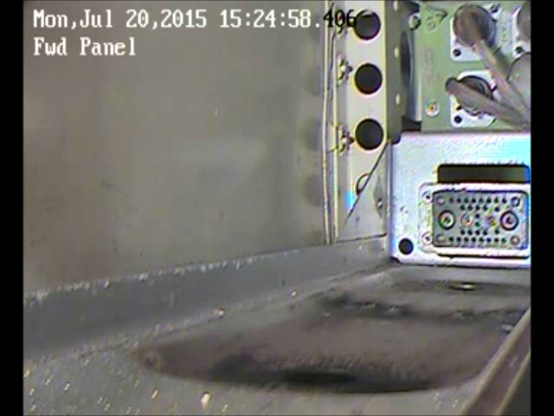
737 Cargo Compartment Results
8 cells at 50% SOC
2.6 cells at 100% SOC
.594 psi peak pressure

Slide 18
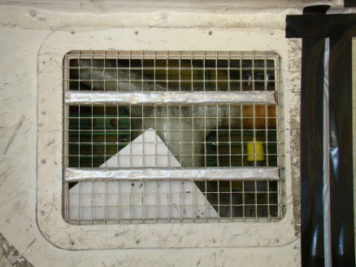
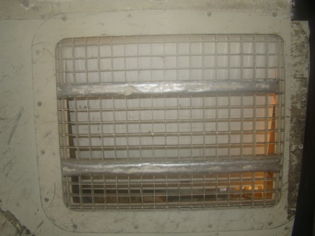
737 Cargo Compartment Results

Slide 19
Summary
If gasses from 8 18650 cells at 50% SOC
or
If gasses from 3 18650 cells at 100% SOC
accumulate in a loaded 737 fwd. cargo compartment and ignite, the halon suppression system would be compromised.

Slide 20
Future Work
Test setup is underway to characterize the vent gasses from li-metal button cells.

