Slide 1
Halon Replacement for Aircraft Portable Fire Extinguishers – Progress Report
PRESENTATION TO:
International Aircraft Systems Fire Protection Working Group
October 22, 2015
Jim Lonergan, Bradford Colton
American Pacific Corp.

Slide 2
Quick Refresher – Why BTP?
2-Bromo-3,3,3-trifluoropropene (2-BTP or BTP)
Airframe Manufacturer concerns about environmental regulations
  BTP has bromine, but only a 7 day lifetime
    Limited transport to stratosphere
    Ozone Depleting Potential of 0.0028
      Halon 1211 = 7.9
    Global Warming Potential of 0.26
      Halon 1211 = 1890
  BTP not restricted by current environmental regulations
Airframe Manufacturer concerns about space limitations and weight
  BTP is more weight effective than available alternatives
  Drop-in to standard extinguishers Boeing uses

Slide 3
Quick Refresher – Work Completed
FAA Handheld MPS requirements completed
  5B:C Pan Test
  FAA Hidden Fire Test
  FAA Seat Fire / Toxicity Test
Physical Properties and Toxicological Tests Completed for Regulatory Approvals
  EU REACH Approval received May 2014
  EPA TSCA/SNAP Submissions are complete

Slide 4
Quick Refresher – General Characteristics
Halogenated evaporating liquid
  34°C (93°F) Boiling Point
Acute Toxicity
  Acute toxicity similar to halon 1211
  HF generation in seat fire test acceptable
Stabilizers added to protect against air and moisture
  Current recommendation is 12 year extinguisher shelf life
    Coincides with NFPA 10 hydrostatic test interval for cylinder

Slide 5
Recent Work
Additional handheld development with P3
  They will provide update today
Computer compatibility test
  No specific industry standard to test against
  Dell Optiplex mini-tower computer
  Sprayed internals for complete discharge period, ~9.5 sec, 3.75 Lb
    Motherboard, DVD drive, power supply, graphics card, RAM cards
  Variety of software tools used to validate working order
    Computer still in working order 1 week after test

Slide 6
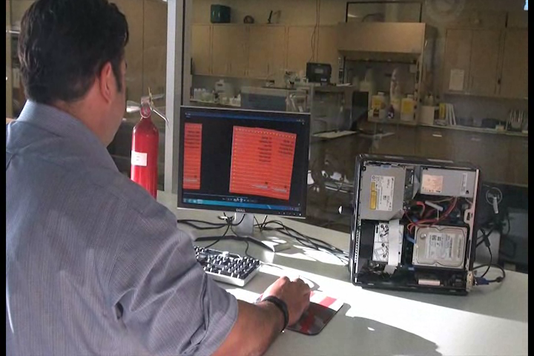
Computer Compatibility Test

Slide 7
BTP - Upcoming
Development of ASTM specification
Commercialization
  We believe that the US regulatory approvals will be received in 2016 with commercialization starting immediately afterward

Slide 8
Contact
Bradford Colton
Research Engineer
Halotron Division, American Pacific Corporation
3883 Howard Hughes Pkwy, Suite 700
Las Vegas, NV 89169-5995 USA
Tel: 702.699.4131
bradford.colton@ampac.us
halotron.com

