Slide 1
Test Results of Lithium Battery Transport Containment Concept
IASFPWG 22nd October 2015
Nadine Gomm - Fire Protection Pressurized Fuselage

Slide 2
Motivation
The established understanding within the industry is that existing cargo compartment fire protection systems certified to FAR/CS 25.857 are not designed with respect to fires involving high density shipments of lithium batteries.
Airbus is actively supporting committees to further enhance safe transport of lithium batteries as cargo.
Within this subject, Airbus validates concepts of different solutions having the aviation environment in mind.

Slide 3
Aim of the Test
Validation of a containment concept developed by Celono/Poraver with support from Airbus for the transport by air
3 test scenarios with an increasing quantity of batteries (NCR18650; 3100mAh; 3.6V)
Test 1
360 batteries
Test 2
1800 batteries
Test 3
3240 batteries

Slide 4
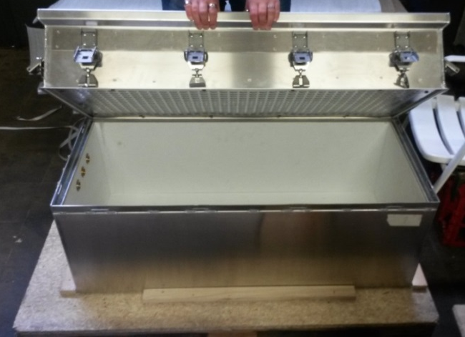
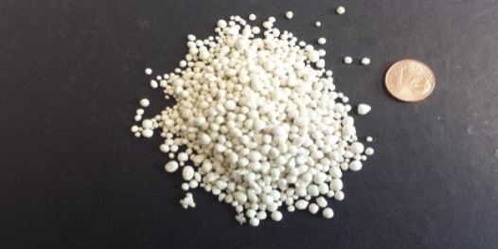
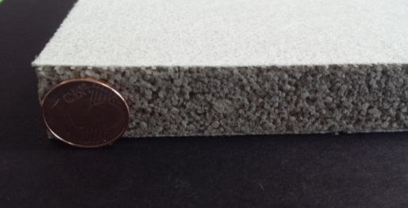
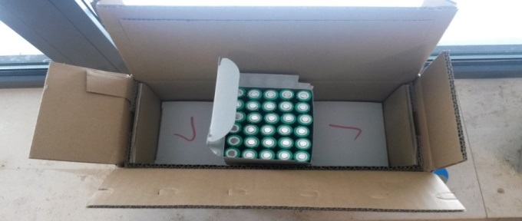
Test Description – Containment
Quantity of batteries defined due to the properties of the material used and the packaging size.
In top of containment: loose material
Refractory lining
State of Charge
Each package:
180 batteries
50%
60%
-

Slide 5
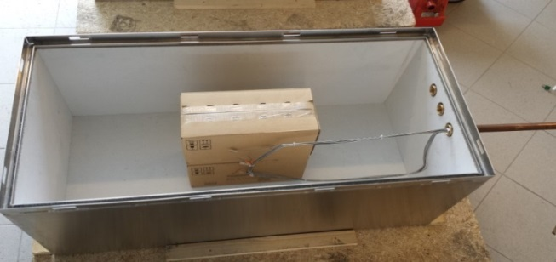
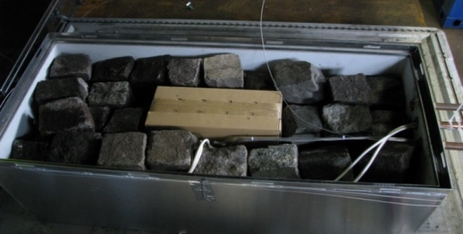
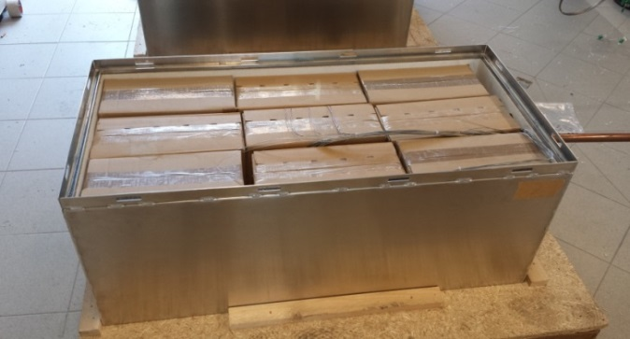
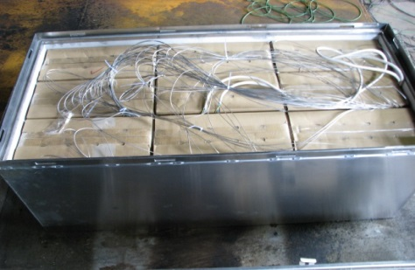
Test Set-up
Test 1
2 Packages
360 Batteries
Empty space filled with stones
10 Packages
1800 batteries
8 Packages filled with aluminium
Test 3
Test 2
18 Packages
3240 Batteries
No empty space

Slide 6
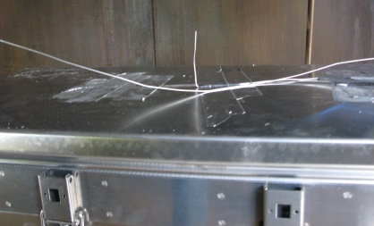
Measurement
Temperature trend monitoring
in ignition package
in each package
in outgassing
Surface of containment
4 inch from surface (CS25.855, Appendix F Part III)
Gas measuring via gas bags
continuously measurement challenging, but it was shown that out coming gases are flammable
Efforts to be taken to measure the quantity of outgassing
Outlet valve blocked due to condensate

Slide 7
Tests – Video

Slide 8
Test 1 – Pressure/Temperature
Temperature [°C]
Pressure [mbar]
Pressure [mbar]
T Cartridge Heater [°C]
T next to CH [°C]
T 2nd circle [°C]
T 3rd circle [°C]
T 4th circle [°C]
T Package 2 [°C]
T Surface [°C]
Time [hh:mm]

Slide 9
Test 2 – Pressure/Temperature
Pressure [mbar]
T Cartridge Heater [°C]
T next to CH [°C]
T 2nd circle [°C]
T 3rd circle [°C]
T 4th circle [°C]
T Package 2 [°C]
T Package 3 [°C]
T Package 4 [°C]
T Package 5 [°C]
T Package 6 [°C]
T Package 7 [°C]
T Package 8 [°C]
T Package 9 [°C]
T Package 10 [°C]
T Surface [°C]
T 4inch to surface [°C]
Temperature [°C]
Pressure [mbar]
Time [hh:mm]

Slide 10
Test 3 – Pressure/Temperature
Pressure [mbar]
T Cartridge Heater [°C]
T next to CH [°C]
T Package 1 [°C]
T Package 2 [°C]
T Package 3 [°C]
T Package 4 [°C]
T Package 5 [°C]
T Package 6 [°C]
T Package 7 [°C]
T Package 8 [°C]
T Package 9 [°C]
T Package 10 [°C]
T Package 11 [°C]
T Package 12 [°C]
T Package 13 [°C]
T Package 14 [°C]
T Package 15 [°C]
T Package 16 [°C]
T Package 17 [°C]
T Package 18 [°C]
T Surface [°C]
T 4inch to surface[°C]
Temperature [°C]
Pressure [mbar]
Time [hh:mm]

Slide 11
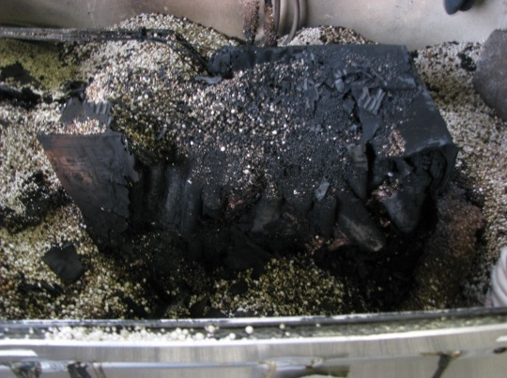
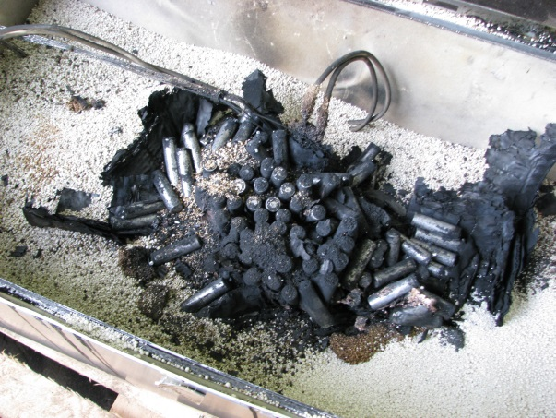
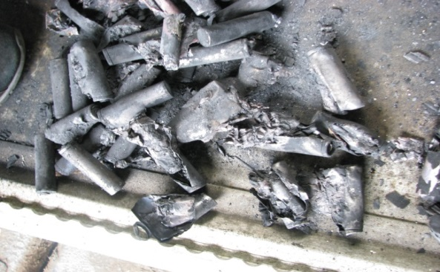
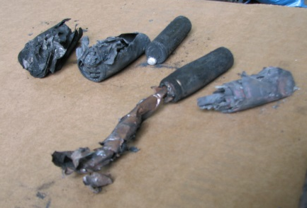
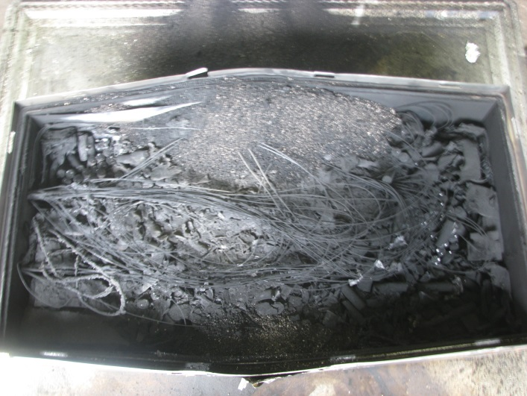
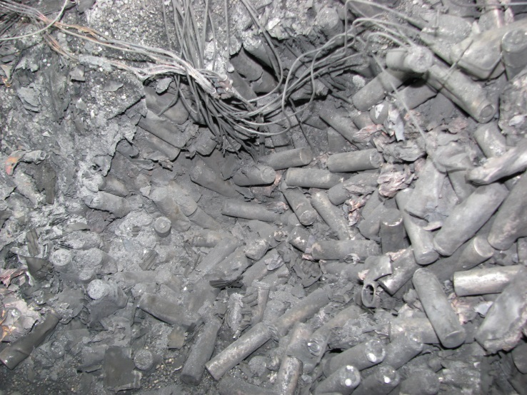
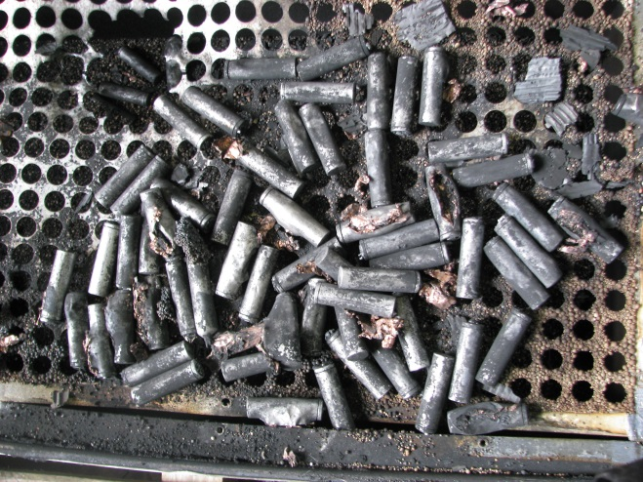
Pictures from inside after test
Test 1
Test 2
Test 3

Slide 12
Conclusion
Heat contained
No fire outside containment
No explosion outside containment
Outgassing flammable
Need to mitigate the amount of outgassing
Proposals to mitigate the hazard of outgassing
Venting overboard
Catalyzer
Separation to stop the propagation from package to package
Need to avoid blocking of the exhaust stream due to condensate

Slide 13
© Airbus Operations GmbH. All rights reserved. Confidential and proprietary document. This document and all information contained herein is the sole property of Airbus Operations GmbH. No intellectual property rights are granted by the delivery of this document or the disclosure of its content. This document shall not be reproduced or disclosed to a third party without the express written consent of Airbus Operations GmbH. This document and its content shall not be used for any purpose other than that for which it is supplied. The statements made herein do not constitute an offer. They are based on the mentioned assumptions and are expressed in good faith. Where the supporting grounds for these statements are not shown, Airbus Operations GmbH. will be pleased to explain the basis thereof. AIRBUS, its logo, A300, A310, A318, A319, A320, A321, A330, A340, A350, A380, A400M are registered trademarks.
Thank you for
your attention
Questions?

