Slide 1
Carbon Dioxide as Cargo Hold Fire Suppression Agent
IASFPWG Fall 2014
Paul Rohrbach and Rainer Beuermann

Slide 2
Motivation
Fire Suppression Mechanism
Gaseous Agents
Non-gaseous Agents
Inhibition
CFCs/ Halons
Aerosols
HFCs / Ketone
Cooling
Water
Inert Gases & CO₂
Suffocation
HFCs/Ketone no option due to overpressure phenomenon observed during MPS exploding aerosol can test

Slide 3
Motivation
Fire Suppression Mechanism
Gaseous Agents
Non-gaseous Agents
Inhibition
Aerosols
Corrosion & Certification
Cooling
Water
Inert Gases & CO₂
Operation (Freezing) & Certification
Suffocation
Many agents have thoroughly been considered in the past except CO₂

Slide 4
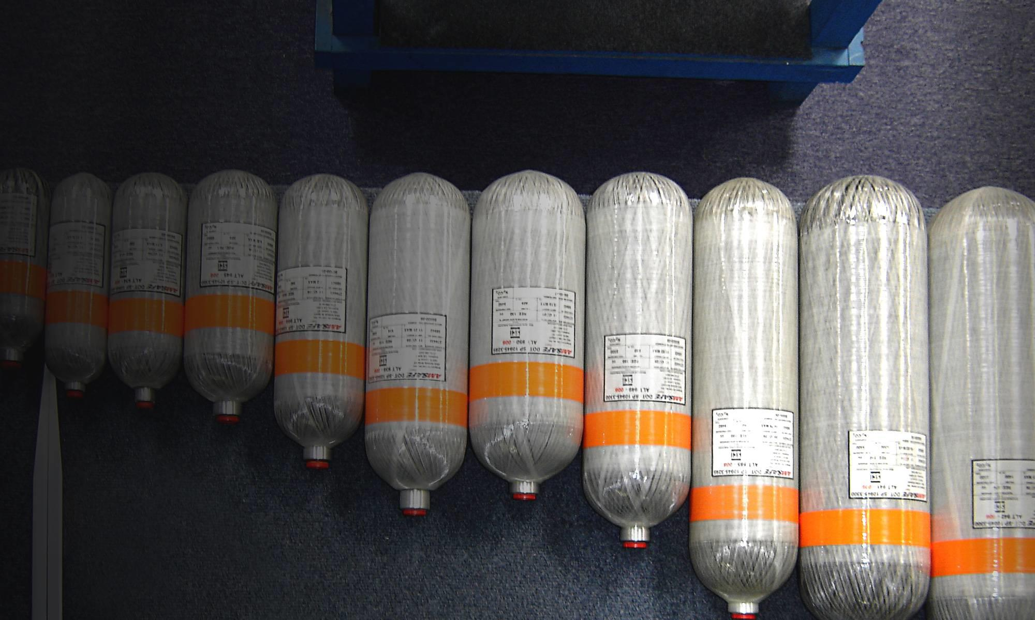
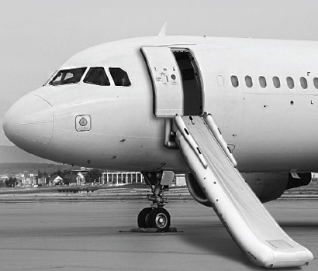
CO₂ Systems in Aviation
Design / Engineering
CO₂/N₂ systems are operated onboard aircraft
Regulations/guidelines are in place for handling, manufacturing, shipment, operation, and maintenance of such systems
Manufacturing / FAL
Operations / Maintenance
© AMSAFE BRIDPORT

Slide 5
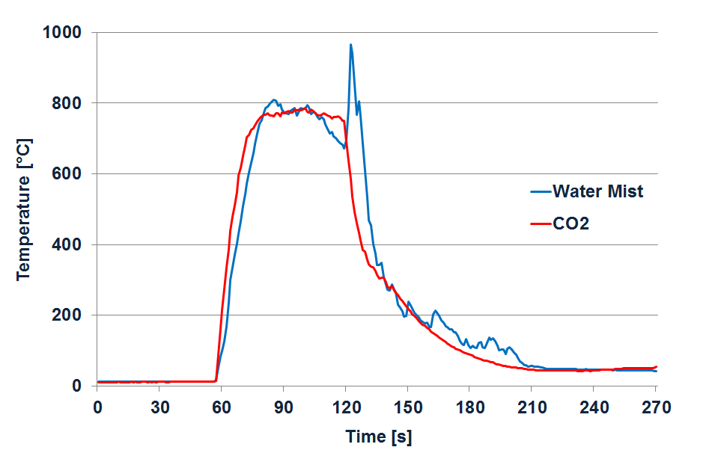
Performance
Surface-Burning Fire

Slide 6
Value and Risks
Good Penetration Capability
Good Heat Capacity
Preliminary MPS Tests
SNAP
Liquefiable Gas
CO₂
Clean / Nonconductive
Zero Safety Margin
© K. Kallergis

Slide 7
Technical Challenges
Lack of information on CO₂/N₂ gas mixtures (phase diagrams) covering the desired temperature range
Characteristics of these mixtures – mainly pressure vs temperature – need to be established
Risk of CO₂ desublimation if system is not properly designed
Three-step approach formulated with research partner DLR to address technical challenges

Slide 8
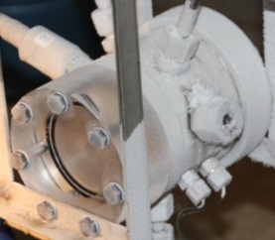
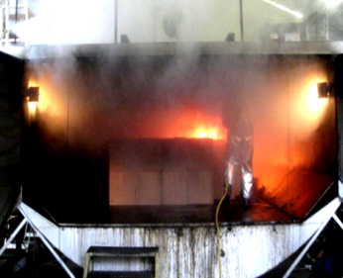
Technical Challenges - Approach
Lab Tests
Pre-selection of CO₂/inert gas mixture
Determination of filling density over required temp. range
Mid-Scale Tests
Validation of lab-scale test results
Preliminary MPS Tests
Preliminary tests scheduled for Q1- 2015
Comparison of results with theoretical models
Agent discharge tests (cylinder→piping→nozzle)
Agent distribution tests in relevant environment
Page 8

Slide 9
CO₂ Discharge Tests

Slide 10
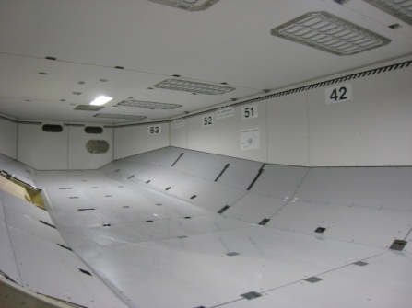
Concept
Guidance material available for gaseous agents / CS-25 AMC 25.851(c)
For Knock-down part → system concept similar to State-of-the-Art System
Standards/guidelines are available for handling, manufacturing, shipment, operation, and maintenance of CO₂/N₂ cylinders
Knock down Fire
Suppress Fire
Cargo Fire Suppression
CO₂/N₂
NEA
What if we would use an escape slide cylinder and discharge it into the cargo hold ?
CO₂ will be replaced over time with Nitrogen Enriched Air (NEA)

Slide 11
Health and Safety
CO₂/N₂ systems seem to be technically feasible but health and safety issues need to be addressed and examined and technical benefits must be weighed against potential risks
FAR/CS Regulations already adressing health and safety issues associated with the use of fire suppressants:
There must be means to exclude hazardous quantities of […] extinguishant […] from occupied areas to comply with the regulations
Risks for air cargo ground operation and maintenance personnel would need to be assessed

Slide 12
Some Thoughts
What would generally be the difference between handling, shipping and maintaining an escape slide cylinder containing CO₂/N₂ and a fire suppression cylinder containing CO₂/N₂ ?
Could ground operation issues be managed per design and with procedures (discharge not to occur on ground while people in the cargo hold and cargo doors are open), with placards, training…?

Slide 13
Finally
.....and now – please throw in your thoughts, perceptions, comments..…

Slide 14
© Airbus Operations GmbH. All rights reserved. Confidential and proprietary document. This document and all information contained herein is the sole property of Airbus Operations GmbH. No intellectual property rights are granted by the delivery of this document or the disclosure of its content. This document shall not be reproduced or disclosed to a third party without the express written consent of Airbus Operations GmbH. This document and its content shall not be used for any purpose other than that for which it is supplied. The statements made herein do not constitute an offer. They are based on the mentioned assumptions and are expressed in good faith. Where the supporting grounds for these statements are not shown, Airbus Operations GmbH will be pleased to explain the basis thereof. AIRBUS, its logo, A300, A310, A318, A319, A320, A321, A330, A340, A350, A380, A400M are registered trademarks.

