Slide 1
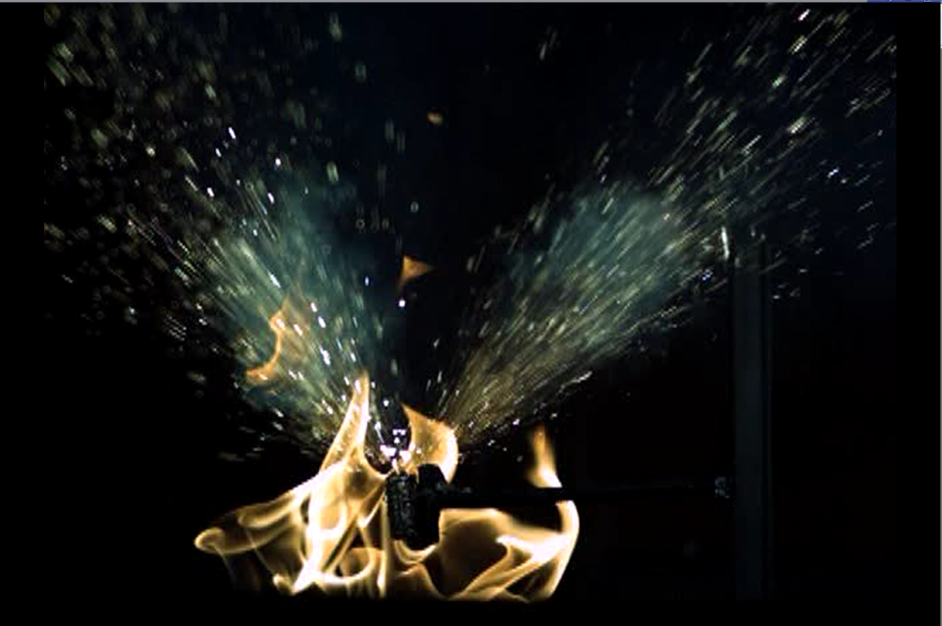
Lithium Battery Thermal Runaway Vent Gas Composition
Systems Meeting
Thomas Maloney, FAA Fire Safety
10-29-2014

Slide 2
Introduction
Lithium-metal and lithium-ion cells contain flammable hydrocarbon electrolytes which react during thermal runaway and cause a gaseous flammable environment.
The gasses can accumulate and cause an explosion.

Slide 3
Background
Numerous explosions have occurred during large scale battery tests.
  The class-C cargo area in a 727 exploded in full scale tests conducted by Harry Webster (See “Full Scale Battery Tests…” in 5/14/2014 systems meeting presentation on website).
  Two cargo containers exploded in tests done by Dhaval Dadia (FAA fire safety).

Slide 4
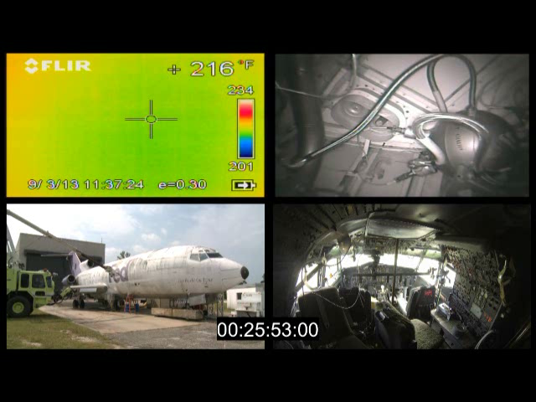
Background (727 test)

Slide 5
Introduction
Two test Setups.
  Initial Test: Large scale with lithium ion cells to demonstrate hazard.
  Later Tests: Small scale with multiple cells to analyze hazard.

Slide 6
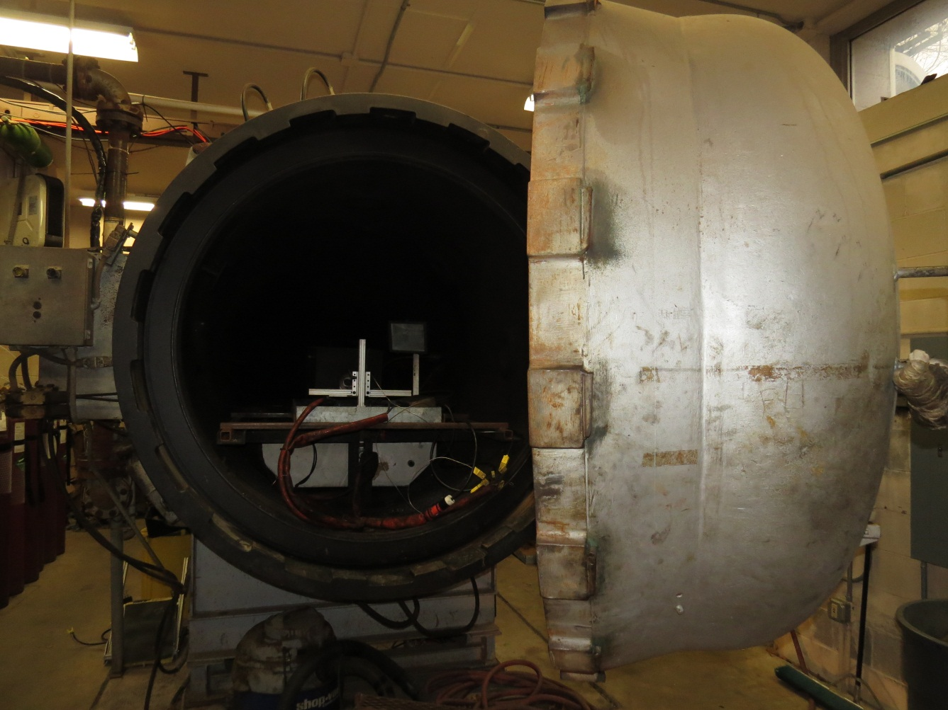
Pressure Chamber (Initial Test)
Vacuum down to .5 psi
Maximum 750° at 600 PSI

Slide 7
Initial Test
A test was done initially in a 10m³ pressure chamber.
  Thermal runaway was initiated with 400 lithium-ion (LiCoO₂) cells at 50% SOC.
  A fan was present to adequately mix the vent gasses.
  After a “sufficient” amount of time, a spark igniter was activated.

Slide 8
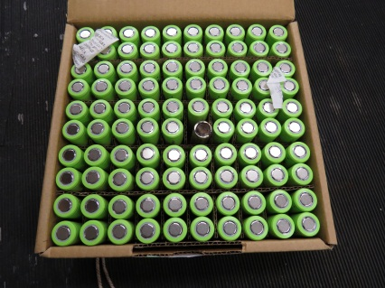
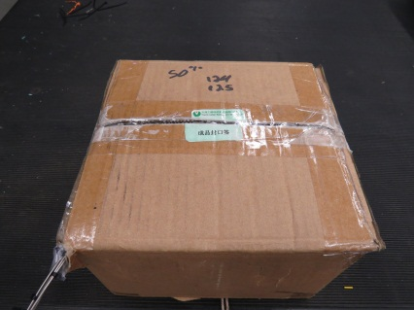
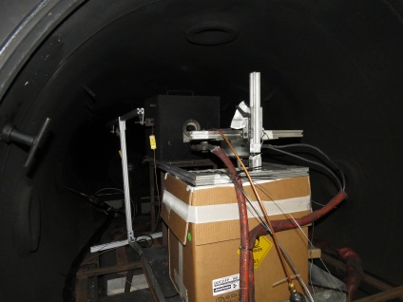
Setup of Initial Test
A Cartridge Heater was placed in the center of a 100 cell package.
2 100 cell boxes were set-up with thermocouples and placed in a larger box.
2 of the larger boxes (400 cells total) were placed in an O₂ over-pack container
  The top of the box was sealed except for a small slit to cause a rich mixture and prevent premature combustion.
A THC analyzer probe was installed close to the spark igniter and a camera was used for observation.

Slide 9

Result
Maximum Pressure: 28 PSI

Slide 10
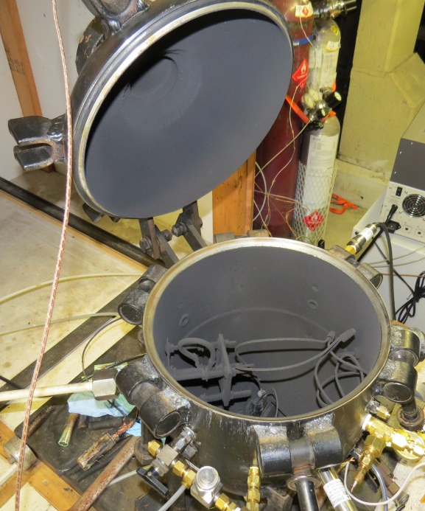
Later Tests (Vent Gas Analysis)
Tests were next carried out in a smaller 21.7L combustion sphere to characterize the type and quantity of gasses emitted.
Pressure Transducer
Clamp-style cell holder (for cell and cartridge heater)
Gas collection port for sample bag.

Slide 11
Procedure (Vent Gas Analysis)
  The combustion sphere was brought to .2 psia with a vacuum pump.
  Nitrogen was bled into the sphere to increase the pressure to 10psia (approximate cruise pressure)
  Thermal runaway was initiated and after the gasses vented and the temperature cooled to the initial temperature, the pressure was increased to 20 PSIA with the addition of Nitrogen.
  The resultant gas was bled into a bag for gas analysis
    A GC was used to quantify Hydrogen and hydrocarbons (C1 to C4)
    An IR analyzer was used to quantify CO, CO₂ and O₂.
    A FID THC analyzer was used to quantify the total hydrocarbon content.

Slide 12
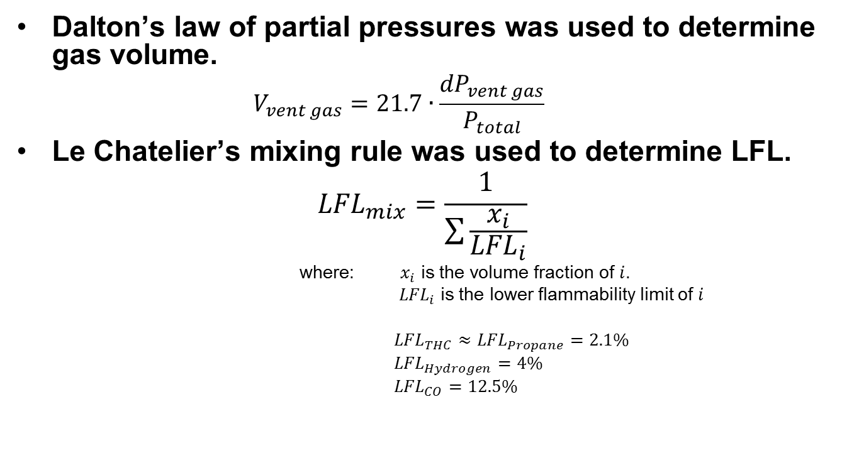
Data Processing

Slide 13
Results: State of Charge (LiCoO₂)
Due to the significant change in volume, all concentrations were normalized to 5 liters.

Slide 14
Results: State of Charge (LiCoO₂)
THC, H₂, and CO decreased as SOC decreased.
Disclaimer: The sample was filtered with a 15 micron particle filter which may have removed atomized liquid hydrocarbons that ejected from the cell.

Slide 15
Lower Flammability Limit
Assumptions: The only flammable gasses are THC, H₂ and CO
The THC reading is treated as propane.
Le Chatelier’s mixing rule was used.

Slide 16
Lower Flammability Limit (con’t)
The calculated number of cells required for an explosive mixture in an LD3 increases exponentially as SOC decreased.

Slide 17
Chemistry Variation
LCM: NiCoMn (c-long ion)
LFP: FePO₄ (c-long ion)
LCO: CoO₂ (18650 ion)
MnO₂: MnO₂ (cr123 metal)
The flammable gasses emitted from a metal cell are close to a LCO ion cell at 50% SOC.
LFP cells have the least flammable gas composition (of the cells tested).
LCM cells have the most flammable gas composition (of the cells tested).
Disclaimer: The sample was filtered with a 15 micron particle filter which may have removed atomized liquid hydrocarbons that ejected from the cell.

Slide 18
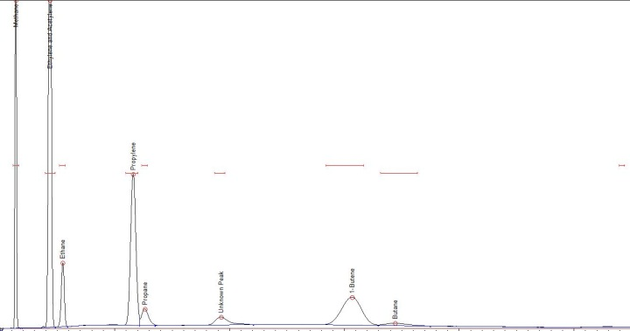
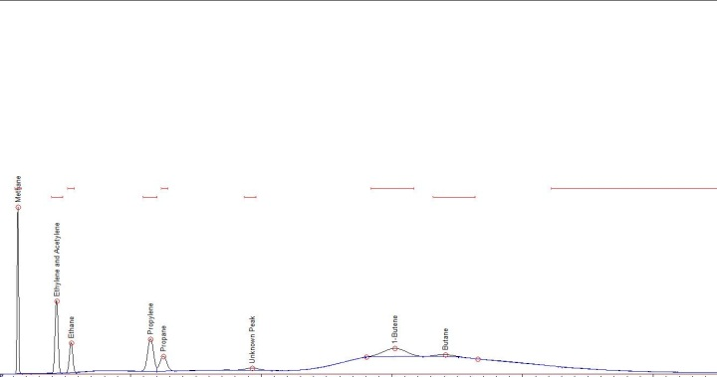
Additional Info. (LiCoO₂)
Cell case temperature increased with SOC
80% SOC
30% SOC
As State-of-Charge decreased the proportion of heavier, non-recognized hydrocarbons increased.

Slide 19
Summary
Vented gasses from Li-Ion cells can produce a pressure pulse of at least 28psi
Volume of gas emitted from cells decreases with SOC.
THC, H₂ and CO (normalized to 5 liters) decrease with SOC.
The number of LiCoO₂ cells that can vent in an LD3 before the LFL is reached appears to increase exponentially as SOC decreases.
Vented gas composition varies with differing cell chemistries.

Slide 20
Future Work
Run verification tests with less nitrogen dilution.
Test additional cell chemistries.
Combust vent gasses in air to determine pressure increase.
Verify LFL readings with a flammability analyzer.
Run a large scale test with halon 1301.

Slide 21
Questions?
Contact
  Thomas Maloney
  Office: 609-485-7542
  Thomas.Maloney@faa.gov

