Slide 1
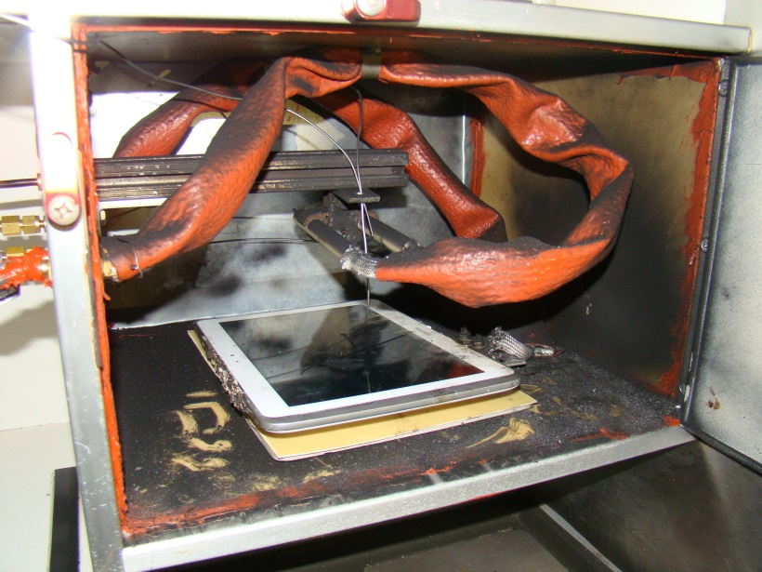
FAA Tablet Tests
Systems Meeting
FAA Fire Safety
11/2017

Slide 2
Background FAA Tests

Slide 3
Background of Current Tests
E-tablets are being used for the electronic flight bag in the cockpit. – What would happen if thermal runaway happened in the cockpit?
E-tablets are used as in-flight entertainment and are stored in the galley. – What would happen if thermal runaway happened in the galley storage area?

Slide 4
Introduction
In both locations we looked at:
Smoke accumulation
Hazardous gas accumulation
Fire Hazard
Temperatures

Slide 5
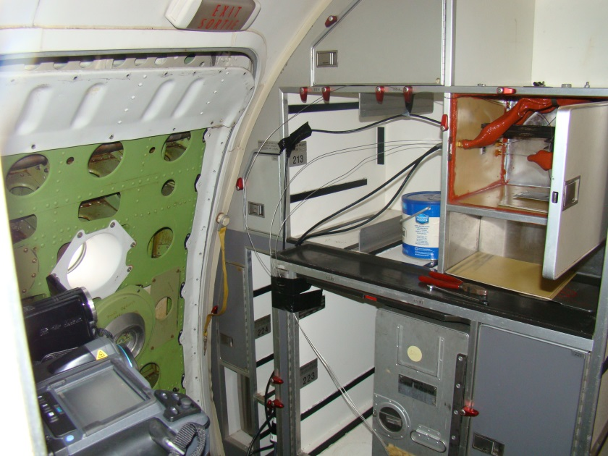
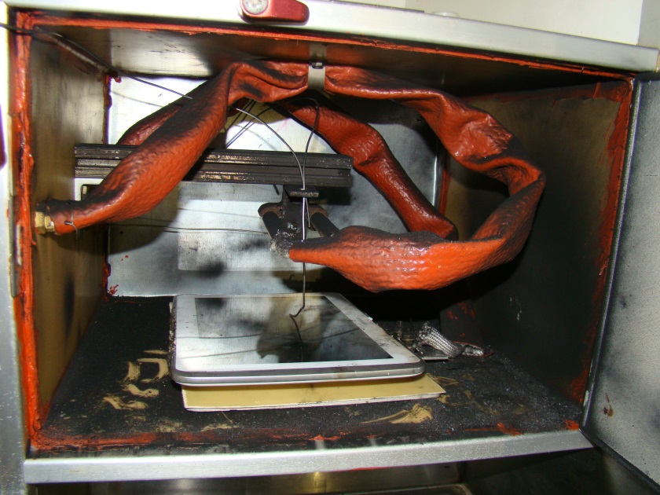
Galley Compartment Setup
CO, CO₂ concentration data was collected in the walkway near the compartment.
Temperature was measured in the compartment.

Slide 6
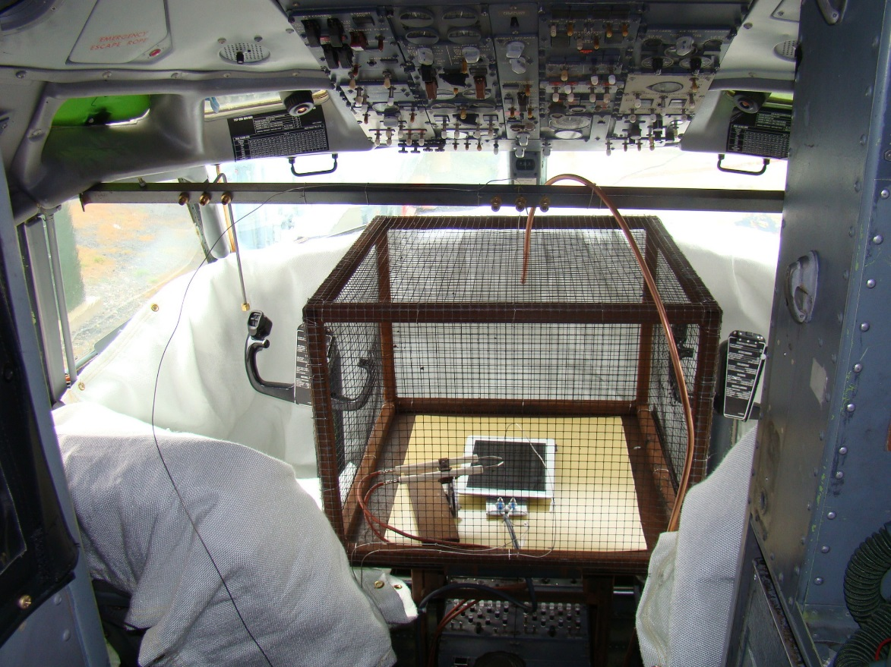
Cockpit Setup
CO, CO₂ concentration was measured at the face height of pilot.
Temperature was measured about 18 inches above tablet.
Smoke obscuration was measured near pilots head.
6

Slide 7
Result Galley
 | Max CO₂ | Max CO | Max Compartment Temperature
Test 1 | 128 ppm | 98 ppm | 86 C
Test 2 | 246 ppm | 140 ppm | 62 C
Test 3 | 245 ppm | 82 ppm | 150 C
Test 4 | 188 ppm | 95 ppm | 113 C

Slide 8
Smoke Accumulation Galley

Slide 9
External Temperatures – Galley Compartment

Slide 10
Results Cockpit
 | Max Smoke Obscuration per Foot | Max CO₂ | Max CO | Max Temperature
Test 5 | 100% | 2450 ppm | 620 ppm | 51 C
Test 6 | 100% | 780 ppm | 520 ppm | 24.9 C
Test 7 | 91.2% | 4460 ppm | 60 ppm | 173.6 C
Test 8 | 95% | 5430 ppm | 396 ppm | 102.9 C

Slide 11
Fire Hazard - Cockpit

Slide 12
Smoke accumulation - Cockpit

Slide 13
Summary
Early warning signs of a tablet overheating.
Screen delaminates from tablet.
A small quantity of smoke or odor may be noticeable.
Smoke accumulation could impair a pilots vision.
CO and CO₂ concentrations are considered non-toxic for the amount of time that a pilot or flight attendants would be exposed.
Fire may erupt from the tablet.

Slide 14
Questions?
Contact information:
Thomas.Maloney@faa.gov
1-609-485-7542

