Slide 1
Modeling of Hidden Fire in Aircraft Overhead Area
International Aircraft Systems
Fire Protection Working Group Meeting
November 1 – 2, 2017
Atlantic City, New Jersey, USA
Haiqing Guo¹, Ezgi S. Oztekin², Sean Crowley³, Paul Scrofani⁴, Richard E. Lyon³
¹ CFar Services, Marmora, NJ
² Diakon Solutions, Cape May Court House, NJ
³ Federal Aviation Administration, William J. Hughes Technical Center, Atlantic City Airport, NJ
⁴ Technology and Management International, LLC; Toms River, NJ

Slide 2
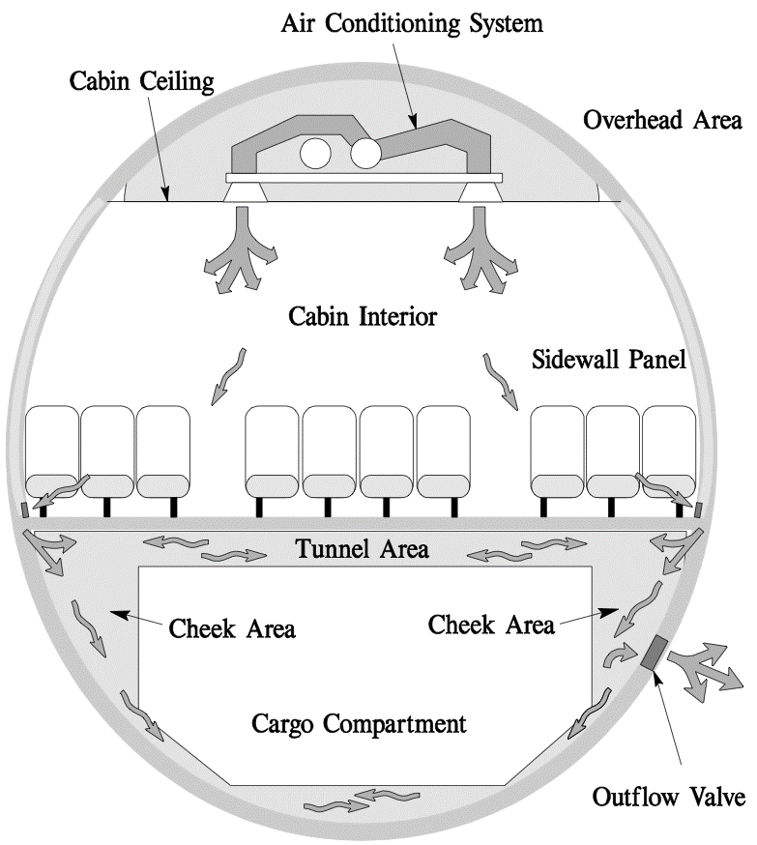
Introduction
Hidden fires are not readily accessible, may be difficult to locate, and more challenging to extinguish. (FAA AC 120-80A).
The indications of hidden fires include:
  abnormal operation,
  circuit breakers,
  hot spots,
  fumes and visual sighting of smoke.

Slide 3
Motivations and Objectives
Motivations:
The hidden area in the aircraft involves:
  more complex geometry (more obstruction along the plume path and highly curved ceiling surface),
  highly flammable insulation materials.
Performing full-scale test is expensive, destructive, and highly hazardous.
Number of test scenarios increases with variance in fire source, fire location, cabin configuration, etc.
Inflight fire at cruise altitude is not possible.
Placement of smoke detector, temperature sensor, and CO detector in transport and cargo aircraft need more information.
Objectives:
Perform CFD simulation of a chosen scenario.
Validate the simulation with full-scale test.

Slide 4
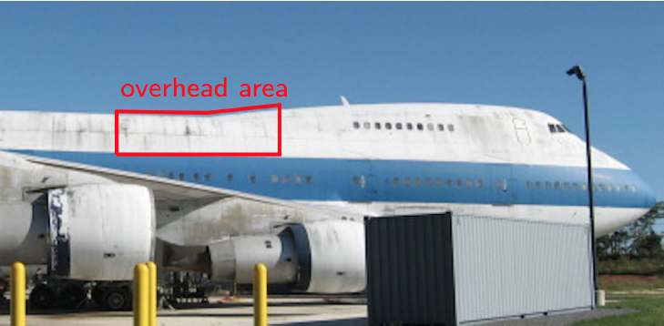
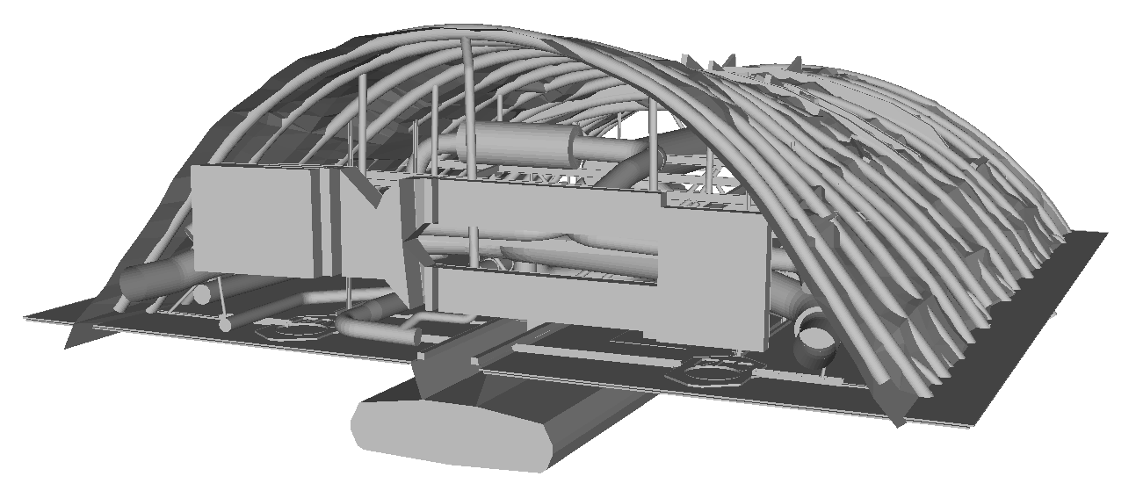
Experiment
Test article Boeing 747-SP.
Selected region: 6.7 m long × 5.4 m wide × 2 m tall.
The light detection and ranging (LIDAR) technology is used to generate 3-D CAD model.
A 11 kW propane gas burner (square vent with 178 mm in sides) is used as fire source.

Slide 5
Experiment
50 thermocouples (Type K, 36-AWG) are installed on top (5 cm below ceiling).
Two thermocouple trees (A and B) are to monitor hot gas layer development.

Slide 6
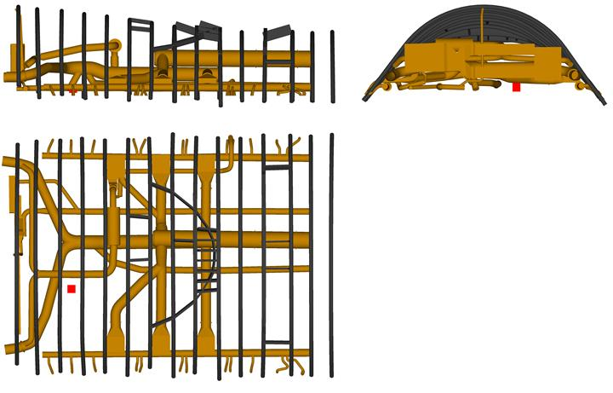
Simulation
Fire Dynamics Simulator (FDS) developed by NIST.
Total of 7 million cells in 84 meshes (1 cm cell at critical regions, and 2 cm cell at the rest regions).
Computations are performed by 3 nodes in FAA’s HPC system.
Radiative fraction is 0.3.

Slide 7
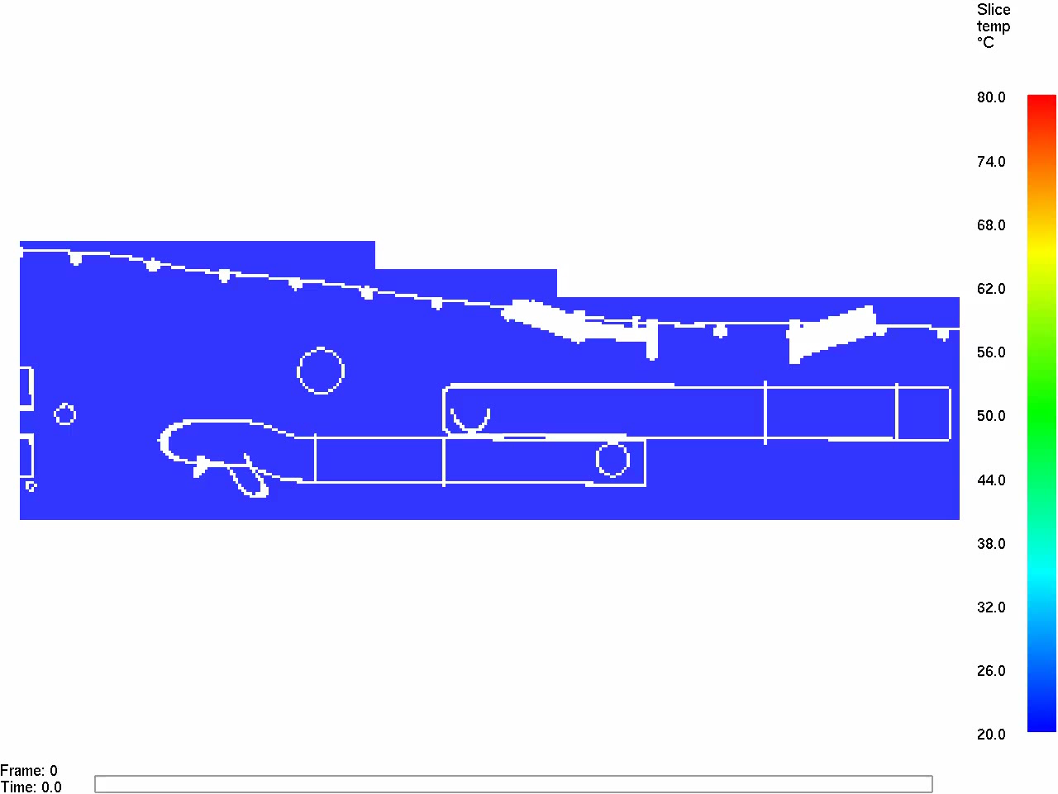
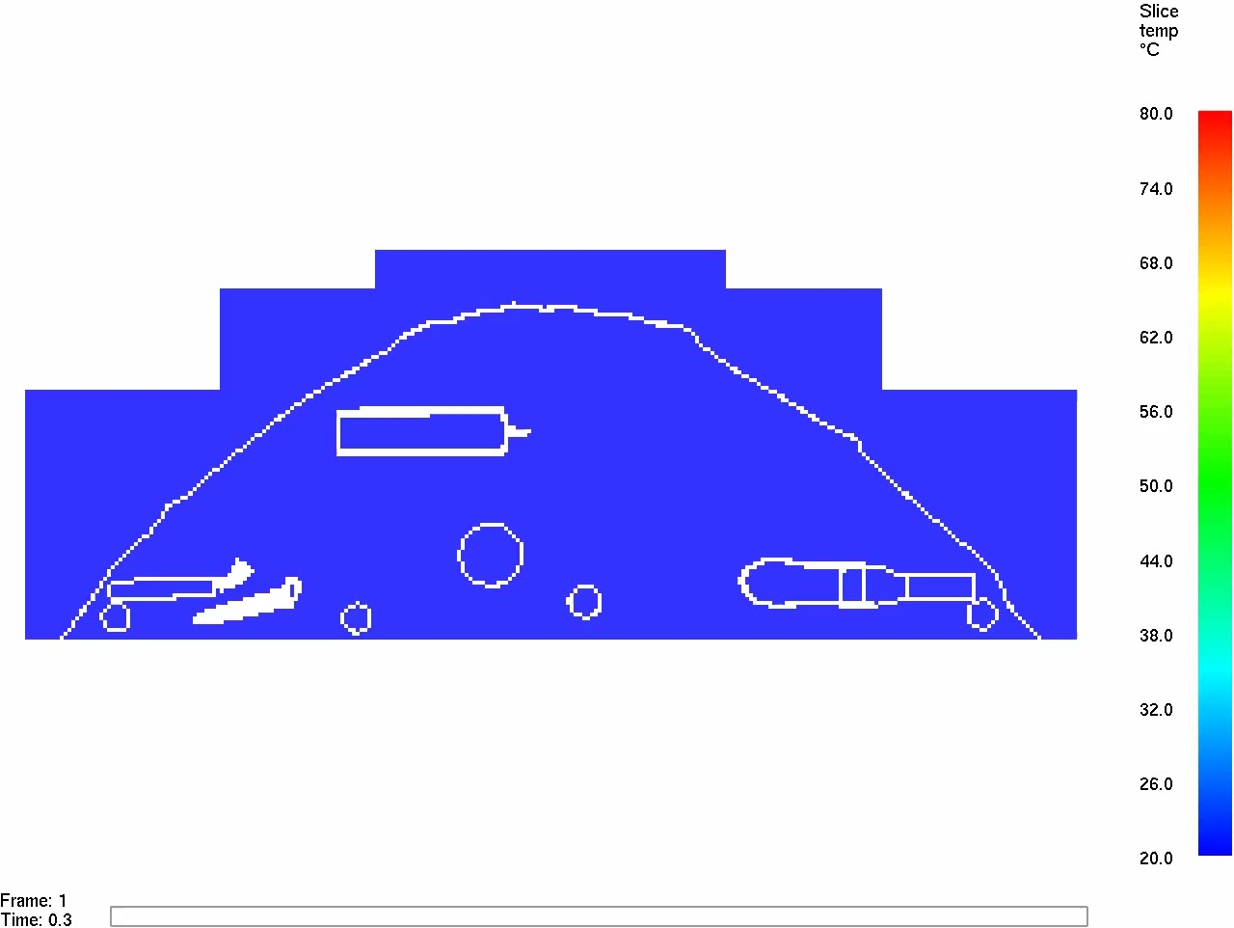
Temperature Results
Side View: y = 3 m
Front View: x = 2.25 m

Slide 8
Results – TC Comparison
along the centerline

Slide 9
Results – TC Comparison
TC tree B

Slide 10
Results – Contour Comparison
Test
Simulation

Slide 11
Simulation – Reduced Pressure
along the centerline

Slide 12
Simulation – Reduced Pressure
Simulation (1 bar)
Simulation (0.75 bar)

Slide 13
Conclusions
A selected section of the cabin overhead area in Boeing 747-SP is investigated.
CFD simulation with complex geometry is performed and the simulation results are compared with tests.
The temperatures agree within 5°C in most of the test region, and within 10 °C in the rear region.
Decreased pressure results in higher ceiling temperature.

