Slide 1
Cargo MPS Task Group
Issues and Potential Updates

Slide 2
Background
DOT/FAA/TC-TN12/11 is the latest version of the Aircraft Cargo Compartment Halon Replacement Fire Suppression Systems
https://www.fire.tc.faa.gov/pdf/TC-TN12-11.pdf
Range of issues with the current MPS document.
  Test procedures
  Test criteria
  Minor typos

Slide 3
Main Talking Points
Aerosol Can Explosion Simulation Scenario
Surface Burning Fire Scenario

Slide 4
Aerosol Can Simulator Scenario
Criteria for the Aerosol Can Simulator is stricter than what was tested in the MPS development tests with Halon 1301.
“The criterion for the aerosol can explosion simulation scenario is that there is no evidence of an explosion or reaction. Evidence of an explosion or reaction includes deflagrations, flashes, and overpressures, etc. There shall be no overpressures (zero pressure rise). In addition, when the agent concentration is below its inert concentration, the explosion intensity and peak pressures shall not be greater than the values exhibited during an explosive event when no suppression agent is present in the compartment.” – §Acceptance Criteria, 2012 MPS Document
“There was no ignition of the contents of the simulator in four of the five tests. There was a very brief ignition of some of the contents during one test (test 28), but no overpressure was recorded.” - §4.8, 2000 MPS Development Report
Issue arose as we were testing a potential Halon replacement agent and observed a brief flash during the testing.

Slide 5
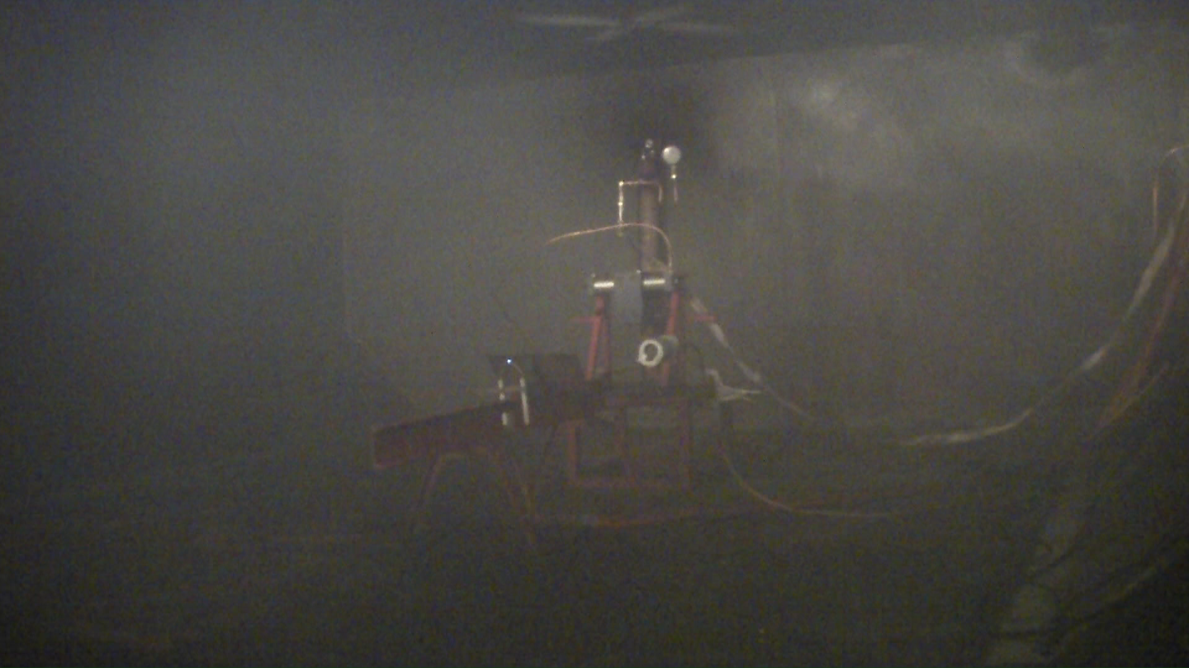
Boeing Sponsored Agent

Slide 6
Summary
As per the current MPS, this test would be considered a failure.
  Flash / Deflagaration was observed.
  No overpressure was observed.

Slide 7
Halon 1301
Can Halon 1301 pass the MPS test method as currently written?
Tested the Aerosol Can simulator Scenario using the MPS Development Scenario.
  Discharged Halon 1301 into the cargo compartment.
  Activated aerosol can simulator when the point conc. near the ignitor reaches 3% in the compartment.
  Activated aerosol can simulator when the bulk average conc. reaches 3% in the compartment.

Slide 8
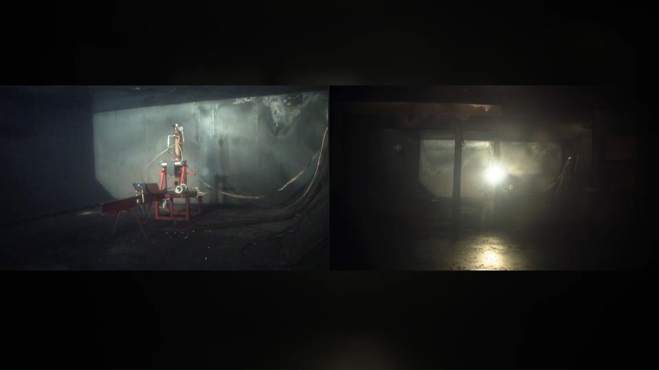
Halon 1301- Test 4
Overpressure of 0.045 psi

Slide 9
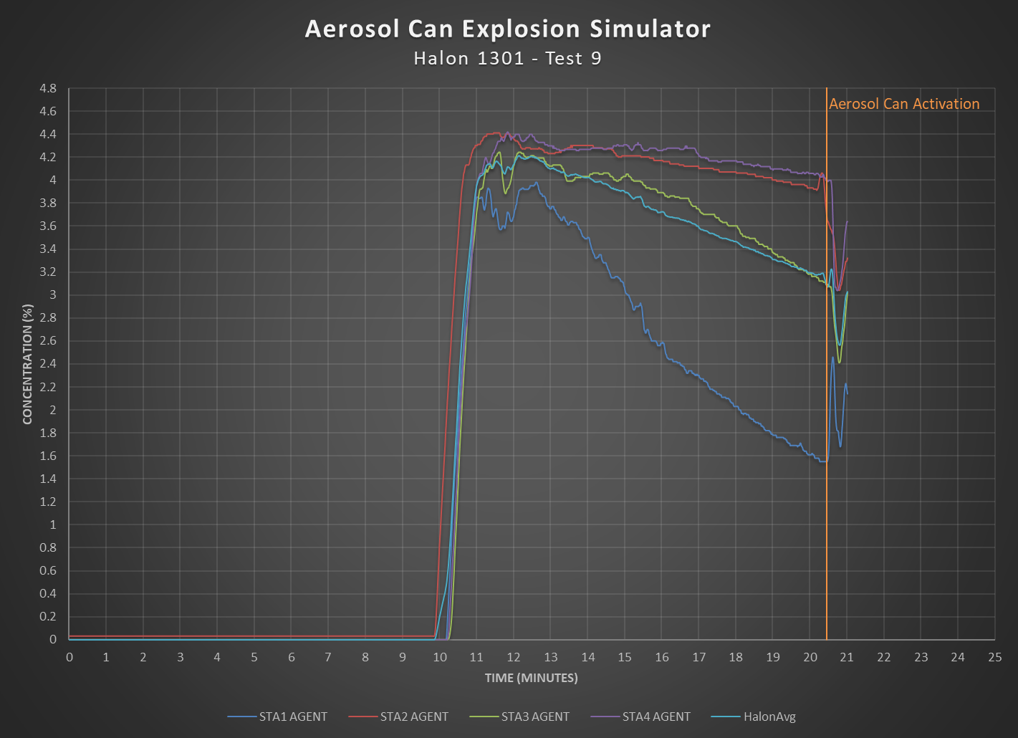
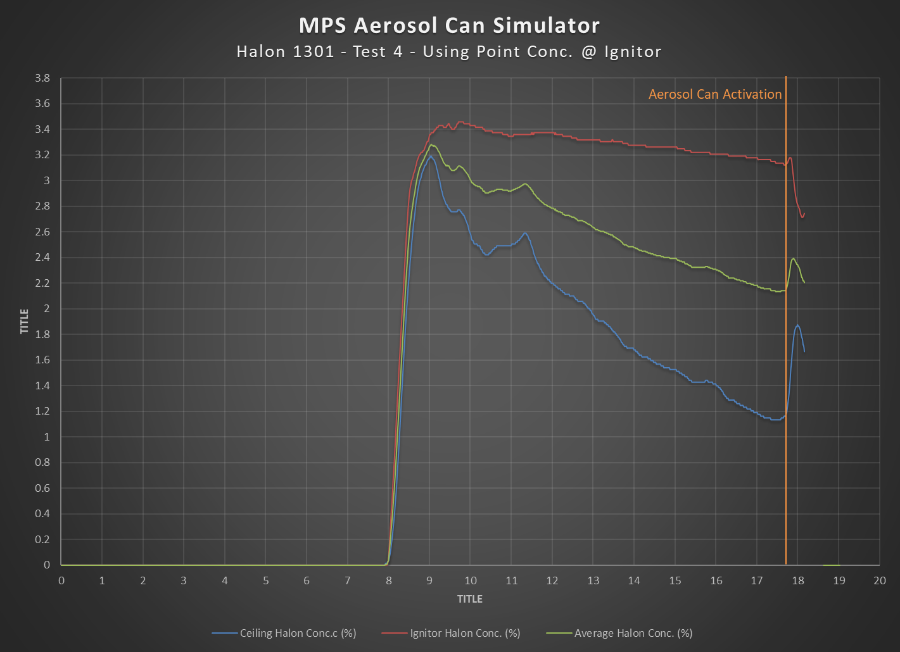
64.70% SD
Notes:
Issues: Simulator was not within its required pressure. Might need to rerun the test.

Slide 10

Halon 1301 – Test 9
Notes:
Test conditions: Bulk avg. conc.

Slide 11
36.70% SD

Slide 12
Halon 1301 – Test 10
Overpressure of 0.095 psi
Notes:
Test conditions: Bulk Avg. Conc.

Slide 13
Halon 1301 – Test 10
Overpressure of 0.095 psi was recorded in an empty compartment.
This equates to 0.495 psi if the cargo compartment was 80% full.
Blowout panels in cargo compartments fail in the range of 0.5psi – 1psi.

Slide 14
Issue with Test Criteria
According to the MPS, the aerosol can is activated when the minimum inerting concentration (3%) is reached at the height of the ignitor.
This creates an unintended behavior of a very low concentration of Halon near the ceiling.
  Including stratification of the agent throughout the compartment.

Slide 15
Proposal for Alternate Test Method
Use mixing fans in the compartment to ensure there is not a stratification effect of the agent.
Increase the height of the setup so that the simulator is activated with a higher concentration of agent at the ceiling.

Slide 16
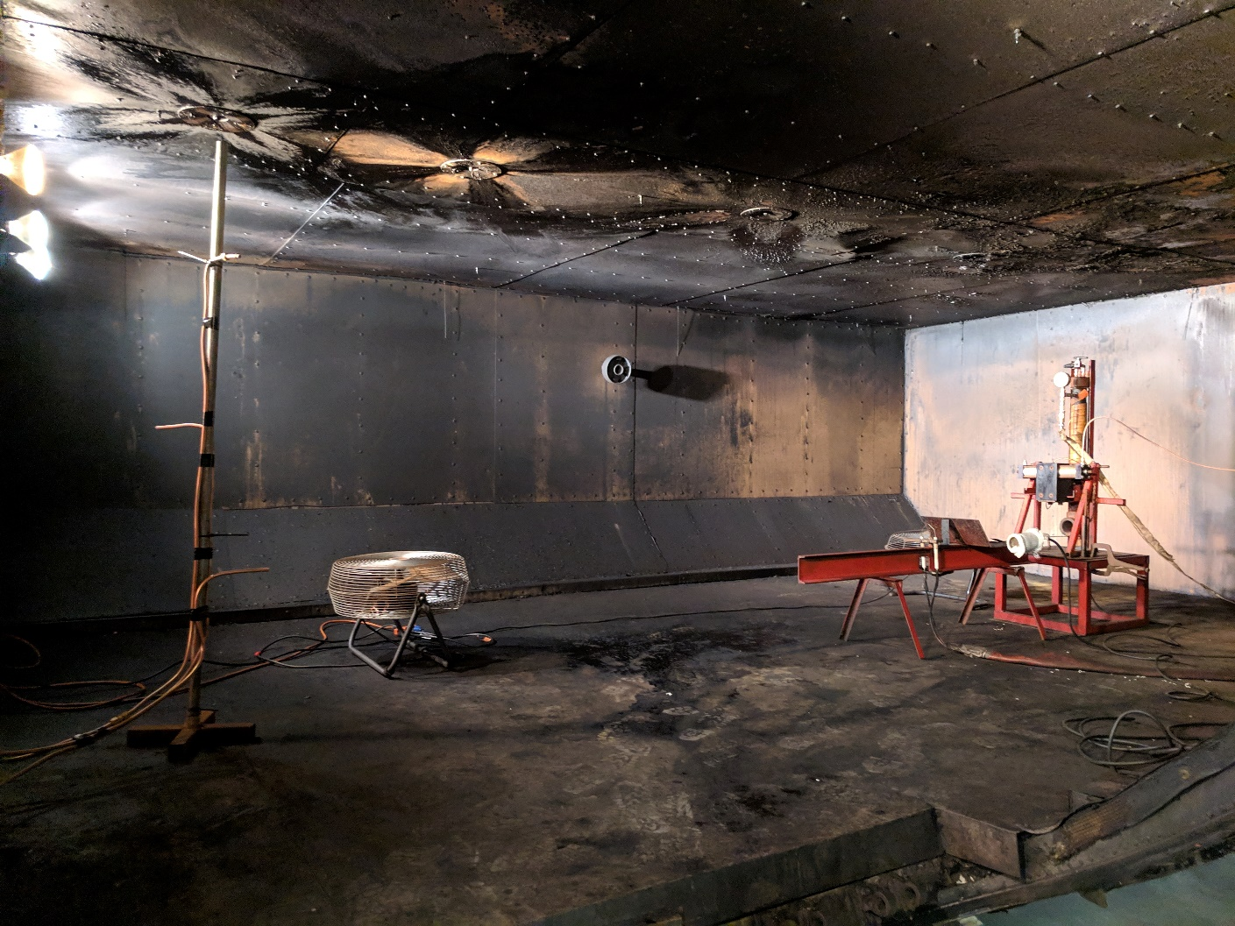
Mixing Fans Setup

Slide 17
Mixing Fans Test Video – Test 14

Slide 18
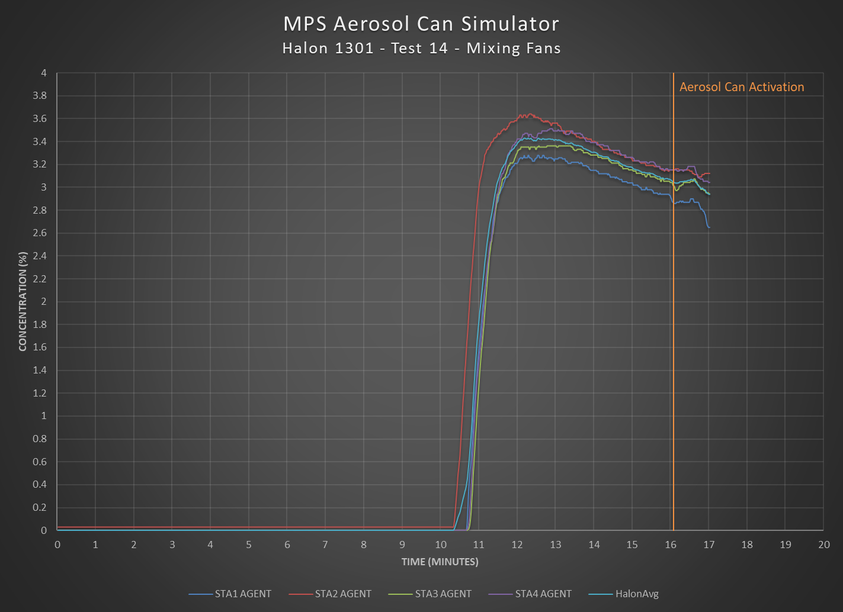
3.88% SD

Slide 19
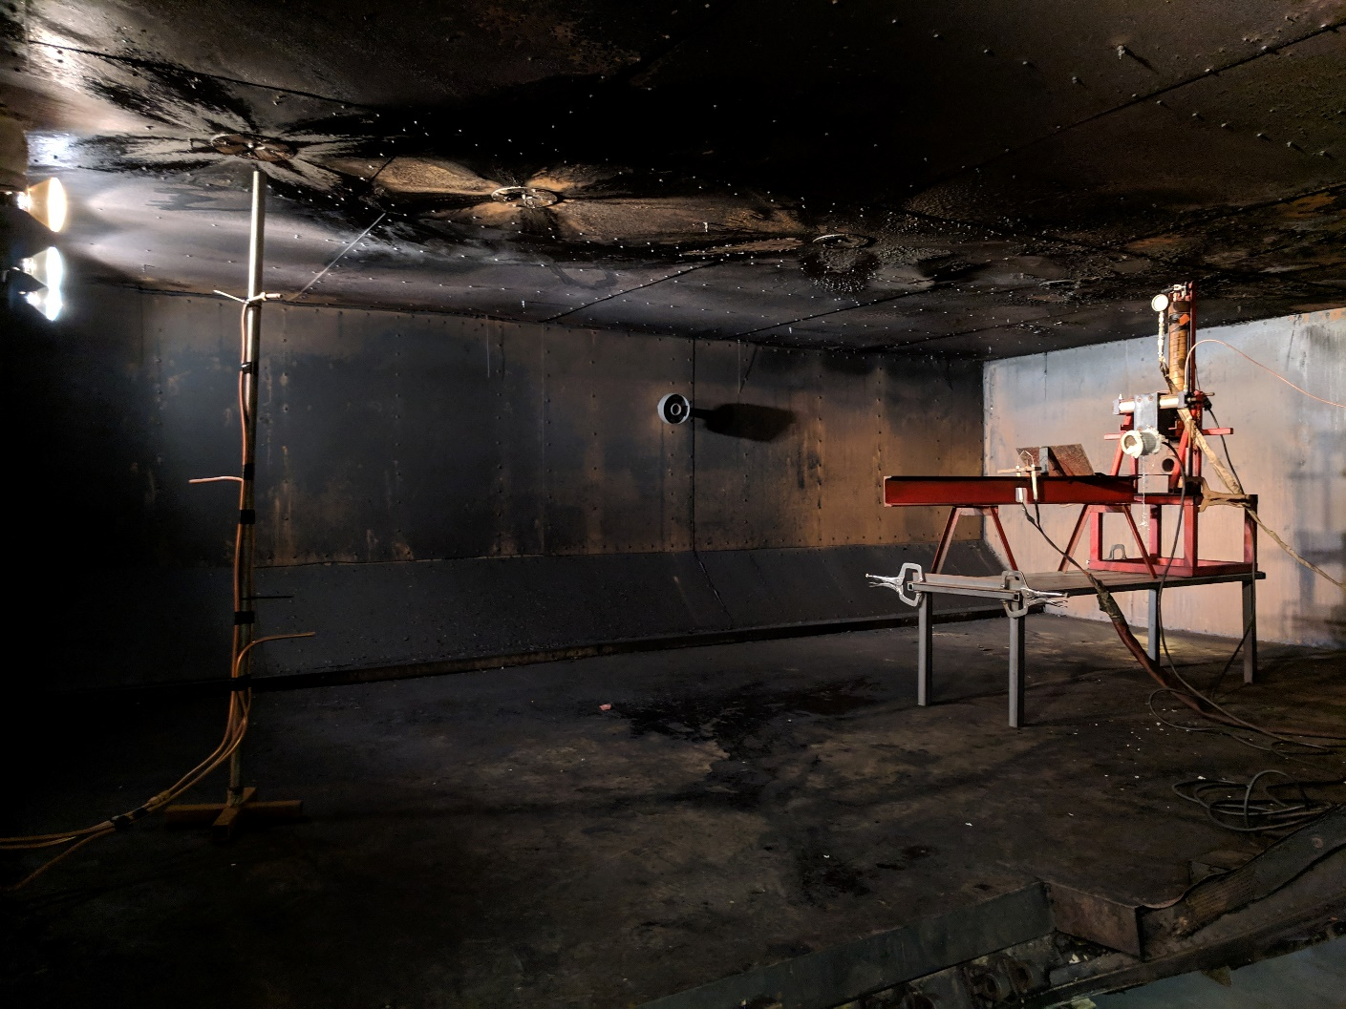
Increase Setup Height

Slide 20
Increase Setup Height

Slide 21
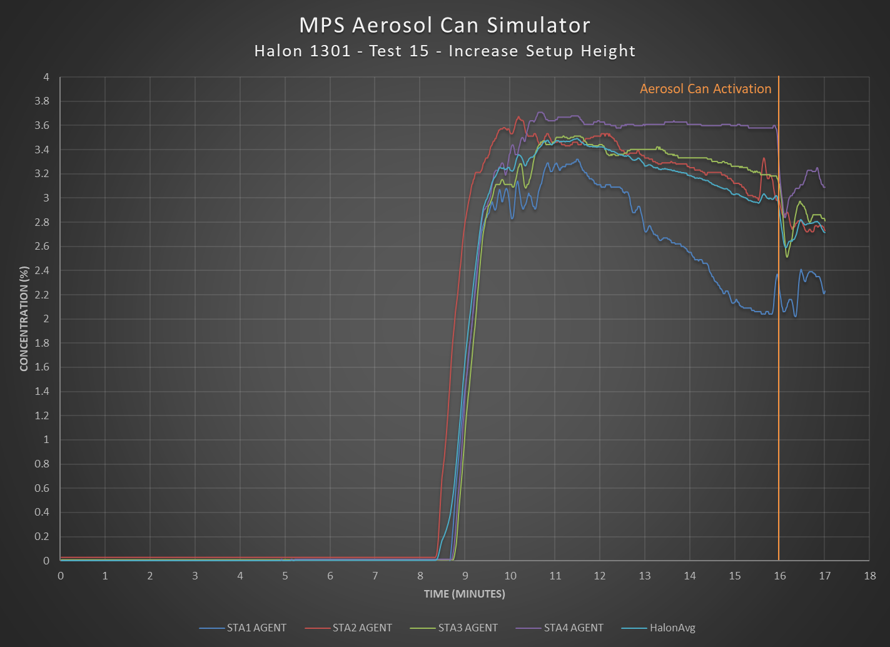
15.32% SD

Slide 22
Summary
Issues with the current test methodology will be addressed in the Cargo MPS Task Group.
Outcomes could lead to:
  Changes in acceptance criteria
  Changes in the test methodology.

Slide 23
Surface Burning Fire Test Method
Positioning of the pan can affect the peak temperatures and time-temperature integrals.
“The pan should be positioned in the cargo compartment in the most difficult location for the particular suppression system being tested.” §Fire Scenario – 2012 MPS Update
MPS development testing doesn’t specify the location of thermocouple in reference to the pan
Results from Boeing Sponsored Agent shows an increase when the pan is placed directly underneath
  19% increase in average peak temperatures
  17% increase in average peak time-temperature integrals.

Slide 24
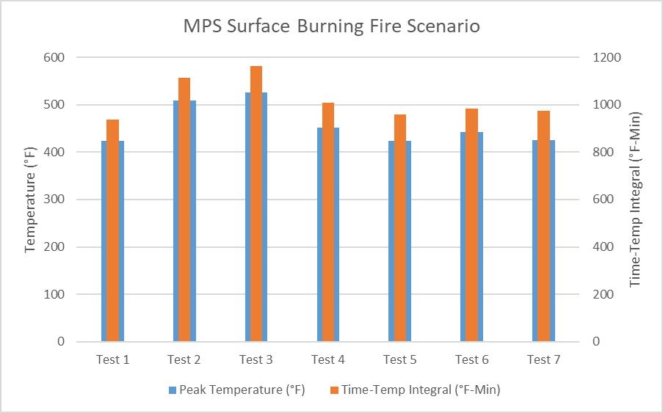
Surface Burning Fire Scenario Chart
Centered underneath T/C

Slide 25
Summary
There is an observed effect on the peak temperatures by changing the location of the pan in the compartment.
Compare data with other facilities to observe similar phenomenon, if available.

Slide 26
Other Issues
Conflicting measurements of the size of the simulator pressure vessel.
Opening timing of simulator.
Standard Deviation miscalculation for the peak temperature criteria.
Leak rate calculation for test compartment.
Calculation methods / Interpretation of the acceptance criteria.
Challenge Fire Scenario.

Slide 27
Cargo MPS Task Group
Date: May 16, 2019
Time: 9:00 AM
Room:

Slide 28
Questions
Contact Info :
Dhaval Dadia
dhaval.dadia@faa.gov
609-485-8828 (W)

Slide 29
The Ninth Triennial International Fire & Cabin Safety Research Conference
Oct 28 – 31, 2019

