Slide 1
Cabin Altitude Discharge of 2-BTP
Int’l Aircraft Systems Working GrpAudience>
Harry Webster, FAA Tech Ctr
May 9, 2018

Slide 2
Introduction
2-BTP is new handheld fire extinguisher agent offered as a replacement for Halon 1211.
2-BTP has physical characteristics that differ from Halon 1211 that could potentially affect extinguisher discharge performance in low pressure environments.
  2-BTP has a higher boiling point than 1211, 93 DegF vs. 24.8 DegF
  2-BTP has a lower vapor pressure than 1211, 0.74 bar @ 77 DegF vs. 2.8 bar

Slide 3
TEST PARAMETERS
Examine the discharge characteristics of handheld 2-BTP fire extinguishers:
  Sea Level
  8000 ft. cabin altitude
    Ambient temperature
    Cold soaked to -35 DegF
    Hot soaked to 155 DegF
  12000 ft. cabin altitude

Slide 4
Test Setup
Tests were performed in the FAA Technical Center Environmental Chamber
The chamber was fitted with a target consisting of 10 fire cups, identical to the cups used in the Hidden Fire Test, arranged in a vertical array.
A remote discharge device was installed such that the extinguisher was aimed at the center of the target array.

Slide 5
Dimensions
Target Array:
  Five pairs of fire cups
  16” horizontal spacing
  12” vertical spacing
Remote discharge:
  Nozzle height above floor: 42.5”
  Distance to target array: 76”
    Compares to the MPS Seat Fire Toxicity Test distance of 72” from firefighter to the front of the seat

Slide 6
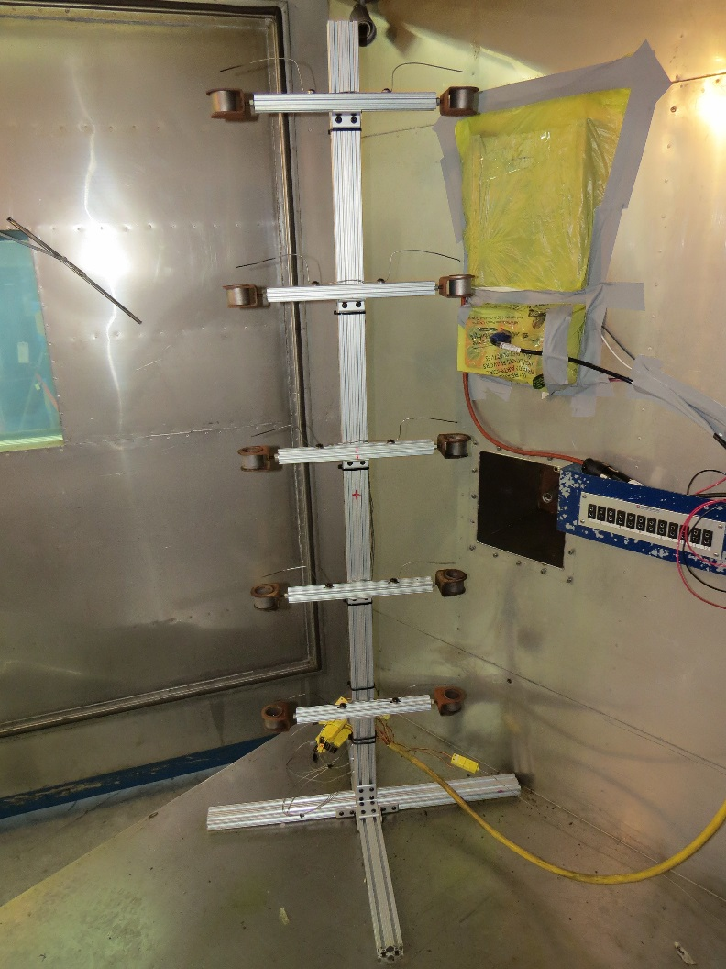
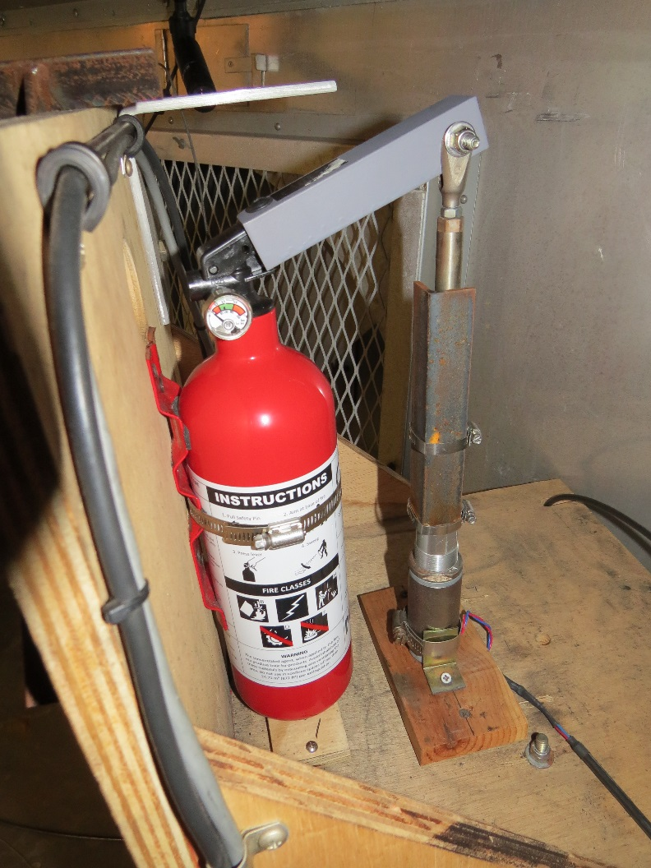
Target Array and Remote Discharge

Slide 7
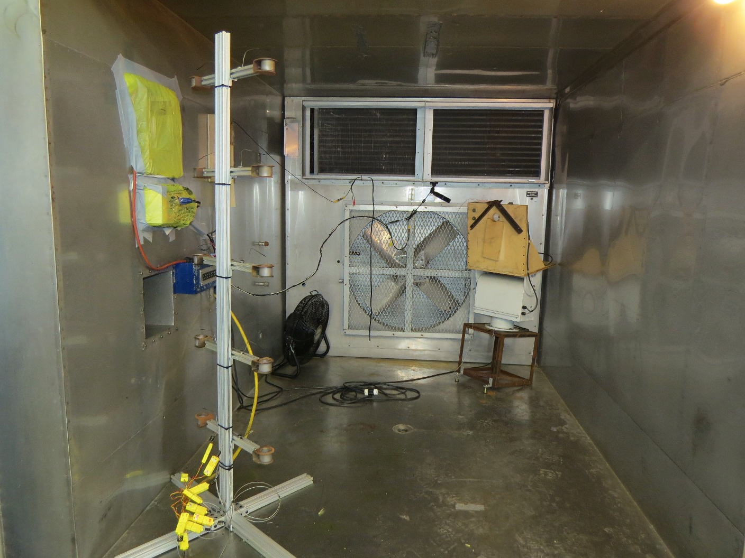
Test Apparatus installed in the Environment Chamber

Slide 8
Test Procedure
Basic setup:
  Extinguisher installed in remote discharge assembly
  Extinguisher nozzle orientation adjusted with a laser to center the stream on the middle pair of fire cups three feet above the floor.
  Cups filled 2/3 full with 1-propanol
  Cup fires were lit with a propane torch
  Chamber sealed and test conditions set

Slide 9
Test Procedure
Test Conduct
  Altitude tests
    Cups ignited and chamber sealed
    Chamber altitude set
    Four minute time lapse from cup ignition to extinguisher discharge
    Extinguisher discharged fully
    Number and location of cups extinguished noted
  Hot and Cold soak tests
    Six hour temperature soak prior to test
      Chamber, with extinguisher installed set to -40F or 155F
    Fire cups removed prior to temperature soak.
    Fire cups reinstalled and filled before altitude conditions set.
    Follow altitude test procedure above.

Slide 10
Test Matrix and Results
Test 1: 2- BTP @ Sea Level
Test 2: 2-BTP @ Sea Level
Test 3: 2-BTP @ 8000’ cabin altitude
Test 4: 2-BTP @ 8000’ cabin altitude
Test 5: 2-BTP @ 12500’ cabin altitude
Test 6: 2-BTP @ 12500’ cabin altitude
Test 7: 2-BTP @ 8000’ cold soaked
Test 8: 2-BTP @ 8000’ cold soaked
Test 9: 2-BTP @ 8000’ hot soaked
Test 10: 2- BTP @ 8000’ hot soaked
Test 11: Halon 1211 @ 8000’
Test 12: Halon 1211 @ 8000’
8 cups ext.
8 cups
10 cups
8 cups
10 cups
10 cups
No data
7 cups
10 cups
10 cups
10 cups
9 cups

Slide 11

Halon 1211 Baseline @ 8000’

Slide 12
2-BTP @ 8000’

Slide 13
Cold Test @ -12 DegF Ext. Temp.

Slide 14
Hot Test @ 147 DegF Ext. Temp.

Slide 15
OBSERVATIONS
Vaporization appears to improve as cabin altitude is reduced. This results in a slightly wider stream diameter.
The stream at cold temperatures is tighter than at ambient with reduced vaporization. There does not appear to be any effect on throw range
The stream at high temperature is more forceful, with better vaporization.

Slide 16
Conclusions
Cabin altitude has only a minimal effect on the 2-BTP extinguisher stream characteristics.
The 2-BTP extinguisher retains its effectiveness at the rated temperature extremes tested at 8000’ cabin altitude.
Performance of the 2-BTP extinguisher, as measured in this test, is comparable to Halon 1211 at 8000’ cabin altitude.

