Slide 1
Smoke Transport Modeling for
Cargo Bay Applications
Changmin Cao, May Corn, Vaidya Sankaran
United Technologies Research Center
Kenneth Bell
UTC Aerospace Systems
May 8, 2018
FAA Systems Working Group Meeting – Cologne, Germany – May 8, 2018

Slide 2

Acknowledgements
FAA
  Matthew Karp
  Robert Ochs
UTC Aerospace Systems
FAA Systems Working Group Meeting – Cologne, Germany – May 8, 2018

Slide 3
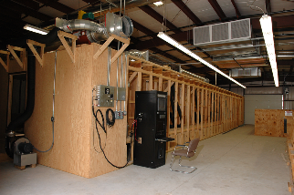

Cargo bay Detection system development
Substantial number of tests required to develop and certify detection system
Design and Optimize Detection System
Certify Detection System
FAA Systems Working Group Meeting – Cologne, Germany – May 8, 2018

Slide 4
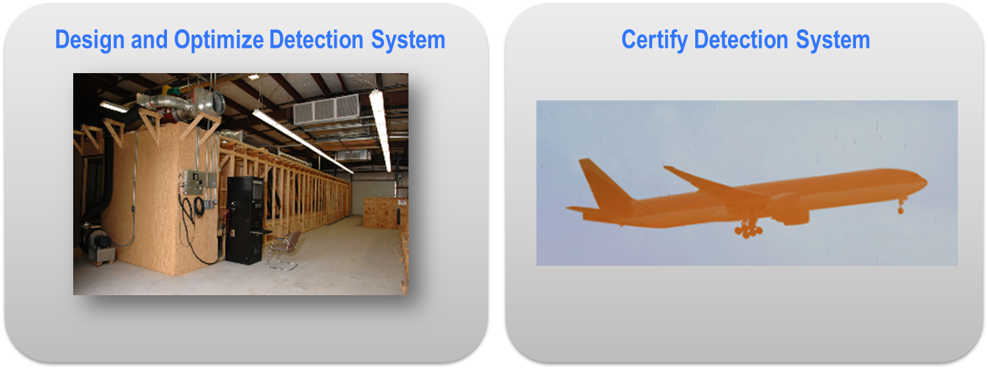
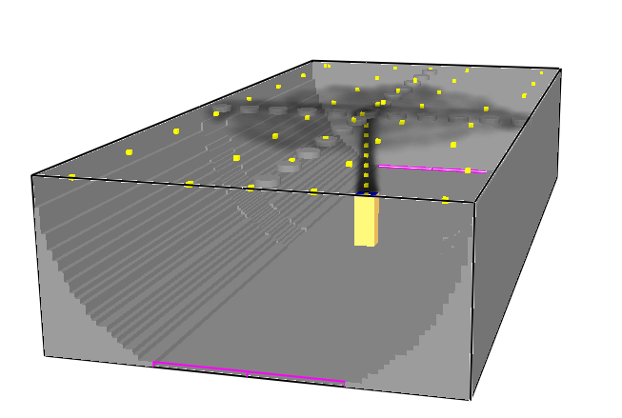
Model-based design vision: detection system development
Objective: Develop a model-based tool to augment and streamline certification process
Cargo Bay Detection System Design Tool
Benefits:
Virtual tests
Parametric variations
Physical insight
Accelerate development
Reduce number of flight certification tests
Reduce cost of certification
FAA Systems Working Group Meeting – Cologne, Germany – May 8, 2018

Slide 5
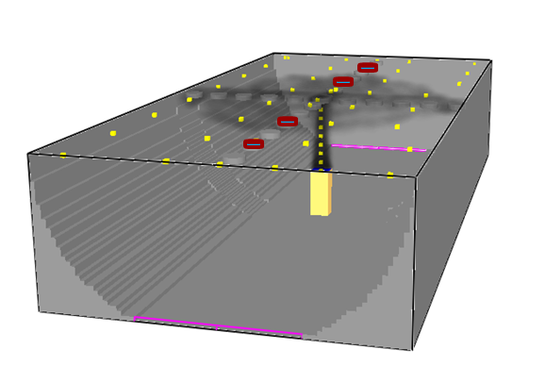
Cargo bay Detection system design tool framework
Input Parameters
Smoke generator
Flow rates, Size Distribution
Temperature, Velocity
Location
Cargo Bay
Geometry
Obstructions
Ventilation
Location
Flow rates
Detector
Geometry
Placement
Smoke Transport in the Cargo Bay
Computational Fluid Dynamics (CFD) Model
Smoke Mass Dispersion (Function of space and time)
System Response Time of Detector Layout
models
Detection System Performance?
Refine
Select promising designs to test
FAA Systems Working Group Meeting – Cologne, Germany – May 8, 2018

Slide 6
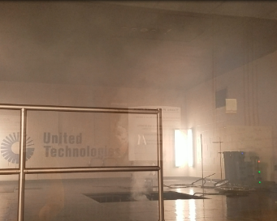
Model components
System Response Time
Obscuration (smoke concentration) & transport time
Smoke Transport to the ceiling
Large room features/obstructions
Small scale features – detector tray
Buoyancy Ventilation
Environmental conditions
Smoke Source
Size distribution
Temperature
Velocity
Steady vs. transient
Smoke Transport CFD Model
Smoke Transport prediction depends on validity of Smoke Source simulation
First step: develop a CFD model to simulate the Smoke Generator
FAA Systems Working Group Meeting – Cologne, Germany – May 8, 2018

Slide 7
Smoke source: smoke generator
Smoke Generator
Particle size generation and velocity affected by
Heater size and arrangement
Atomization / Condensation
Flow rates
Difficult to characterize and generalize smoke generator
http://www.concept-smoke.co.uk/
Measurements from FAA – One Set of Operating Conditions
max
min
FAA Systems Working Group Meeting – Cologne, Germany – May 8, 2018

Slide 8
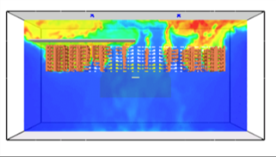
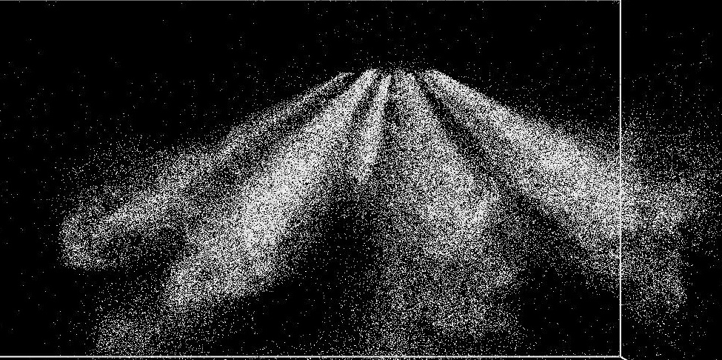
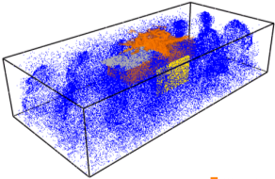
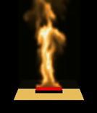
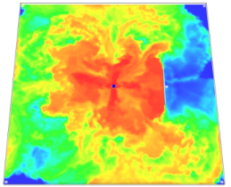
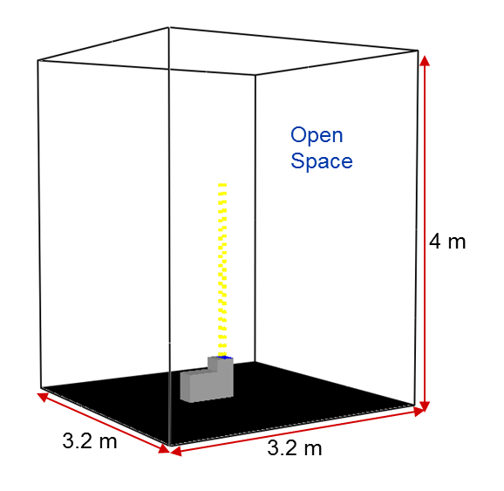
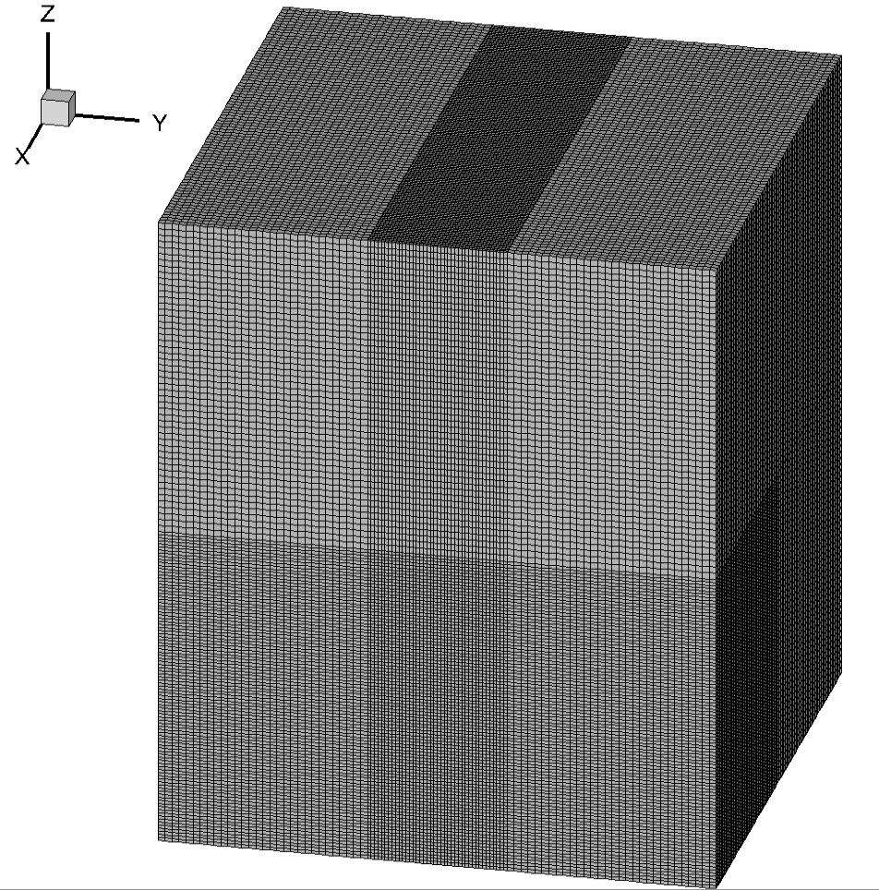
Simulation tool & set-up
Fire Dynamics Simulator (FDS)
3-D, unsteady solver from NIST (version 6.6.0)
Large Eddy Simulation (LES)
Low Mach with Direct Poisson equation solver for pressure
Time Integration: 2nd order explicit predictor-corrector scheme
Smoke Generator Set-Up
Total cells: 1.62 million
Hexahedral cells
Non-uniform sized mesh
Parallel computing cluster (~100 cores)
FAA Systems Working Group Meeting – Cologne, Germany – May 8, 2018

Slide 9
Smoke generator model
How should we model the injection of the smoke from the generator?
Evaluate the following Injection Approaches
Method 1: Inject aerosol as a distribution of particles
Realistic, but may be computationally expensive
Method 2: Inject aerosol as a gas
Reasonable if sub-micron particles follow the flow
FAA Systems Working Group Meeting – Cologne, Germany – May 8, 2018

Slide 10
Smoke generator model
Initial Conditions at Smoke Generator Injection Plane
 | Particle Injection Method 1 | Aerosol-as-Gas Method 2
Aerosol flow rate | Oil + Carrier N₂ | Mass fractions of Smoke and N₂
Particle size distribution | derived from representative data | n/a
Temperature | Same initial temperature
Velocity | Same initial velocity
Turbulence intensity | Same initial turbulence intensity
FAA Systems Working Group Meeting – Cologne, Germany – May 8, 2018

Slide 11
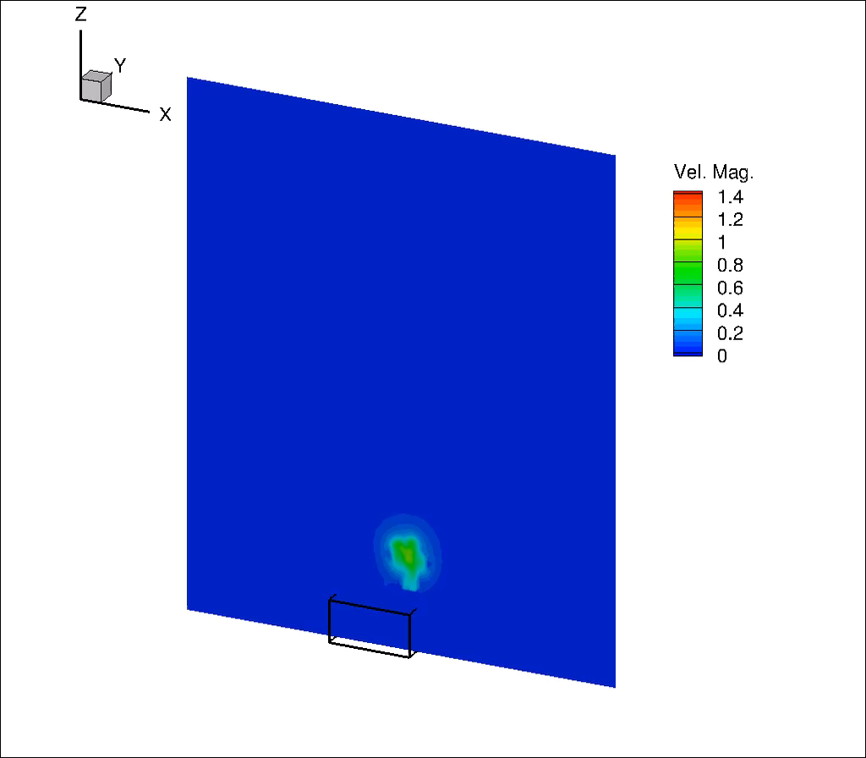
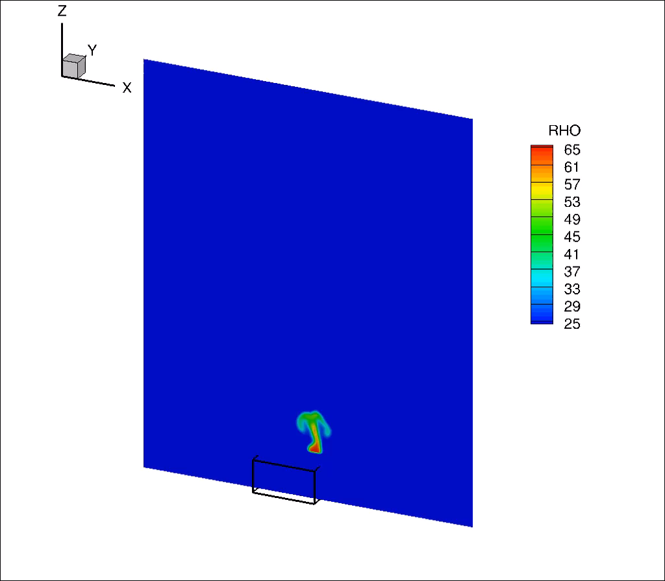
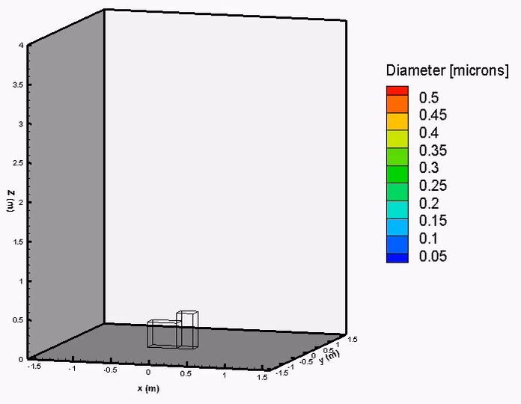


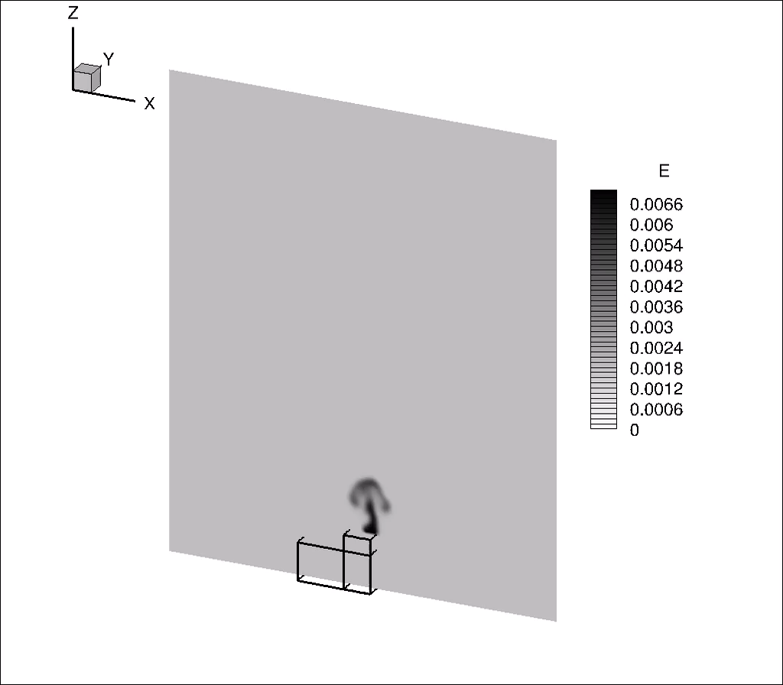
Qualitative comparison of flow fields
Aerosol-as-gas method produces similar plume features as particle injection method
Method 1: Particle injection
Gas velocity (m/s)
Temperature (⁰C)
Particle sizes
Method 2: Aerosol-as-gas
(kg/kg)
Gas velocity
Temperature
Mass fraction
FAA Systems Working Group Meeting – Cologne, Germany – May 8, 2018

Slide 12
Quantitative comparison with data
Both injection methods (particle-based and gas-based) produce similar profiles
Centerline Plume Temperature
Centerline Plume Velocity
Simulations fall within upper end of measurement range
FAA Data – Max Velocities
FAA Data
Simulations match the measured profile
FAA Data – Min Velocities
Method 1: Particle Injection
Method 2: Aerosol as Gas
FAA Systems Working Group Meeting – Cologne, Germany – May 8, 2018

Slide 13
Plume centerline particle size
Particle size distribution parameters do not vary significantly with height
Particle size distribution parameters
20 cm x 20 cm x 20 cm cubes interrogated
Results suggest that particles follow the flow
What happens when the plume is dispersed by cross-flowing ventilation?
FAA Systems Working Group Meeting – Cologne, Germany – May 8, 2018

Slide 14
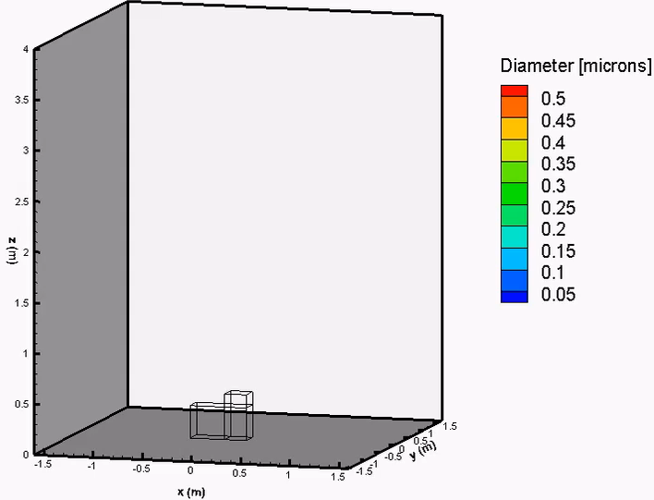
Plume centerline particle size: cross-flowing air present
Particle size distribution parameters do not change significantly as the plume is interacts with a crossflow
VENT
Particle size distribution parameters
20 cm x 20 cm x 20 cm cubes interrogated
This scenario also suggests that particles follow the flow.
Plume can be modeled as a gas with constant particle size distribution
FAA Systems Working Group Meeting – Cologne, Germany – May 8, 2018

Slide 15
Quantitative comparison: centerline smoke concentrations
Gaseous injection method produces similar smoke distribution profiles as particle injection method
FAA Systems Working Group Meeting – Cologne, Germany – May 8, 2018

Slide 16
Summary—smoke generator simulation approach
 | Key Observations | Computational Time
Method 1: Particle Injection | Particles follow the flow Size distribution does not change | 3 hours - 9 hours
Method 2: Aerosol-as-Gas | Similar results as Method 1 Gas velocity Temperature Smoke concentration | 2 hours
Computational time for Method 1 will increase in a closed room simulation because of particle accumulation
Method 2 sufficiently predicts velocity, temperature, smoke concentration profiles.
Therefore, select Aerosol-as-Gas Method to simulate the smoke generator in a Cargo Bay Simulation
FAA Systems Working Group Meeting – Cologne, Germany – May 8, 2018

Slide 17
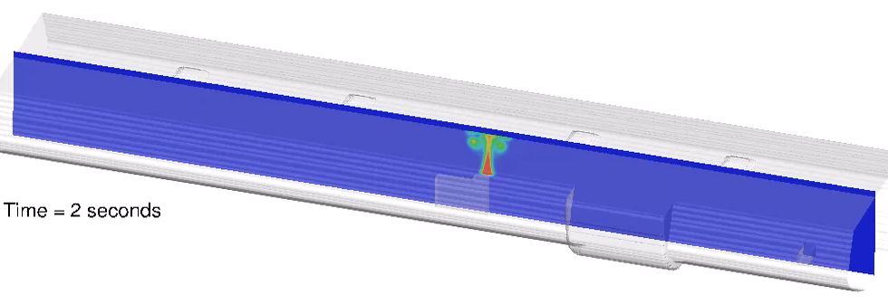
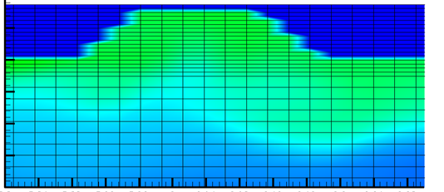
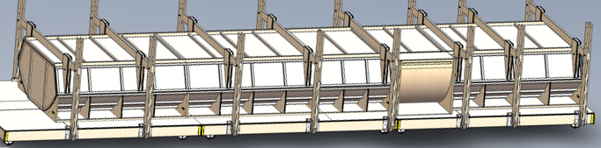
Cargo bay simulation demonstration
Simulations conducted with the current smoke generator model to predict smoke transport in the cargo bay
- Varied smoke generator position, ventilation scenarios
Smoke transport into the detector tray
Additional data being acquired to validate transport models for the cargo bay
UTC Aerospace Systems
Cargo Bay Test Simulator
FAA Systems Working Group Meeting – Cologne, Germany – May 8, 2018

Slide 18

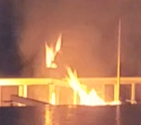
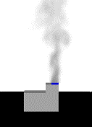
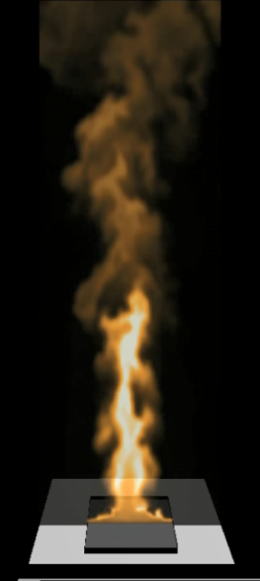
Cargo bay smoke transport modeling: next steps
Mature tool to encompass smoke generated from fire sources
Characterization of Smoke Generators
Characterization of Transport Dynamics in Cargo Compartments
Characterization of Fires
Assess Smoke Detection Performance via Simulation Methodology
FAA Systems Working Group Meeting – Cologne, Germany – May 8, 2018

