Slide 1
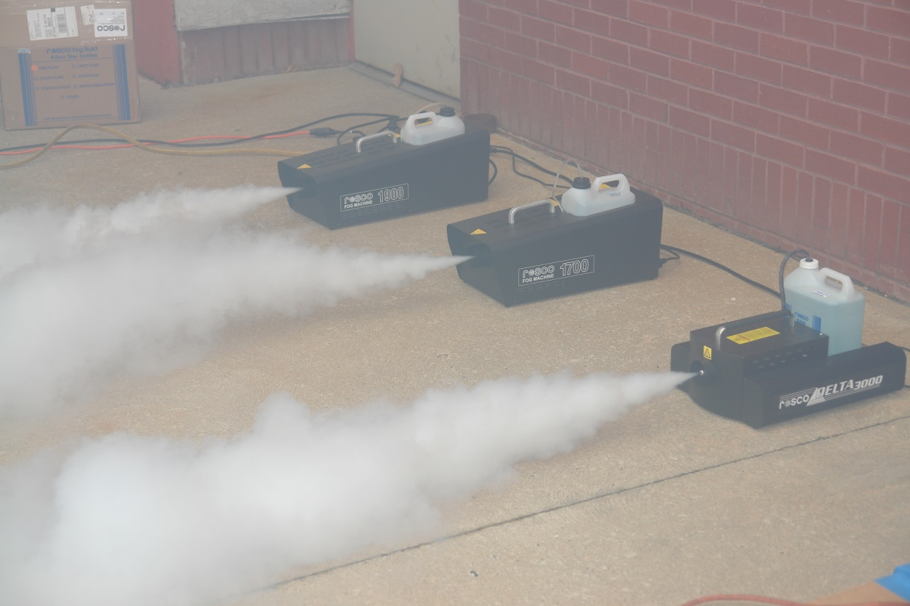
Smoke Source Project
Systems Working Group Meeting
Toulouse, France
Robert Morrison, FAA Technical Center Fire Safety
May 18 - 19, 2016

Slide 2

Purpose
The objective is to compare different theatrical smoke generating smoke sources to a 4800 lithium primary battery fire test performed in a Class E cargo compartment that resulted in completely obscuring the flight deck in as little as 16 minutes on a Boeing 727 aircraft.
Harry Webster’s February 26, 2013 Lithium Battery Test Video

Slide 3
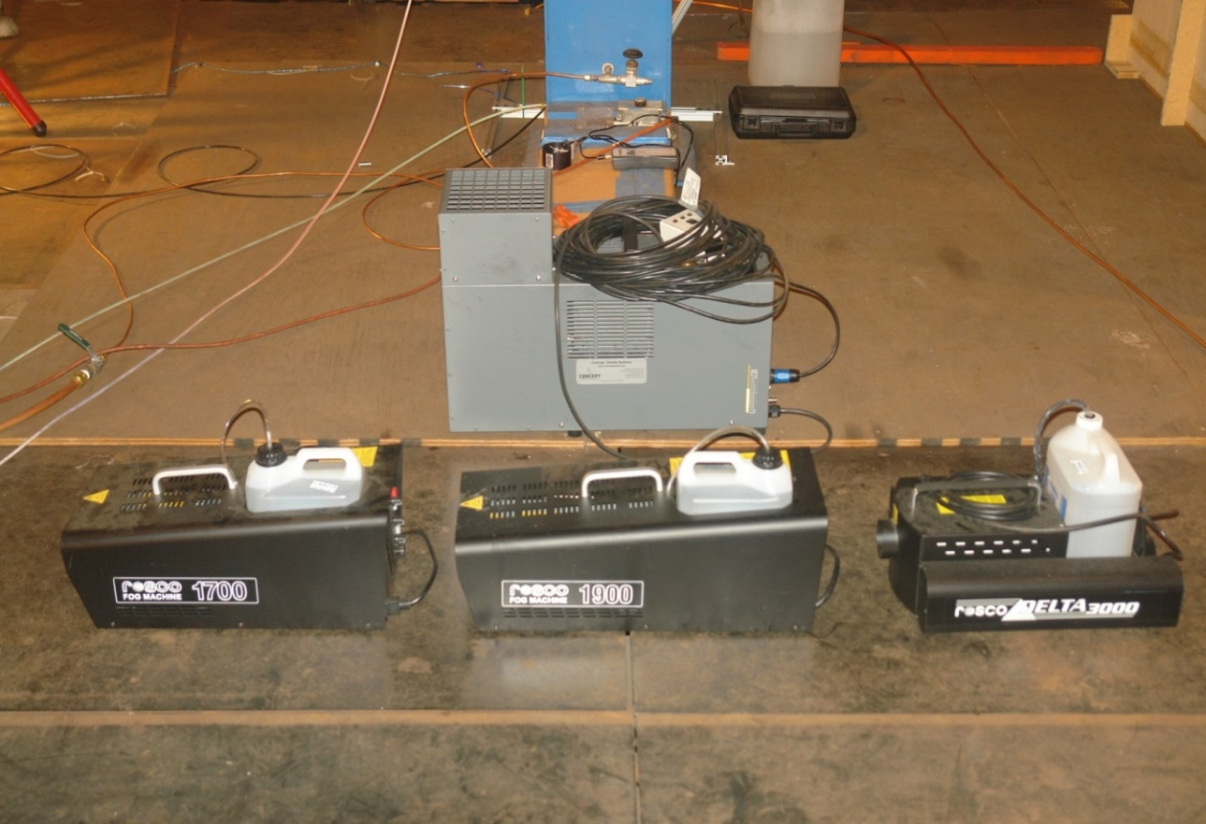
Project Work
The scope of the project is to evaluate in-house theatrical smoke generators and see how the addition of heat and Helium effects smoke transport time
Four smoke sources are being evaluated
ViCount SDT
Rosco 1700
Rosco 1900
Rosco 3000

Slide 4
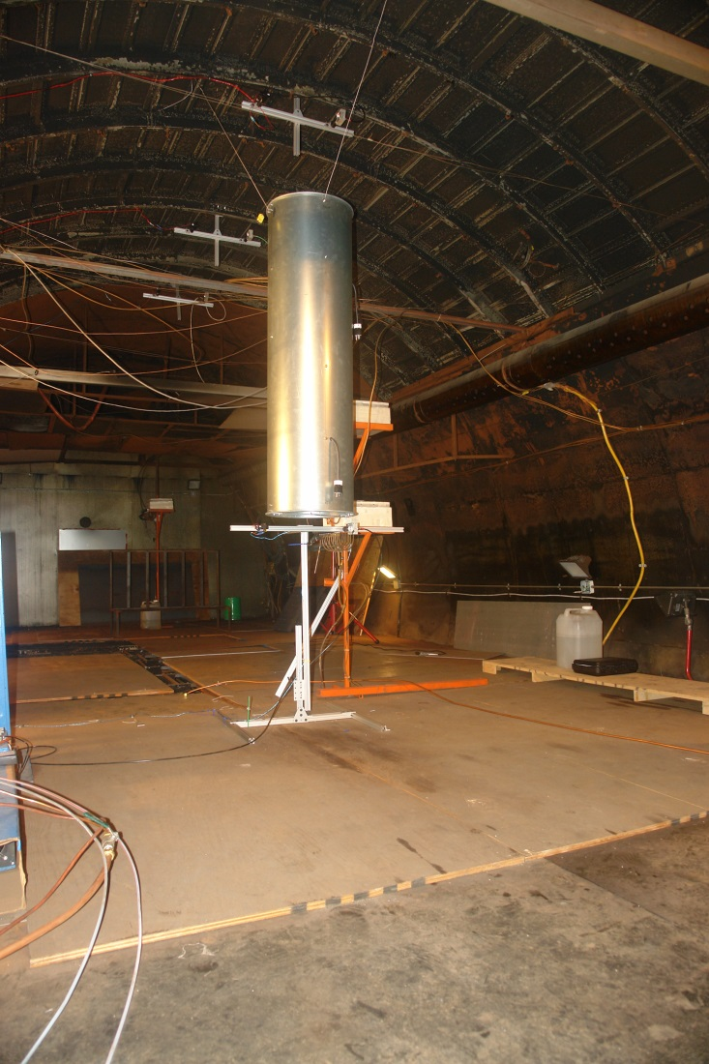
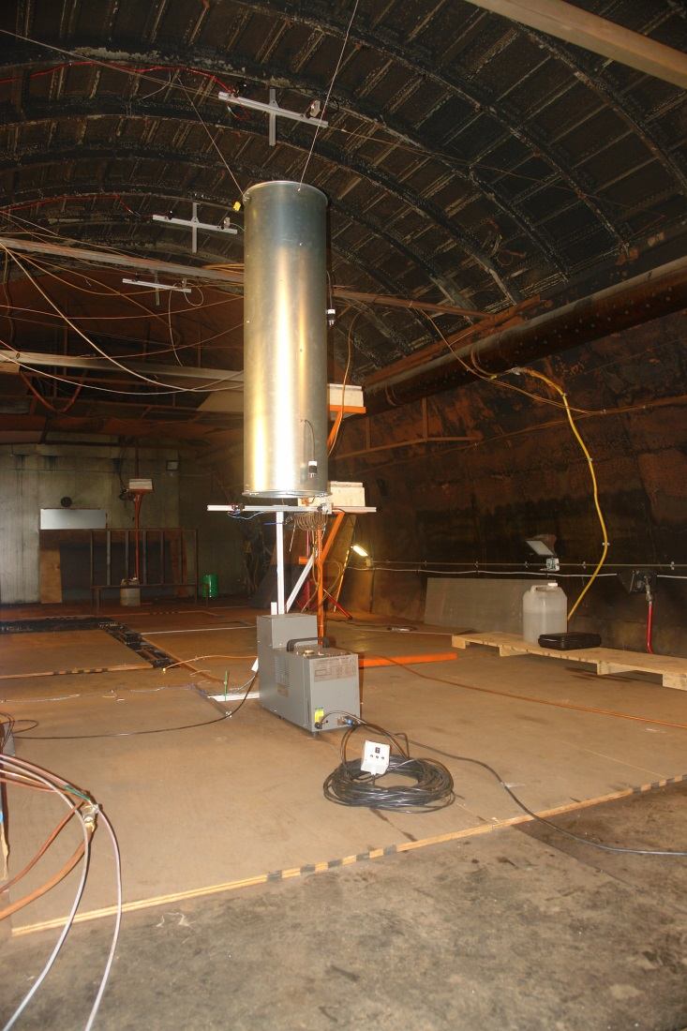
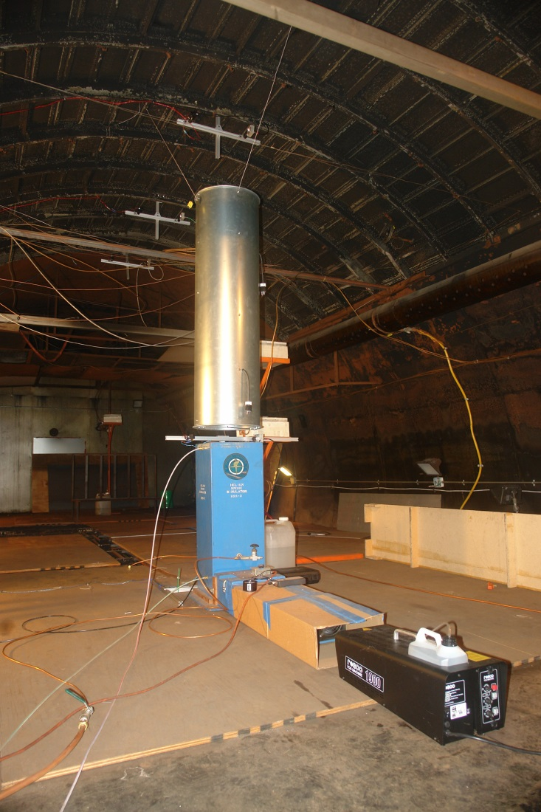
Test Setup
Base setup with 4 Smoke Meters and a flow straightener
ViCount SDT test setup
Rosco 1900 with FAA Helium injection box test setup

Slide 5
Test Setup
#2
Base setup for all smoke machines
4 Smoke Meters used to measure 1 vertical and 2 horizontal speed components over a 16.5’ distance
  #1 – Located at base of flow straightener
  #2 – Located 6’9” above #1
  #3 – Located 4.9’ to the rear of #2
  #4 – Located 4.75’ to the rear of #3
A 5’ long, 16” diameter flow straightener was installed to direct and standardize the smoke plumes from each machine
Four 700 watt heater bars were installed for future smoke plume heating tests
#3
#4
#1

Slide 6
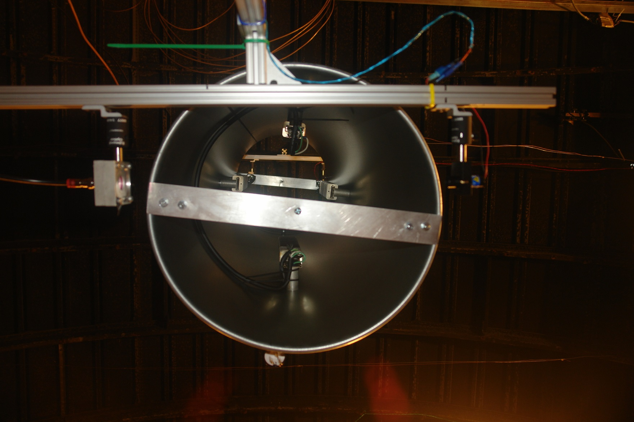
Test Setup – Flow Straightener
700 Watt Heaters
#1 Smoke Meter Receiver
#1 Smoke Meter Laser
View Looking Up

Slide 7
Test Setup
ViCOUNT SDT theatrical smoke generator
  Uses CO₂ as a propellant gas to generate smoke, normally set to 45 PSI, but has an adjustable range of 0 – 75 PSI
  Has 4 selectable heater bars with a total heat output of 400 watts
ViCOUNT SDT test settings
  CO2 regulated at 45 PSI, no Helium, all heat settings tested
  Helium as propellant, regulated at 45 PSI, all heat settings tested
  Helium as propellant, regulated at 75 PSI, all heat settings tested

Slide 8
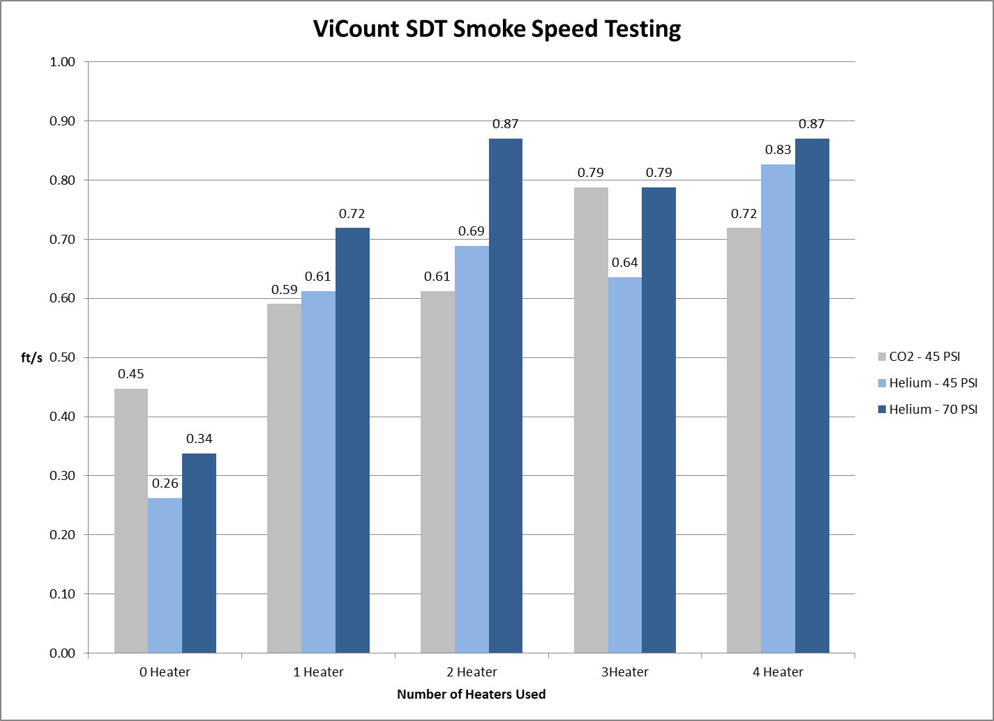
Interim Testing Results

Slide 9
Test Setup
Rosco theatrical smoke generators
  Model number (1700, 1900, 3000) indicates wattage of heat exchanger used to vaporize oil to create smoke delivered from the oil pump
FAA Helium Injection Box
  12” x 12” x 30” test section used to mix Helium and air with theatrical smoke
  Oxygen concentration is measured in the test section to calculate and set Helium/Air mixture
Rosco smoke generator test settings
  Each Rosco model with no heat
  Each Rosco model with 2400 watts of heat
  Each Rosco model with Helium injection box, 50/50 Helium/Air mixture, with no heat
  Each Rosco model with Helium injection box, 60/40 Helium/Air mixture, with no heat
  Each Rosco model with Helium injection box, 70/30 Helium/Air mixture, with no heat

Slide 10
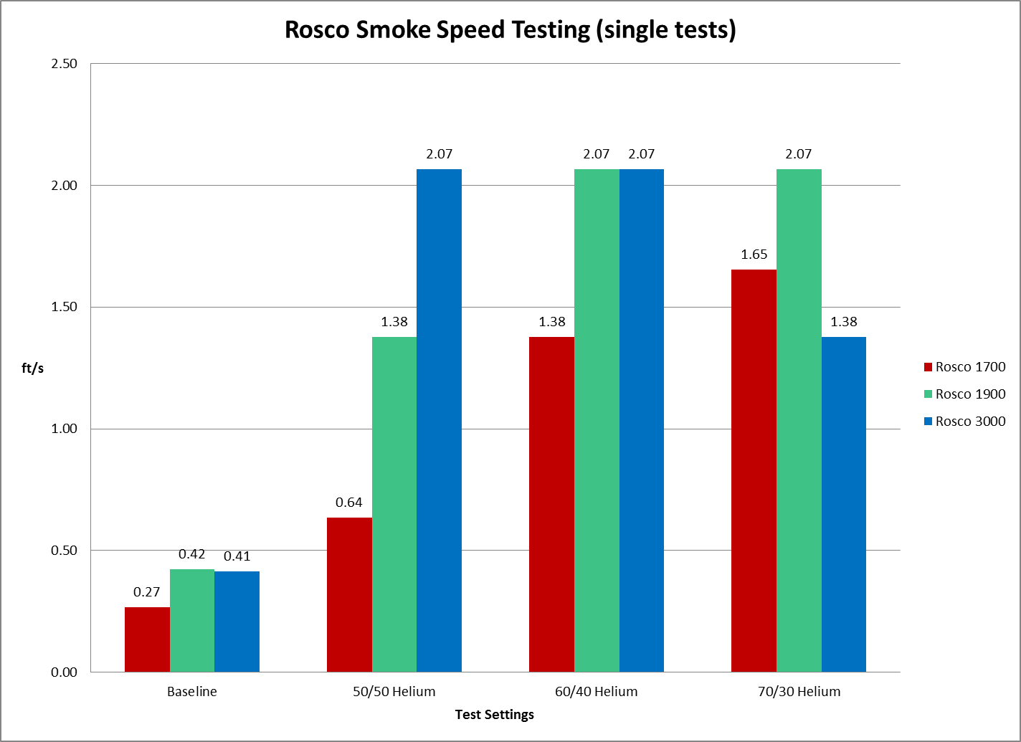
Interim Testing Results

Slide 11
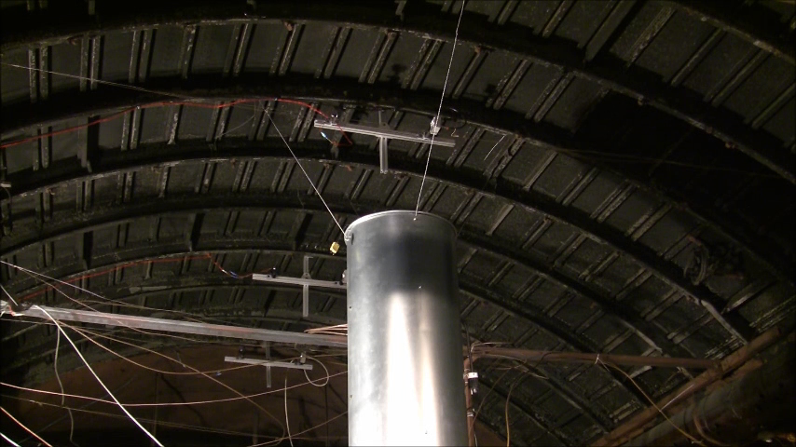
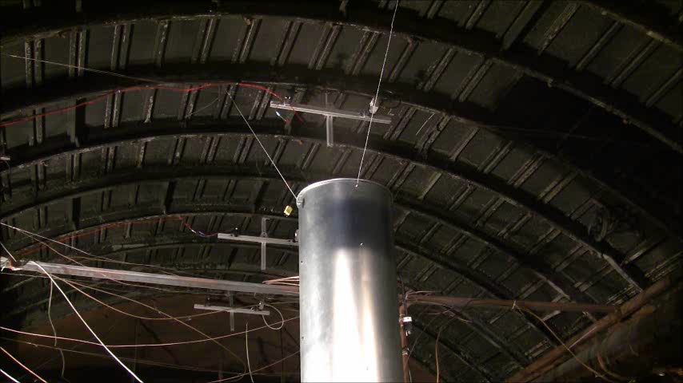
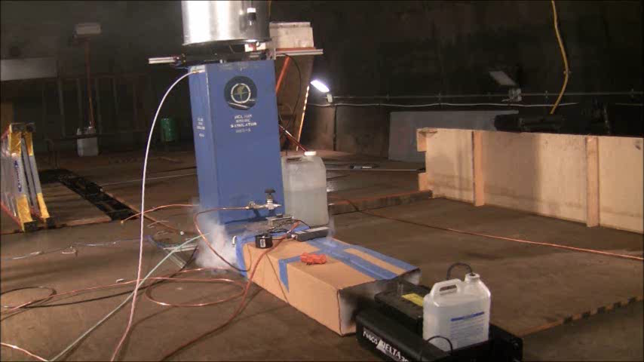
Rosco 3000 Smoke Comparison
Without Helium
With 60/40 Helium/Air
~30 seconds to get from sensor #1 to sensor #4
~12 seconds to get from sensor #1 to sensor #4

Slide 12
Planned Work
Begin Rosco 1700, 1900, and 3000 series theatrical smoke generator testing with heated chimney and Helium injection
  70/30 Helium/Air mix
  60/40 Helium/Air mix
  50/50 Helium/Air mix
Perform a smoke test in the same Boeing 727 Class E cargo compartment as the February 26, 2013, 4800 lithium primary battery fire test using the best performing smoke system from this test series and video the flight deck results
Contact Info & Questions: robert.morrison@faa.gov (609) 485-4507

