Slide 1
SAE/ISO Fire Containment Covers (FCC) and Fire Resistant Containers (FRC) Standards
International Aircraft Systems Fire Protection Working Group. Toulouse, France
David Blake, Federal Aviation Administration
May 18-19, 2016

Slide 2
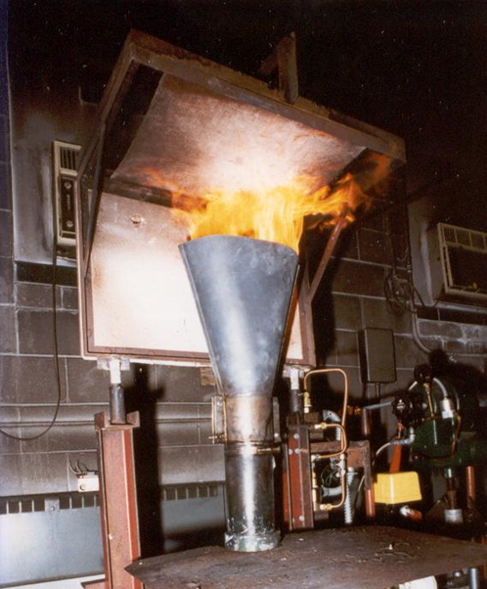
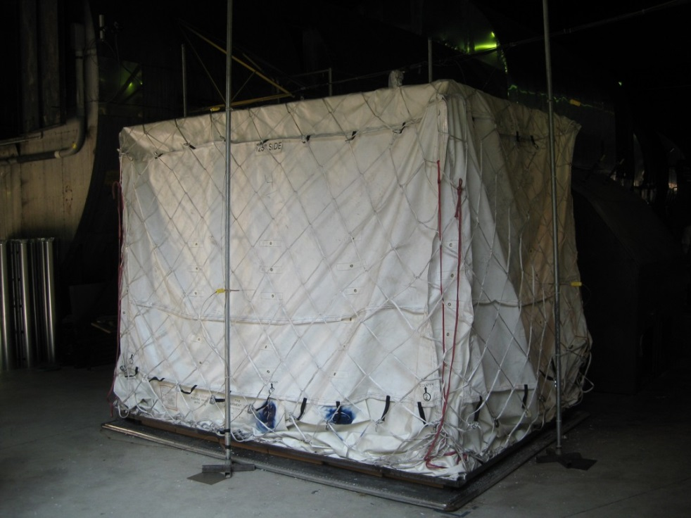
Fire Containment Covers
TSO 203 (published in July 2014) references SAE AS6453 standard with modifications.
Modifications are mostly for removal of references to non FAA requirements, maintenance, and pallet and net requirements.
Cargo liner oil burner test
Full scale mockup fire test

Slide 3
The most recent meeting was held on April 12-13, 2016 in Geneva.
A new project was approved to revise SAE AS6453 Fire Containment Covers in October 2015. The current version allows unlimited external flaming on the FCC if either:
The external flame is not in close proximity to a thermocouple, or
The fire load had shifted and measured temperatures from thermocouples that are no longer within 4 +/- ½ inch from the FCC are no longer valid.
It was previously agreed that this was not acceptable. Detailed discussion on the issue was not on the meeting agenda due to lack of interested attendees.
Next meeting is scheduled for Oct. 18-19, 2016 in San Antonio, Texas

Slide 4
FCC External Flaming

Slide 5
Fire Resistant Containers (FRC)
ISO/CD 19281 was published on Feb. 1, 2016.
SAE standard AS 6278 Fire Resistant Containers is under development. Differences exist between the two standards. The main difference is the SAE standard only requires the main panels of the FRC be subjected to the cargo liner oil burner test (CFR Part 25 Appendix F, Part III) while the ISO standard requires all materials used in the construction of the FRC be subjected to the test. (Floor panel is not required to meet oil burner test in either standard)
ISO/SAE harmonization is desired.

Slide 6
Unresolved Issues:
External flaming on FRC (If T/C not at location of flames)
Lithium Batteries.
Possible delayed smoke detection from a fire originating in either a FCC covered pallet or inside a FRC.
FRCs with built in detection and/or suppression systems.

