Slide 1
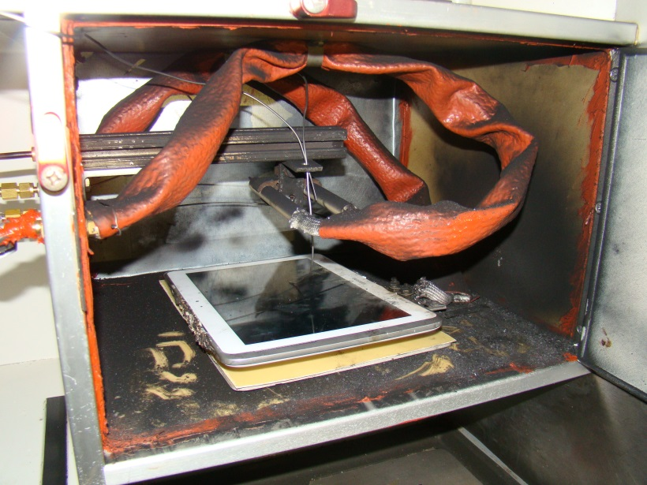
E-Tablet Fire Tests: Storage in the aircraft
Systems Meeting
Thomas Maloney, FAA Fire Safety
5-12-2015

Slide 2
Background
E-tablets are increasing in popularity as supplied personal entertainment device aboard passenger aircraft.
E-Tablets are also used by flight attendants and pilots as electronic flight bags.

Slide 3
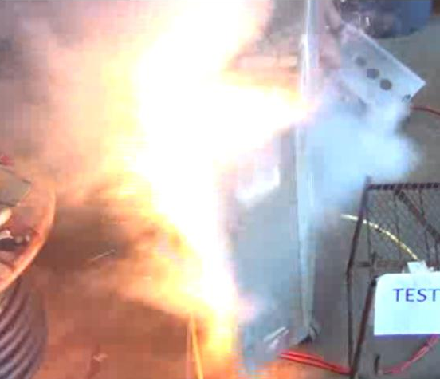
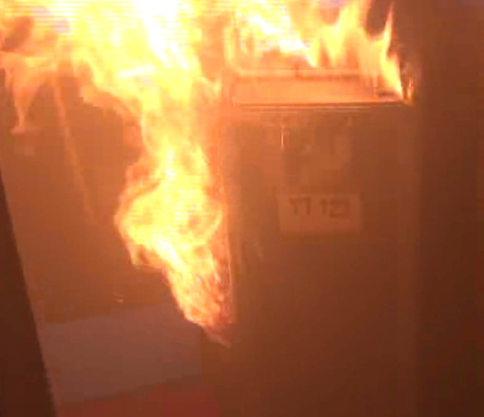
Background
Tests were conducted in a galley cart to assess hazard of bulk-stored tablets. (Report recently published)

Slide 4
Introduction
E-tablet fire tests were performed in the forward galley of a fully functional 727 to assess the potential fire and explosion hazard of the compartment, toxic gas concentration increase in the cabin and temperature rise in the compartment.

Slide 5
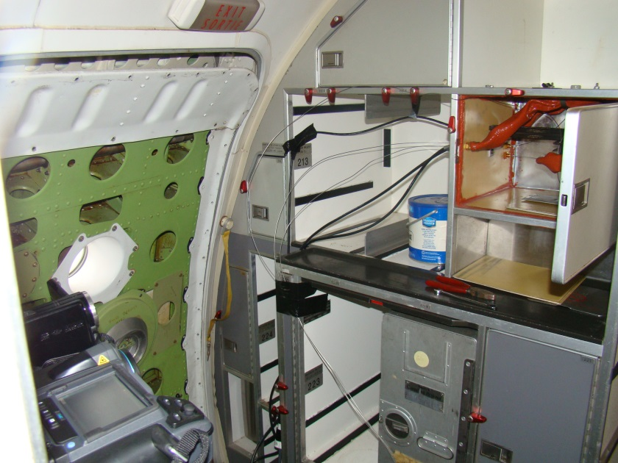
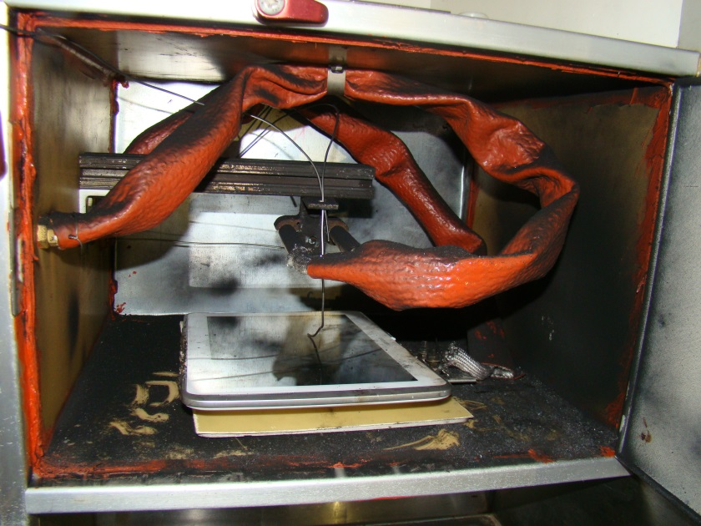
Test Setup
Aircraft ventilation was on.
Temperature data was collected with a heater T/C, a tablet T/C, a compartment ambient T/C and an IR camera on the outside facing the compartment.
CO, CO₂ and O₂ gas concentration data was collected in the walkway near the compartment.

Slide 6
Procedure
A tablet was placed in the compartment and the door was closed.
Thermal runaway was initiated with a heater plate.
A spark igniter was activated to ignite the gasses in test 3 and 4 if they didn’t ignite naturally.

Slide 7
Test Setup (con’t)
Each of the two tablets was tested once with the igniter and once without it.
 | Spark Igniter | E-Tablet Type 1 | E-Tablet Type 2
Test 1 |  | X
Test 2 |  |  | X
Test 3 | X | X
Test 4 | X |  | X

Slide 8
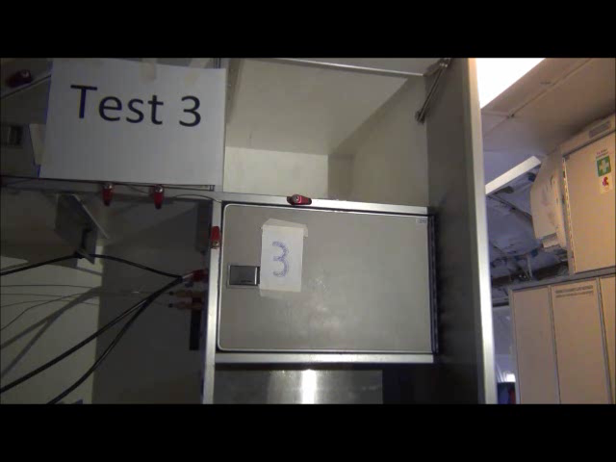
Results

Slide 9
Results
Increase in CO and CO₂ concentrations correspond to thermal runaway events.

Slide 10
Results (con’t)
 | Max CO (ppm) | Max CO₂ (ppm) | Max Compartment Temp (°C)
Test 1 | 97.6 | 128 | 86
Test 2 | 140 | 247.6 | 63.6
Test 3 | 81.3 | 245 | 149
Test 4 | 94.8 | 188 | 112.9
Lower temperatures were observed in Test 1 and Test 2 due to lack of ignition.
Maximum temperature outside the compartment was 81°C observed in test 3.

Slide 11
Summary
The galley compartment was able to withstand the pressure rise from combustion in these configurations.
Gas concentrations within the cabin remained below the human toxicity limit though a larger number of tablets involved in the fire could prove more dangerous.

Slide 12
Questions?
Contact
  Thomas Maloney
  Office: 609-485-7542
  Thomas.Maloney@faa.gov

