Slide 1
Modeling of Hidden Fire Smoke Signature in Aircraft A CASE STUDY OF OVERHEAD AREA
Ezgi Öztekin, PhD
Technology and Management International (TAMI) LLC, Toms River, NJ
Fire Safety Branch (ANG-E21),
Aviation Research Division,
FAA William J. Hughes Technical Center, NJ
International Aircraft Systems Fire Protection Working Group Meeting,
14-15 May 2014, Bremen, Germany

Slide 2
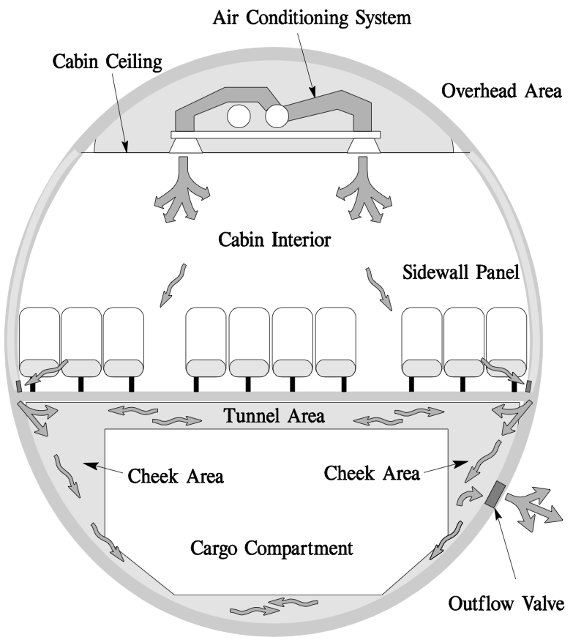
Introduction
FAA Advisory Circular (AC) 120-80, In-Flight Fires, 2004.
Definition of hidden in-flight fires: “Fires that are “hidden” are not readily accessible, may be difficult to locate and are more challenging to extinguish.”
examples: fires behind sidewall paneling or in overhead areas.
Potential causes:
Wiring failures, electrical component failures, lightning strikes, hot temperature bleed air leaks, faulty circuit protection.
Indications:
Abnormal operation or disassociated component failures, circuit breakers, hot spots, odor, visual sighting – smoke.
Locations of interest:
Overhead area, cheek area, sidewall panel.

Slide 3
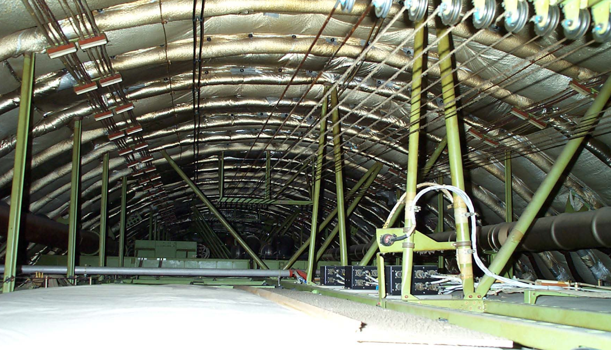
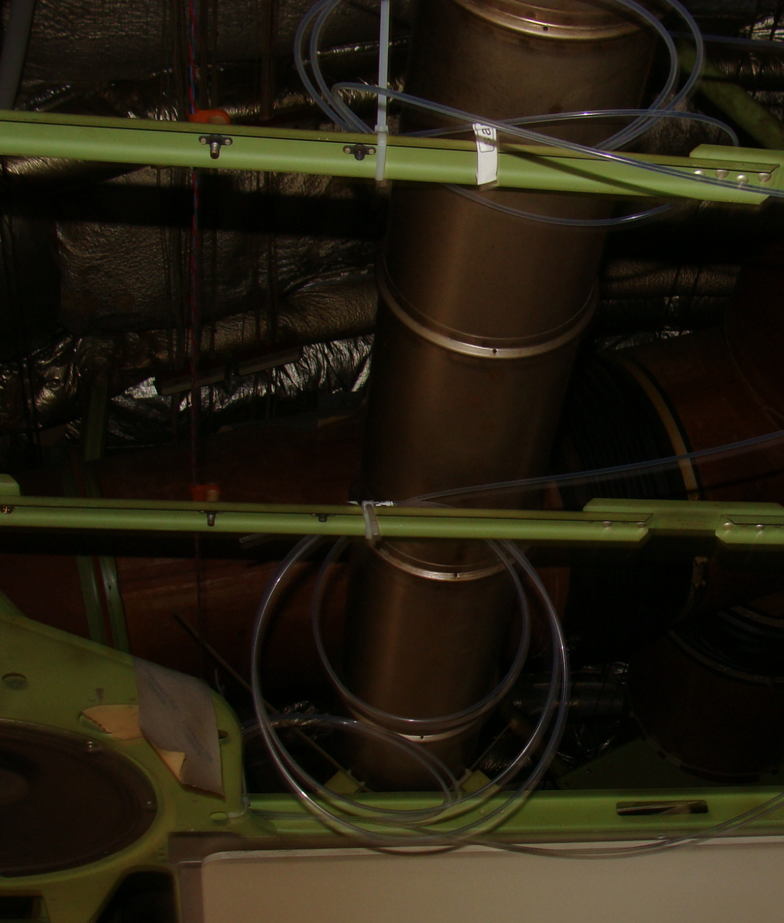
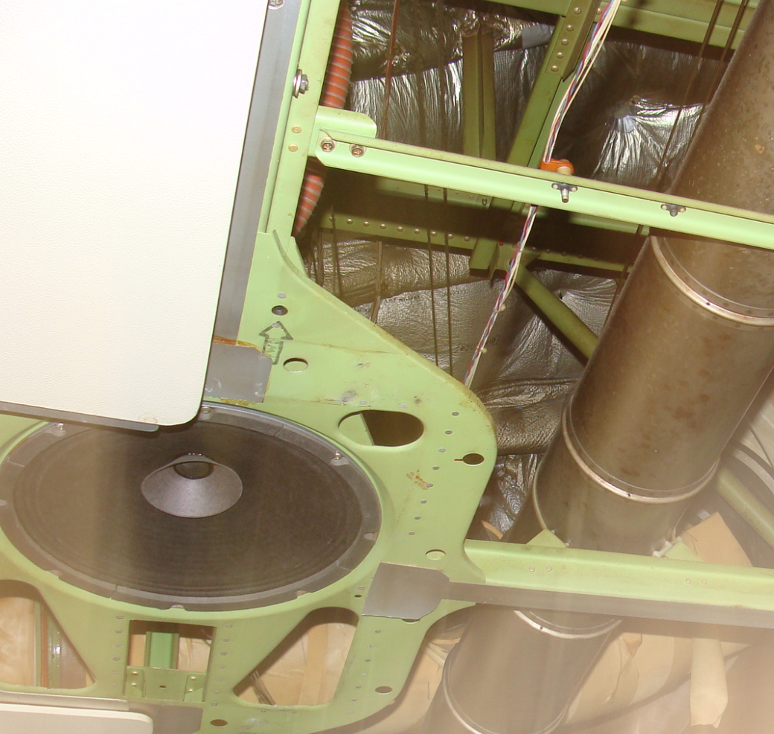
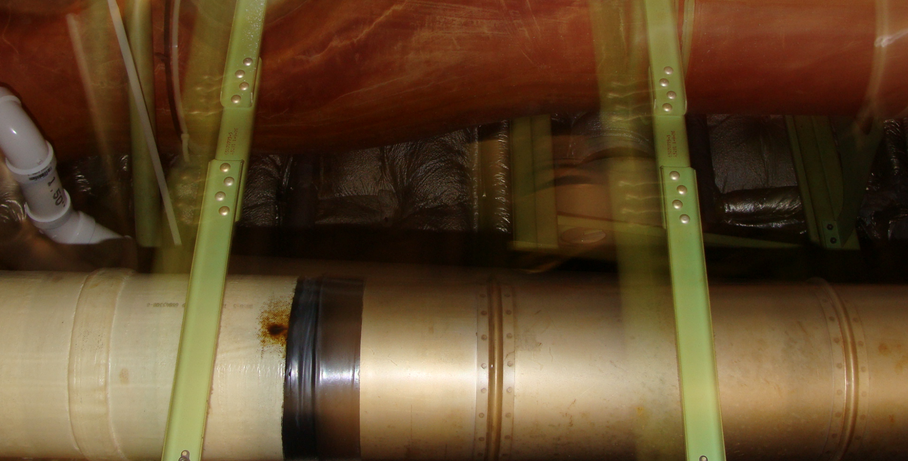
Objective
Overhead area of B747 SP test article
Objective of the planned work is twofold
to improve understanding of hidden in-flight fires with the help of analytical tools,
to build analytical capabilities that will complement the existing experimental work for other fire scenarios.
More specifically, the effect of
clutter,
ventilation/air circulation
on the smoke movement due to a possible fire hazard in the overhead area of B747 SP aircraft will be studied using CFD (computational fluid dynamics).
Photograph is courtesy of T. Marker

Slide 4
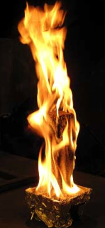
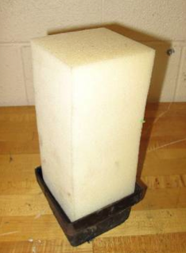
Methodology
Fire source - introduction:
The FAA Tech Center Aircraft Fire Safety group has adopted the polyurethane foam block as the standard fire-threat for in-flight fires*, §, ¶.
4x4x9 inch³ in size,
49 kW/m², 781 ºC,
Total burn time ≥ 10 minutes, active burn time ~ 1 minute.
Fire source¶
Photos are courtesy of R. Ochs
* “Development of a repeatable hidden fire source”, Serge Le Neve, Toulouse Aeronautical Test Centre (CEAT), Oct 2009.
§ “Development of an improved fire test method and criteria for aircraft electrical wiring”, J.W. Reinhardt, FAA Tech Report, 2010.
¶ “Composite structure flame propagation test method development”, R. I. Ochs, FAA Tech Center, Feb 2012.

Slide 5
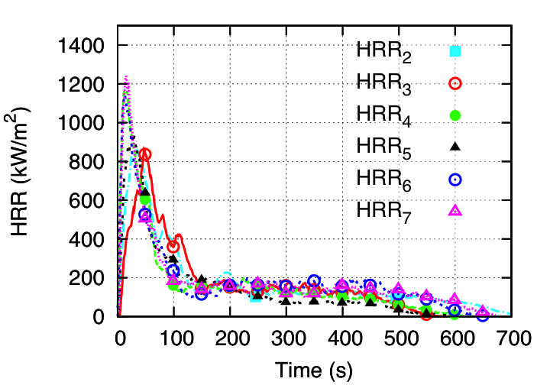
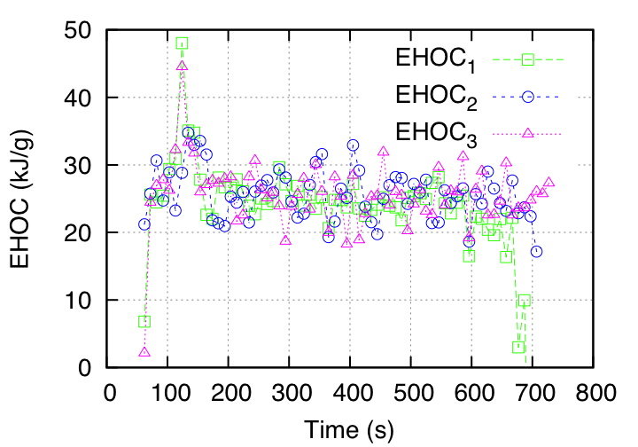
Methodology
Heat release rate (HRR)
Fire source - characterization:
The rates of heat release and mass loss are measured in bench-scale tests,
The heat of combustion is calculated from the experimental (cone calorimeter) data,
The stoichiometry and the radiative fraction for the fire source are still unknowns. The selected values for these parameters will affect the simulation results.
Radiative fraction is assumed to be 0.335,
Stoichiometry is decided based on the known heat of combustion value.
Effective heat of combustion (EHOC)

Slide 6
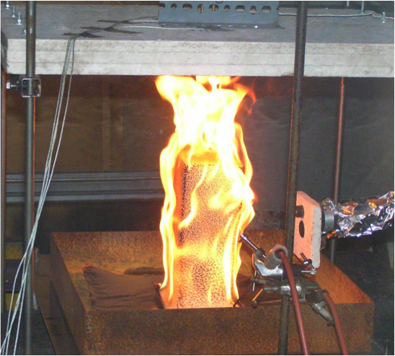
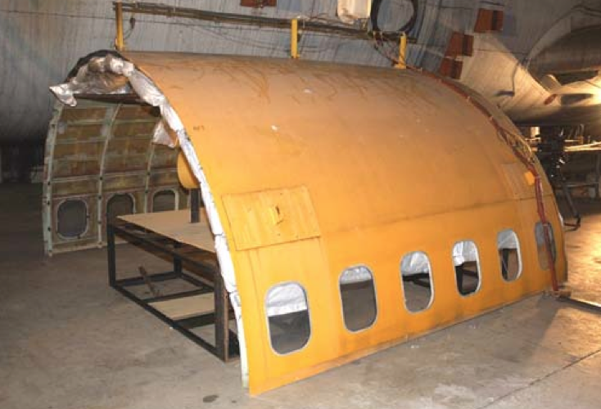
Methodology
Test case 1
Preliminary test cases:
Two test cases are simulated:
Test Case 1- Foam block is placed under a horizontal ceiling 9 inches away from the top of the foam block. This case has been tested previously*, measurements of heat flux and temperatures are available.
Test Case 2 - Foam block is placed under a curved surface, representative of an aircraft skin, inspired by earlier intermediate-scale tests§, except the block is placed farther away from the ceiling.
Test case 2
* “Development of a repeatable hidden fire source”, Serge Le Neve, Toulouse Aeronautical Test Centre (CEAT), Oct 2009.
§ “Development of an improved fire test method and criteria for aircraft electrical wiring”, J.W. Reinhardt, FAA Tech Report, 2010.

Slide 7
Methodology
Solver selection and set-up:
Two computational fluid dynamics (CFD) packages are employed:
For Test Case 1- Both Fire Dynamics Simulator (FDS)§, developed by National Institute of Standards and Technology (NIST), and fireFOAM¶, developed by FM Global, are used.
For Test Case 2 - Only fireFOAM is employed because of the flexibility of this solver for complex geometries.
General solver set-up:
Subgrid-scale turbulence is modeled either with the WALE (Wall Adapting Local Eddy viscosity), or the dynamic Smagorinsky models,
Combustion (fire) is modeled assuming infinitely fast chemistry,
Thermal conduction to the outer skin is assumed to be one-dimensional,
Simulations are second-order accurate in time and space,
Radiation is modeled using the finite volume discrete ordinates method.
§https://code.google.com/p/fds-smv/
¶ https://code.google.com/p/firefoam-dev/

Slide 8
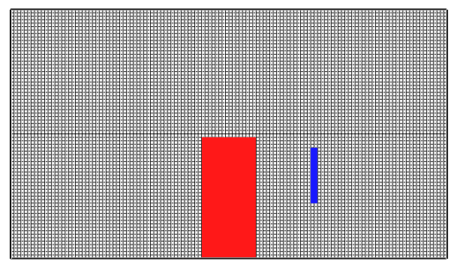
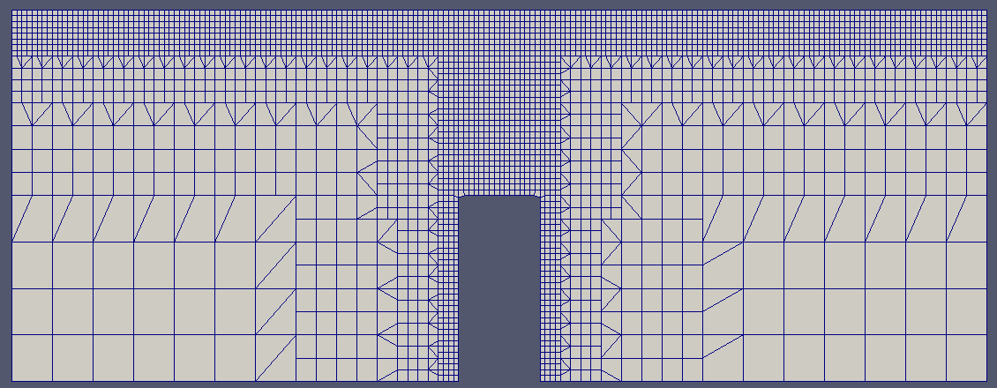
Test Case 1
Test case 1*
Grid and Geometry:
An earlier experimental study* is simulated,
FDS simulations
The computational domain is 0.8m x 0.5m x 0.8m in x, y and z directions, respectively,
More than 1 million grid points are used, the grid is uniform with 0.00625m in size.
fireFOAM simulations
The computational domain is 1.2m x 0.5m x 1.2m in x, y and z directions, respectively,
Less than half million grid points are used, the minimum grid spacing is 0.00625m and placed close to the high-gradient regions.
The insulation material is assumed to be Kaowool with 13 cm thickness.
Grid in x-z plane (FDS)
Grid in x-z plane (fireFOAM)
* “Development of a repeatable hidden fire source”, Serge Le Neve, Toulouse Aeronautical Test Centre (CEAT), Oct 2009.

Slide 9
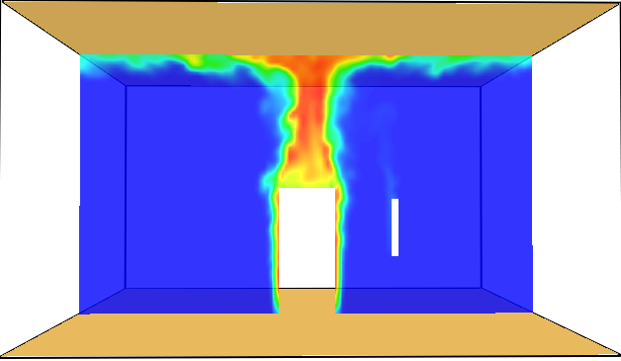
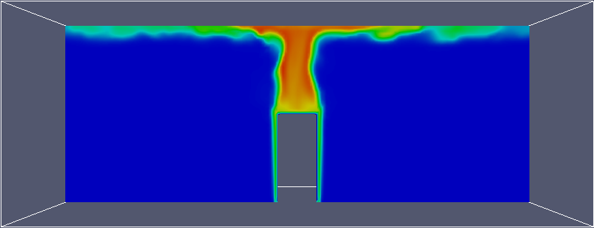
Test Case 1
Test case 1*
Results:
The maximum temperature, measured at 20s, is ~ 550 ºC (~ 823 Kelvin). In spite of the uncertainties in the model parameters, predicted temperature range is close to that measured in the previous experiments*.
Courtesy of Serge Le Neve*
Contourplots of instantaneous temperatures at t=20s.
FDS results
fireFOAM results
* “Development of a repeatable hidden fire source”, Serge Le Neve, Toulouse Aeronautical Test Centre (CEAT), Oct 2009.

Slide 10
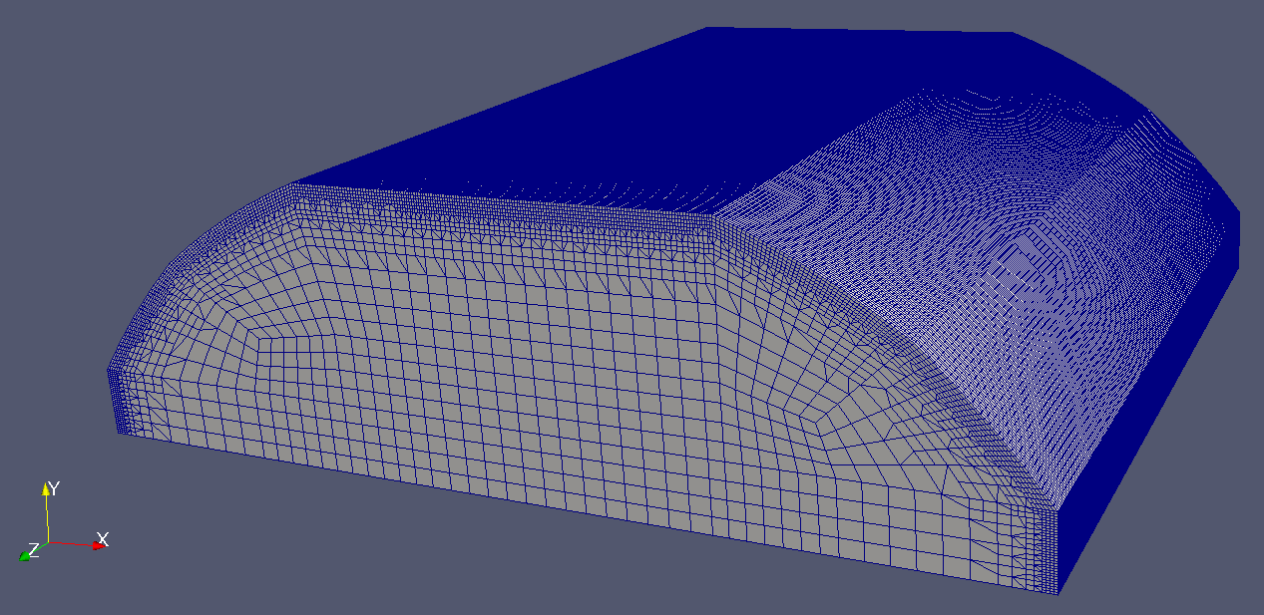
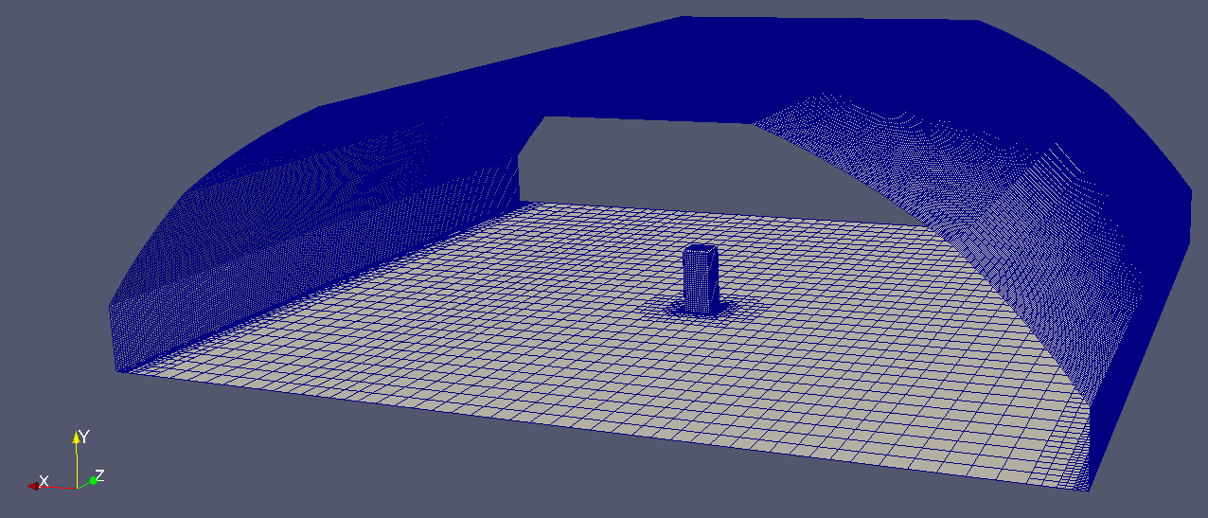
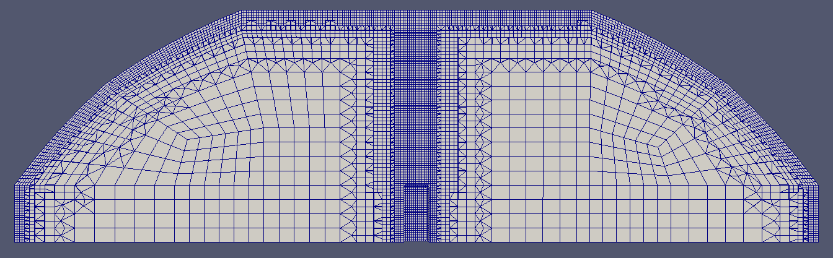
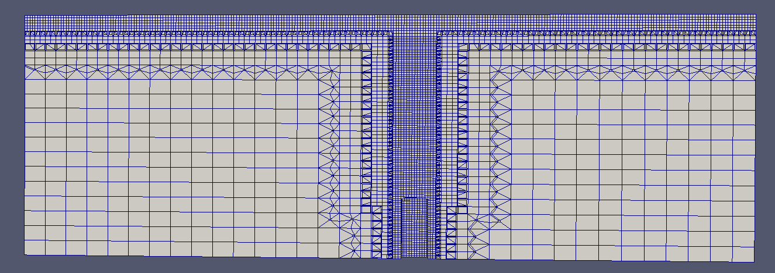
Test Case 2
Test case 2
Grid and Geometry:
A fictitious mock-up is simulated:
open at each end in z direction (similar to the earlier experimental work except the block is placed farther away from the ceiling),
with the following dimensions:
3m x 1m x 3m in x, y and z directions, respectively.
There are ~1million grid points, mesh is finer close to the foam block and the walls.
The insulation material is assumed to be Kaowool with 2.5 cm thickness.
Grid in x-y plane (fireFOAM)
Grid in x-z plane (fireFOAM)

Slide 11
Test Case 2
Results:
Instantaneous temperature variations for the first 10 seconds into ignition:

Slide 12
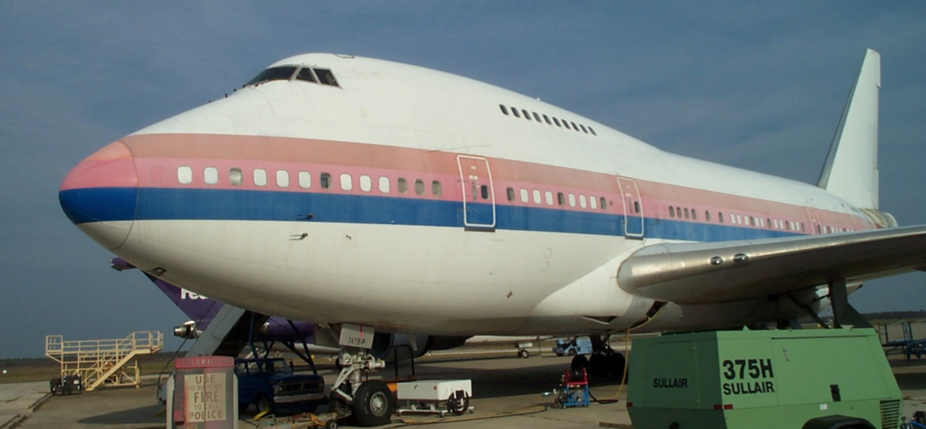
Summary and Future work
B747 SP Test Article
Summary:
Neither of these test cases are representative of an in-flight fire scenario. These simplified cases are studied only to illustrate the current capabilities of available fire modeling tools.
Next steps:
The following are the necessary next steps:
Build a CAD model for the overhead area of the 747SP test article.
Already have the accurate measurements of internal dimensions in the overhead area of 747SP test article obtained using the LIDAR technology.
Set-up the boundary and initial conditions for the CFD model.
Determine thermal and optical properties of chosen materials for obstructions,
Specify accurate velocity field due to Environmental Control System (ECS).
Plan for full-scale tests.
Identify appropriate instrumentation for the tests,
Specify their locations in the overhead area.

