Slide 1
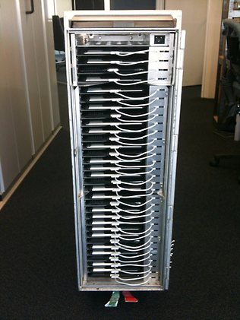
E-Tablet Fire Tests
Systems Meeting
FAA Fire Safety
05-14-2014
[1]

Slide 2
Background
There is use of E-Tablets as an airline supplied personal entertainment device aboard passenger aircraft.
Lithium-ion batteries are known to undergo “thermal runaway” and propagate “thermal runaway” to additional adjacent batteries.
Large quantities of e-tablets stored adjacent to each other can lead to a significant fire.

Slide 3
Related Tests
FAA
The effect of IPad battery overheating was observed under various conditions.
Tests have been done with other Lithium-Ion devices and cells to understand propagation and heat release.

Slide 4
Objective
Perform experiments to understand the fire hazard of storage of large quantities of e-tablets.
Variation of e-tablet spacing.
1 inch separation
No separation
Variation of e-tablet orientation.
Horizontal orientation vs. vertical orientation.
Variation of e-tablet battery capacity.
Battery storage capacity varies among e-tablets and is known to contribute to the heat of reaction.
Variation of the manufacturer of the e-tablet.
E-tablet materials vary among manufacturers and may contribute differently to the fire hazard (e.g. aluminum vs. plastic).
Variation of ignition source.
Alcohol fire: Simulated an external fire leading to thermal runaway in battery
Heat plate: Simulated an adjacent battery in thermal runaway
Determine the hazard of the accumulation of unburnt battery hydrocarbons.

Slide 5
Test Setup
Three types of e-tablets were used:
Type 1: 43 Wh capacity, aluminum case material.
Type 2: 25 Wh capacity, aluminum case material.
Type 3: 25.9 Wh capacity, plastic case material.
Heat from a hot plate or alcohol fire was used to initiate thermal runaway.
Temperature data was collected.
Thermocouples were positioned on the front and back of each tablet.
A thermocouple was placed on the top of the cart.
A thermocouple was positioned to determine ambient air temperature within the cart.
Finally, temperature on the outside of the cart was measured with an IR camera.
A pressure transducer was attached to measure pressure within the cart.
Later tests were done in a 737 passenger aircraft with a 20 kJ
spark igniter placed in the bottom of the cart.
The aircraft had supplied air ventilation from an external ground cart.

Slide 6
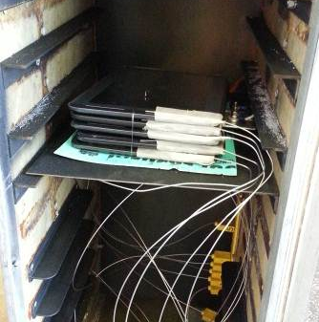
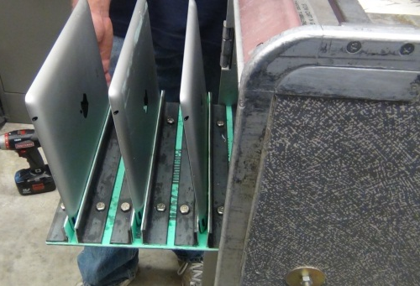
Tests Performed
Additional Test
Tests were conducted to determine the hazard of the accumulation of unburnt hydrocarbons.
 | 1 inch separation Hot Plate Ignition | 0 inch separation Hot Plate Ignition | 1 inch separation Alcohol Fire Ignition | 0 inch separation Alcohol Fire Ignition
E-Tablet type 1 positioned in a horizontal orientation
E-Tablet type 2 positioned in a horizontal orientation
E-Tablet type 3 positioned in a horizontal orientation
E-Tablet type 1 positioned in a vertical orientation
E-Tablet type 2 positioned in a vertical orientation
E-Tablet type 3 positioned in a vertical orientation
Horizontal Orientation
Vertical Orientation

Slide 7
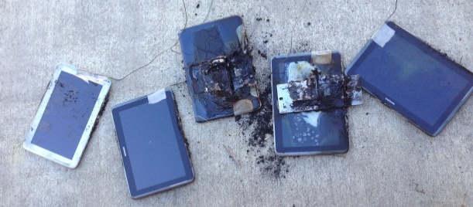
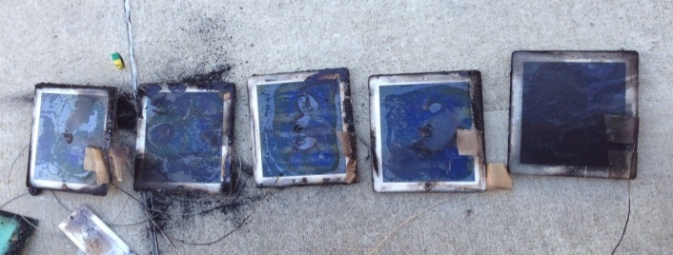
Results: Separation Distance
1” separation: Thermal runaway didn’t propagate in any of the tests.
0” separation: Thermal runaway propagated with e-tablet type 1 (43Wh, Aluminum) in the horizontal orientation.
Partially Burnt E-Tablets
Fully Burnt E-Tablets

Slide 8
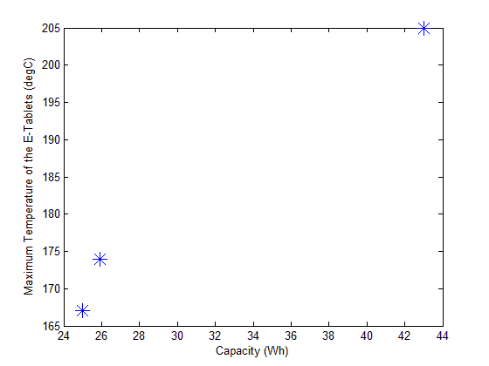
Results: Battery Capacity
A correlation of increasing temperature with increased battery capacity was observed.

Slide 9
Results: E-Tablet Material
Thermal runaway occurred faster in plastic e-tablets than aluminum e-tablets.
Typical time to thermal runaway with plastic e-tablets: 10.5 minutes
Typical time to thermal runaway with aluminum e-tablets: 15 minutes

Slide 10
Results: Tests in 737
Upon initiation of the spark ignition source a pressure pulse caused the door to burst open.

Slide 11
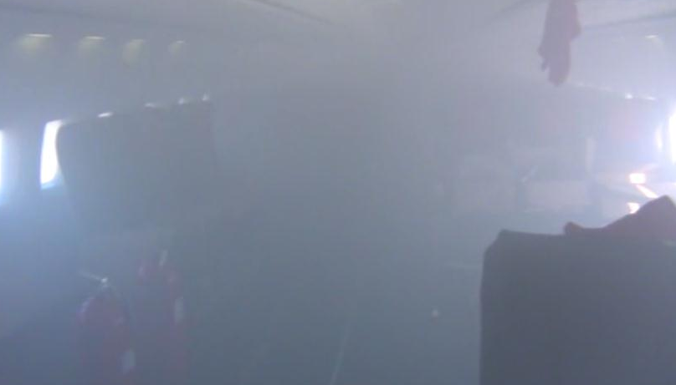
Results: Tests in 737 (con’t)
Combustion occurred within the galley cart.
Combustion before the hydrocarbons had completely spread throughout the inside of the cart caused localized flaming which penetrated the door seal.
Combustion after the hydrocarbons had completely spread throughout the inside of the cart caused a pressure pulse that caused the cart door to burst open.
Despite use of the aircraft ventilation system, the aircraft filled with smoke.

Slide 12
Additional Observation
The alcohol fire heated the e-tablets more rapidly than the heat plate.
The fire had a higher heat release rate.

Slide 13
Summary of Results
Higher battery capacities produced higher e-tablet temperatures.
E-tablets made of aluminum were able to absorb more heat than plastic e-tablets before reaching thermal runaway.
The build-up of hydrocarbons within the cart produced a flammable mixture, which when ignited caused the door to burst open and release flames and smoke in large enough quantities to overpower the aircraft ventilation system.

Slide 14
Questions or Suggestions?
Contact
Thomas Maloney
Office: 609-485-7542
Thomas.ctr.Maloney@faa.gov

Slide 15
Citations
[1] Griffith, Chris. "News." PC Locs IN THE MEDIA Firm Sells IPad Charging Carts to Qantas Comments. N.p., 14 Nov. 2012. Web. 27 Feb. 2013.

