Slide 1
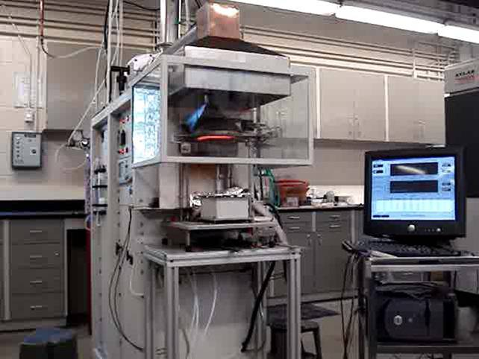
Battery Heat Release Data
International Aircraft Systems Fire Protection Working Group
Dave Blake, FAA Fire Safety
May 22-23, 2013. Koeln, Germany

Slide 2
The testing was conducted in a standard cone calorimeter. The testing was directed at three main areas.
Heat release of lithium, lithium-ion, and lithium polymer batteries under varied incident heat flux.
Heat release of lithium-ion 18650 cells at varied states of charge (SOC).
Heat release of AA sized batteries of differing chemistries.
May 22-23, 2013
Koeln, Germany
Battery Heat Release Data

Slide 3
<Slide Title>
Typical Lithium-ion battery heat release
May 22-23, 2013
Koeln, Germany
Battery Heat Release Data

Slide 4
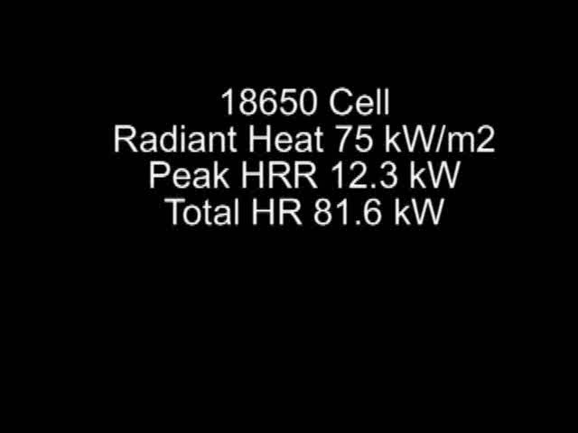
<Slide Title>
Typical Lithium-ion battery heat release
May 22-23, 2013
Koeln, Germany
Battery Heat Release Data

Slide 5
Heat Release of Lithium, Lithium-Ion, and Lithium Polymer Batteries at Varied Incident Heat Fluxes
May 22-23, 2013
Koeln, Germany
Battery Heat Release Data

Slide 6
Heat Release of Lithium-Ion 18650 Batteries at Varied SOC
May 22-23, 2013
Koeln, Germany
Battery Heat Release Data

Slide 7
Heat Release of AA Batteries of Different Chemistries
May 22-23, 2013
Koeln, Germany
Battery Heat Release Data

Slide 8
<Slide Title>
This data will be submitted for publishing as an FAA Technical Note.
May 22-23, 2013
Koeln, Germany
Battery Heat Release Data

