Slide 1
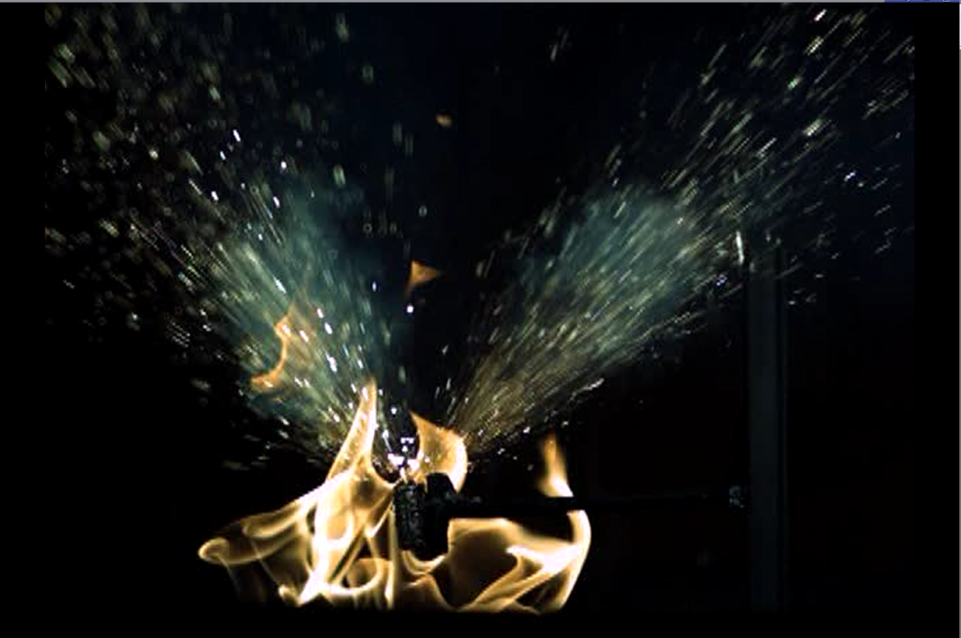
Lithium Battery Thermal Runaway Vent Gas Composition
IAPG CWG Safety Panel Meeting
Thomas Maloney, FAA Fire Safety
02-18-2015

Slide 2
Introduction
Lithium-metal and lithium-ion cells contain flammable hydrocarbon electrolytes which react during thermal runaway and cause a gaseous flammable environment.
The gasses can accumulate and cause an explosion.

Slide 3
Background
Numerous explosions have occurred during large scale battery tests.
  The class-C cargo area in a 727 exploded in full scale tests conducted by Harry Webster (See “Full Scale Battery Tests…” in 5/14/2014 systems meeting presentation on website).
  Two cargo containers exploded in tests done by Dhaval Dadia (FAA fire safety).
  An additional test was carried out in a 10m³ chamber and initiated this study.

Slide 4
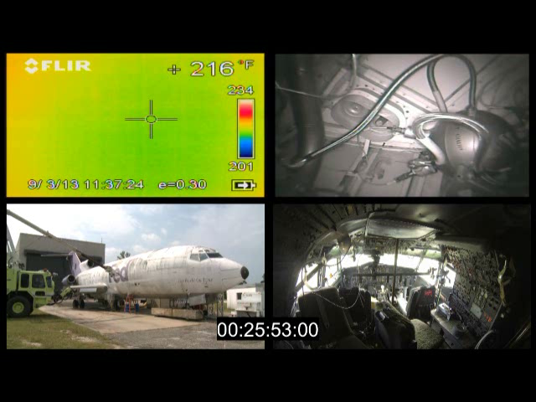
Background (727 test)

Slide 5
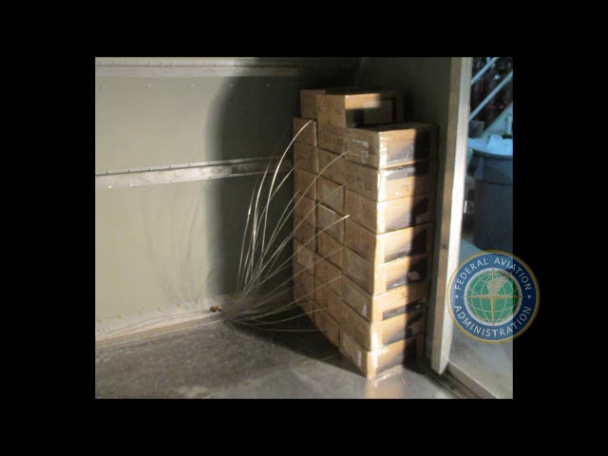
Background (Cargo container test)

Slide 6

Background (10m³ test)
Maximum Pressure: 28 PSI

Slide 7
Introduction
Two test Setups.
  Small Scale tests with multiple cell chemistries and SOC to analyze hazard.
  Large scale tests with lithium-ion cells to verify the hazard on a full scale and evaluate the effectiveness of Halon 1301 at suppressing combustion.

Slide 8
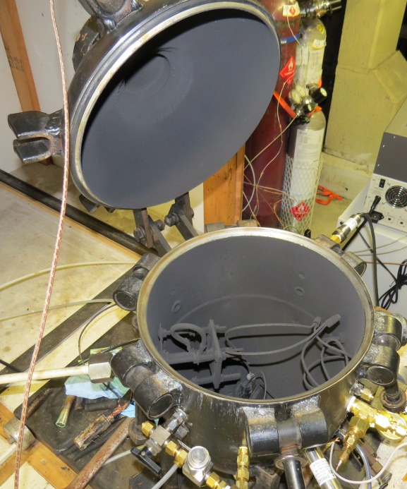
Small Scale Tests (Vent Gas Analysis)
Tests were carried out in a smaller 21.7L combustion sphere to characterize the type and quantity of gasses emitted.
Pressure Transducer
Clamp-style cell holder (for cell and cartridge heater)
Gas collection port for sample bag.

Slide 9
Procedure (Vent Gas Analysis)
  The combustion sphere was brought to .2 psia with a vacuum pump.
  Nitrogen was bled into the sphere to increase the pressure to 10psia (approximate cruise pressure)
  Thermal runaway was initiated and after the gasses vented and the temperature cooled to the initial temperature, the pressure was increased to 20 PSIA with the addition of Nitrogen.
  The resultant gas was bled into a bag for gas analysis
    A GC was used to quantify Hydrogen and hydrocarbons (C1 to C4)
    An IR analyzer was used to quantify CO, CO₂.
    A paramagnetic analyzer was used to measure O2
    A FID THC analyzer was used to quantify the total hydrocarbon content.

Slide 10
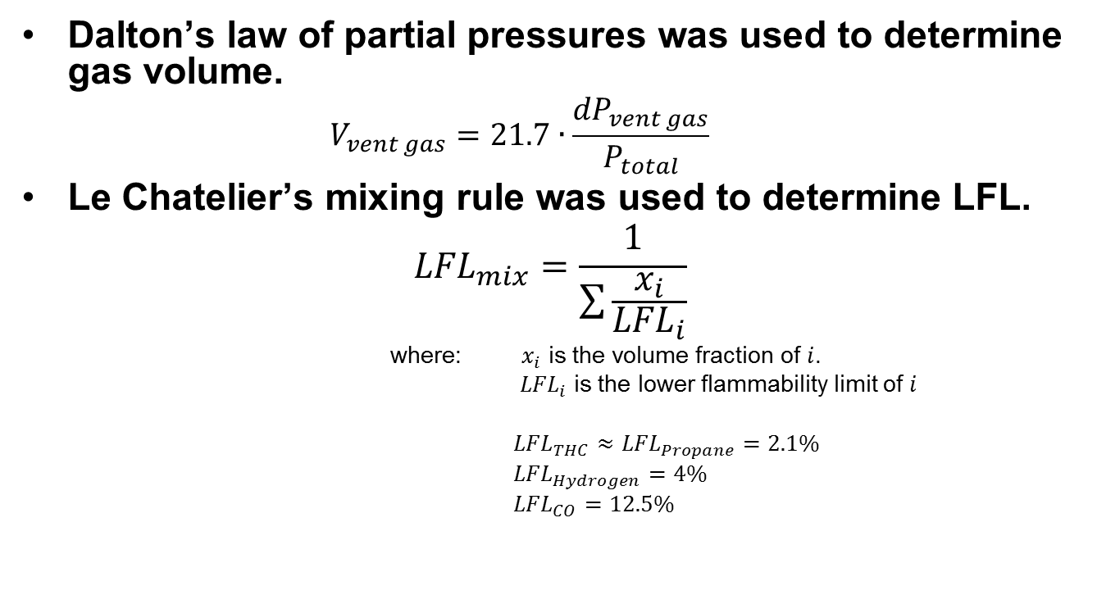
Data Processing

Slide 11
Results: State of Charge (LiCoO₂)
Due to the significant change in volume, all concentrations were normalized to 5 liters.

Slide 12
Results: State of Charge (LiCoO₂)
THC, H₂, and CO decreased as Charge decreased.
Disclaimer: The sample was filtered with a 15 micron particle filter which may have removed atomized liquid hydrocarbons that ejected from the cell.

Slide 13
Lower Flammability Limit
Assumptions: The only flammable gasses are THC, H₂ and CO
The THC reading is treated as propane.
Le Chatelier’s mixing rule was used.

Slide 14
Lower Flammability Limit (con’t)
The calculated number of cells required for an explosive mixture in an LD3 increases as SOC decreased.

Slide 15
Chemistry Variation
LCM: NiCoMn (c-long ion)
LFP: FePO₄ (c-long ion)
LCO: CoO₂ (18650 ion)
MnO₂: MnO₂ (cr123 metal)
The flammable gasses emitted from a metal cell are close to a LCO ion cell at 50% SOC.
LFP cells have the least flammable gas composition (of the cells tested).
LCM cells have the most flammable gas composition (of the cells tested).
Disclaimer: The sample was filtered with a 15 micron particle filter which may have removed atomized liquid hydrocarbons that ejected from the cell.

Slide 16
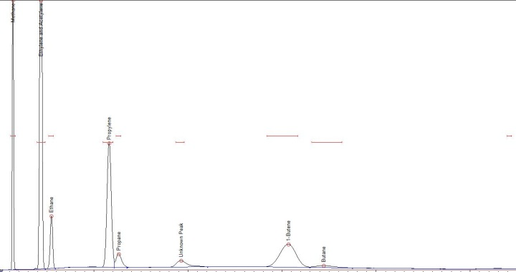
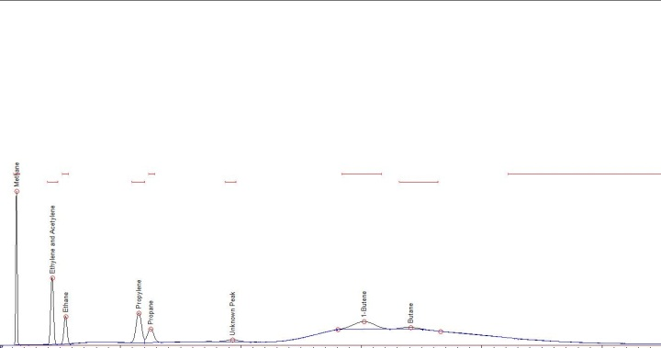
Additional Info. (LiCoO₂)
Cell case temperature increased with SOC
80% Charge
30% Charge
As State-of-Charge decreased the proportion of heavier, non-recognized hydrocarbons increased.

Slide 17
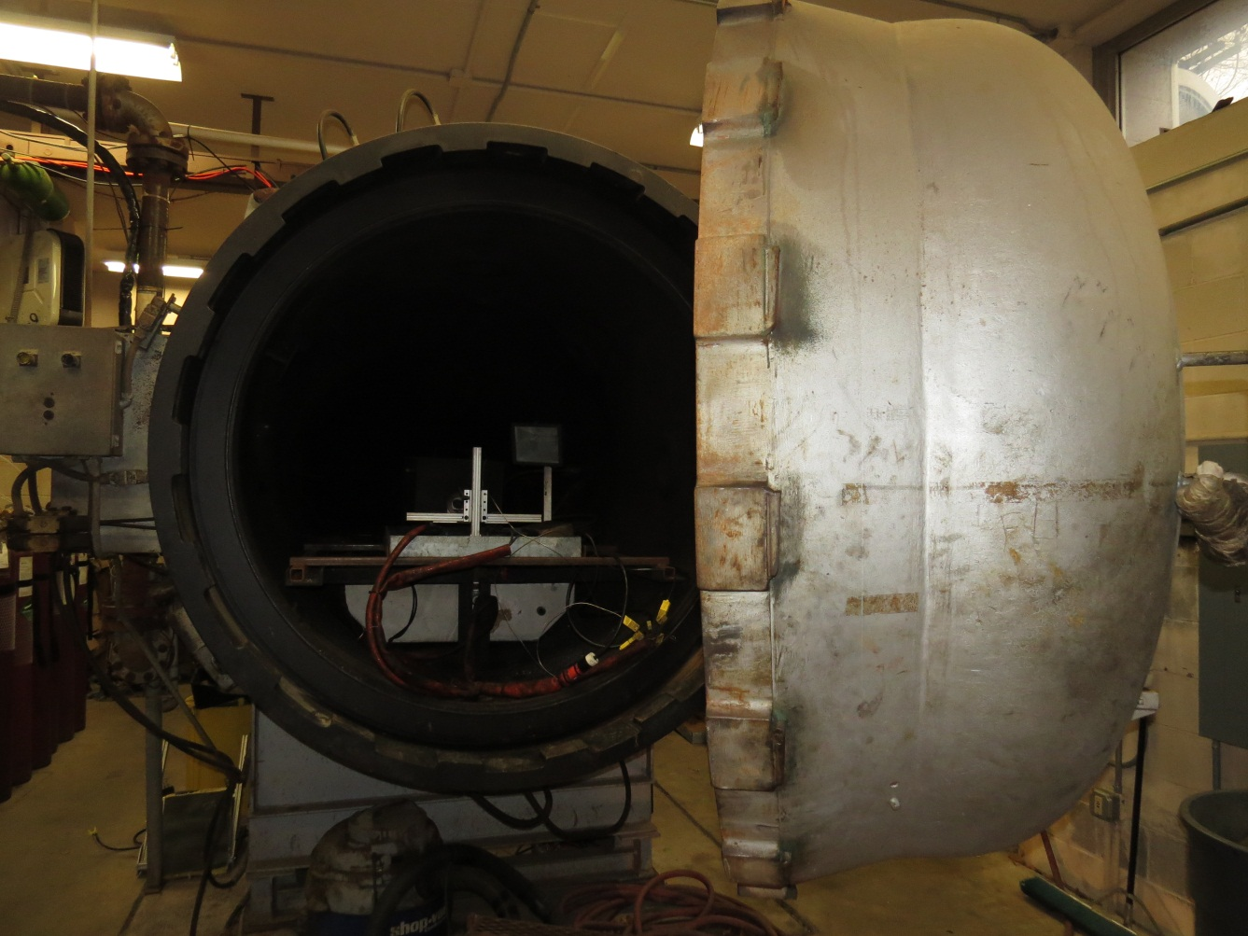
Pressure Chamber (Large Scale Tests)
Vacuum down to .5 psi
Maximum 750° at 600 PSI

Slide 18
Number of Cells Required (large scale test)
Stoichiometric equation was used to determine the required vent gas concentration for cells at 50% SOC to be 12.4%. Calculation assumes:
    Conc. THC ≈ Conc. C₃H₈ = 17.55%
    Conc. H₂ = 19.22%
    Conc. CO = 5.2%
550 cells produce 1237.39 liters or 12.34% concentration in the 10m³ chamber.

Slide 19
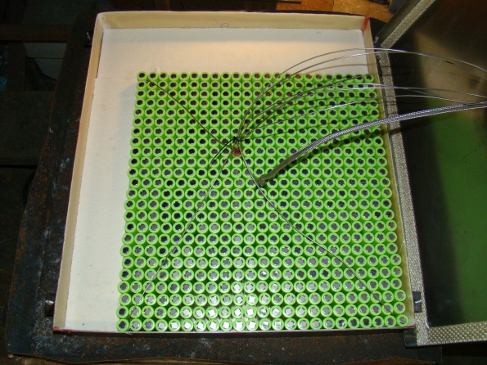
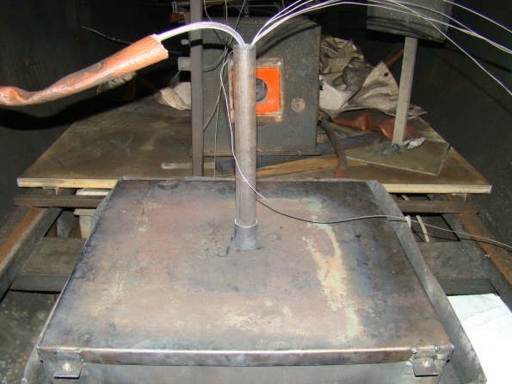
Setup of Large Scale Tests
A cartridge heater was placed in the center of a 550 cell array.
Type-k thermocouples were attached to cells at each of the 4 corners and one was attached adjacent to the cartridge heater.
The array of cells was enclosed in a steel container with a chimney to create a rich fuel mixture and prevent premature ignition.
A spark igniter was installed in the center of the chamber.
Additional instrumentation:
  2 THC analyzers at different heights to check for stratification.
  An H2 analyzer.
  A CO, CO2, O2, Halon 1301 analyzer
  An LFL analyzer.

Slide 20
Large Scale Tests
Baseline Test
  The chamber was vacuumed to -6 psi.
  Thermal runaway was initiated with 550 lithium-ion (LiCoO₂) cells at 50% SOC.
  A fan was present to adequately mix gasses.
  After all cells vented, the spark igniter was activated.
Test with Halon 1301
  The chamber was vacuumed to -6.53 psi and halon 1301 was bled in to increase the chamber pressure to -6 psi.
  Thermal runaway was initiated with 550 lithium-ion (LiCoO₂) cells at 50% SOC.
  A fan was present to adequately mix gasses.
  After all cells vented, the spark igniter was activated.

Slide 21
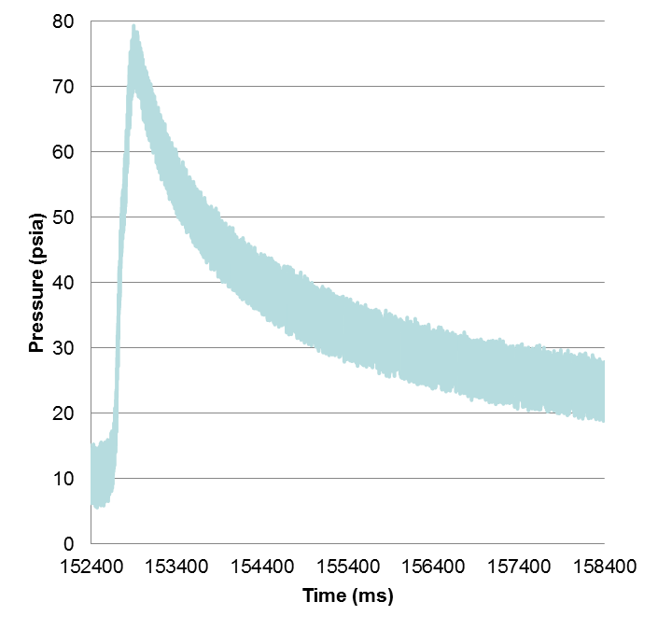
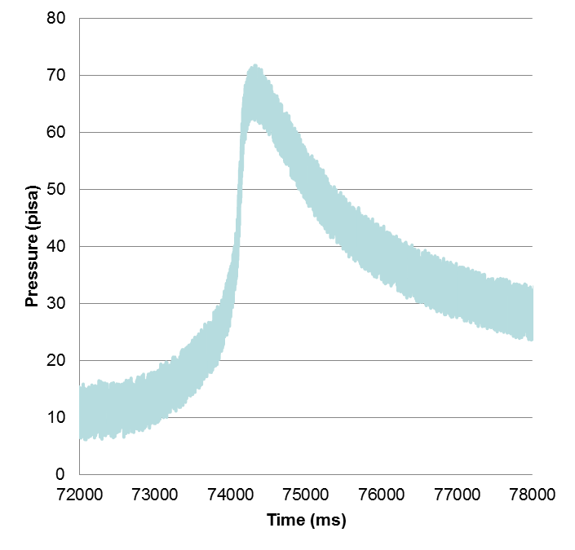
Results (Large Scale Tests)
6 second time window
Test without suppression
Test with 5.28% Halon

Slide 22
Results (Large Scale Tests)
 | Predicted Concentration 10m³ chamber | Actual Concentration
THC | 2.17% | 2.45%
H₂ | 2.37% | 2.74%
CO | .64% | 1.38%
CO₂ | 3.14% | 3.97%
 | Predicted Concentration 8.8m³ chamber | Actual Concentration
THC | 2.47% | 2.45%
H₂ | 2.7% | 2.74%
CO | .705% | 1.38%
CO₂ | 3.58% | 3.97%
Takes into account items in the chamber that would reduce the chambers effective volume.

Slide 23
Summary
Volume of gas emitted from cells decreases with SOC.
THC, H₂ and CO (normalized to 5 liters) decrease with SOC.
The number of LiCoO₂ cells that can vent in an LD3 before the LFL is reached appears to increase exponentially as SOC decreases.
Vented gas composition varies with differing cell chemistries.
Vented gasses from Li-Ion cells can produce a pressure pulse of at least 75psia
Halon 1301 was less effective than previously thought at preventing combustion of battery gasses.
Small scale tests reasonably predicted gas concentrations for large scale tests.

Slide 24
Future Work
Planned
  Combust vent gasses in air with various concentrations of halon 1301 to determine effect on pressure rise.
  Combust vent gasses in air to determine pressure increase vs. concentration of gasses for various states of charge.
Possible
  Test additional cell chemistries.
  Verify LFL readings with a flammability analyzer.

Slide 25
Questions?
Contact
  Thomas Maloney
  Office: 609-485-7542
  Thomas.Maloney@faa.gov
A majority of this content is available in various presentations at:
http://www.fire.tc.faa.gov/systems.asp

