Slide 1
CABIN
Bunsen Burner
Burn Length Determination
Scott Campbell
Safran Group Technical Fellow
Safran Cabin Inc.
OCT 2023

Slide 2
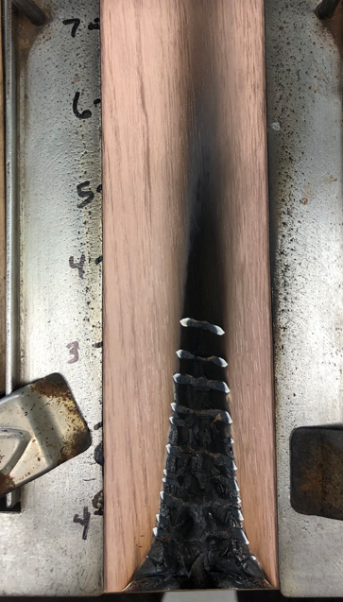
What is Burn Length?
14 CFR 25.853(a)
Appendix F Part I par. (b)(8)
Burn length. Burn length is the distance from the original edge to the farthest evidence of damage to the test specimen due to flame impingement, including areas of partial or complete consumption, charring, or embrittlement, but not including areas sooted, stained, warped, or discolored, nor areas where material has shrunk or melted away from the heat source.

Slide 3
Burn Length – DOT/FAA/AR-00/12 Aircraft Materials Fire Test Handbook, Chapter 1 Supplement
1.2.4 Clarifies Burn length “damage to the test specimen due to that area’s combustion” “because it is a better description of the intent of the rule and is consistent with current test practices”
1.2.4 a. “it is necessary to observe the specimen continuously during the test”.
1.2.4 a. Flame impingement on the specimen may lead to outgassing due to thermal decomposition. As these gases burn, radiating heat may cause discoloration, sooting, staining, melting, etc., to areas above the flame front. This type of damage is not a result of thermal decomposition due to flaming and, therefore, would not be included in the burn length.
Note, 1.2.4 provides guidance to assist in determine the burn length for polymeric materials, textiles, carpeting and polyurethane foams.

Slide 4
Burn Length – Summary
Burn Length | Not Burn Length
farthest evidence of damage to the test specimen due to flame impingement¹ | areas where material has shrunk or melted away from the heat source¹
areas of partial or complete consumption, charring or embrittlement¹ | areas sooted, stained, warped, or discolored¹
damage to the test specimen due to that area’s combustion² | Flame impingement on the specimen may lead to outgassing due to thermal decomposition. As these gases burn, radiating heat may cause discoloration, sooting, staining, melting, etc., to areas above the flame front²
¹ Reference 14 CFR 25 Appendix F, Part I(b)(8)
² DOT/FAA/AR-00/12 Aircraft Materials Fire Test Handbook, Chapter 1 Supplement

Slide 5
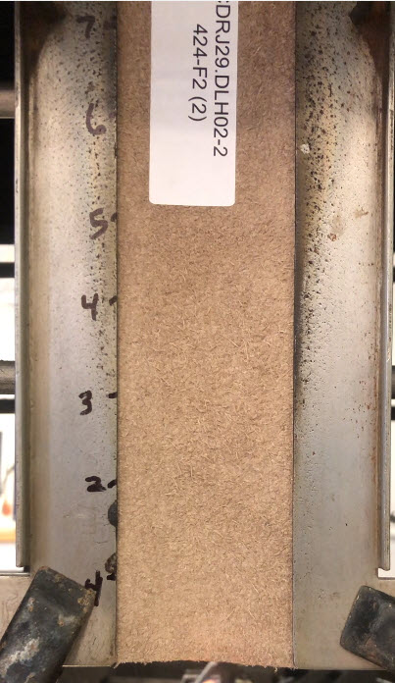
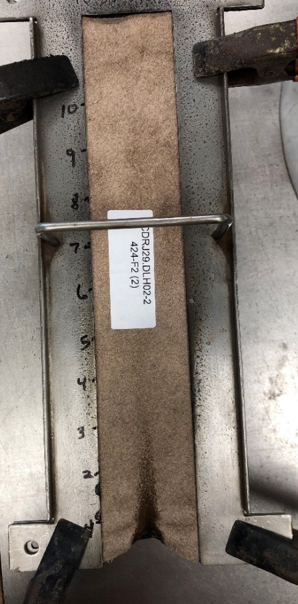
Burn Length Examples
Leather Example
What’s the burn length?
Before Test
After Test

Slide 6
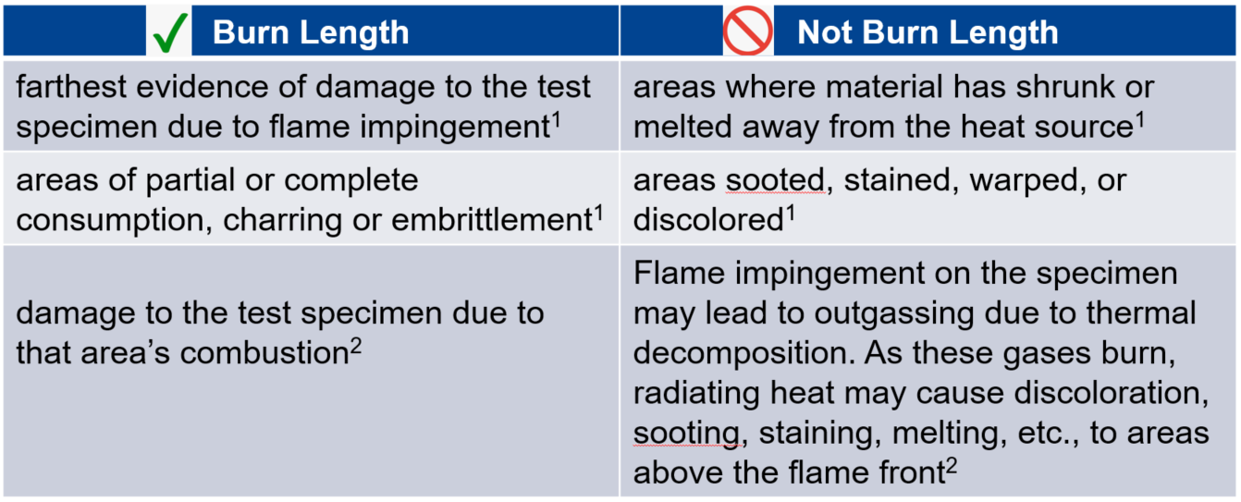
Burn Length Examples
Leather 12-Second Ignition Test Video
What’s the burn length?

Slide 7
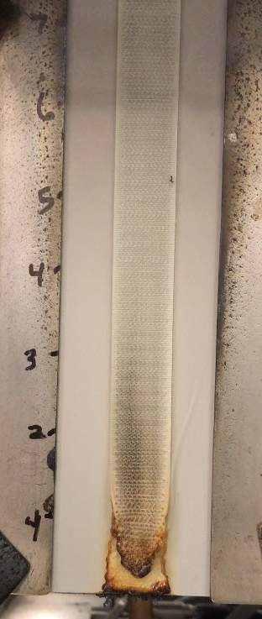
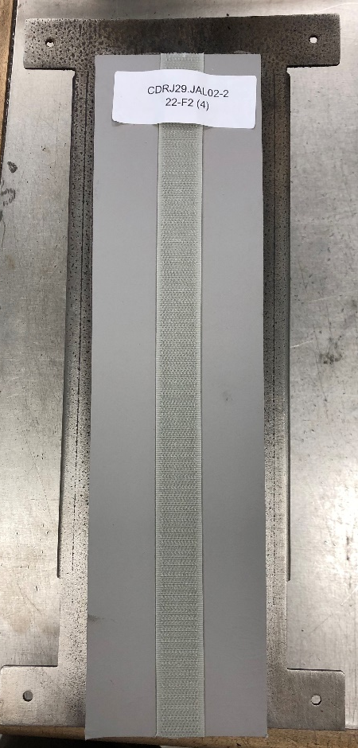
Burn Length Examples
Hook Example
What’s the burn length?
Before Test
After Test

Slide 8
Burn Length Examples
Hook 12-Second Ignition Test Video
What’s the burn length?

Slide 9
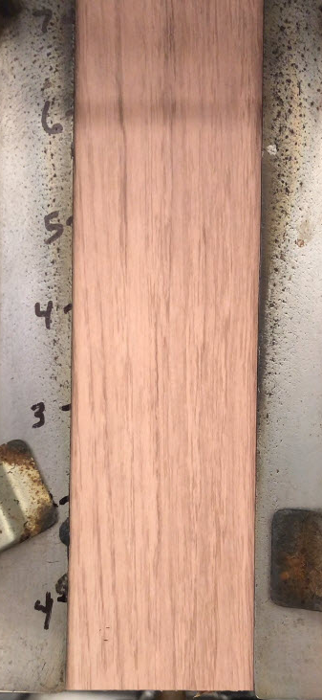
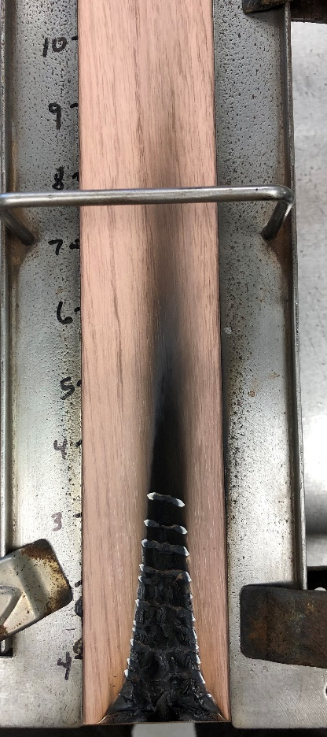
Burn Length Examples
Décor on Panel Example
What’s the burn length?
Before Test
After Test

Slide 10
Burn Length Examples
Decor 60-Second Ignition Test Video
What’s the burn length?
Note that aircraft decorative laminates are designed to darken with application of heat as part of the mechanism to lower heat release values.

Slide 11
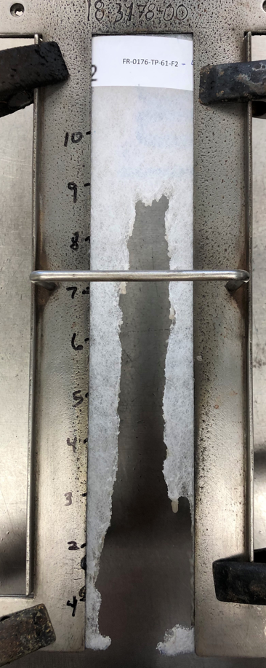
Burn Length Examples
Foam Example
What’s the burn length?
Before Test
After Test

Slide 12
Burn Length Examples
Foam 12-Second Ignition Test Video
What’s the burn length?

Slide 13
What’s the Burn Length?
Burn Lengths are the most subjective of any fire test.
Be familiar with the definition
Ensure You watch the test!!

