Slide 1
Hydrogen Flame Characteristics
International Aircraft Systems Fire Protection Forum
John Kurtanidze
Oct. 17-18, 2023

Slide 2
Introduction
Interest in hydrogen propulsion for commercial aircraft
Hydrogen is abundant, source of renewable energy
Can power electric aircraft via hydrogen fuel-cells
  Produces no noise pollution
Can be burned in traditional jet engines
  Produces no CO2 emissions
  Non-toxic combustion products
Byproduct of using hydrogen is water
  Water can be recycled w/i aircraft for other purposes

Slide 3
Challenges
Challenges with Hydrogen:
  Easy to ignite and explosive (MIE: 0.019mJ; flammability limit 4-75% by volume)
  Hard to detect a leak (odorless, makes little sound)
  Can auto-ignite (T=1040F or 560C air)
  Dangerous in confined spaces
  Difficult to store
  Hydrogen embrittlement
  Can permeate through metals
Challenges with Hydrogen Flames:
  Invisible in daylight
  Has very low quenching limit

Slide 4
Project Objective
Experimentally imitate tiny hydrogen leak ignition
Study hydrogen flame characteristics
  Heat flux
  Temperature
  Flame Length
Note the effects of:
  Leak size and shape
  Standard flow rate (SFR)
  Exit-plate spacing

Slide 5
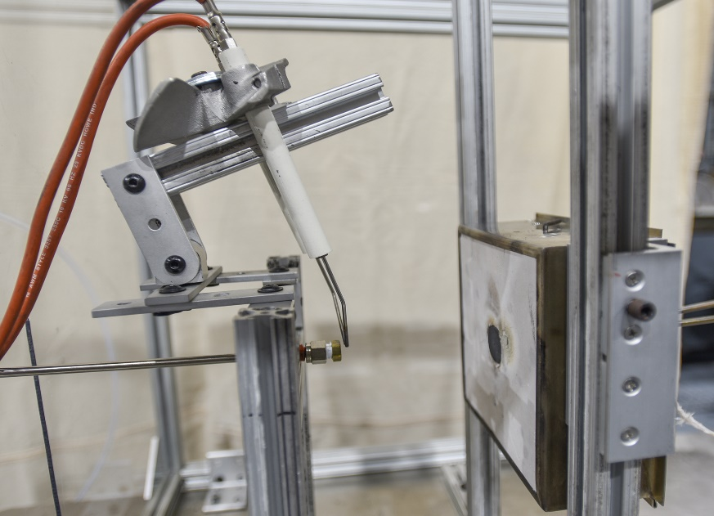
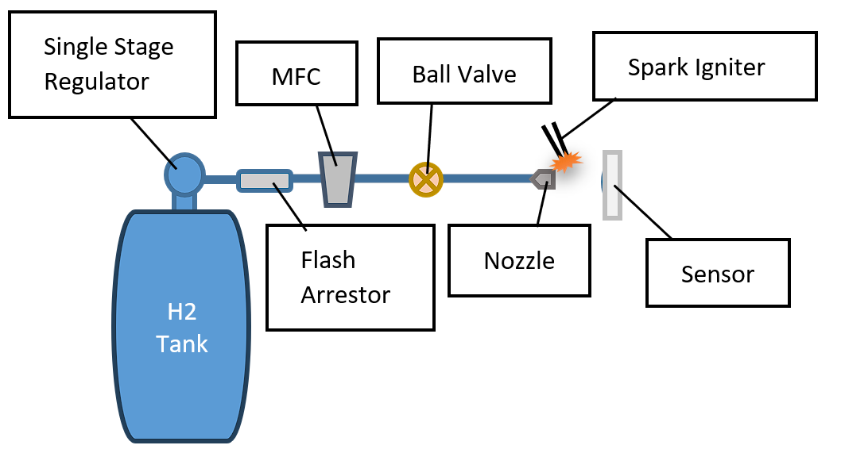
Experimental Setup
Custom hydrogen burner
Igniter
Sensor
Nozzle

Slide 6
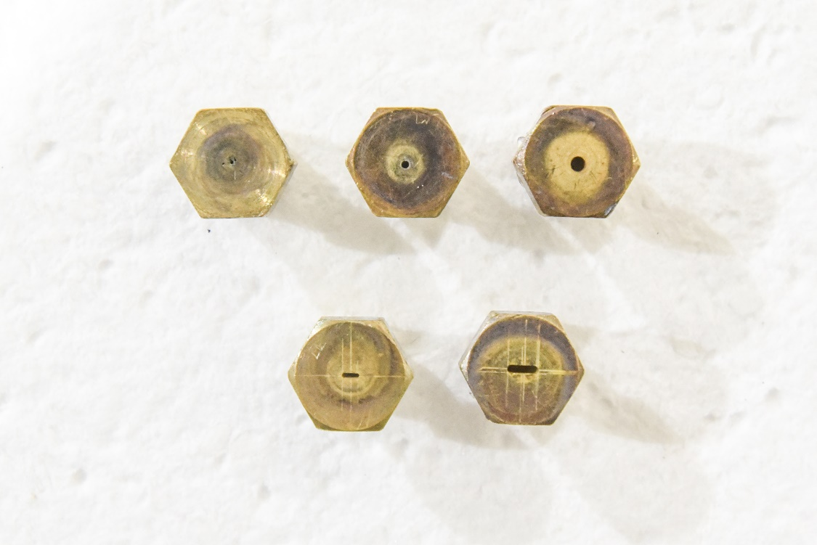
Nozzles
Circular
vs.
Slot
#1
#2
#3
#4
#5

Slide 7
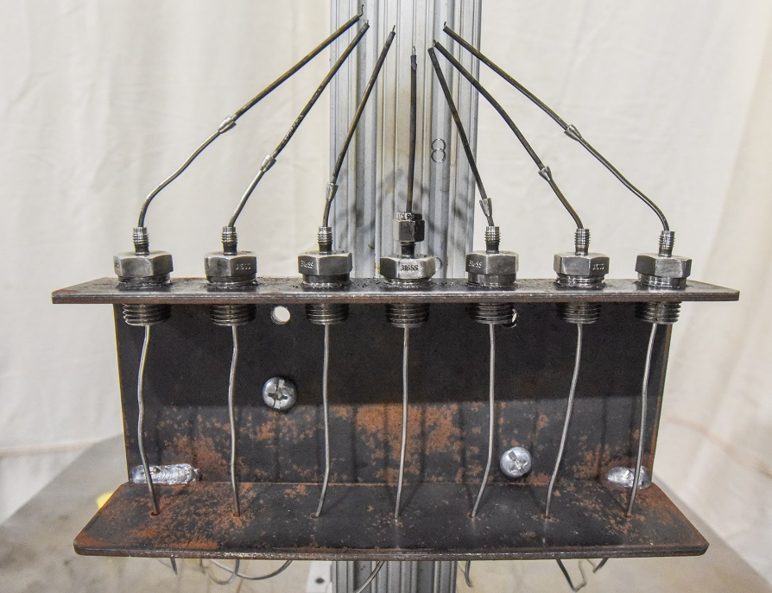
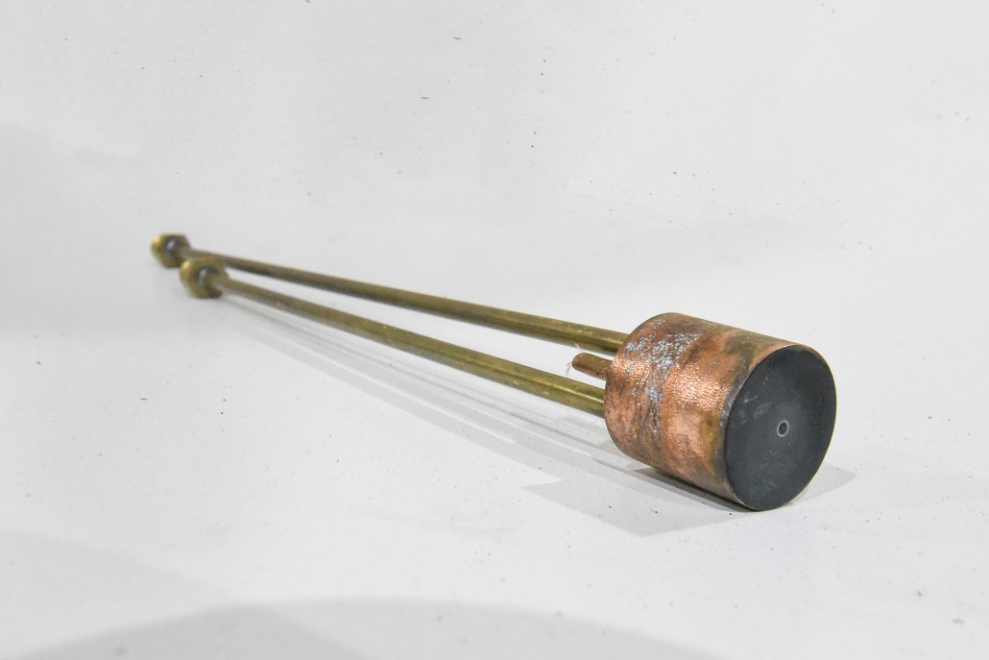
Sensors
Thermocouple Rake Heat Flux Gauge
(TCs spaced 1/8’’(~3mm) apart) (Water-Cooled Gardon Gauge)
7
6
5
4
3
2
1

Slide 8
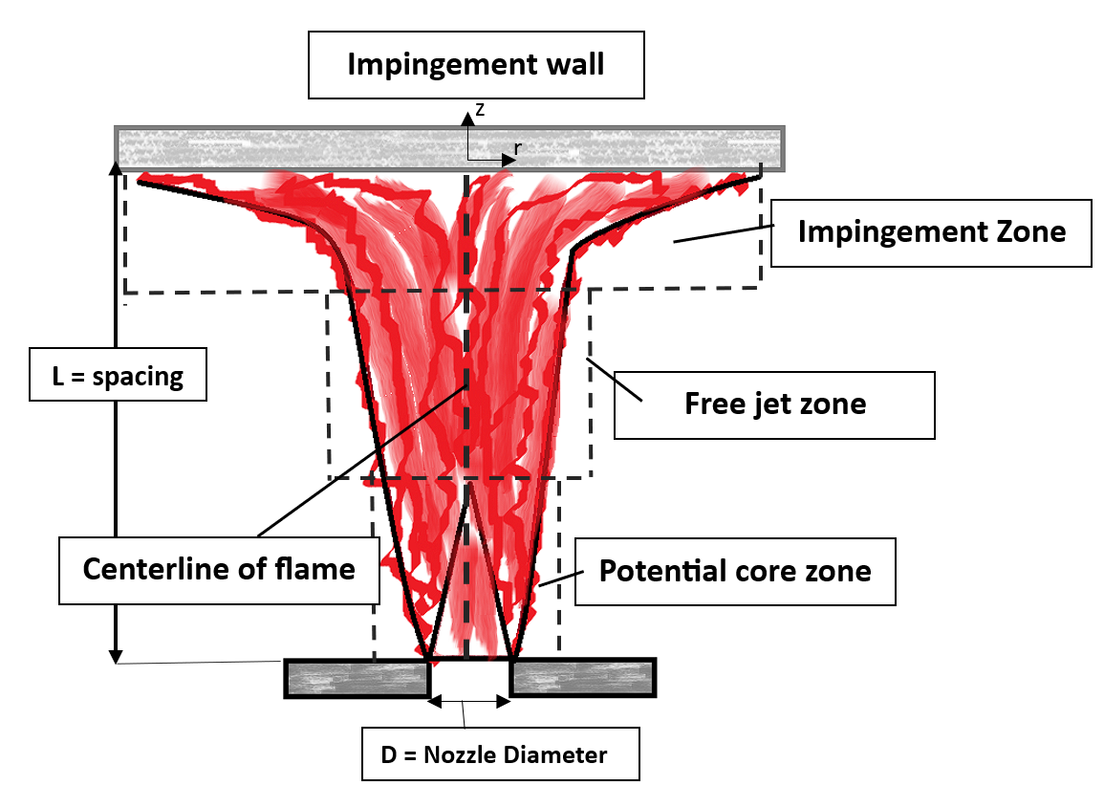
Experimental Method
Parameters varied:
  Nozzle orifice size
    D = 0.4-1.7mm
  Standard flow rate (SFR)
    M = 1-5SLPM
  Exit-plate spacing
    L = 1-4in (25-100mm)
Re #: 110-2400; Fr #: 55-10200

Slide 9
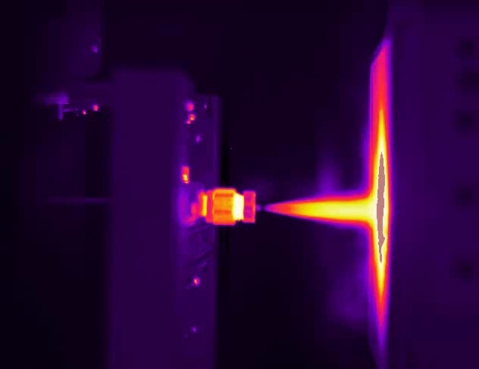
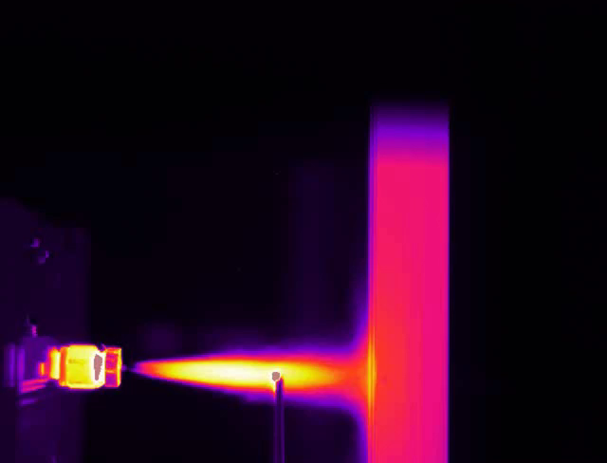
Experimental Method (videos)
Heat Flux Test Temperature Test

Slide 10
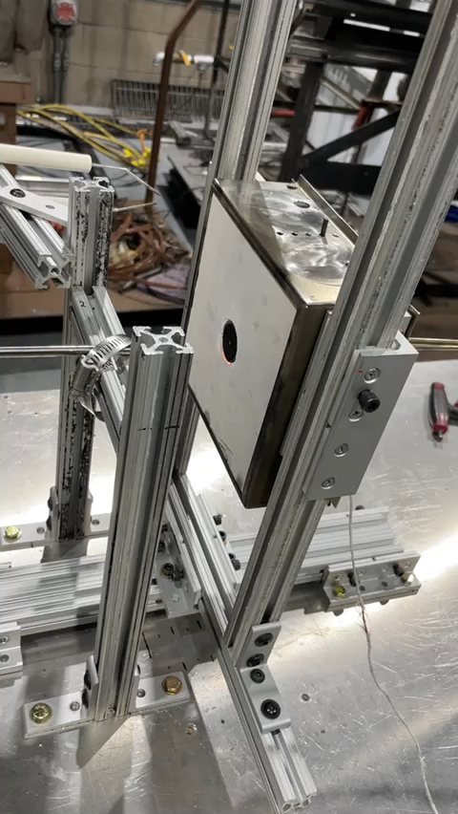
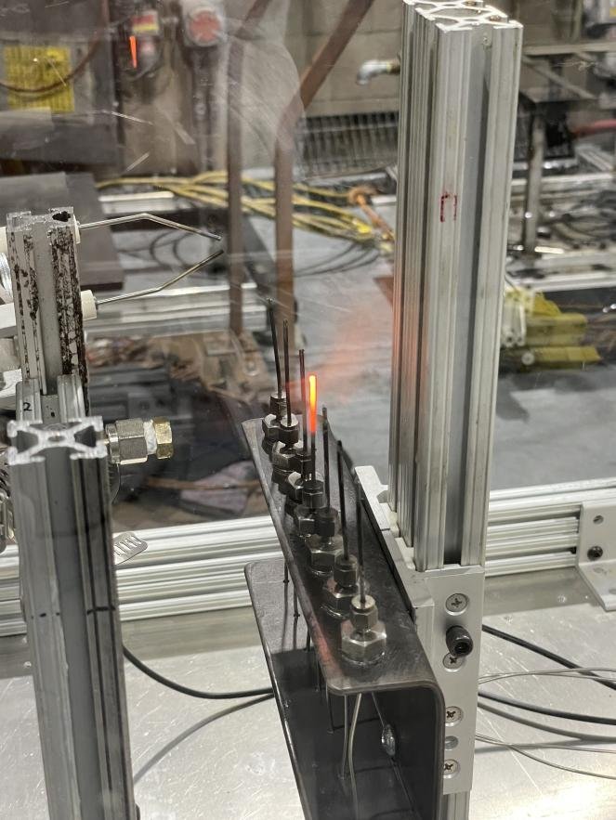
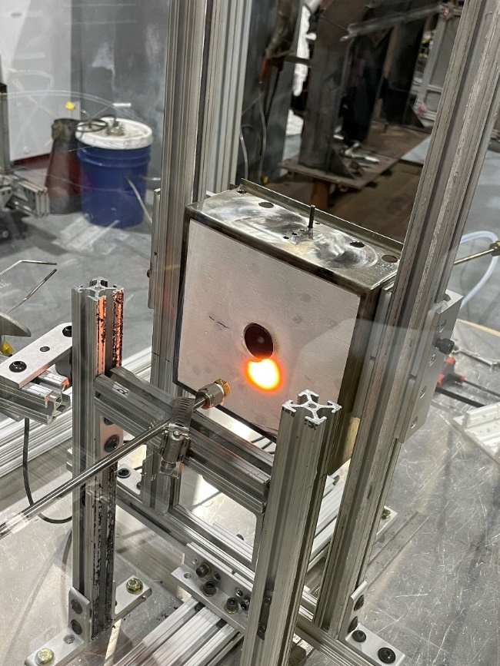
Hydrogen Flame Invisibility Examples

Slide 11
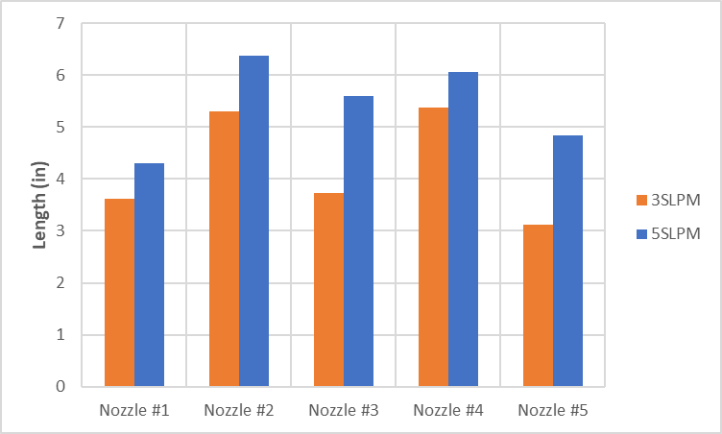
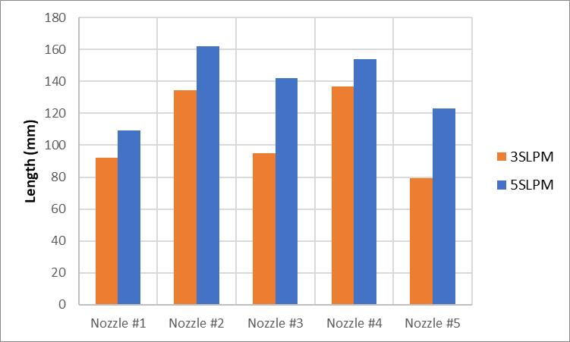
Flame Length
Takeaway: Length increases with SFR while leak size does not have much influence

Slide 12
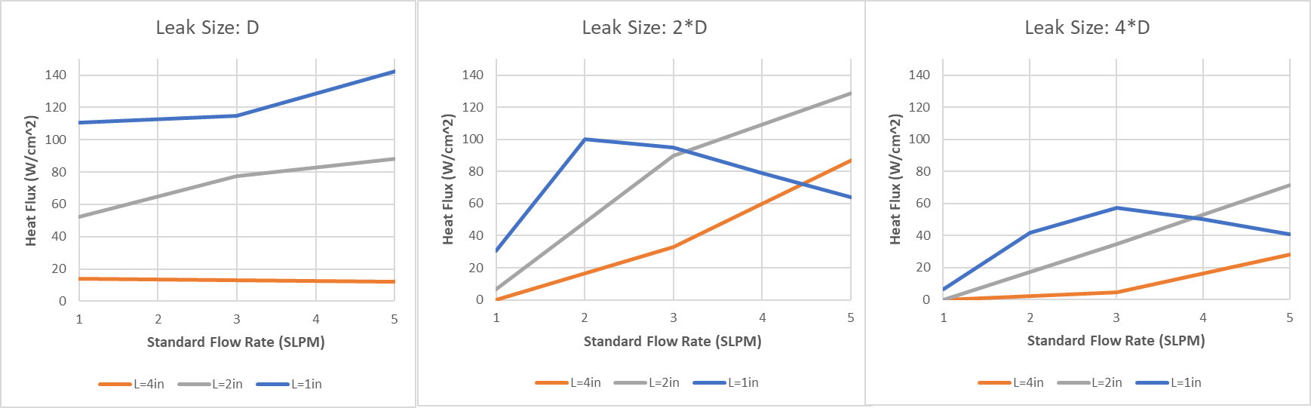
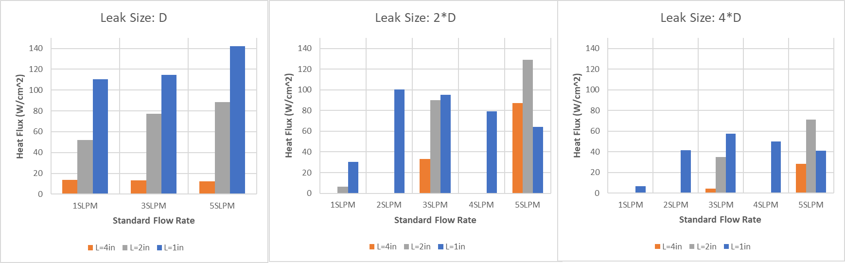
Flame Heat Flux
Decrease in spacing→ Increase in Heat Flux
Bigger leak→ Lower Heat flux
D=0.4mm

Slide 13
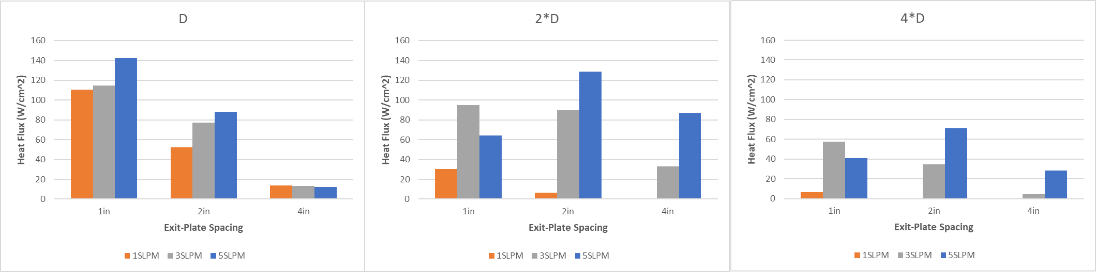
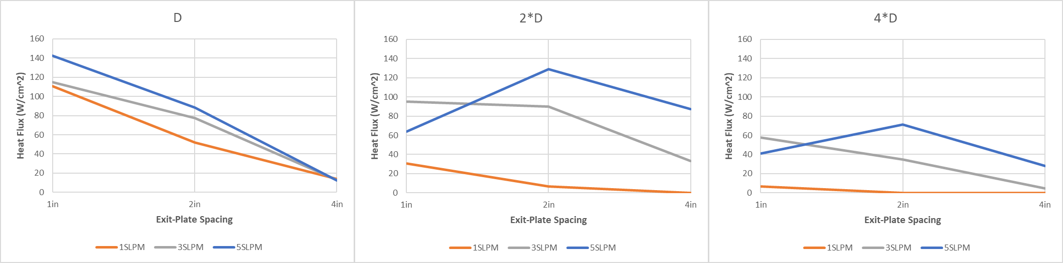
Flame Heat Flux (cont.)
Increase in SFR→ Increase in Heat Flux
Takeaway: Little spacing and high SFR results in lower Heat Flux b/c of cold, unburned H2 gas
D=0.4mm

Slide 14
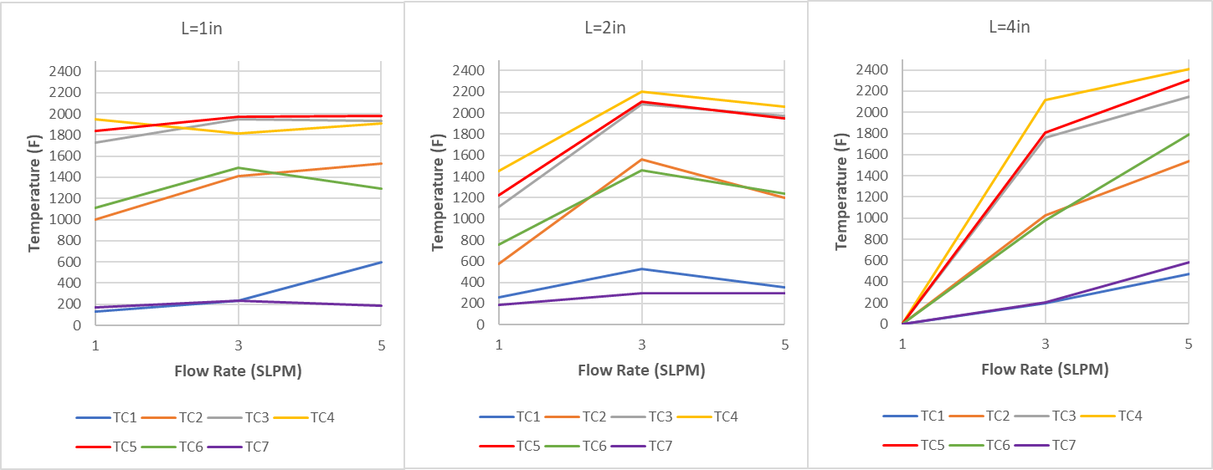
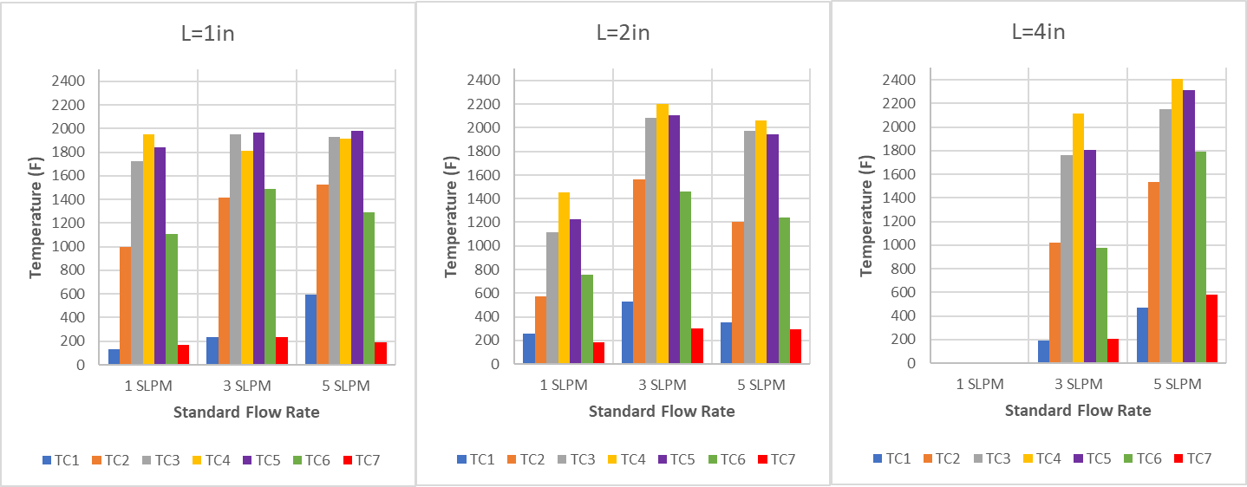
Flame Temperature
Increase in SFR→ Increase in Temperature
Increase in spacing→ Increase in Temperature
Takeaway: Temperature increases along the z-axis and reduces radially away from the centerline
D=0.8mm

Slide 15
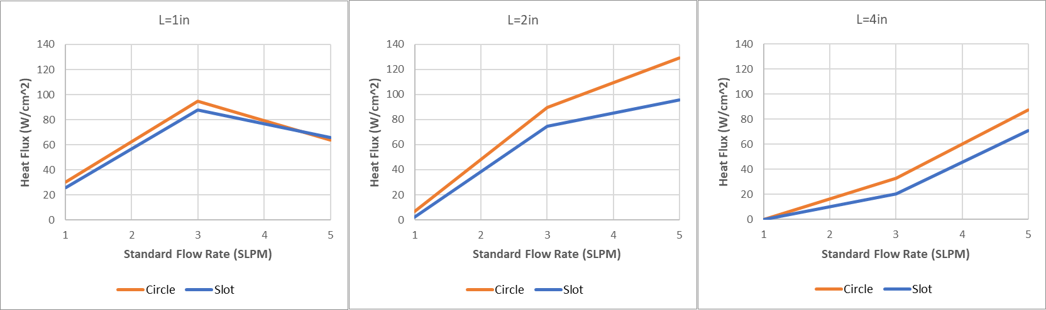
Circular vs. Slot Nozzles
Flames from circular nozzles output higher heat flux than flames from slot nozzles
Takeaway: Shape of a leak has little influence on flame characteristics. SFR and leak size are the major determining factors

Slide 16
Summary
H2 flame consists of 1) Potential core zone, 2) Free jet zone, 3) Impingement zone
SFR is the most influential factor for H2 flame; higher SFR → More intense flame
Leak size is closely correlated with SFR, i.e., the bigger the leak, the higher the SFR must be to produce high heat flux and temperature
Bigger leak for the same SFR produces lower heat flux and temperature due to lowered flame velocity and lowered intensity
The closer the impingement surface → Higher the heat flux and temperature unless the potential core zone of a flame is impinging on the surface
Potential core zone is less pronounced/exposed for smaller leaks and lower SFR
Increasing Leak Size→ lower flame velocity → shorter flame → lower heat flux and temperature
Increase in SFR → Increase in Flame Length up to ~6.5in
Change in Leak Size does not have as much influence as SFR for flame length
Leak shape has little influence on flame characteristics; what matters is the volume of gas being released and ignited
Flame Temperature increases along the z-axis and reduces radially away from the centerline
Flame temperature can vary b/w 200-2400F; Flame heat flux can vary b/w 10-140 W/cm^2

Slide 17
Future Work?
Can continue this experiment to test:
  Vertical burner over horizontal
  Bigger orifices
  Higher flow rate flames
  Burn-through tests for various materials
  More applicable sensors for heat flux & temperature measurement

Slide 18
Thank You.
Any Questions?

