Slide 1
RTCA Development of a New Flammability Test for Electronic Boxes

Slide 2
Introduction
Working on new method to fire test electronic boxes whole, rather than test individual components in Bunsen burner
Test method based on Telecom Industry test ANSI T1.319
Will be added to RTCA-DO160H
  Draft due to committee in Spring 2020
Focused on refining test method
Since the last meeting:
  Mainly focused on defining a pass/fail criteria

Slide 3
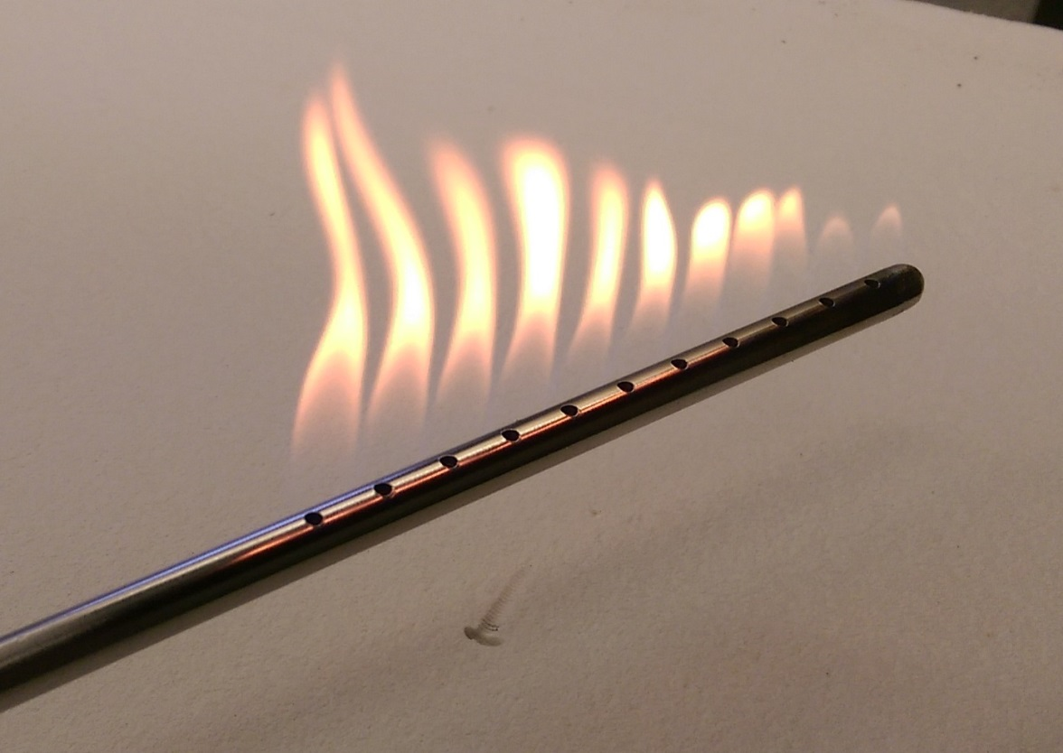
Programmable Line Burner
3/8” stainless steel tube with (11) 7/64” holes places 1/2” apart
Methane Fuel with variable flow rate controlled by computer program
Burner holes can be covered for smaller box or lower flow rates

Slide 4
Pass/Fail Criteria
Original idea was that no flame more severe than the 1.5-inch, 12-second vertical Bunsen burner flame should be allowed to escape box
Difficult to measure flame height and time at the same time
What if there is a bigger flame for a shorter time or smaller flame for a longer time?
New idea is to only measure time so testing was done to see if a larger flame for a shorter time would be more severe than Bunsen burner flame

Slide 5
Pass/Fail Criteria
In Bunsen burner tests, 1” x 3” samples of 1/16” garolite ignited in 5 sec, 1/8” ignited in 14 sec.
  Does not self-extinguish once ignited
  Took 7 sec to ignite with 2 and 3 inch flames unless the sample was moved higher to be in hottest part of flame
12” x 3” sample ignited in same time
Tested several samples of 1/16” garolite with line burner while varying fuel flow rate, sample distance above burner, and flame time.
  8 L/min, 4 in. above burner
  3.5 L/min, 2.5 in. above burner
  0.14 L/min, 0.75 in. above burner

Slide 6
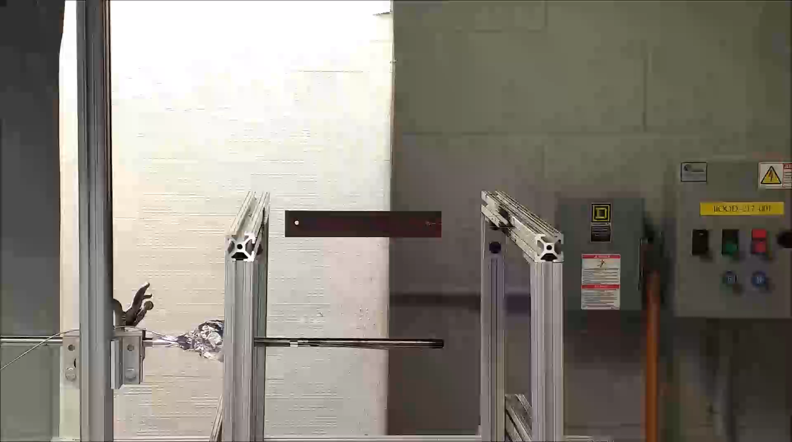
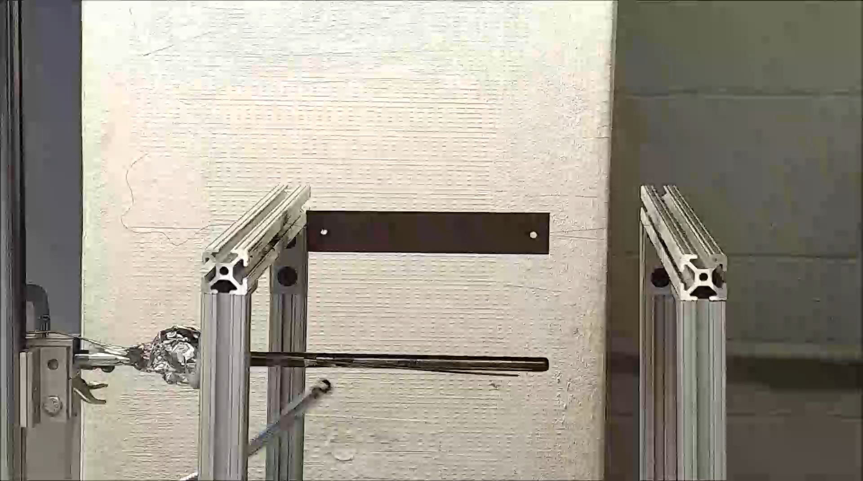
5-second flame time
8 L/min flame, 4-inch distance
3.5 L/min flame, 2.5-inch distance

Slide 7
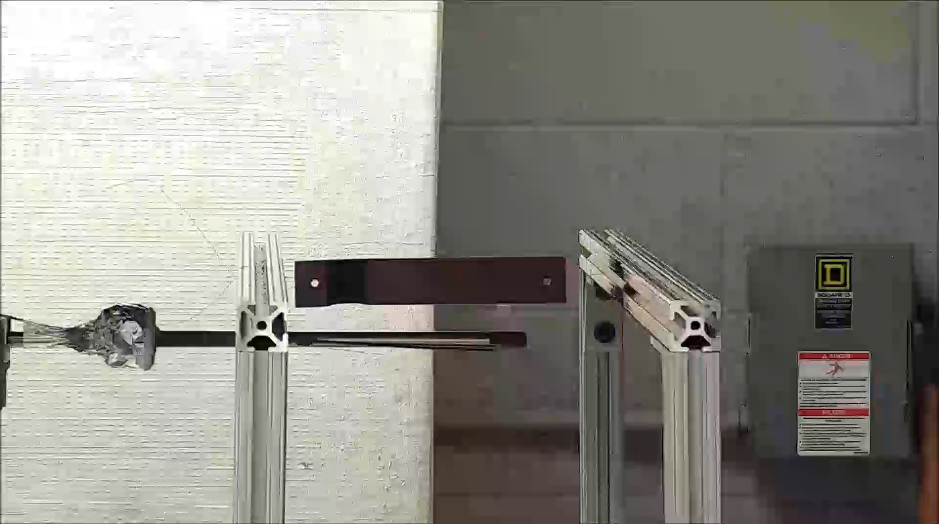
5-second flame time
3.5 L/min flame, 2.5-inch distance
0.14 L/min flame, 0.75-inch distance

Slide 8
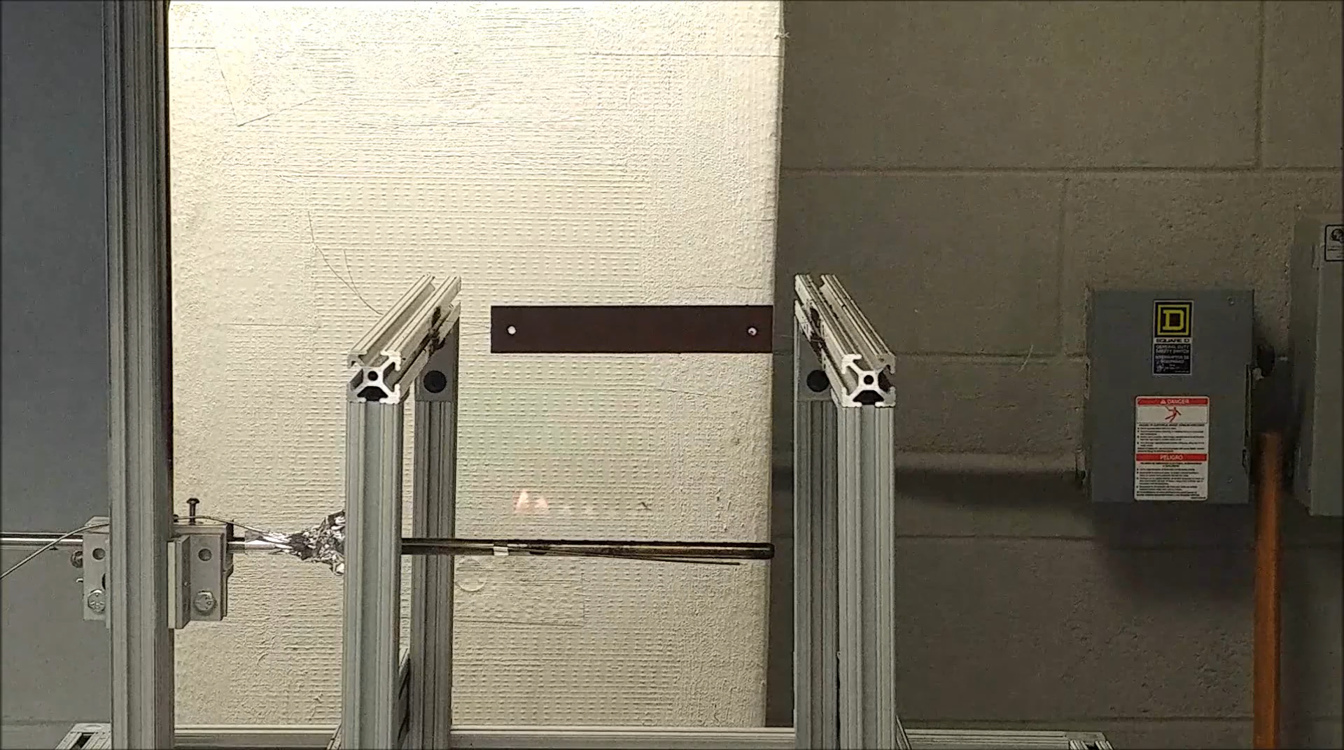
8 L/min flame, 4-inch distance, 7 seconds

Slide 9
Pass/Fail Criteria
Larger flames did not ignite material more easily than smaller flames
Location of material in flame had much bigger effect than flame size
  Material ignited more easily in hottest part of flame
Smaller flames ignited material in less time because it was easier to place in hottest part of flame

Slide 10
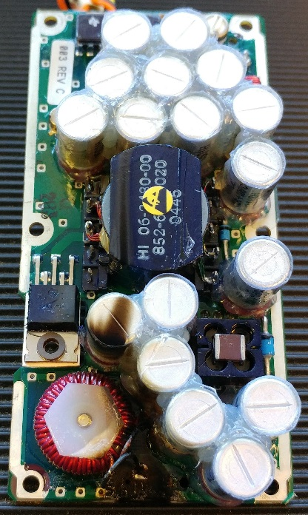
Pass/Fail Criteria
4 sheets of 1” x 6” x 1/16” garolite and 1 sheet of 1/8” garolite placed 0.75” above box
PCB with (17) 50V 15μF capacitors
4.25” x 2.125” PCB
1.04 L/min max. fuel flow rate
In Bunsen burner tests, 1” x 3” samples of 1/16” garolite ignited in 5s, 1/8” ignited in 14s.
  Does not self-extinguish once ignited
  Took 7s to ignite with 2 and 3 inch flames unless the sample was moved higher to be in hottest part of flame
12” x 3” sample ignited in same time

Slide 11
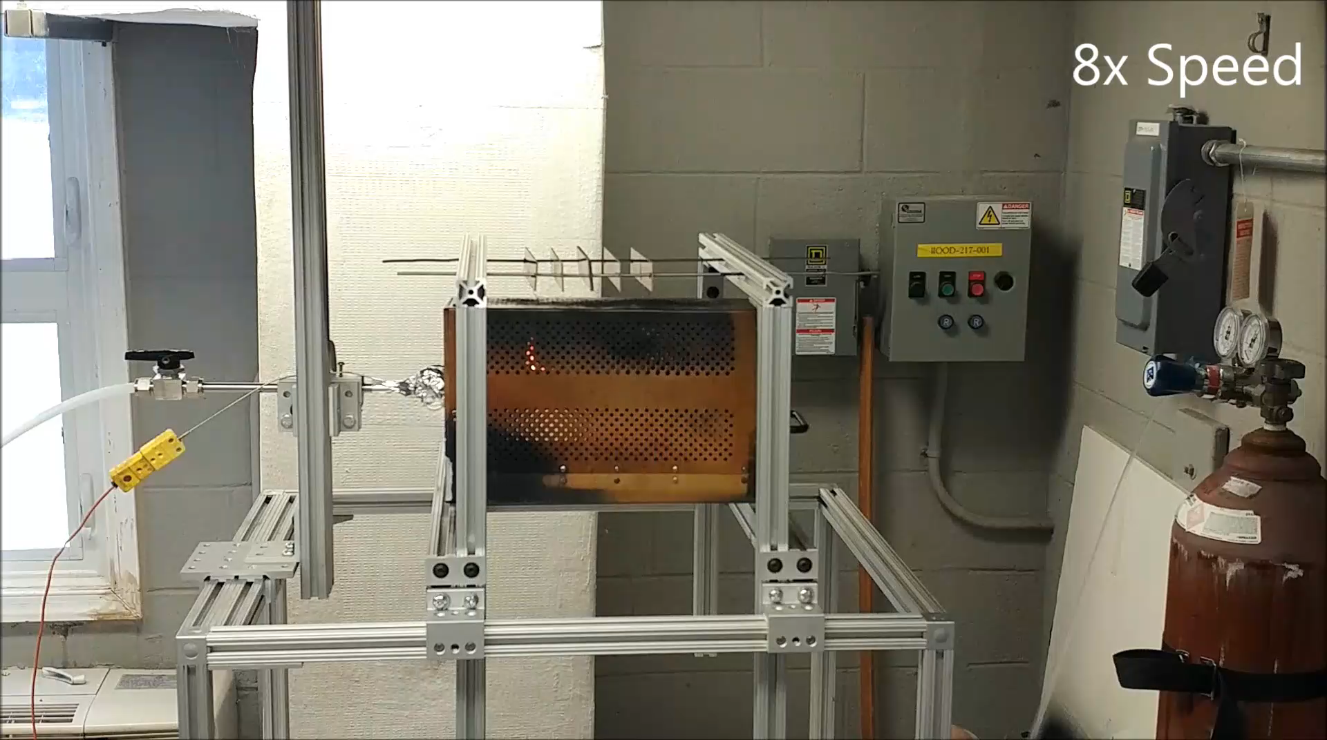
Flames escaped box 11 times for a cumulative 6.19 seconds

Slide 12
Pass/Fail Criteria
Difficult to determine amount of time flames escaped box in situation like this
  Watch video frame-by-frame to get exact time
Most tests will likely be easy to determine pass or fail because either:
  No flames will escape
  Flames will be outside the box for a long time
  Flames will escape once or twice for a few seconds each rather than several small explosions with <1 sec. flame time each
Borderline test results will likely require video for assistance in measuring flame time
  Possible use infrared camera?

Slide 13
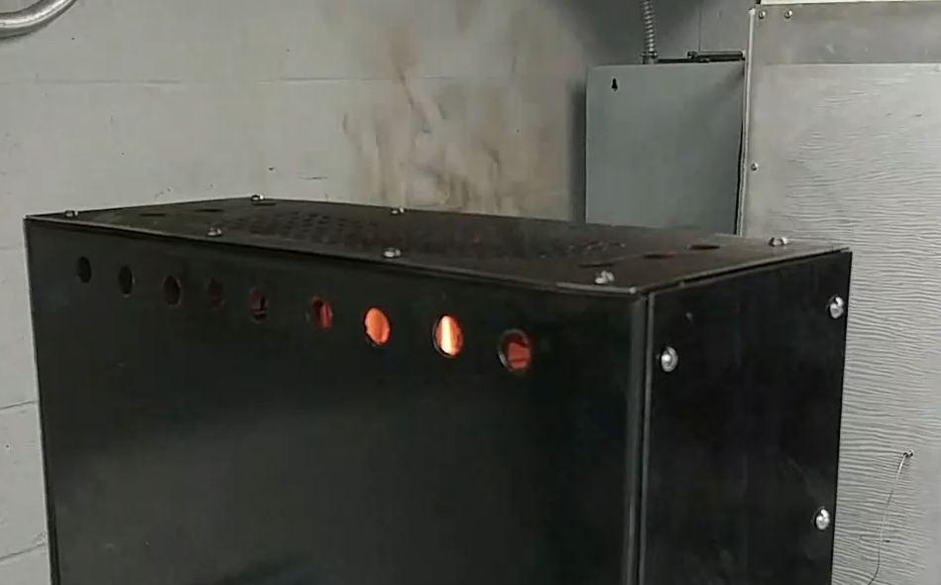
Tiny flamelets coming through holes in box should not count as flames escaping

Slide 14
Conclusion & Future Work
Using only flame time as pass/fail criteria looks promising since larger flames do not seem to ignite materials easier
Will recommend that video is taken of tests to aid in measuring flame time
Need to do comparative testing to ensure repeatable results across labs

Slide 15
Questions?
Contact:
Steven Rehn
Federal Aviation Administration
William J. Hughes Technical Center
Fire Safety Branch, Bldg. 203
Atlantic City Int’l Airport, NJ 08405
(609) 485-5587
steven.rehn@faa.gov

