Slide 1
Flow Visualization in the OSU
IAMFTFM
Tina Emami
October 29, 2018

Slide 2
Airflow Project Goals
Create an adjustment to the current OSU apparatus in order to create an even and reproducible air flow.

Slide 3
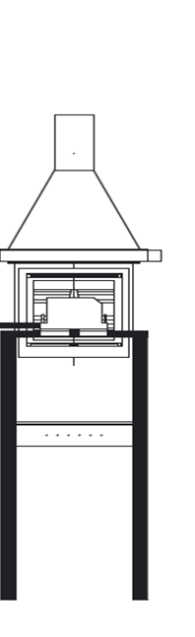
Test Setup
96.64mm
Aluminum oxide powder is seeded through the OSU
Laser light sheet is directed towards the side of the OSU and the PIV camera is placed perpendicular to this light sheet to capture seeding particles
Camera can capture data of size 96.64mm x 72.71mm
The width of the OSU fits 4 measurement frames
Measurement frame
72.71mm

Slide 4
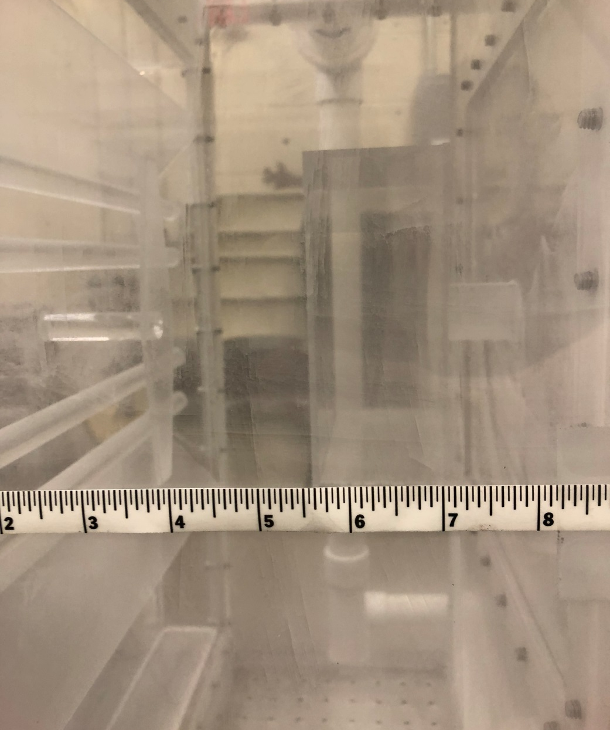
Measurement Location

Slide 5
Measurement Location
The PIV camera is aligned to view the flow between the middle two glow bars

Slide 6
New Measurement Redo
Airflow measurements at regular settings were redone ½ inch away from sample face to accurately measure velocities

Slide 7
Background
Original Set Up
Bottom Air Inlet Set Up

Slide 8
Background
Moved the location of the air inlet from the side of the OSU to the bottom to test imbalance in flow
This created air circulation through the center of the OSU near the test sample, but created a more even upwards flow on both sides of the OSU

Slide 9
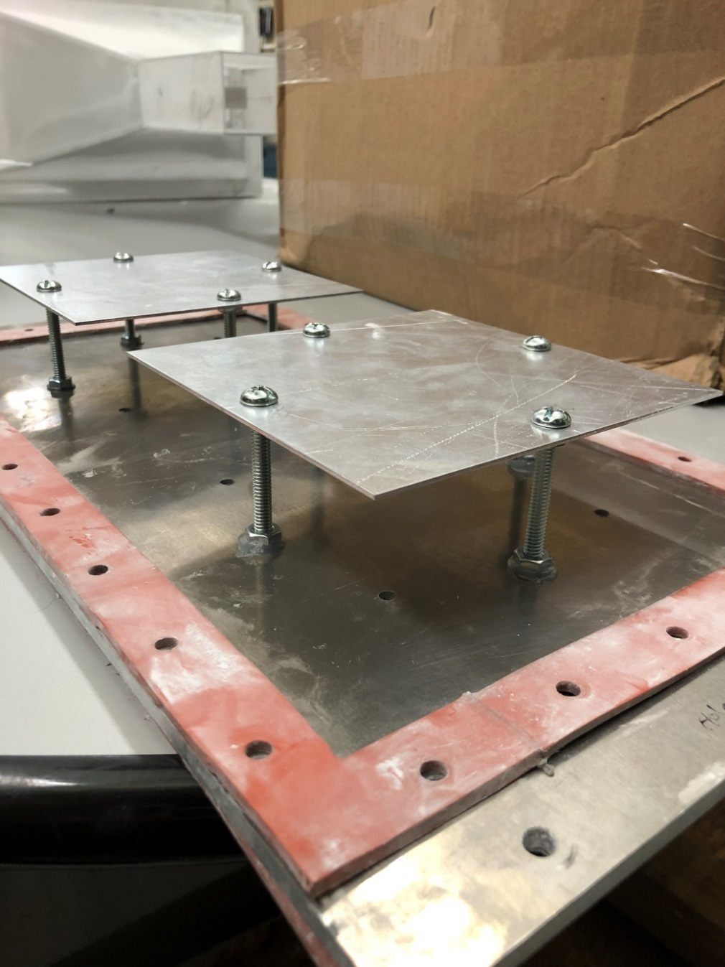
Background cont.
Two Plate Setup

Slide 10
Background cont.
Two Plate Setup

Slide 11
Background cont.
One Plate Setup

Slide 12
Background cont.
One Plate Setup

Slide 13
New Test Setup
Air inlet was moved back to its original location
PVC tube with two rows of evenly spaced ¼” holes 45° from horizontal was constructed
Cap is glued to the end of the tube
Tube is placed in the bottom chamber of the OSU
Holes will be oriented to face downwards in order to more evenly mix the flow

Slide 14
New Test Setup
OSU laying down on side
Bottom View

Slide 15
New Test Setup

Slide 16
New Test Setup

Slide 17
New Test Setup Flow of Right End Location

Slide 18
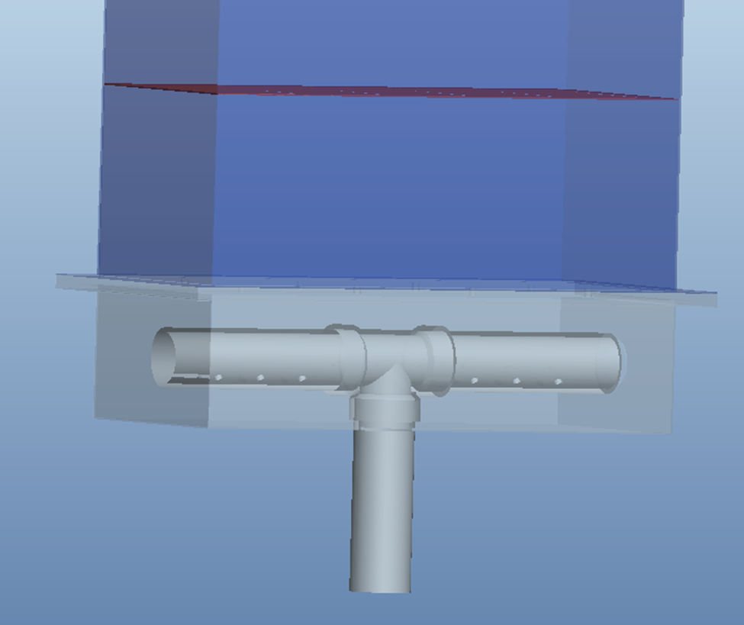
Potential new design

Slide 19
Conclusion
New setup shows a slower but even distribution of air flow in front of the sample face.
Test second design
Testing in a hot OSU to understand how this setup affects the burning of samples

Slide 20
Questions or Comments?
Tina Emami
FAA William J. Hughes Technical Center
ANG-E212 Materials Fire Test
Building 275
Atlantic City Int’l Airport, NJ 08405
Tina.Emami@faa.gov
609-485-4277

