Slide 1
RTCA Update

Slide 2
Introduction
RTCA DO-160G is the current international standard for environmental testing of commercial avionics
Section 26, Category C defines the flammability testing requirements for electronic housings and component parts
Next revision for DO-160(H) is due January 2019
The goal is to eliminate confusion on how to apply the current standards and simplify the tests required for the next revision

Slide 3
Current test standards
Small part exemptions

Slide 4
Goal
Create alternative test procedure where the electronic enclosure with its internal components is tested whole instead of testing each part individually

Slide 5
Survey Results
Criterion | Approach 1 | Approach 2 | Approach 3
Maximum allowable volume and/or outer dimensions of the box? | No limit to start | 22 L (1343 in²) | 65.5L (4000 in²)
Maximum power dissipation (heat)? | No limit to start | 200 W | Not sure
Maximum vent holes? (percentage open or total open area?) | No limit to start | Up to 5% open or <200 mm² | Not sure
Maximum forced venting with fan or other device? (maximum air flow rate?) | No limit to start | No limit to start | Not sure
Does the location on the aircraft matter? | No | Pressurized section of fuselage | No
What type of tests do the Housing + labels + other exterior subparts have to pass? | If the box is metal, none | 12 second vertical BB | 12 second vertical BB
Maximum flame that is allowed outside the box? | Minimal | None | < 1”
Evaluate smoke escaping box? | No | No | Yes

Slide 6
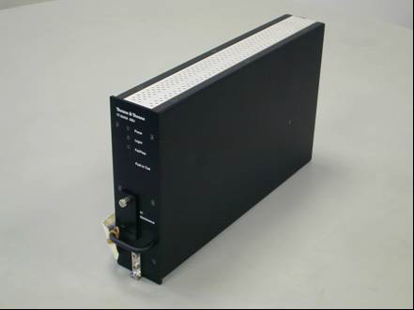
Current Test Methods
Identified two current test methods which test electronic enclosures whole
These will be used as a starting point to be evaluated and refined for this group

Slide 7
Method 1
Methane line burner as fuel source
11 $7/{64}"$ holes spaced $1/2"$ apart
Fuel regulated by a methane flow controller (simulates circuit board igniting and burning through to completion)

Slide 8
Method 1
If printed circuit boards (PCB) are oriented horizontally, methane flow rate is fixed at 5L/min for 120s
If PCBs are vertical, methane flow rate follows a curve based on PCB height
$Q_{peak}=\left(0.071×h^{1.26}−0.03\right)×1.8$
Q_{peak} = Maximum methane flow rate (L/min)
h = vertical dimension of tallest PCB (cm)

Slide 9
Method 1

Slide 10
Method 1
Requires insertion of a programmable burner into the equipment chassis
Flame is placed to impinge area within chassis with most fuel load
Heat released is measured along with observations of smoke
Fire is not allowed to escape the enclosure to ignite any surrounding equipment

Slide 11
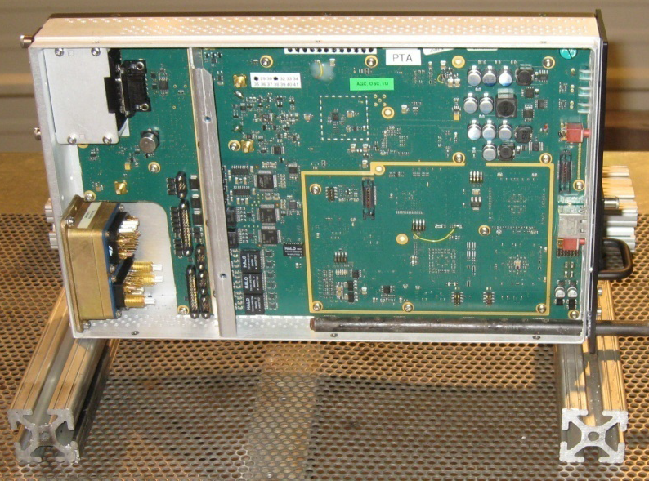
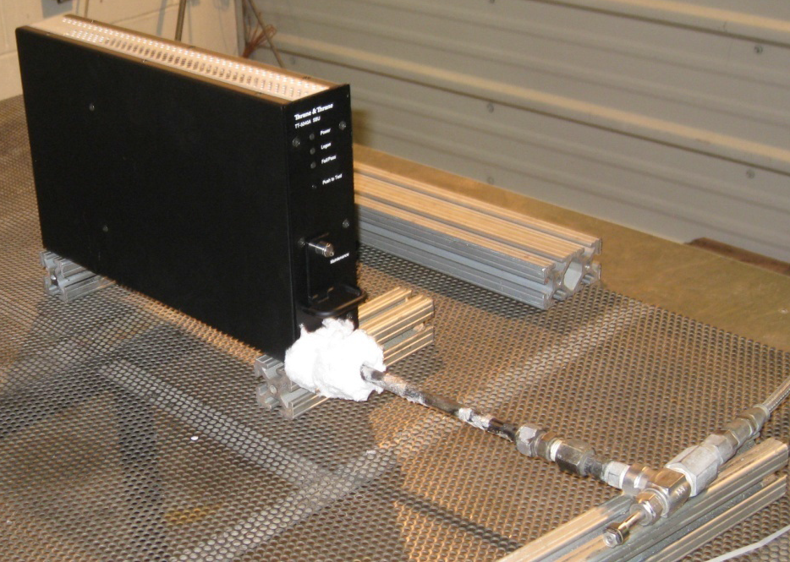
Method 1

Slide 12
Method 1

Slide 13
Method 1

Slide 14
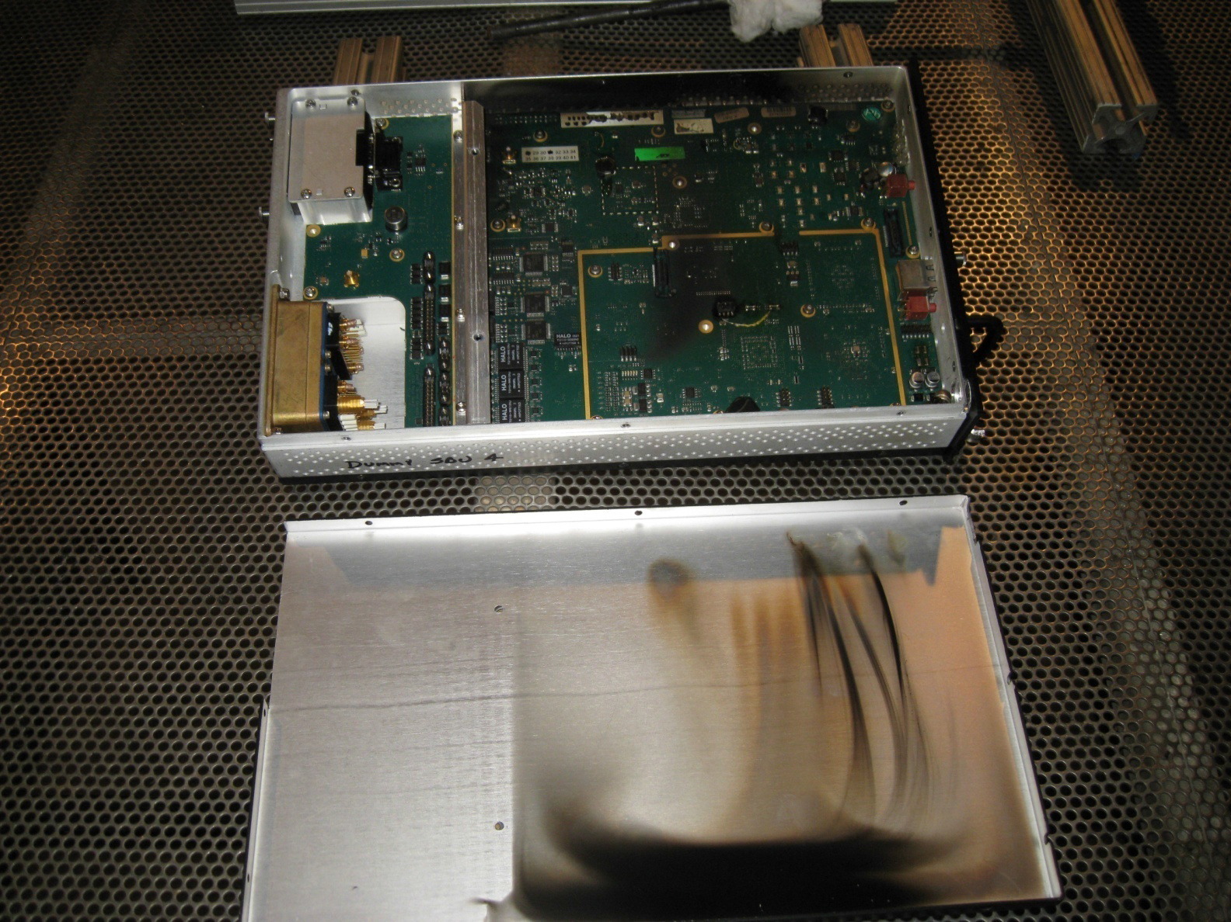
Method 1

Slide 15
Method 2
Foam block + heptane as fuel source
Fuel load is based on the mass of each material in the box and its combustion energy
Polymer | Combustion Energy (MJ/kg)
Epoxy | 34.3
PA | 32.6
PE | 47
PP | 47
PET | 23.2

Slide 16
Method 2
Foam block + heptane is sized to match the combustion energy of the internal components of the box
Ratio is kept close to 10mL heptane to 4”x4”x9” foam block, but can be adjusted if space is limited
Foam block is positioned near critical parts for worst case scenario
Fire Source | Combustion Energy (MJ/kg)
PUR | 37.3
n-Heptane | 44.7

Slide 17
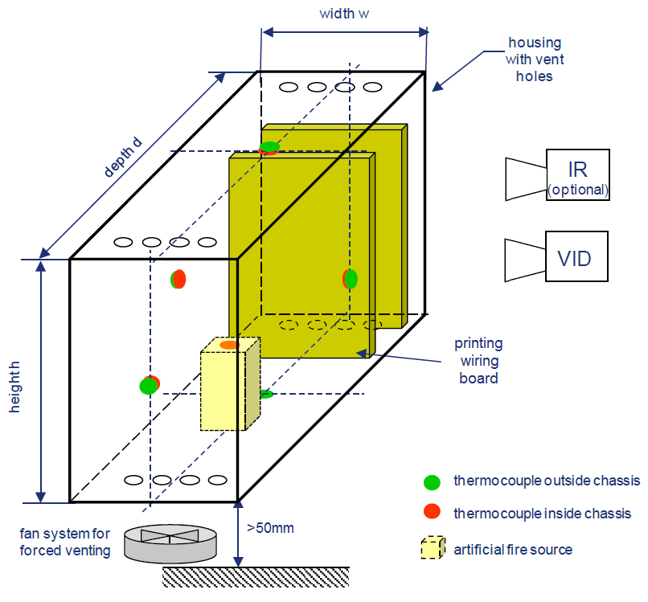
Method 2
Fire must not leave the housing and propagate into the surrounding area

Slide 18
Future Plans and Questions
Test identical electronic boxes using the two methods and compare results
What measurements are taken?
Pass/Fail criteria?
Correlation to current Bunsen burner tests?
Can you pass one test and not the other?
What if there is an external fire source?

Slide 19
Questions?

