Slide 1
Development of a Lab-Scale Fire Test Method for Composite Structure

Slide 2
Objective
Develop a lab-scale test method for composite structure
  Representative of the threat
    Moderate fire about the size of the block of foam fire
  Relatively simple
    Radiant heat source + Pilot ignition
  Low cost
    Small sample size
  Can be adapted to other inaccessible area materials
    Ducts
    Wire Insulation
    Other composites that are not small parts as defined in regulations

Slide 3
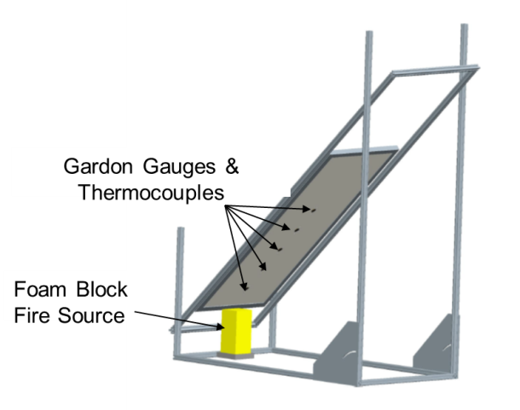
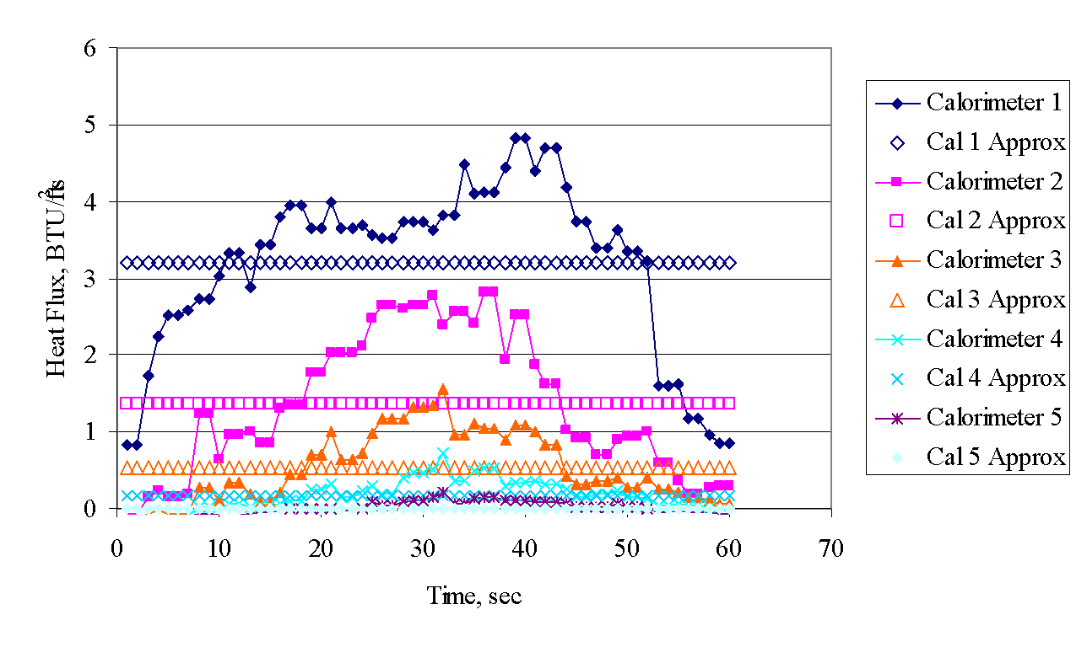
Lab-Scale Test Method Development
The foam block fire source was characterized by measuring the heat flux gradient along an insulated board for the duration of the foam burning event
This heat flux gradient will then be used to impose a similar heat flux on a smaller sample in a lab-scale test apparatus

Slide 4
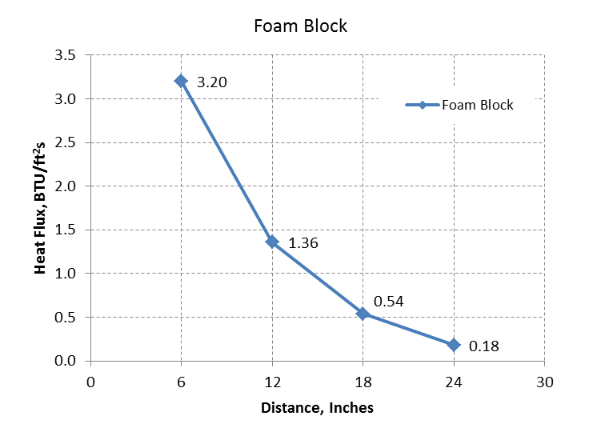
Foam Block Heat Flux Gradient

Slide 5
Vertical Radiant Panel (VRP) Development
Objective: to develop a “new” radiant panel type test that will:
  Simulate conditions of a foam block test
    Incident heat flux on sample
    Duration
    Geometry
  Correlate results from foam block test
    Use current database of materials already tested
      Aerospace/non-aerospace grade composites (1/8” thick)
      Aerospace grade carbon epoxy, varying thicknesses
      Cargo liners and floor panels, varying thicknesses

Slide 6
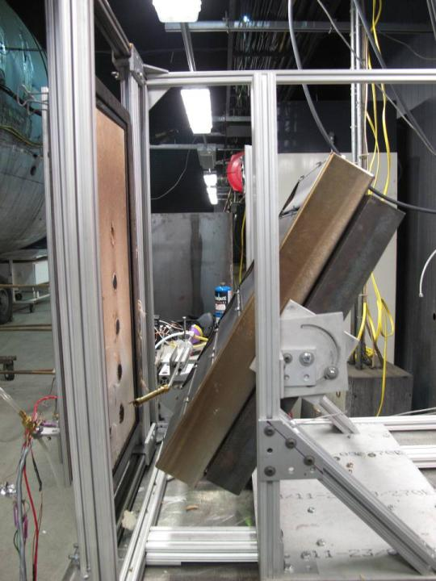
VRP Configuration
Heat flux gradient
  A tilted panel was used to attempt to achieve the same measured gradient as the foam block test
  Furthest backward tilt (70°) could not achieve steep enough gradient
  Zero position heat flux too low
Next attempt:
  Separate emitter strips into 3 individually controlled pairs to control the heat flux gradient

Slide 7
Bottom 2 Strips Only

Slide 8
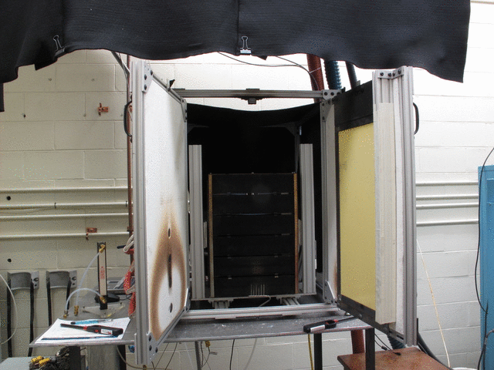
Modifications to VRP
Swivel doors added to make switching between calibration and testing quick and easy

Slide 9
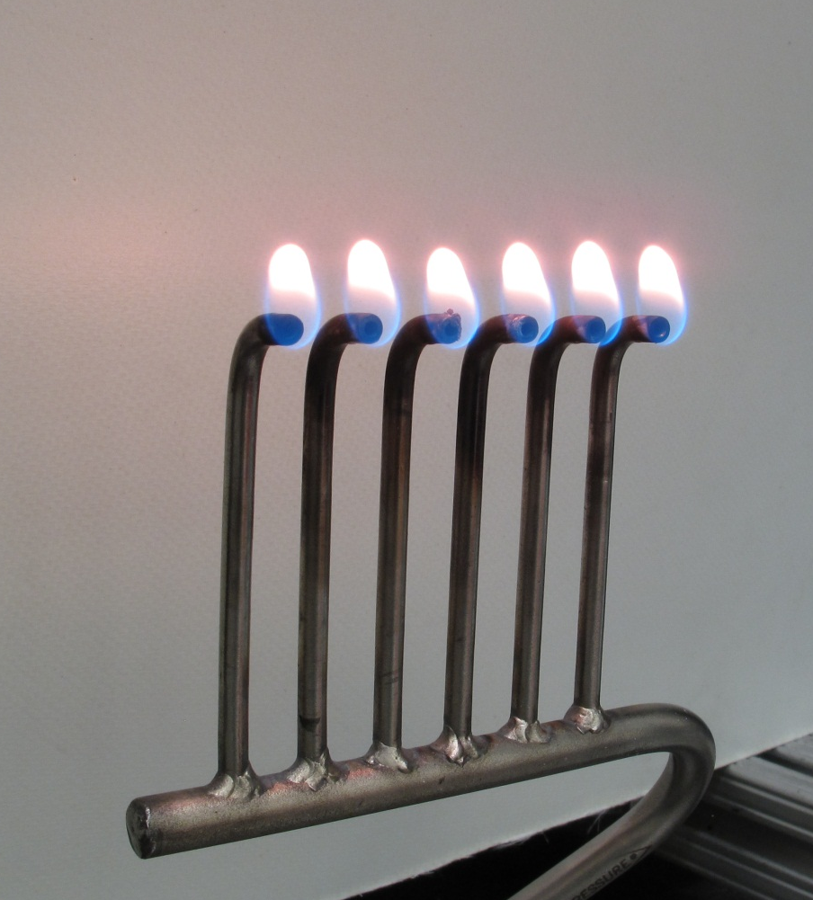
Unidirectional NBS Chamber Pilot Burner
2”
50 ccm @ 20 psig propane

Slide 10
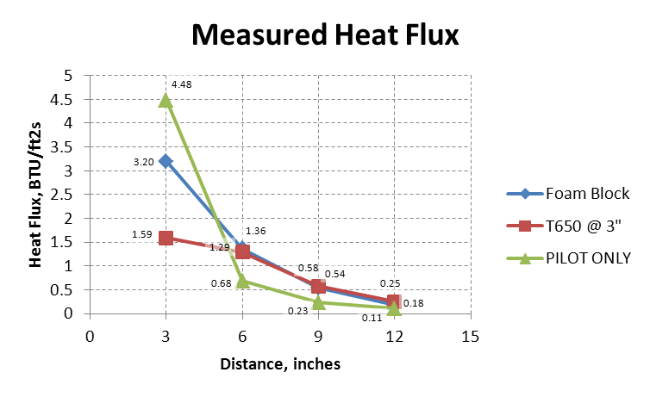
Multiple Flamelet Burner

Slide 11
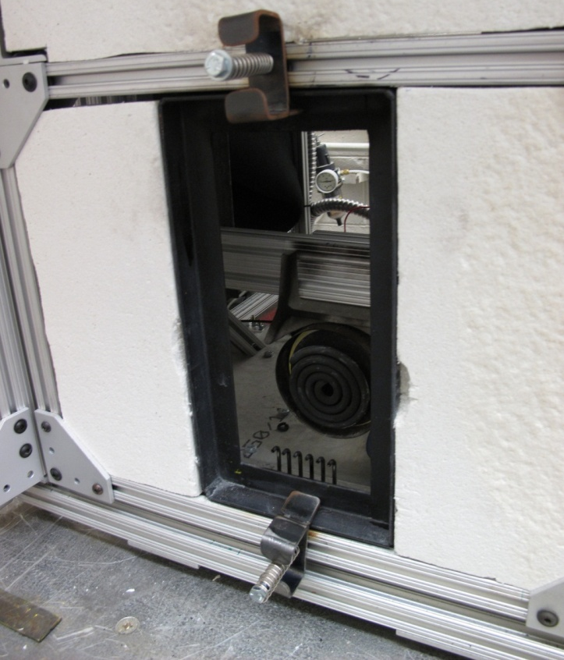
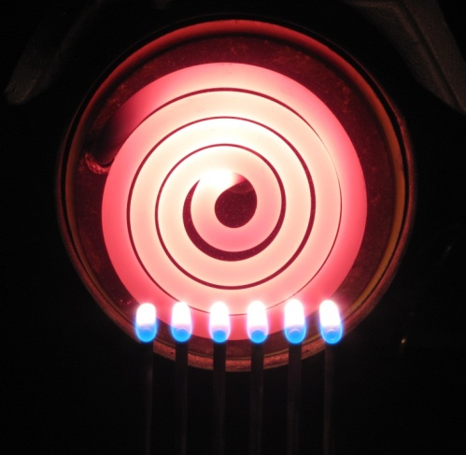
Recent Modifications
NBS furnace is widely used in FAA fire test community
  Smoke chamber
  Slide test
Provides steady, intense thermal radiation
Runs on 110V ac, no special power requirements
Controlled with variable AC transformer instead of backside TC and temp controller

Slide 12
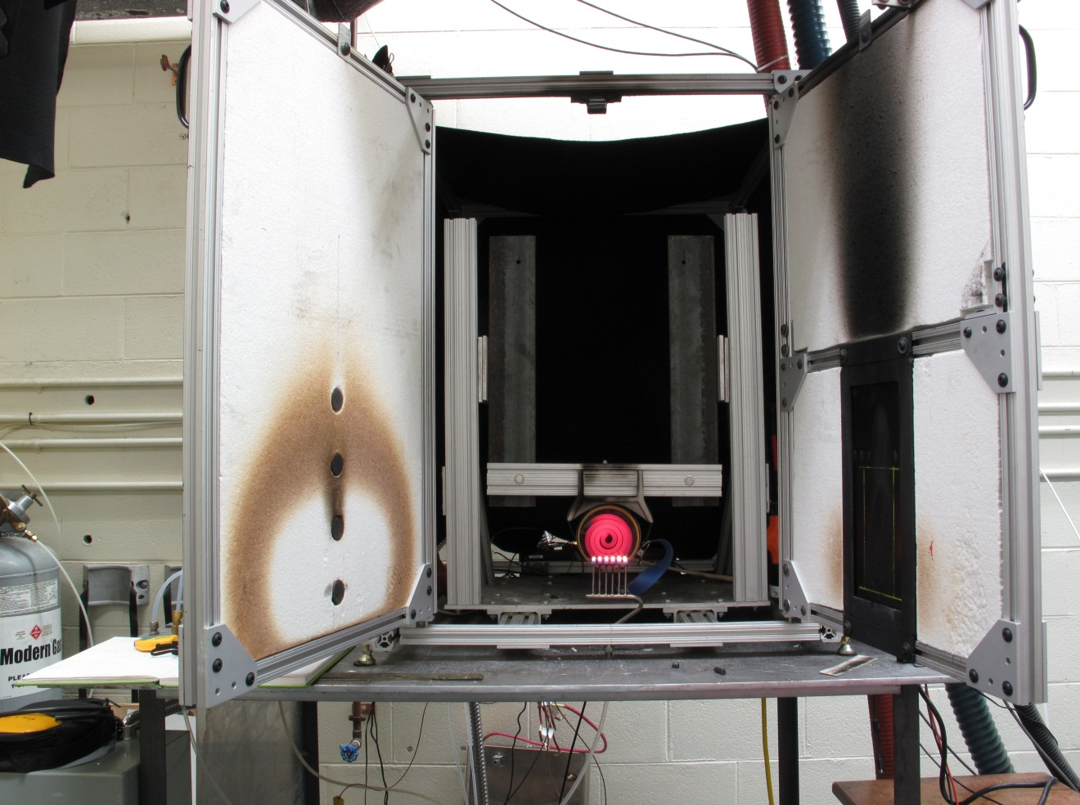
Recent Modifications
Furnace
6” x 12” sample holder
Schmidt-Boelter
Gauges
Pilot Burner

Slide 13
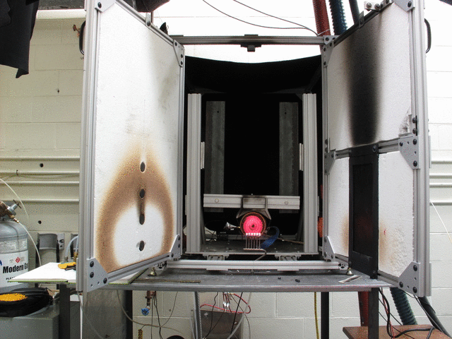
Recent Modifications

Slide 14
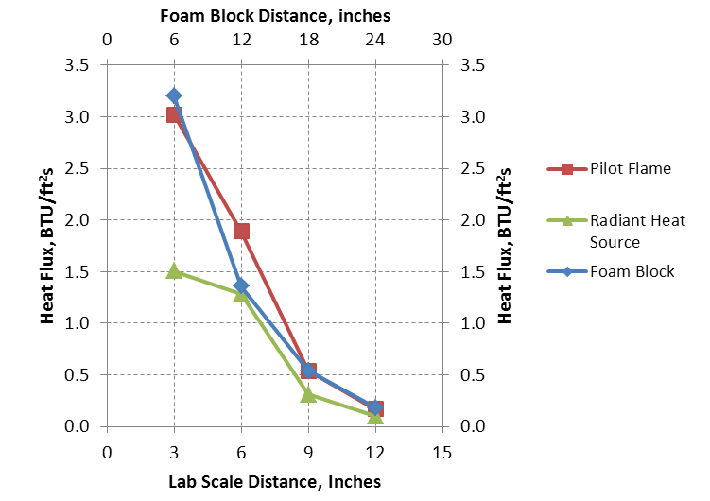
Measured Heat Flux

Slide 15
Recent Testing
Procedure
1 | Set Heat Flux Gradient, 5 minute average of each calorimeter
2 | Install Pilot Burner
3 | Install Sample
4 | Ignite Pilot Burner, set propane pressure and flow rate
5 | Swing away calorimeter door
6 | Swing in sample door, start timer
7 | Impinge flame and expose sample to radiant heat for 60 sec.
8 | At 60 sec., pilot burner is turned off, sample remains exposed to radiant heat and allowed to burn
9 | Test is terminated when flames extinguish, sample is removed and allowed to cool
10 | Once sample is cool, degreaser is used to wipe away sooted areas
11 | Burn length and width are measured, and after flame time is assessed from video

Slide 16


Slide 17
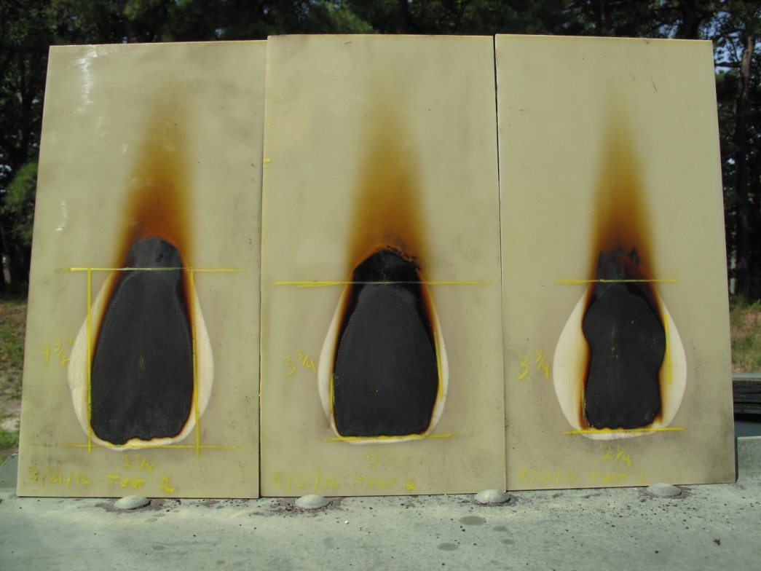
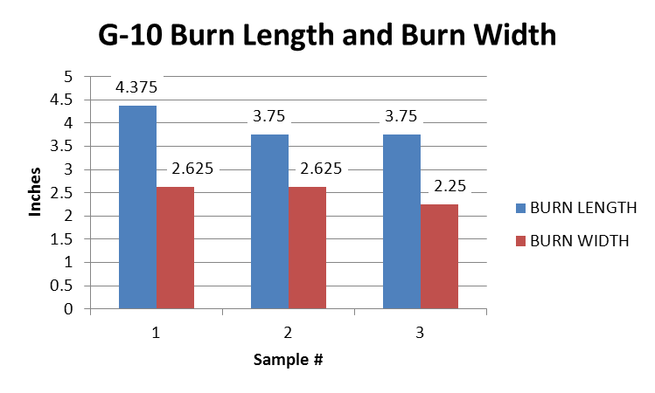
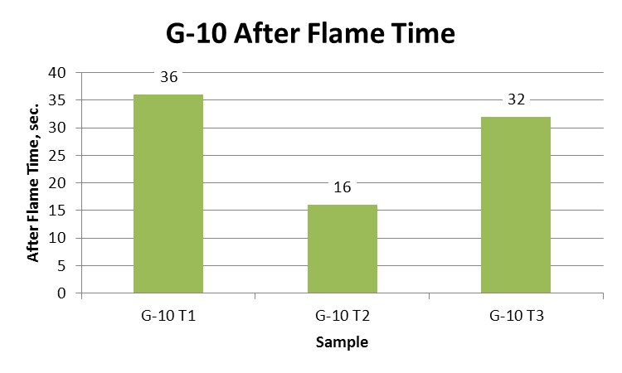
G-10 Glass Epoxy
BL_{avg}=3.95”
  %sd=9.11%
BW_{avg}=2.5”
  %sd=8.66%
AF_{avg}=28 sec.
  %sd=37.8%

Slide 18
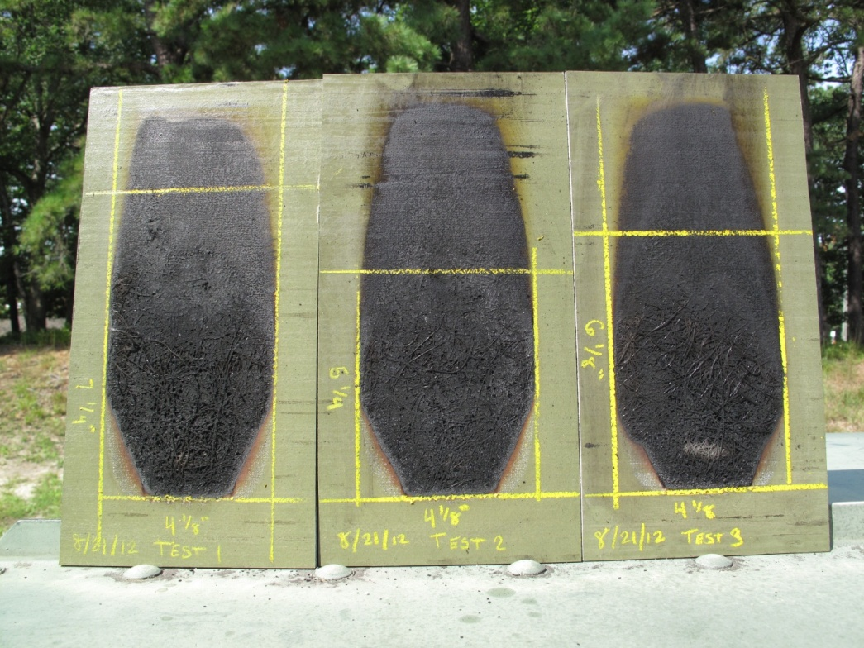
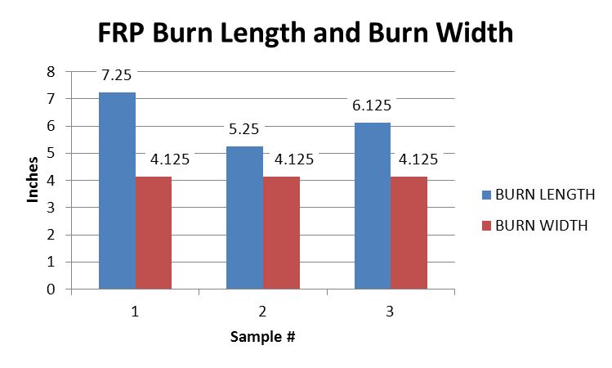
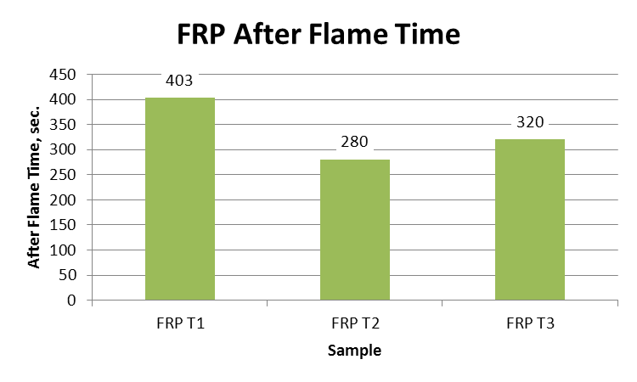
Fiber Reinforced Polyester
12”
6”
BL_{avg}=6.208”
  %sd=16.14%
BW_{avg}=4.125”
  %sd=0%
AF_{avg}=334.3 sec.
  %sd=18.75%

Slide 19
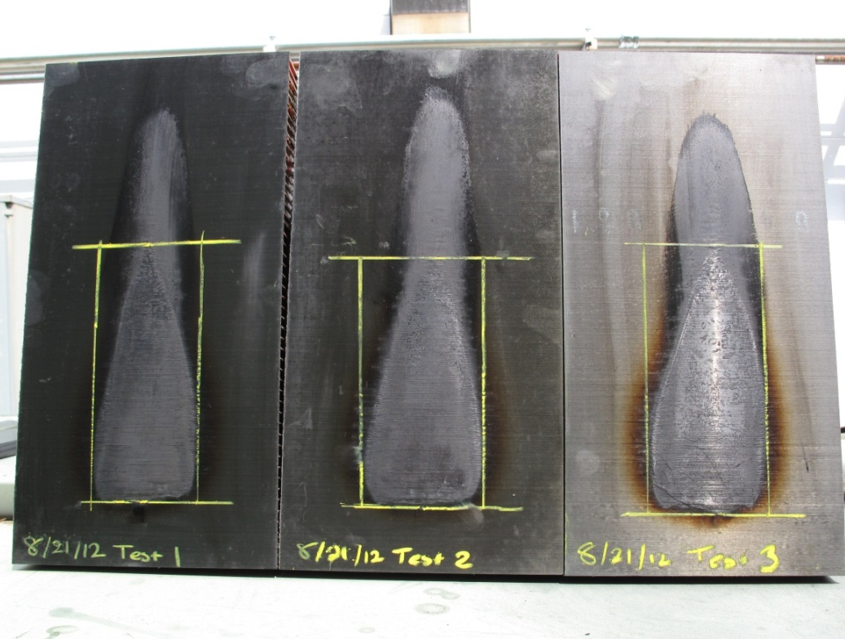
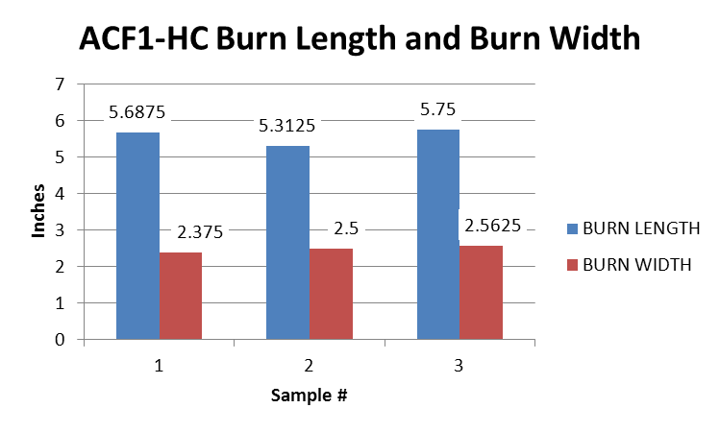
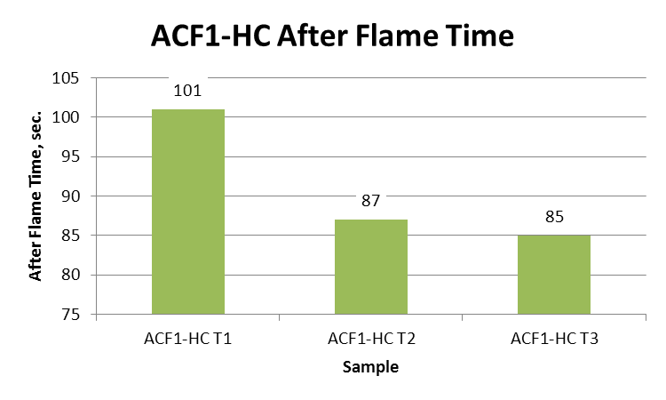
ACF1-HC
BL_{avg}=5.58”
  %sd=4.23%
BW_{avg}=2.48”
  %sd=3.85%
AF_{avg}=91 sec.
  %sd=9.57%

Slide 20
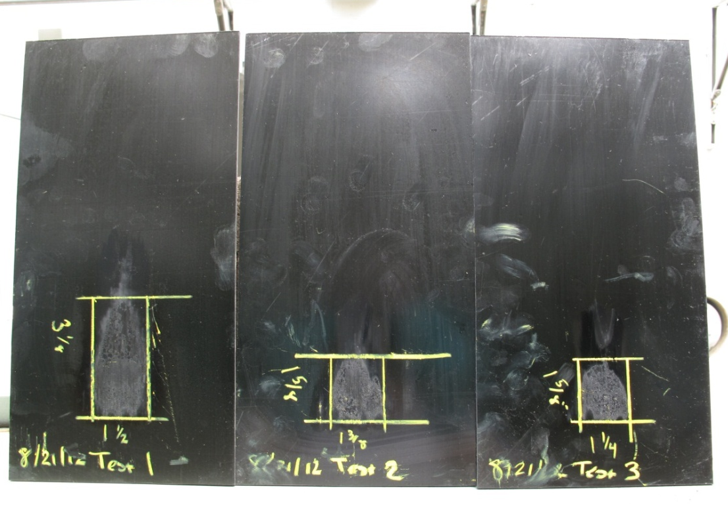
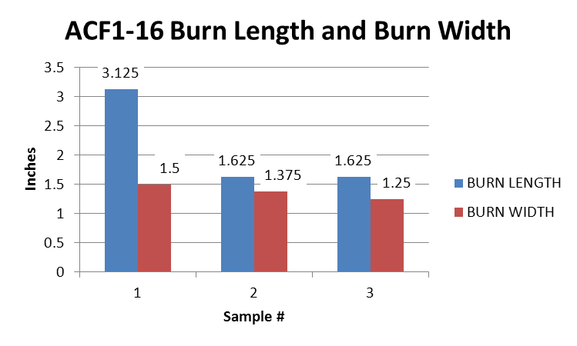
ACF1 16 ply
BL_{avg}=2.125”
  %sd=40.75%
BW_{avg}=1.375”
  %sd=9.09%
AF_{avg}=9.5 sec.
  %sd=126.53%

Slide 21
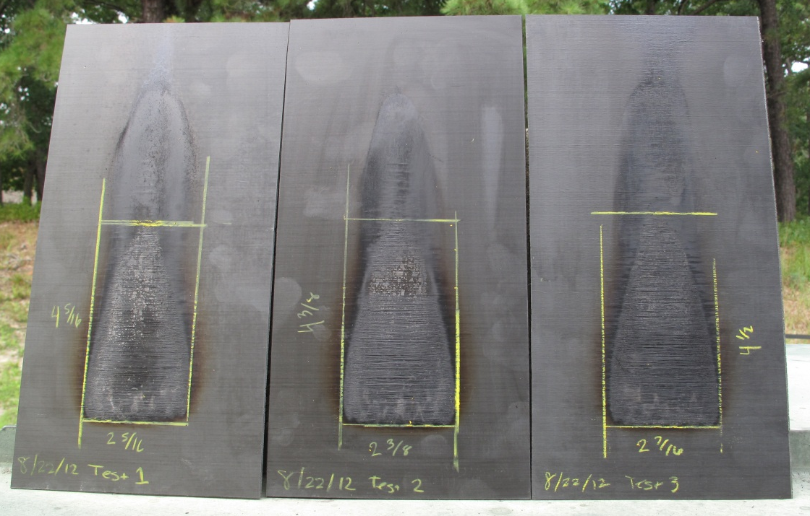
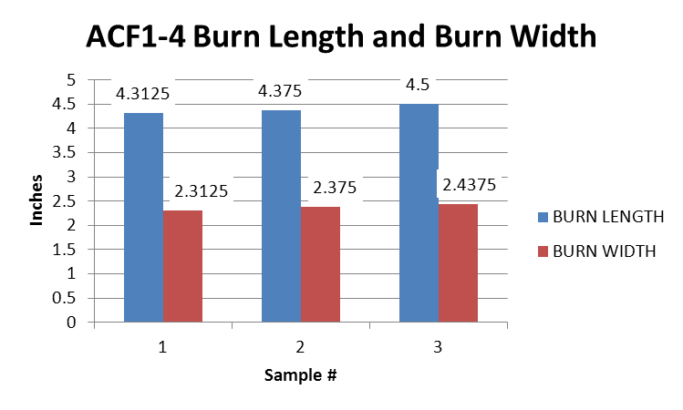
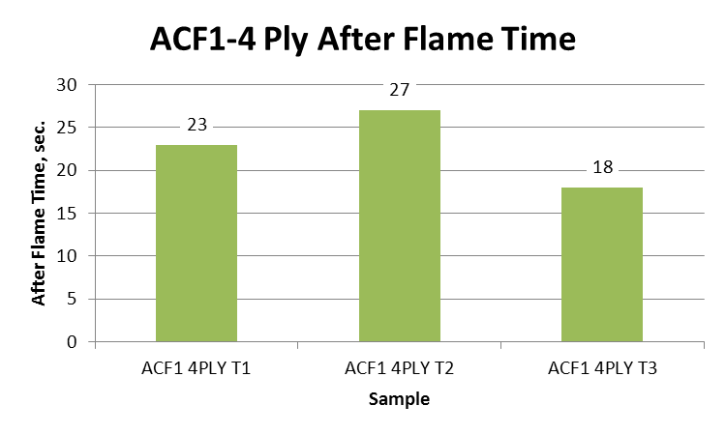
ACF1 4 ply
BL_{avg}=4.395”
  %sd=2.17%
BW_{avg}=2.375”
  %sd=2.63%
AF_{avg}=22.67 sec.
  %sd=19.89%

Slide 22
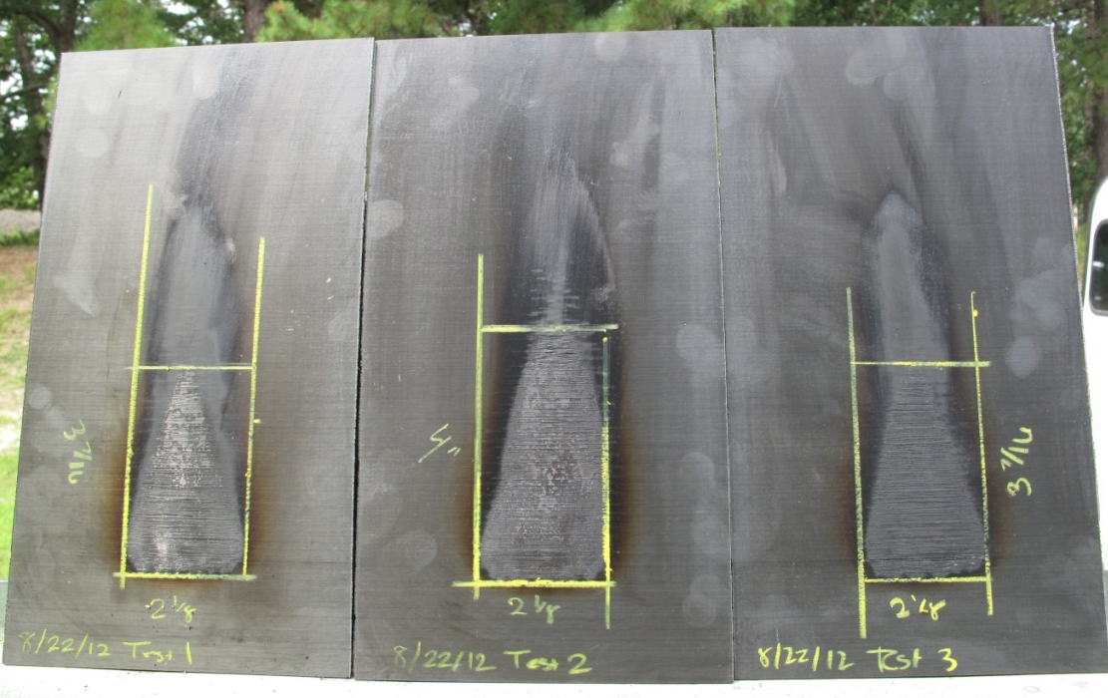
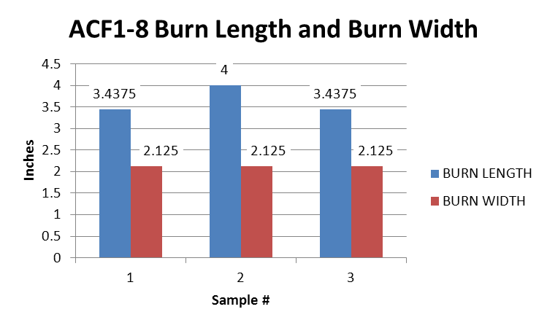
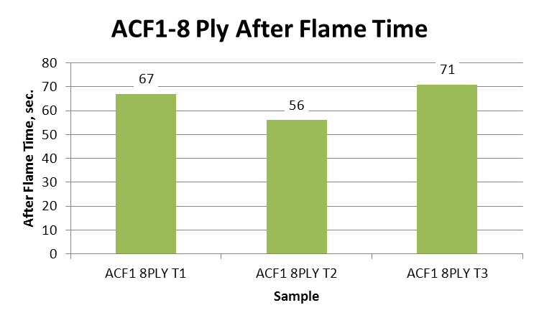
ACF1 8 ply
BL_{avg}=3.625”
  %sd=8.95%
BW_{avg}=2.125”
  %sd=0%
AF_{avg}=64.67 sec.
  %sd=12.011%

Slide 23
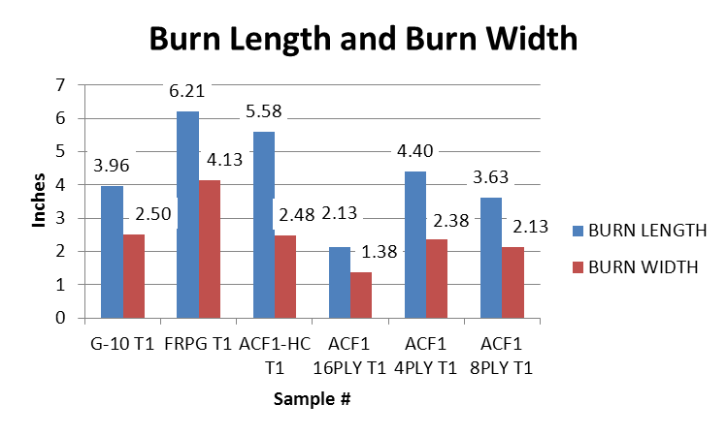
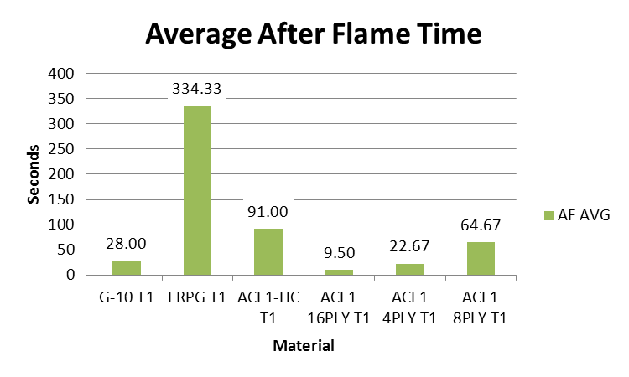
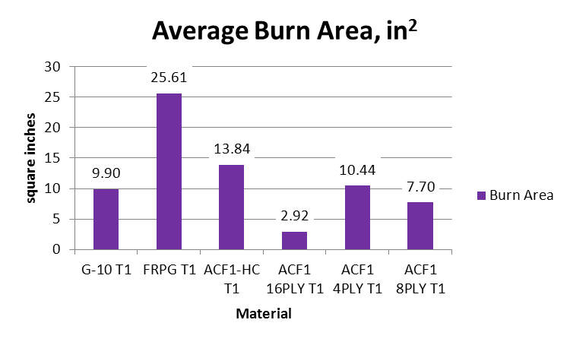
Average Results

Slide 24
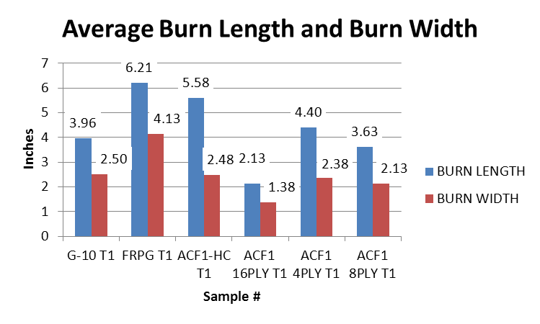
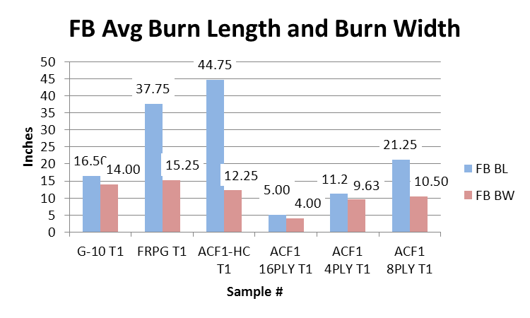
VRP vs. Foam Block Burn Length & Width

Slide 25
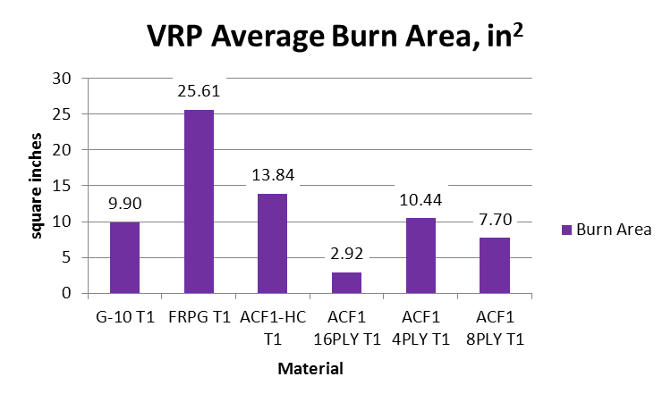
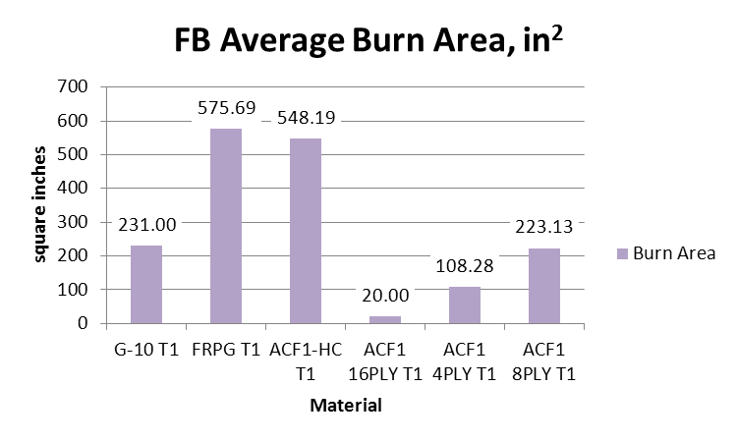
VRP vs. Foam Block Burn Area

Slide 26
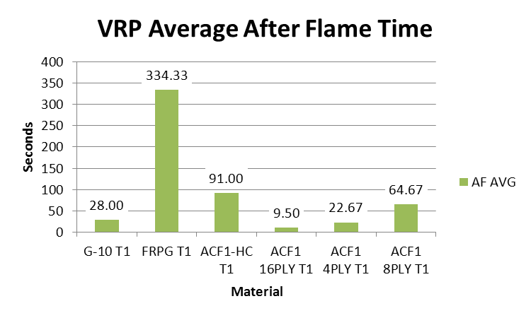
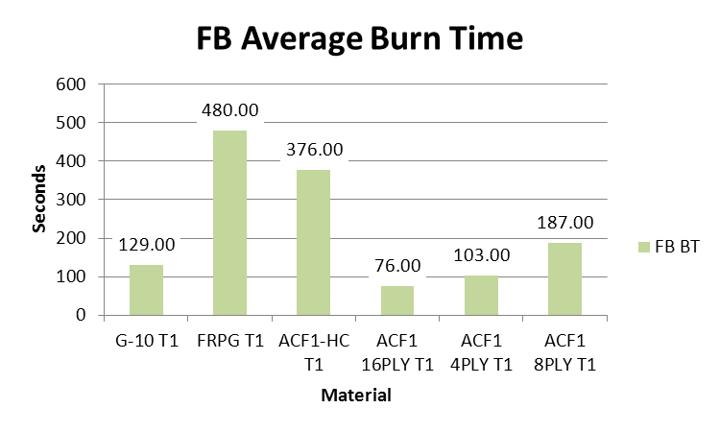
VRP vs. Foam Block Burn Time

Slide 27
Recent Testing – Summary
Fairly good repeatability was found for most sample sets
  Average %SD
    Burn Length: 13.56%
    Burn Width: 4.04%
    After Flame: 37.43%
  More tests need to be performed to standardize a procedure, environmental influences, etc.
Lab scale test results generally correlate with intermediate scale testing

Slide 28
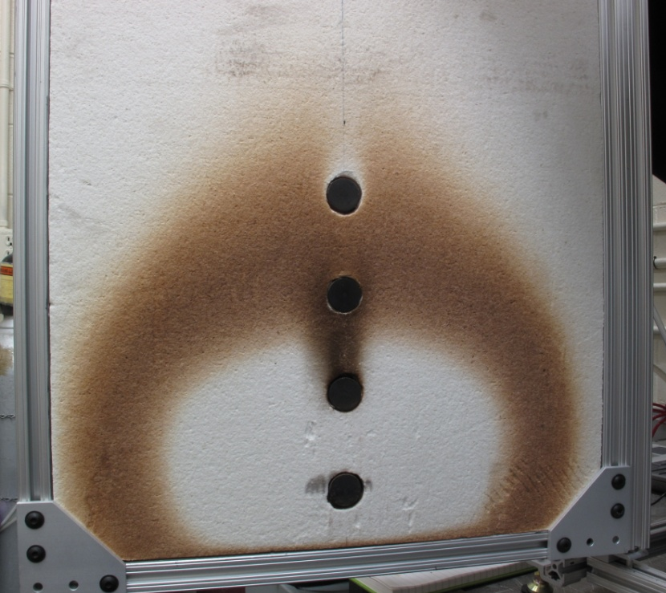
Effect of Drafts on Heat Flux
Three scenarios were tested to determine the effect of enclosing the apparatus on air drafts near the sample or heat flux gauge surfaces
  Baseline: Partially shrouded, no exhaust fans
  Partially shrouded, exhaust fans approximately 6’ above top of apparatus gently drafting air out of room
  Fully shrouded, no exhaust fans
SB4
SB3
SB2
SB1

Slide 29
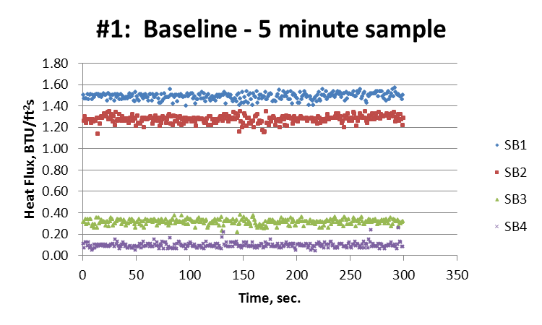
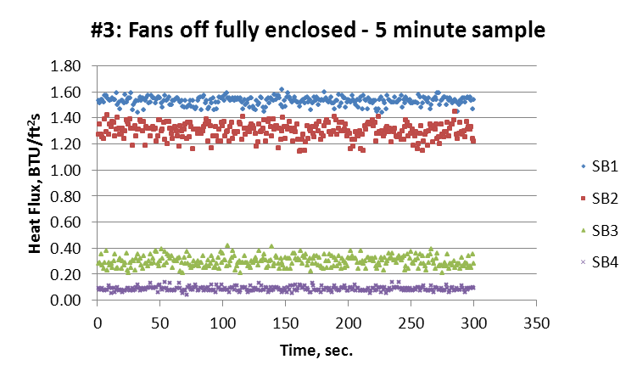
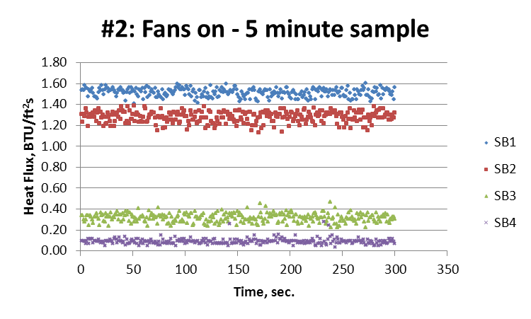
SB1
SB2
SB3
SB4
SB1
SB2
SB3
SB1
SB4
SB2
SB3
SB4

Slide 30
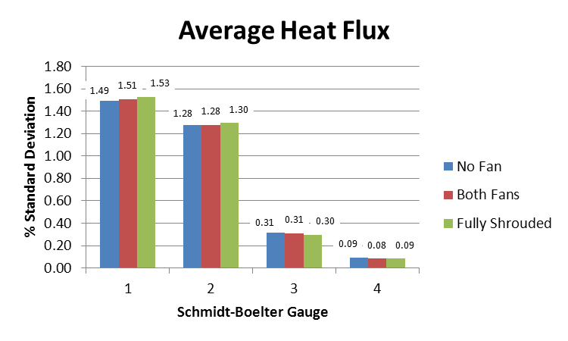
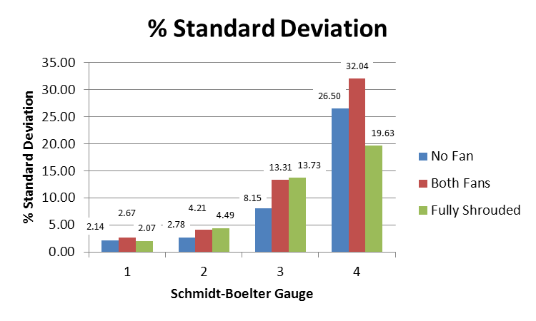

Slide 31
Heat Flux Fluctuations
Bottom 2 flux gauges have less relative fluctuation than the top 2
The average measured values at each SB gauge changed little from test to test
Burn tests can be performed to determine the actual effect on test results
The final design will specify how to enclose the apparatus to standardize air currents and fluctuations

Slide 32
Next Steps
Furnace comparison
  Spiral tubular heating elements were ordered from different manufacturers to determine the difference in measured heat output at the same power settings, distance
Calibration
  Determine if specification of power (voltage, current), distance from heat flux gauge, and furnace specifications will adequately represent the desired incident flux
    Removing HFG from calibration procedure would reduce cost of running test and eliminate uncertainty of calibration and use of HFG
  Mapping of furnace with HFG on a traverse
    Monitor input voltage and current while traversing SB gauge to map heat flux vs. input power, distance
    Determine repeatability
      Different day
      Different furnace

Slide 33
Next Steps cont.
Version 2.0
  Once design and test parameters are confirmed, perform repeatability testing
    Will be receiving large quantity of 6” x 12” carbon fiber composite samples of varying ply thicknesses, layups, fibers, and epoxies
  Construct one or more units
    Perform comparative testing on multiple units to determine reproducibility

Slide 34
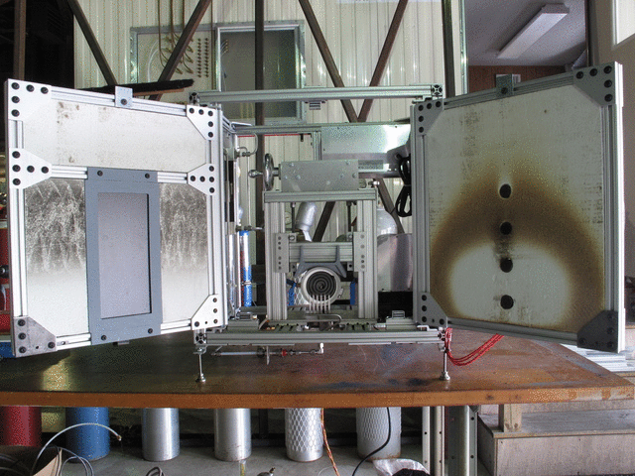
Version 2.0

Slide 35
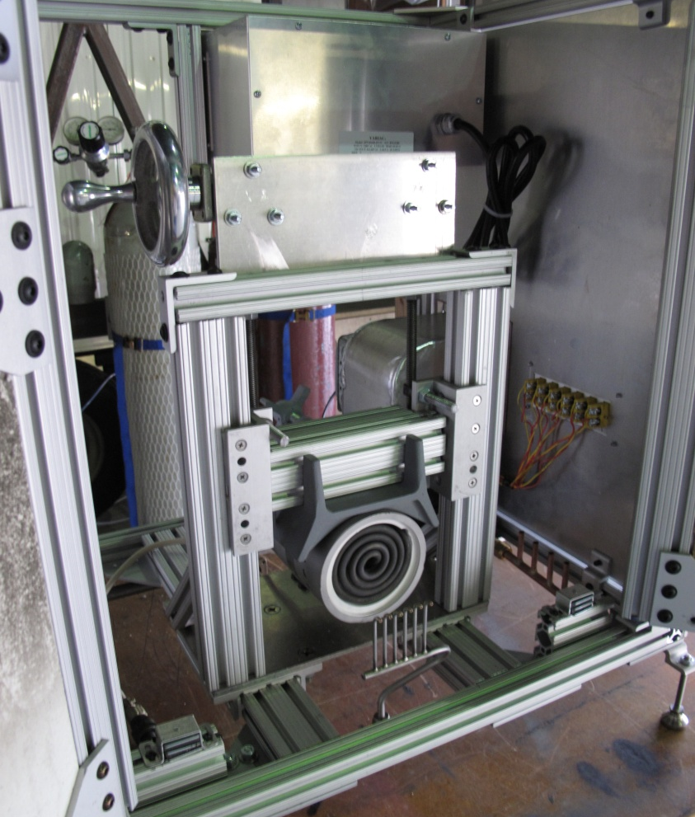
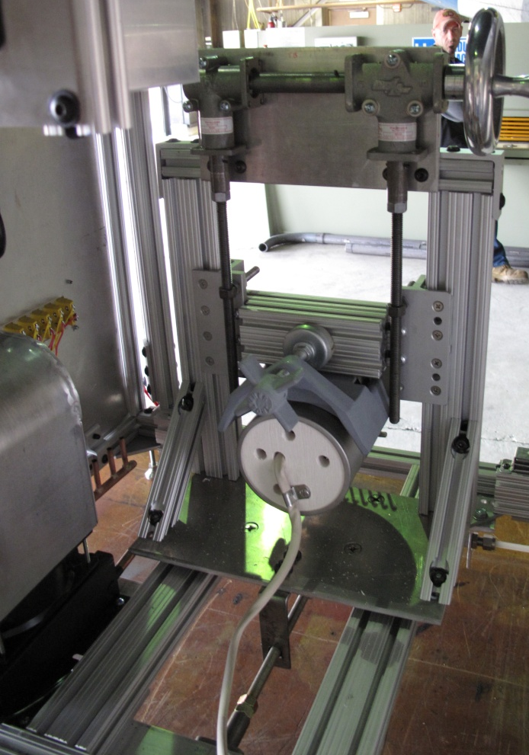
Version 2.0
Furnace height adjustment
Furnace distance adjustment

Slide 36
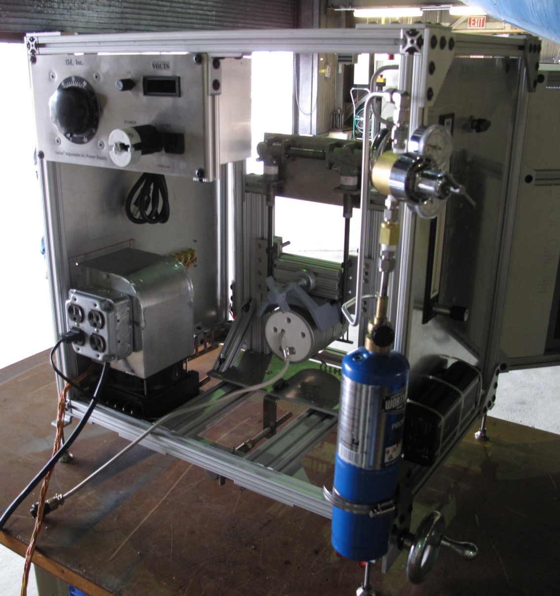
Version 2.0
Variable AC Transformer
Pilot burner gas
on/off valve
Propane gas
pressure regulator
Propane gas flow meter
Cooling fan for SB gauge water
Propane gas for
Pilot burner
Furnace distance adjustment

Slide 37
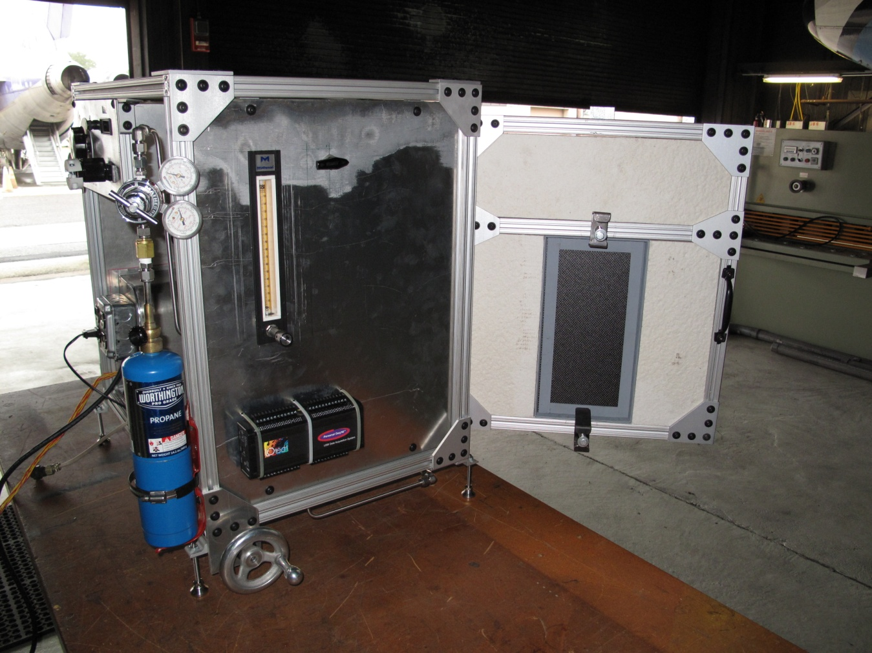
Version 2.0
Propane gas
pressure regulator
Pilot burner gas
on/off valve
Variable AC Transformer
Propane gas flow meter
Propane gas for
Pilot burner
Furnace distance adjustment

