Slide 1
Flow Visualization in the OSU
IAMFTFM
Tina Emami
March 5-6, 2019

Slide 2
Airflow Project Goals
Create an adjustment to the current OSU apparatus in order to create an even and reproducible air flow.

Slide 3
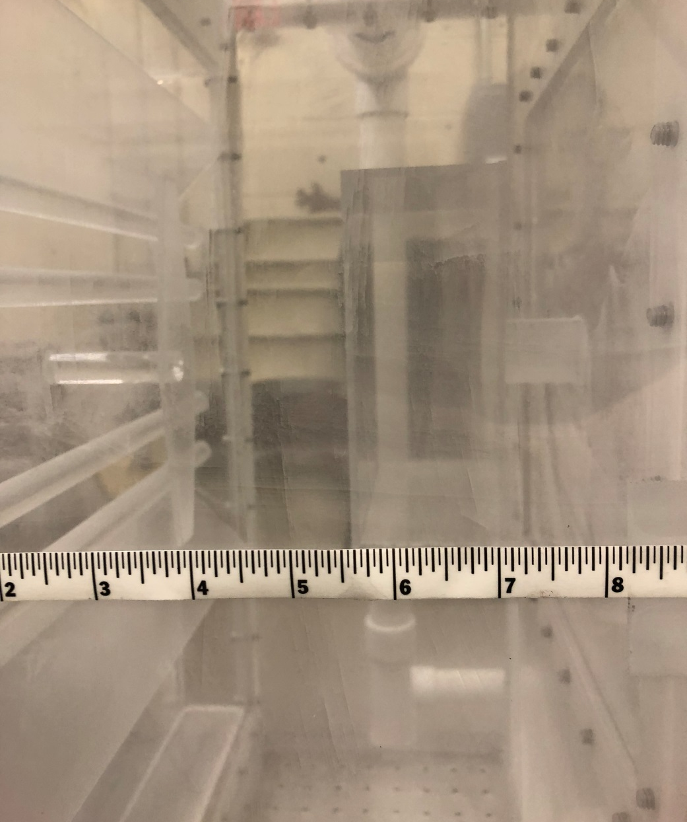
Measurement Location

Slide 4
Measurement Location
The PIV camera is aligned to view the flow between the middle two glow bars

Slide 5
New Test Setup
Air inlet was moved back to side inlet location
PVC tube with two rows of evenly spaced 5/8” holes 45° from horizontal was constructed
Cap is glued to the end of the tube
Tube is placed in the bottom chamber of the OSU
Holes will be oriented to face downwards in order to more evenly mix the flow

Slide 6
New Test Setup

Slide 7
5/8- inch Holes in Air Distribution Tube
Air
Inlet

Slide 8
Preliminary Measurements
While the unit is cold, air velocity was measured in the OSU with an anemometer
Right:
0 m/s
Center:
0.32-0.40 m/s
Left:
0.44 m/s
Air
Inlet

Slide 9
Preliminary Measurements
While the unit is cold, pressure was measured in the OSU with digital manometer
120 Hole Plate
Interspace Area:
0.4 inch WC
0.0144 Psi
8 Hole Plate
Lower Plenum:
10.8 inch WC
0.389 Psi

Slide 10
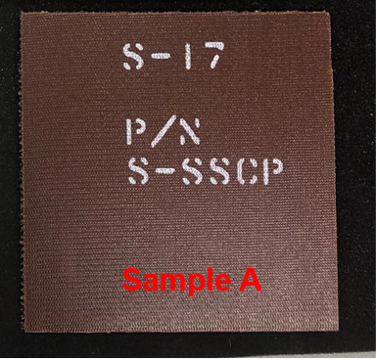
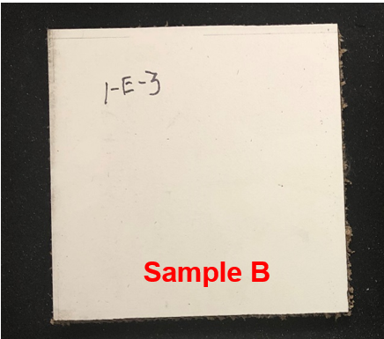
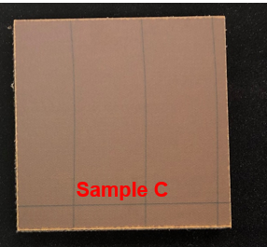
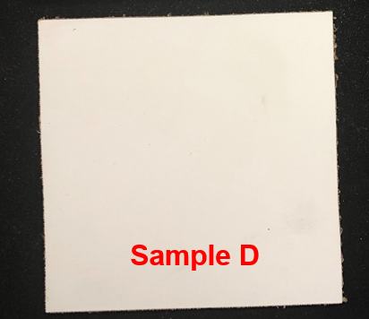
Preliminary Tests in the OSU
Four different honeycomb samples were tested in the OSU for comparative purposes
Each sample was tested five times
Sample | Thickness
Sample A | 1/8 in
Sample B | 11/16 in, white decorative
Sample C | 7/8 in
Sample D | 1/4 in, white decorative

Slide 11
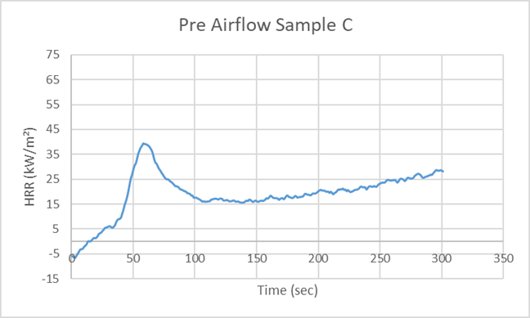
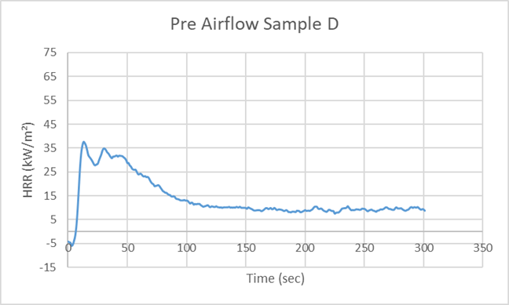
Preliminary Tests in the OSU Baseline Test Results: Average of 5 Tests Shown Per Sample; No Changes Have Been Done to the Original OSU Setup Yet

Slide 12
Drawing of new setup

Slide 13
Animation of New Setup

Slide 14
Conclusion
New setup shows an even distribution of air flow in front of the sample face.
Will test materials in a hot OSU to understand how this setup affects the burning of samples

Slide 15
Questions or Comments?
Tina Emami
FAA William J. Hughes Technical Center
ANG-E212 Materials Fire Test
Building 275
Atlantic City Int’l Airport, NJ 08405
Tina.Emami@faa.gov
609-485-4277

