Slide 1
PIV in the OSU by RIO, PHD

Slide 2
Introduction
FAA’s PIV system was set up around an OSU rate of heat release apparatus
PIV is a non-intrusive, whole flow field velocity measurement technique

Slide 3
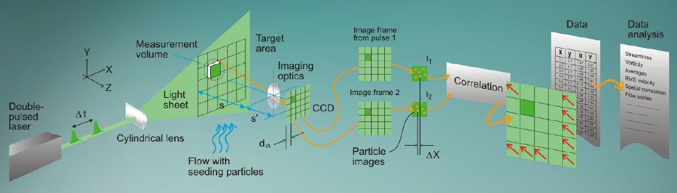
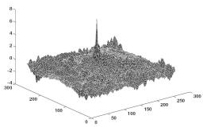
Particle Image Velocimetry
*From www.dantecdynamics.com
Peak Detection
Cross-Correlation

Slide 4
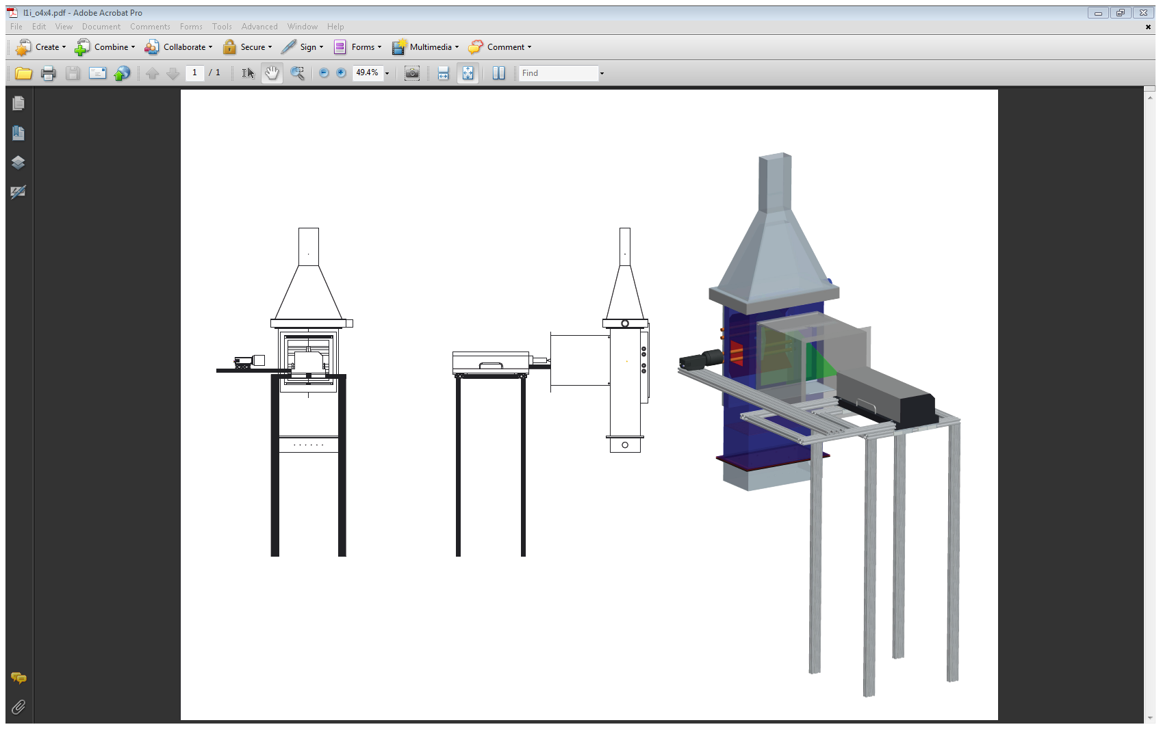
Setup
OSU
Measurement Plane
Camera
Laser

Slide 5
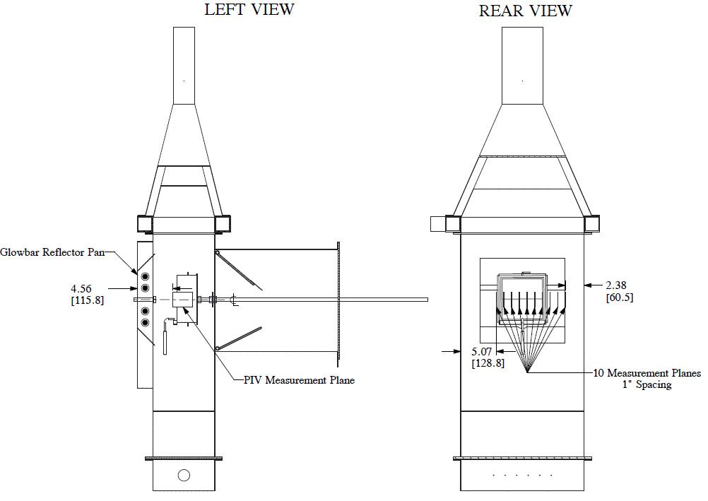
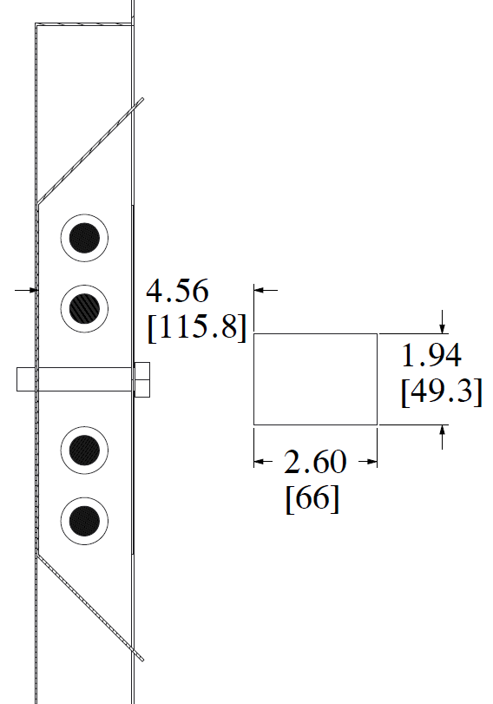
Setup
PIV Measurement Area
2.60” wide x 1.94” high

Slide 6
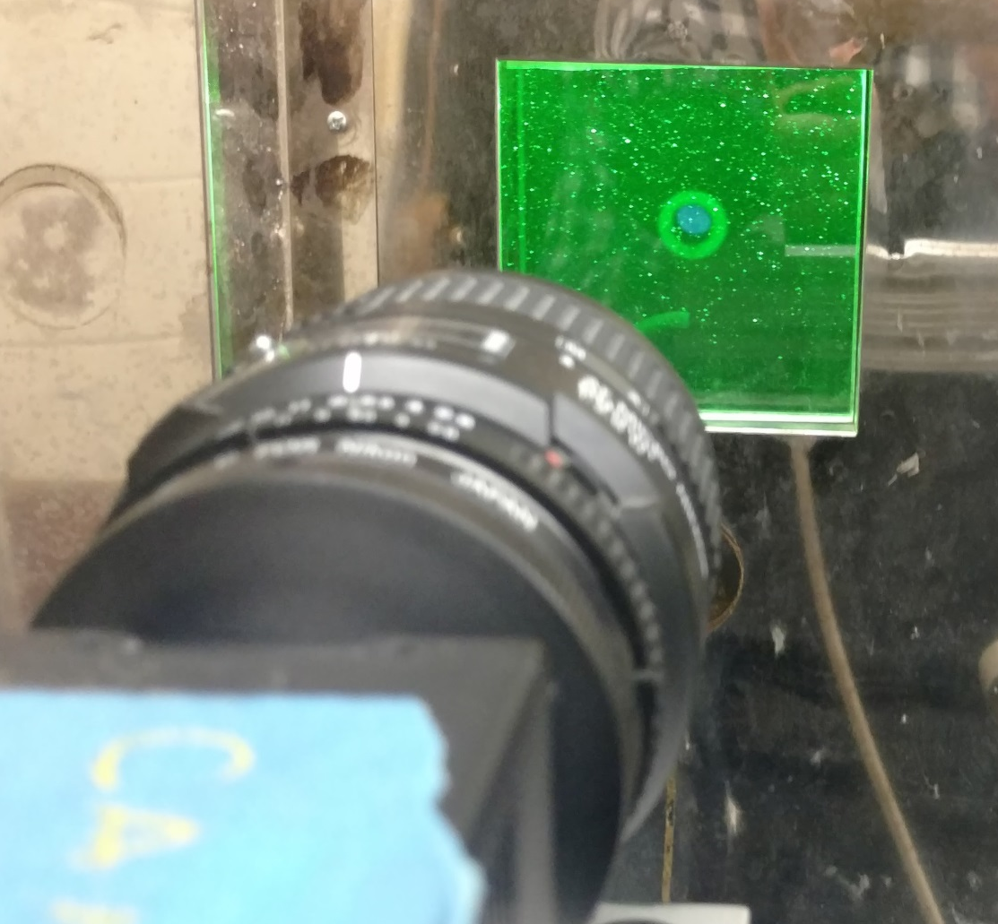

Slide 7
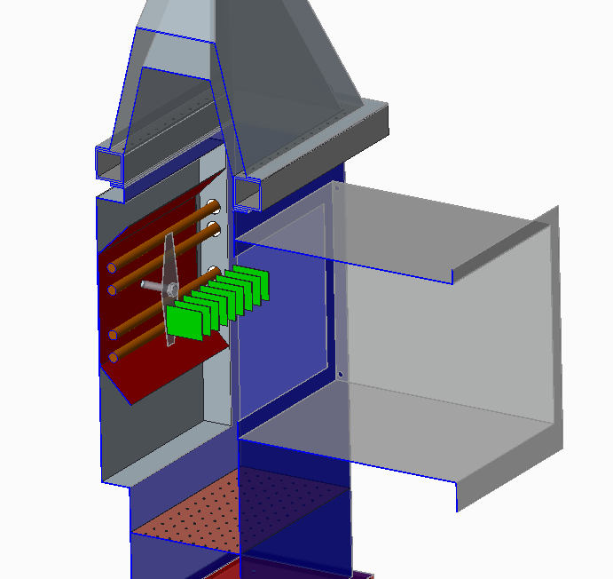
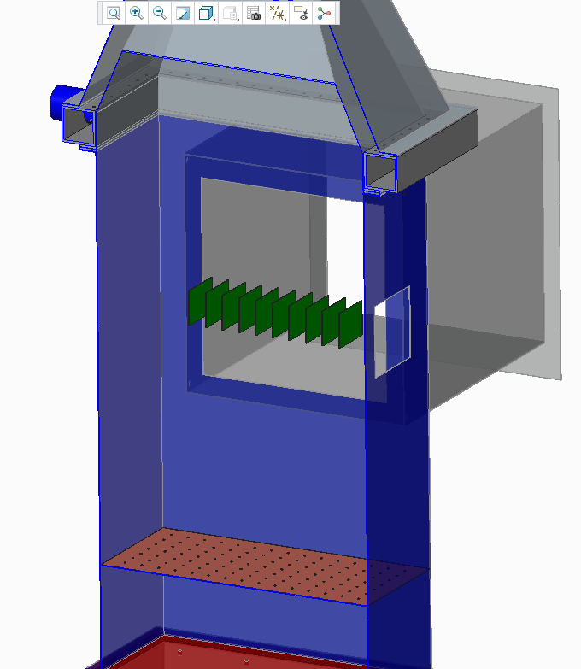

Slide 8
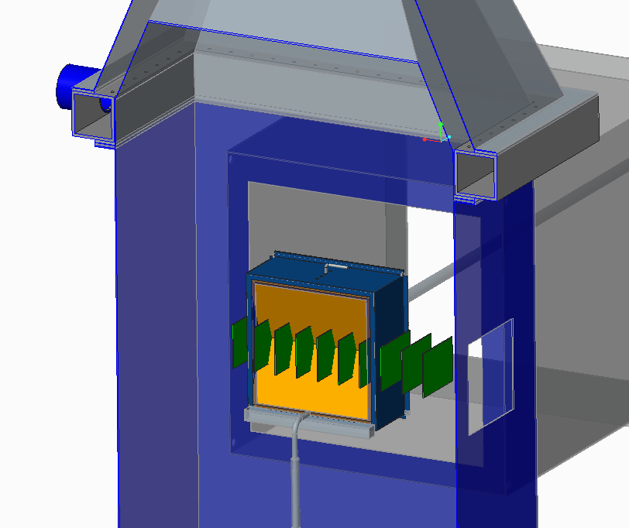

Slide 9
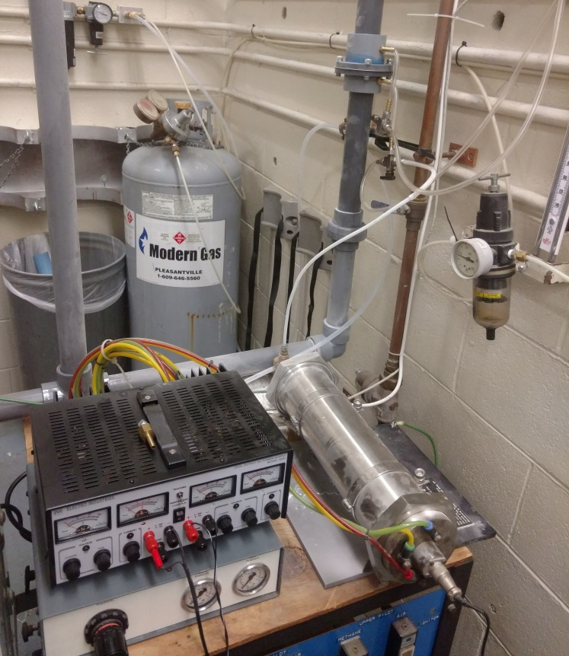
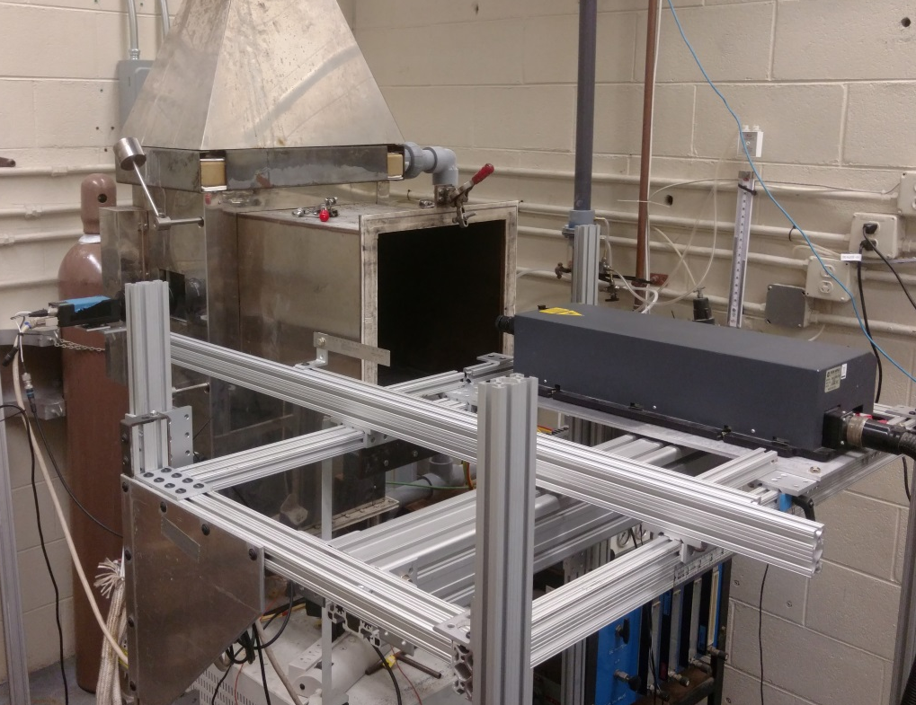
Orifice Plate
Low Pressure Tap
Camera
PIV Laser
Seeder
Aluminum Oxide Powder
500# ≈ 35 micron

Slide 10
PIV Measurement Details
Acquisition Settings
  Time between pulses
    300 μs
  Trigger rate
    15 Hz
  Number of Images
    500
  Time domain
    33.3 seconds
Analysis Settings
  64 x 64 Interrogation Area
  50% Overlap
  Peak Validation 1.2 relative to nearest peak
  Moving Average local neighborhood validation
Resulting Vector Map
  49 x 36 vectors
  1764 total vectors per measurement area

Slide 11
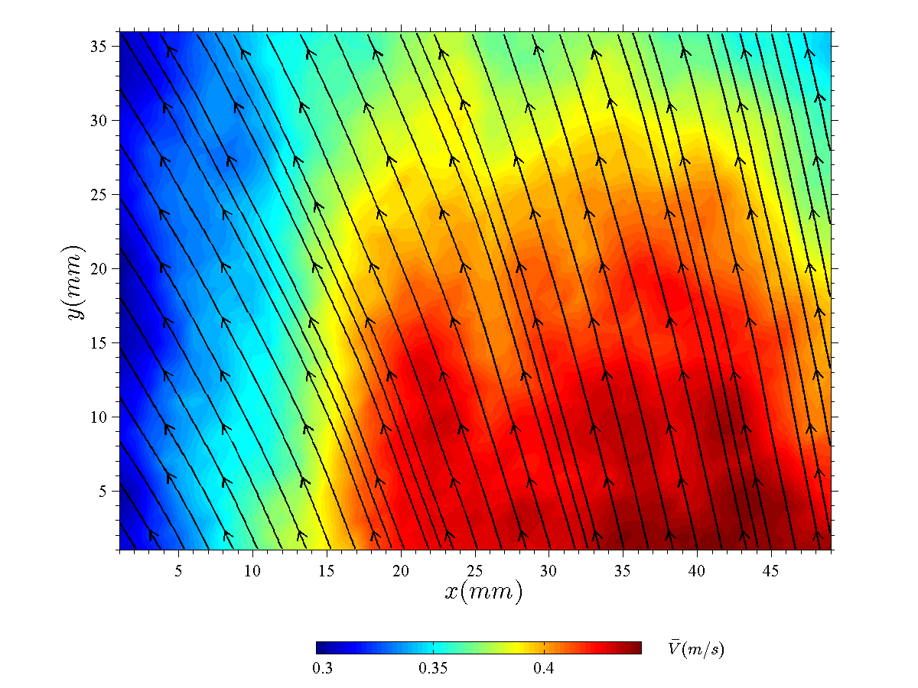
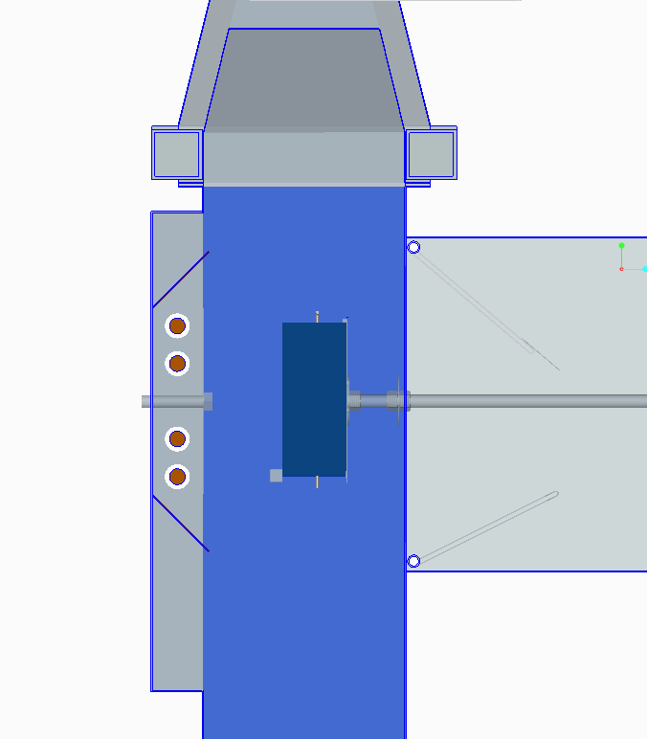
Glowbar Side
7/8” from left wall
Sample Side

Slide 12
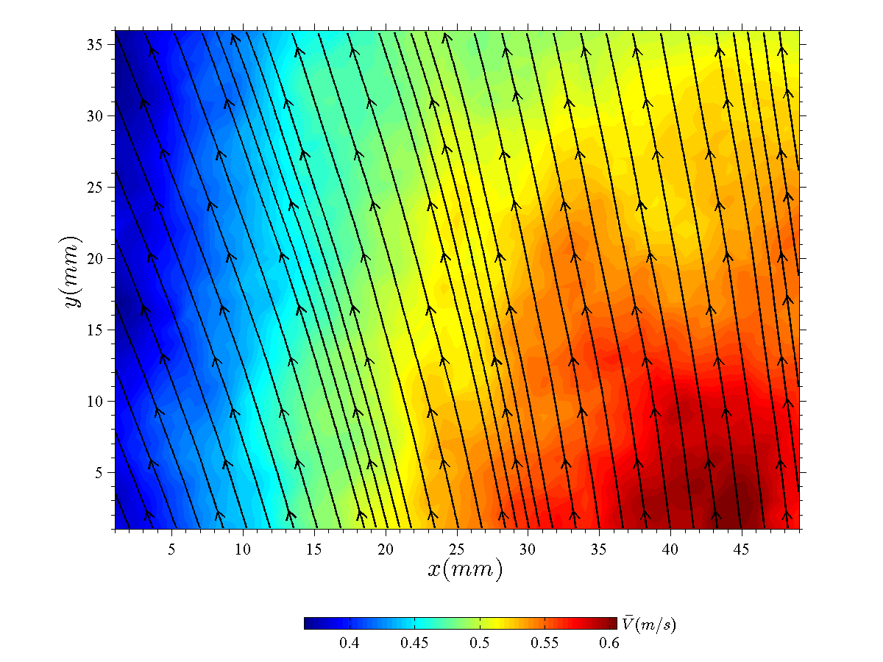
Glowbar Side
1 7/8” from left wall
Sample Side

Slide 13
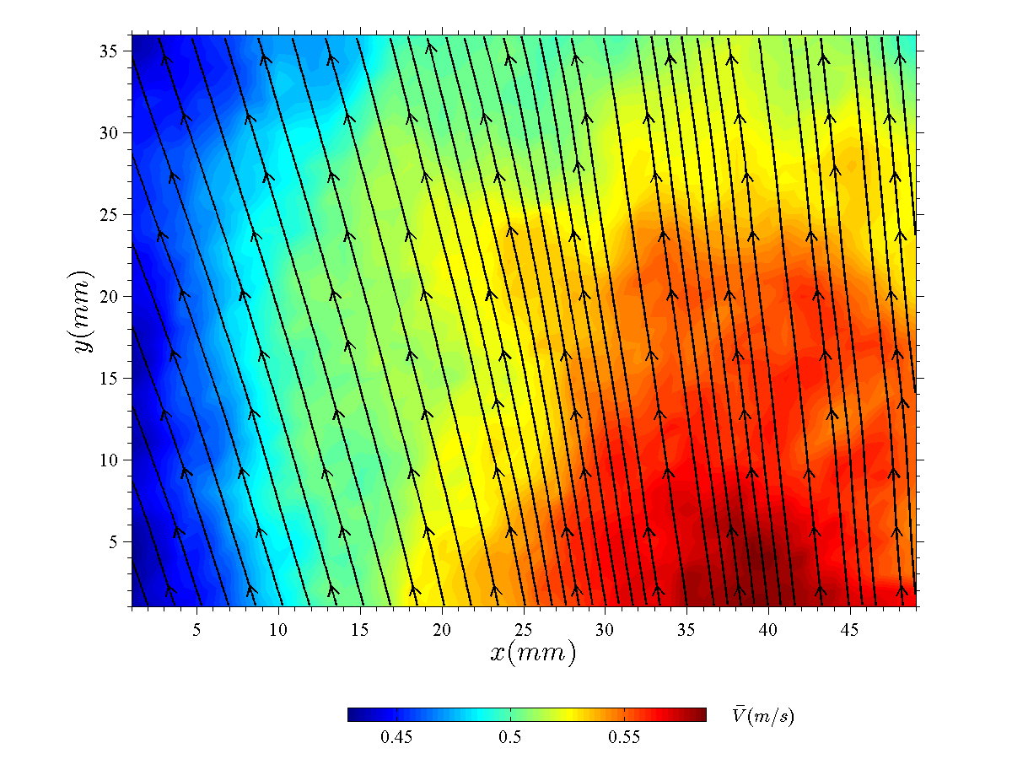
Glowbar Side
2 7/8” from left wall
Sample Side

Slide 14
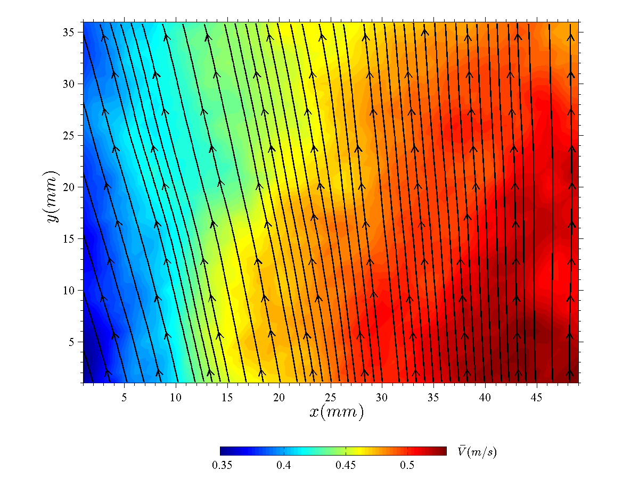
Glowbar Side
3 7/8” from left wall
Sample Side

Slide 15
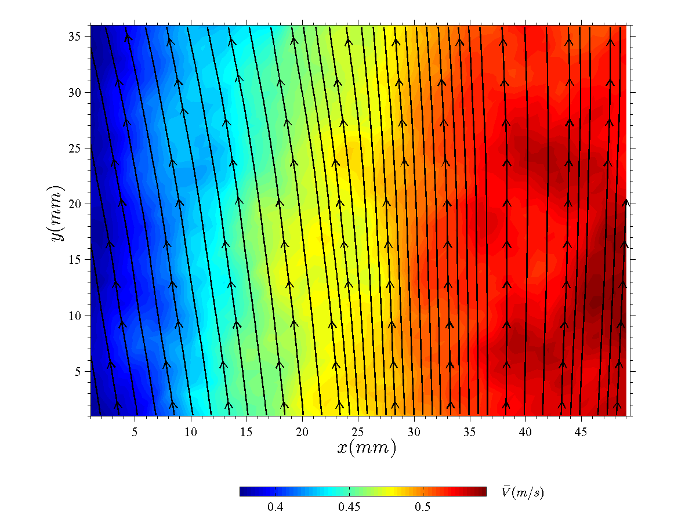
Glowbar Side
4 7/8” from left wall
Sample Side

Slide 16
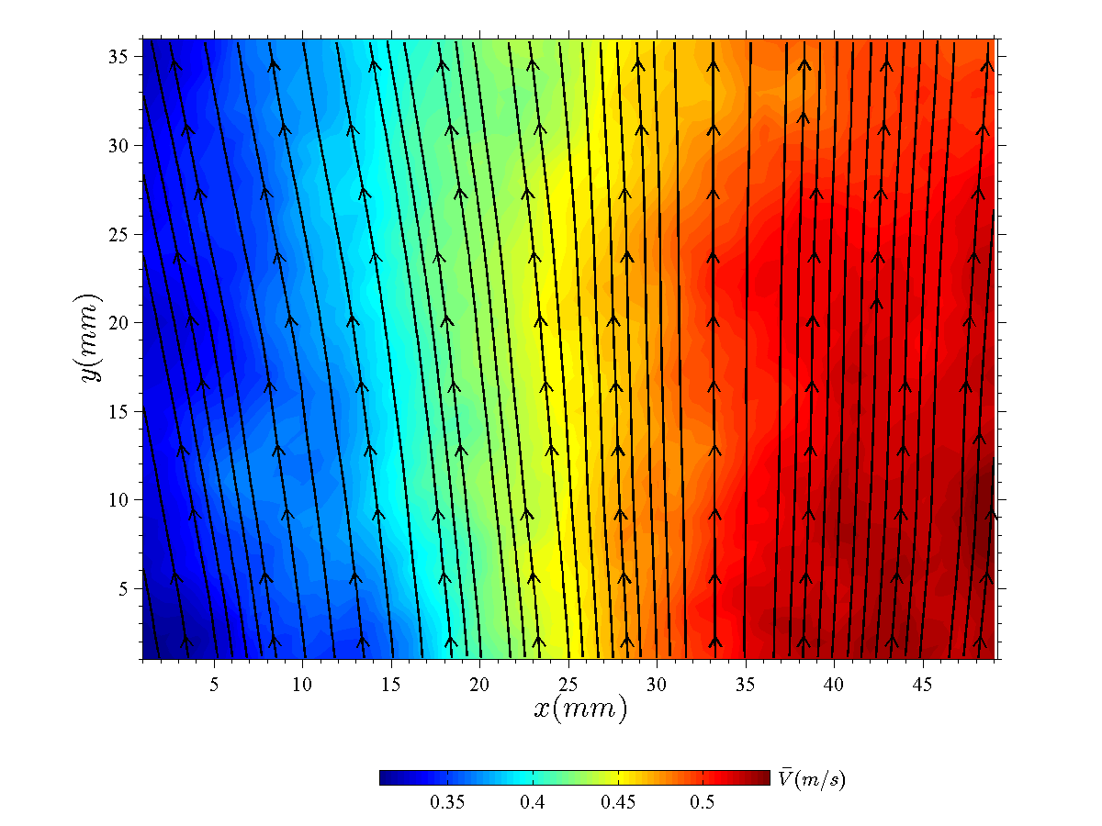
Glowbar Side
5 7/8” from left wall
Sample Side

Slide 17
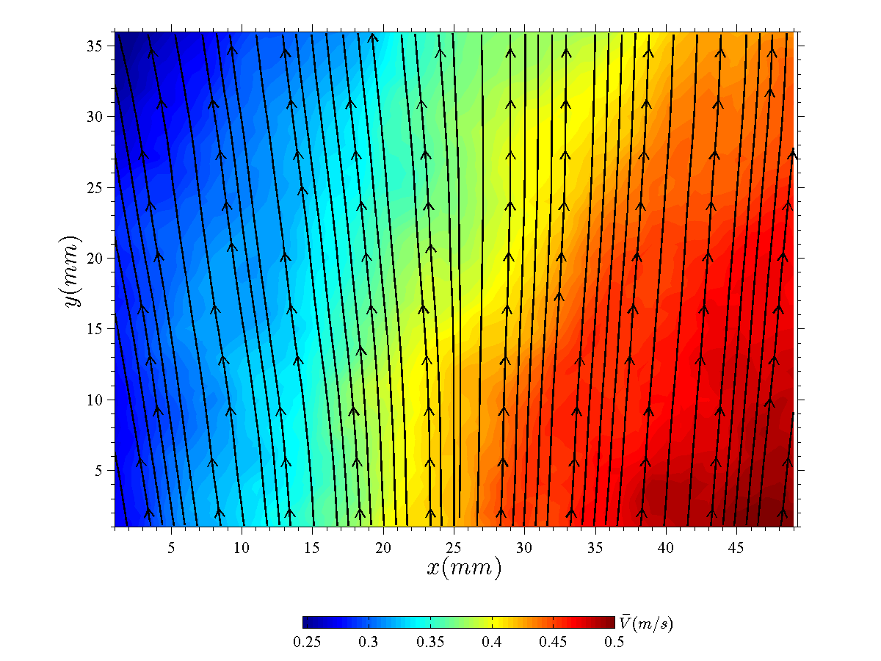
Glowbar Side
6 7/8” from left wall
Sample Side

Slide 18
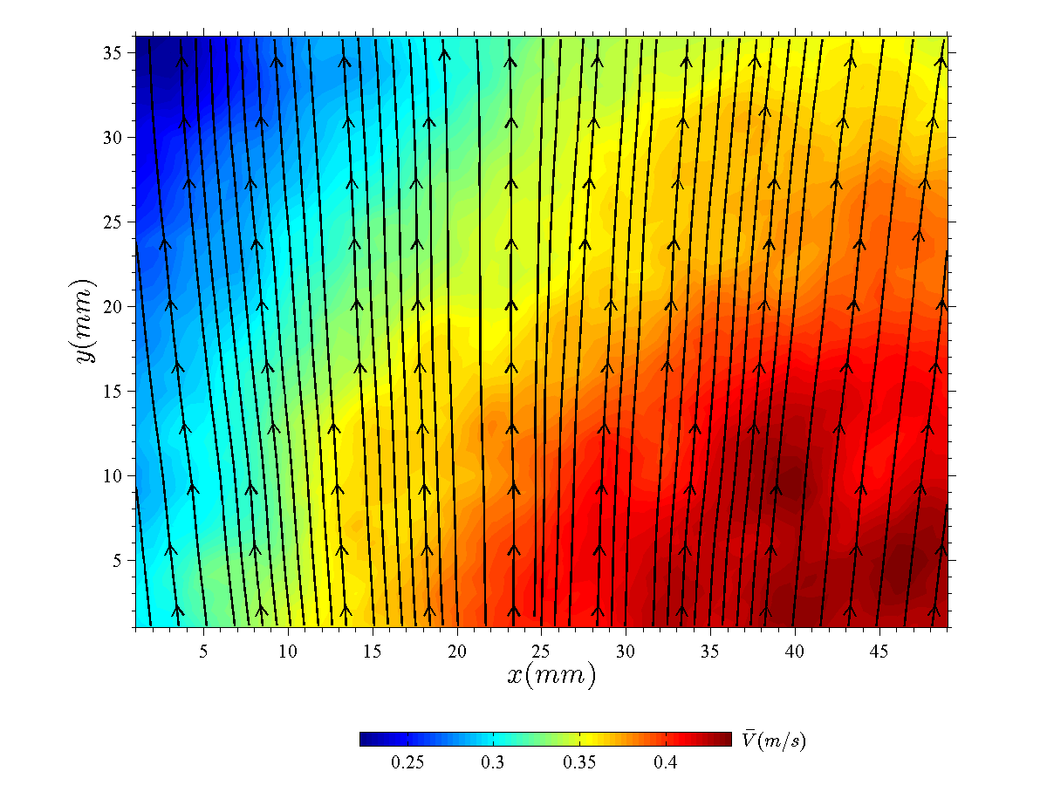
Glowbar Side
7 7/8” from left wall
Sample Side

Slide 19
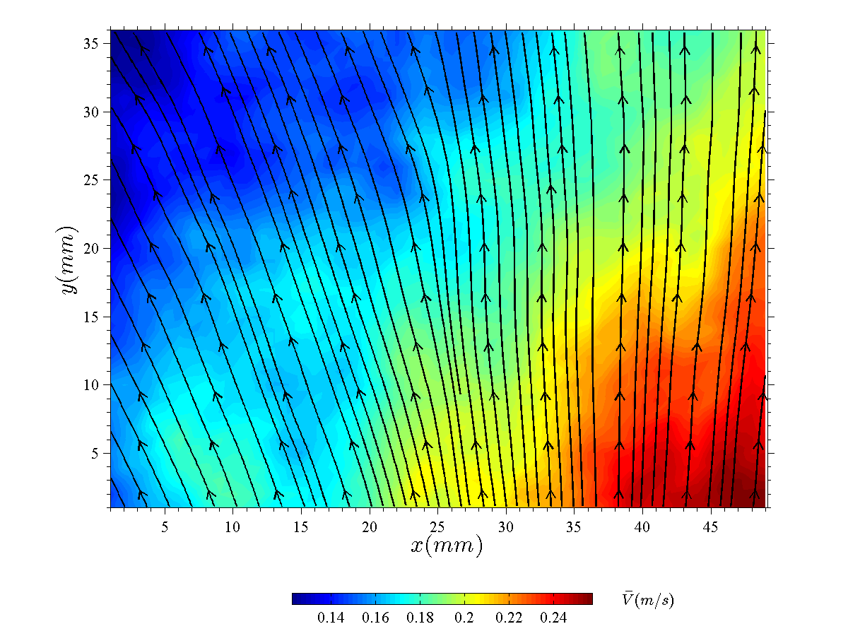
Glowbar Side
8 7/8” from left wall
Sample Side

Slide 20
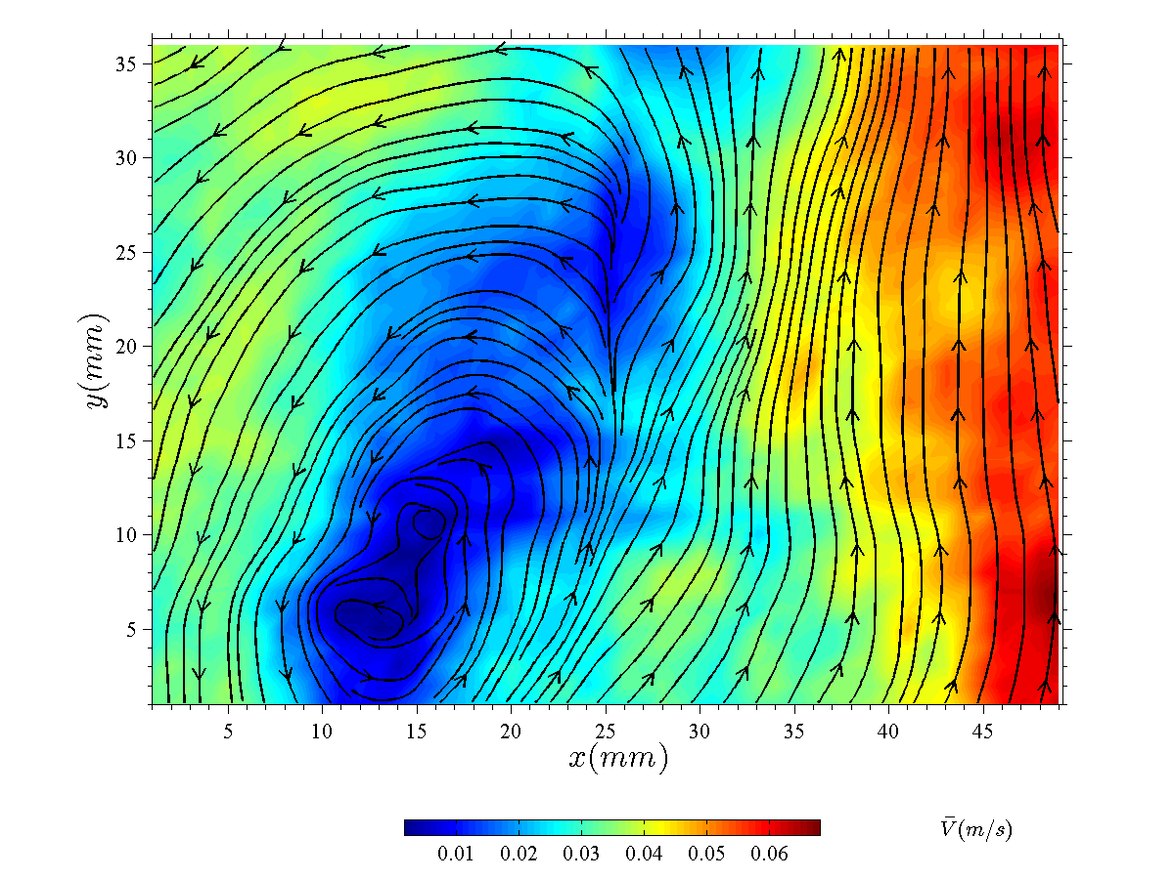
Glowbar Side
9 7/8” from left wall
Sample Side

Slide 21
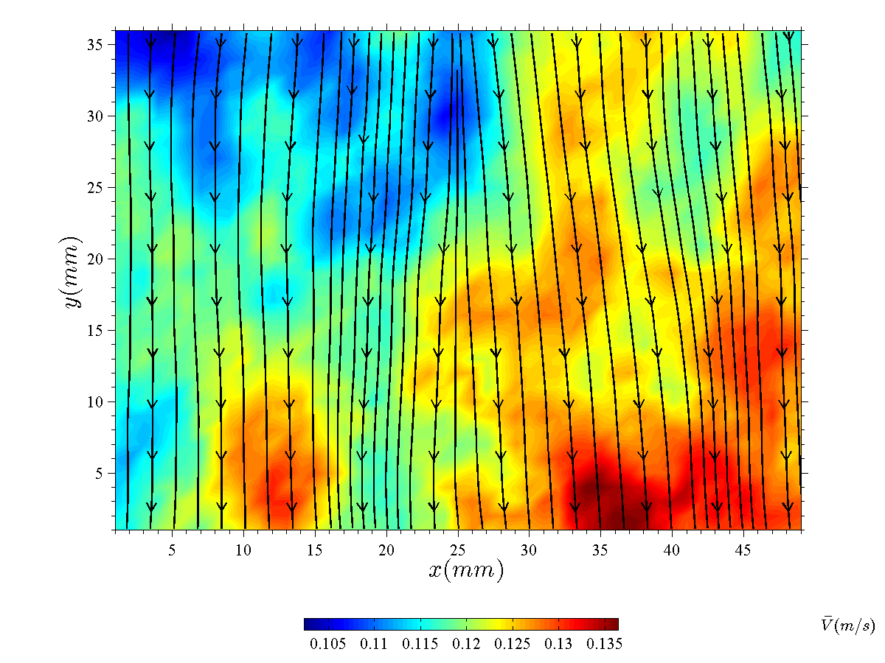
Glowbar Side
10 3/8” from left wall
Sample Side

Slide 22
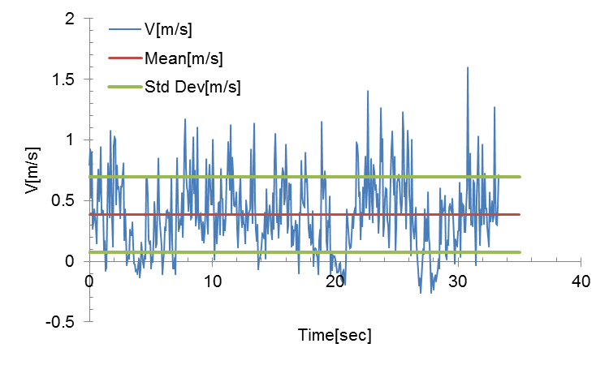
7/8” from left wall
Mean V Velocity = 0.385 m/s
Std Dev = 0.313
%Std Dev = 81%

Slide 23
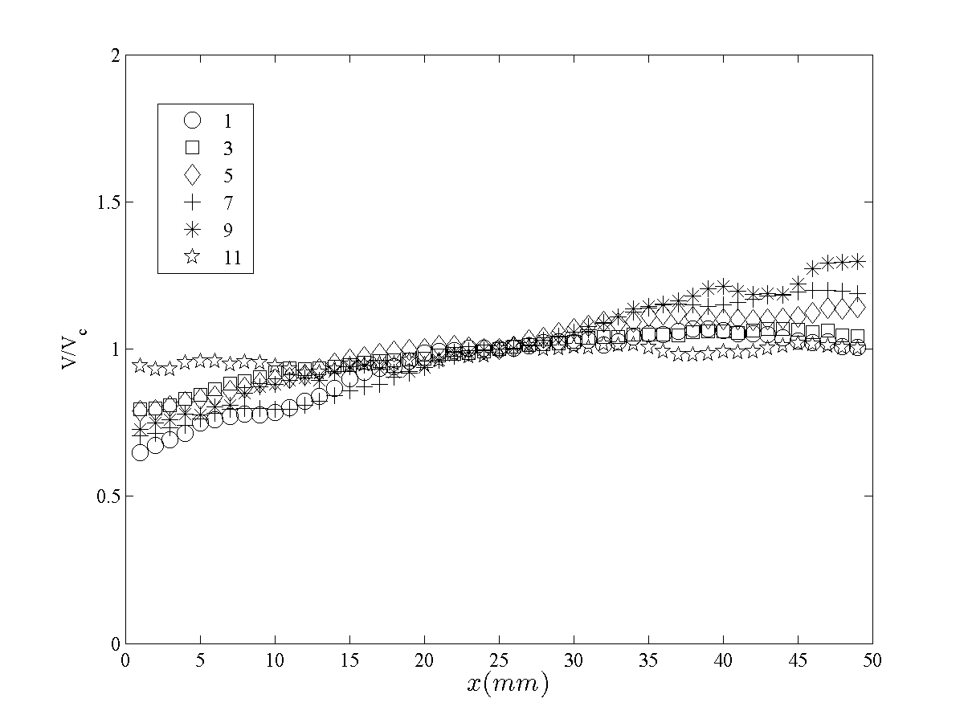
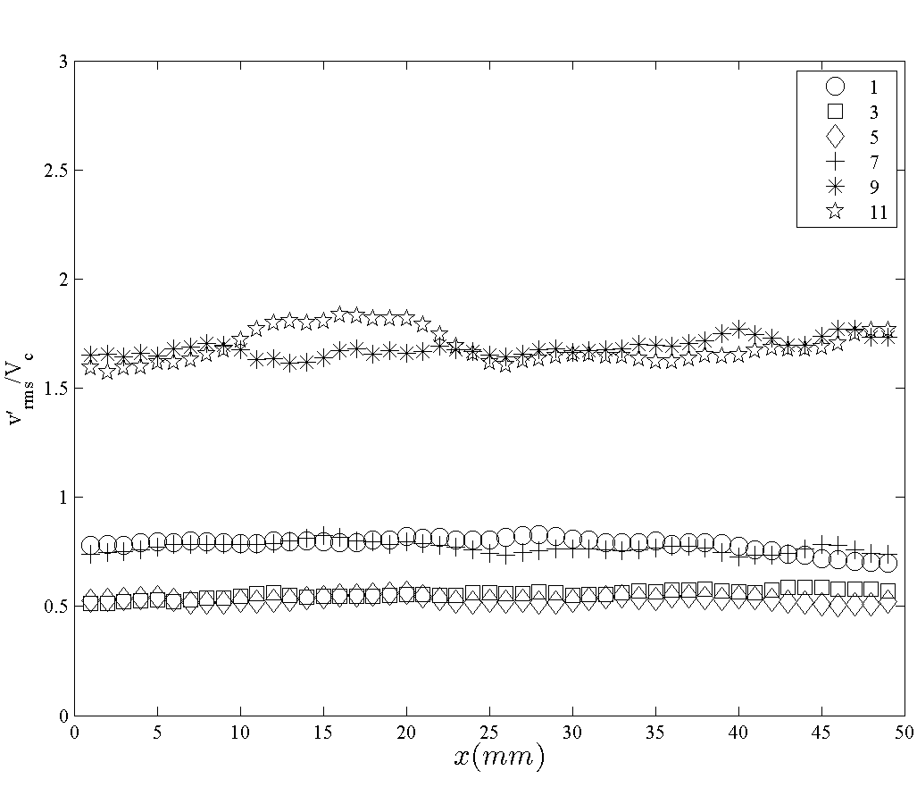
Normalized Vertical Velocity
Normalized Vertical Velocity Turbulence Intensity

Slide 24

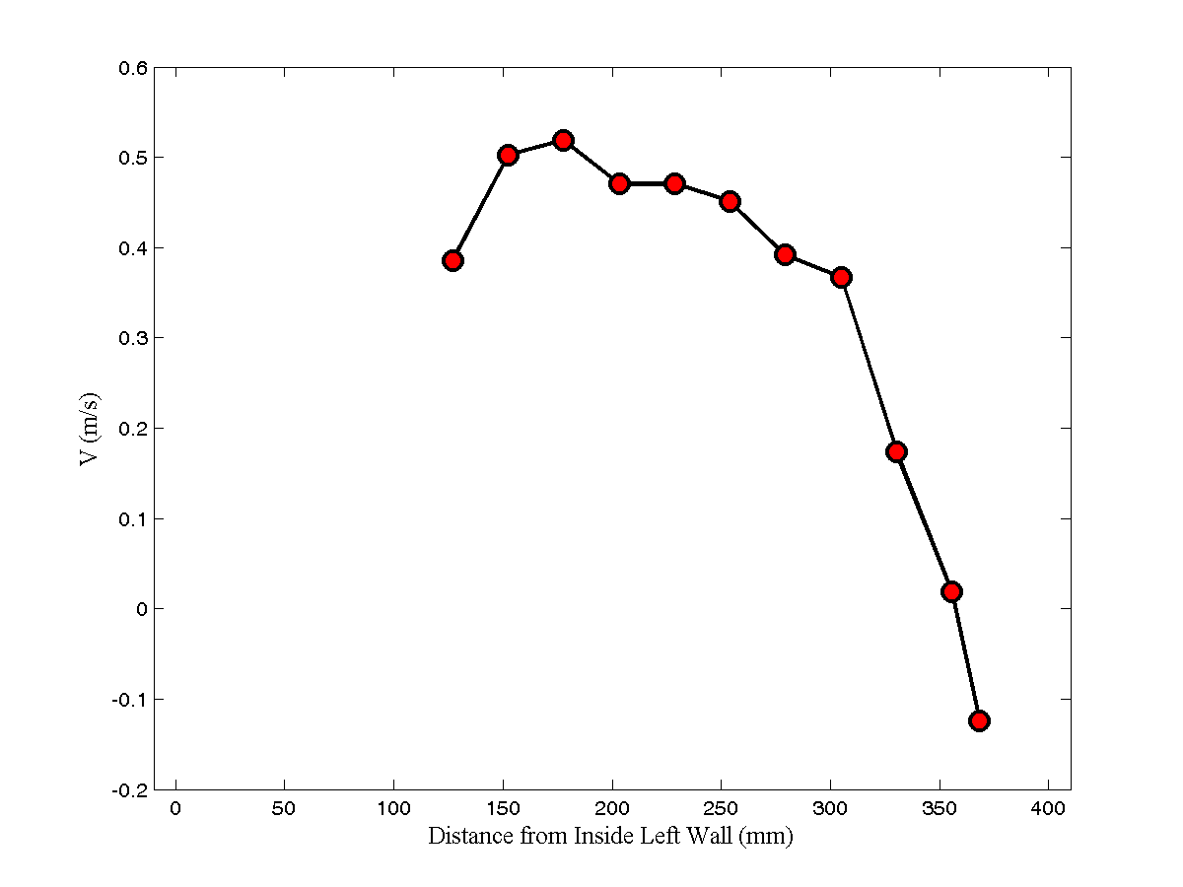

Center Point Average Velocity Across Chamber

Slide 25
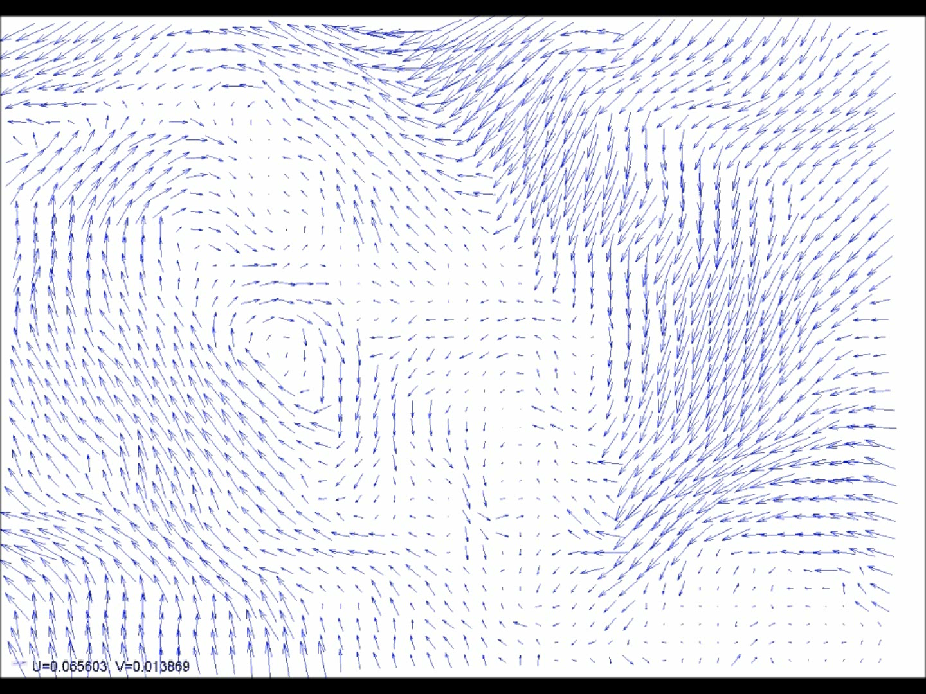
Glowbar Side
Sample Side
Not to Scale!

Slide 26
Summary
PIV measurements were successfully made in the OSU
High levels of turbulence and non-uniform flow fields were measured
Possible improvements will be tested to determine if turbulence can be reduced and flow field can become more uniform
Will attempt to perform measurements when OSU is “hot” to characterize total flow field (forced + buoyant)
Will take suggestions for other possible measurements

