Slide 1
CFRP Flammability Tests
Test Configuration Influence on Flame Propagation

Slide 2
Introduction
Tests were performed to determine the influence of a variety of configurational factors on inboard flame propagation of composite fuselage panels
Insulation-panel spacing
Heat retention near panel surface
Outboard surface heat loss
The original foam block fire source and test rig were used
CFRP panels were procured for this testing
0.1” thickness
Quasi-isotropic tape layup, single outer ply of woven fabric
350°F cure toughened epoxy

Slide 3
Test Series
Flat Panel Tests
Baseline
Thermal-Acoustic insulation blanket between inboard face of test panel and test rig shroud
Vary gap from tightly pressed up to panel → 1” gap
If significant flame propagation is found,
Determine if increasing the rate of heat transfer from the outboard surface influences inboard flame propagation
Simulated Structure and Panel Tests
Determine if both the structure and panel will propagate flames under conditions found previously
Determine if increasing the rate of heat transfer from the outboard surface influences inboard flame propagation
Simulated Primary Lithium Battery Powered Electronic Locator Transmitter (ELT) failure adjacent to CFRP panel
Higher intensity fire source
Determine if this fire source will cause CFRP panel to propagate flames similar to foam block
Will more intense fire source overcome increased rate of heat transfer from the outboard surface?

Slide 4
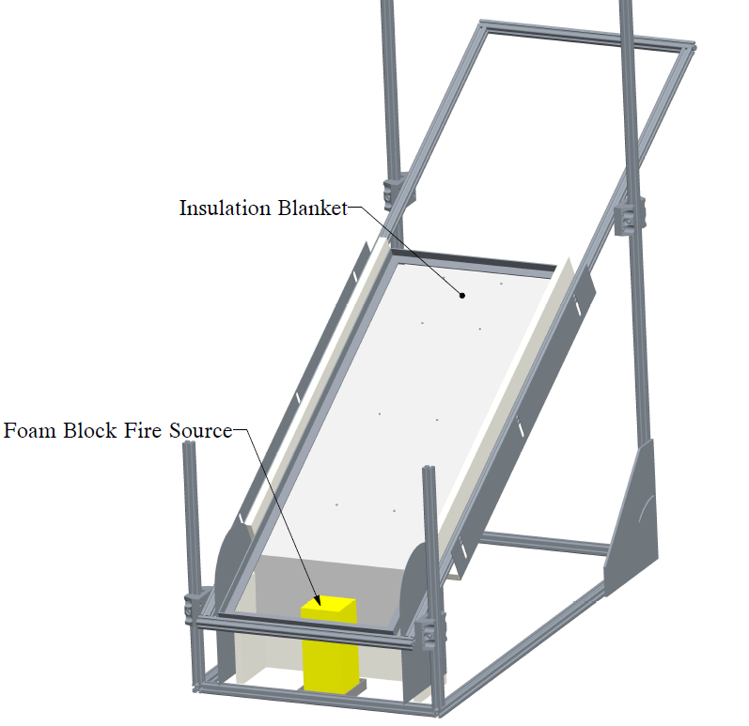
Foam Block Test Configuration

Slide 5
Test Matrix: Foam Block Ignition Source
Date | Test Name | Configuration | Insul. Dist. | Burn Length | Burn Width
1/22/2015 | Baseline | Std. Config. | n/a | 6.5625 | 6.6875
1/22/2015 | Insulation 1 | Insul Pressed Tightly to Skin | 0 | 0 | 0
1/26/2015 | Insulation 2 | Insul Pressed Tightly to Skin | 0 | 7.5 | 15.25
1/27/2015 | Insulation 3 | Insul slightly further from skin | 0.5 | 10 | 15
1/27/2015 | Insulation 4 | Insul further from skin | 1 | 9.25 | 6.25
1/28/2015 | Insulation 5 | Insul closer, added gasket | 0.5 | 46 | 12
3/4/2015 | Insulation 6 | Insulation 5 w/water cooling | 0.5 | 0 | 0
3/9/2015 | Insulation 7 | repeat of insulation 6 | 0.5 | 0 | 0
3/17/2015 | Insulation 8 | CFRP with frames | 0.5 | 46 | 12
3/19/2015 | Insulation 9 | CFRP with frames & water cooling | 0.5 | 3 | 3
3/24/2015 | Insulation 10 | CFRP frames & stringers | 0.5 | 16 | 14
3/27/2015 | Insulation 11 | CFRP frames & stringers (flipped panel) | 1 | 2 | 5
4/2/2015 | Insulation 12 | CFRP frames & stringers | 1 | 8 | 7
4/2/2015 | Insulation 13 | CFRP frames & stringers (flipped panel) | 1 | 9 | 8
4/2/2015 | Insulation 14 | CFRP frames & stringers (sealed w/RTV) | 1 | 7 | 4
4/30/2015 | Insulation 15 | CFRP frames & stringers (flipped panel+RTV) | 0.5 | 8 | 5
4/30/2015 | Insulation 16 | CFRP frames & stringers (sealed w/RTV) | 0.5 | 33.5 | 14
5/28/2015 | Insulation 17 | Insulation 16 w/water cooling | 0.5 | 9 | 9.75

Slide 6
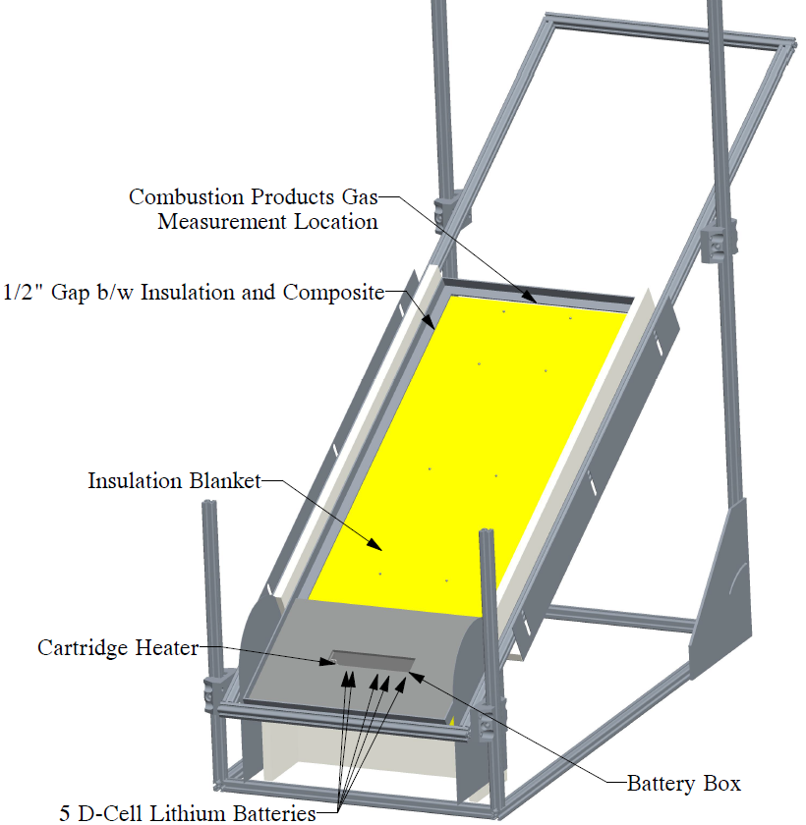
Lithium Battery Ignition Source Test Configuration
Lithium Battery Test Configuration
5 D-Cell Lithium batteries (non-rechargeable)
Battery box insulated w/ ½” ceramic fiberboard
Battery box surface within ½” of CFRP inboard panel surface
Insulation blanket placed between shroud and inboard face of CFRP panel
Thermocouples penetrate through insulation blanket, within ¼” of CFRP panel surface
Thermocouples on each battery cell and on cartridge heater

Slide 7
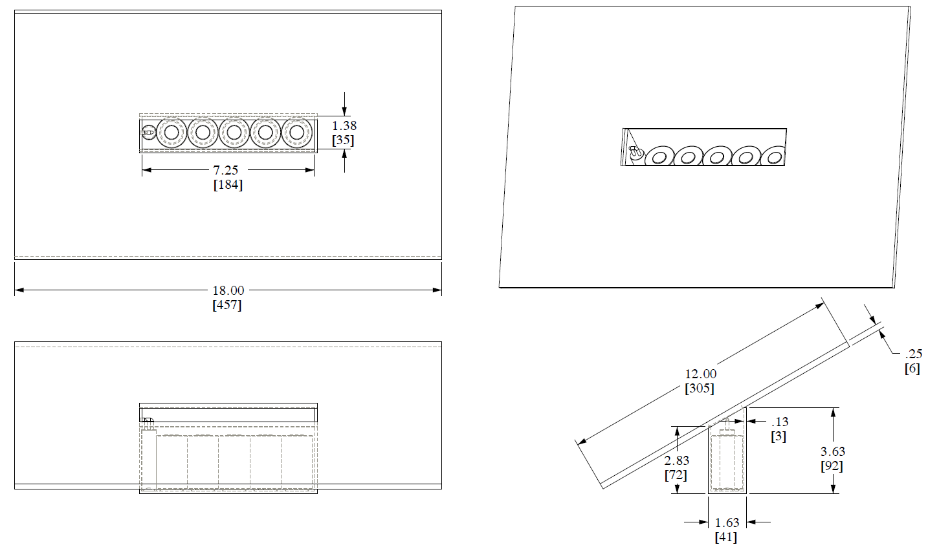
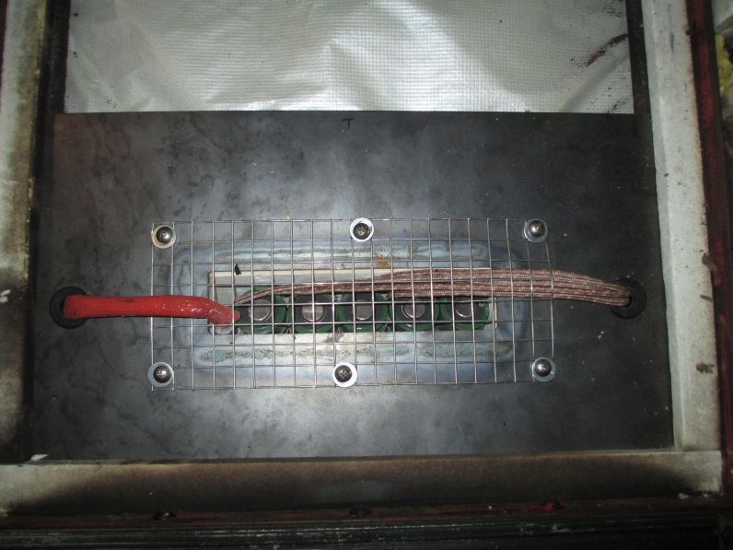
Battery Configuration

Slide 8
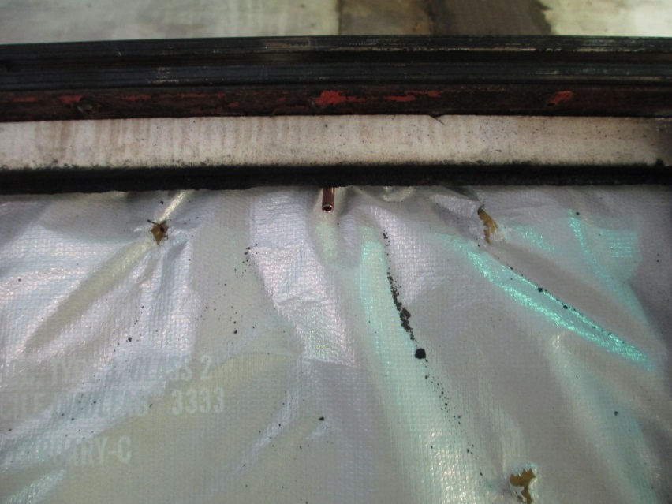
Gas Analyzers
Non-dispersive IR Measurement of CO and CO₂
Paramagnetic Measurement of O₂
Single stream sample plumbed in series
Filtered and dried to 1 micron & 5°C dew point
6 Lpm flowrate
Approx 20’ of ¼” sample line
Gas Measurement Location

Slide 9
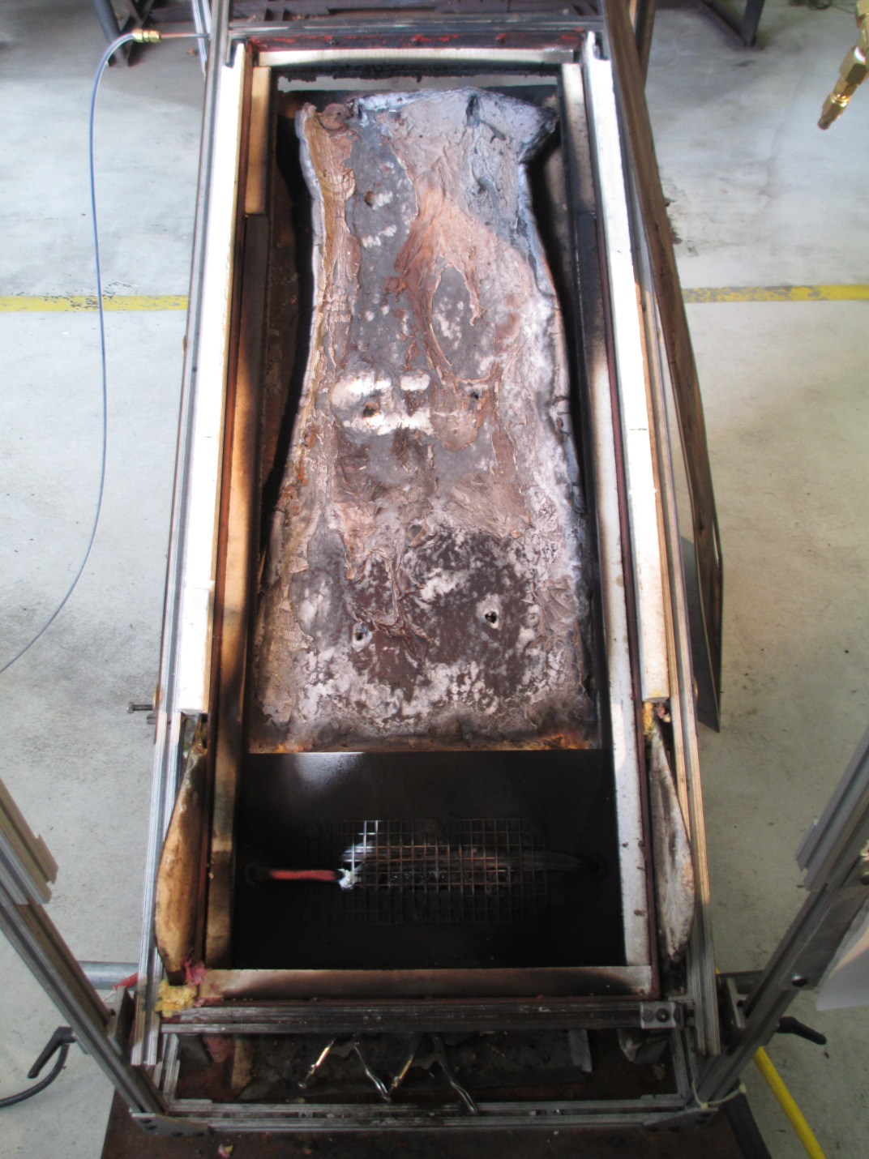
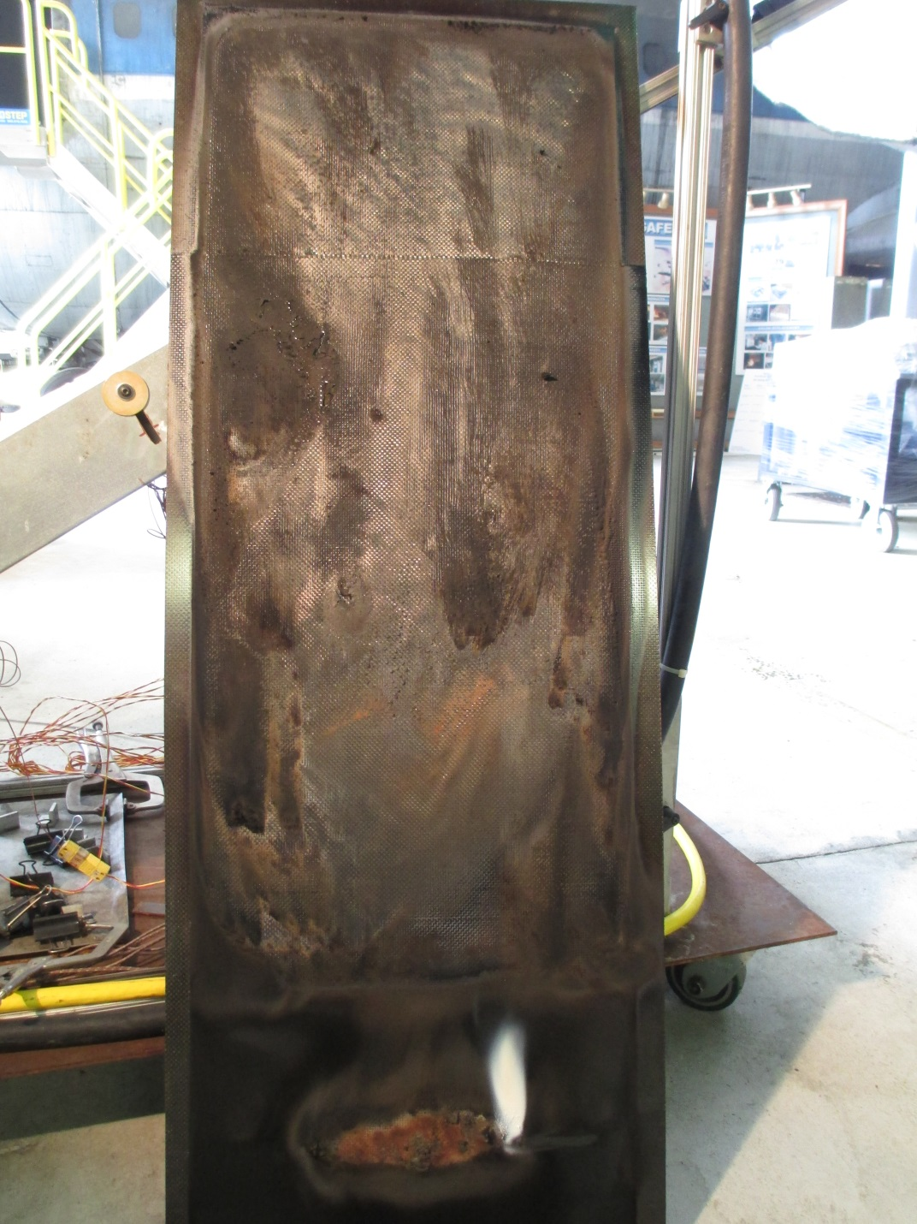

Slide 10
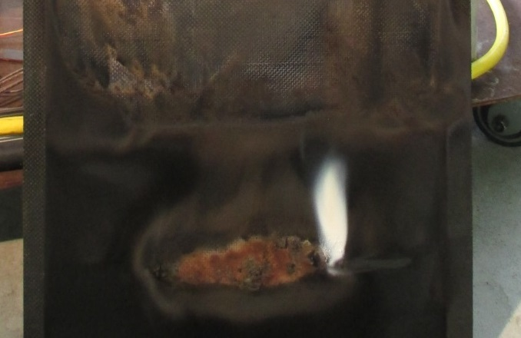

Slide 11
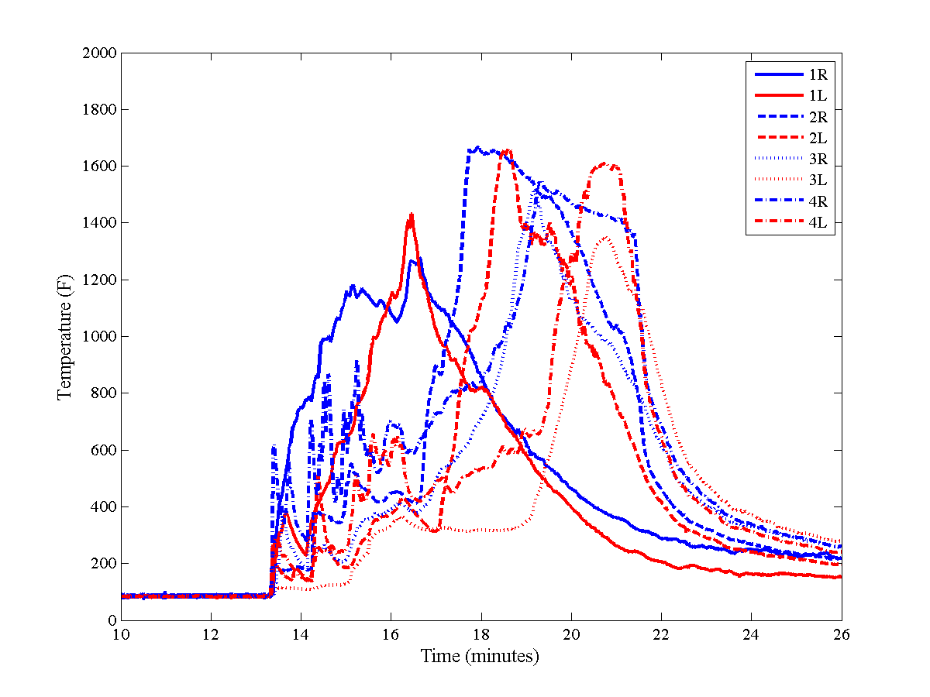
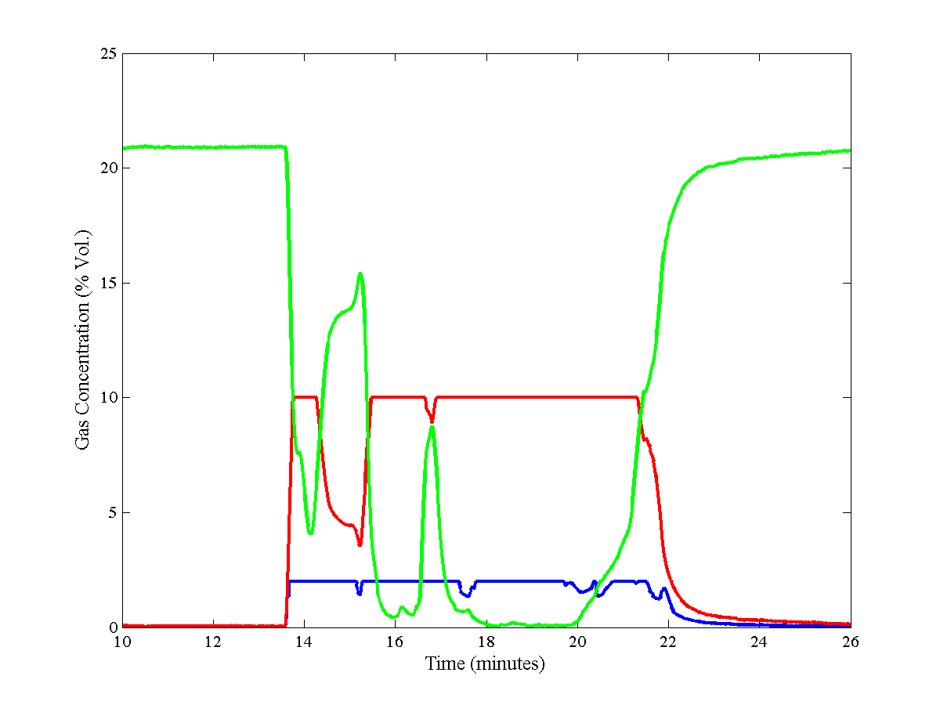
10 Ply CFRP, Battery Ignition Source
Inboard Panel Temperatures
Measured Gas Concentrations

Slide 12
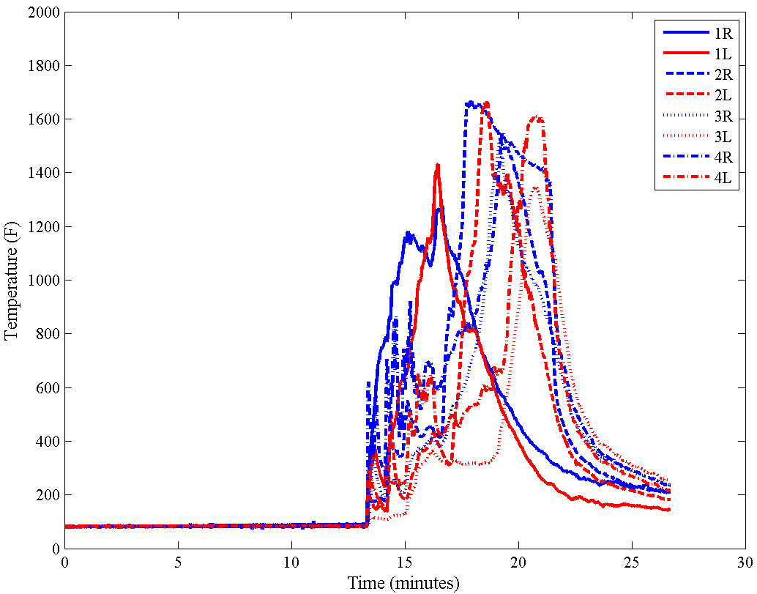
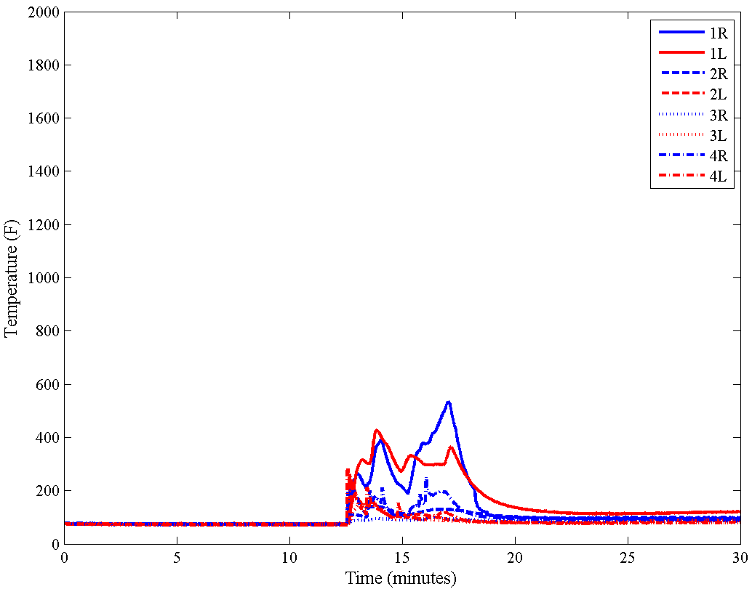
Comparison: Static Ambient vs. Cooled Backside
Inboard Panel Temperatures
Static Ambient
Cooled Backside

Slide 13
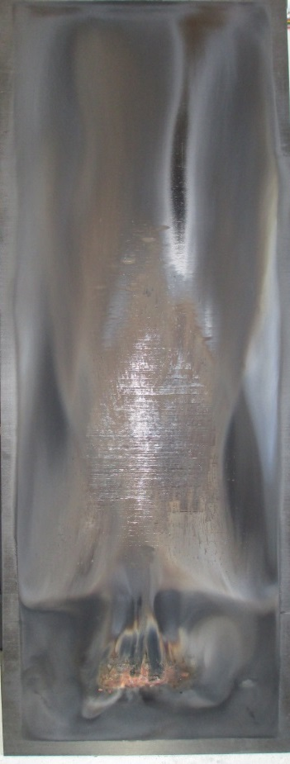
Test Matrix: Lithium Battery Ignition Source
Date | Test Name | Configuration | Panel Thickness (in.) | Insul. Dist. (in.) | Burn Length (in.) | Burn Width (in.)
7/9/2015 | ELT 1 | Simulated ELT, insulation, no cooling | 0.098 | 0.5 | 46 | 15
7/16/2015 | ELT 2 | Simulated ELT, insulation, w/cooling | 0.098 | 0.5 | 3 | 6
8/6/2015 | ELT 3 | Simulated ELT, insulation, no cooling, 32 Ply | 0.366 | 0.5 | 17 | 10.5
8/13/2015 | ELT 4 | Simulated ELT, insulation, no cooling, 24 Ply | 0.275 | 0.5 | 24 | 10
8/25/2015 | ELT 5 | Simulated ELT, insulation, no cooling, 16 Ply | 0.13 | 0.5 | 43.5 | 15.5
24 Ply CFRP

Slide 14
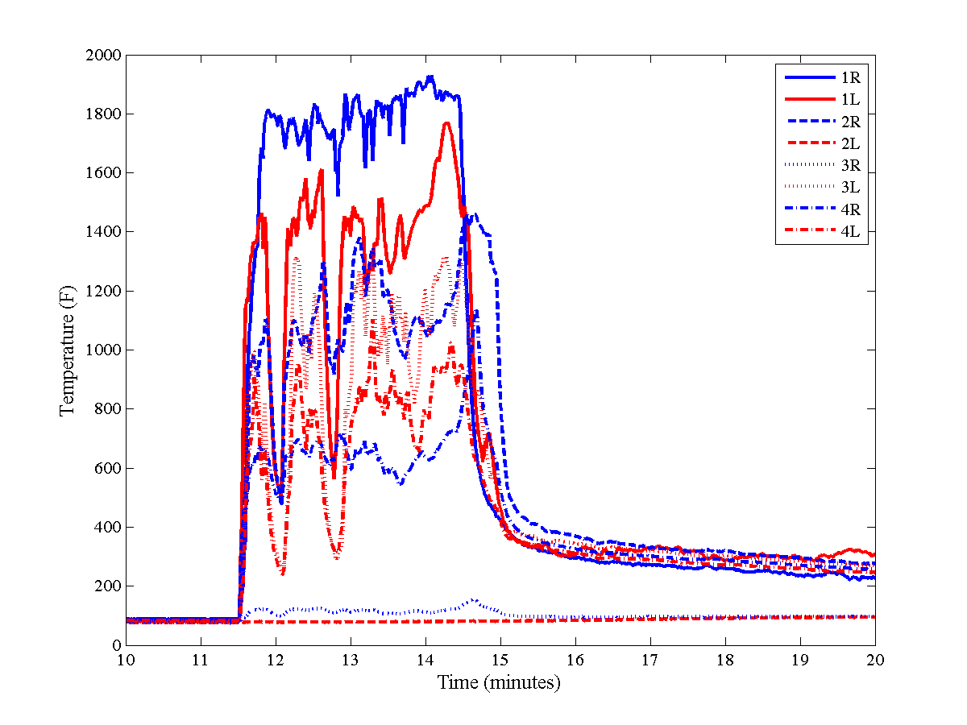
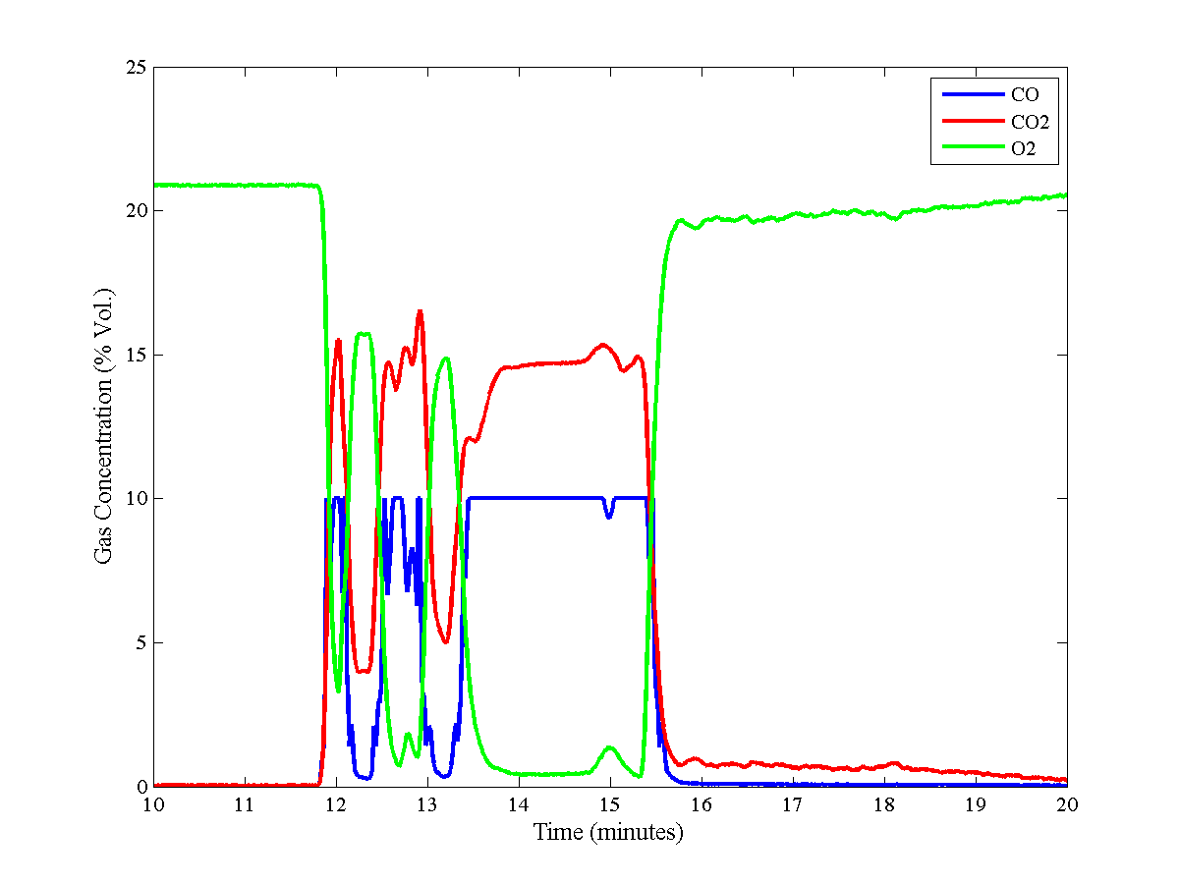
24 Ply CFRP, Battery Ignition Source
Inboard Panel Temperatures
Measured Gas Concentrations

Slide 15
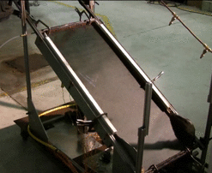
Next Steps
Increase measurement range of CO analyzer to 30%
Re-test CFRP 10 ply w/foam block
Quantify cooling efficiency
Compare to calculated and/or measured in-flight heat loss rates for CFRP airplanes
Once cooling rate is fixed, re-test foam block and Lithium battery configurations w/new cooling rate

Slide 16
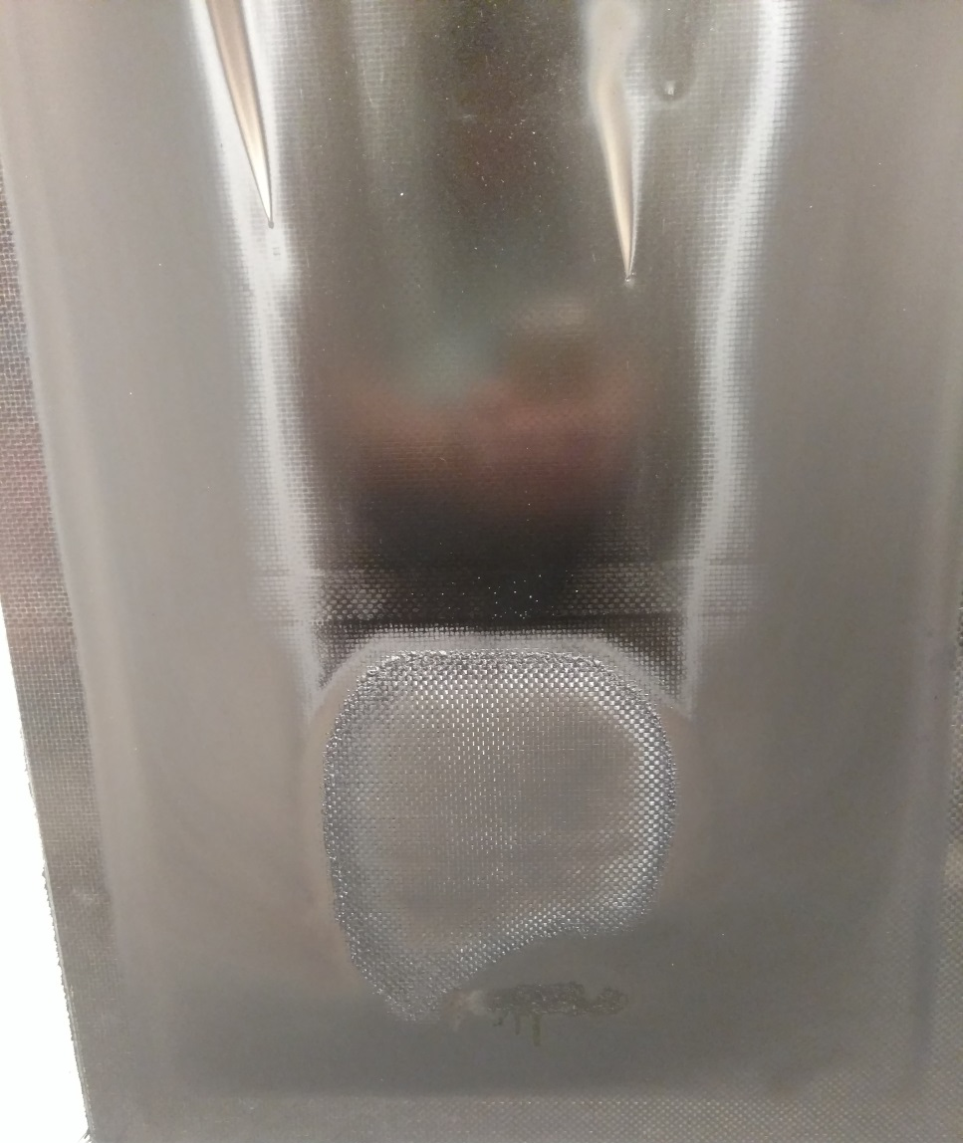
Foam Block Baseline – 8x
Fabric Overlap Seam

Slide 17
Foam Block Baseline Observations
The seam created where two pieces of prepreg fabric overlap is a significant barrier for flame propagation
If the fire is unable to develop fully, it will not propagate
The gas sampling system clogged, resulting in no gas data. A new method is required

Slide 18
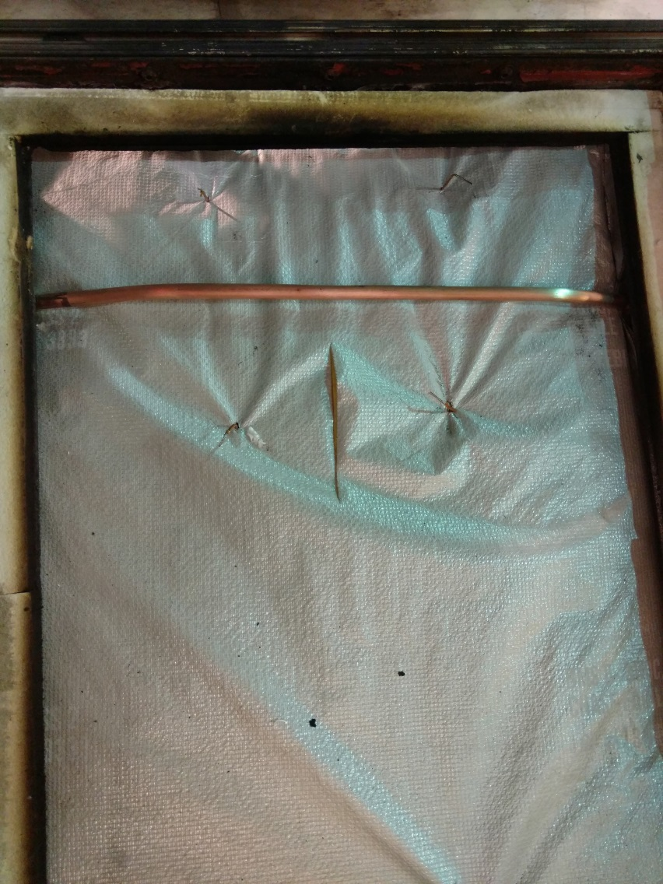
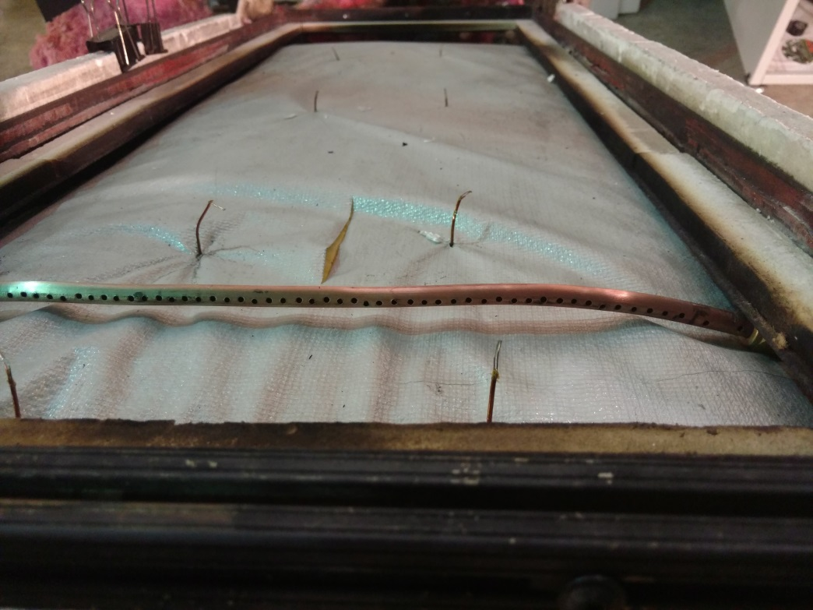
Gas Sampling Modifications

Slide 19
10 ply CFRP Foam Block 8x – Expanded CO Range 0-30%

Slide 20
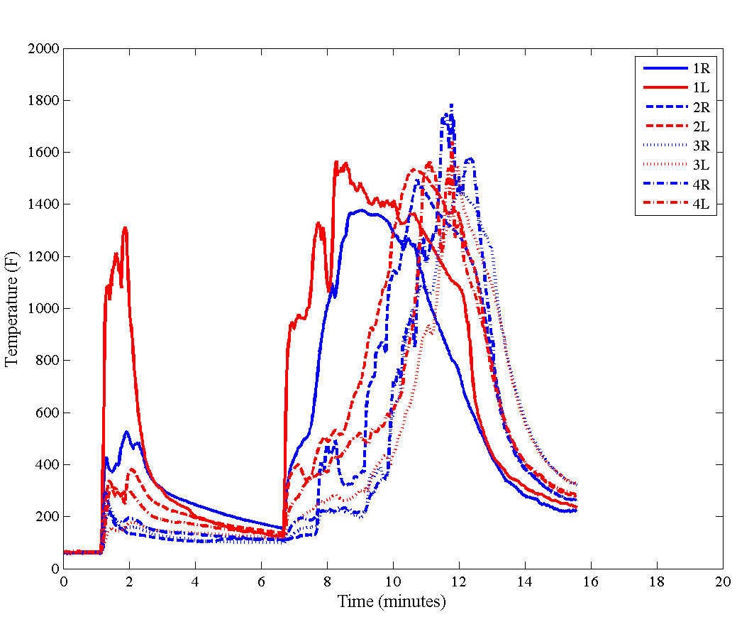
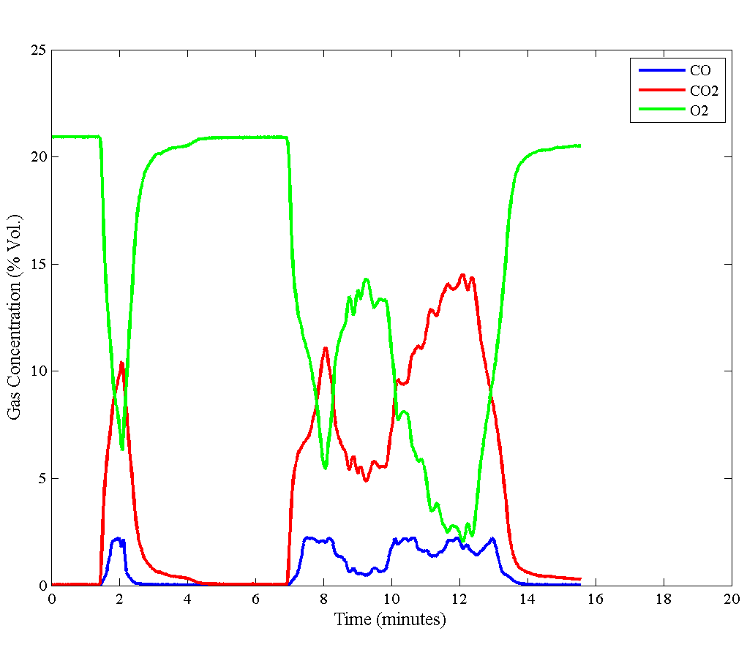
10 ply CFRP Foam Block – Expanded CO Range 0-30%

Slide 21
Foam Block Baseline 2 Observations
Heat escaped from back of fire box area resulting in a stalled flame propagation
A better method of closing fire box area is required
Igniting a second foam block was able to produce a full-length flame propagation
Although the CO measurement range was expanded to 30%, peak CO measurements of only 2-3% were observed
This is most likely due to an over-ventilated configuration with the foam block source
Previous measurements of 10% or greater CO were obtained using the lithium battery source, which has significantly less available air for combustion
A battery source baseline will be run with the expanded CO measurement range to validate this

Slide 22
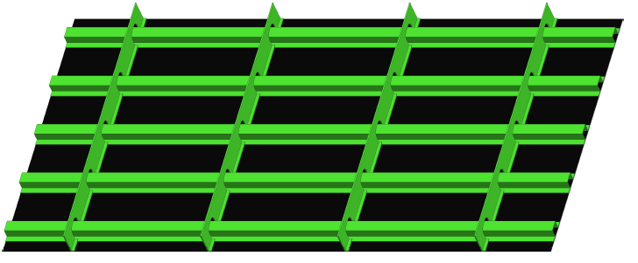
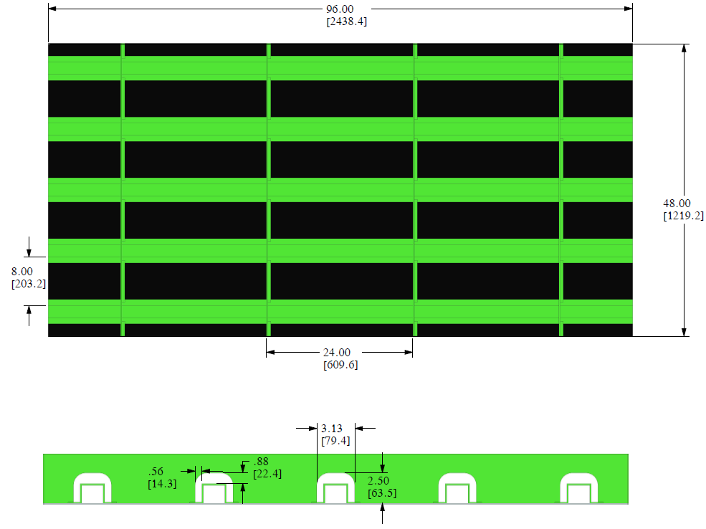
Large Scale CFRP Skin & Structure Tests
Large scale CFRP skin and structure test fixture
Study propagation of fire from bay-to-bay with and without cooling

Slide 23
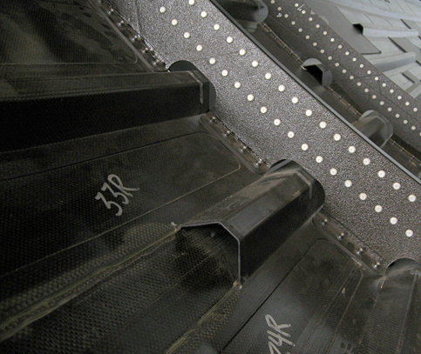
CFRP Structure Tests

Slide 24
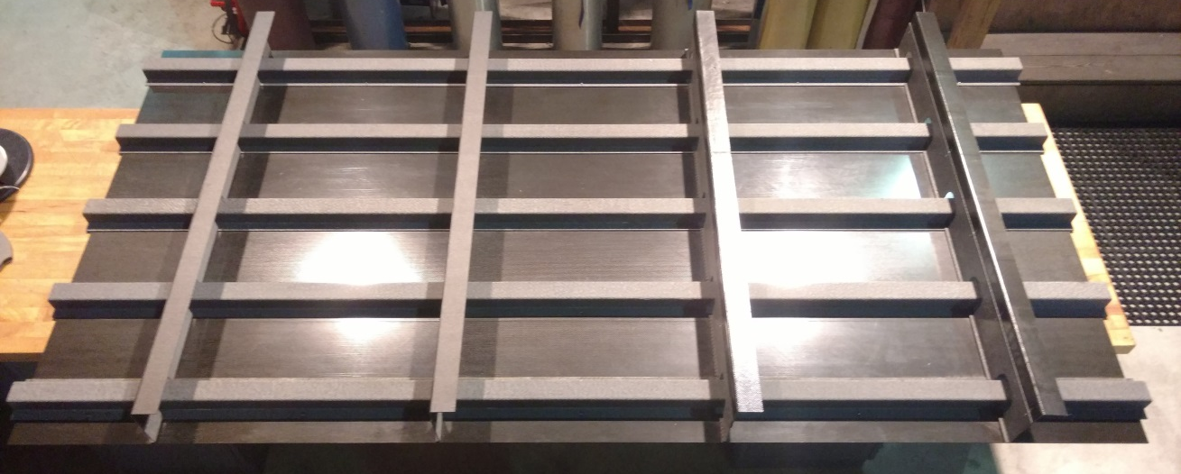
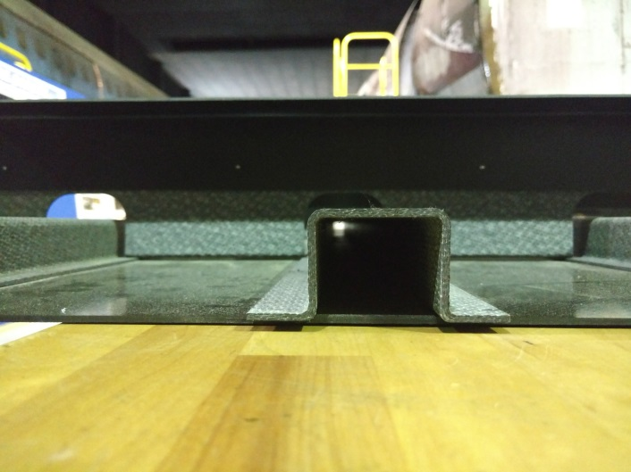
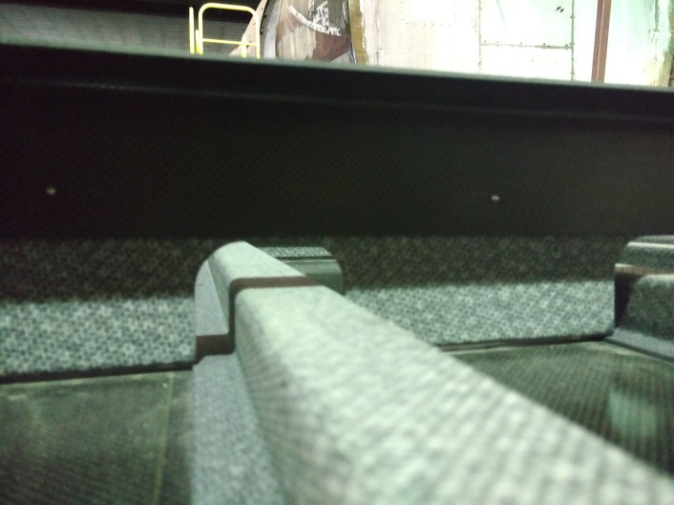
Simulated CFRP Aircraft Structure
8’
4’

Slide 26
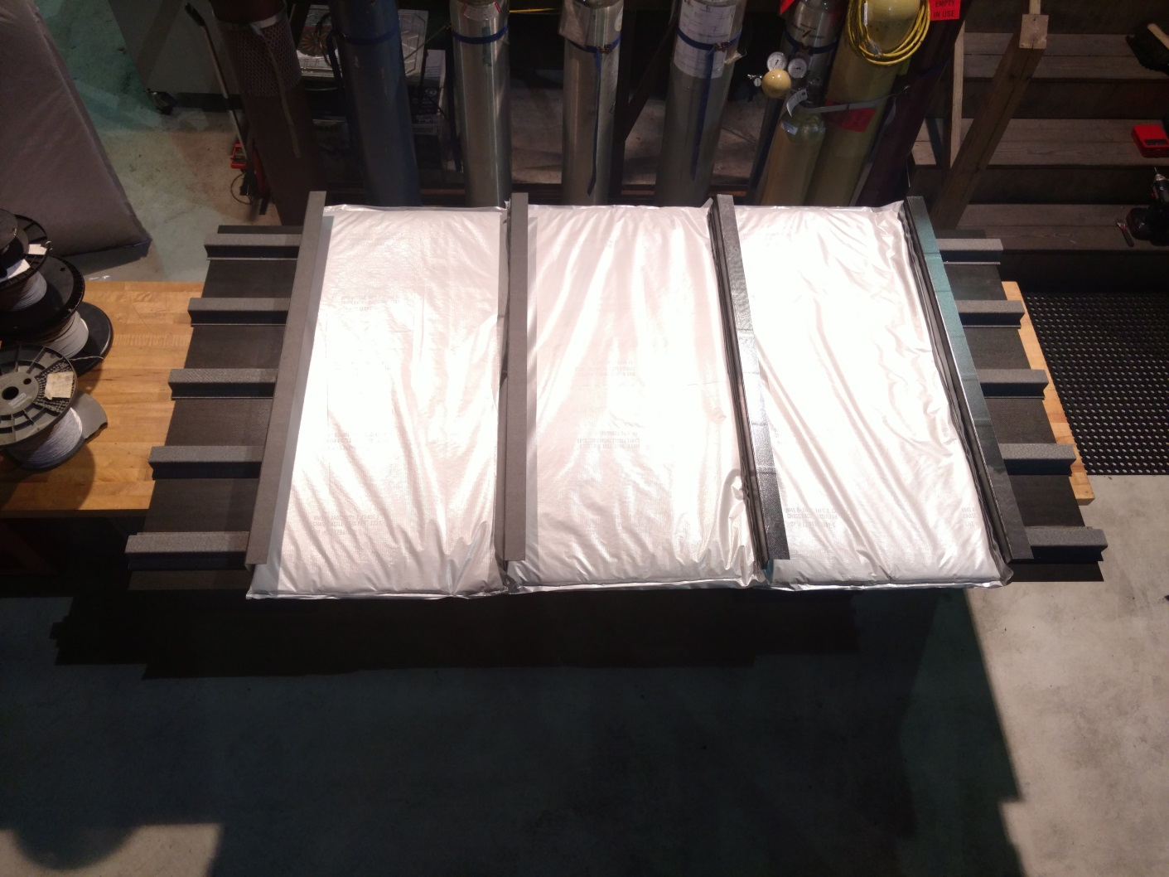

Slide 27
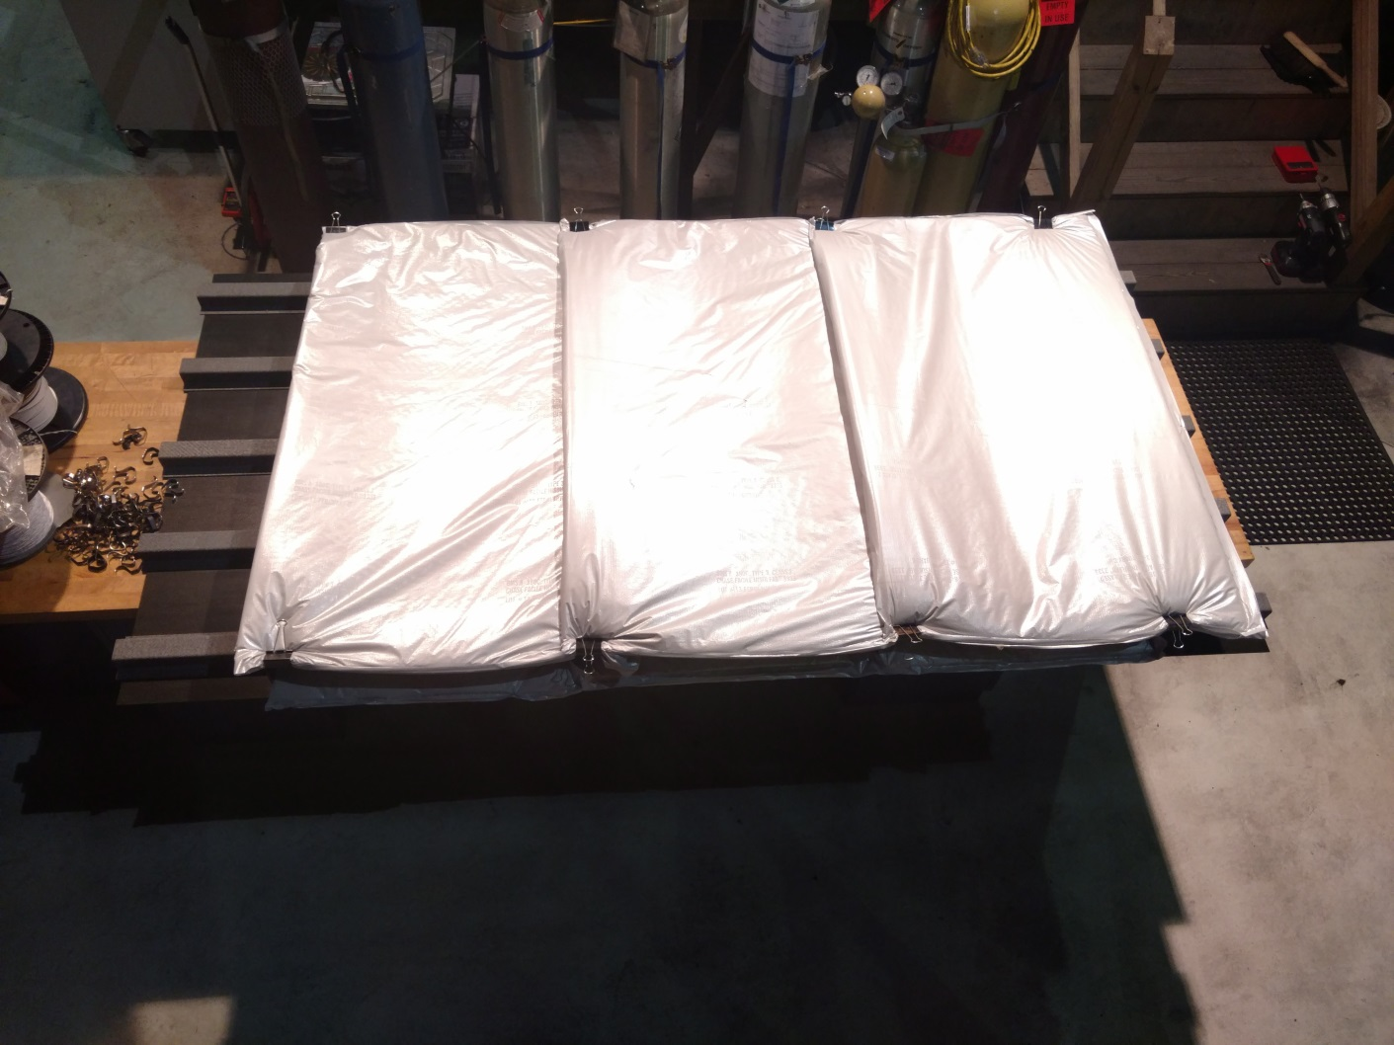

Slide 28
Large Scale Test Plan
Continue evaluating backside heat transfer methods to accurately represent in-flight cooling
Begin planning baseline tests
Construct rig to hold test panel at variable angles
Static ambient conditions on backside
Foam block
Simulated ELT
Test configuration guidance or suggestions welcome and encouraged

