Slide 1
International Aircraft Materials Fire Test Working Group Meeting
Development of a New Flammability Test for Magnesium-Alloy Seat Structure
International Aircraft Materials Fire Test Working Group, Bordeaux, France
Tim Marker, FAA Technical Center
March 16-17, 2016

Slide 2
Magnesium Alloy Task Discussion Items
Mag Use in Other Cabin Components: What is the appropriate method of testing?
Radiant Panel Testing (58 Tests Conducted)
Oil Burner Testing of Solid Components Exceeding the SAV Ratio of 20
Discussion Items for Task Group
Video of Radiant Panel Test (time permitting)

Slide 3
Surface Area-to-Volume (SAV) Ratios of Seat Components
Low SAV ratio = low probability of ignition
High SAV ratio = high probability of ignition

Slide 4

Surface Area-to-Volume (SAV) Ratios of Seat Components
SAV ratio solid ≤ 20
SAV ratio hollow ≤ 40

Slide 5
The Use of Magnesium Alloy in Other Cabin Areas
What is the appropriate method of test?
Use in other non-
primary seat
components
Use in 5 primary
seat components
Use in other
cabin components
Oil Burner
Oil Burner
Accessible
Below seat height
Accessible
Above seat height
inaccessible
Ignition/Self
Extinguishment
Oil Burner
Oil Burner

Slide 6
Possible Criteria for Allowing Substantiation of non-Seat
Components Using the Oil Burner per Chapter 25
1. Component is accessible
2. Surface Area-to-Volume (SAV) Ratios (≤ 20 solids, ≤ 40 hollow)
3. Component is Located at Height Comparable to Seat Height
4. Proximity to Electrical Components is Minimized

Slide 7
The Use of Magnesium Alloy in Other Cabin Areas
What is the appropriate method of test?
Use in other non-
primary seat
components
Use in 5 primary
seat components
Use in other
cabin components
Oil Burner
Oil Burner
Accessible
Below seat height
Accessible
Above seat height
inaccessible
?
Ignition/Self
Extinguishment
?
Oil Burner
Oil Burner

Slide 8
Possible Methodology for SAV Ratio > 20
Solve for t
Minimum Burn Time > (t / .25) x 2 Min

Slide 9
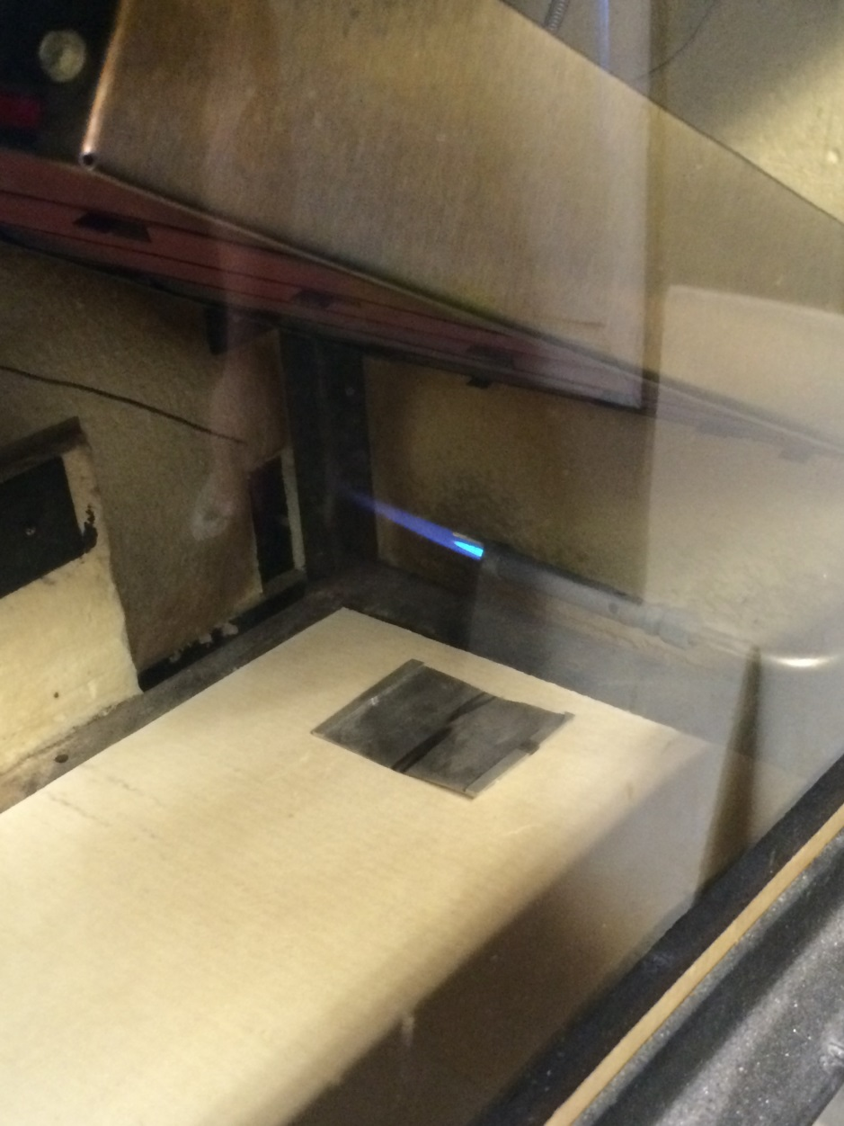
Testing of Thin Magnesium Sheet in Radiant Panel

Slide 10
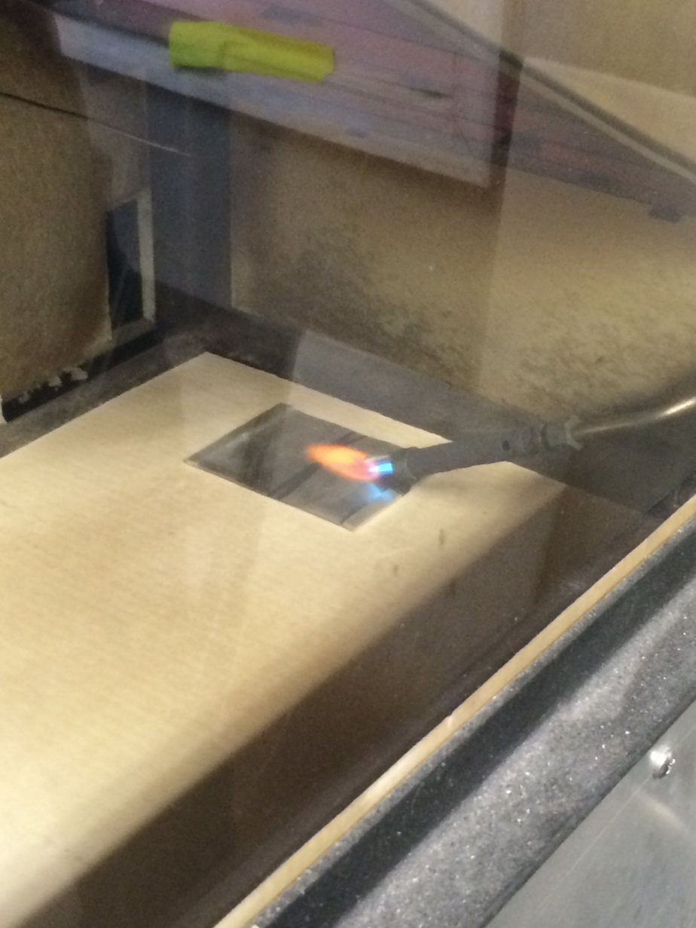
Testing of Thin Magnesium Sheet in Radiant Panel
Initial Testing using 3- by 4-inch
sample size

Slide 13
Preliminary Testing of Thin Magnesium Samples in Radiant Panel
Greater thickness proportional to increased time to ignite
AZ31 ignited very easily and burned completely compared to EL43
Pilot light on edge of sample resulted in earlier time of ignition vs. pilot in center
1 minute preheat did not result in earlier ignition
Weight loss proportional to amount of burning (burn length)

Slide 14
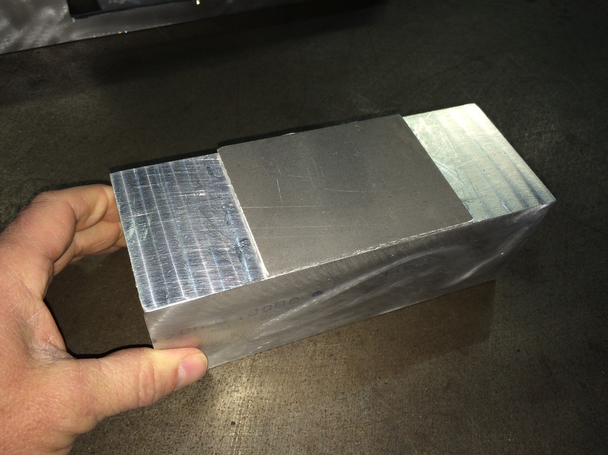
Machining Thin Magnesium Samples
Mag plate glued to jig
Jig used for machining

Slide 15
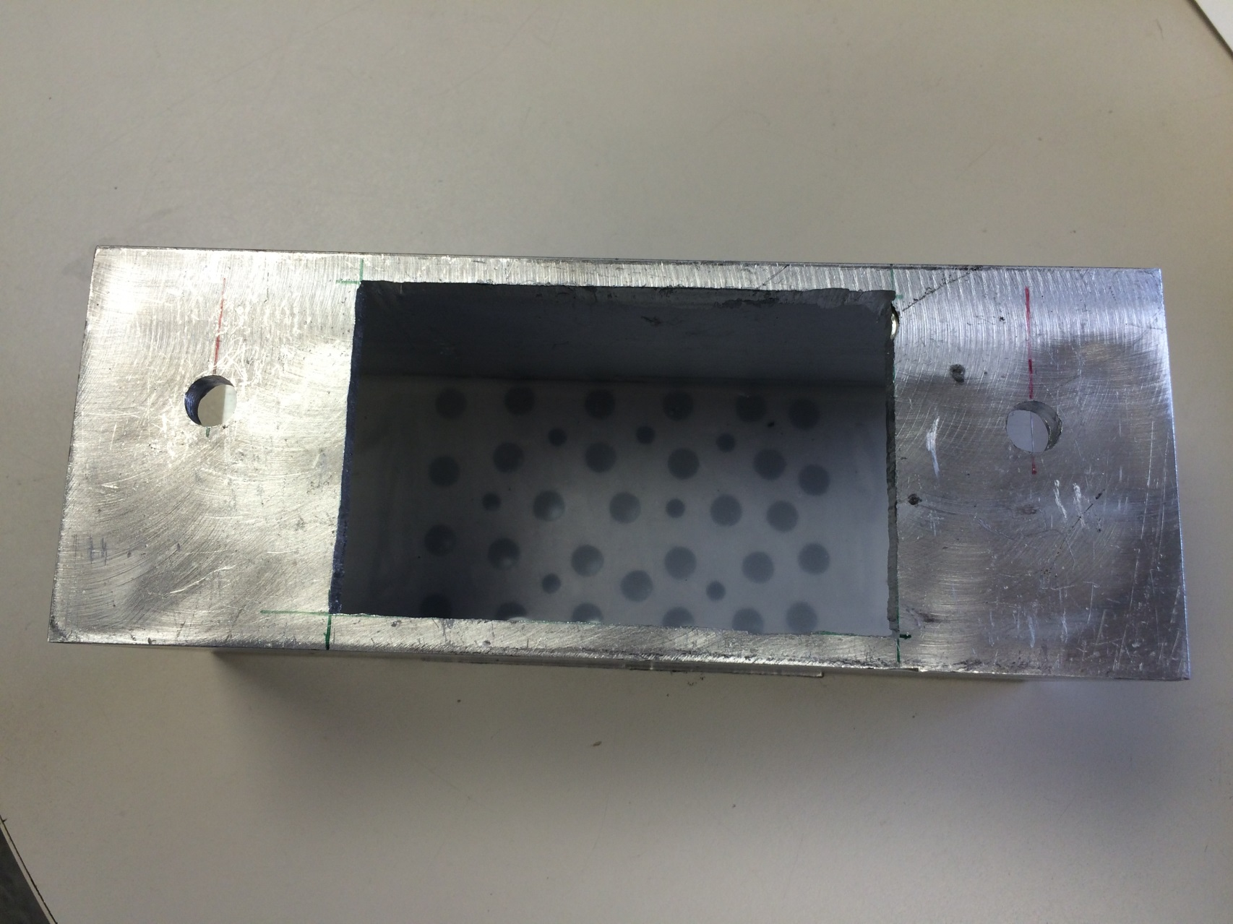
Machining Thin Magnesium Samples
Thermoset adhesive
Underside of jig

Slide 16
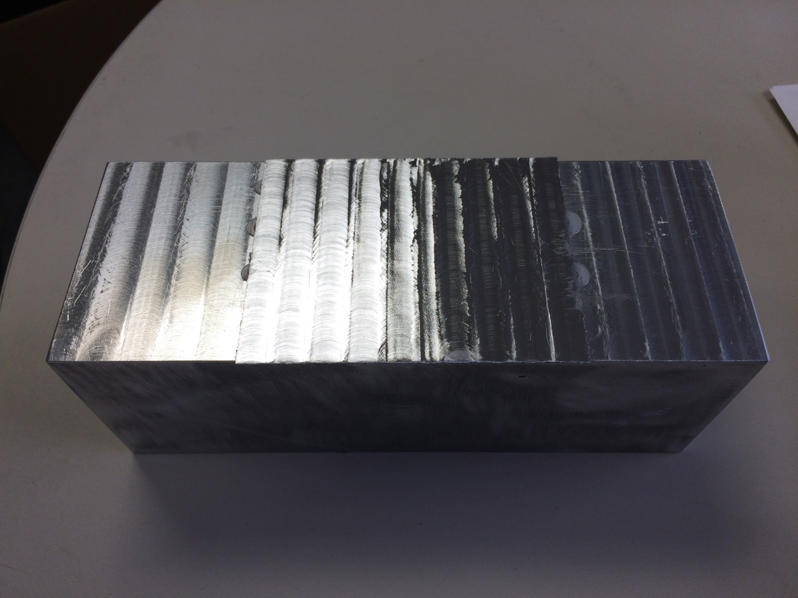
Machining Thin Magnesium Samples
Machined sample

Slide 17
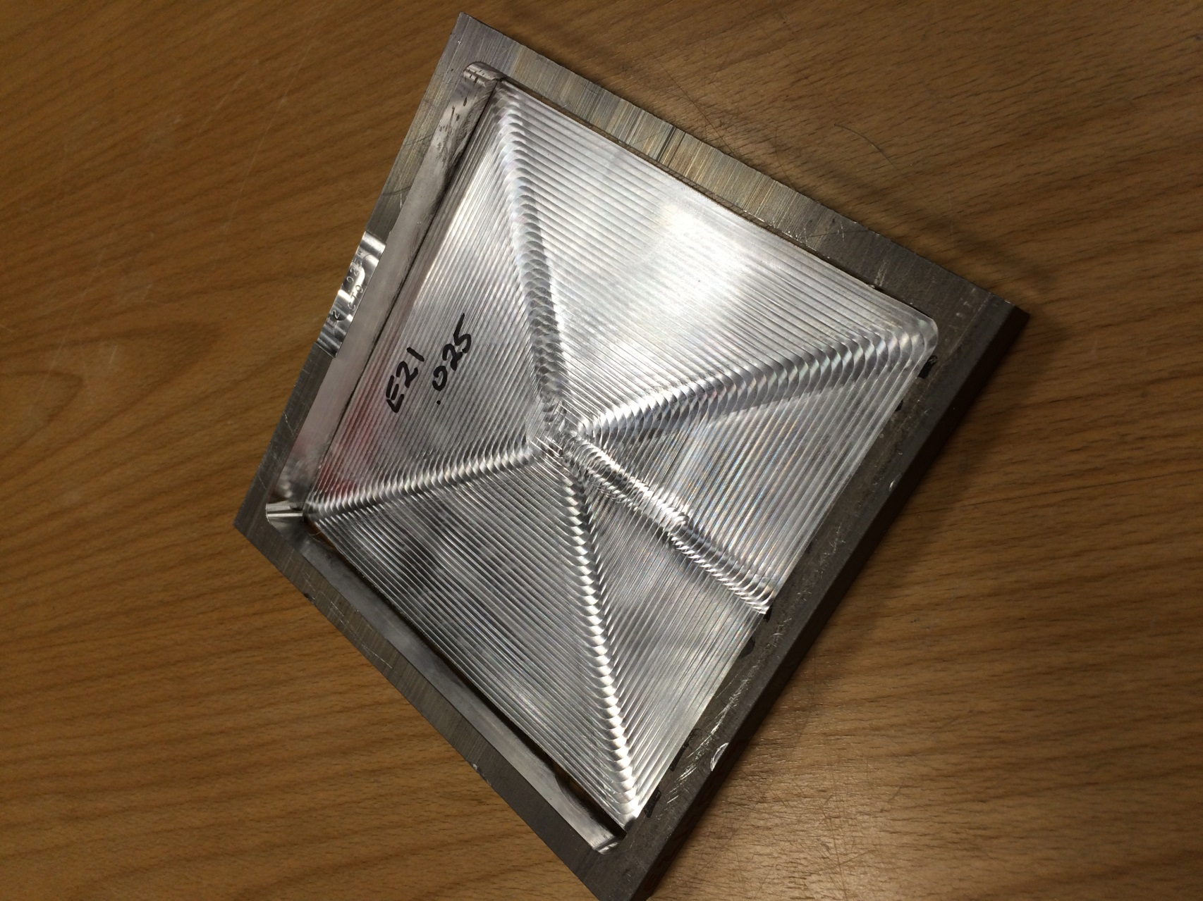
Machining Thin Magnesium Samples
Thicker plate of mag
Area machined out

Slide 18
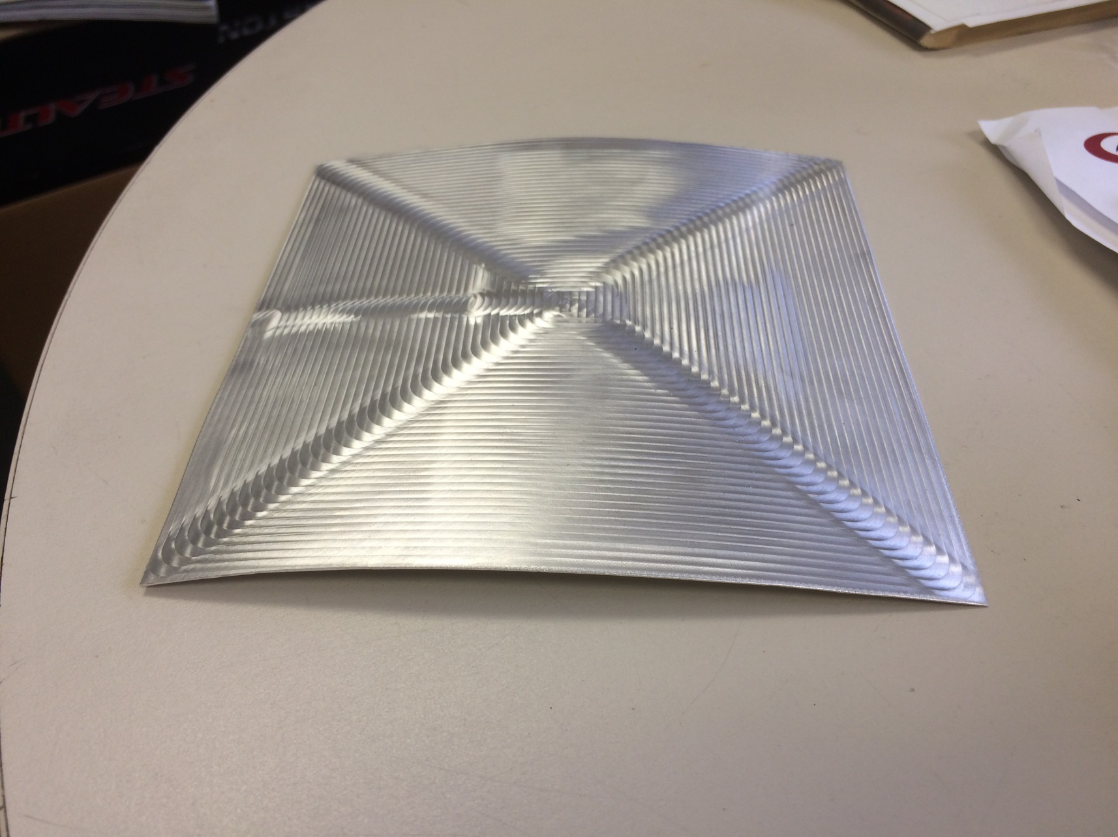
6- by 6-inch Machined Area Removed from Box

Slide 19
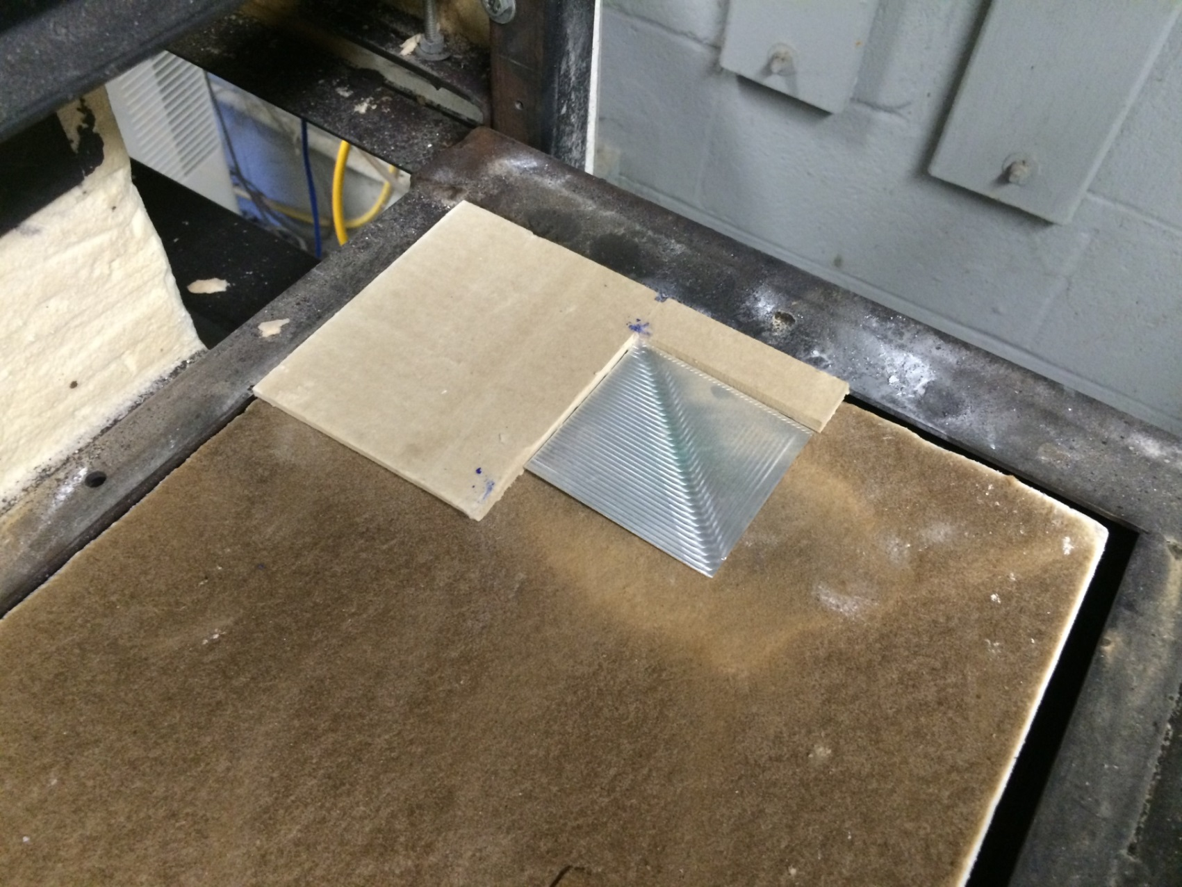
Testing of 3- by 3-Inch Thin Magnesium Sample
3
3

Slide 20
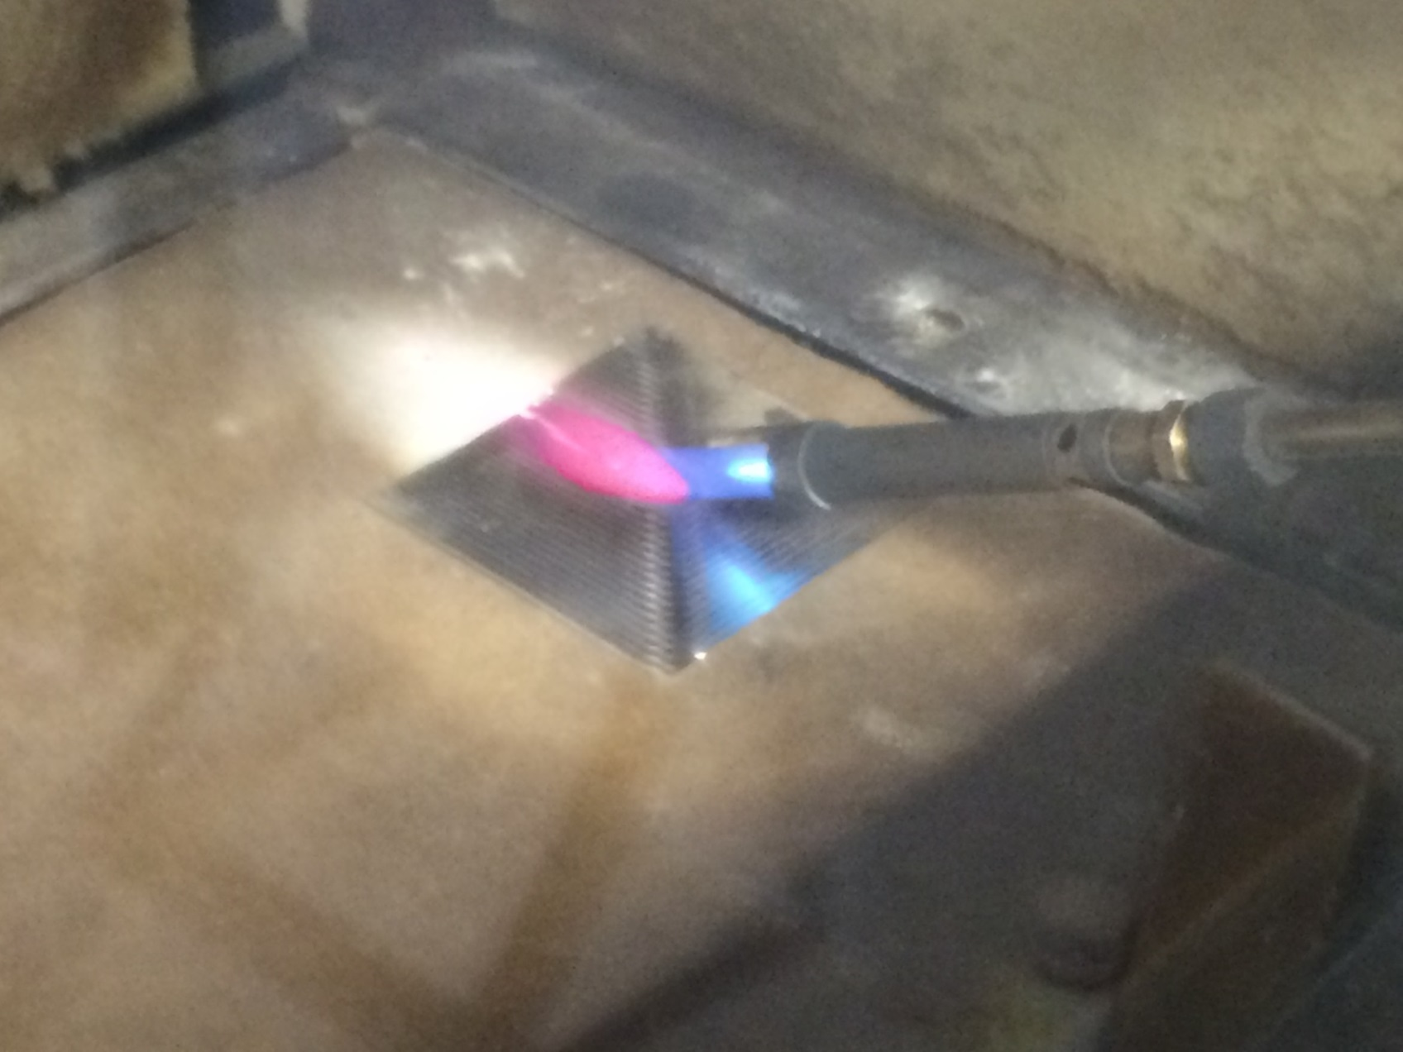
Testing of 3- by 3-Inch Thin Magnesium Sample
Pilot light in geometric center of sample

Slide 22
Preliminary Findings of 3- by 3-inch Magnesium Sample Testing
When using 3- by 3-inch sample size, large % of coupon is covered in flame
EL21 ignited more easily than EL43
Some of EL21 samples burned completely under this configuration (100% weight loss)
3- by 3-inch sample size may be too small (not scaled for the apparatus)
Propose increased sample length to allow sample the opportunity to self extinguish
Propose forcing ignition of sample, and determining it’s ability to self extinguish
Propose moving pilot light to end of sample

Slide 23
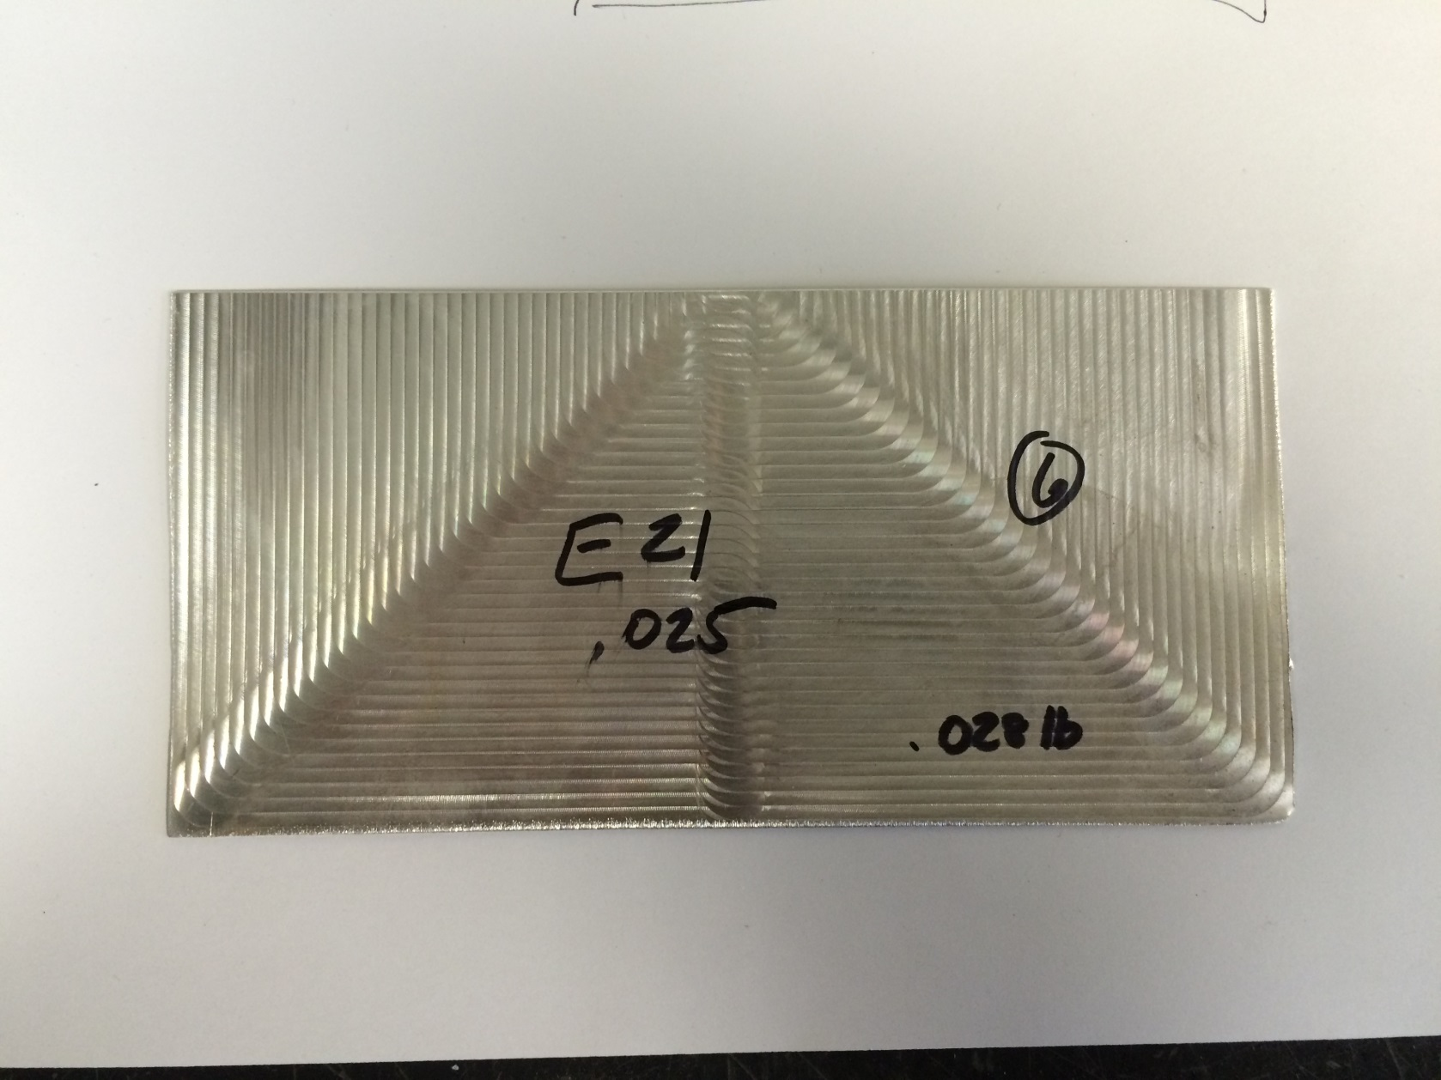
3- by 6-inch Thin Magnesium Sample
Initial piloted ignition
Burn

Slide 24
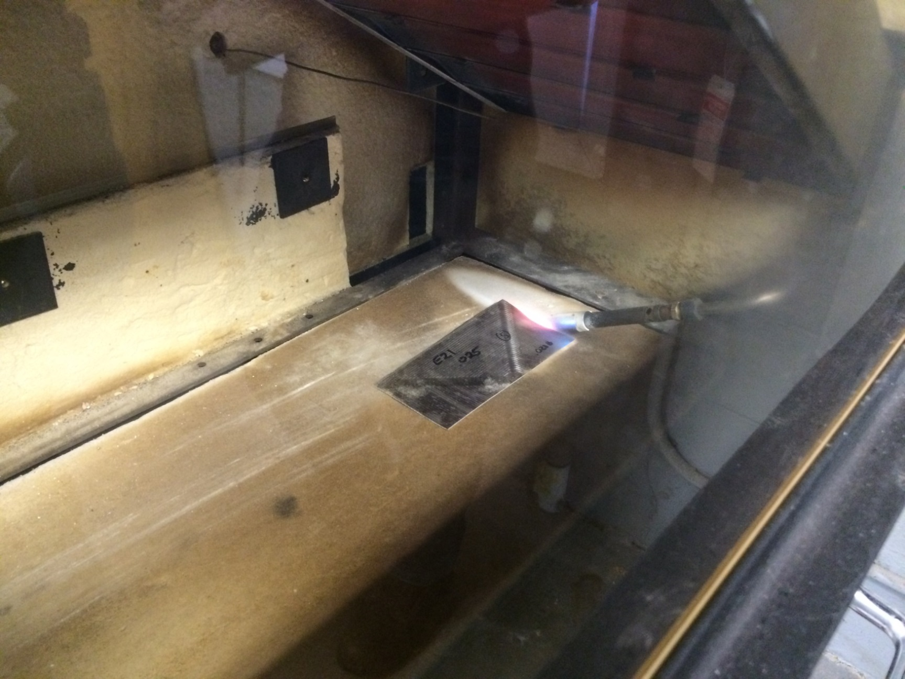
3- by 6-inch Thin Magnesium Sample

Slide 25
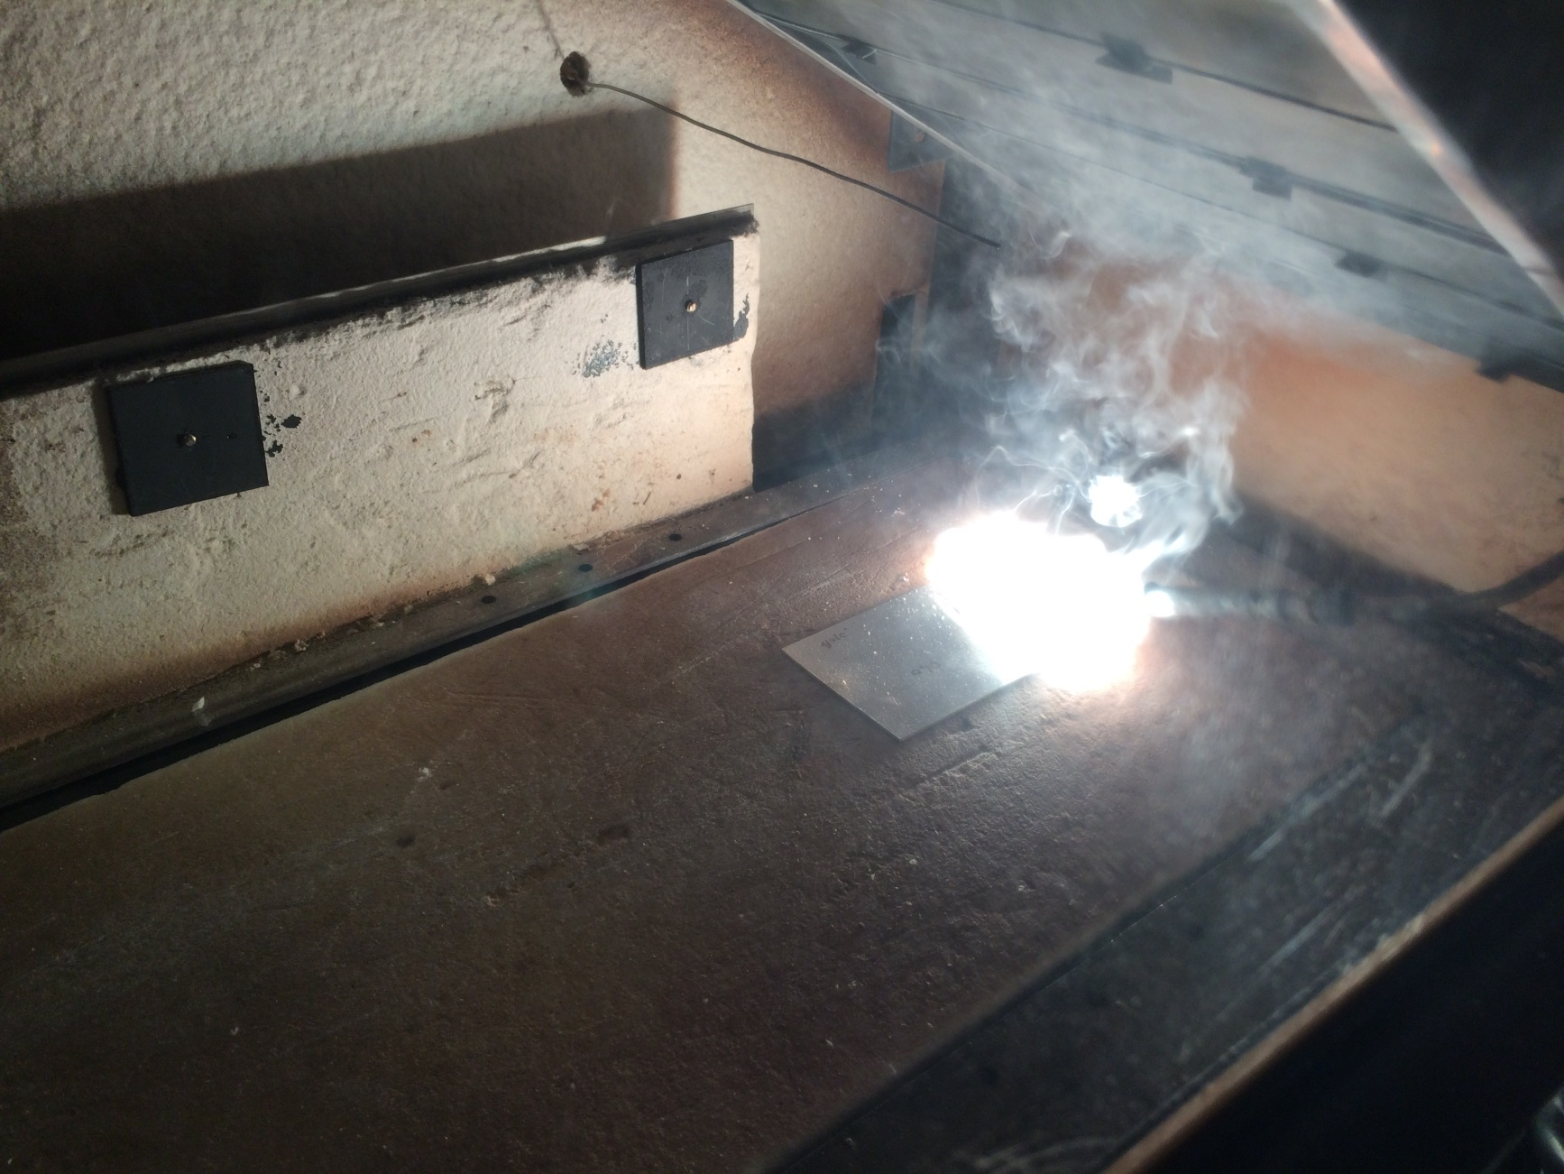
3- by 6-inch Sample of AZ-31

Slide 26
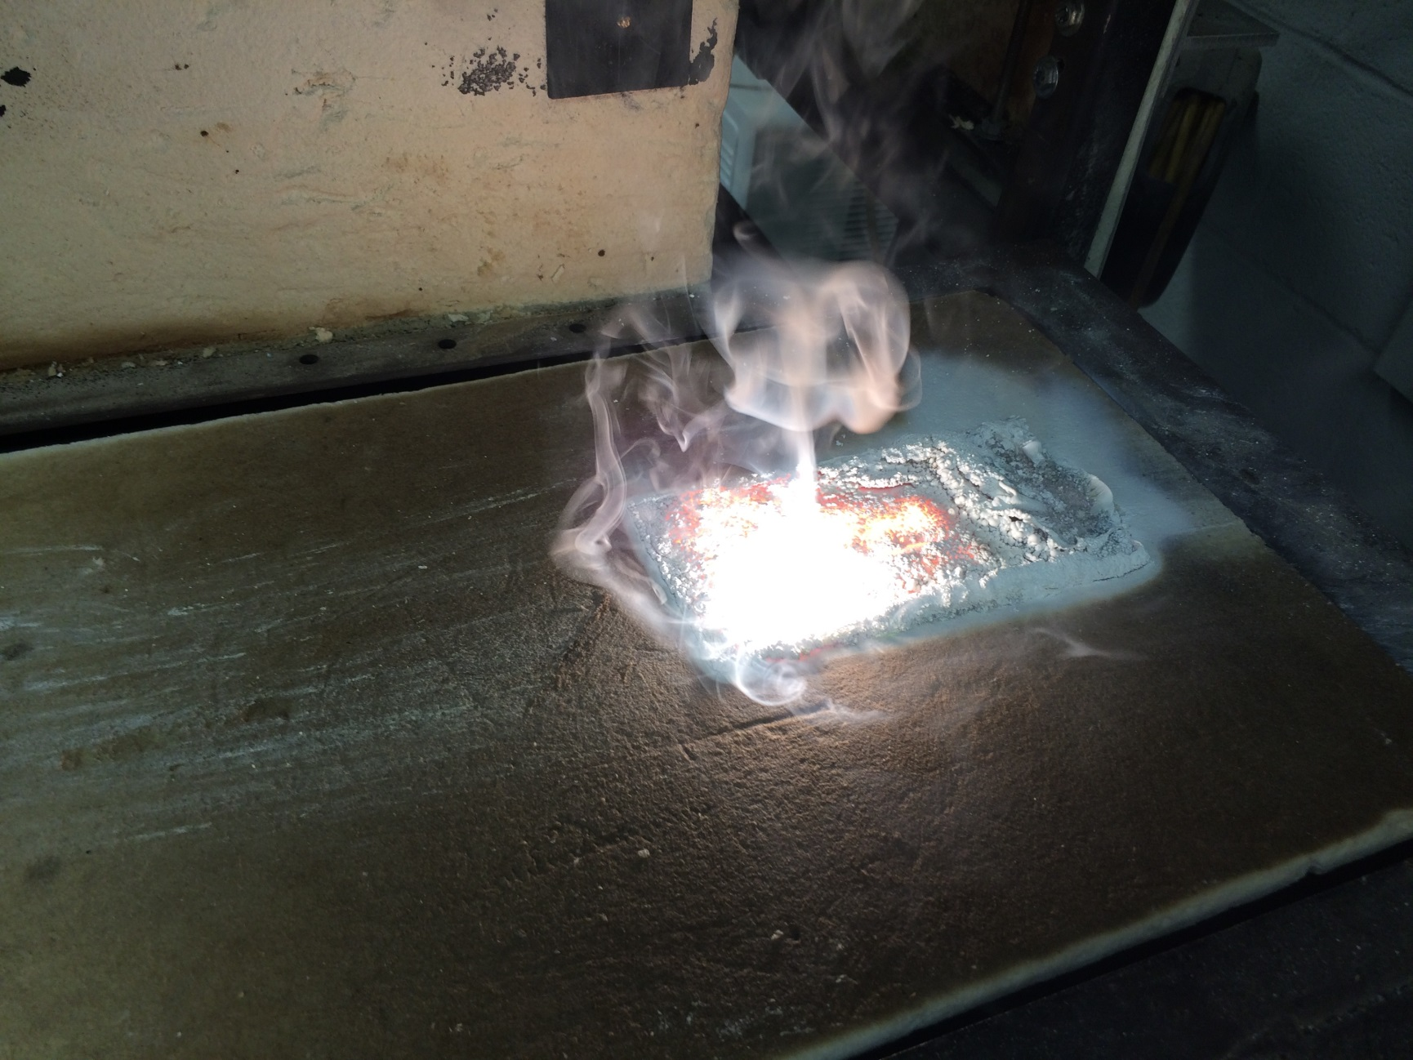
3- by 6-inch Sample of AZ-31

Slide 27
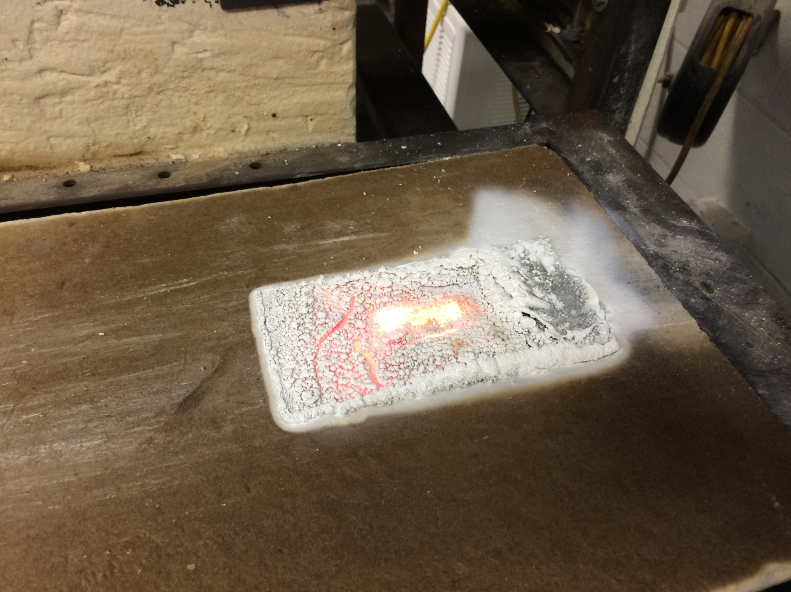
3- by 6-inch Sample of AZ-31
Sample completely consumed (100% weight loss)

Slide 29
Preliminary Findings of 3- by 6-inch Magnesium Sample Testing
When using 3- by 6-inch sample size, better separation between good and poor alloys
EL21 ignited more easily than EL43
Neither EL21 or EL43 samples burned completely (100% weight loss)
3- by 6-inch sample size scaled more appropriate for the apparatus
Increased sample length allows sample the opportunity to self extinguish
Time of ignition may not be important, provided the sample demonstrates ability to
self-extinguish
Pilot light repositioned to ½-inch from end of sample

Slide 30
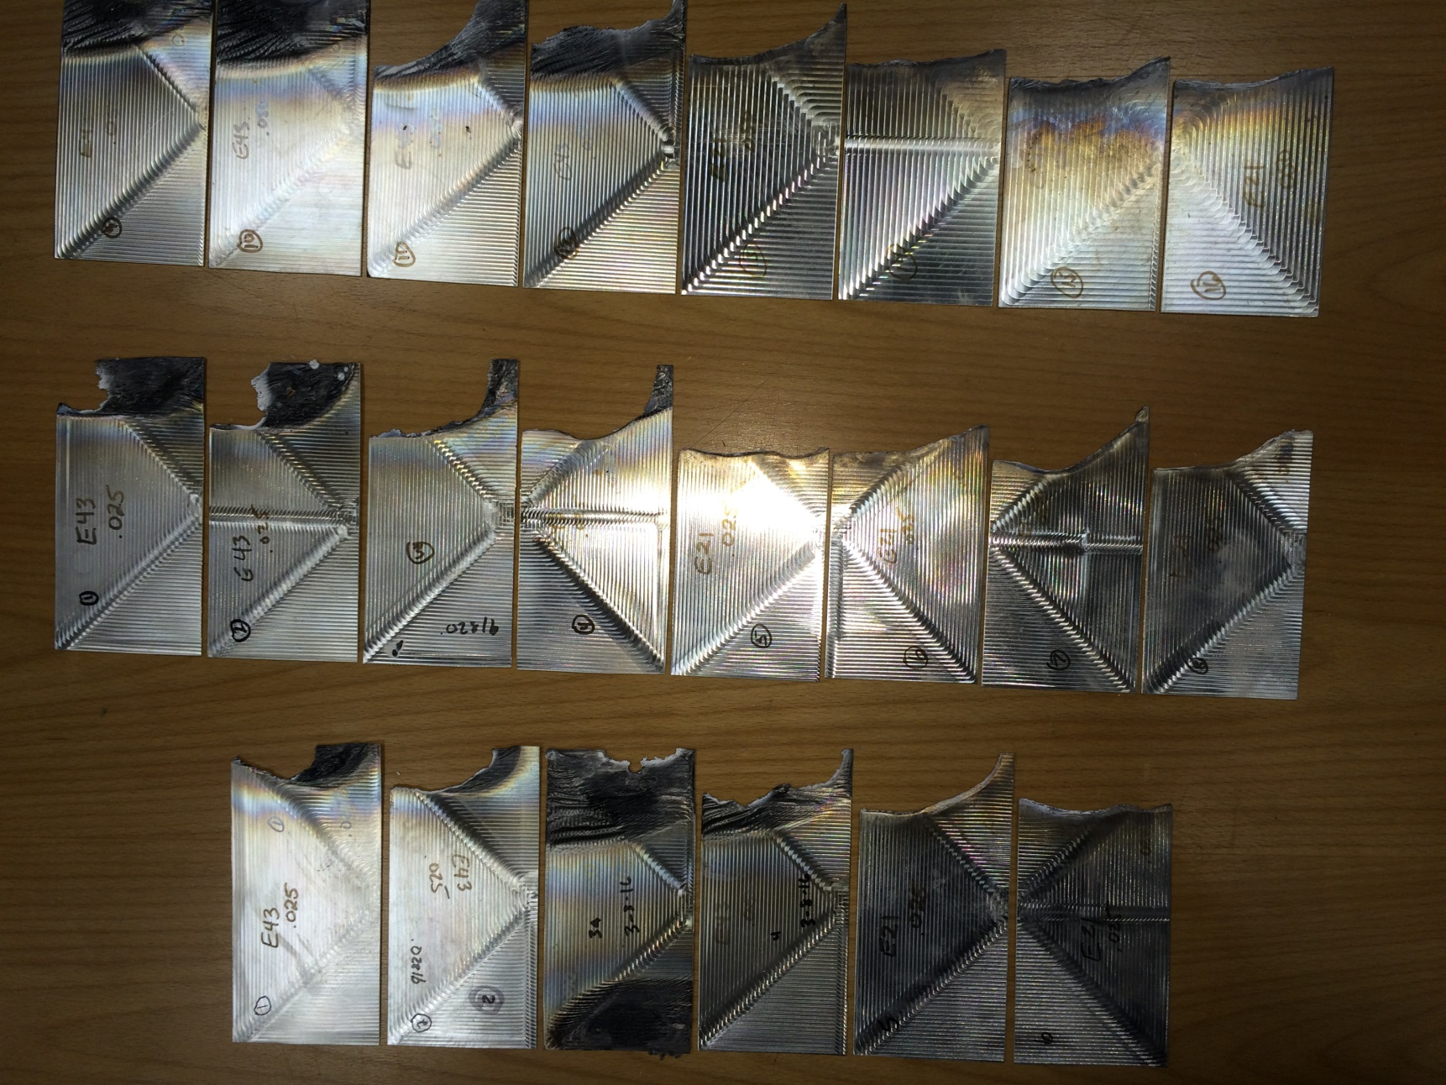
Test Results of 3- by 6-inch Thin Magnesium Samples

Slide 31
Questions on Radiant Panel Testing of Thin Samples?

Slide 32
Testing of Thinner Bar Samples Using Oil Burner
Proposed SAV ratio limit of 20 for “solid” seat components
What if solid seat component exceeds SAV ratio? example: tray table arm
2 SAV ratios studied: 23 and 26

Slide 33
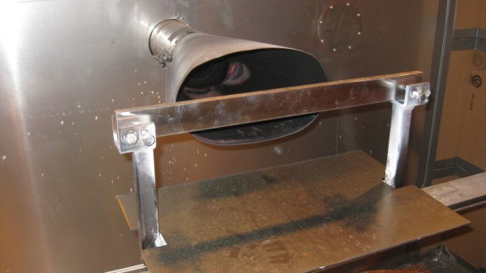
Surface Area to Volume Ratio
For rectangular bar test sample:
Surface Area = (2 x 0.25 x 20) + (2 x 1.5 x 20) + (2 x 0.25 x 1.5)
Surface Area = (10) + (60) + (0.75) = 70.75 in²
Volume = (0.25 x 1.5 x 20) = 7.5 in³
SAV Ratio = 70.75 ÷ 7.5 = 9.43 in⁻¹
SAV Ratio = 9.43

Slide 34
Testing of Thinner Bar Samples Using Oil Burner

Slide 35
Testing of Thinner Bar Samples Using Oil Burner

Slide 36
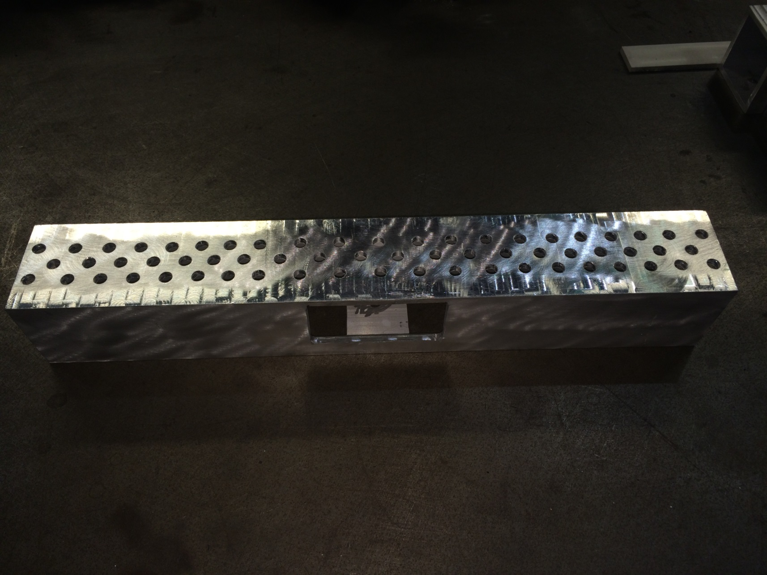
Machining Thin Magnesium Bar Samples

Slide 37
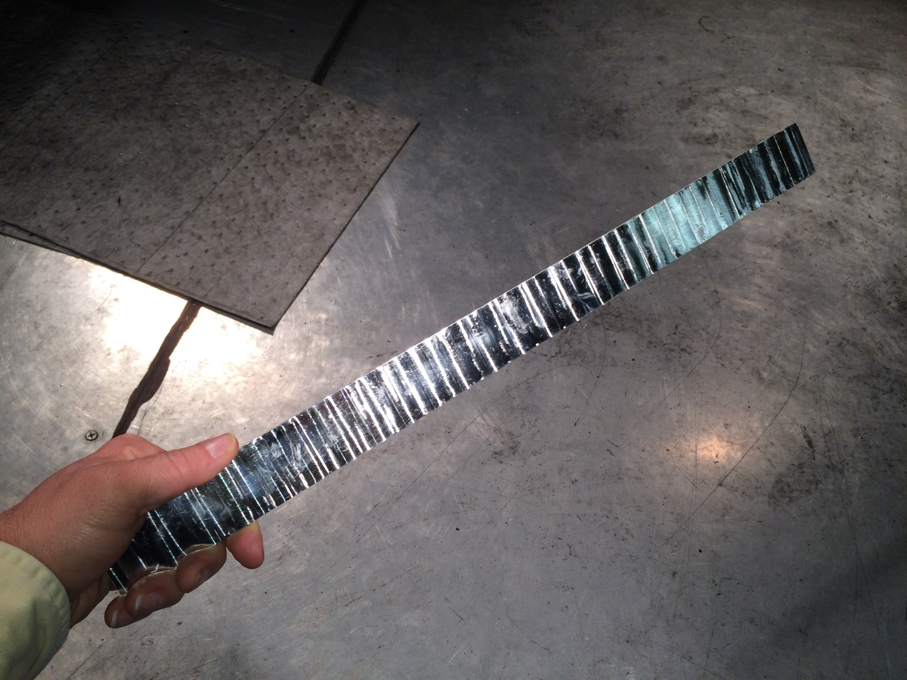
Testing Thin Magnesium Bar Samples

Slide 38
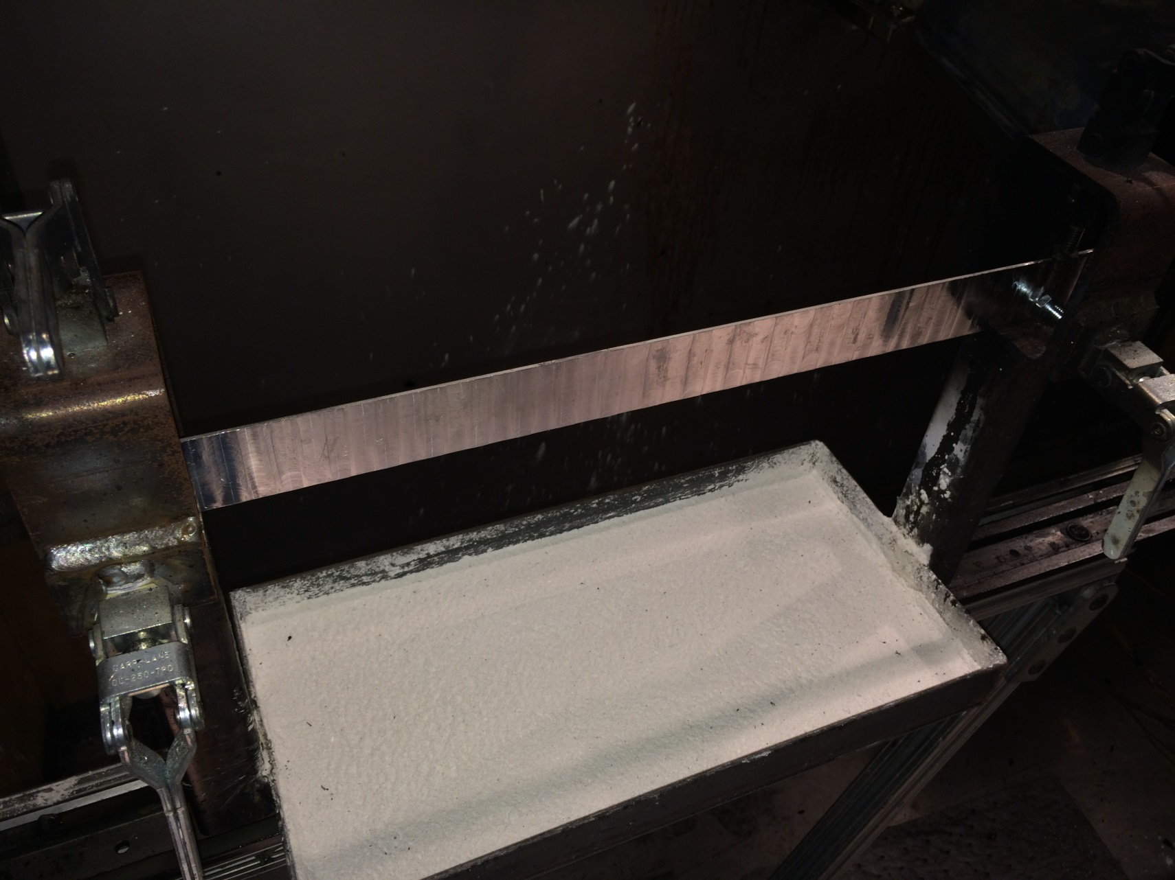
Testing Thin Magnesium Bar Samples

Slide 40
Discussion Items for Task Group
Continue the development of acceptance criteria for allowing the use of the
oil burner for:
non-primary seat components (ex: tray table arms). Discuss recent
oil burner tests on thin bar samples.
non-seat components (ex. galley carts).
Continue radiant panel testing of thin magnesium alloy samples, develop
pass/fail criteria for inaccessible area components.
Discuss use of magnesium alloy components located in accessible areas that are
situated higher than seat back height.

Slide 41
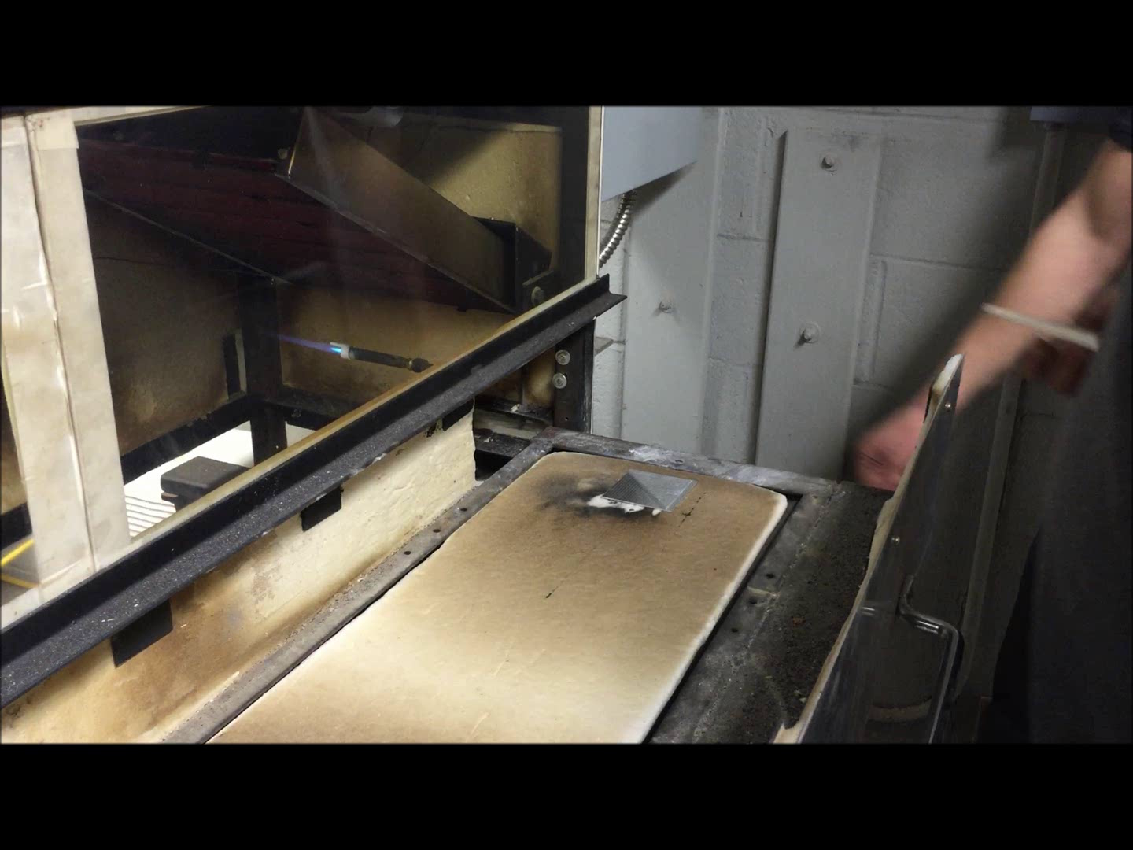
Video of Thin Magnesium Sample in Radiant Panel

