Slide 1
OSU
&
HR2 Updates
2014 March Materials Meeting
Savannah, GA
Materials Working Group
Michael Burns, FAA Tech Center
March, 2014

Slide 2
AGENDA
OSU
  Wet Test Meter Calibration
  HRR Negative Values
HR2 Update
  Upper Pilot Burner Discussion
  HR2 Manufacturing Update
Summary / Future Work

Slide 3
Wet Test Meter Calibration Facilities

Slide 4
OSU Negative Heat Release Rates
Part IV—Test Method To Determine the Heat Release Rate From Cabin Materials Exposed to Radiant Heat.
(g) Criteria. The total positive heat release over the first two minutes of exposure for each of the three or more samples tested must be averaged, and the peak heat release rate for each of the samples must be averaged. The average total heat release must not exceed 65 kilowatt-minutes per square meter, and the average peak heat release rate must not exceed 65 kilowatts per square meter.
Chapter 5: FAA Fire Test Handbook
5.7.12 Compute and record the total heat released during the first 2 minutes of testing by integrating the heat release rate versus time curve during the first 2 minutes.
* Negative HRR values: Included in the 2-minute THR summation as a zero.

Slide 5
  HR2: Upper Pilot Burner Alternatives
  Upper Pilot Burner typically makes up approximately 30% of Baseline mV Signal
  FR off-gassing products can have a tremendous impact on pilot burner stability
  Alternatives included:
      Pilot Burner Relocation
      Hot Surface Ignition (HSI)
      Hybrid (Standard Burner with HSI)

Slide 6
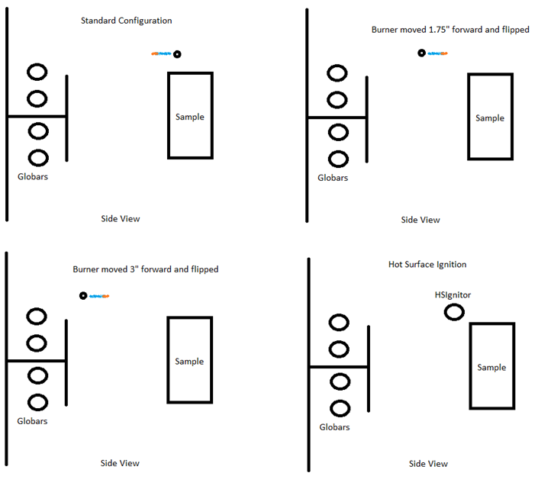

Slide 7
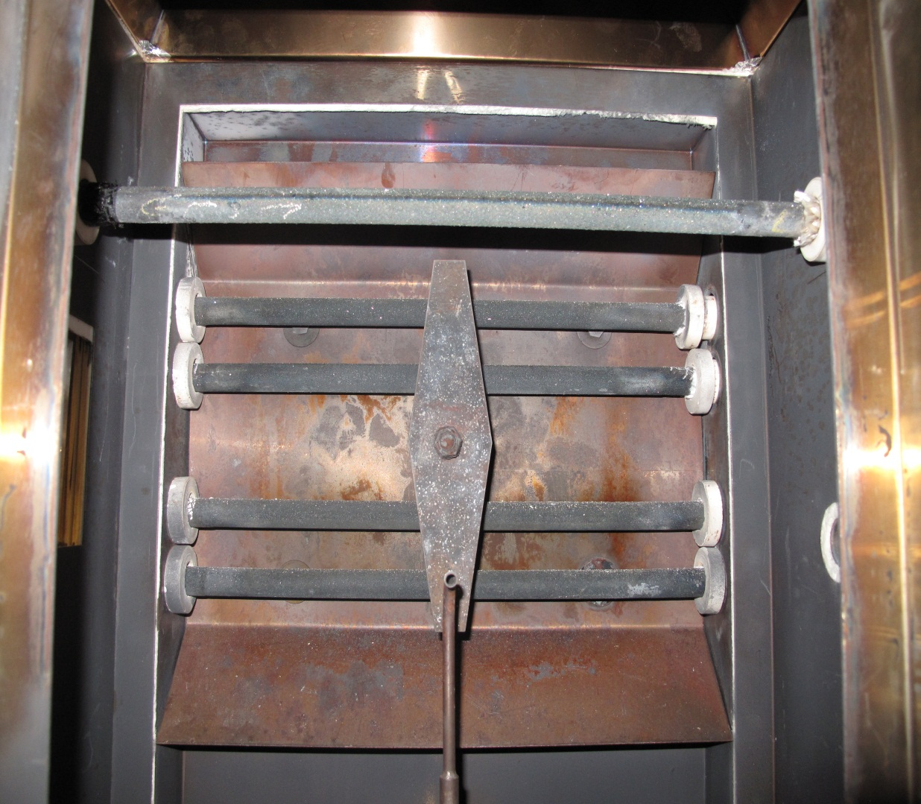
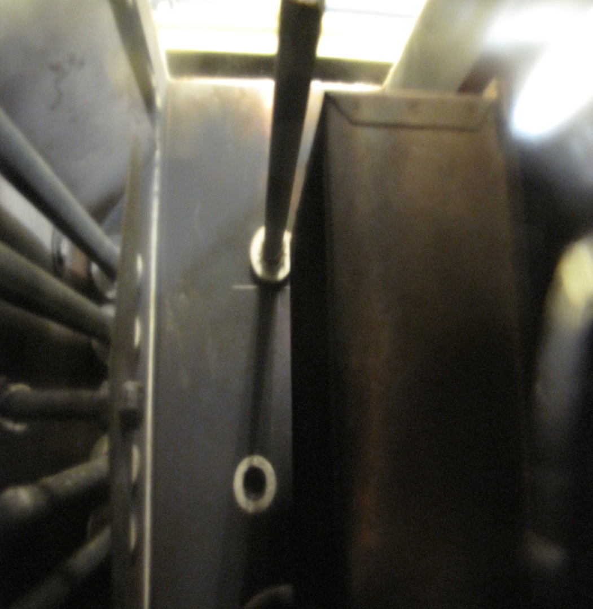
Hot Surface Ignition (Globar)
  Mounted ¾” above and forward of the specimen face
  AC Voltage controlled using Variac transformer

Slide 8
  Hot Surface Ignition (Globar)
  Looking at Heat Release Data and Repeatability
  Open Flame (15 Hole Standard Upper Pilot Burner)
  OSU: ~ 7 mV rise from Baseline (Upper & Lower)
  HR2: ~ 14 mV rise from Baseline (Upper & Lower)
  Hot Surface Ignition (HSI)
  HR2: Matched heat output to 14 mV thermopile rise
    2000 Watts ( 53.5 VAC @ 37.8 Amps)
  HR2: Matched heat output to 7 mV thermopile rise
    925 Watts (33.85 VAC @ 27.3 Amps)

Slide 15
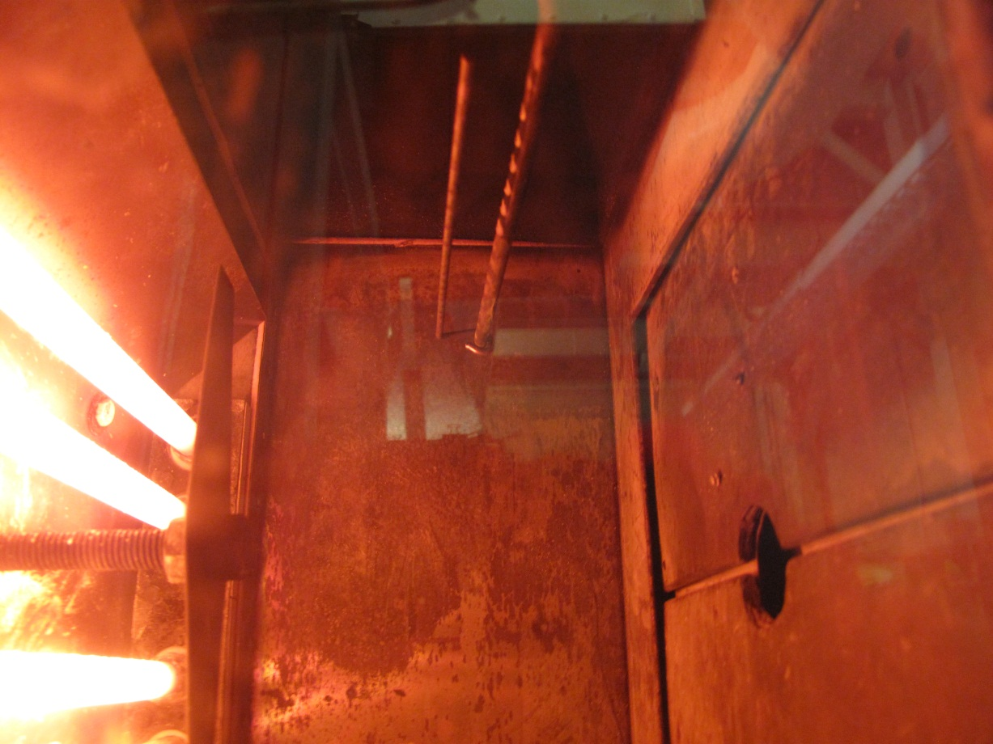
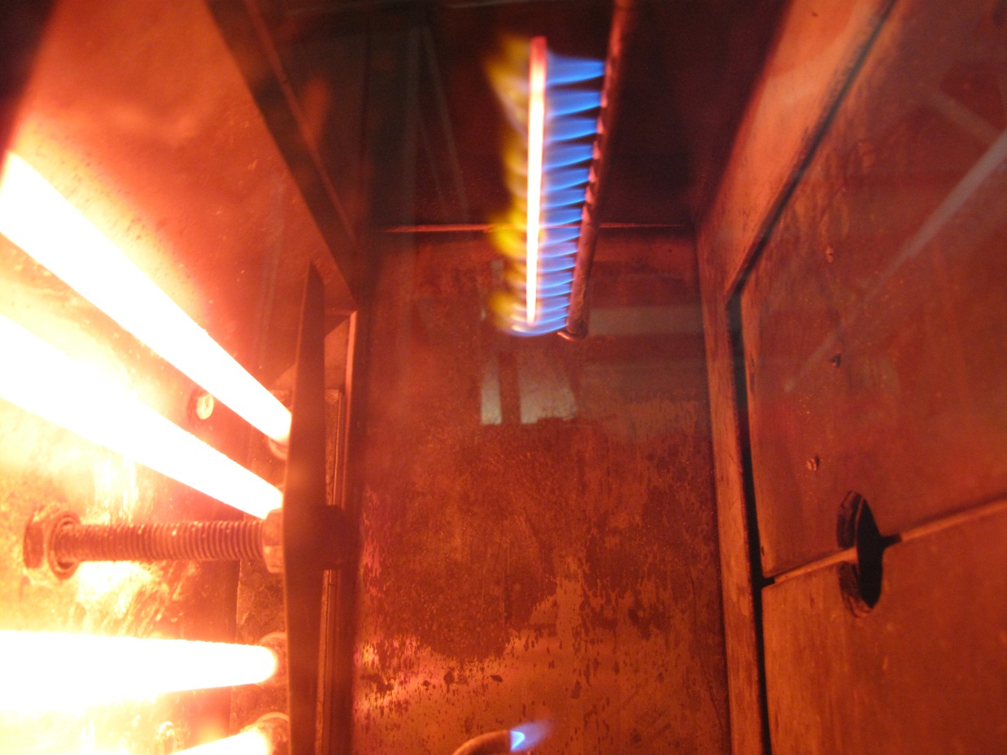
Hybrid Burner: Standard Burner / HSI
  1/8th Inch Rod (same as sample holder rod) mounted ~ ¾” forward of burner tube in hottest part of flame
  No Power Required / Continuous Automatic Re-ignition of all 15 Flamelets

Slide 16
Hybrid Burner: Standard Burner / HSI

Slide 17
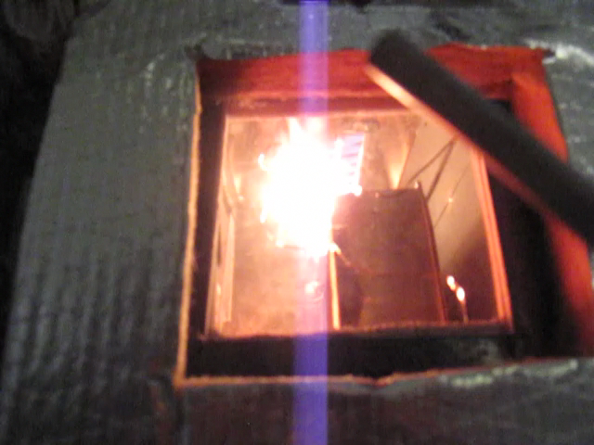
Hybrid Burner: Standard Burner / HSI

Slide 18
Upper Pilot Burner / HSI Summary
  Burner Position
  Repositioned burner made no improvements
  HSI
  Large power requirement needed to maintain equal heat output of current burner (2000 Watt)
  Trend: Increased HSI Wattage = increase PHR/THR; decrease TTP
  Reduced heat output showed better data equivalency to OSU (925 Watt)
  Hybrid Burner
  Shows potential however more testing needed
  Input needed from Task Group

Slide 19
HR2 Buildups
  Marlin Engineering, WA (Martin Spencer) * Currently working with Tech Center
  2200 Division Street Suite A
  Bellingham, WA 98226 USA
  Phone: (360) 671-0155
  Email: mspencer@marlinengineer.com
  Govmark, IL (Fred Schall) * Currently working with Herb Curry, Inc. Lab
  4004 W Dayton St
  McHenry, IL 60050
  USA
  Phone: (815) 322-2013 ext. 101
  Email: fred.schall@govmarkltd.com

Slide 20
FUTURE WORK
  Continue OSU Round Robin Support
  Upper Pilot Burner Alternatives
    (Task Group Input)
  Conduct testing using multiple HR2’s
    Repeatability / Reproducibility
    Pass / Fail Criteria (65/65)

Slide 21

Questions?

