Slide 1
NexGen Burner Comparative Testing

Slide 2
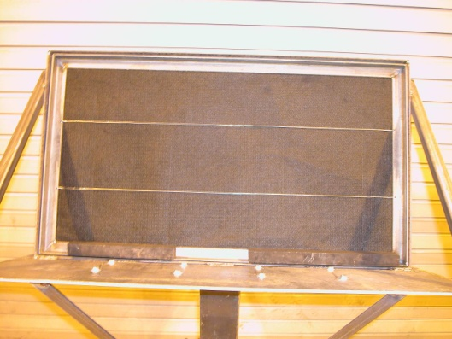
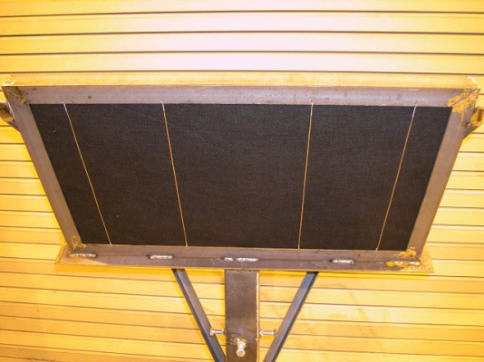
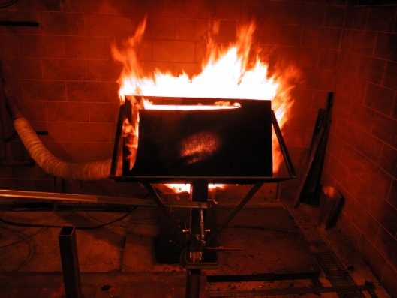
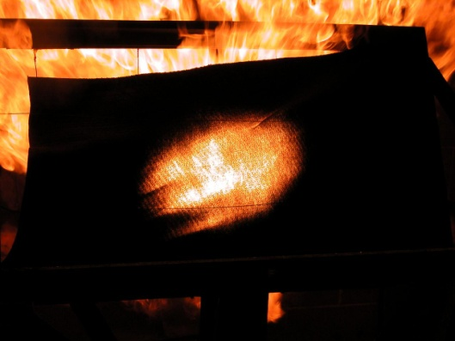
Objectives
Perform comparative burnthrough testing to determine the effect of various parameters on test results
  Use picture frame sample holder and PAN material to determine burnthrough performance
Test results will help to determine which parameters are most critical when specifying the burner in the new workbook

Slide 3
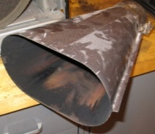
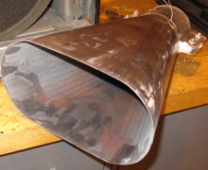
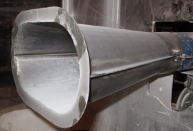
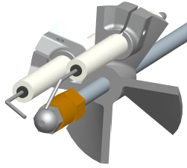
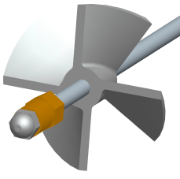
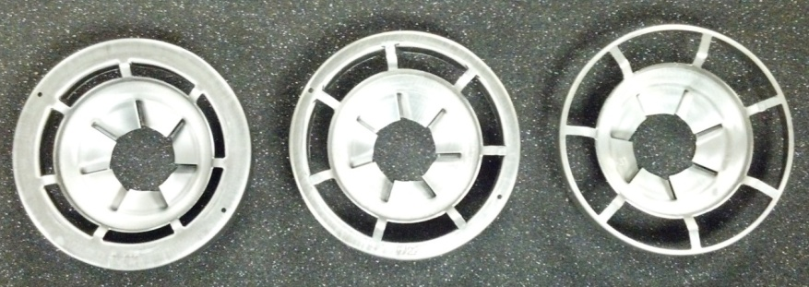
Review from Toulouse
Comparative BT tests were performed to determine effect of various parameters on BT time
  Sonic choke location
    Moving the choke upstream before a 6’ flex hose had little effect on BT
  Burner cones
    Cones of different construction and age had an effect on BT times
  Igniter-less stator
    Introducing a symmetric stator and removing the igniters significantly increased the BT time
  Flame retention heads
    Combined stator-turbulator devices on new OEM oil burners
    Different FRH’s had different effects on BT times
    F-22 model showed similar results to current NexGen burner configuration

Slide 4
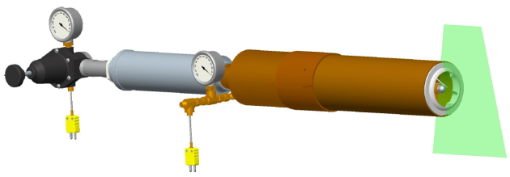
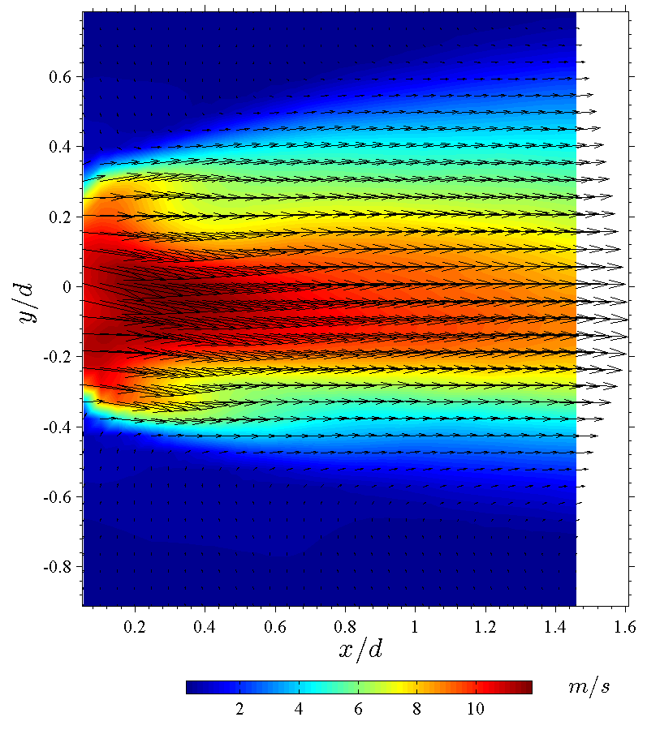
Review from Indy
PIV measurements were made for various configurations of the stator and flame retention heads
Despite having the same mass flow rate of air (regulated by sonic choke), different configurations resulted in varying velocity profile shapes and peak velocity
A strong correlation was made between measured peak velocity and burnthrough time
Indicates that not only is the mass flow rate a critical parameter, but the configuration of the internal components can result in drastically different velocity profiles which can affect the burnthrough performance

Slide 5
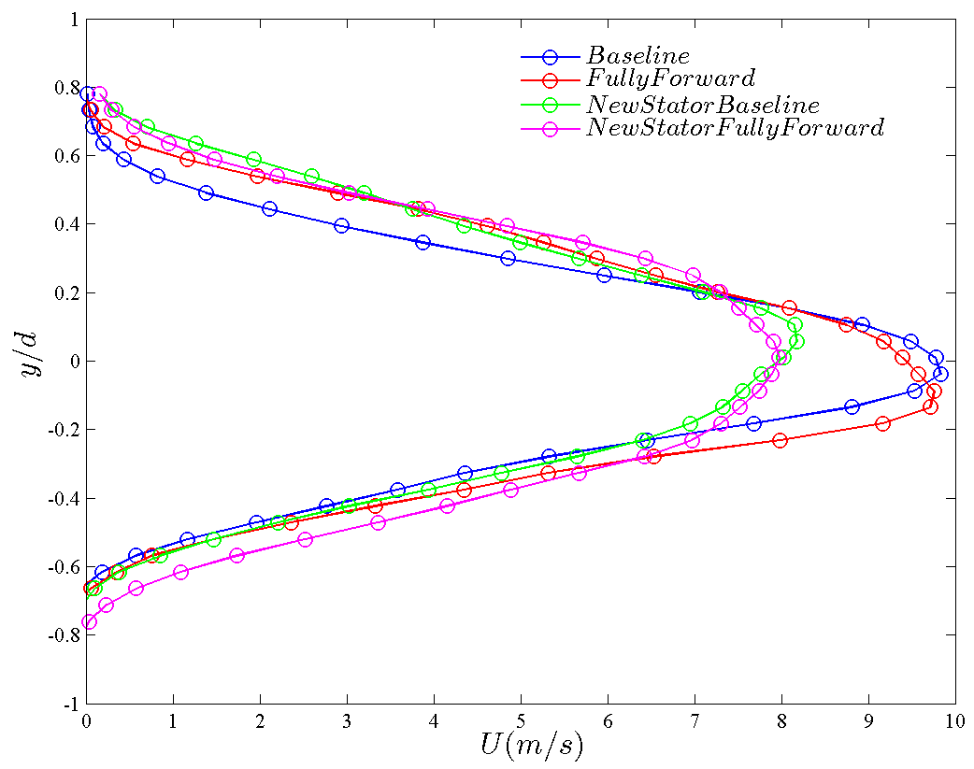
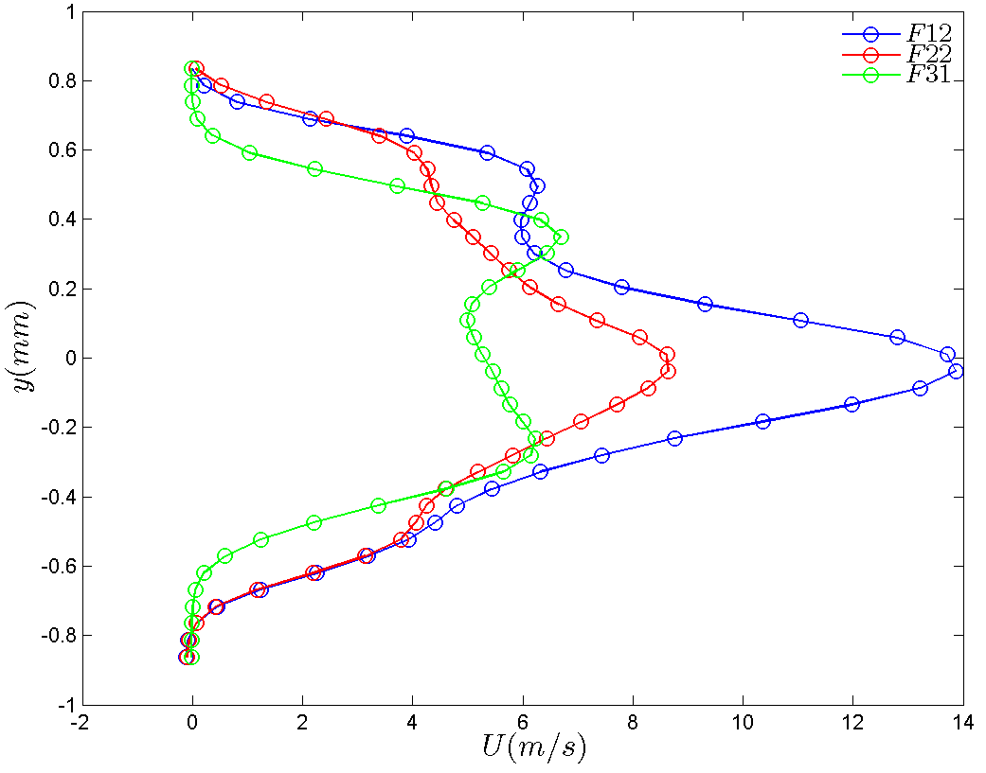

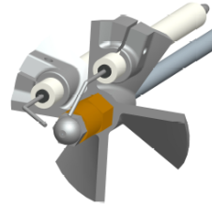

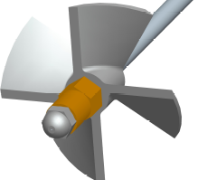
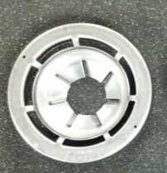


Mean axial velocity profiles at one pipe diameter (4 inches) downstream from turbulator exit
Stators + Turbulator
Flame Retention Heads
Baseline
Baseline
Fully
Forward
New Stator
New Stator
Fully
Forward
F12
F22
F31

Slide 6
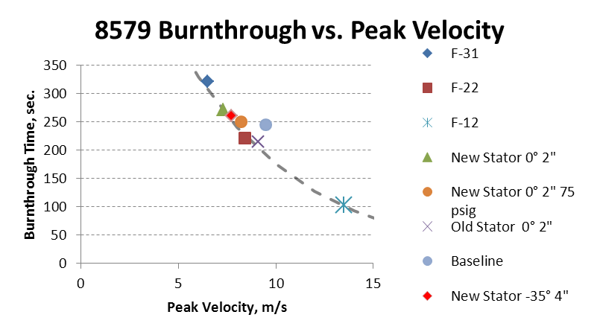
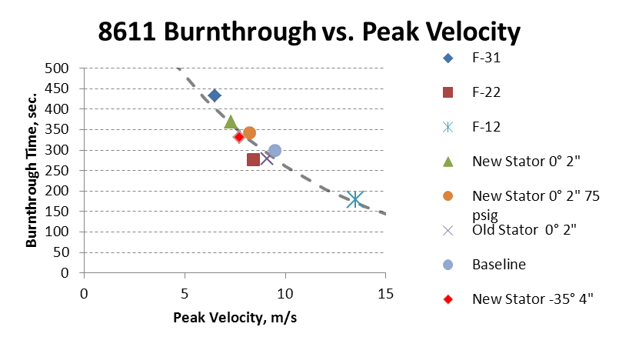
Burnthrough vs. Peak Velocity

Slide 7
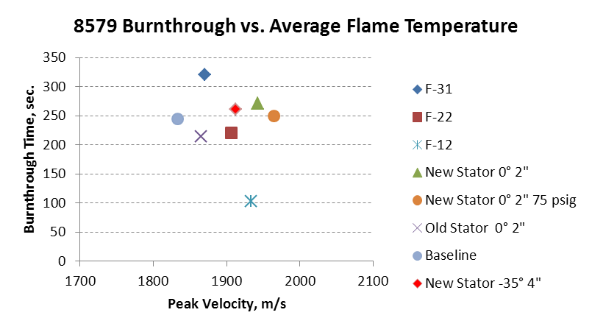
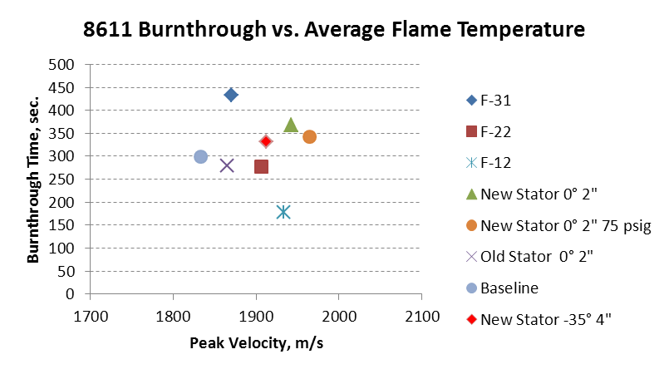
Burnthrough vs. Average Flame Temperature

Slide 8
Burnthrough vs. Peak Velocity – Summary
A strong dependence between peak velocity and material burnthrough was found
  The higher the peak velocity, the quicker the burnthrough
Despite having the same sonic choke-controlled mass flow rate of air into the burner, the stator & turbulator or FRH can shape the velocity profile and change the burnthrough time
No correlation was found between burnthrough time and average flame temperature

Slide 9
Nozzle Comparison
The spray nozzles tested compare reasonably well with baseline Monarch nozzle
  Some are within 1 standard deviation, the rest are within 2 standard deviations of baseline
Nozzles that flow 5.8 gph @ 120 psig compare well with those that flow 6.0 gph
  Further evidence for the 6.0 ± 0.2 gph tolerance
  The nozzle that flows 5.5 gph @ 120 psig does not compare with the rest
Specification of fuel flow rate is not adequate for describing fuel spray
  Fuel pressure and nozzle rating should be specified, as well as spray type should be specified
  Other factors that were not measured in this test series may have an impact on test results
    Spray asymmetry
    Droplet size

Slide 10
Fuel Type Comparison
One variable that cannot be controlled is the type of fuel used for the burner
Jet fuels, kerosene, and diesel are all similar in specification but will vary in composition
  Refinery location
  Local demands
  Seasonal changes
Comparative BT testing was performed to determine the effect of fuel type on BT results
*all tests run at 120 psig fuel pressure

Slide 11
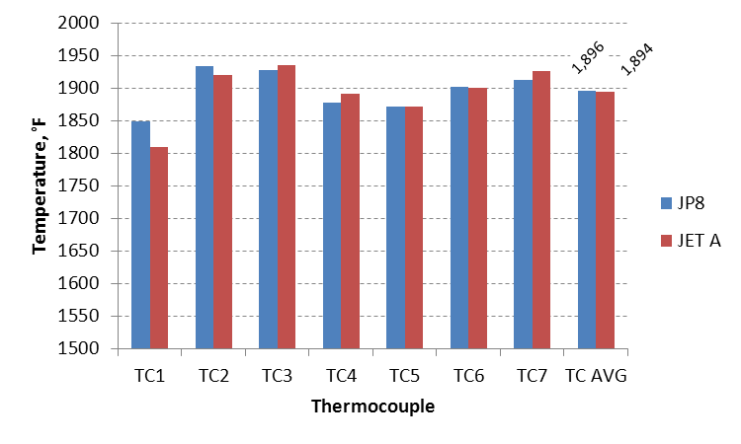
JP8 vs. Jet-A, December 2010
Same burner configuration, tests performed within 1 day of each other
Only variable was the type of fuel

Slide 12
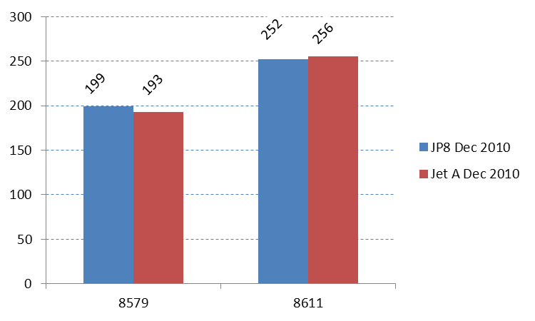
JP8 vs. Jet-A, December 2010
% SD 5.10 or less
Jet A % difference
  8579: -3.18%
  8611: 1.39%
Jet A and JP8 provide similar BT results under similar conditions

Slide 13
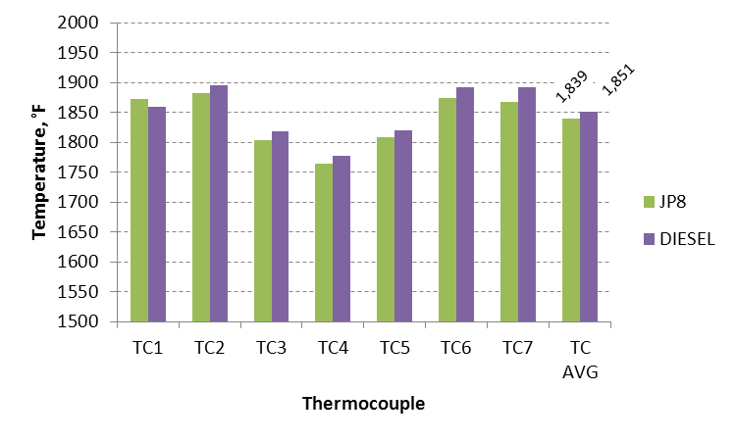
JP8 vs. Diesel, November 2012
New baseline with JP8 was obtained
Tests performed within one day of each other

Slide 14
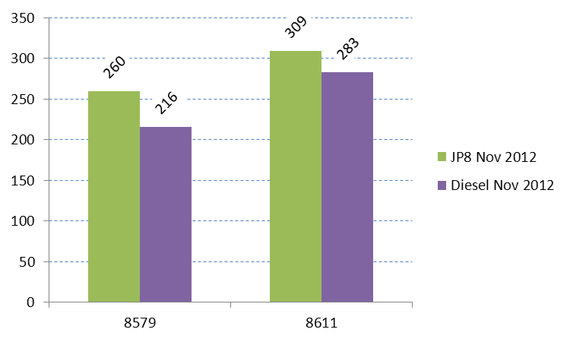
JP8 vs. Diesel, November 2012
%SD less than 5.9%
Diesel % difference
  8579: -17%
  8611: -8.5%
Diesel produced a much greater amount of soot than JP8 or Jet A
Large, glowing soot particles blast away at the PAN material, causing the material to burnthrough quicker

Slide 15
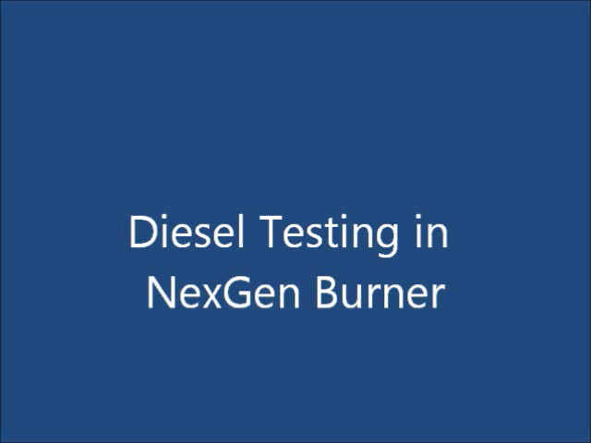

Slide 16
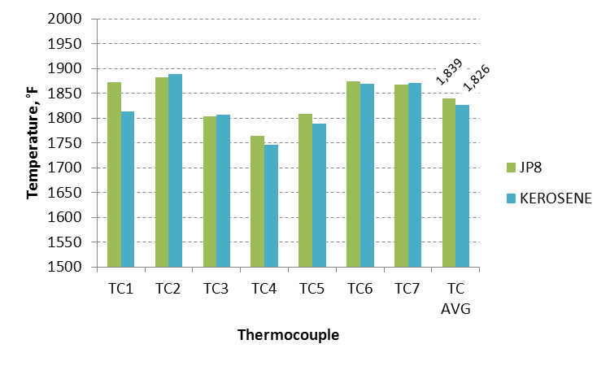
JP8 vs. K1 Kerosene
Same burner configuration
Tests performed 2 months apart under similar environmental conditions

Slide 17
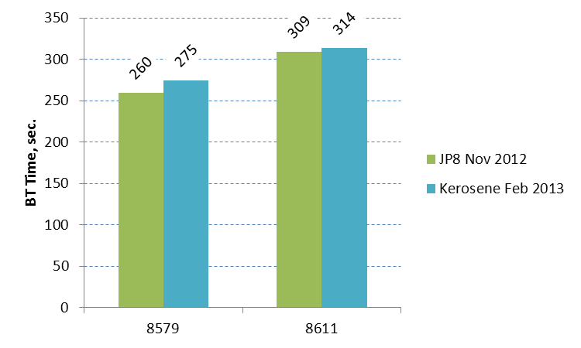
JP8 vs. K1 Kerosene
%SD less than 4.15%
Kerosene % difference
  8579: 5.78%
  8611: 1.46%
JP8 and Kerosene produce similar results under similar conditions

Slide 18
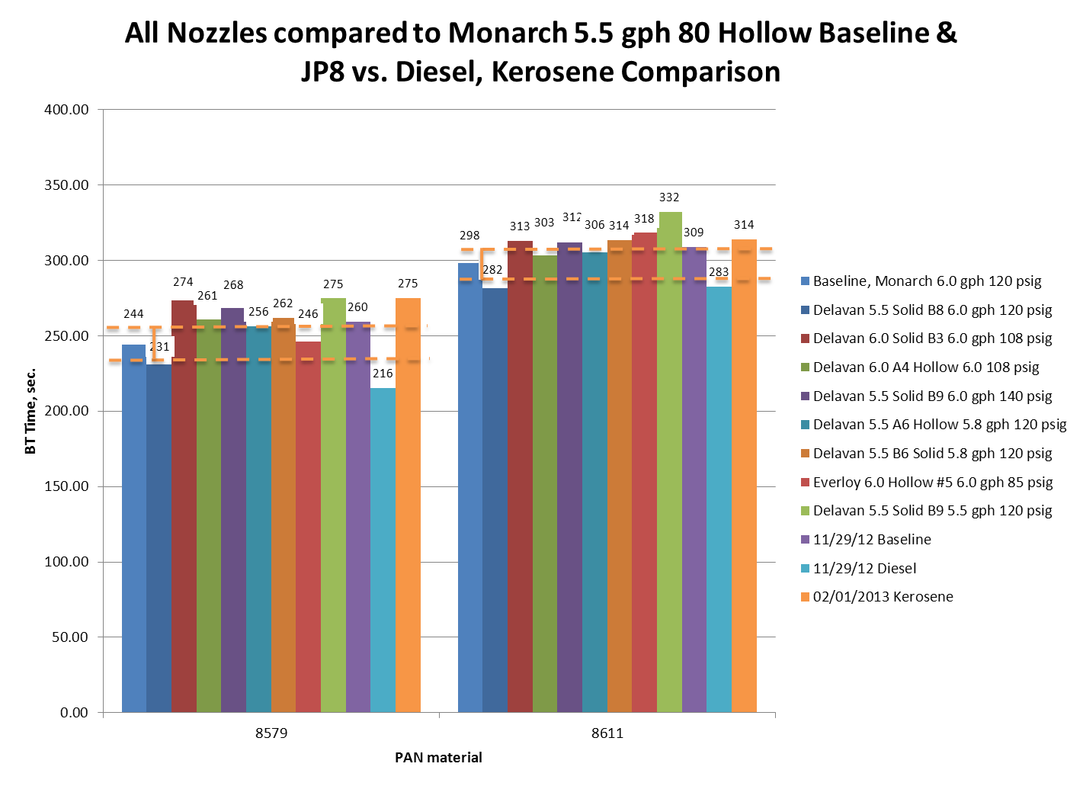

Slide 19
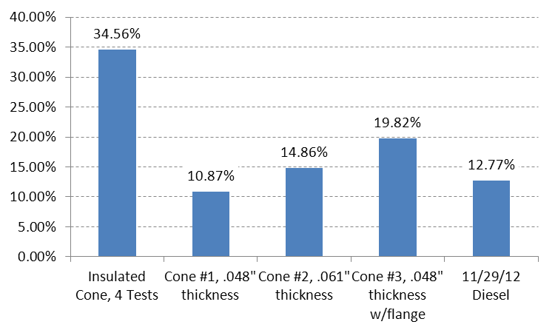
Comparison to Effect of Cones
Diesel fuel has a comparable effect to the use of a newer cone or a cone of different construction
The cones and diesel fuel all increase the severity of the burner performance, providing a more conservative test

Slide 20
Fuel Type Summary
The fuel type can have a significant impact on test results
  The use of Jet A in place of JP8 yields similar results
  The use of Diesel fuel in place of JP8 results in significantly quicker BT times (more conservative)
  The use of kerosene in place of JP8 results in similar BT times

Slide 21
NexGen Burner Round Robin
Discussed starting up an inter-laboratory comparative test series at last task group meeting
  Received interest from six labs worldwide with NexGen burners
  Will use the picture frame blanket holder and PAN materials to measure a lab’s burnthrough performance
Will be a two-part test series
  Evaluate current burnthrough performance of all labs as they are currently set up without making any changes
  Evaluate burnthrough performance after making changes recommended by FAATC and with parts provided by FAATC
    Changes could include cone, nozzle, FRH provided by FAATC. Same combination would be sent around to all labs
    Fuel type can not be changed, only noted
FAATC will develop test parameters over the next several months
  Test data sheets
  Instructional video
  Photos/videos of tests would be helpful

