Slide 1
Aircraft Wiring
Federal Aviation
Administration
Pat Cahill
Engineer, Fire Safety Team
FAA Wm. J. Hughes Technical Center
Atlantic City International Airport, NJ 08405
International Aircraft Materials Fire Test Working Group
Seattle, Washington
March 6 – 7, 2013

Slide 2
Test Methods and Apparatus
With the exception of number of wires and cables in the bundles and bundle diameters, test methods and apparatus are in accordance with Draft version 5.7, Chapter 4 (Flammability Test Method and Criteria for Aircraft Electrical Wiring).
Currently, this is the test method being pursued.

Slide 3
Reviewing Sleeves and Heat Shrink Tubing
Sleeves
We made the decision to use copper tubing as the non-combustible core for sleeves and heat shrink tubing.
A 13 inch +/- 0.125 inch (330mm+/_ 6.35mm) long piece of ¼ inch (6.35mm) outer diameter (OD) copper tube is the size used for sleeves.
A 14 ½ inch (368mm) long piece of ½ inch (12.7mm) sleeve material is the size for use over the copper tube.
Lacing cord or safety wire should be used to tie the sleeving around the copper tube.
Videos of testing are available on our website.

Slide 4
Reviewing Sleeves and Heat Shrink Tubing
Heat Shrink Tubing
A 13 inch +/-0.125 inch (330mm+/- 6.35mm) piece of 3/8 inch OD (9.52mm) copper tube is used for heat shrink tubing.
A 14 inch (355mm) long 2:1 piece of 0.47inch (11.9mm) shrink tubing is the size for use over the copper tube.

Slide 5
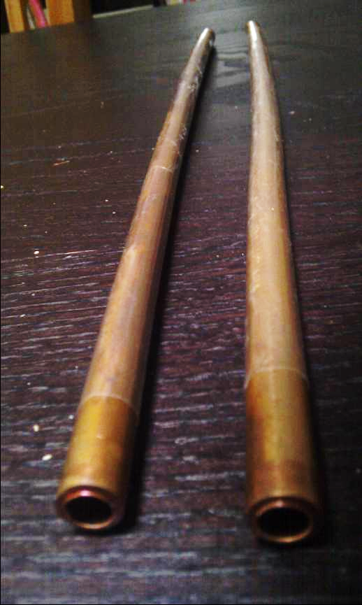
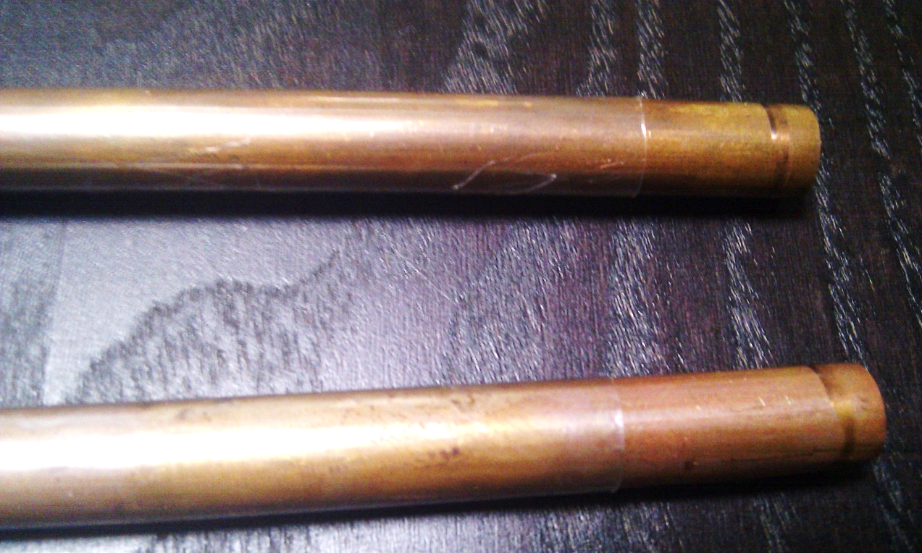
TFE Heat Shrink Tubing over 3/8 inch Copper Tube

Slide 6
Radiant Panel Wire Test Sample Setup and Testing

Slide 7
Under Investigation
Radiant Panel oriented vertically in small chamber.
We will begin evaluating wire samples in this chamber.
This test method is going to be evaluated for this application and this evaluation should not be interpreted as a planned change in test method.
Again, the current wire test performed in the standard Radiant Panel Test Chamber is the test method we are focusing on.

