Slide 1
Vertical Bunsen Burner Testing of 3-D Printed Material

Slide 2
Introduction
Test solid 3-D printed material in Vertical Bunsen Burner
Ultem Support material
0.060 inch thick Samples
Printed in 3 orientations
Flat (XY), Sideways (YZ), and Standing (ZX)
Attempting to find worst-case scenario in order to simplify future testing

Slide 3
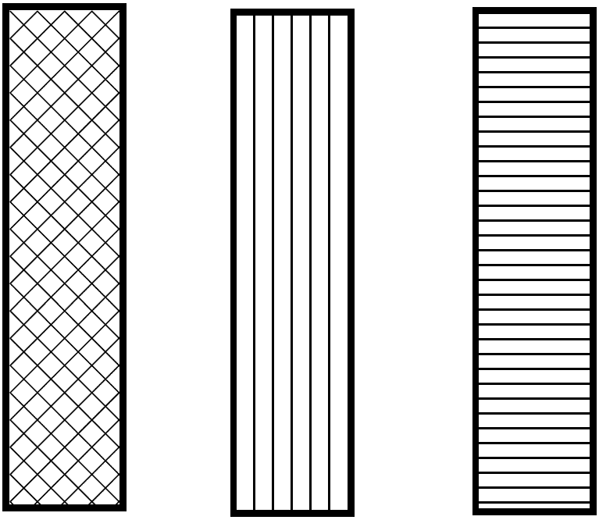
Printing Orientations
3 orientations
0.10” slice height
0.20” printing width
XY-Direction
YZ-Direction
ZX Direction

Slide 4
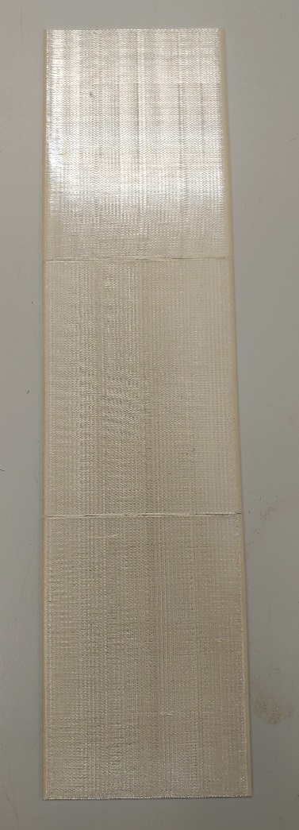
Ultem Support Material
(Used as support material when printer is building with Ultem 9085)
XY Direction
YZ Direction
ZX Direction

Slide 9
*All Ultem Support samples were allowed to self extinguish – above graph is percentage of samples with flame time > 60 seconds

Slide 10
Ultem Support vs. Nylon-12 Dripping
Ultem Support
Nylon-12
Nylon-12 continuously drips while Ultem Support had one big drip at most

Slide 11
Summary of Results and Future Work
Ultem Support showed some difference in printing orientation
YZ-direction only dripped on one sample vs every sample for the other print orientations
ZX-direction was most severe case for Ultem Support
XY-direction was most severe case for Nylon-12
Ultem Support seems to be a good candidate for a “borderline” material
Will test different thicknesses and infill percentage next

Slide 12
Questions?
Contact:
Steven Rehn
Federal Aviation Administration
William J. Hughes Technical Center
Fire Safety Branch, Bldg. 203
Atlantic City Int’l Airport, NJ 08405
(609) 485-5587
steven.rehn@faa.gov

