Slide 1
Additive Manufacturing Task Group
International Aircraft Materials Fire Test Forum
Cologne, June 18th 2019
T. Krause, Fire Safety Engineering & Fire Test

Slide 2
Additive Manufacturing Task Group
Generate approved guidance material for simplification of compliace approaches for Additive Manufacturing
ULTEM 9085 CG as an example to measure the influence of various build parameters in the Fused Deposition Modelling process
However, this PEI inherently has low after flame time and burn length, making it difficult to differentiate between material performance and influence of build variations

Slide 3
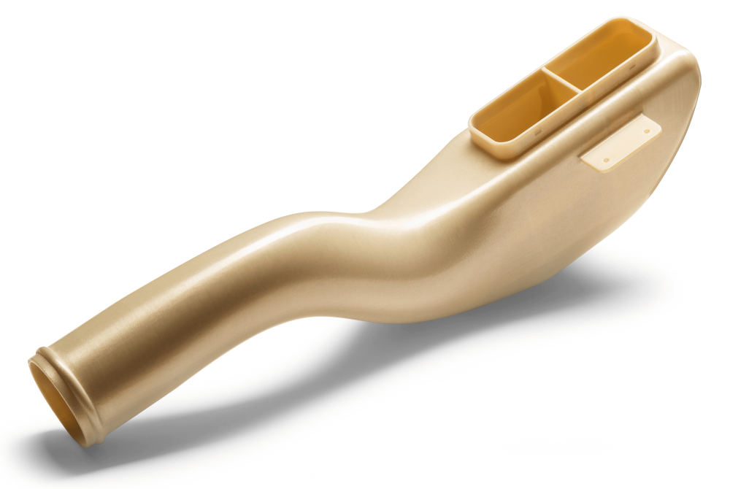
Parameters
Printing directions
Raster angle
Layer thickness
Thickness
Infill (%)
Single specimens vs. cut from bigger plate
cross section

Slide 4
Recap

Slide 5
Recap

Slide 6
Sandwich coupons
6 layers 1.5 mm
75 mm
100 %
52 %
33 %
standard printer settings
air gaps betw. adjacent rasters = 0,8 mm
air gaps betw. adjacent rasters = 1,2 mm
combine layer types
e.g.
100 % outside
33 % inside

Slide 7
Sandwich coupons
Layer 1/6 | Layer 2/5 | Layer 3/4 | Average | Coupon weight
100 % | 100 % | 100 % | 100 % | 100 %
100 % | 100 % | 33 % | 78 % | 89 %
100 % | 52 % | 52 % | 68 % | 77 %
100 % | 52 % | 33 % | 62 % | 89 %
100 % | 33 % | 33 % | 55 % | 67 %
1
2
3
4
5
6
Investigate discrepancies of coupon weight vs. theoretical layer weight
Coupon weight used for this study

Slide 8
12 s VBB
sandwich
sandwich

Slide 9
12 s VBB
sandwich
sandwich

Slide 10
12 s VBB
sandwich
sandwich

Slide 11
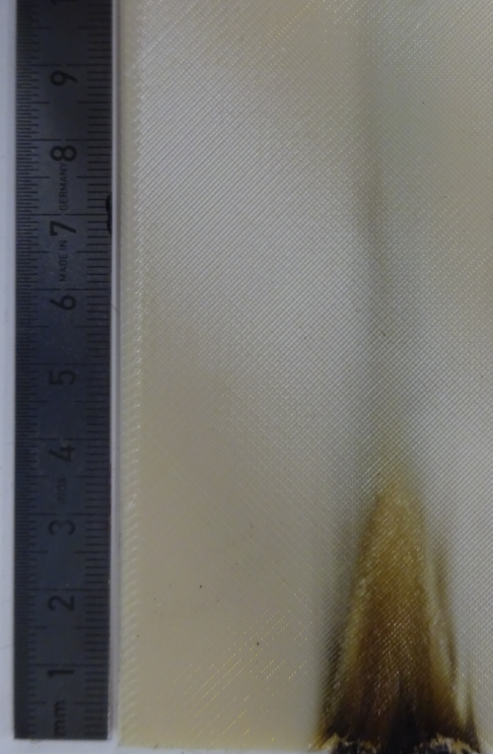
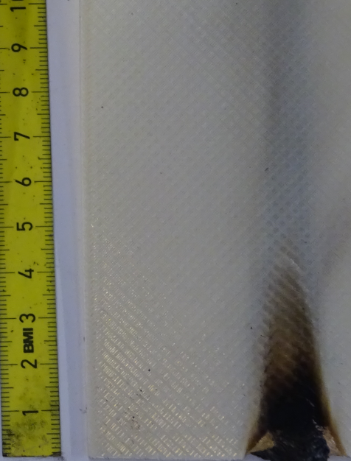
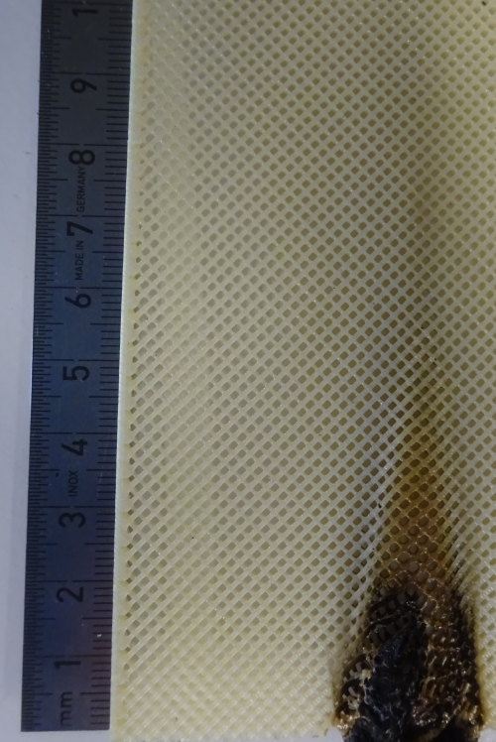
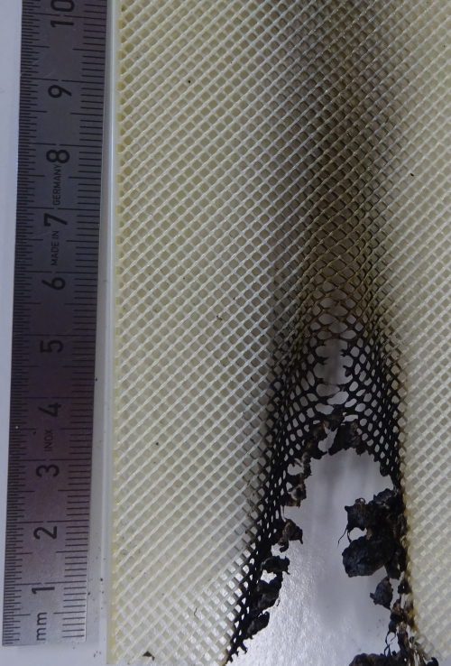
12 s VBB
100 %
67 %
sandwich
52 %
33 %

Slide 12
12 s VBB
67 %
sandwich
33 %

Slide 13
60 s VBB
sandwich
sandwich

Slide 14
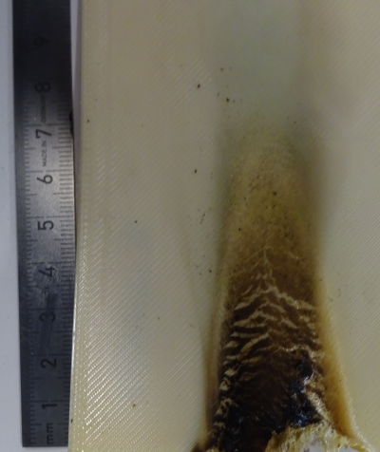
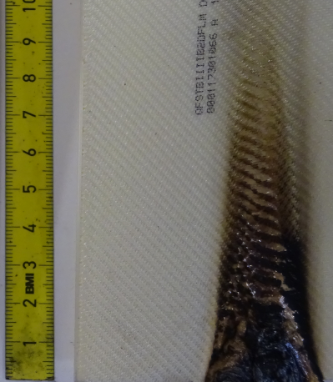
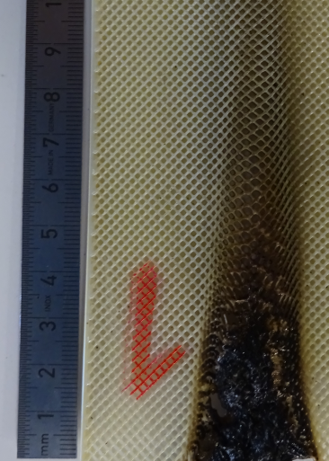
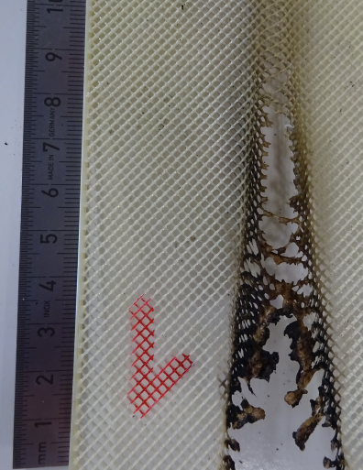
60 s VBB
100 %
67 %
sandwich
52 %
33 %

Slide 15
Summary
Lower infill leads to (generally) higher burn length and after flame time
For sandwich configurations, burn length may be more dependent on the outer layer infill than after flame time → expand data base
60 s shows similar burn length characteristics, but no stable after flame time for any infill due to intumescent effect of PEI

Slide 16
Task Group
Wednesday, 08.30 h

Slide 17
Thank you

