Slide 1
International Aircraft Materials Fire Test Working Group Meeting
Study of Reinforced Cone for use with Oil Burners
International Aircraft Materials Fire Test Working Group
Tim Salter, FAA Technical Center
June 6-7, 2018, Montargis, France

Slide 2
Presentation Outline
Background Information
Standardized Cone Design
Cone Warpage Issues
Reinforced Cone Vs. Standard Cone Study
Test Result Comparison and Outcome
Additional Item
Burner Flame High Speed Video

Slide 3
Burner Cone Background
Burner cone dimensions and diagrams have been standardized since burner conception
Cones subject to warpage due to heat cycling
Various designs or frames, clamps, and rings have been used by labs to reduce warpage
No standardized design for cone reinforcement
FAA study revealed cone reinforcements influence airflow emitted from burner cone exit plane
Alterations to cone design discouraged due to unknown influence on test results

Slide 4
Defined Cone Specifications
Alloy type
Sheet metal gage (thickness)
Placement of bends, welds, and small features
Tolerance for cone exit plane dimensions
Replace or repair cone if out of tolerance
Cone dimensions should be checked at the beginning and end of test day
Test results may be void if cone is found to be out of tolerance after testing

Slide 5
Cone Warpage Study
Cone exit plane may expand or contract out of tolerance
Some labs experiencing excessive cone warpage and frequently repairing or replacing cones
Costly and time consuming
Allow cone reinforcement?
Conduct study to determine if cone reinforcement may be permitted
Are the test results the same? More or less severe?

Slide 6
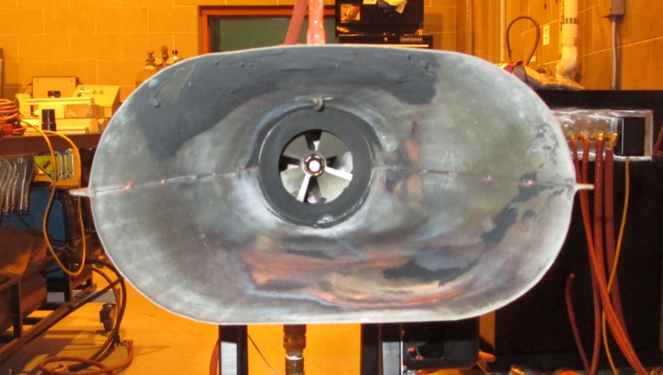
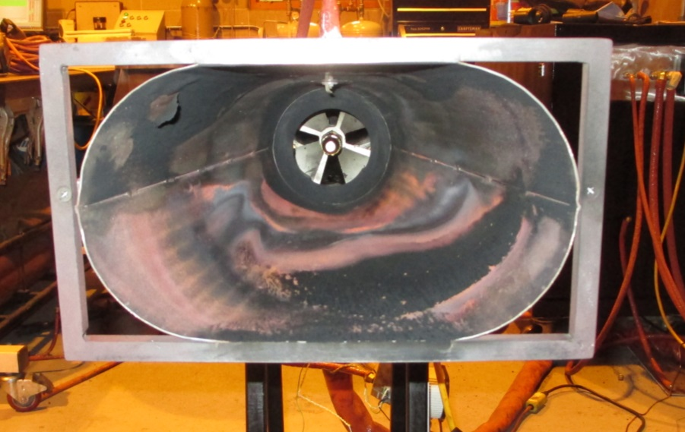
Cone Comparison Study
Study involving two labs
FAA T.C. and outside test lab
Run tests with standard and reinforced cones
Same reinforced cone used by both labs
Seat cushion test method used for study
Seat test samples more sensitive than other burner test samples
Tests results most likely to show influence of cone reinforcement frame

Slide 7
Cone Comparison Study
Identical seat test sample used for both cone designs
Fire hardened foam
Same manufacturer
No dress covering
9 samples per cone
3 different foam densities
3 samples of each density
3 + 3 + 3 = 9
FAA T.C. results showed excessive burning on bottom of sample due to burner misalignment

Slide 8
Low Density Foam Results
FAA T.C. Test Lab
Outside Test Lab

Slide 9
Medium Density Foam Results
FAA T.C. Test Lab
Outside Test Lab

Slide 10
High Density Foam Results
FAA T.C. Test Lab
Outside Test Lab

Slide 11
Outcome of Study
Average percent weight loss and burn lengths differed between labs
Burner configuration issue
Reinforced cone results more conservative for nearly all test parameters at both labs
More severe burning of samples
Frame successfully prevented warpage
Study results show reinforced cone design may be acceptable for certification testing

Slide 12
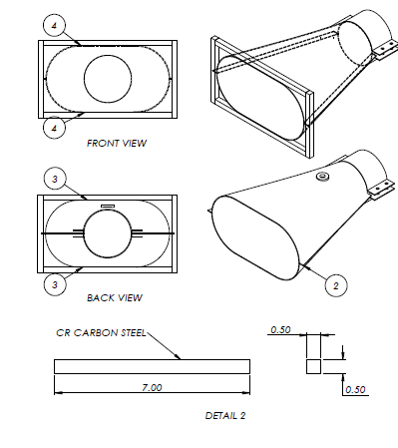
Handbook Updates
Dimensions and drawings of cone frame will be added to Fire Test Handbook
Chapter 7
Frame is optional
Conventional or reinforced cone permitted for testing
No other reinforcement designs tested
Use the frame design provided in Handbook

Slide 13
Burner Flame Video
High speed video TCs in burner flame
Cargo burner flame shown
Demonstrates transient flame
TCs not continuously immersed in flame
Thermocouples with a high number of heat cycles do not respond to temperature as rapidly as new thermocouples
Reason why lower temperatures are seen when using worn thermocouples

Slide 14
Thermocouples in Burner Flame

Slide 15
Questions?
timothy.salter@faa.gov
(1)-609-485-6952

