Slide 1
VFP Update

Slide 2
Introduction
Carbon fiber composites are being used more frequently in aerospace applications
Increased strength
Lower density
Better corrosion resistance
New designs of commercial transport airplanes include primary and secondary structure constructed from carbon fiber composites
Current FAR’s do not require flammability testing for fuselage skins or structures, as traditional designs are inherently non-flammable
Special Conditions for certification of fire resistance of composite fuselage
Must demonstrate level of safety equivalent to or better than traditional constructions
To continue with the FAA’s efforts to enhance in-flight fire safety, materials in inaccessible areas of the cabin should meet a flammability test based on the “block of foam” fire source

Slide 3
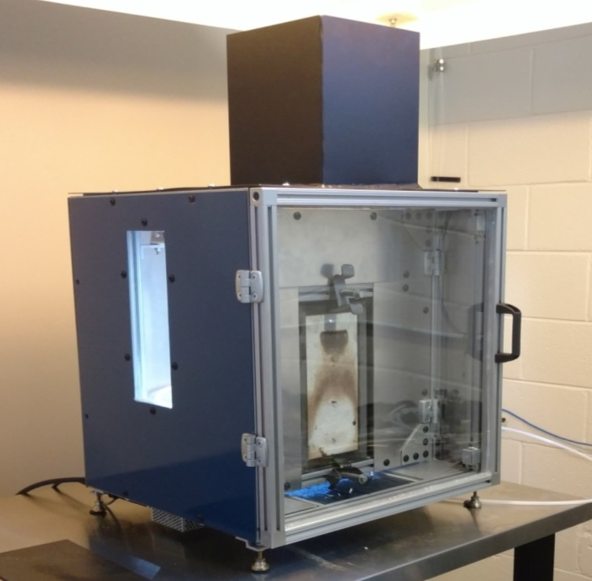
Introducing VFP 3.0
New and improved VFP
Features:
Smaller footprint
Controlled air inlet
Double-door system to keep backside smoke out of lab
Larger viewing windows

Slide 4
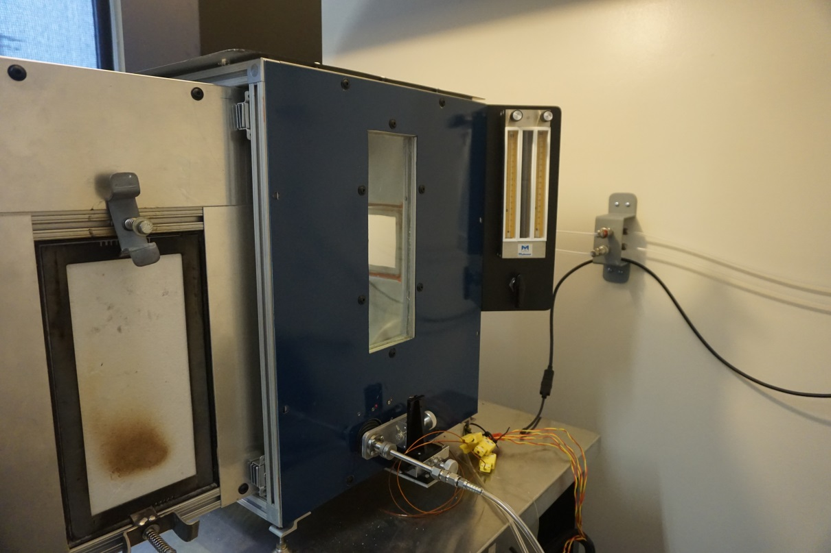
VFP 3.0 Features
Panel mounted flow meters
Larger windows on both sides
Traversing pilot flame mechanism

Slide 5
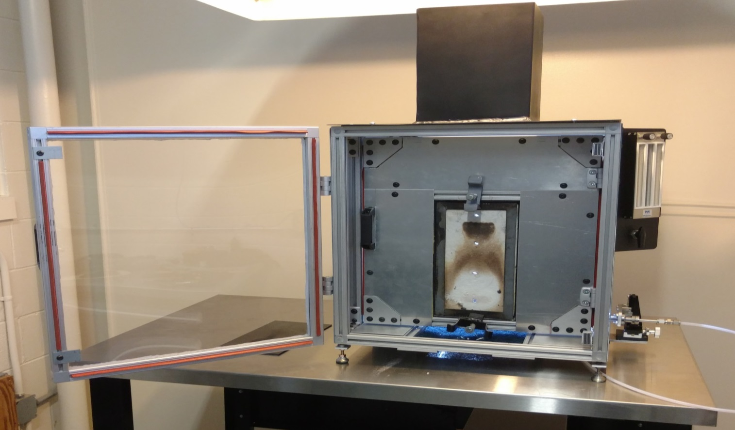
VFP 3.0 Features
Outer door
Inner door

Slide 6
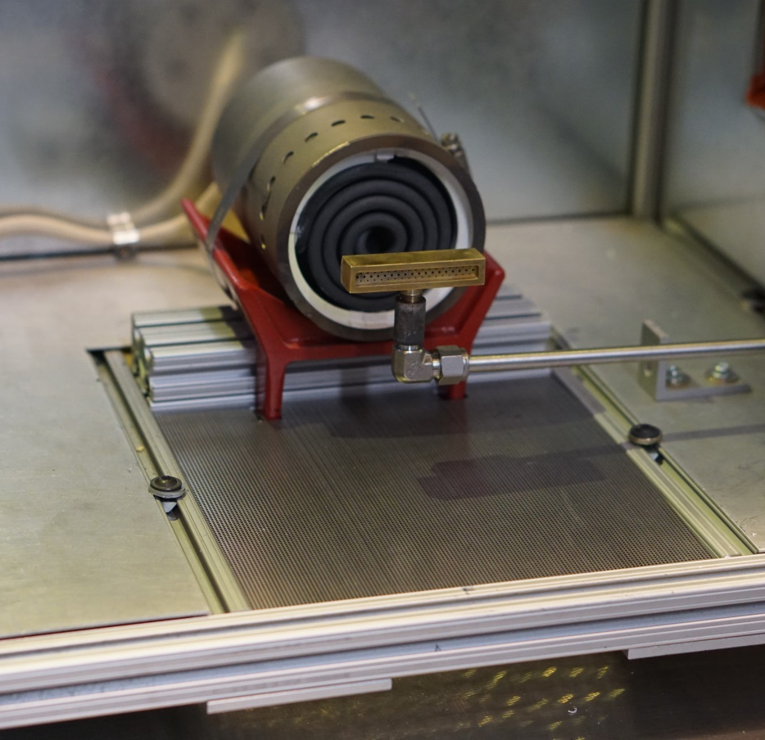
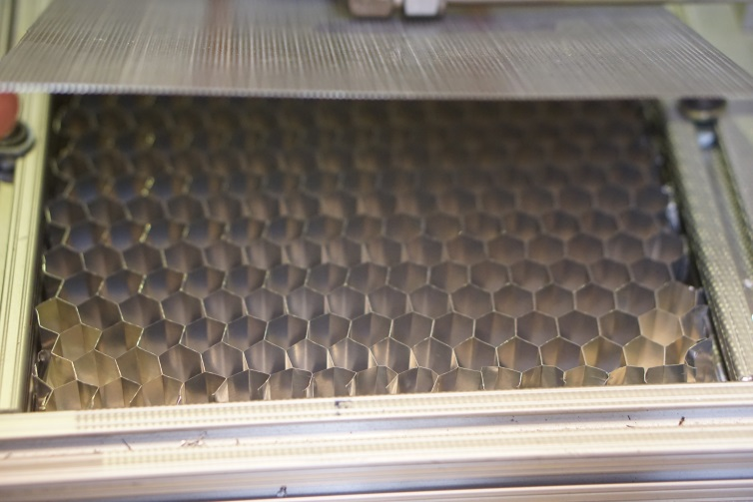
VFP 3.0 Features
Fixed Furnace
Perforated Steel Sheet
304 Stainless Steel
0.024” thick
24 gauge
0.045” hole diameter
37% open area
0.066” hole center-to-center
Honeycomb
3003 Aluminum
¾” thick
½” cell size
Fixed Air Inlet

Slide 7
New Power Supply
Keysight Technologies 6802A Basic AC Power Source
Max output power 1000 W
Max voltage 270 V
Max current 10 A
VFP requires 706 W, 112 V, 6.3 A
Built-in accurate measurement of Voltage, Current, and Power
Accuracy:
Voltage ±0.25% of reading + 0.15V (typical)
Current ±0.25% of reading + 0.04A (typical)
AC Power ±01% of reading + 1W (typical)
Uses SCPI commands (Standard Commands for Programmable Instruments) to control and query measurements of voltage, current, and power

Slide 8
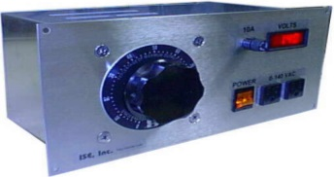
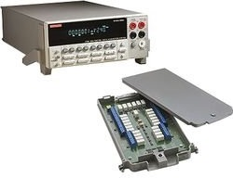
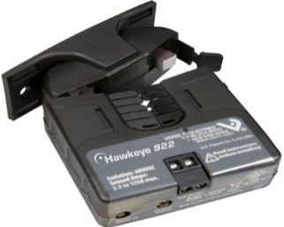
New Power Supply
Variac
$1077
Keithley digital multimeter
$1940
Keithley expansion board
$500
Current transducer
$100
Total Cost
$3617
Keysight 6802A
$4300
OR

Slide 9
VFP 3 Demonstration Test

Slide 10
Propane vs Methane
It was requested to determine if methane could be used instead of propane
3 K-type exposed junction thermocouples used to quantify flame temperature
Ceramic fiberboard used behind thermocouples to simulate test sample impingement
TCs mounted 1” above burner face

Slide 11
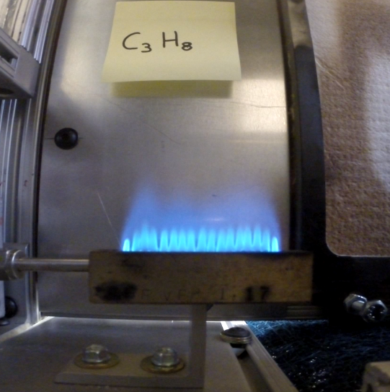
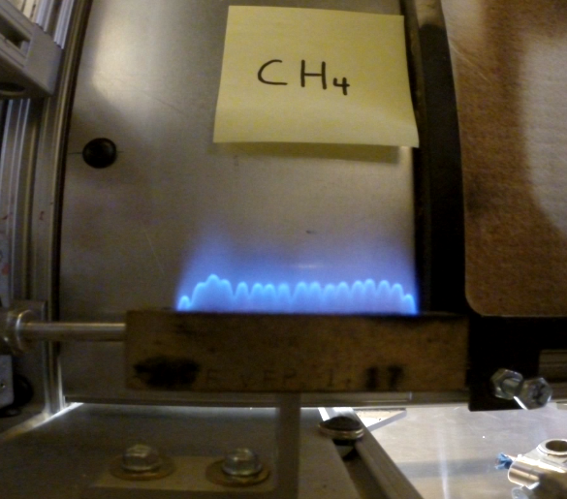
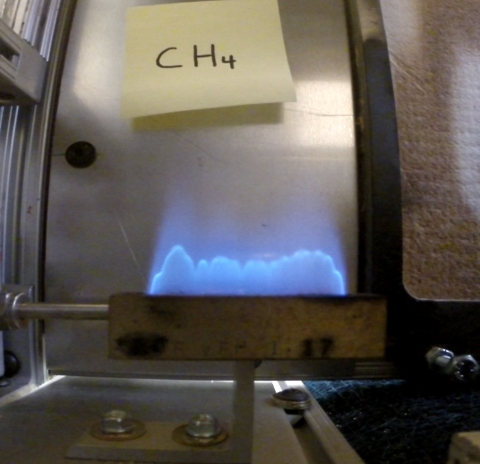
Flame Profile Comparison
Propane 45/90
Methane 80/80
Methane 100/100

Slide 12
Propane vs Methane
Initial test results indicate that similar temperatures and profiles can be achieved by increasing the flow rate when using methane
Can not be certain that both gases are equivalent until burn tests are performed with both gases on the same materials

Slide 13
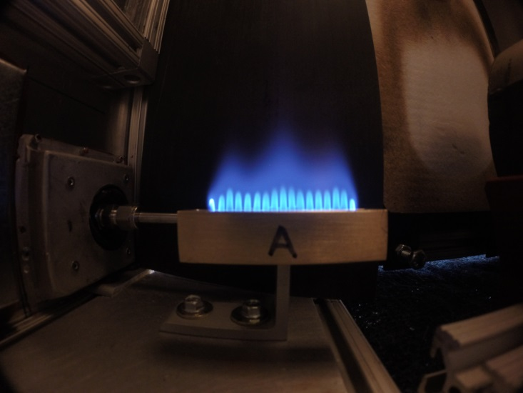
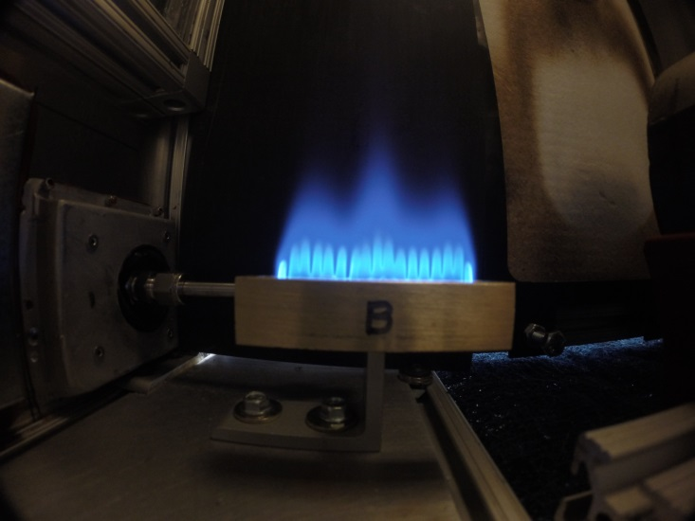
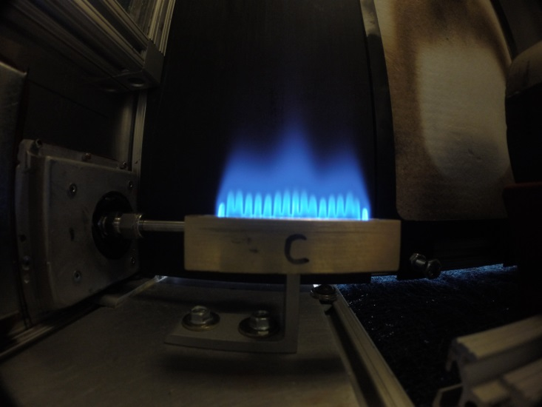
New Ribbon Burners
A
B
C
Recently received 3 new ribbon burners
Will loan one to Boeing, one to Airbus for installation in their current VFP 2 machines

Slide 14
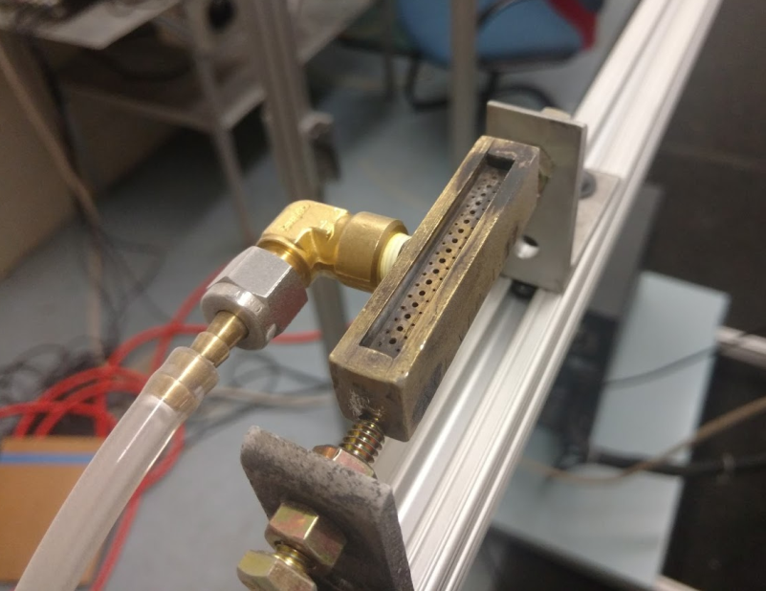
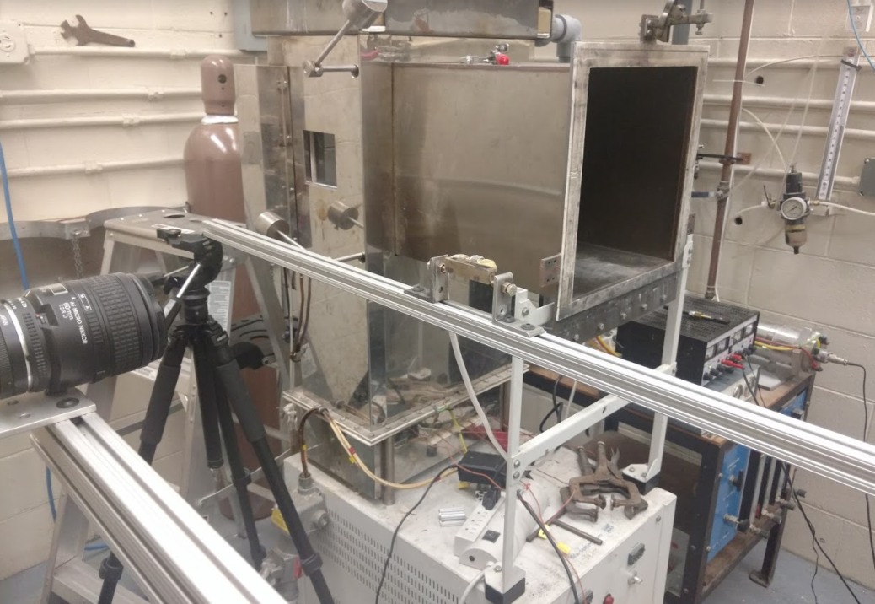
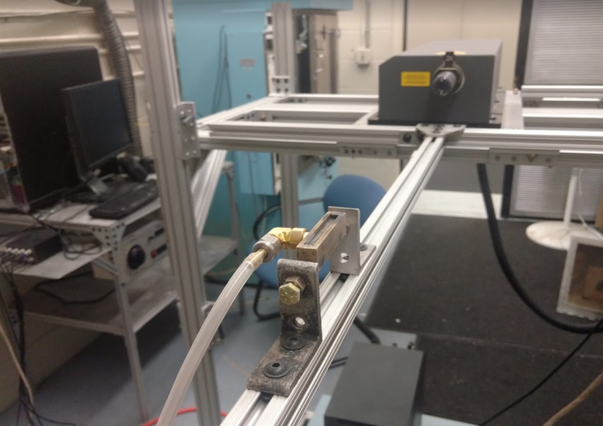
PIV Setup
Ribbon Burner
Camera
Laser

Slide 15
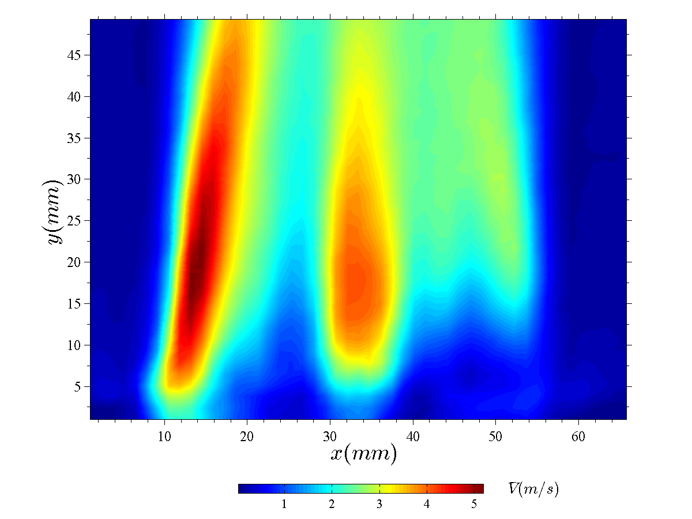
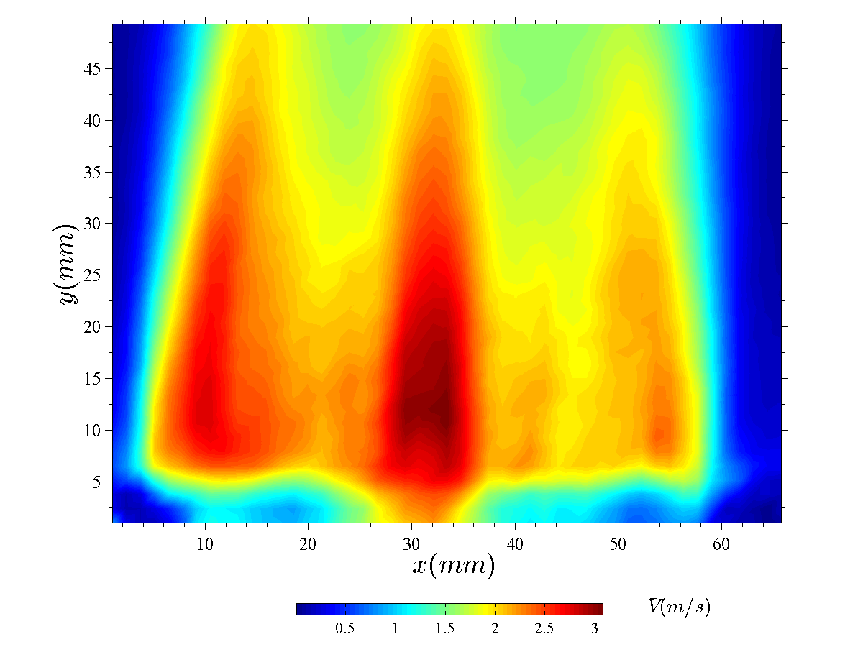
Mean Velocity Fields
Current VFP Burner
Marlin Burner

Slide 16
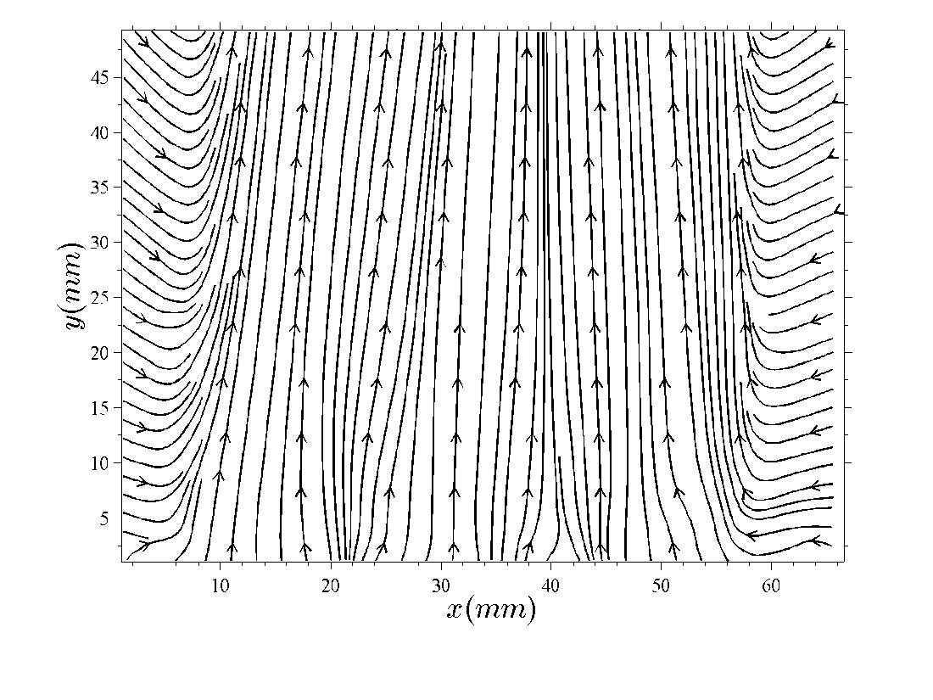
Streamlines
Current VFP Burner
Marlin Burner

Slide 17
Vertical Velocity Profiles*
Current VFP Burner
Marlin Burner
*At various heights from the burner exit plane

Slide 18
Visual Comparison
Current VFP Burner
Marlin Burner

Slide 19
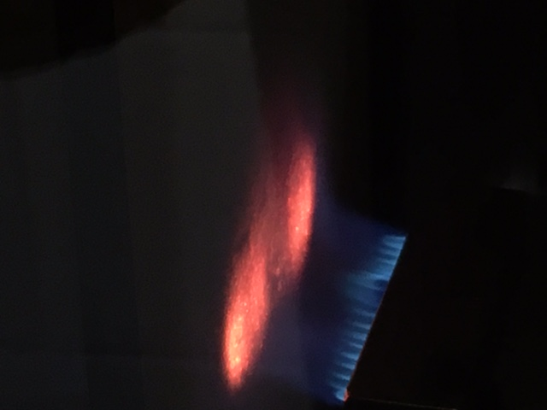
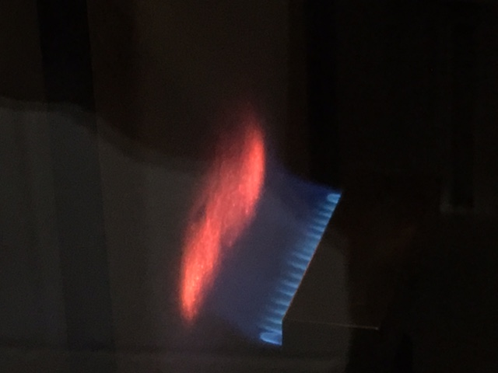
Impingement Comparison
Current VFP Burner
Marlin Burner

Slide 20
Summary
Continue development and testing of VFP 3
Work with equipment manufacturers to build commercial versions
Develop detailed drawings for VFP 3
Comparison testing with commercial versions once complete
Develop better sample holding methods for panels, wires, and ducts
Standardize test method procedure
Find materials for comparative testing with new machines

