Slide 1
International Aircraft Materials Fire Test Working Group Meeting
Development of a New Flammability Test for Magnesium-Alloy Seat Structure
International Aircraft Materials Fire Test Working Group, Bremen, Germany
Tim Marker, FAA Technical Center
June 3-4, 2015

Slide 2
Magnesium Alloy Flammability Highlights
Availability: Test method is currently in the Materials Fire Test Handbook
Coatings: summary of recent testing and recommendations
Air regulators: recent findings
Round Robin III: results obtained so far
Mag Use in Other Areas: What is the appropriate method of testing?
Arc testing: recent test results
Full scale testing/weight of components
Miscellaneous Items/Future

Slide 3
Magnesium Alloy Flammability Highlights
826 tests completed to date

Slide 4
Availability of Test
Magnesium Alloy Flammability Test Method is
now in the Aircraft Materials Fire Test Handbook!

Slide 5
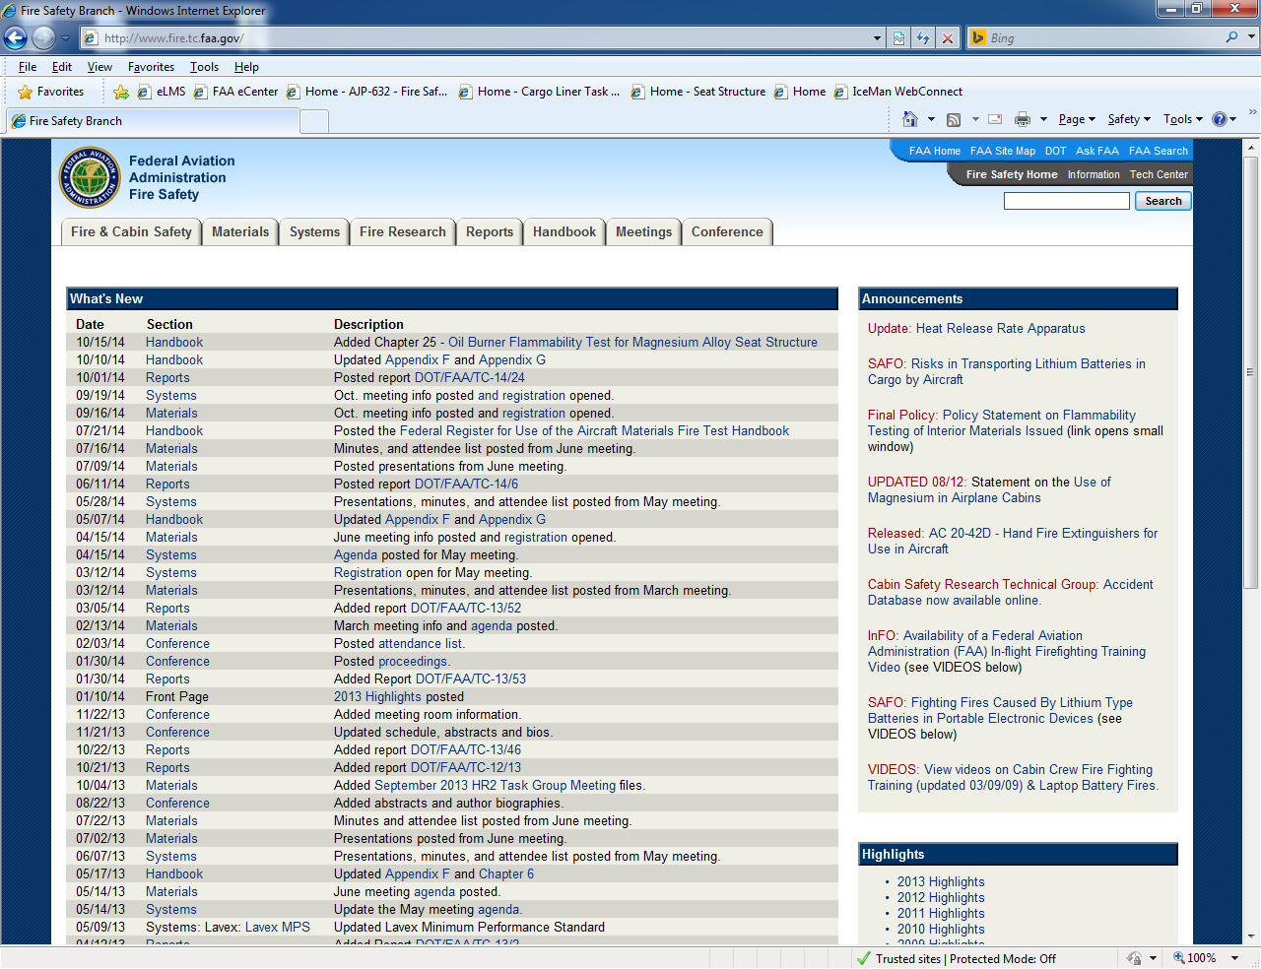

Slide 6
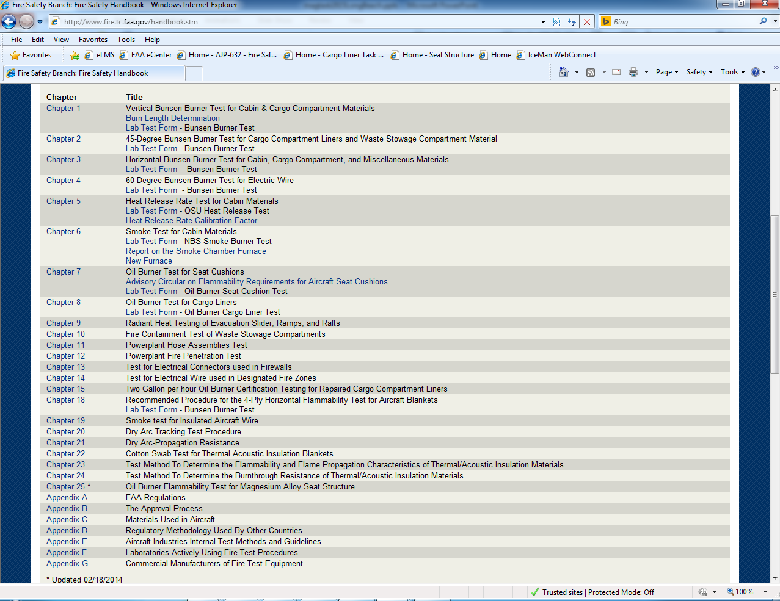

Slide 7
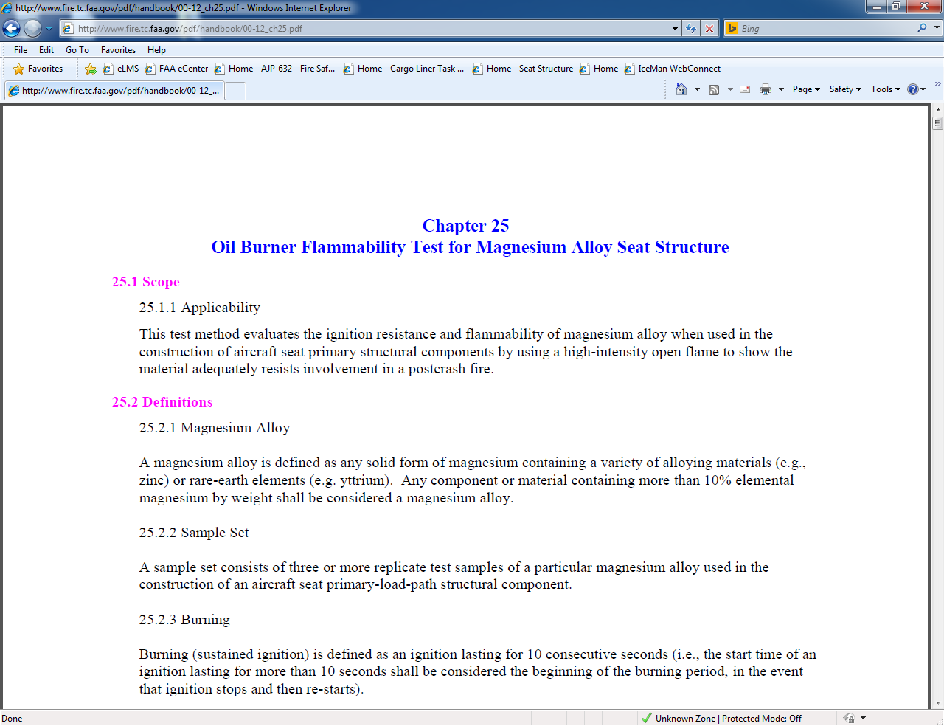

Slide 8
First 2 test labs officially set up to run mag test

Slide 9
Testing of Coated Magnesium Samples
In the Handbook test method…
25.4 Test Samples
25.4.6 Sample Coatings
If a finish coating, anodizing, or other surface treatment is used on the alloy in service, additional test samples must also be prepared and tested with this treatment to ensure it does not adversely affect sample performance.
December 2014: Various coated samples tested at FAATC…
-Chromium-free pre-treatment conversion coatings
-Polyester
-Polyester/Epoxy blend

Slide 10
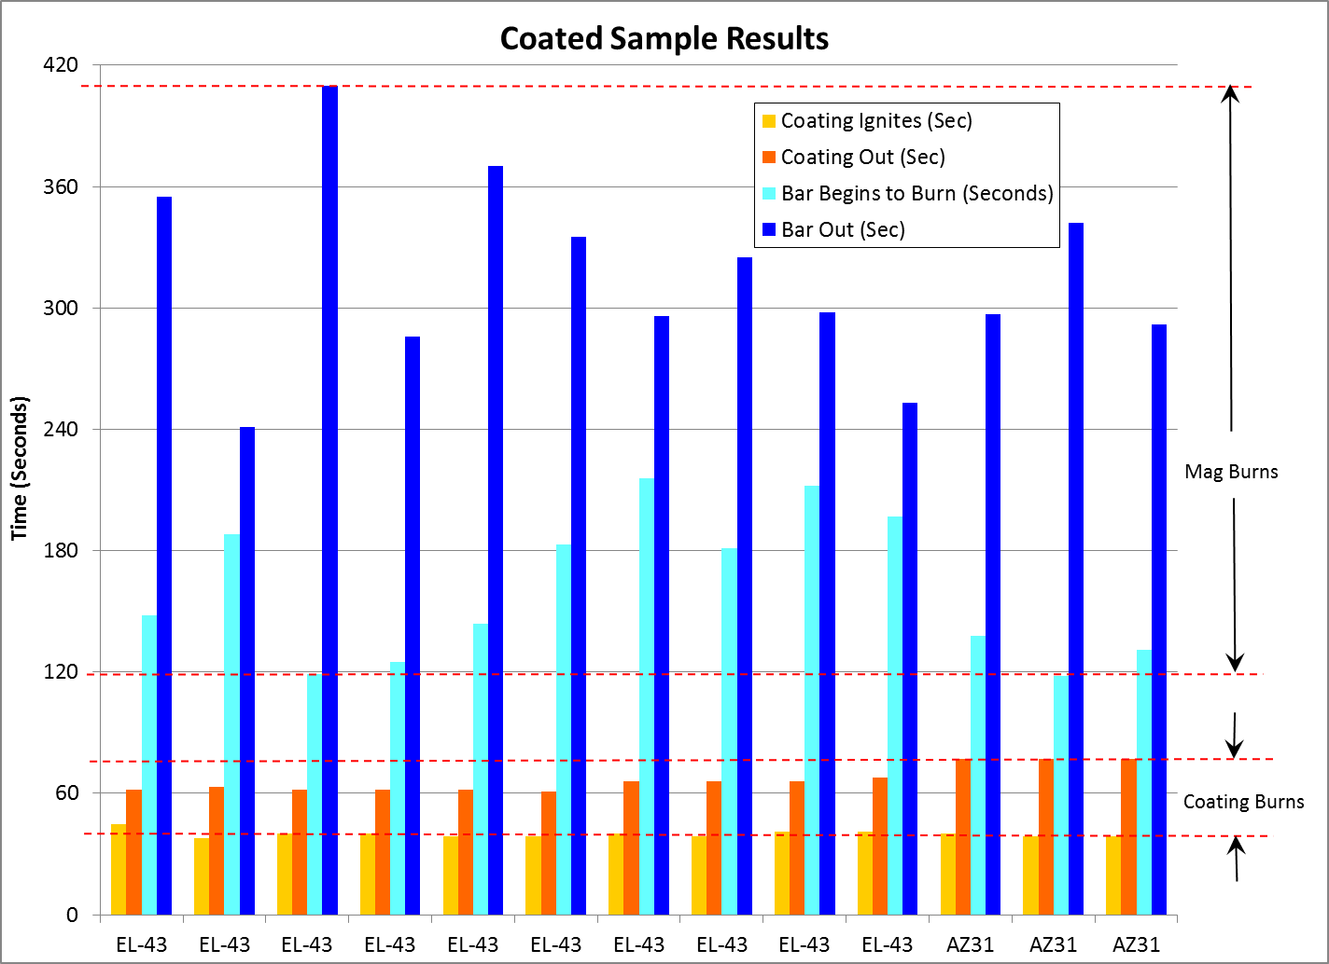

Slide 11
Testing of Coated Magnesium Samples
Argument Against Burner Testing of Coatings
- Currently, aluminum alloy seat structure is not oil-burner tested
- Oil-burner testing of mag-alloy seat structure “over and above”
Recent Testing of Coatings
- Suggestion was made to coat EL43 samples with “undesirable” coatings
- If undesirable coatings do not cause EL43 to fail, it can be assumed there are
no typical aircraft coatings that would cause the underlying magnesium alloy to fail

Slide 12
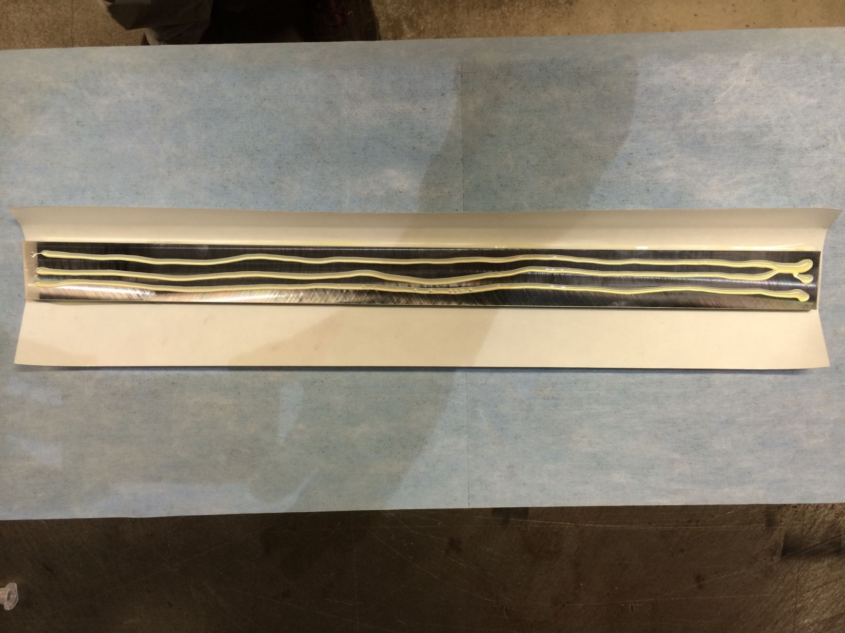
Testing of Coated Magnesium Samples

Slide 13
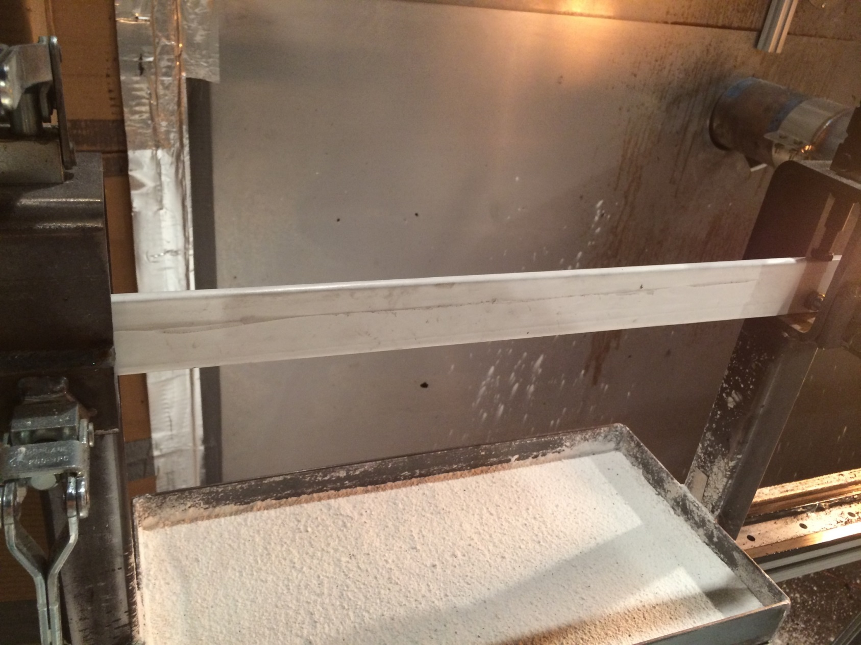
Testing of Coated Magnesium Samples

Slide 14
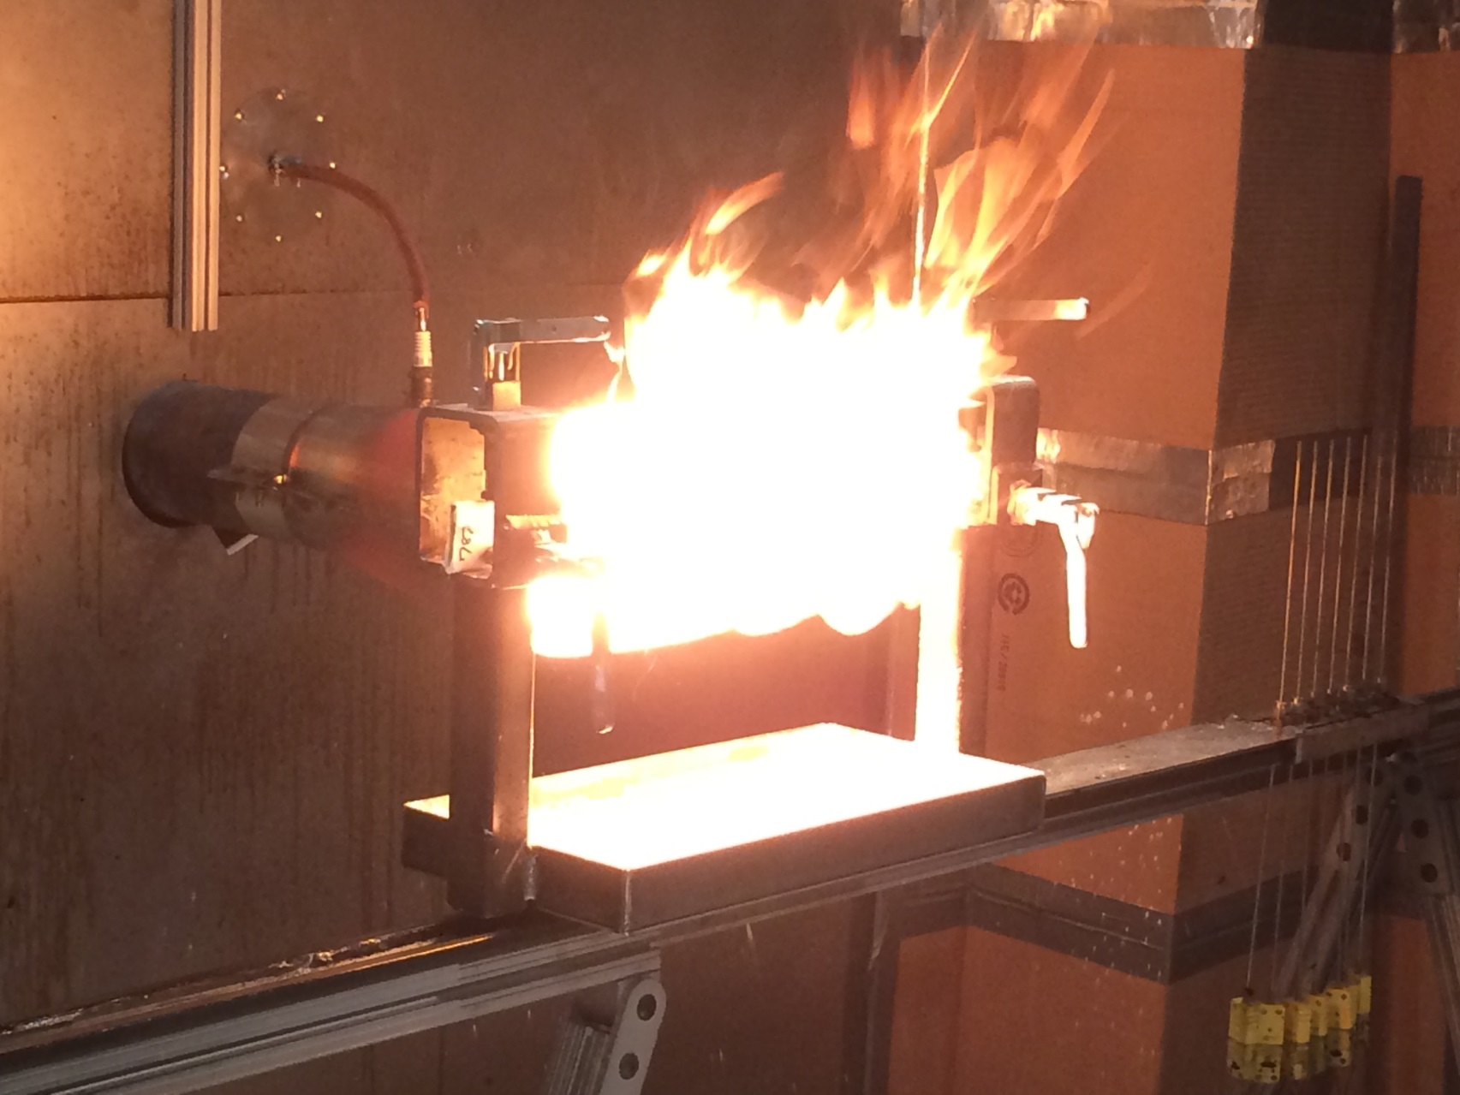
Testing of Coated Magnesium Samples

Slide 15
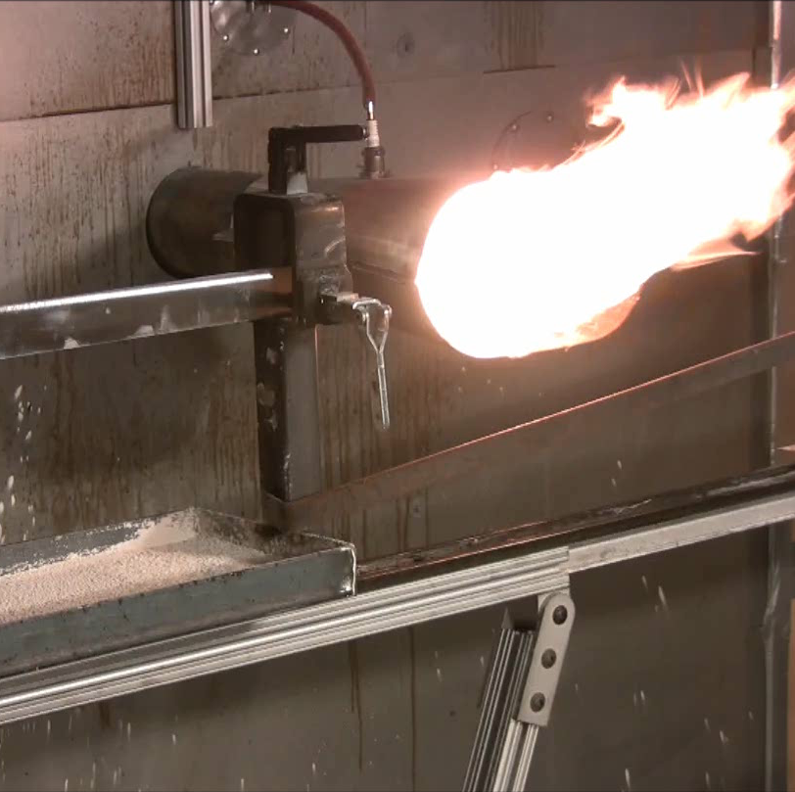
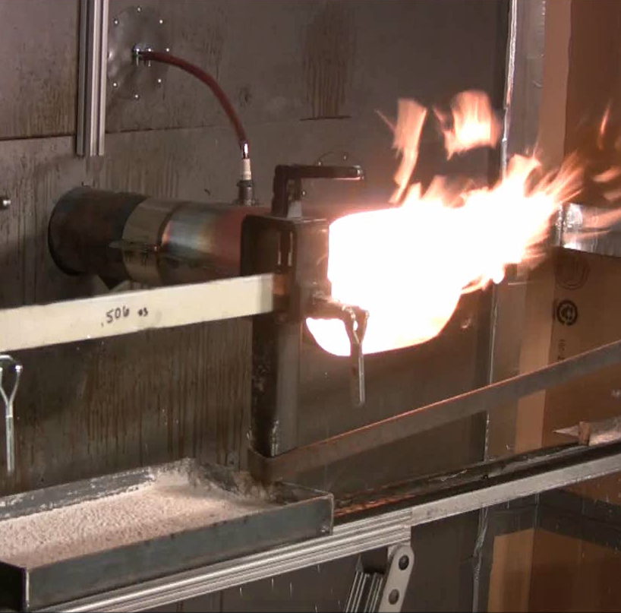
Testing of Coated Magnesium Samples
Bare Sample
Coated Sample

Slide 18
Testing of Coated Magnesium Samples
Coatings caused accelerated melt times in all cases
80% of coated samples resulted in magnesium ignition after 2 minutes (80% pass)
Coatings not causing underlying magnesium alloy to become more hazardous
Recommendation 1: Continue testing mag alloy using oil burner (non-coated)
Recommendation 2: Test coatings using 12-sec VBB over mag alloy substrate

Slide 19
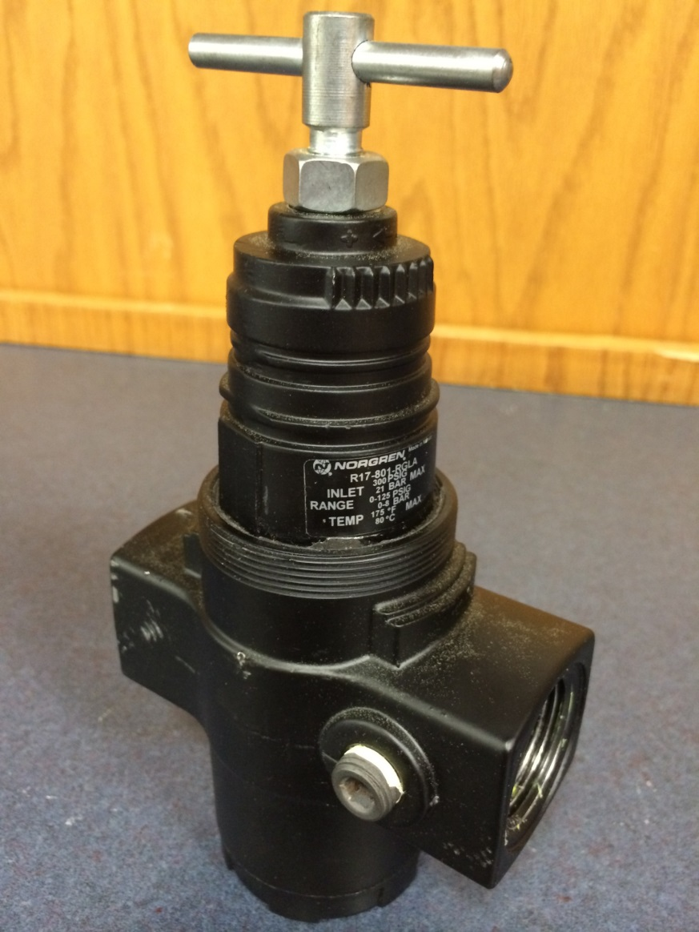
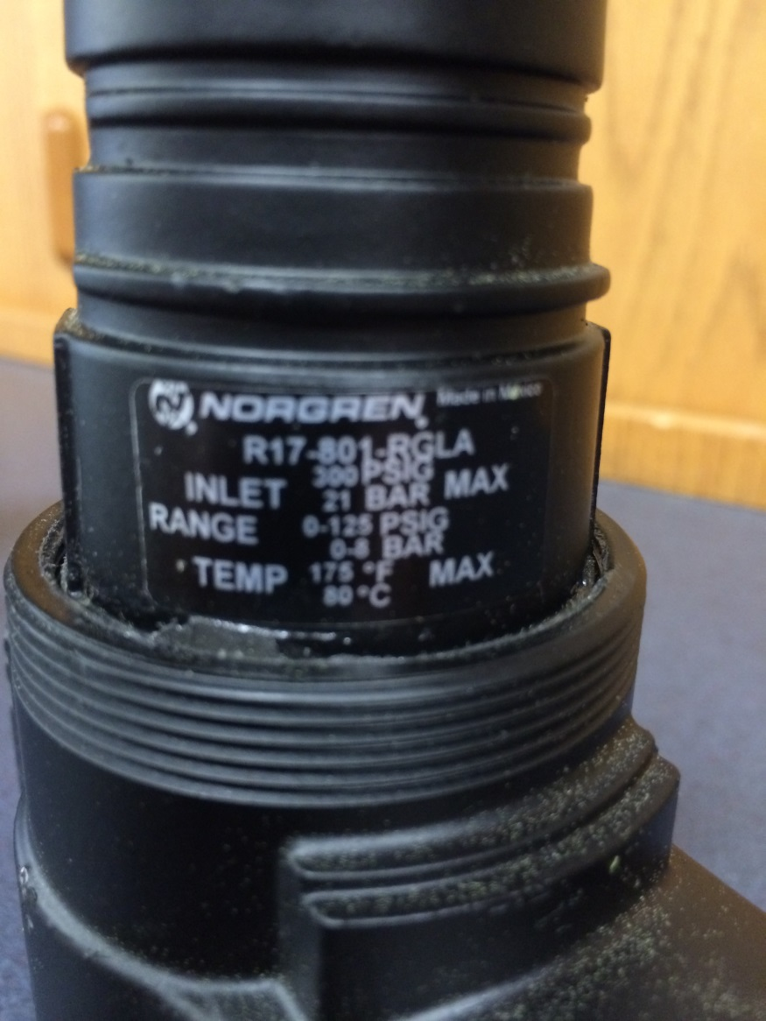
Testing of Various Air Regulators
Originally-supplied unit (Norgren) caused fluttering, “trumpeting” on cargo liner rig

Slide 20
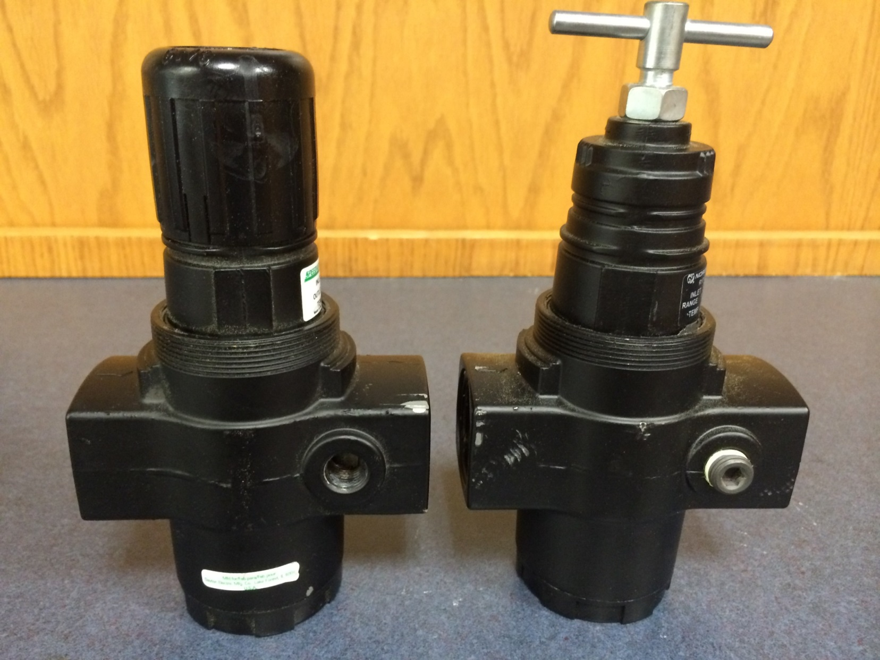
Testing of Various Air Regulators
Speedaire
Norgren

Slide 21
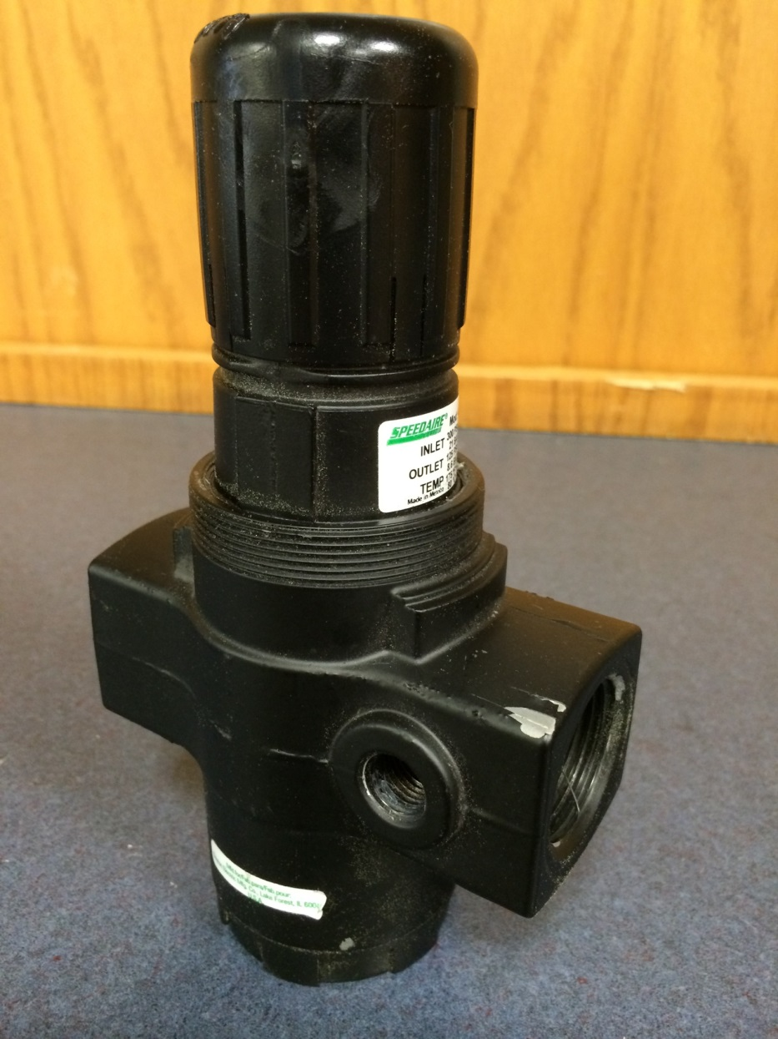
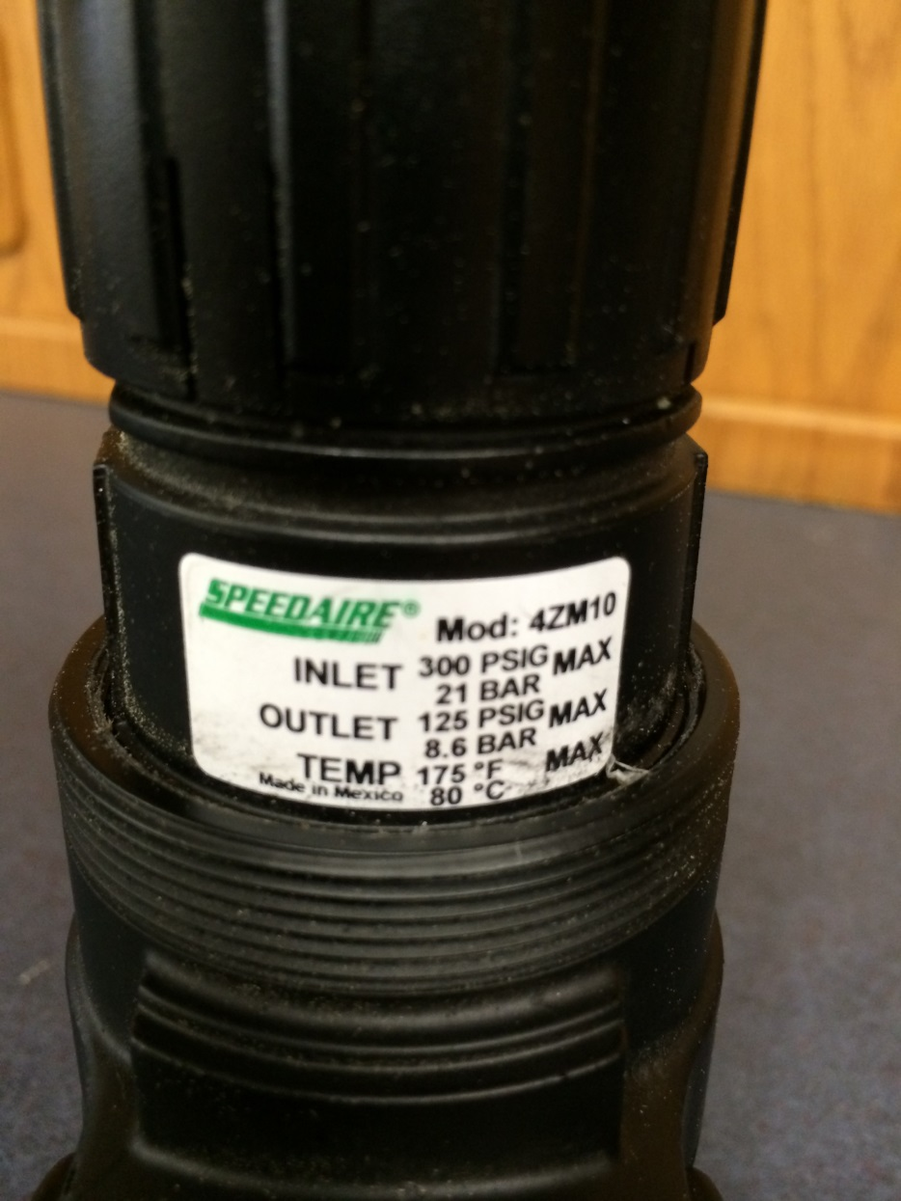
Testing of Various Air Regulators

Slide 22
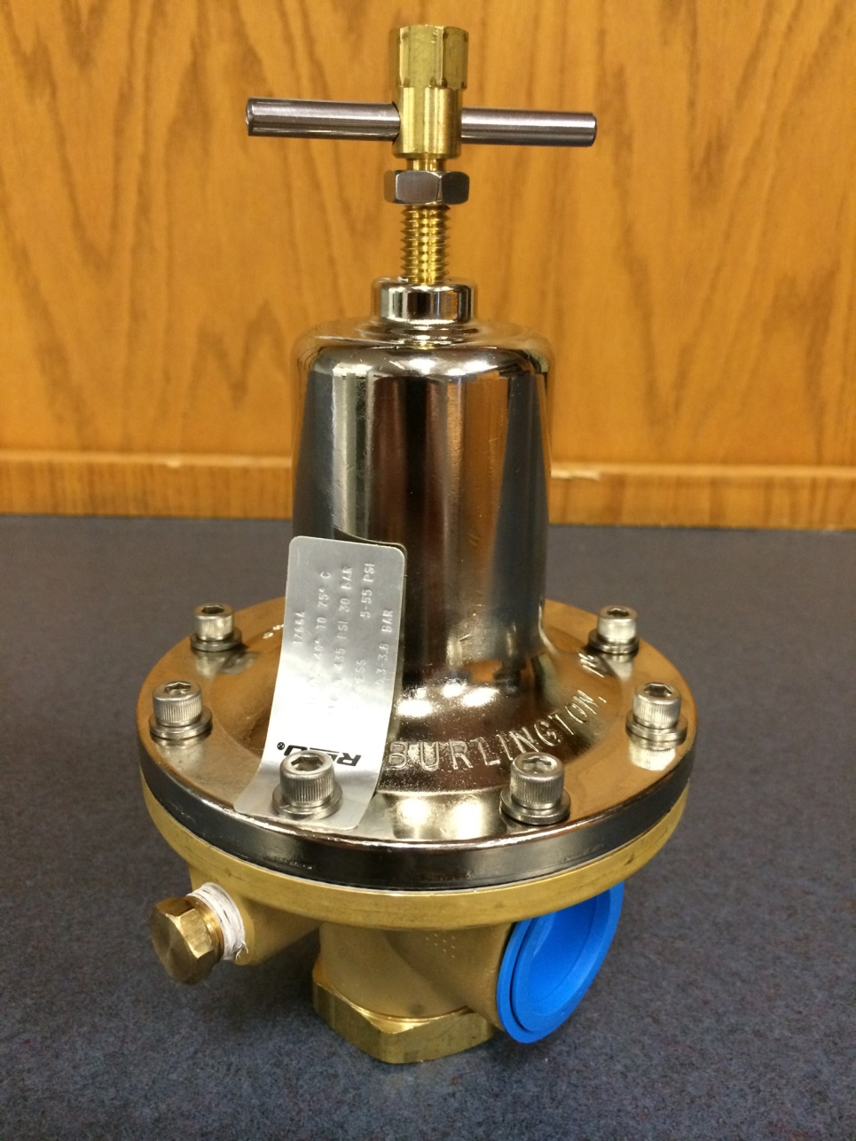
Testing of Various Air Regulators
Purchased brass/chrome units
Manufactured by REGO
Supplied by McMaster-Carr
Part number 49305K23
Operating range of 0-55 psi

Slide 23
Testing of Various Air Regulators
Unit installed on mag test burner
Noticeable elevated level of smoke
during calibration
Suspected reduced airflow through
burner, causing elevated smoke

Slide 24
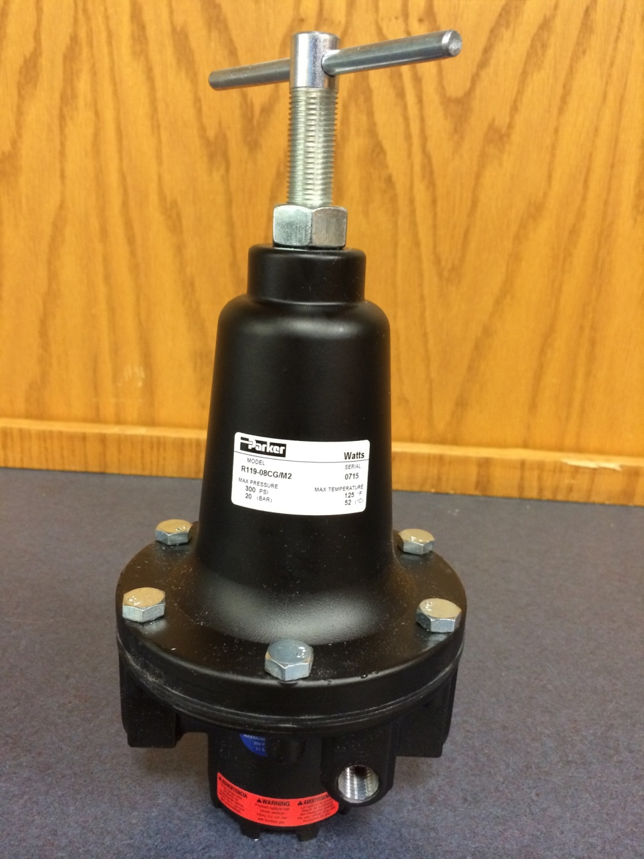
Testing of Various Air Regulators
Manufactured by Parker
Model R119-08CG/M2
Supplied by MSC Industrial
Part number 73535627

Slide 25
Measurement of Intake Pressure vs Exit Air Velocity

Slide 26
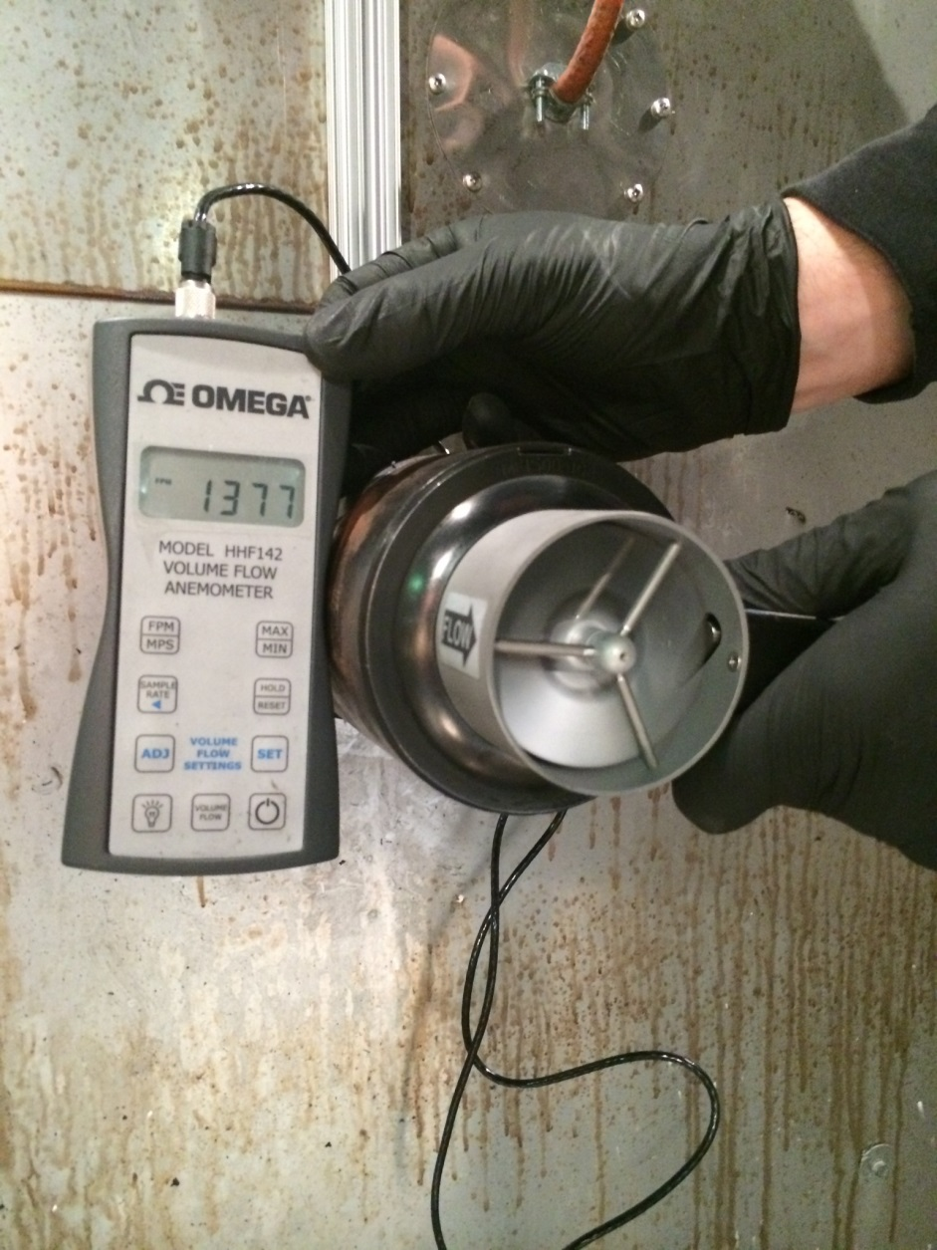
Measurement of Exit Air Velocity Using Omega Velocity Meter

Slide 27
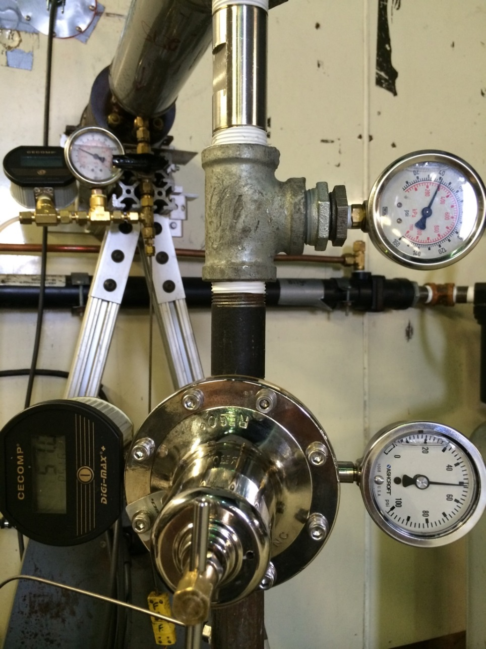
Measurement of Exit Air Velocity Using Omega Velocity Meter

Slide 28
Measurement of Intake Pressure vs Exit Air Velocity

Slide 30
Testing of Various Air Regulators
Findings:
Brass/chrome REGO regulator not suitable for NexGen burner application
Speedaire 4ZM10 acceptable for NexGen burner use
Parker R119-08CG/M2 acceptable for NexGen burner use
Intake pressure vs. exit velocity relationship linear
Accurate control of pressure/exit velocity is essential in proper calibration

Slide 31
Magnesium Alloy Flammability Test Round Robin III
Purpose: To help identify differences in labs. Results will help in the
development of a repeatable test.
Technique: Test identically-prepared samples under controlled conditions
Participants: FAA, Accufleet, Airbus, Magnesium Elektron
Equipment: Igniterless stator, spark plug, new clamp-style
sample holder, 20 samples of EL43, 1 sample AZ31

Slide 39
Magnesium Alloy Flammability Test Round Robin III
Preliminary Findings:
Temperature Check shows burner flame agreement using igniterless stator
Melt times consistent between labs, indicating samples being exposed similarly
Time when sample begins to burn also consistent between labs
Time for sample to self extinguish remains inconsistent
Weight Loss results still an issue, with excessive scatter
Further analysis to follow when all data received

Slide 40

The Use of Magnesium Alloy in Other Cabin Areas
Which Test?
Use in other non-
primary seat
components
Use in 5 primary
seat components
Use in other
cabin components
Oil Burner
Oil Burner ?
accessible
inaccessible
Oil Burner ?
Elec Arc ?

Slide 41
The Use of Magnesium Alloy in Other Cabin Areas
Can Surface Area-to-Volume (SAV) Ratio be used?
Can “Equivalent Geometry” be defined using SAV ratio?
BE 990 Coach seat cross tube = 22.6
Other seat cross tubes as high as 31.8
Typical Leg Surface Area-to-Volume Ratio = 13
Typical Spreader Surface Area-to-Volume Ratio = 12
Test Method Rectangular Bar Sample = 9.4

Slide 42
The Use of Magnesium Alloy in Other Cabin Areas
Is full-scale testing necessary to determine max allowable % of magnesium?
What is typical maximum % of magnesium in seat (target)?
How could full-scale tests be conducted?
Is the goal a strict limit, or simply guidance material in future Advisory Circular?

Slide 43
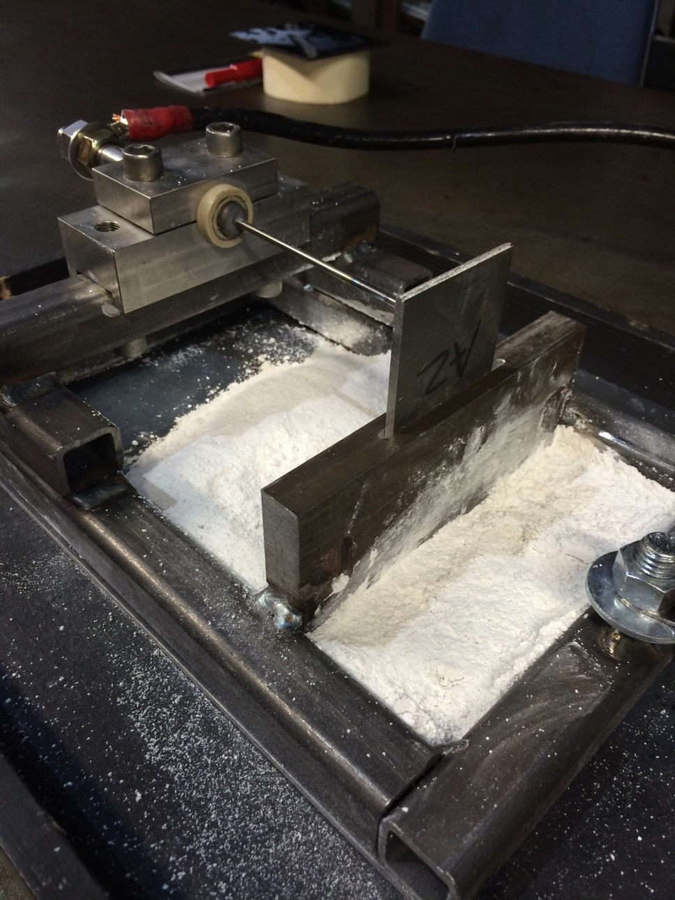
Update on electrical arc testing
electrode
Thin sample

Slide 44
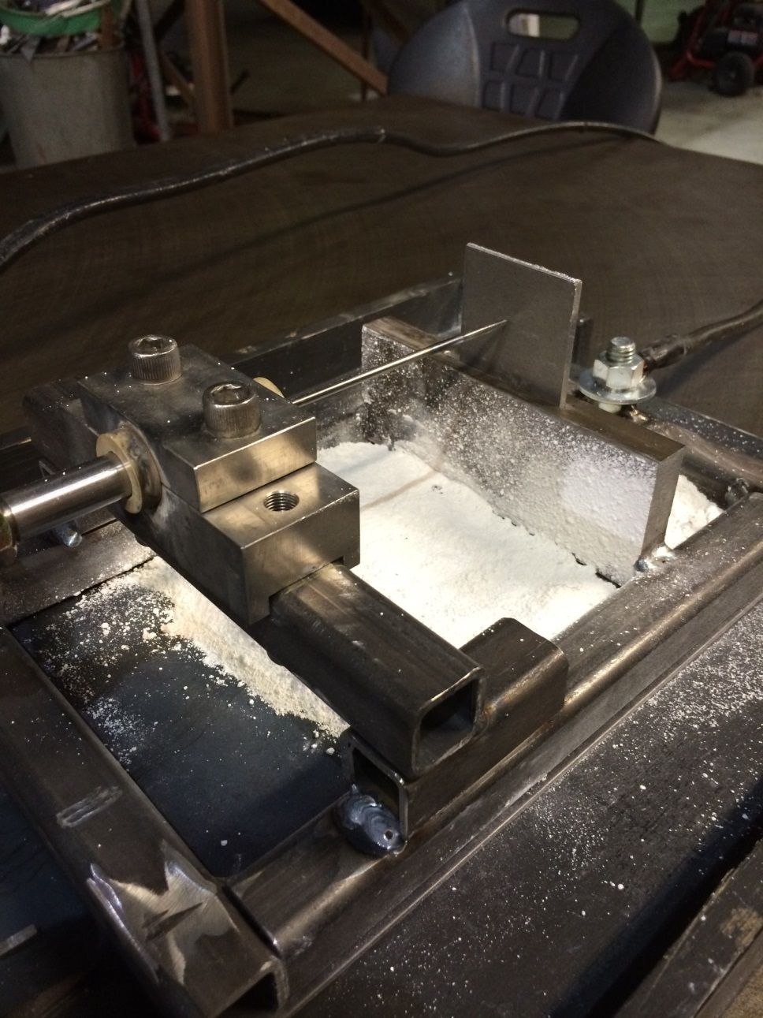
Update on electrical arc testing
Thin sample
electrode
plot amps vs thickness
.046875 and 11 amps
.0625 and 11 amps

Slide 45
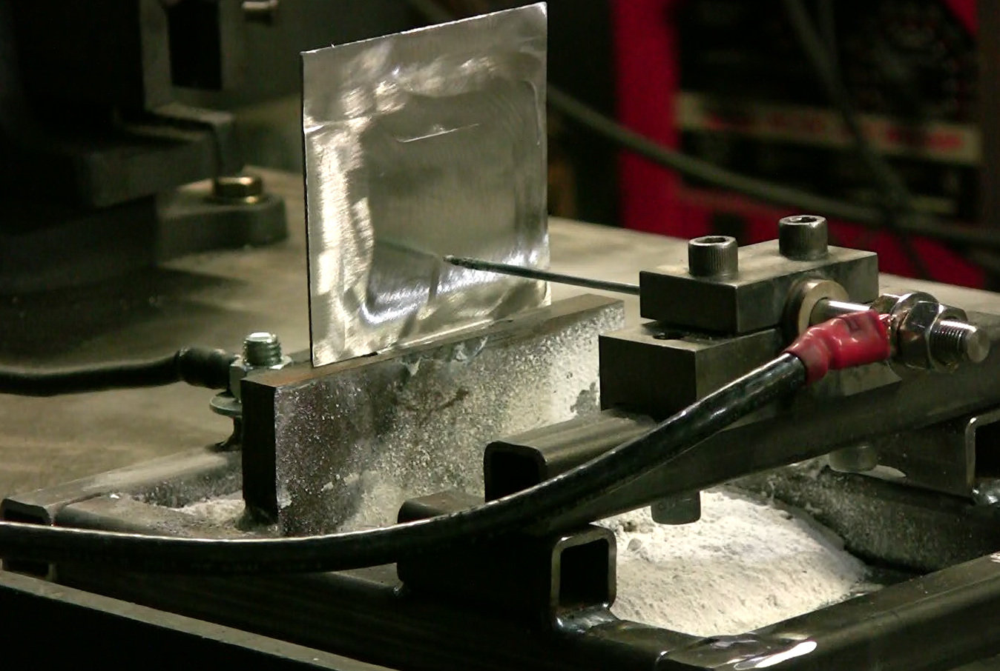
Update on electrical arc testing

Slide 46
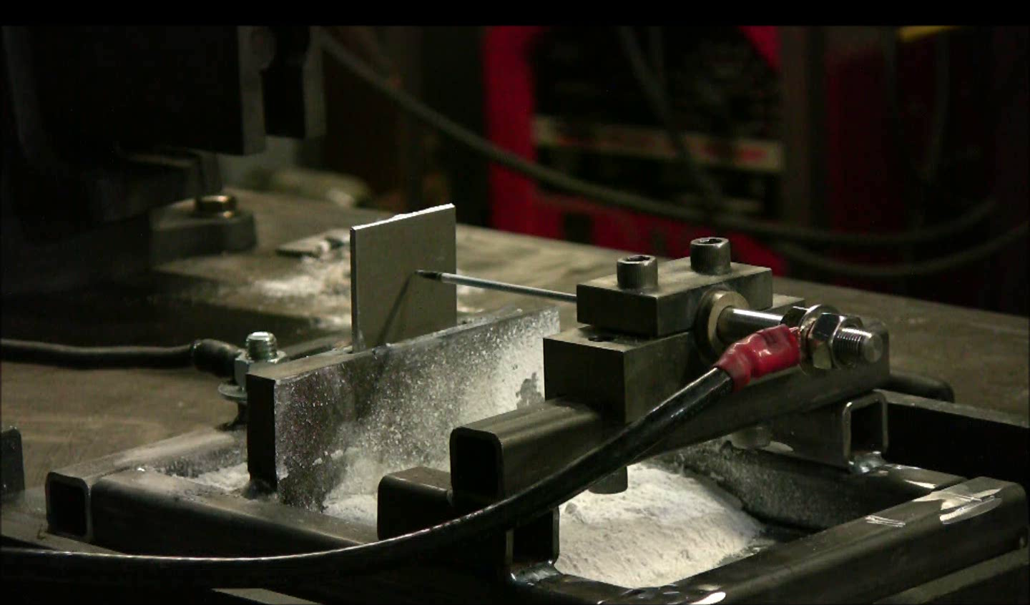
Update on electrical arc testing

Slide 47
Questions?

