Slide 1
AIRBUS Project
FaBLE
FAA-IAMFTWG June 2015 Bremen
Thomas Vielhaben
ESCMB2
Development and validation of a foam block equivalent

Slide 2
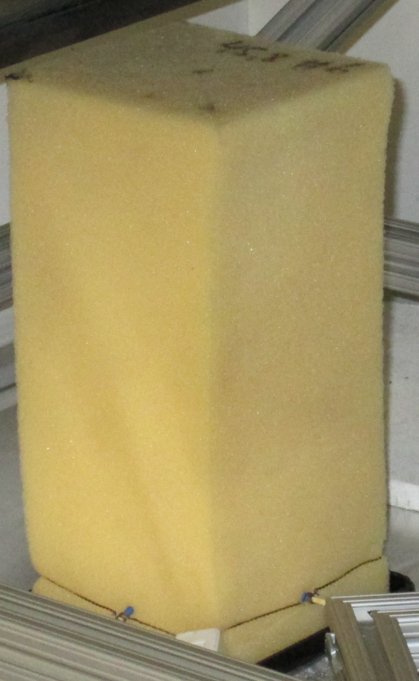
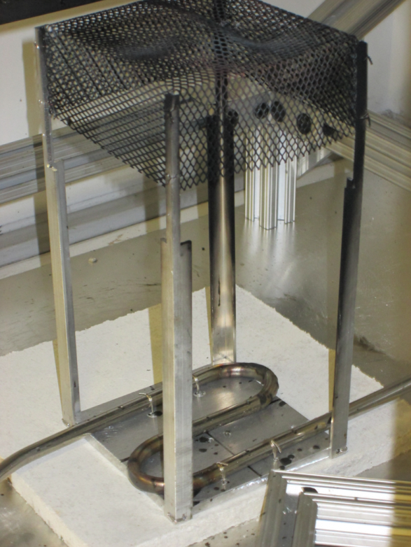
Content
What is FaBLE?
Foam Block Properties
Project Requirements
Project Implementation
Project Validation
  Heatflux / Temperature
  Coupon test
Conclusion

Slide 3

What is FaBLE?
FaBLE is an equivalent to the FAA-TC hidden area fire source
(Foam Block Equivalent)
FaBLE reproducably reflects the foam block properties
FaBLE is simlpe in use
?

Slide 4

Foam Block Properties
Heatflux ca. 7.25 W/cm²
About 1150 °F (620 °C)
4 in
Blackening flame
9 in
ca. 1200 kJ
4 in
10 ml heptane
4 in
(102 mm x 102 mm x 229 mm)

Slide 5
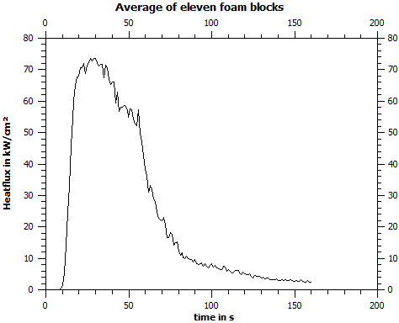
Foam Block Properties
Heatflux ca. 7.25 W/cm²
About 1150 °F (620 °C)
4 in
Primary
phase
Secondary
phase
9 in
4 in
4 in
  0 – 60 s: primary phase, high heatflux, most of damage
  >60 s: secondary phase, low heatflux, few additional damage
(102 mm x 102 mm x 229 mm)

Slide 6
Requirements for FaBLE
Properties
Same geometry as foam block
Equal maximum heatflux and comparable heatflux evolution
Equal maximum temperature and comparable temperature evolution
FaBLE
Similar calorific value
Operation/construction
Easy handling
Safe concept
Simple construction (standard parts)
No aging effects

Slide 7
Implementation: Setup
Heat mesh
Propane
MFC
0-10 l/min
0 or 10 l/min
Gas burner
Laptop
booster
ARDUINO controller

Slide 8
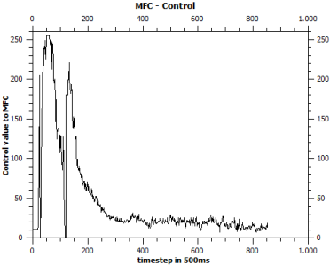
Implementation: Setup
Heat mesh
Propane
Valve sequence to create foam block heat release profile
→ Calculated from 11 foam block tests
MFC
Gas burner
Laptop
ARDUINO controller

Slide 9
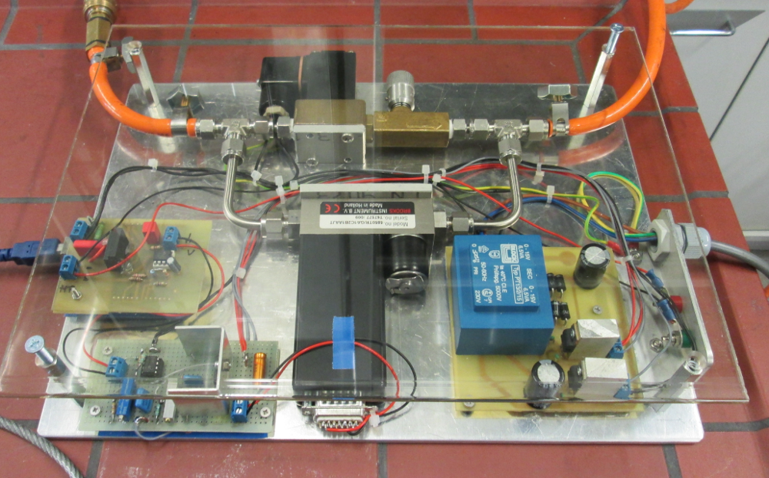
Implementation: Setup
Heat mesh
Propane
Booster.
MFC
Gas burner
Laptop
Arduino & Shield
ARDUINO controller
PS.
Valve –Amp..
MFC.

Slide 10
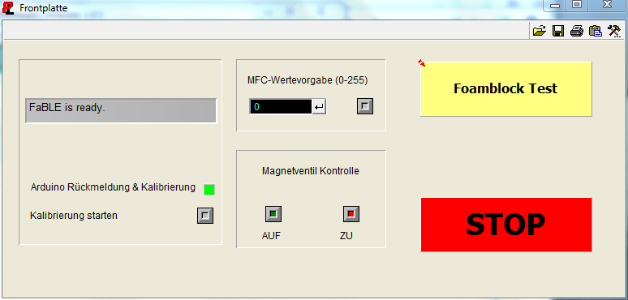
Implementation: Human interface

Slide 11
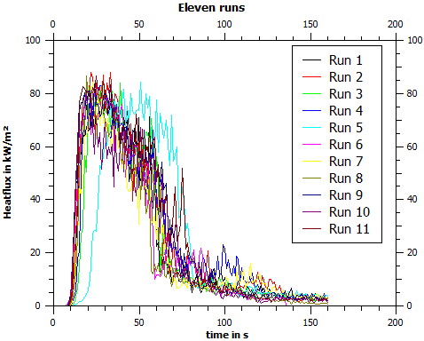
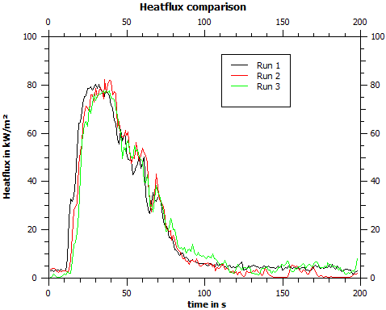
Validation: Comparison of heatflux
Foam block
Gordon gauge calorimeter
type K thermocouple
Equal max. heatflux
Equal temperature profile
4 in
FaBLE
9 in
✓
4 in
4 in
(102 mm x 102 mm x 229 mm)

Slide 12
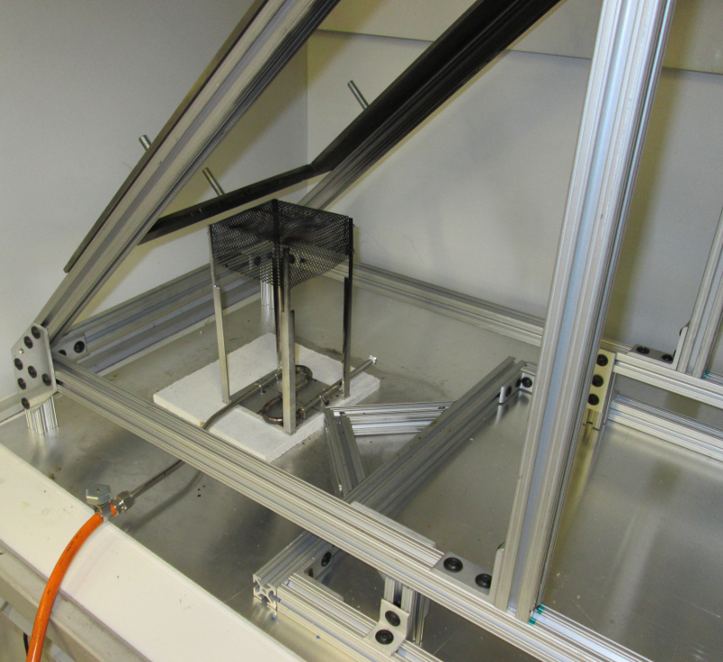
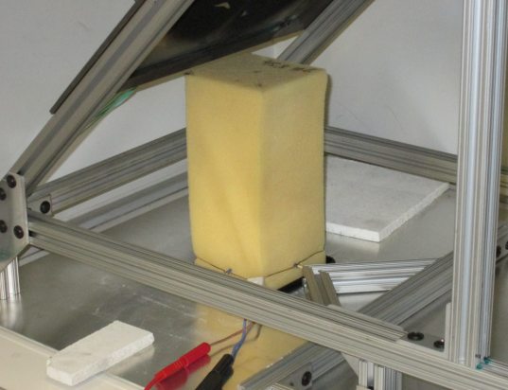
Validation: Coupon test
Specimen (width 13 in)
24 in
temperature
angle of 45 degrees
5 in
4 in
FaBLE
(or foam block)

Slide 13
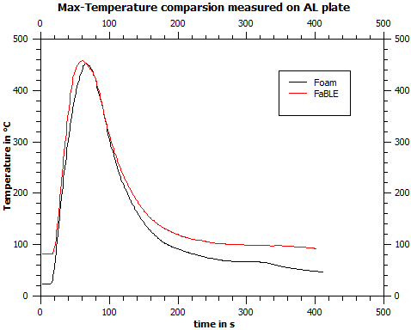
Validation: Coupon test
Specimen (width 13 in)
24 in
temperature
✓
5 in
4 in
FaBLE
(or foam block)
Equal max. temperature and temperature plot
Low temperature deviation in the secondary phase due to heat mesh radiation

Slide 14
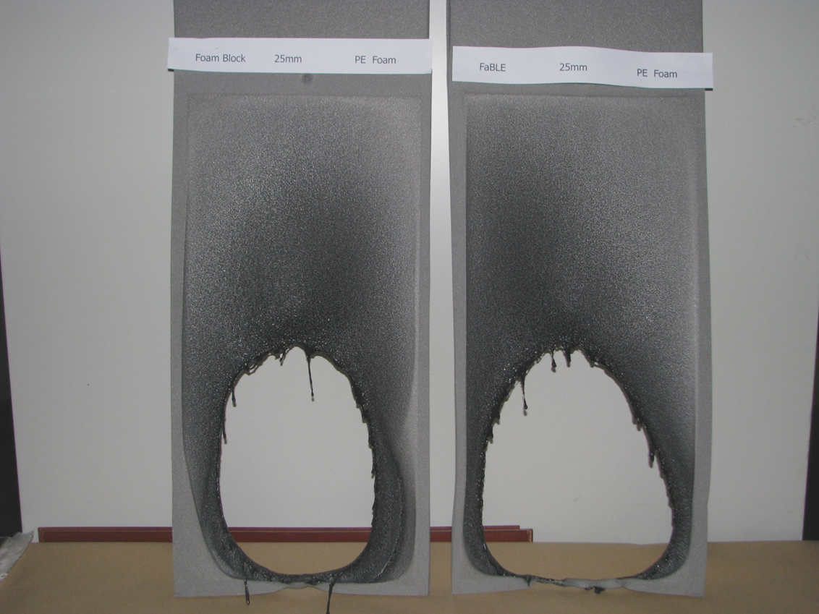
Validation: Coupon test
PE cellular material 25mm
Foam Block
FaBLE
✓

Slide 15
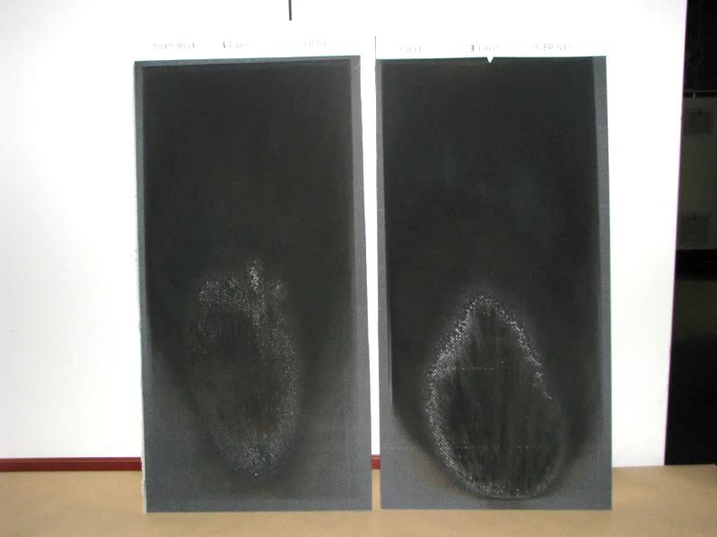
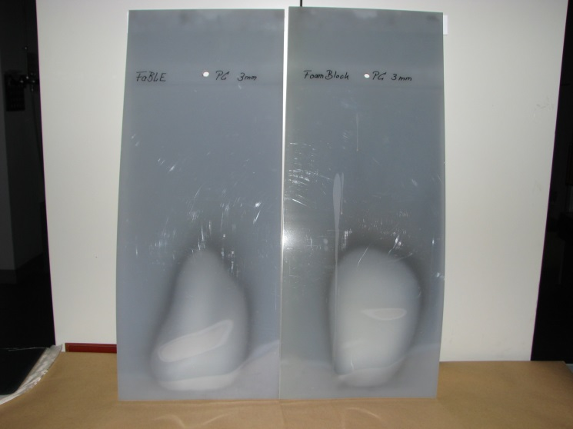
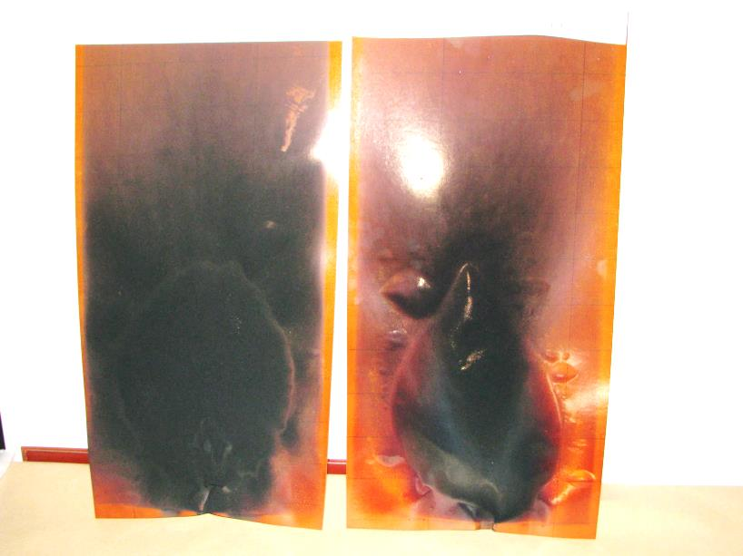
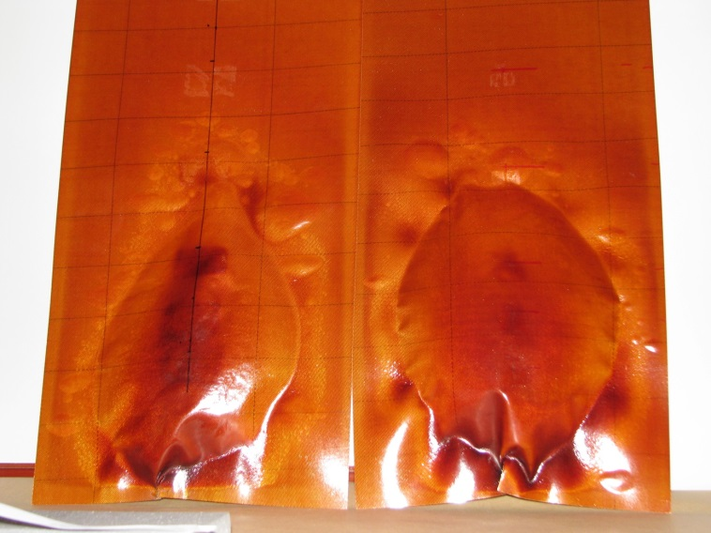
Validation: Coupon test
C-EP-53% three layers
PC 3mm
Foam Block
FaBLE
FaBLE
Foam Block
to PHG-50% - test side
to PHG-50% - test side
Foam Block
FaBLE
Foam Block
FaBLE
✓

Slide 16
Conclusion
All specified requirements will be fulfiled
FaBLE is a reproducible fire source and represents foam block properties
FaBLE is a low cost device, made from world wide available standard parts
FaBLE is an equivalent to the hidden area fire source
For further validation we will send one of our first series model to FAA tech-center

Slide 17
© Airbus Operations GmbH. All rights reserved. Confidential and proprietary document. This document and all information contained herein is the sole property of Airbus Operations GmbH. No intellectual property rights are granted by the delivery of this document or the disclosure of its content. This document shall not be reproduced or disclosed to a third party without the express written consent of Airbus Operations GmbH. This document and its content shall not be used for any purpose other than that for which it is supplied. The statements made herein do not constitute an offer. They are based on the mentioned assumptions and are expressed in good faith. Where the supporting grounds for these statements are not shown, Airbus Operations GmbH will be pleased to explain the basis thereof. AIRBUS, its logo, A300, A310, A318, A319, A320, A321, A330, A340, A350, A380, A400M are registered trademarks.

Slide 18


