Slide 1
International Aircraft Materials Fire Test Working Group Meeting
Restraining Leather Cushions for the Seat Oil Burner Test
International Aircraft Materials Fire Test Working Group
Tim Salter, FAA Technical Center
June 25-26, 2014, Solothurn, Switzerland

Slide 2
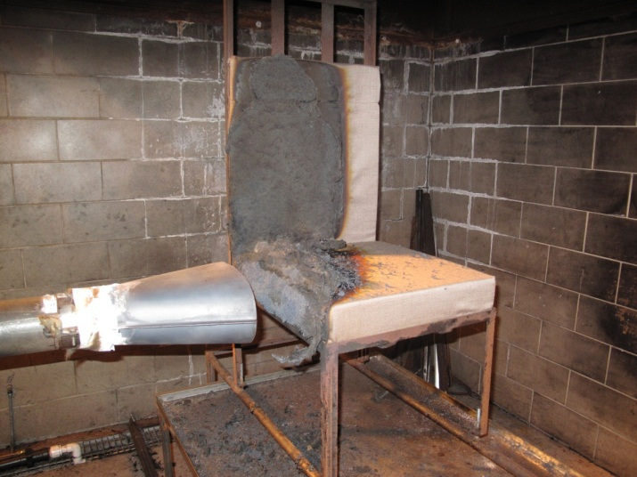
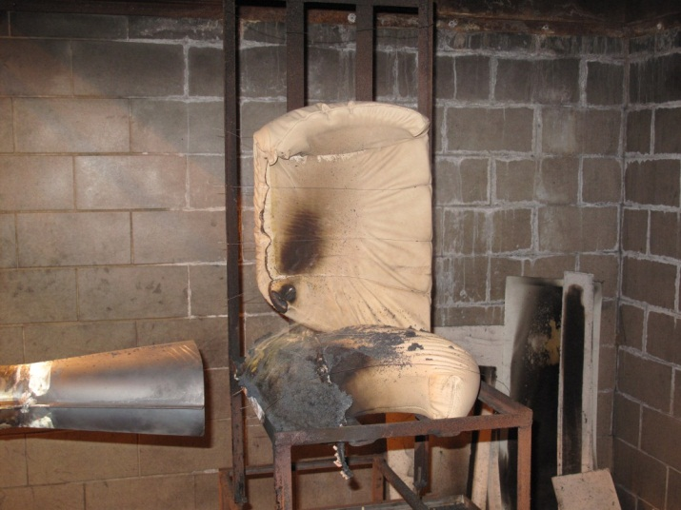
Why are restraints necessary for testing of leather seat cushions?
Typical fabric covered seat cushions burn away but do not deform when tested (top)
Leather cushions will tend to shrink and pull away from the burner flame (bottom)
If the cushion pulls away from the flame during testing, does this decrease weight loss and burn lengths? Are the results still valid?

Slide 3
From the Handbook
7.3.5 Specimen Mounting Frame
The mounting frame for the test specimen will be fabricated of 1 by 1 by 1/8-inch (25 × 25 × 3-mm) steel angle, as shown in figure 7-1. A wire can be added to the mounting frame for the seat back cushion to secure the specimen into place. More than one wire may be used to restrain leather seat components as long as the wires do not impede or redirect the flame. The mounting stand will be used for mounting the test specimen seat bottom and seat back, as shown in figure 7-2. Reference paragraph 7.3.5 of Chapter 7 Supplement.

Slide 4
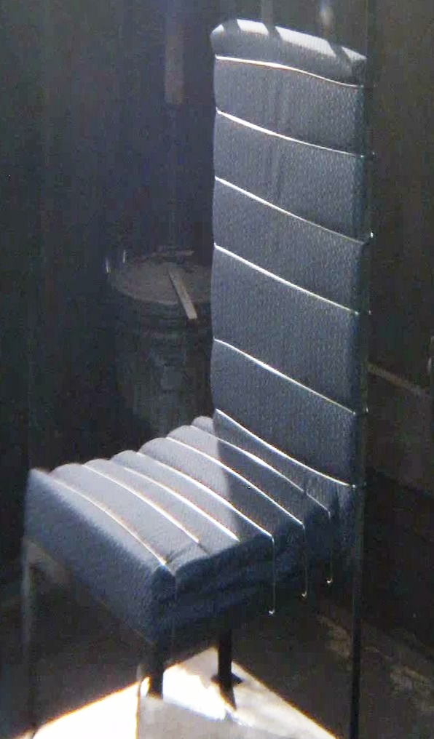
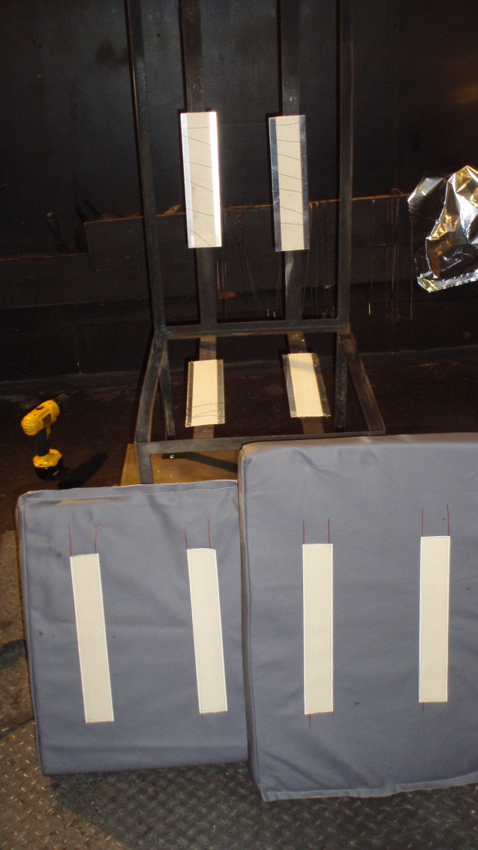
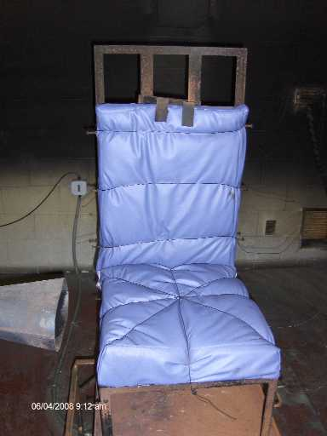
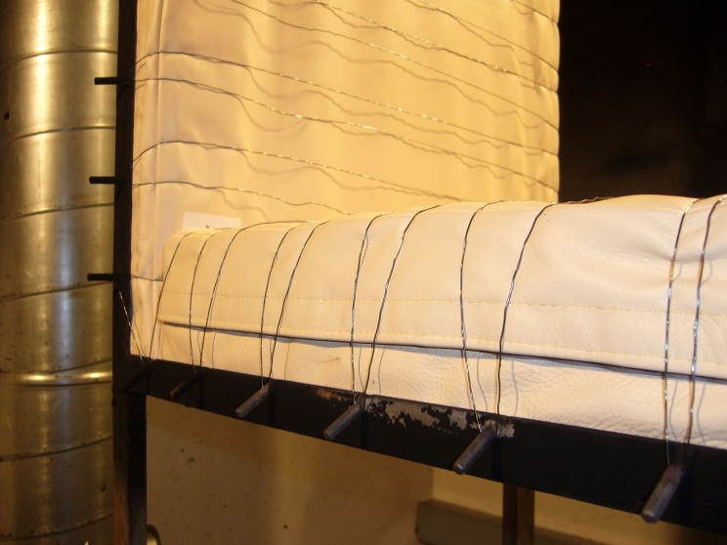

Slide 5
Leather Cushion Restraints
Current definition of leather cushion restraint method is vague and open to interpretation
Different methods of restraint among test labs can lead to disparities in test results and be the difference between a specimen that passes or a specimen that fails
Testing and research has been done in the past, but no final decisions were made regarding a standardized leather cushion restraint method
Past data has shown that there is not necessarily a correct or incorrect method of restraining leather cushions, so long as restraints do not impede the flame
A standardized restraint method used by all labs should increase test result repeatability

Slide 6
Selecting a Restraint Method
Things to consider when deciding on a restraint method:
Configuration
  The arrangement of the restraints
Quantity
  The number of individual restraints
Materials
  Steel rod, safety wire, hook and loop, etc.
Goal
  Devise a method of restraint to maximize repeatability, but not overcomplicate restraint method in order minimize sample preparation time

Slide 7
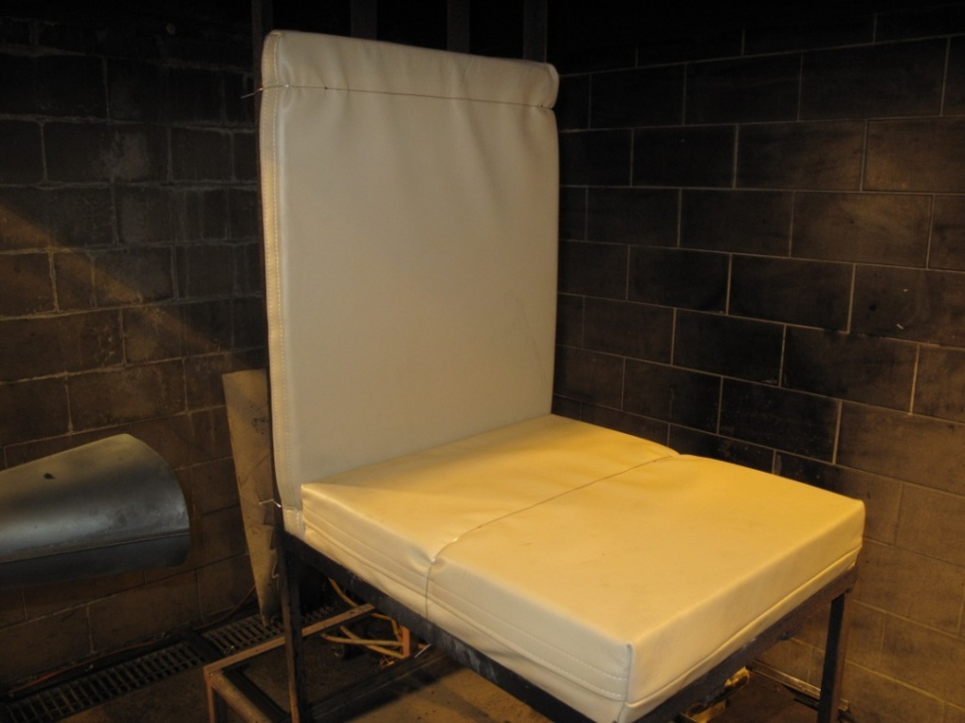
Standardized Restraint Configuration
After testing numerous configurations, it was determined that the most effective and simple method of restraint uses only three pieces of 0.032” steel wire wrapped around the cushions and frame
Wire placement:
1.5” ± 0.5” from top of vertical cushion
1.5” ± 0.5” from bottom of vertical cushion
Center of horizontal cushion

Slide 8
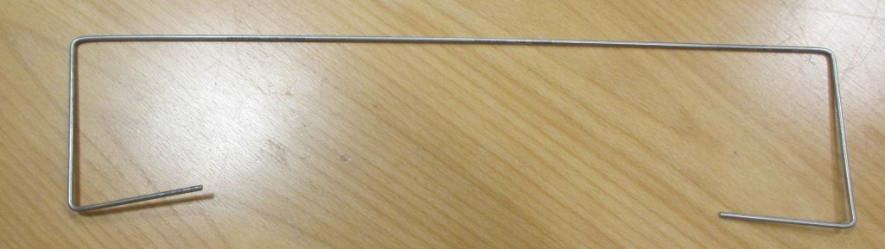
Restraint Materials
Initial testing involved the use of safety wire wrapped around the cushion and frame
Alternatively, pre-bent 1/8 inch stainless steel rod was selected as an option due to its ease of use
The rod can quickly be “clipped” onto the cushion and frame, and reused for many tests
Safety wire is more tedious to attach, and must be disposed of for each test run
Using the clip-on SS rod can save time and money if it can demonstrate to be an effective method of restraint

Slide 9
Bend 1/8” stainless steel rod, and “clip” onto seat cushions as shown.
1.5” ± ½”
18”
2”
3”
18”
4”
3”
10” ± ½”
1.5” ± ½”

Slide 10
Interlab Study
A “mini round robin” was performed to test the effectiveness of the new configuration, as well as compare the performance of SS rod compared to 0.032” steel wire
The FAA Tech Center and Accufleet conductedthe round robin
The test specimens used were fire hardened foam cushions covered in four different materials
  3 different styles of leather
  1 synthetic type leather
3 specimens of each type were tested for both the SS rod and safety wire restraint configurations
  3 specimens x 4 leather types x 2 configurations = 24 tests per lab

Slide 11
Round Robin Results
 | Dark Blue Synthetic Leather | Tan Leather | Light Blue Leather | Brown Leather
1/8" SS Rod | 5.68% | 6.80% | 9.53% | 7.79%
Saftey Wire | 7.39% | 8.42% | 11.07% | 9.01%
Weight Loss % Difference | 1.71% | 1.61% | 1.54% | 1.22%
 | Dark Blue Synthetic Leather | Tan Leather | Light Blue Leather | Brown Leather
1/8" SS Rod | 6.50% | 7.14% | 6.28% | 6.37%
Saftey Wire | 5.81% | 6.68% | 5.40% | 6.15%
Weight Loss % Difference | 0.21% | 0.46% | 0.68% | 0.88%

Slide 12
Additional Notes
The 1/8” is strong, reusable, and moves with the seat cushion as it shrinks from exposure to the flame
The safety wire can be used only once, sometimes snaps during a test, and the seat cushion back can sometimes shrink out from under the restraint

Slide 13
Questions?

