Slide 1
International Aircraft Materials Fire Test Working Group Meeting
Development of a New Flammability Test for Magnesium-Alloy Seat Structure
International Aircraft Materials Fire Test Working Group, Solothurn, Switzerland
Tim Marker, FAA Technical Center
June 25, 2014

Slide 2

Activities Since Last Meeting
Refined method of determining when sample begins to burn (10-sec dwell)
Refined method of determining when sample self-extinguishes (video)
Investigated various techniques when measuring post-test weights
Investigated use of igniterless stator for more consistent flame
Experimentation with not moving sample away from burner after test
Experimentation with new sample holder that allows elongation during heating
Insert new test method into Handbook

Slide 3
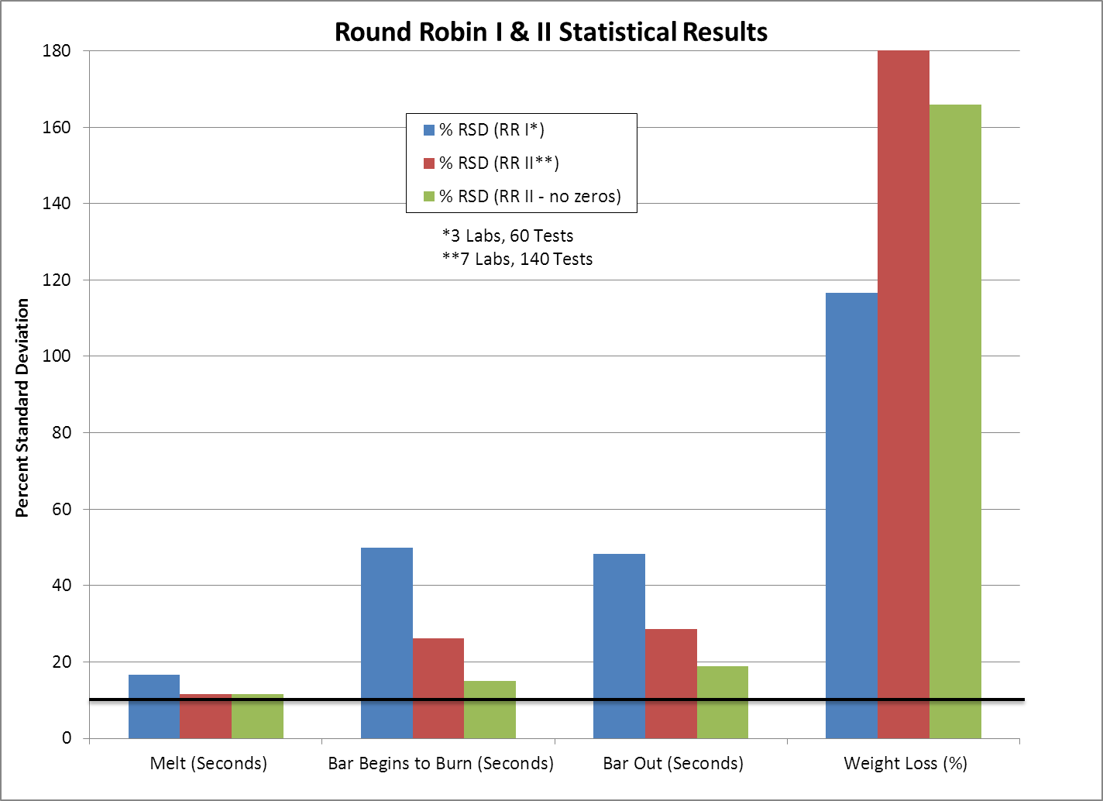

Slide 4
Measurement of Bar and Residue Weight
After 1 hour
After 4 hours
After 24 hours
After wire-brushing
After hammering!

Slide 5
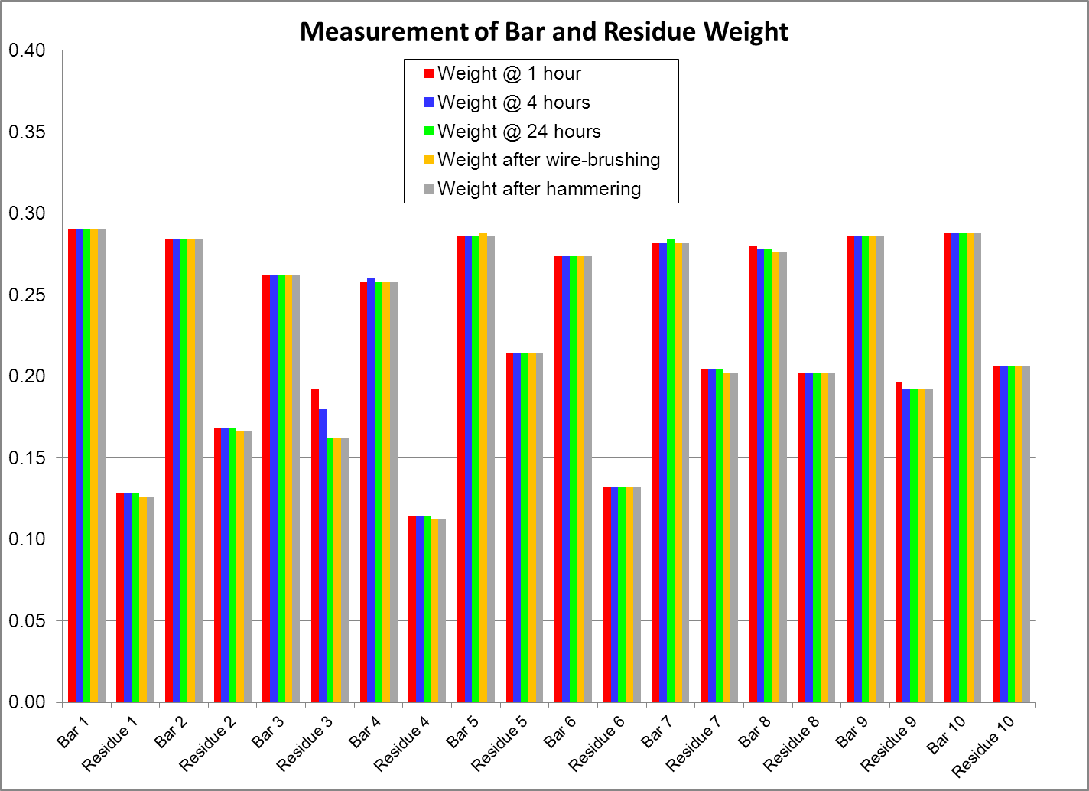

Slide 6


Refinement of Burner Flame for Increased Repeatability
(using Elektron-43 as the testing material)
Use of Stator/Turbulator (baseline) 90% passing
Use of Flame Retention Head yields only 24% passing
Use of Modified Flame Retention Head yields only 79% passing
Igniterless Stator 85% passing

Slide 7
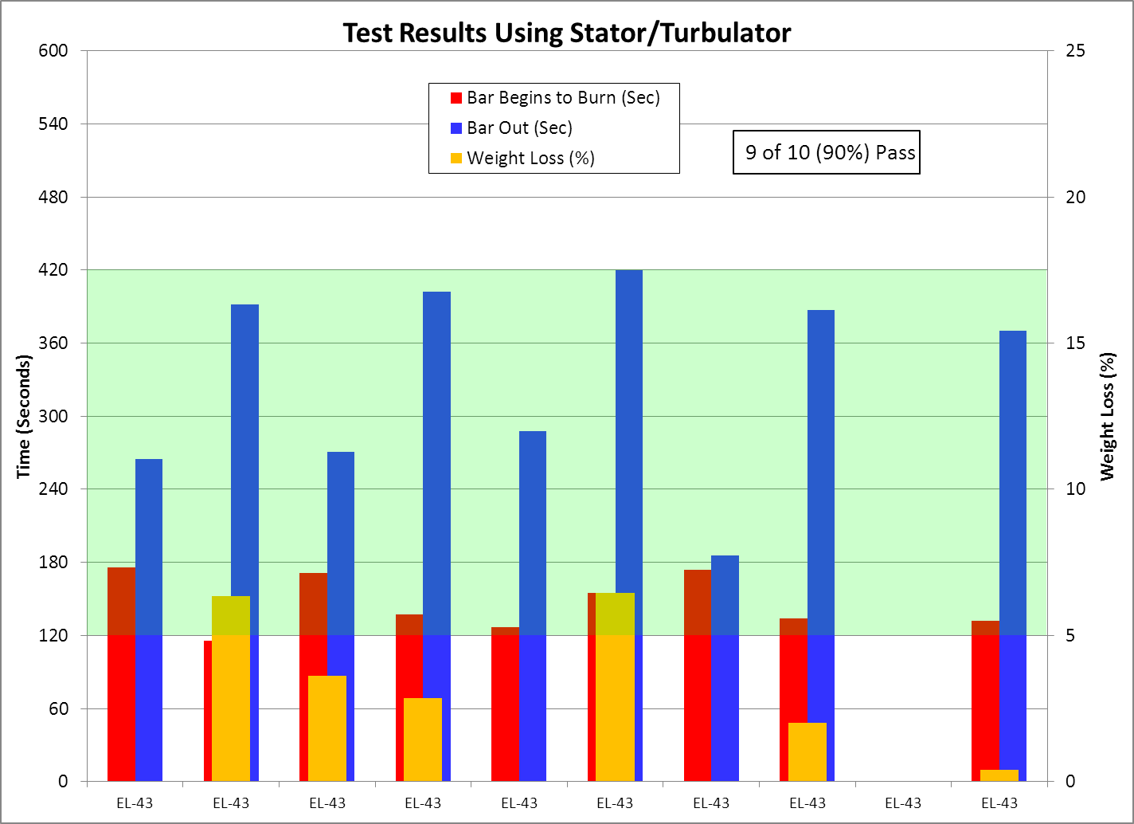

Slide 8
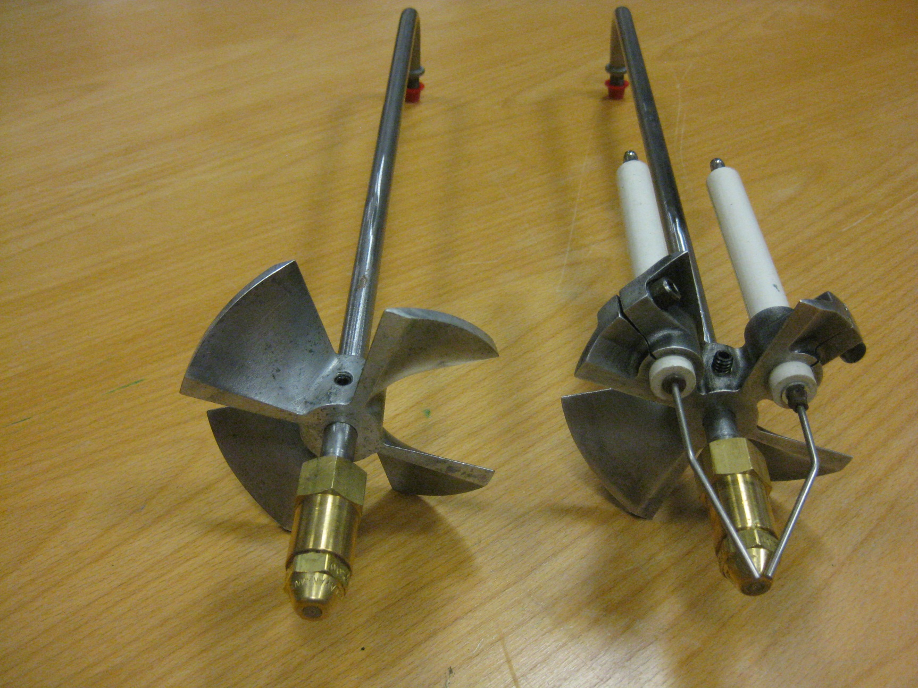
Igniterless Stator Testing

Slide 9
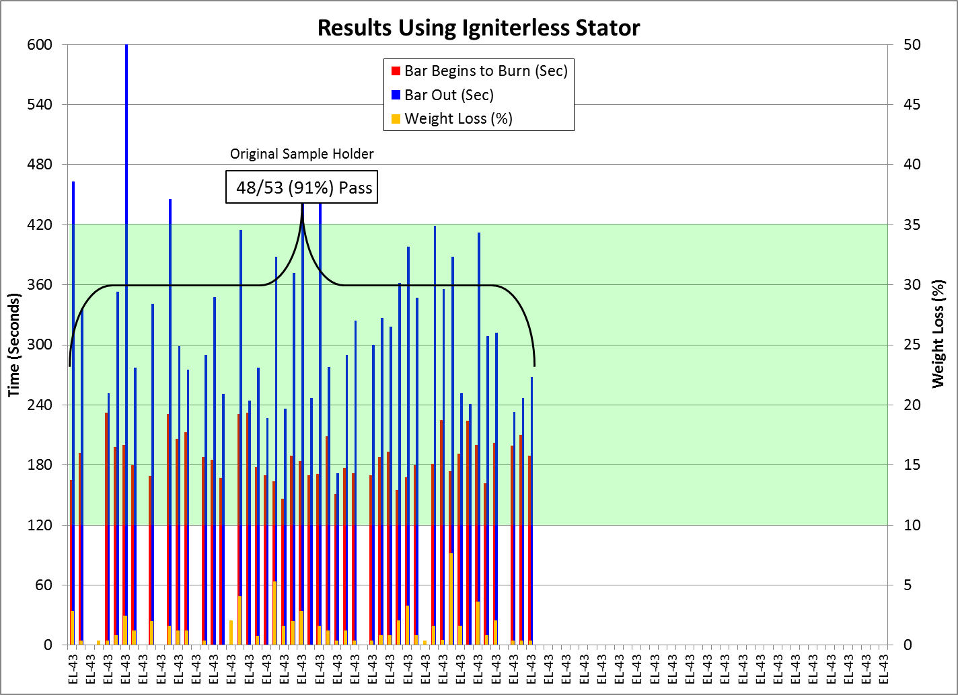

Slide 10
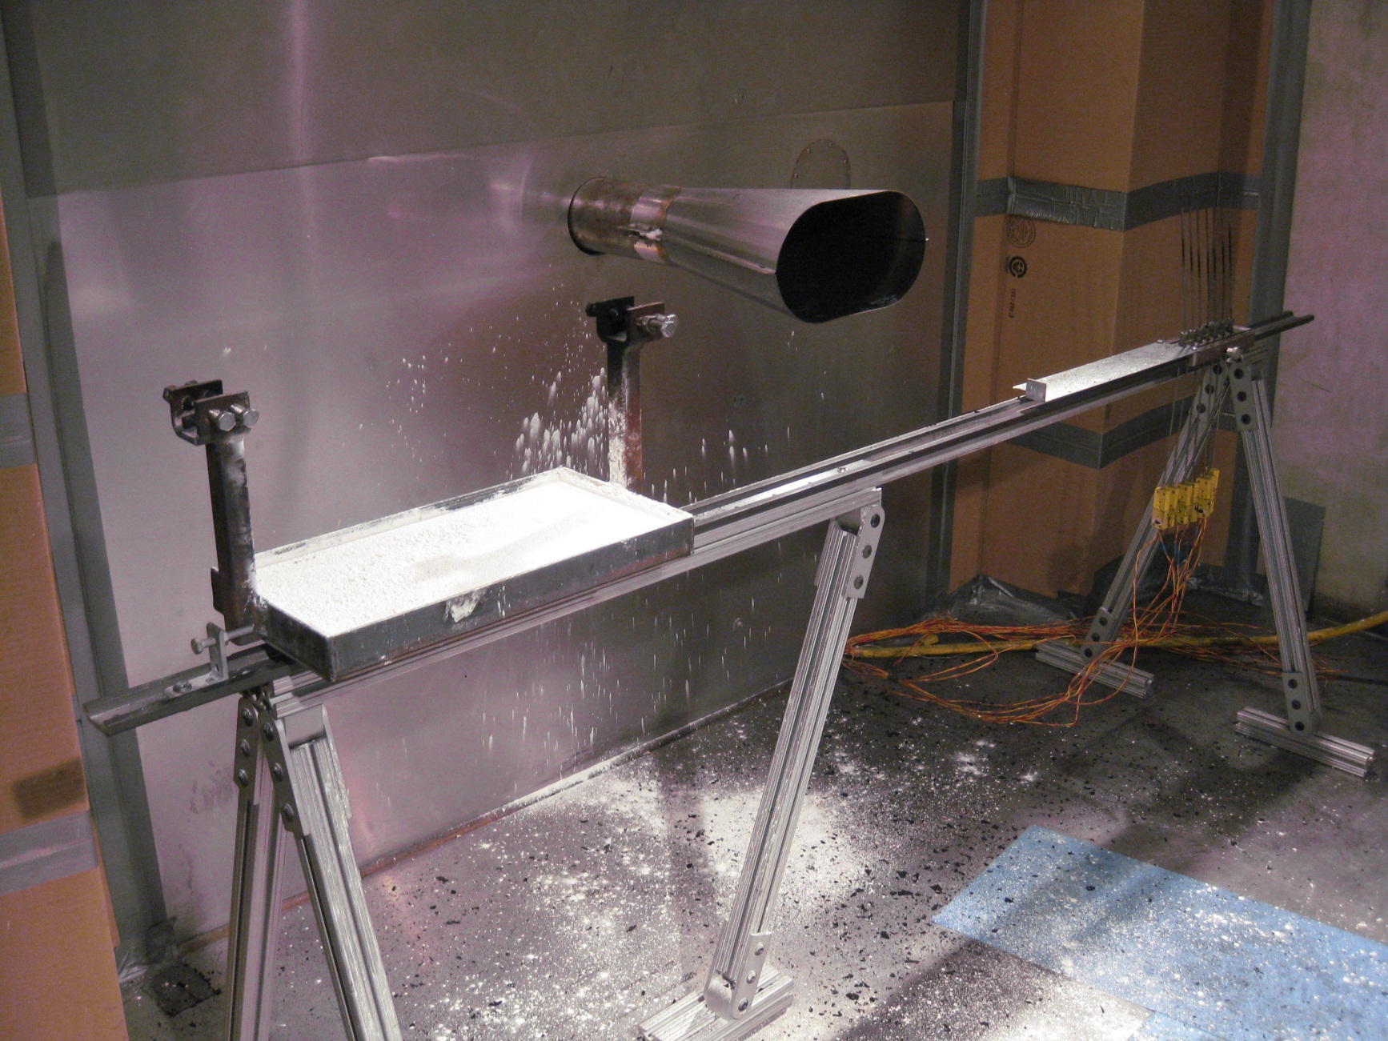
Translation of Sample Away from Burner

Slide 11
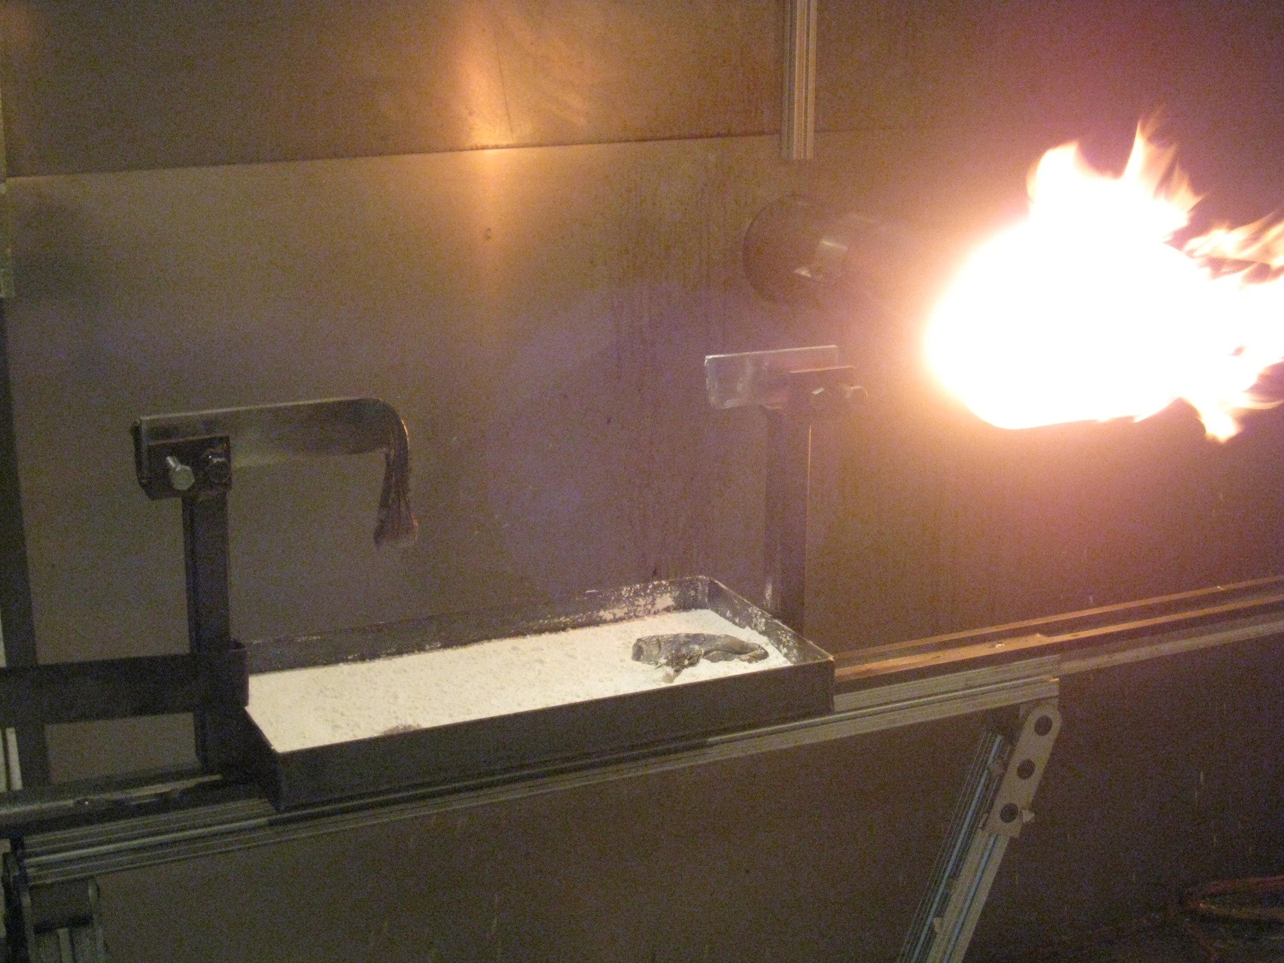
Vibration or Momentum Can Cause Burning Sample to Fall

Slide 12
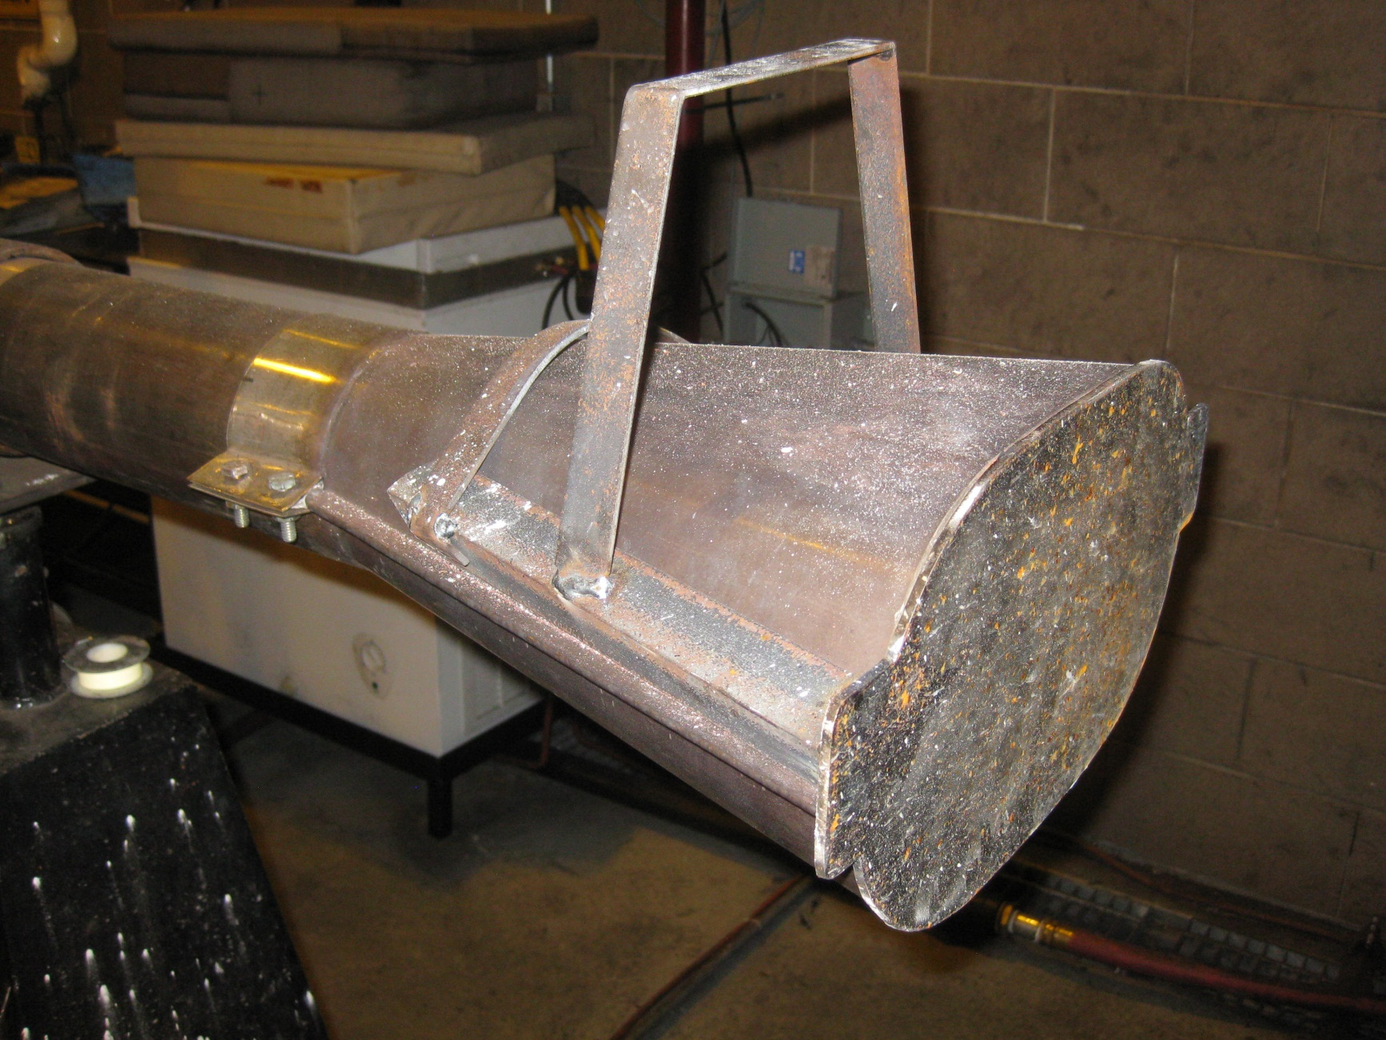
Steel Cover for Cone

Slide 13
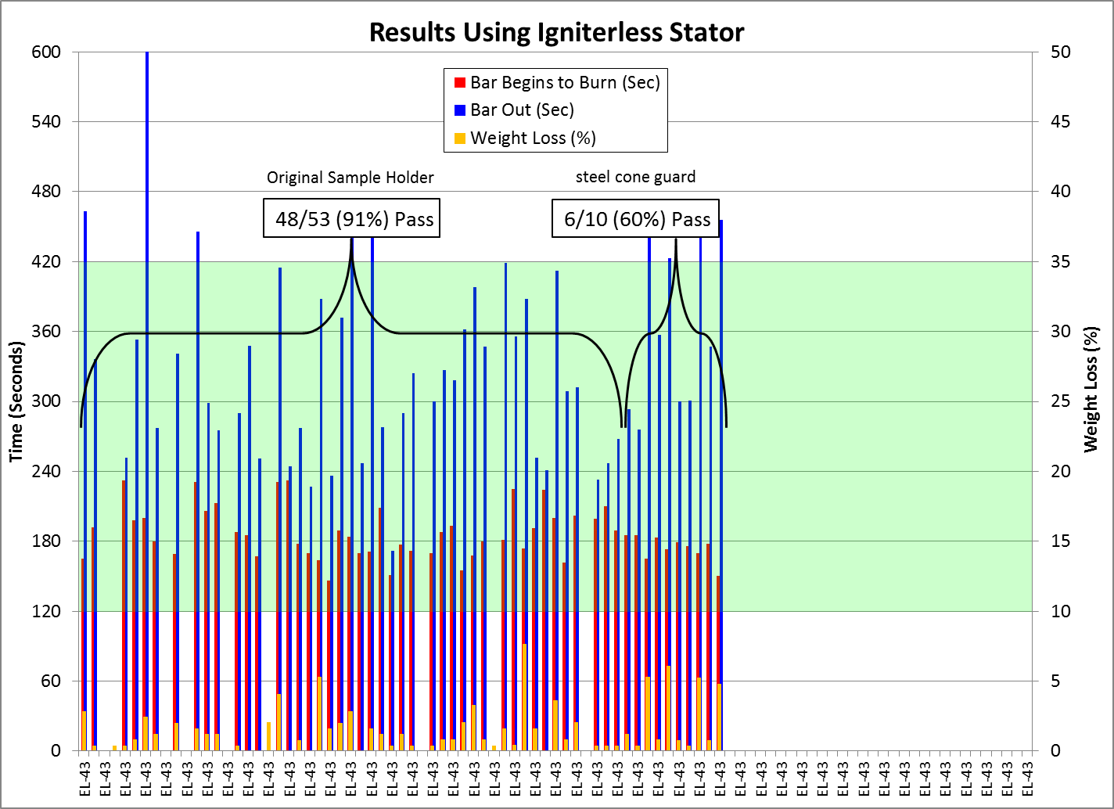

Slide 14
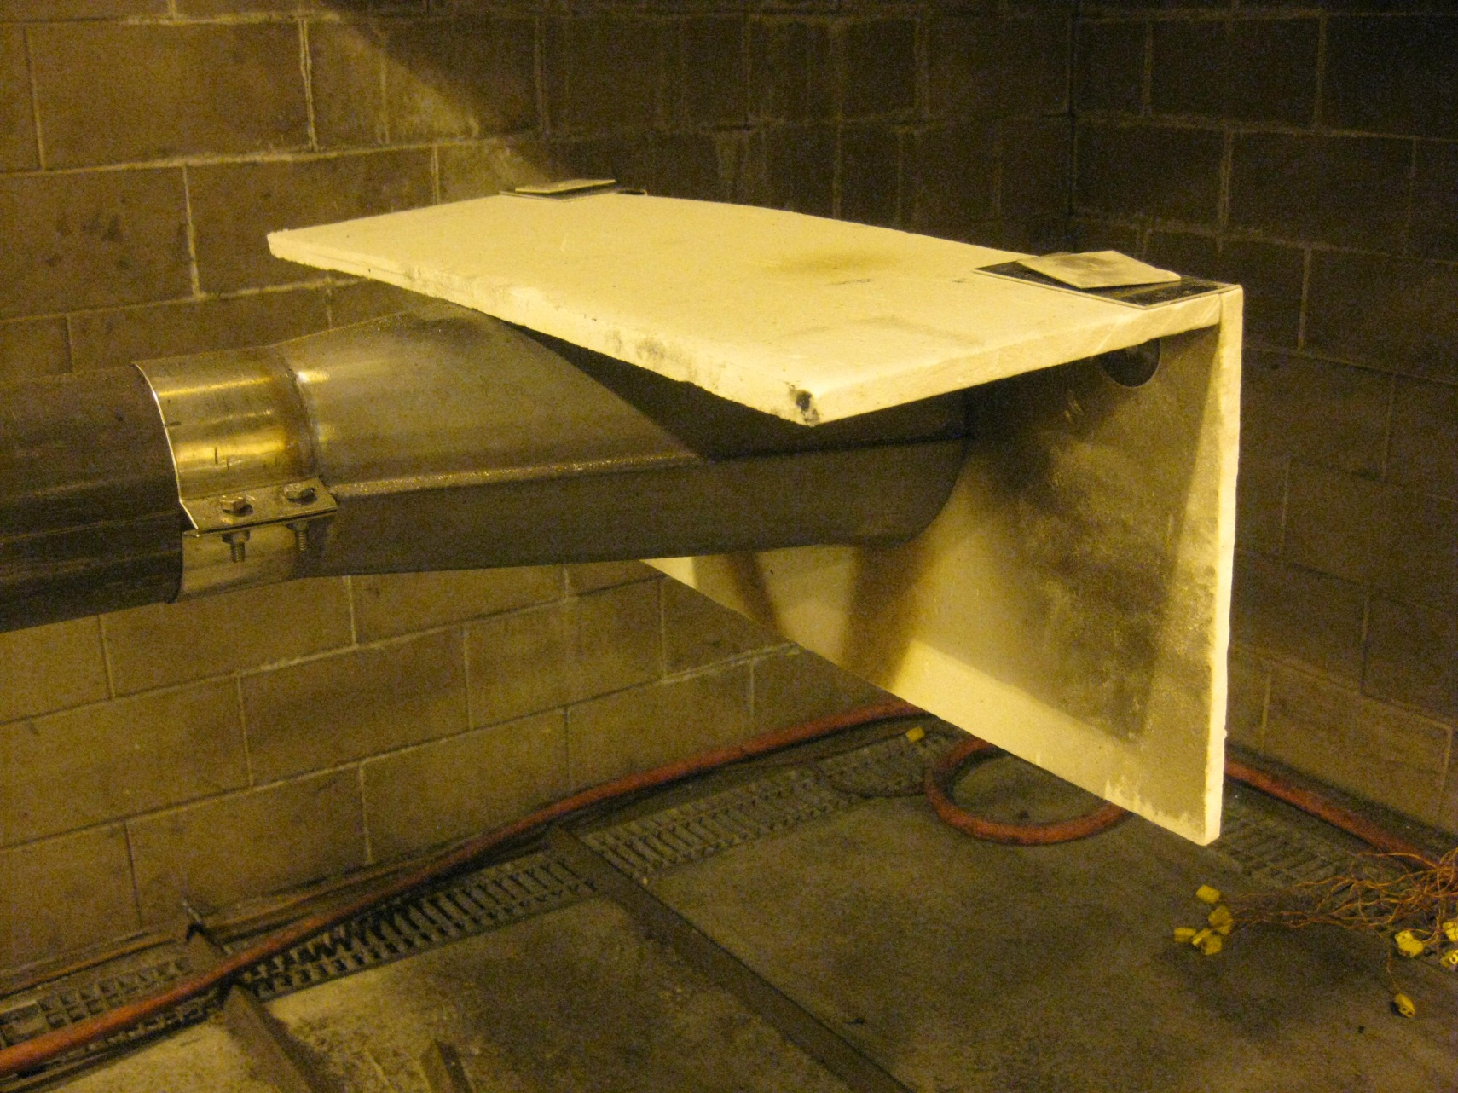
Super Wool Cover for Cone

Slide 15
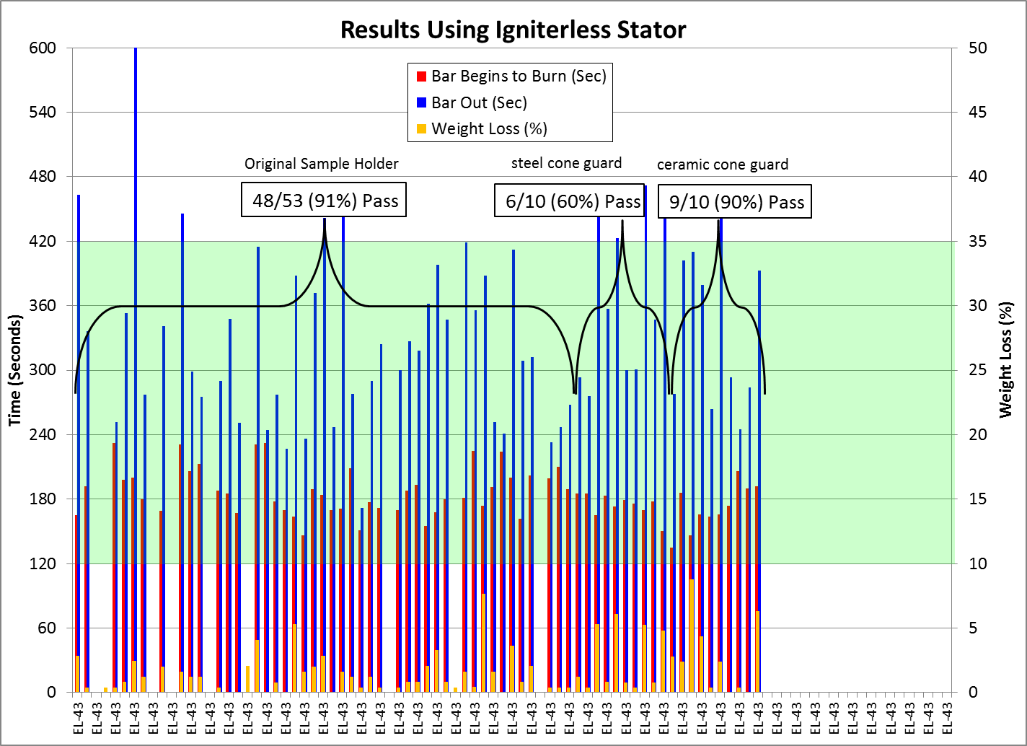

Slide 16
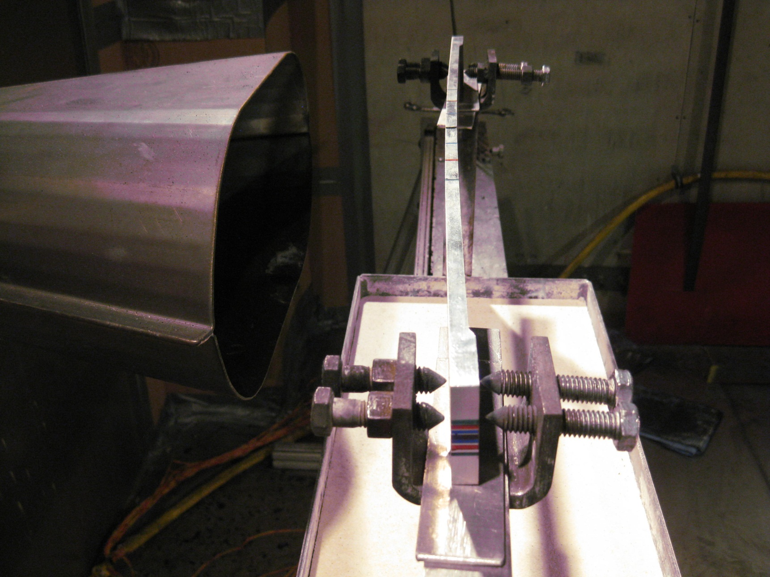
Warped Sample Restrained in Fixture

Slide 17
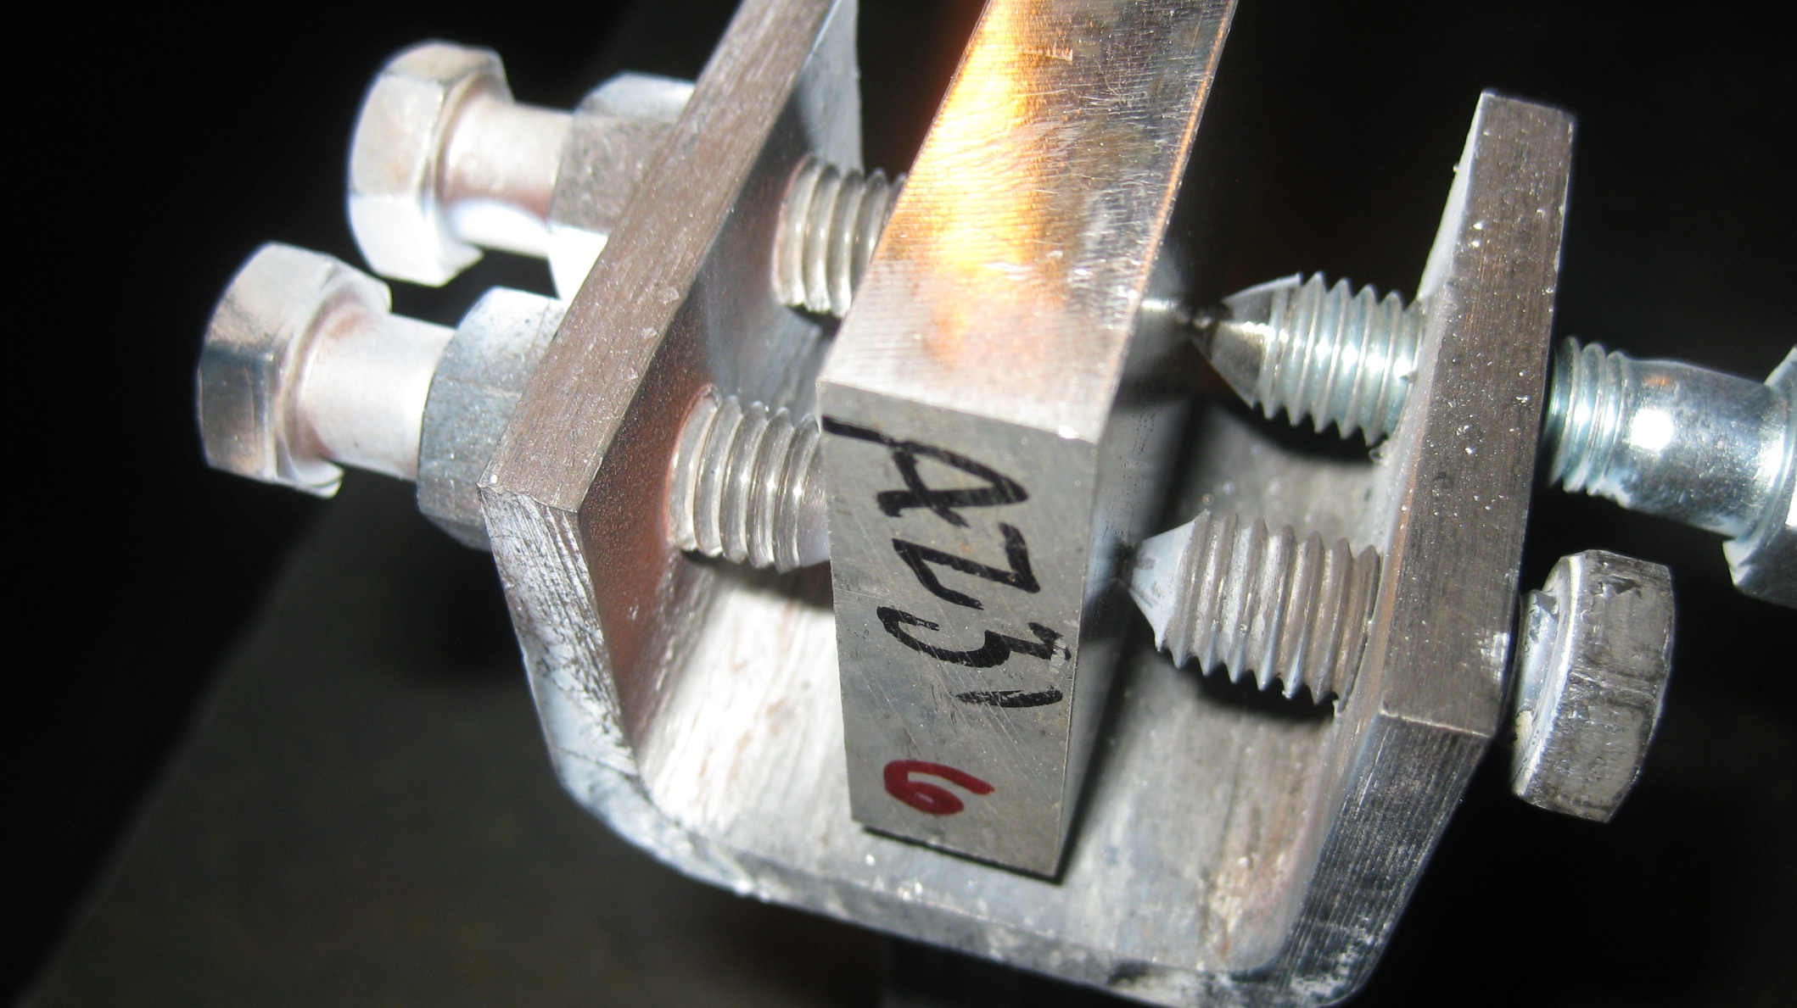
Sample Restrained in Fixture - Locked

Slide 18
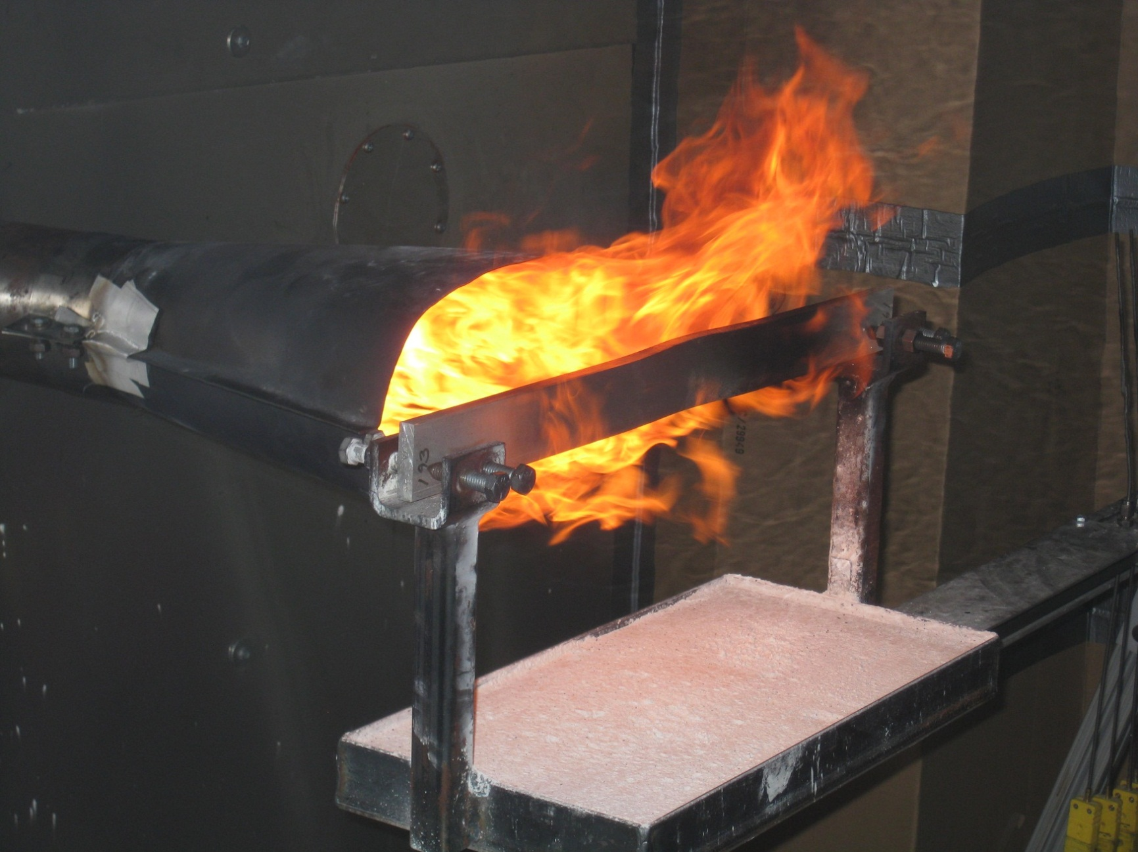
Elongation of Restrained Sample

Slide 19
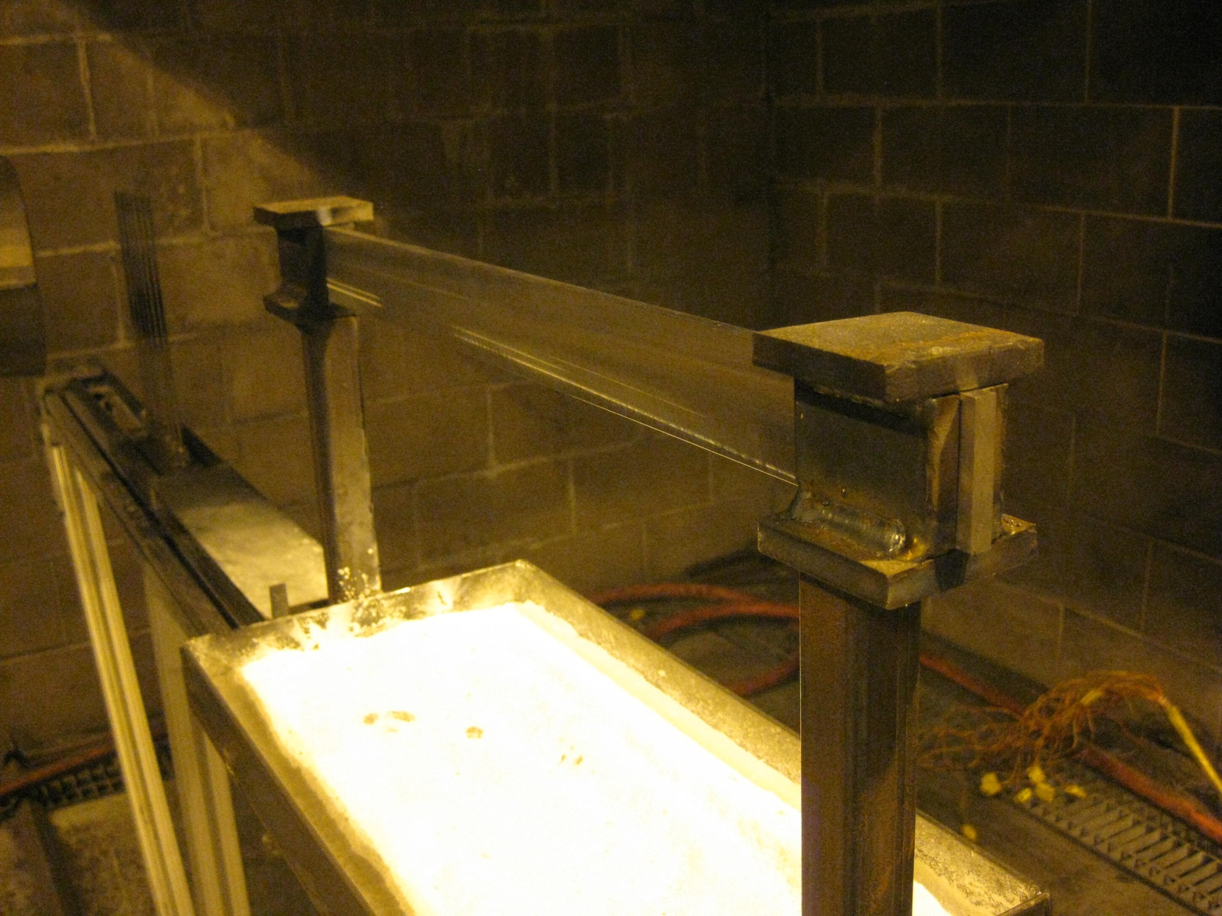
Alternate Sample Holder Allows Elongation

Slide 20
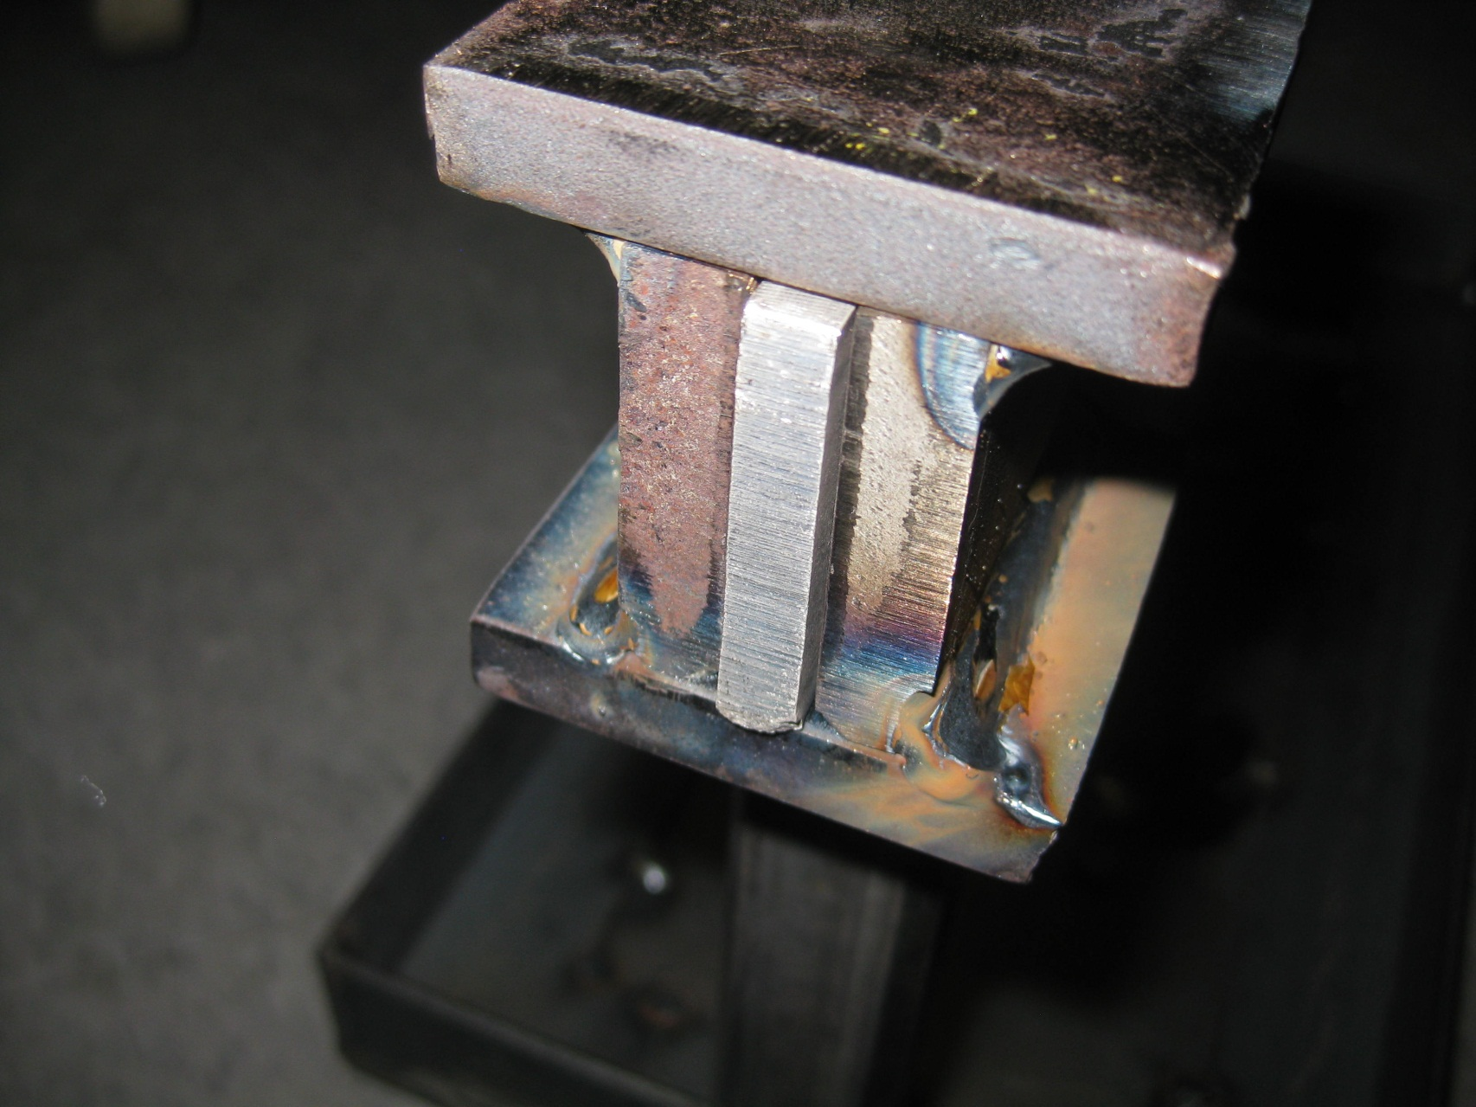
Alternate Sample Holder Allows Elongation

Slide 21
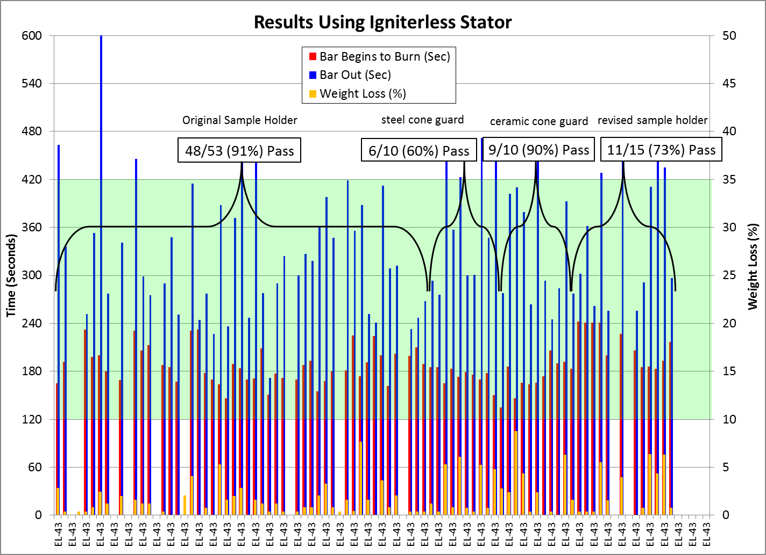

Slide 22
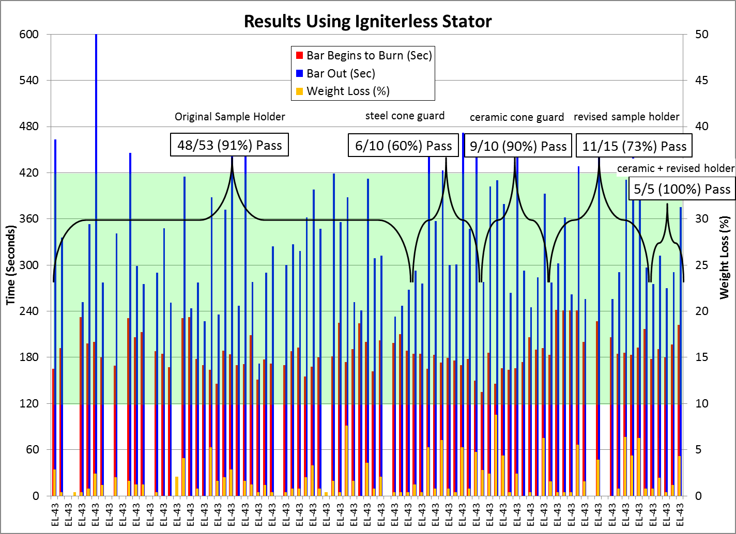

Slide 23
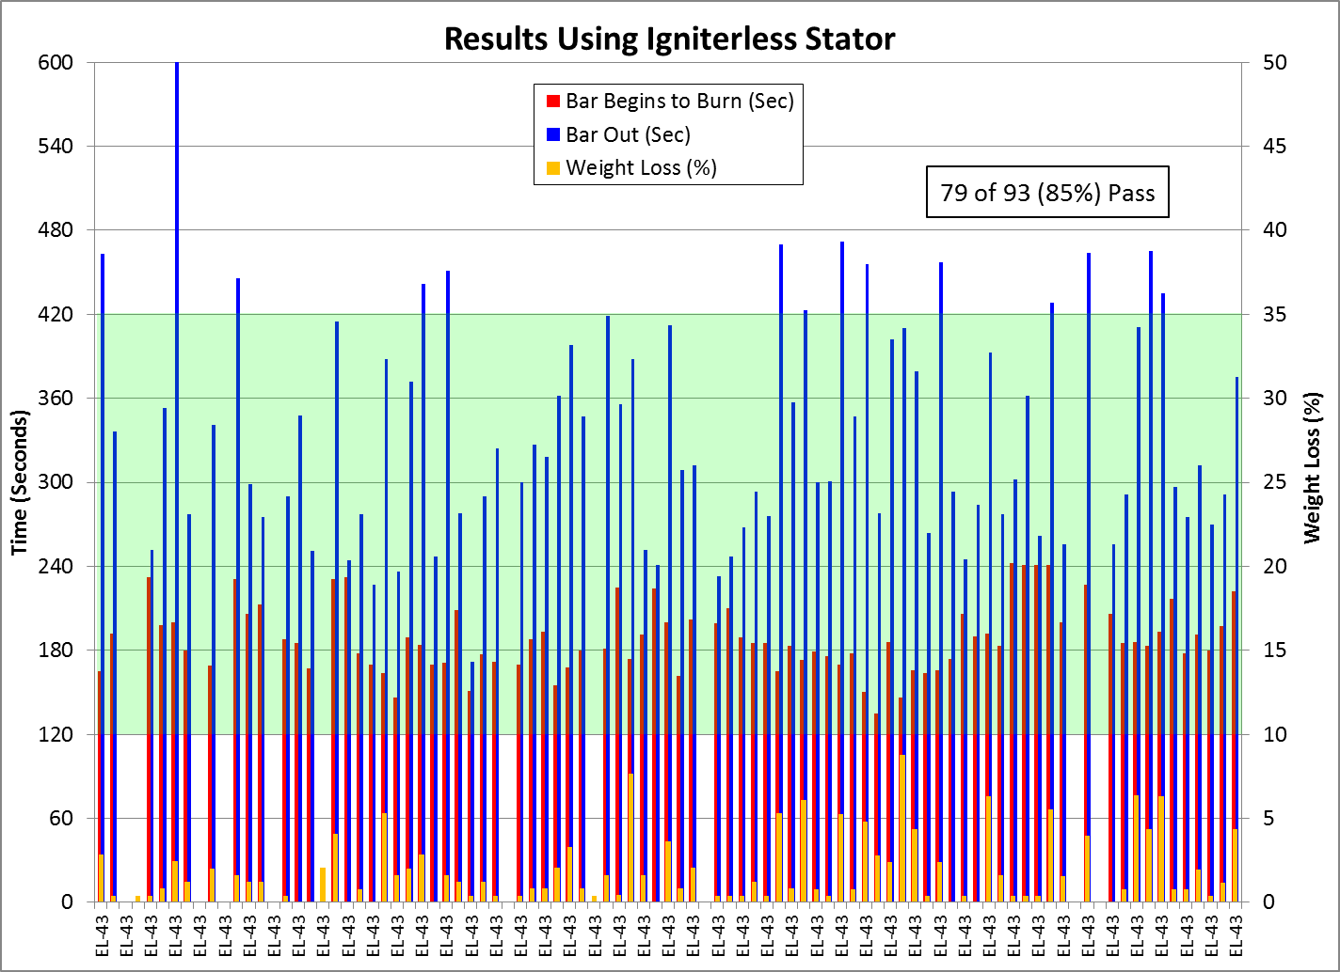

Slide 24
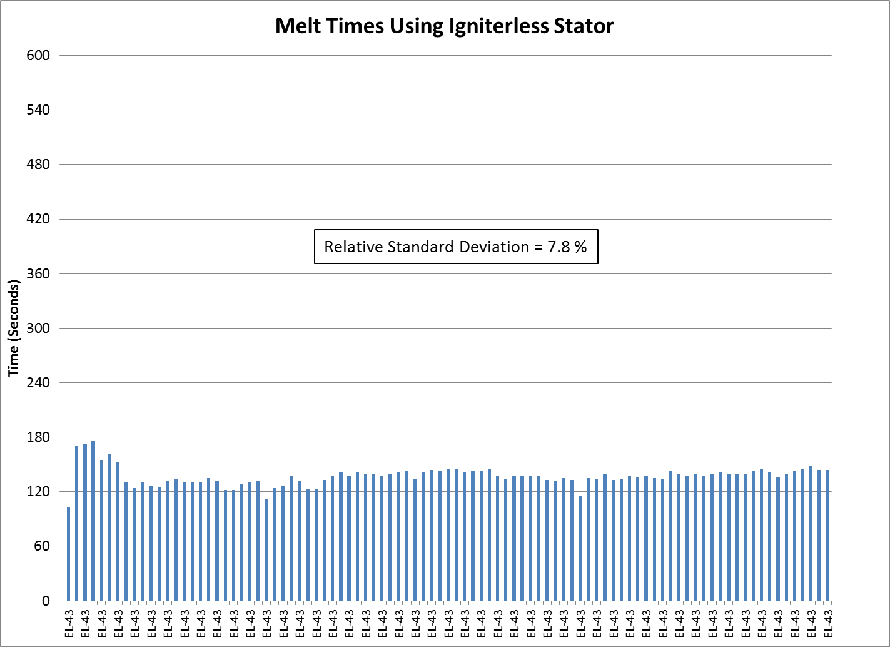

Slide 25
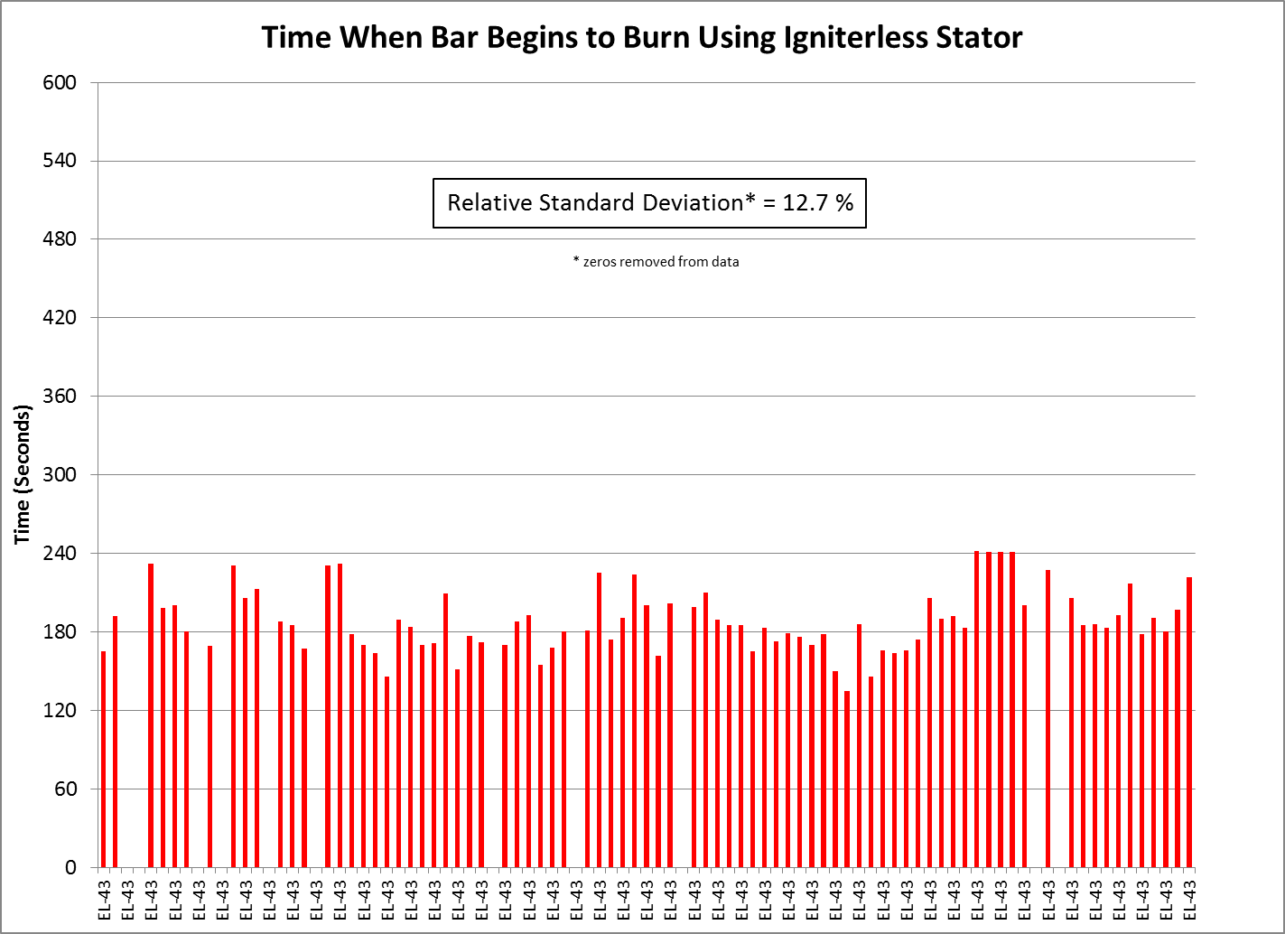

Slide 26
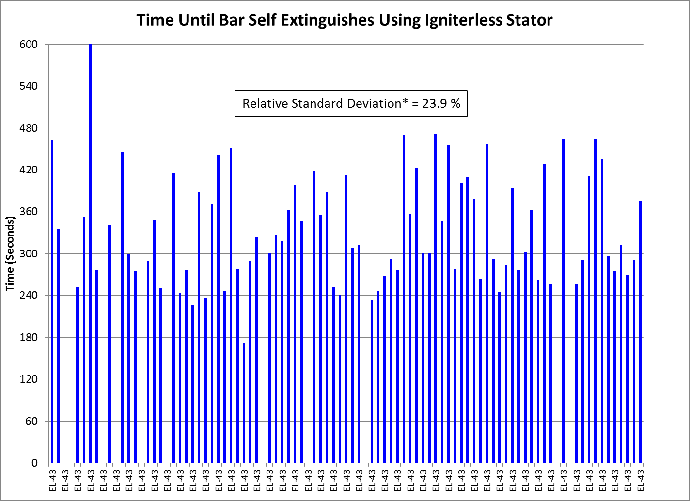

Slide 27
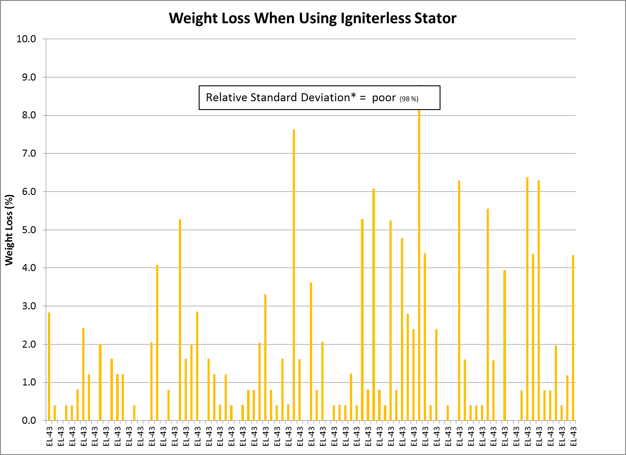

Slide 28
Other Areas of Use?

Slide 30
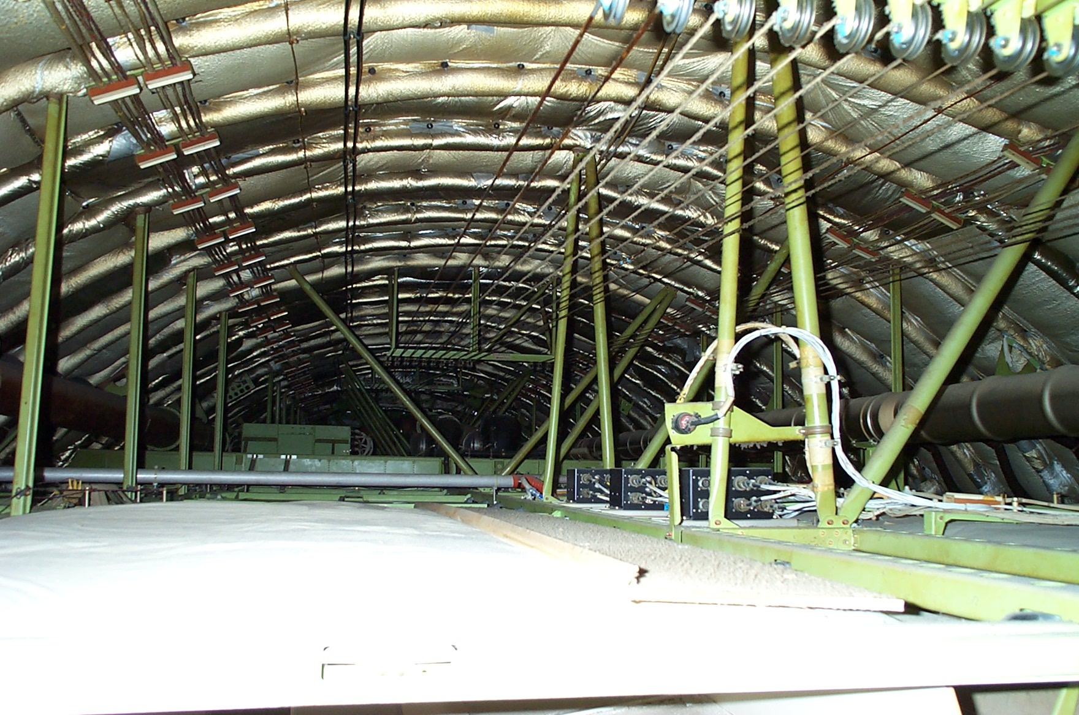
Possible Areas of Mag-Alloy Use

Slide 31
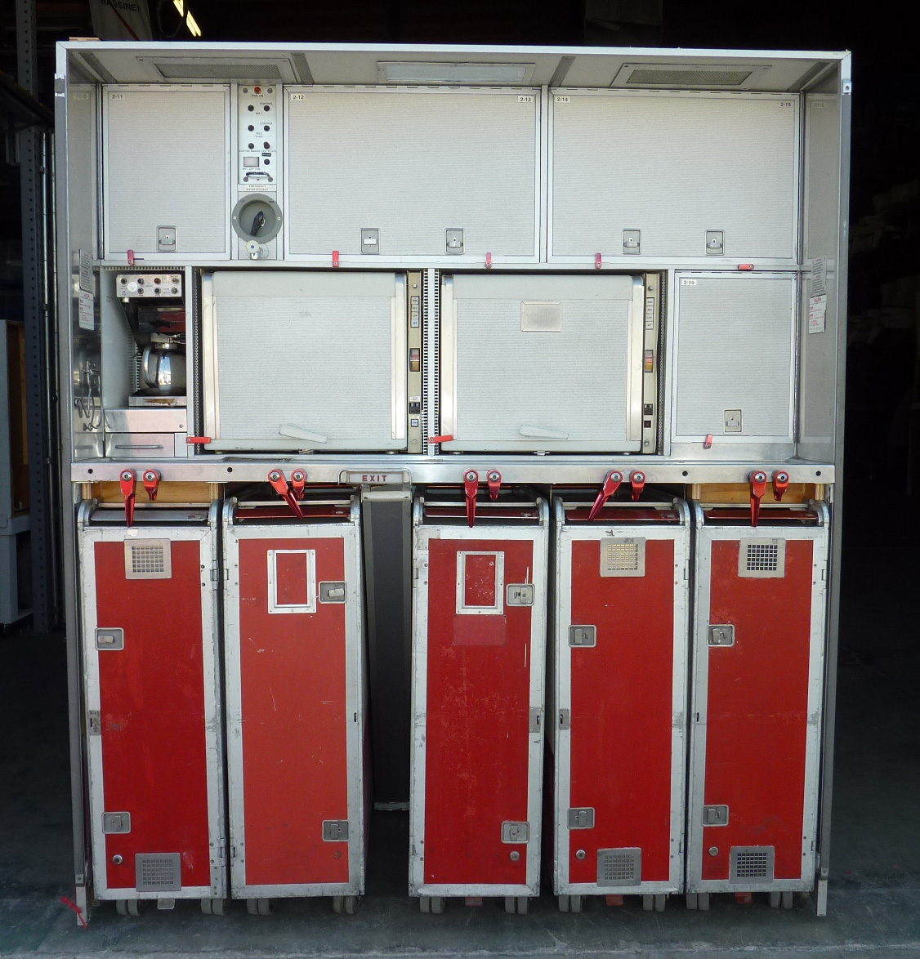
Possible Areas of Mag-Alloy Use

Slide 32
How Can We Certify?

Slide 33
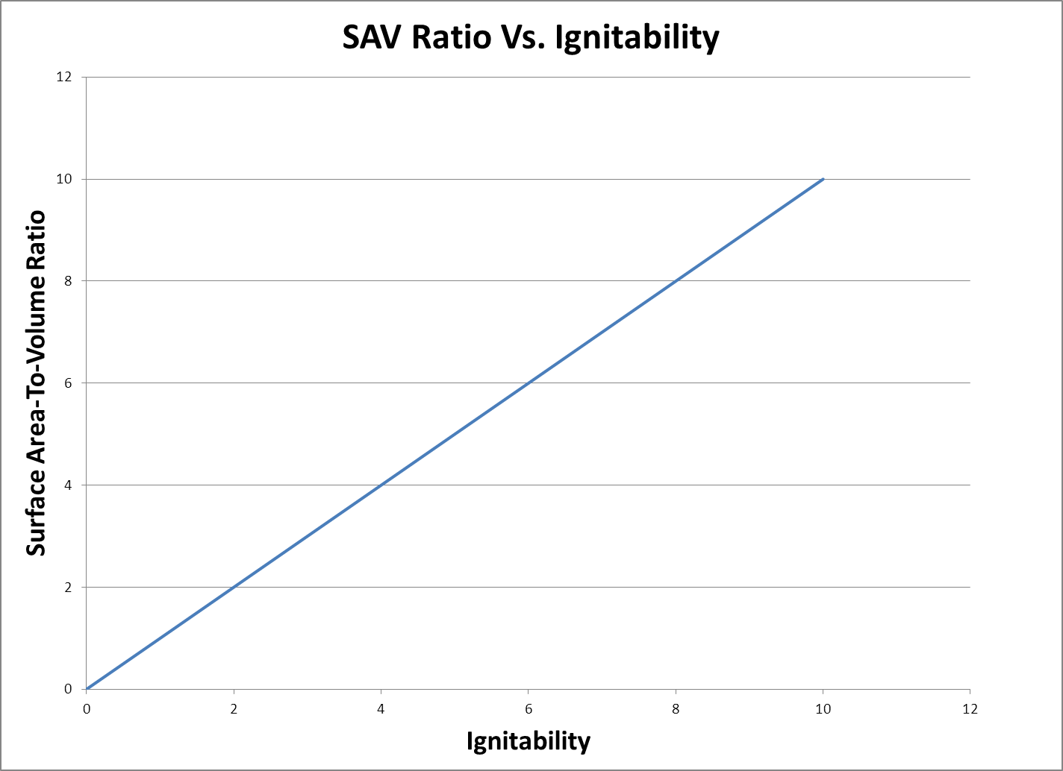
Surface Area to Volume Ratio

Slide 34
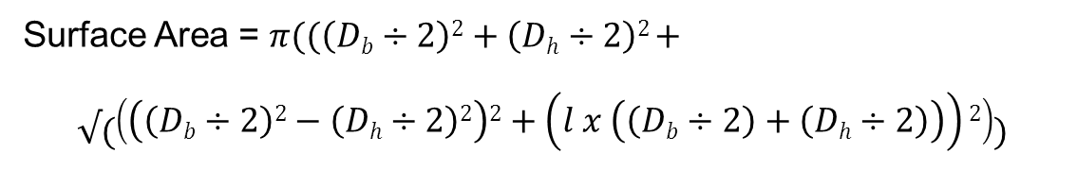
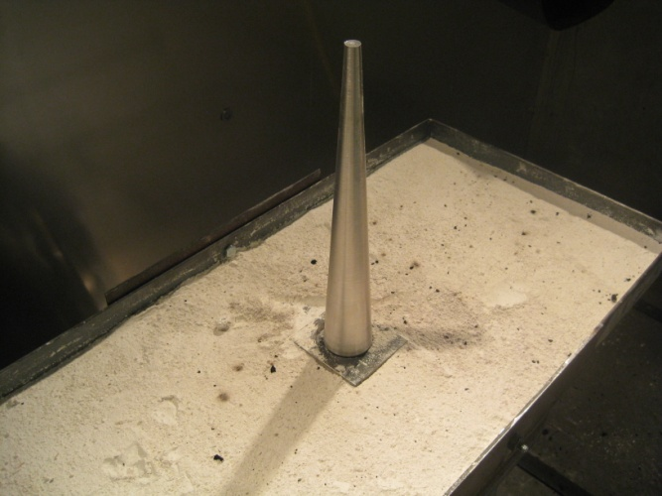
Surface Area to Volume Ratio
For truncated cone test sample: (l = 10, D_{b} = 1.57, D_{h} = 0.40)
Surface Area = 33.0592 in²
Volume = 8.5161 in³
SAV Ratio = 33.0592 ÷ 8.5161 = 3.88 in⁻¹
SAV Ratio = 3.88

Slide 35
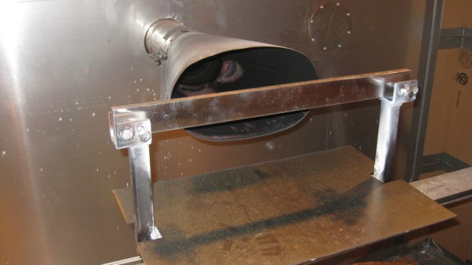
Surface Area to Volume Ratio
For rectangular bar test sample:
Surface Area = (2 x 0.25 x 20) + (2 x 1.5 x 20) + (2 x 0.25 x 1.5)
Surface Area = (10) + (60) + (0.75) = 70.75 in²
Volume = (0.25 x 1.5 x 20) = 7.5 in³
SAV Ratio = 70.75 ÷ 7.5 = 9.42 in⁻¹
SAV Ratio = 9.42

Slide 36

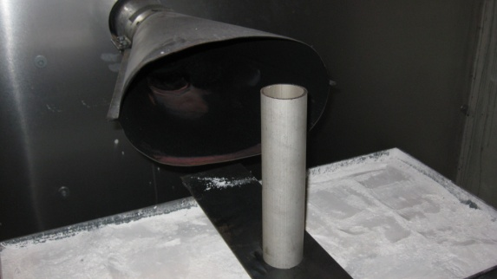
Surface Area to Volume Ratio
For hollow cylinder test sample (1.75 OD, wall thickness = 0.094):
Surface Area = 84.22782 in²
SAV Ratio = 84.22782 ÷ 3.90248 = 21.58 in⁻¹
SAV Ratio = 21.58

Slide 37
Surface Area to Volume Ratio
For thin sheet test sample: (10 inch square, thickness = 0.0625)
Surface Area = (2 x 10 x 10) + (4 x 0.0625 x 10)
Surface Area = (200) + (2.5) = 202.5 in²
Volume = (l x w x t)
Volume = (10 x 10 x .0625) = 6.25 in³
SAV Ratio = 202.5 ÷ 6.25 = 32.4 in⁻¹
SAV Ratio = 32.4

Slide 38

Surface Area to Volume Ratio
For solid basketball-sized test sample: (9.5-inch diameter)
Surface Area = 4 pr²
Surface Area = (4 x 3.14 x 22.5625) = 283.53 in²
Volume = 4/3pr³
Volume = (4 ÷ 3 x 3.14 x 107.17) = 448.92 in³
SAV Ratio = 283.53 ÷ 448.92 = 0.632 in⁻¹
SAV Ratio = 0.632

Slide 39
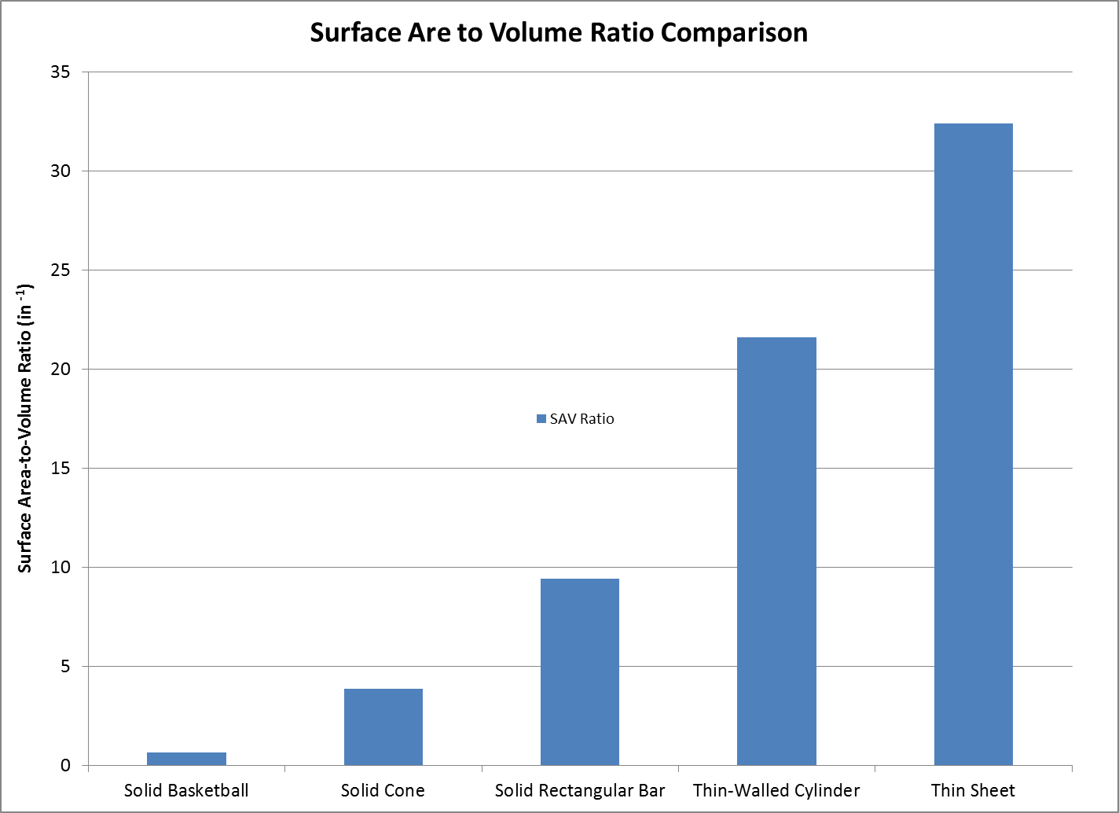

Slide 40
Considerations for Qualifying Other Mag-Alloy Components
Possible to define a maximum SAV ratio + use oil burner test
For Example:
If SAV ratio is less than xx, use oil burner test
If SAV ratio is greater than xx, use suitable electrical arc test

Slide 41
Questions?

Slide 42
http://www.fire.tc.faa.gov/pdf/AR11-13.pdf

Slide 43
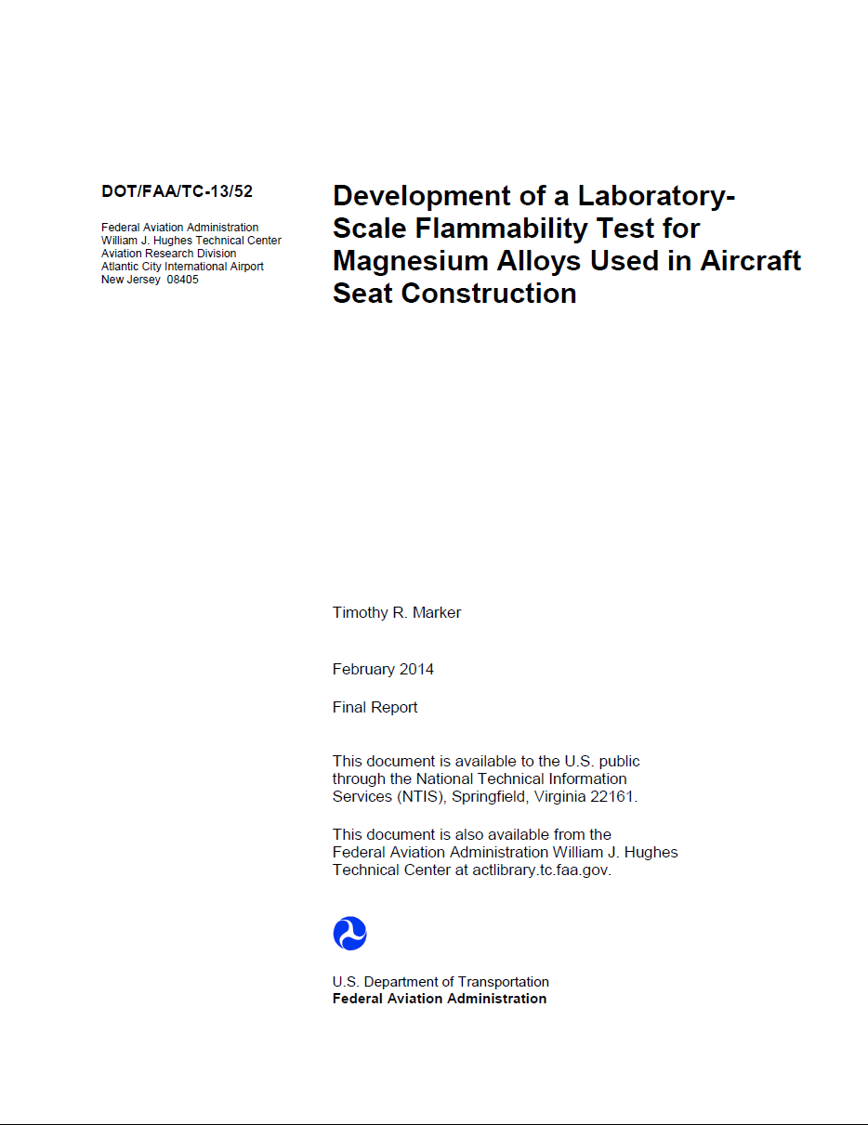
http://www.fire.tc.faa.gov/pdf/TC-13-52.pdf

Slide 44
Discussion Items for Inclusion in Advisory Circular
Testing of coatings (powder coatings, anodizing, paints)
Can other seat components also be made of magnesium alloy?
Can “Equivalent Geometry” be defined using SAV ratio?

