Slide 1
HEAT RELEASE RATE Updates 2014 June Materials Meeting Switzerland
Materials Working Group
Michael Burns, FAA Tech Center
June, 2014

Slide 2
AGENDA
OSU
Orifice Meter Discussion
(Static Pressure Taps)
Chapter HR Update (hr2)
Combined Supplement with Test method

Slide 3
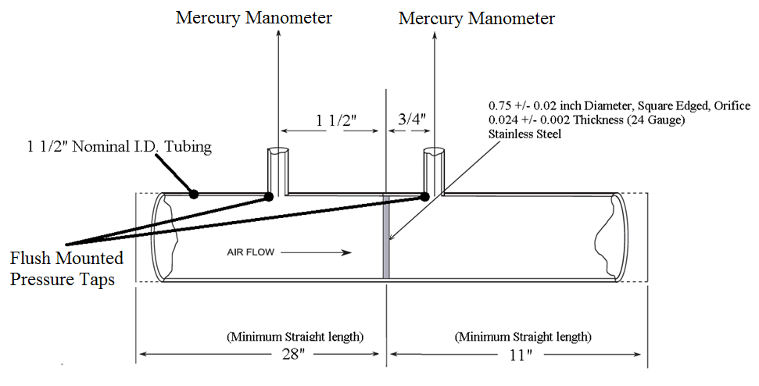
OSU:
Protruding pressure taps (beyond the pipe inner wall) vs. surface pressure taps (flush with inner wall) may have a influence on pressure readings
Could have an influence on total airflow

Slide 4
HR2: HEAT RELEASE TEST METHOD
Supplemental material moved to Test Method as follows:
Added BTU/ft²*sec units
Environmental Chamber – Added Radiation Door Assembly Figure
Radiation Source
Power Supply Capacity – 12 kVA is sufficient
Diamond-Shaped Mask Mounting – ½ inch diameter machine screw
(approximately 4 inches in length)
Mask Position – Approximately 3 inches from the reflector plate
Mask shaft-head or nut only on side facing specimen
(no threads extending towards specimen)

Slide 5
HR2: HEAT RELEASE TEST METHOD
Thermopile Wiring
Color coding differences - Chromel yellow/green; Alumel red/white
Upper Pilot Burner
Caution Statement – Do not disturb burner position once set
Flame Profile – To increase orange tip, reduce air from the mixture
Drill hole sizes added for:
Upper Pilot Burner (#59 Drill)
Air Distribution Plate (# 4 Drill)
Second Stage Plate (# 28 Drill)
Drip Pan - Foil can be used to line the drip pan to facilitate cleaning after use

Slide 6
HR2: HEAT RELEASE TEST METHOD
Heat Flux Gauge (HFG)
Cooling Water Tubing – Rigid due to the high temperatures
Cleaning – Gently wipe with soft, water-dampened sponge
Caution Statement – Damage done to the coating during the cleaning process will affect the measurement accuracy of the sensor
Specimen Preparation
Added recommended specimen foil wrapping technique
Foil trimming – no scoring or incisions permitted
Spring Plate Pressure – Recommended applying equal pressure to specimens of equal thickness by inserting the specimen retaining rod in the same holes for each specimen tested

Slide 7
HR2: HEAT RELEASE TEST METHOD
Heat Flux Calibration Procedure (Corner)
Caution Statement – Do not disturb burner position when rotating calibration fixture 90 degrees
Added options for improving 4-corner uniformity:
Adjust power settings
Reposition globars - Hottest to coolest (bottom to top)
Move mask – Closer to or further from HFG
Move globars – Adjustment left or right
Reflector plate – Adjust slope (top and bottom)
Added Rounding, Accuracy and Units section

Slide 8
HR2: HEAT RELEASE TEST METHOD
Calculation of Calibration Factor Kh – Added example assuming 60 mV baseline; 7 mV rise for each change in flow

Slide 9
HR2: HEAT RELEASE TEST METHOD
Test Preparation
Thermopile – Baseline mV observed daily as an indicator of developing problems
Variations in heat flux (heat flux gauge malfunction)
Defects in thermopile
Air leakage – Environmental chamber/lower plenum, exhaust stack or holding chamber door seal
Test Performance
The use of an externally positioned mirror may assist in viewing upper pilot flames during testing

Slide 10
HR2: HEAT RELEASE TEST METHOD
Heat Release Rate – Added example for calculating HRR (Peak HRR)

Slide 11
HR2: HEAT RELEASE TEST METHOD
Total Heat Release – Added example for calculating Total HR (2-Min. THR)

Slide 12
HR2: HEAT RELEASE TEST METHOD
Test Report
Laboratory
Fully identify the material tested
Graphically report the heat release rate (kW/m²) as a function of time (in seconds) for each test
Maximum heat release rate and time (in seconds) it occurs during each test
Total heat released during the first 2 minutes of each test
Radiant heat flux to the specimen

Slide 13
HR2: HEAT RELEASE TEST METHOD
Test Report (Continued)
Calibration factor Kh (kW/mV )
Average mV baseline for each specimen tested
Melting, sagging, delaminating, or other behavior that affected the exposed surface area or mode of burning that occurred and the time(s) at which such behavior occurred
Total number of materials tested
Total number of materials passed

Slide 14
HR2: HEAT RELEASE TEST METHOD
Requirements
Quantity of Samples – Minimum of three samples must be tested and 80% or greater must pass

Slide 15
QUESTIONS?
What is full of holes, but can still hold a lot of water?
Answer: Sponge

