Slide 1
Vertical Flame Propagation (VFP)- Boeing Update
Fire Test Working Group (6/25/2014)
Prepared by: Yusuf Mansour and Matt Anglin

Slide 2
VFP Background
The FAATC is developing a new test method for extensively used hidden area materials (ECS ducting, composite fuselage skin, electrical wiring).
Boeing received one of three developmental units from the FAATC for round robin testing and equipment R&D.
FAA visited Boeing in March 2014 to run round robin coupons and discuss opportunities for improving the machine’s performance.
Boeing has volunteered to design and conduct an experiment to gather preliminary information on the tolerances of the inputs.
Boeing has also volunteered to design and conduct additional experiments, and perform additional tests to assist in equipment R&D effort.

Slide 3
VFP Tolerance Discussion
Purpose: establish tolerances that are:
Practical (easily set and maintained).
Sufficiently tight to control the variability of the results within acceptable limits.
Strategy: define the order-of-magnitude effect of various inputs on burn length.
Inputs studied:
Flamelet length
Heater power
Exhaust flow rate
Time between tests (door open)
Parameters that were recorded, but not studied:
Lab ambient conditions: temperature, pressure, humidity
Exact sample dimensions
Time in conditioning chamber
Run order
Notes:
Add example for impractical tolerance on flamelet length
Nominal values of inputs:
Flamelet length: 3/16”
Power to heater: 706 W
Exhaust flow rate: 125 FPM (FPM =feet per minute)

Slide 4
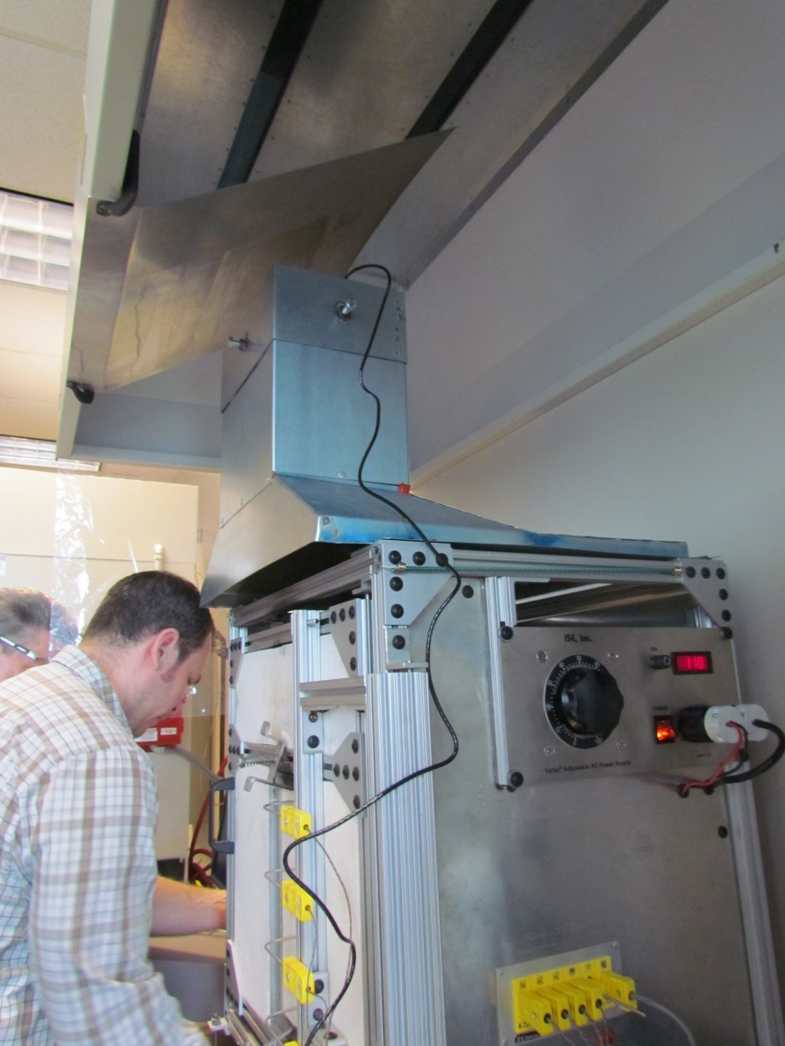
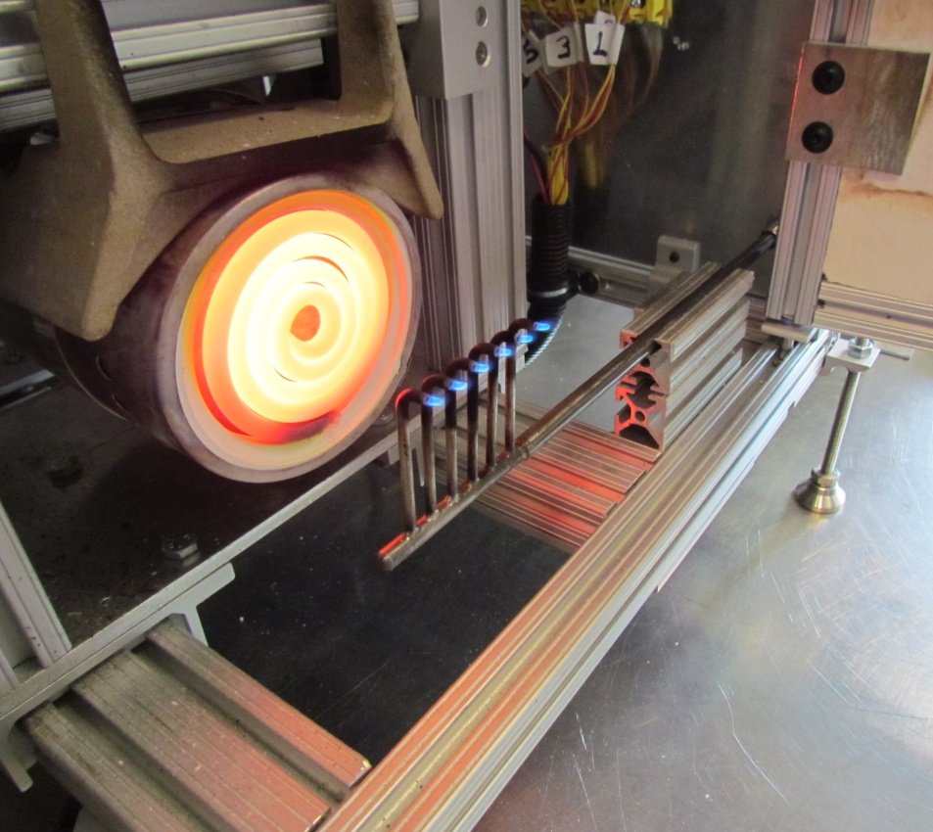
VFP Machine Overview
Exhaust
Radiant heater
6 flamelets
Variac
(to adjust power to heater)

Slide 5
Experimental Design
Design:
2⁴⁻¹ design used: one-half fraction of the full factorial design (test half the number of combinations at the expense of some information).
2⁴⁻¹
Results in 8 combinations
3 replications per combination were used
Total of 24 sample were tested
Test order was randomized (to minimize unknown variable effects)
Only one material was tested, general conclusions about all materials can’t be made yet.
Logistics:
Testing was completed in a single day with a single operator
All coupons were from the same batch of material and cure cycle to minimize material variability
Material selection rationale:
Mid range burn length ~3”
No after flame
Relatively consistent flammability properties
Number of inputs studied = 4
“-1” means one-half fraction
Number of levels of each input = 2 (high and low)

Slide 6
Experimental Runs
StdOrder | RunOrder | Flamelet Length (in)* | Power to Heater (W)* | Exhaust flow rate (fpm)* | Time between tests (min)*
12 | 1 | 3/16 | 706 | 50 | 0
5 | 2 | 3/16 | 400 | 50 | 3
21 | 3 | 7/32 | 400 | 180 | 3
13 | 4 | 7/32 | 400 | 180 | 3
16 | 5 | 3/16 | 706 | 180 | 3
2 | 6 | 3/16 | 400 | 50 | 3
17 | 7 | 7/32 | 400 | 50 | 0
9 | 8 | 7/32 | 400 | 50 | 0
23 | 9 | 7/32 | 706 | 180 | 0
14 | 5 | 3/16 | 400 | 180 | 0
5 | 11 | 7/32 | 400 | 180 | 3
18 | 12 | 3/16 | 400 | 50 | 3
3 | 13 | 7/32 | 706 | 50 | 3
4 | 14 | 3/16 | 706 | 50 | 0
19 | 15 | 7/32 | 706 | 50 | 3
8 | 16 | 3/16 | 706 | 180 | 3
7 | 17 | 7/32 | 706 | 180 | 0
1 | 18 | 7/32 | 400 | 50 | 0
22 | 19 | 3/16 | 400 | 180 | 0
15 | 20 | 7/32 | 706 | 180 | 0
24 | 21 | 3/16 | 706 | 180 | 3
11 | 22 | 7/32 | 706 | 50 | 3
6 | 23 | 3/16 | 400 | 180 | 0
20 | 24 | 3/16 | 706 | 50 | 0
*nominal values for the inputs. Actual values varied and were recorded

Slide 7
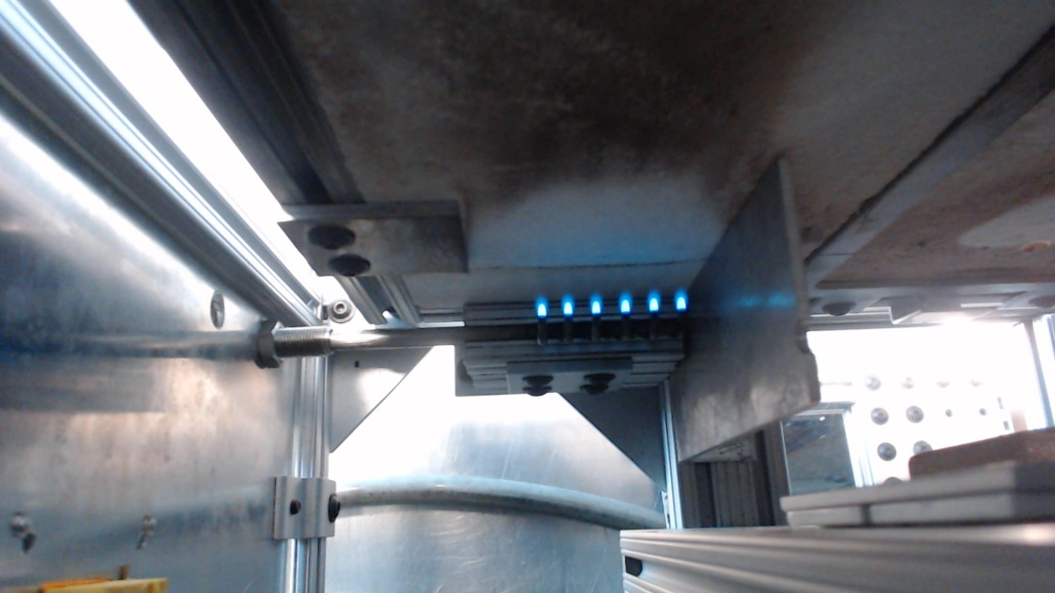
Input 1: Flamelet Length
Flamelet length is difficult to measure accurately with physical measuring devices (i.e. ruler). To achieve accurate length measurements for this study, a camera and software setup was used:
The camera is placed directly above the flamelets in the hold position.
The camera takes multiple pictures and the program analyzes the pictures to determine the average length of each flamelet.
Visual validation of the program output is done to ensure accuracy.
Program output
Visual validation

Slide 8
Input 2: Electrical Power to Heater
Power was set as close as possible to desired values.
Each second, the power to heater was recorded during the test.
The average power during the test run (50s test time + after burn time) was used for analysis.

Slide 9
Input 3: Exhaust Flow Rate
Cannot easily be controlled to a specific value.
Cannot be measured during the test (only before and/or after).
Is influenced by the power to the heater.
Was adjusted by adding and removing a metal plate above the apparatus.
After the test chamber stabilized, exhaust flow rates were recorded every 5 seconds for 2 minutes directly prior to the test and the average was used for analysis.
Metal plate

Slide 10
Input 4: Time Between Tests
Prior to each test, the previously discussed factors were set to the prescribed values. The chamber was closed and allowed to stabilize (i.e. temperature measurements along the thermocouples will be used to validate).
For test runs with 0 minute wait time, the sample were loaded (door open) as quickly as possible and the test was begun.
For samples with 3 minute wait time, the chamber door was left open for that amount of time. The samples were then loaded and tested.
The purpose of this was to determine how impactful the stabilization of the chamber is on the results.

Slide 11
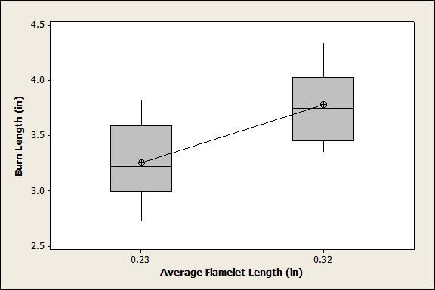
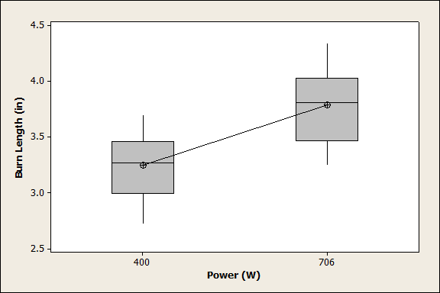
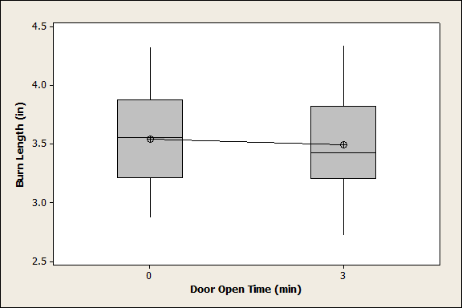
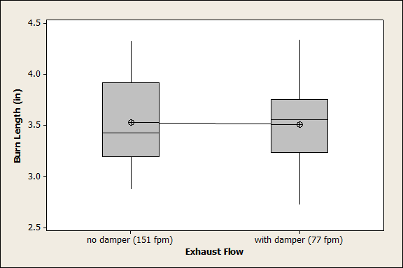
Results Summary (Box Plots of Burn Length vs. Each Input)
For this material system/configuration the biggest contributors to the variation in burn length were the flamelet length and power to the heater. Exhaust flow rate and time with the door open had minimal contribution in this study.

Slide 12
Further Study of Flamelet Length
A refined study that only varied flamelet length was conducted. All other variables were held constant:
4 flamelet lengths were use
3 coupons for each flamelet length
Completed testing in one day with the same operator
Run order randomized
All coupons from the same batch

Slide 13
Results Summary Flamelet Length (cont’d)
For this specific material configuration this means approximately ever 1/32" change in flamelet length can potentially add 0.1” burn length. Other materials may have a steeper or gentler slope.

Slide 14
Conclusion
Flamelet length had a significant effect on burn length.
The effect of the heater power was observed, but only at a large difference in input between the high and low levels (~306 Watts).
The time that the door was open prior to the test and exhaust flow rate had minimal effect on burn length for this particular material.
Further study should be conducted with additional materials and labs to validate and generate universal conclusions on tolerance.

Slide 15
Additional Observations
During the course of testing observations were noted. It’s recommended that these be addressed by the FTWG team:
Thermoplastics are difficult (and in some cases impossible) to test.
Some materials do not correlate with intermediate scale testing.
Pass/fail criteria has not been established.
AC guidance plan has not been developed.

Slide 16
Thermoplastic Testing
At high temperatures, thermoplastics tend to melt/warp and hit the burner. There are two primary issues with this:
Flamelets extinguish, invalidating the test
Melted thermoplastic clogs the burner making it very difficult to clean and possibly impacts subsequent results
Thermoplastics are becoming more common place in airplane design. Any new test/rule must allow for testing of thermoplastics.
One possible solution would be to increase distance between the test article and pilot burner, and increase the pilot burner length. This would allow for movement in the test article during the test.
This could potentially invalidate VFP test data generated to date, but is one possible way to make the test viable for these kinds of materials.

Slide 17
Potential Correlation Issues with Intermediate Scale Tests
There is concern that the VFP does not correlate well with the intermediate scale fire tests.
Caution: all cases below have a minimal amount of data. Typically only one intermediate scale test was conducted for each configuration.

Slide 18
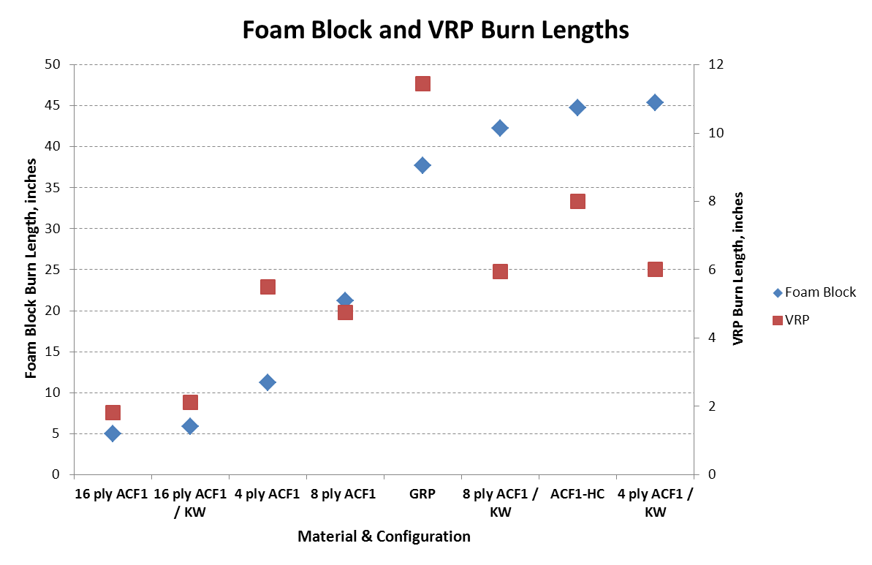
Potential Correlation Issues with Intermediate Scale Tests (cont’d)
From the December 2013 triennial, the following graph was shown:
These materials perform similarly in VFP, but very differently in Foam Block

Slide 19
Potential Correlation Issues with Intermediate Scale Tests (cont’d)
Boeing data collected at FAA Tech Center in May 2013 for early VFP development.
Composite materials 3, 4, 6, 7 and 8 perform similarly in Foam Block, but very differently in VFP
Composite materials 1, 2 and 5 show similar performance in the VFP, but relatively significant difference in Foam Block
Note: 3 VFP data points for each foam block data point

Slide 20
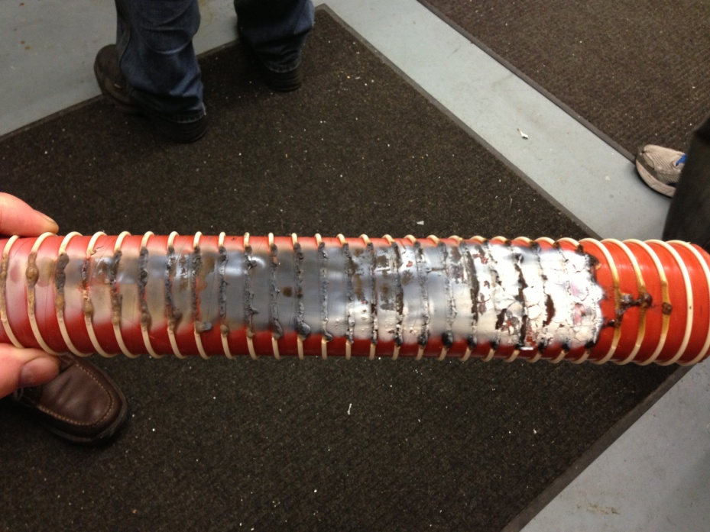
Potential Correlation Issues with Intermediate Scale Tests (cont’d)
Intermediate scale test done by FAA in ~2006
VFP done by FAA in 2013
This was considered a passing material per earlier FTWG presentations
Burn length = 8.3 inches. Relatively high result

Slide 21
Pass/Fail Criteria
The basis to establish pass/fail criteria should be based on the intermediate scale results.
Additional data should be collected on the VFP and intermediate scale tests to determine appropriate level of pass/fail criteria.
Boeing is currently making foam block and VFP test articles of various materials to assist in pass/fail criteria development.
Since it’s not possible to test the entire population for a material, pass/fail criteria should be based on a confidence interval around the mean.
Example:
Assume we have a material that has been determined should pass VFP based on intermediate scale data.
Mean (μ)= 5”
Stdv.(σ) =0.7”
A pass/fail criteria of 5” for the mean would result in failures simply by sampling.
Instead μ + 2σ should be used. This ensures 97.25% of the population passes.

Slide 22
Fictitious Data Example
Population
μ + 2σ
3 Coupon Sets
Recommendations:
Pass/fail criteria must be based on intermediate scale tests
Pass/fail should be based on a μ + 2σ methodology, not only on the mean (μ)

Slide 23
Recommended Next Steps
Update method for setting and controlling flamelet length.
This can probably be done by better controlling the inputs (i.e. propane gas pressure/flow rate)
Conduct a more extensive study on select materials at all companies that have a VFP to:
Validate tolerance levels for different materials on different equipment
Better determine repeatability and reproducibility
Develop solution for testing thermoplastics.
Conduct additional testing of the materials that did not show correlation to intermediate scale test results. If correlation does not exist, modify machine to match intermediate scale tests.
Determine pass/fail criteria based on intermediate scale results. Materials that pass the intermediate scale test should also pass the bench scale VFP testing.
Develop appropriate AC guidance for testing and showing compliance.

Slide 24
Questions?

