Slide 1
Boeing Cargo Liner Sonic Burner Update
Dan Slaton, Technical Fellow
Boeing Commercial Airplanes
International Aircraft Materials Fire Test Working Group
Solothurn, Switzerland
June 25, 2014
Acknowledgements
Tim Salter FAA Tech Center
Lyle Bennett Boeing Engineering Operations & Technology
Tom Little Boeing Commercial Airplanes

Slide 2
Agenda
Background
Boeing Park vs. Boeing Sonic Burner results
Boeing Sonic Burner vs. Industry results
Observations/Discussion
Conclusions

Slide 3
Background
FAA TC has developed Sonic burner (configuration & settings) for cargo liner testing per 14 CFR 25.855(c)
  New Park oil burners as described in 14 CFR 25 Appendix F, Part III & Aircraft Materials Fire Test Handbook can no longer be procured -> alternative to Park burners required.
Overall FAA TC objectives:
  1. Create alternative to Park oil burner which will produce test results sufficiently similar to Park oil burner.
  2. Determine Sonic burner configuration and settings which enable reproducible results.
Boeing keenly interested in both objectives
  Large volume of certification data collected using the Park oil burner.
    For a slight design change, need to ensure future results from Sonic burner are sufficiently similar to Park oil burner certification results.
  Need to ensure results from industry, including Boeing, are consistent and well-matched.

Slide 4
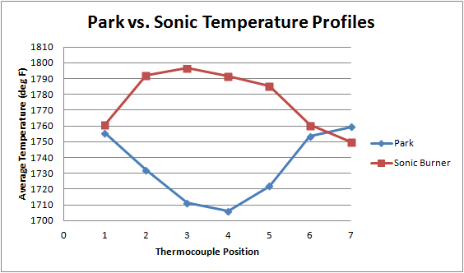

Boeing Park vs. Boeing Sonic Burner
Temperature profile (thermocouple rake data)
Sonic avg: 1777°F
Park avg: 1734°F
Coefficient of variation (CoV) = Std Dev/Mean
Observations
  Temperature profiles are inverted for Park and Sonic burners
  Temperature spread approximately equivalent for both burners (CoV ~1%)
  Difference of average temperatures between Park & Sonic: ~2.5%
  Maximum temperature difference: ~5% (90°F)

Slide 5
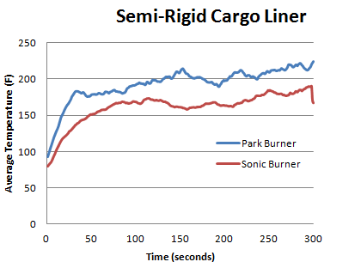
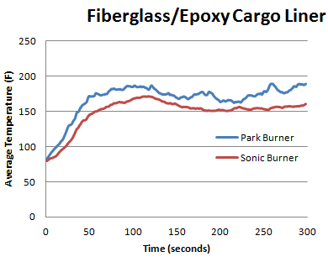
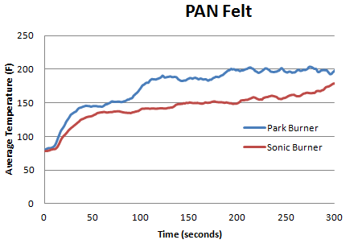
Boeing Park vs. Boeing Sonic Burner
Backside temperatures for FAA round robin test samples
  3 material types
    Heavy woven fiberglass/epoxy cargo liner, light semi-rigid cargo liner, polyacrylonitrile (PAN) felt
  Significant temperature differences between Park and Sonic burner data
    Disclaimer: Park & Sonic data acquired on different days in different test cells
  Sonic burner consistently lower than Park burner

Slide 6
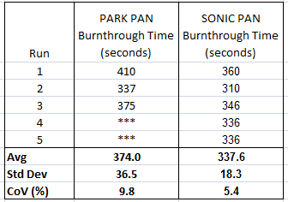
Boeing Park vs. Boeing Sonic Burner
Burnthrough time comparison
  Run PAN felt to failure (burnthrough) -> record burnthrough time (seconds)
  Statistical Analysis (details in backup)
    Average burnthrough times for Park and Sonic are “equivalent” (ANOVA)
    Variances for Park and Sonic are “equivalent” (F-test)
    Caveat: Extremely small sample size -> more data needed to draw proper conclusion
NOTE: Because of Boeing test cell layout and burner height
differences between Park and Sonic, BT time determination
observations differ. Park: naked eye, Sonic: video monitor.

Slide 7
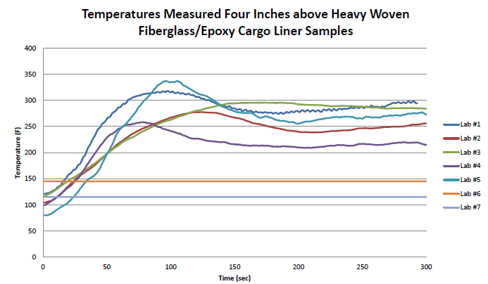
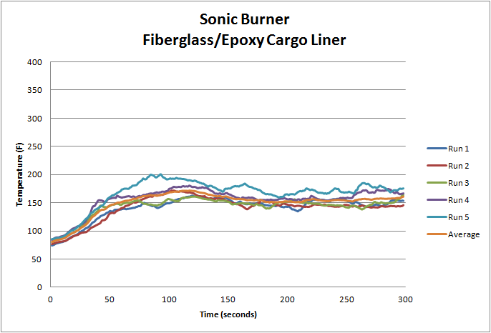
Boeing Sonic Burner vs. Industry
Backside temperature comparison (round robin lab comparison)
  Heavy woven fiberglass/epoxy cargo liner
  Boeing data lower than all other labs
Fiberglass/Epoxy Cargo Liner
FAA TC/Industry*
Boeing
*FAA TC/Industry data presented at March 2014 IAMFTWG
T. Salter, “Task Group Session on Revised Cargo Liner Test”
https://www.fire.tc.faa.gov/materials.asp?meetID=36#pres

Slide 8
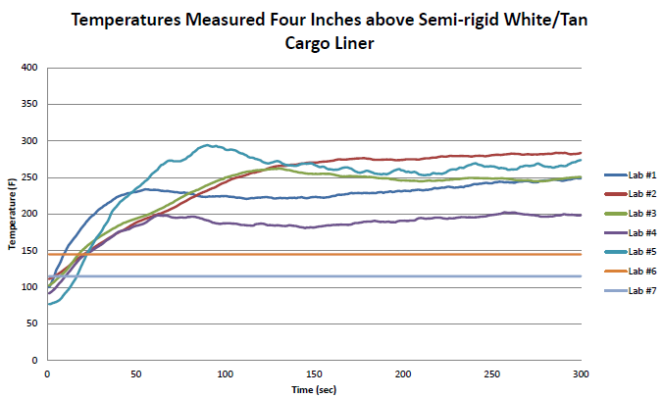
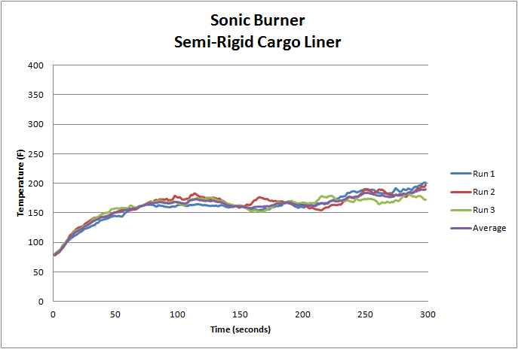
Boeing Sonic Burner vs. Industry
Backside temperature comparison (round robin lab comparison)
  Semi-rigid white/tan cargo liner
  Boeing data lower than all other labs
Semi-Rigid Cargo Liner
FAA TC/Industry*
Boeing
*FAA TC/Industry data presented at March 2014 IAMFTWG
T. Salter, “Task Group Session on Revised Cargo Liner Test”
https://www.fire.tc.faa.gov/materials.asp?meetID=36#pres

Slide 9
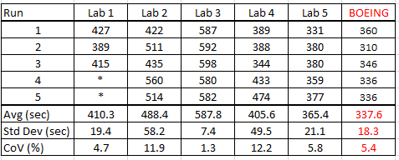
Boeing Sonic Burner vs. Industry
PAN felt burnthrough time comparison (round robin lab comparison)
  Boeing burnthrough time seems to be faster than all other labs!
    Boeing data are internally consistent
    Recall Boeing backside temperature results appear lowest across round robin labs
Industry Round Robin PAN Felt Burnthrough Times
Table adapted from FAA TC presentation, March 2014*
*FAA TC/Industry data presented at March 2014 IAMFTWG
T. Salter, “Task Group Session on Revised Cargo Liner Test”
https://www.fire.tc.faa.gov/materials.asp?meetID=36#pres

Slide 10
Boeing Sonic Burner vs. Industry
PAN felt burnthrough time comparison (round robin lab comparison)
  Statistical analysis (details in backup)
    Clear that data from all labs cannot be considered equivalent
    Lab 3 is an outlier (both mean & std deviation); Lab 2 mean result also high
    Boeing & Labs 1, 4, 5 can be grouped as “equivalent”
      Although Boeing burnthrough times appear to be the lowest, limited data cannot statistically distinguish differences among Boeing and labs 1, 4, 5
Boeing & Labs 1, 4, 5
statistically indistinguishable

Slide 11
Observations & Discussion
Round robin results
  Significant variations in experimental results across labs
    Backside temperatures: average temperatures can differ by up to ~150 deg F
    Burnthrough times: average BT times can differ by >4 minutes between 2 labs
    What are the causes of variation? Answers may require:
      Further analysis of existing data
        TC rake data (average temperatures, temperature profiles)
        Other parameters—fuel T, air T, fuel pressures, air pressures, exhaust flow, relative humidity, …
      Additional data collection
        Evaluation of input parameter tolerance range impacts
        Collection of data from larger sets of samples
        Collection of data from a wider range of materials
Equivalent performance validation (Park vs. Sonic)
  Characterize how present materials/constructions perform for both burners
  Determine degree of similarity between Park and Sonic burners

Slide 12
Conclusion
FAA has done significant development work on Sonic burner with quite good results to date
Still a variety of open issues related to…
  Inter-lab matching of round robin results
  Validation of Sonic burner as a comparable test method to Park oil burner
    A new test method should not have a different safety basis
Continued development work required
  Provide enhanced understanding of Sonic burner performance
  Provide clues to the variations seen in results to date
Recommendation
  FAA TC & Industry Task Group should determine next steps and develop a plan to move forward on continued Sonic burner test methodology development

Slide 13
Questions?

Slide 14
Backup

Slide 15
Statistical Analysis
Boeing Park vs. Boeing Sonic Burner
  ANOVA Means Test: PAN Felt Burnthrough Time (sec) vs. Boeing Burner Type
  Conclusion: From limited data, PAN felt BT times for Boeing Park & Sonic burner statistically indistinguishable at 5% significance level
Source DF SS MS F P
Burner Type 1 3030 3030 4.63 0.075
Error 6 3925 654
Total 7 6955
S = 25.58 R-Sq = 43.57% R-Sq(adj) = 34.16%
Individual 95% CIs For Mean Based on
Pooled StDev
Level N Mean StDev --------+---------+---------+---------+-
Park 3 374.00 36.51 (-----------*-----------)
Sonic 5 333.80 17.74 (--------*---------)
--------+---------+---------+---------+-
330 360 390 420
Pooled StDev = 25.58
Grouping Information Using Tukey Method
Burner
Type N Mean Grouping
Park 3 374.00 A
Sonic 5 333.80 A
Means that do not share a letter are significantly different.
Tukey 95% Simultaneous Confidence Intervals
All Pairwise Comparisons among Levels of Burner Type
Individual confidence level = 95.00%
Burner Type = Park subtracted from:
Burner
Type Lower Center Upper -----+---------+---------+---------+----
Sonic -85.90 -40.20 5.50 (-------------*------------)
-----+---------+---------+---------+----
-70 -35 0 35

Slide 16
Statistical Analysis
Industry Round Robin PAN Felt Burnthrough Time Comparison
  ANOVA Means Test: PAN Felt Burnthrough Time (sec) vs. Lab
  Conclusion: From limited data, PAN felt BT times for Boeing, Labs 1, 4 & 5 are statistically indistinguishable at 5% significance level*
Individual 95% CIs For Mean Based on
Pooled StDev
Level N Mean StDev --+---------+---------+---------+-------
1 3 410.33 19.43 (----*-----)
2 5 488.40 58.21 (---*---)
3 5 587.80 7.36 (---*----)
4 5 405.60 49.52 (---*---)
5 5 365.40 21.13 (---*---)
Boeing 5 337.60 18.30 (---*---)
--+---------+---------+---------+-------
320 400 480 560
Pooled StDev = 35.33
Source DF SS MS F P
Lab 5 208776 41755 33.45 0.000
Error 22 27458 1248
Total 27 236235
S = 35.33 R-Sq = 88.38% R-Sq(adj) = 85.74%
Grouping Information Using Tukey Method
Lab N Mean Grouping
3 5 587.80 A
2 5 488.40 B
1 3 410.33 B C
4 5 405.60 C
5 5 365.40 C
Boeing 5 337.60 C
Means that do not share a
letter are significantly different.
Tukey 95% Simultaneous Confidence Intervals
All Pairwise Comparisons among Levels of Lab
Individual confidence level = 99.50%
*ANOVA assumptions are not satisfied for analysis which includes all labs. A valid ANOVA analysis arrives at the same conclusion if Lab 3 is omitted as an outlier.

