Slide 1
2013/2014 OSU Round Robin Update
Project Leaders
Yaw Agyei – BR&T Flammability
Mike Burns – FAA Tech Center

Slide 2
Agenda
Acknowledgements
Background
  Purpose
  Strategy
Test Results
Trends
  Preliminary analysis
Next Steps
Analysis of 80% pass criterion on sidewall coupons

Slide 3
Acknowledgements
Support within Boeing
  BR&T Flammability (Puget Sound, SC)
  BCA Flammability
  BCA Production
  BR&T Math Group
FAA Tech Center
Participants
  40 participating labs
  46 participating units

Slide 4
Background
Purpose: Pinpoint major sources of variability in OSU Heat Release testing
Unique Round Robin
Strategy
  Set all units in similar conditions
  Record all operating parameters
  Test more samples
  In-depth analysis of gathered data/results
Notes:
Focused on inputs rather than ouput
Previous round robins more of a survey of units, this focuses on determining why results are so different from unit to unit.

Slide 5
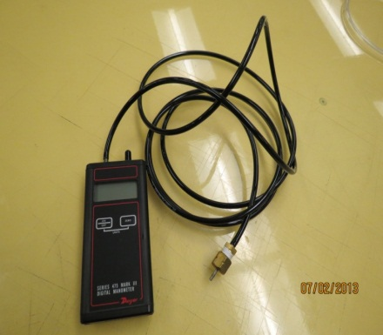
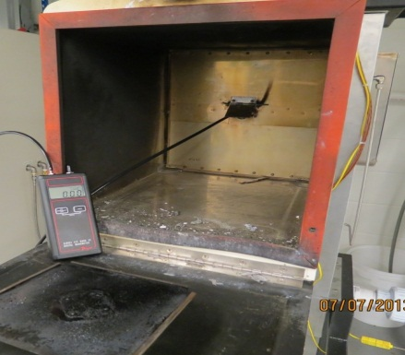
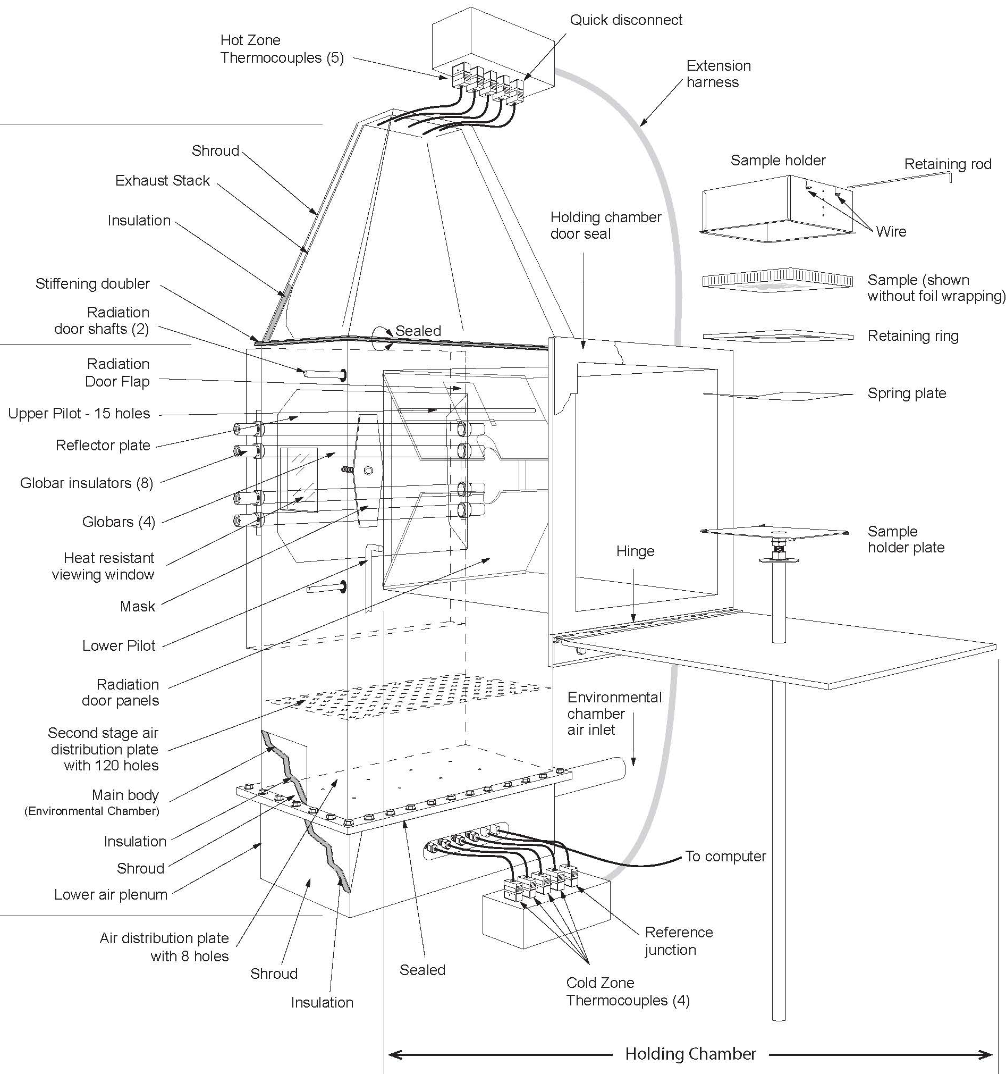
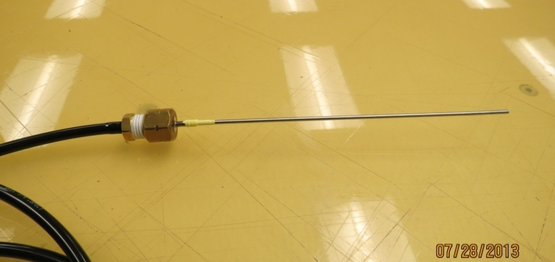
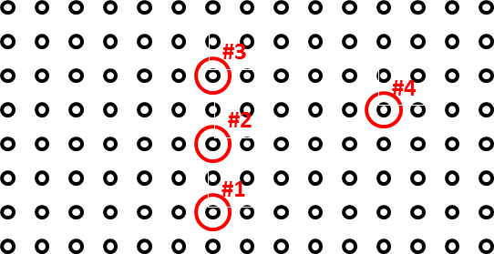
Pressure Measurements
Notes:
Measure lower plenum and interspace pressure to try to understand air flow influence on variation

Slide 6
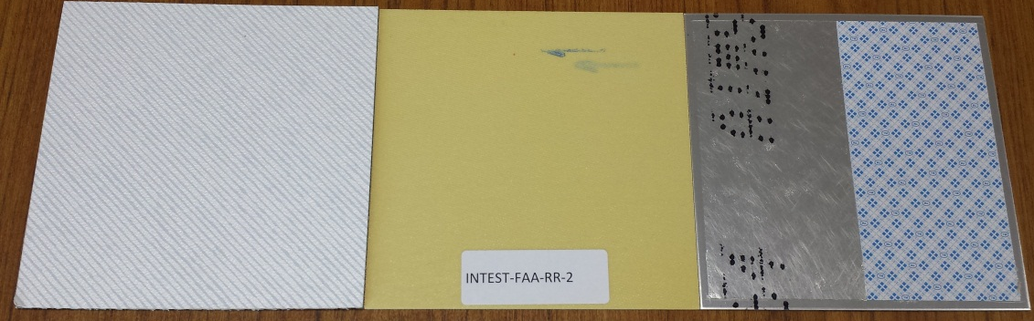
Test Coupons
  Baseline – noise in system
  Honeycomb panel with decorative – representative of aircraft interiors (10)
  4 Ply pre-preg laminate – phenolic resin pre-impregnated glass fabric (10)
  Aluminum with tape – standardized coupons from Lufthansa Technik (5)
2
3
4

Slide 7
Test Results
 | Peak (kW/m²) | THR (kW- min/m²)
Avg | 58.83 | 59.90
Min | 37.43 | 42.61
Max | 71.54 | 81.07
Range | 34.12 | 42.61
% St Dev | 23% | 20%
Notes:
Every line represents a unit. Average of ten coupons per unit.

Slide 8
Test Results

Slide 9
Test Results
 | Peak (kW/m²) | THR (kW- min/m²)
Avg | 30.27 | 31.46
Min | 18.10 | 17.43
Max | 53.97 | 53.22
Range | 35.87 | 35.79
% St Dev | 30% | 27%

Slide 10
Test Results

Slide 11
Test Results
 | Peak (kW/m²) | THR (kW- min/m²)
Avg | 74.69 | 26.84
Min | 61.96 | 12.78
Max | 97.06 | 43.77
Range | 35.10 | 30.99
% St Dev | 23% | 21%

Slide 12
Test Results

Slide 13
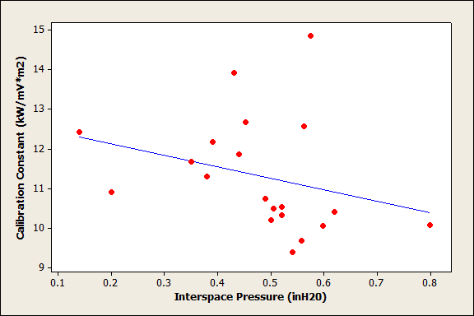
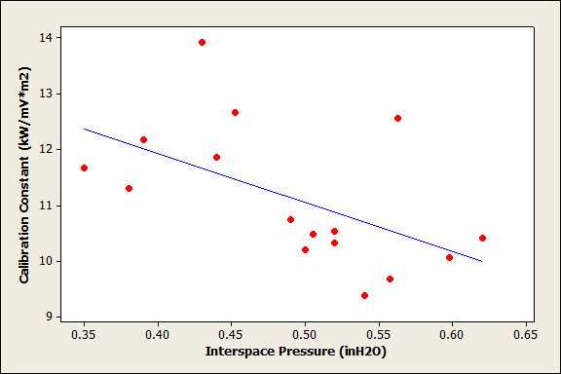
Trends
Possible correlation between Interspace Pressure and Calibration Constant
Outliers Removed
Notes:
Outlier – one or more parameters out of Mike Burns suggested range
Weak or no correlation seen with other parameters

Slide 14
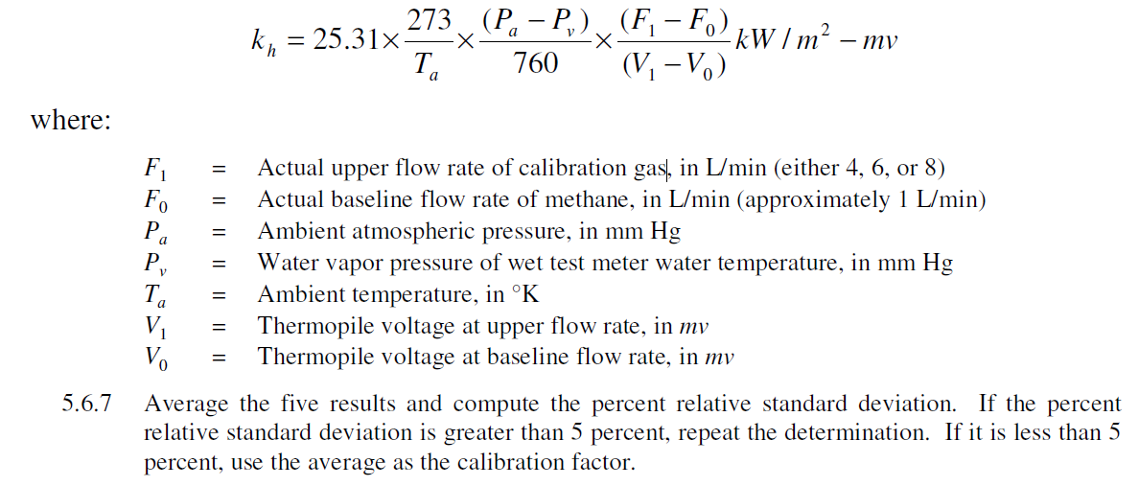
Calibration Constant (k_{h})
Primary factors
  Change in flow rates
  Thermopile voltage
Constant
Ratio of Delta =

Slide 15
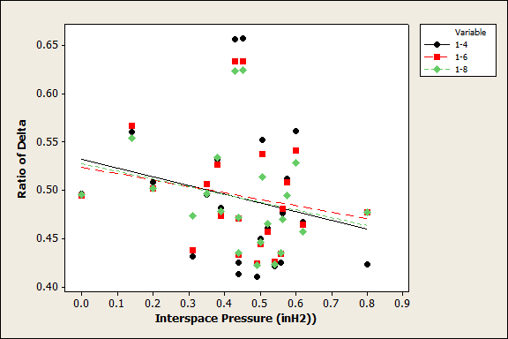
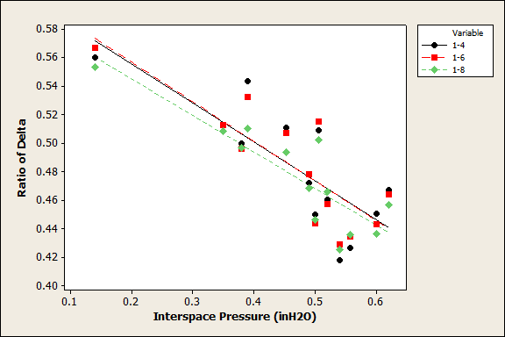
Ratio of Delta
Consistent within unit
Varies from unit to unit
Outliers Removed

Slide 16
Ratio of Delta
Flow rates are consistent for all units
  Flow rates are accurate for most units
  Flow rates are proportional
 | ∆ Flow Rates (L/min)
 | 1-4 | 1-6 | 1-8
Avg | 2.99 | 4.98 | 6.98
% St Dev | 3% | 2% | 3%
% Error | 0.41% | 0.36% | 0.64%
Variations observed for change in thermopile voltage for all units
  Possibly due to air flow split
 | ∆ Thermopile Voltage (mV)
 | 1-4 | 1-6 | 1-8
Avg | 6.18 | 10.20 | 14.28
% St Dev | 13% | 11% | 10%
% Error | ? | ? | ?
Notes:
Add % Error for flow meter difference
Unable to determine %error for change in thermopile voltage because actual change in thermopile voltage values are unknown – currently no measurements have been done for a unit that achieves a 3:1 air flow split
Change in thermopile voltages varies, but proportional within a unit.
Add number of data sets for interspace calibration values

Slide 17
OSU Air Flow
75% of Air
3:1 Ratio
25% of Air

Slide 18
Next Steps
Continue to gather round robin data
Determine change in thermopile voltage for a unit with an air flow split ratio of 3:1
  Further research to replicate observed variances in thermopile voltage
Discussion at FTWG Meetings

Slide 19
80% Criterion on Sidewall Panels
Dan Slaton

Slide 20
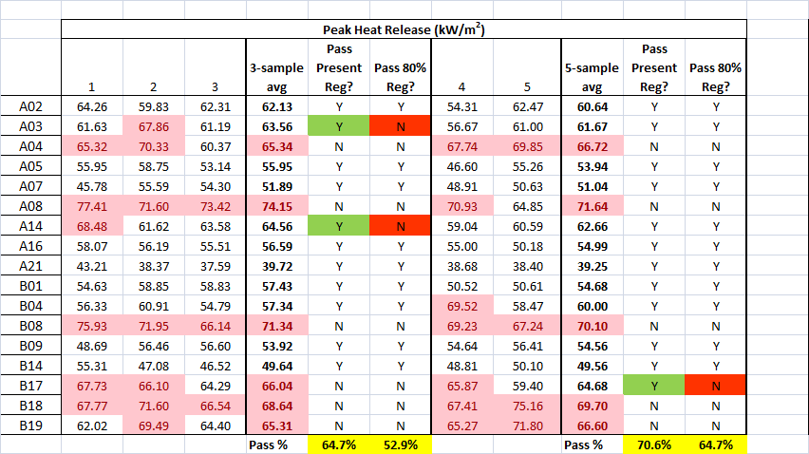
80% Pass Criterion
Heat Release (OSU) Round Robin data (set 1: sidewall panels)
  As of May 2014, engineering data from 17 labs (10 measurements per lab)
  “Pretend” the data are certification data
    Initially test 3 samples -> evaluate results
    Test additional 2 samples -> evaluate results
Peak Heat Release Rate

Slide 21
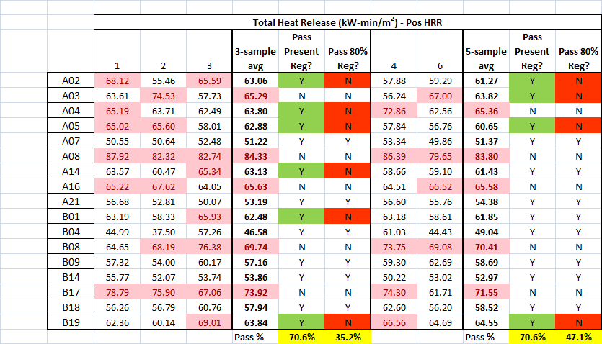
80% Pass Criterion
Heat Release (OSU) Round Robin data (set 1: sidewall panels)
  As of May 2014, engineering data from 17 labs (10 measurements per lab)
  “Pretend” the data are certification data
    Initially test 3 samples -> evaluate results
    Test additional 2 samples -> evaluate results
Total Heat Release

Slide 22
80% Pass Criterion
Summary
  80% pass criterion provides no benefit for either Peak or Total HR
    No “rogue” failures -> failures a result of normal statistical variation in OSU
    Existing “averaging” criterion better suited to account for statistical variation
  Use of 80% pass criterion actually a more stringent certification requirement
Recommendation
  Adopt ARAC Report “alternate proposal” (Sec. 6.2.9)
    Maintain present certification pass/fail requirements
    Add 80% pass criterion as an optional pass/requirement methodology

