Slide 1
NexGen Burner Comparative Testing

Slide 2
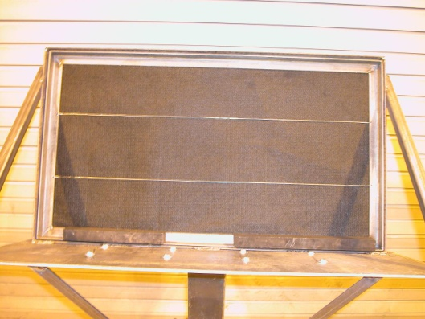
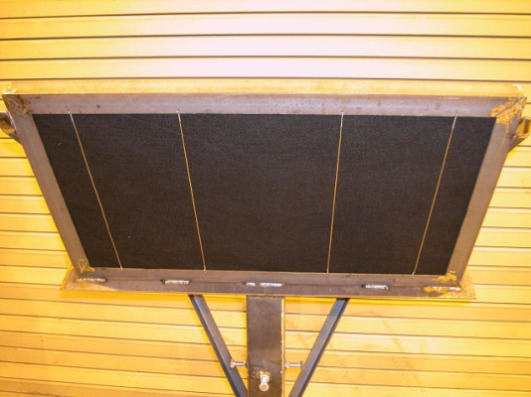
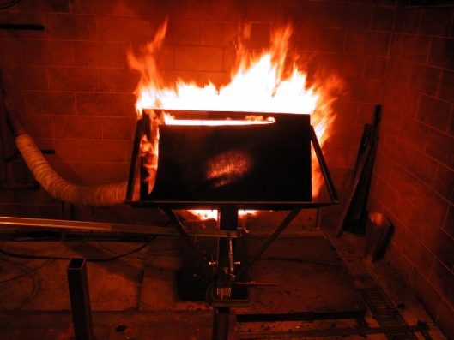
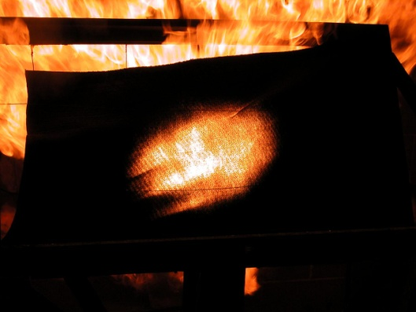
Objectives
Perform comparative burnthrough testing to determine the effect of various parameters on test results
  Use picture frame sample holder and PAN material to determine burnthrough performance
Test results will help to determine which parameters are most critical when specifying the burner in the new workbook

Slide 3
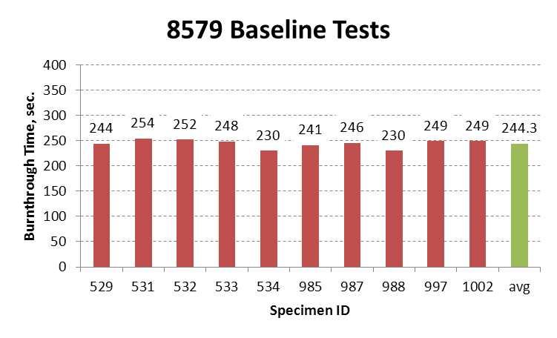
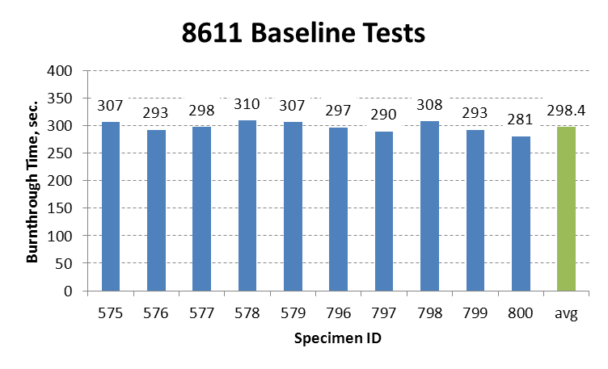
Establish Baseline Dataset
3.43% Standard Deviation
3.17% Standard Deviation

Slide 4
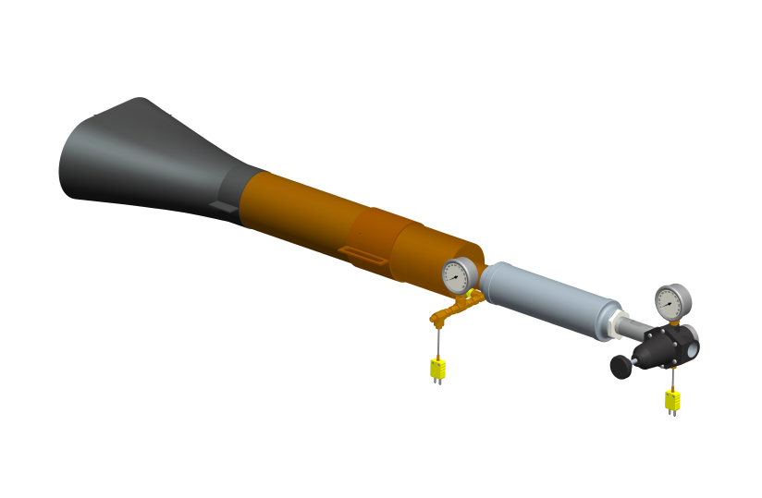
Test 1: Location of sonic choke
Standard Configuration

Slide 5
Relocated Choke

Slide 6
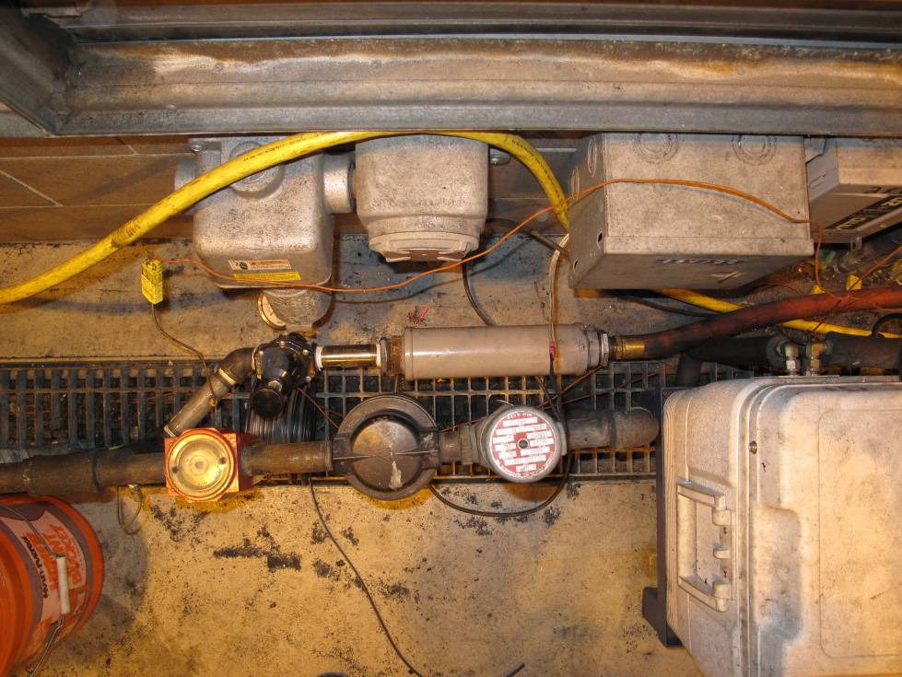
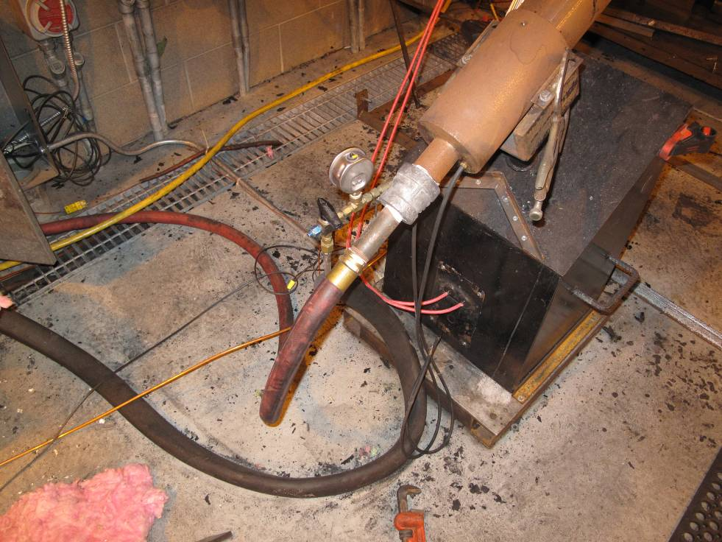

Slide 7
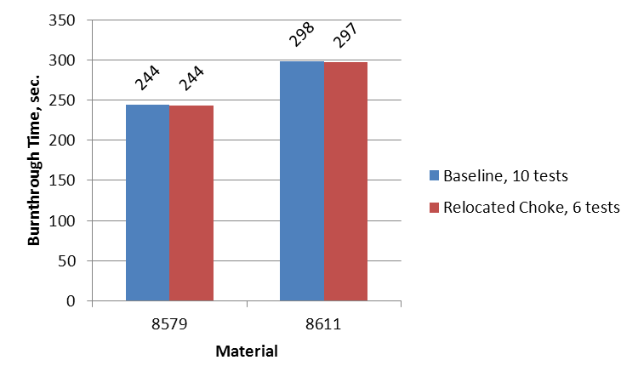
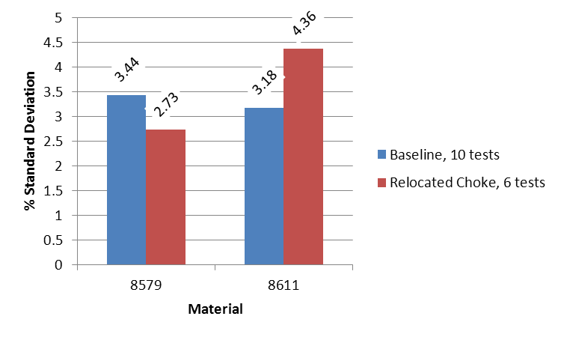
Burnthrough Time
Repeatability

Slide 8
Test Series 1 - Summary
The choke was relocated approximately 6’ from the burner and a curved, flexible hose was added between the muffler and the burner
Test results indicate no noticeable deviation from the baseline configuration

Slide 9
Test Series 2 – Burner Cones
Objective is to determine which cone parameters have an effect on burnthrough time
  Thickness
  Flange
  Material
  Age
Besides the baseline cone, three additional cones were tested (all new)
  Baseline Cone: 0.06” thickness with recessed flange
  Cone #1: 0.048” thickness 18 gauge 310 Stainless Steel
  Cone #2: 0.061” thickness 321h Stainless Steel
  Cone #3: Same as Cone #1 with 1” flange welded on exit plane

Slide 10
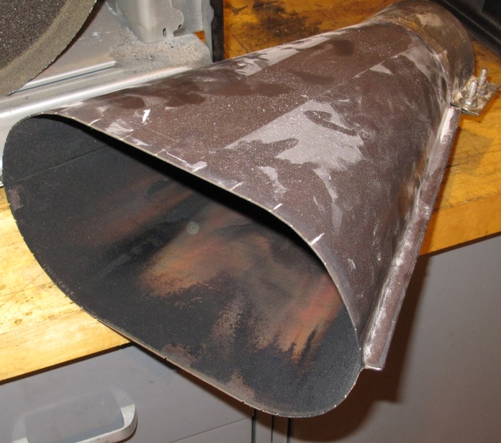
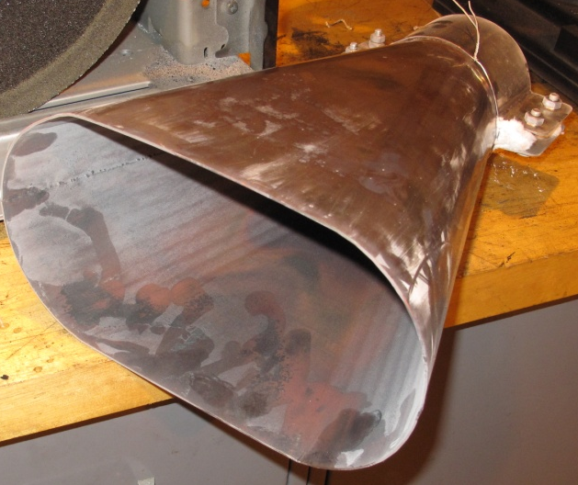
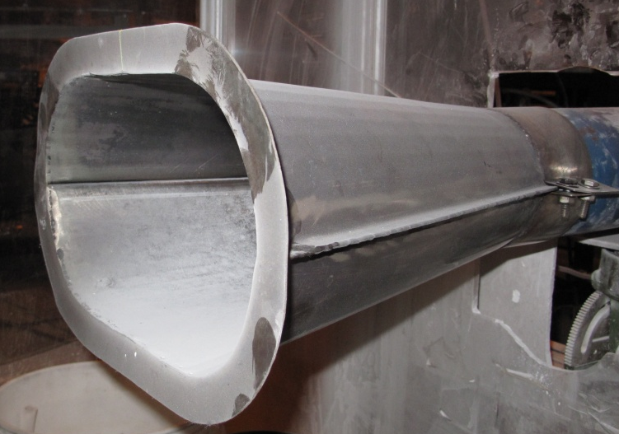
Cones
Cone #1
Cone #2
Cone #3

Slide 11
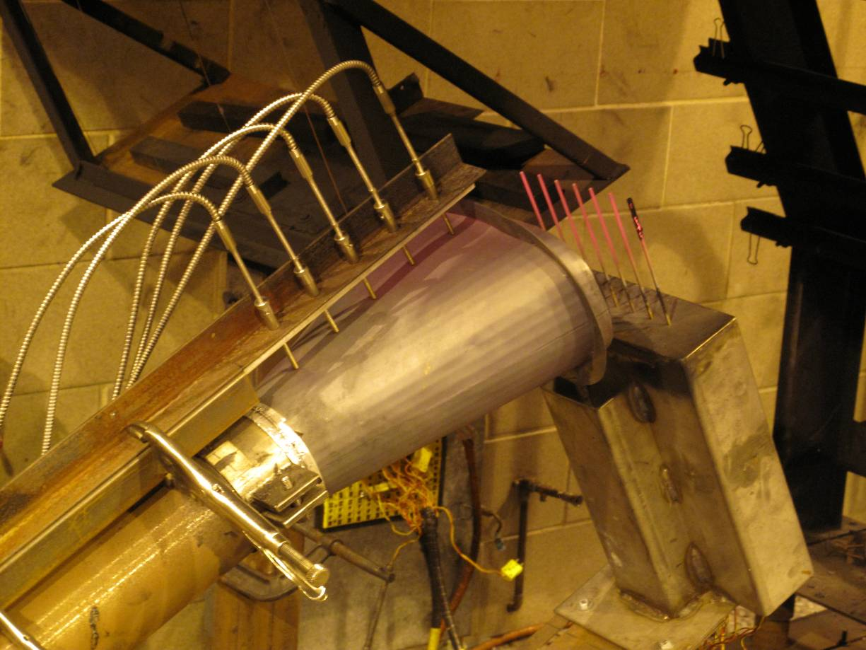
Cone Surface Temperature Measurement
TC5
TC4
TC3
TC2
TC1

Slide 12
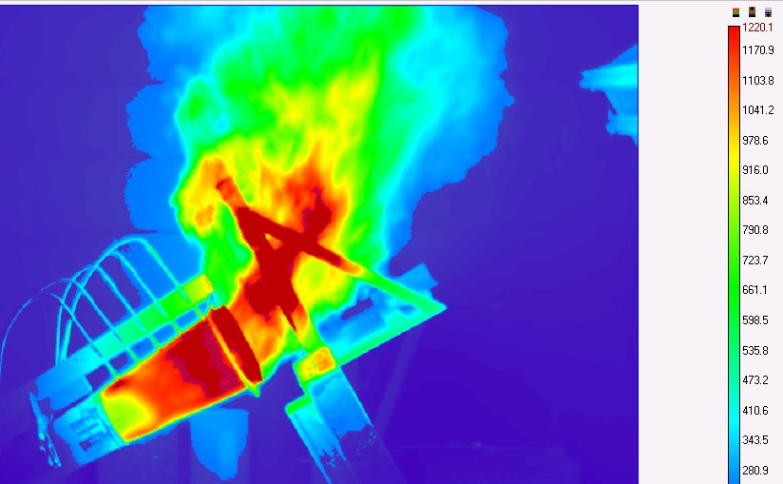
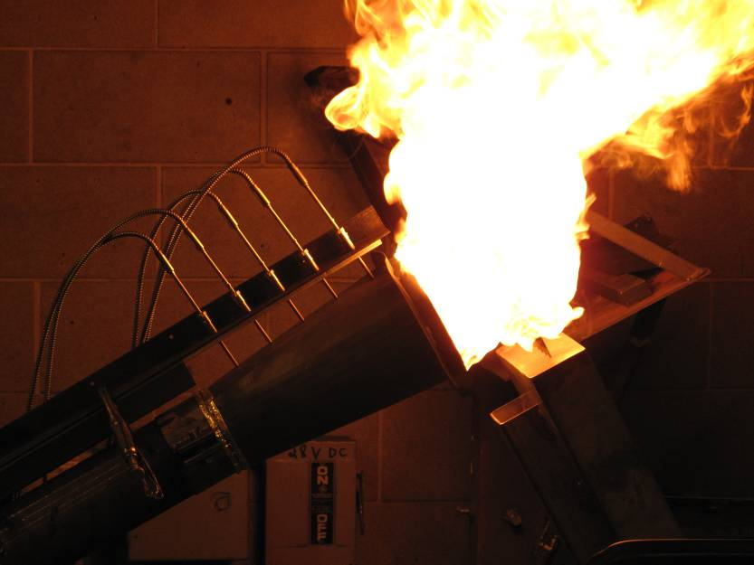
FLIR Imaging

Slide 13
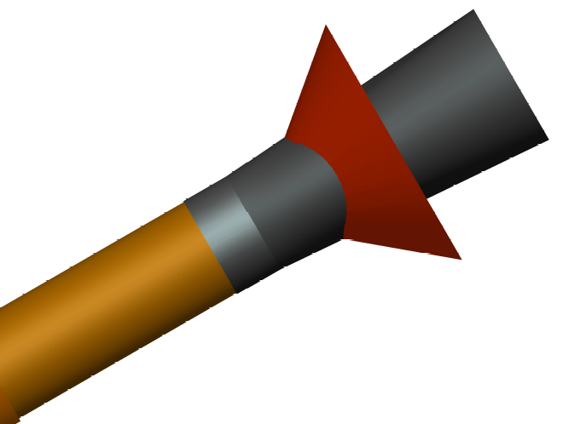
Fuel Nozzle Spray Cone Angle

Slide 14
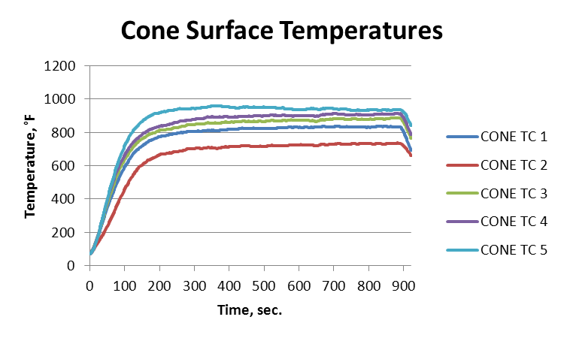
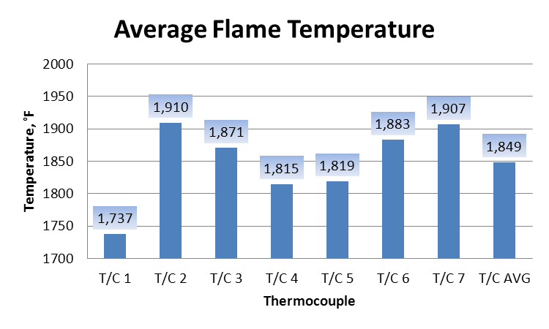
Cone and Flame Temperature

Slide 15
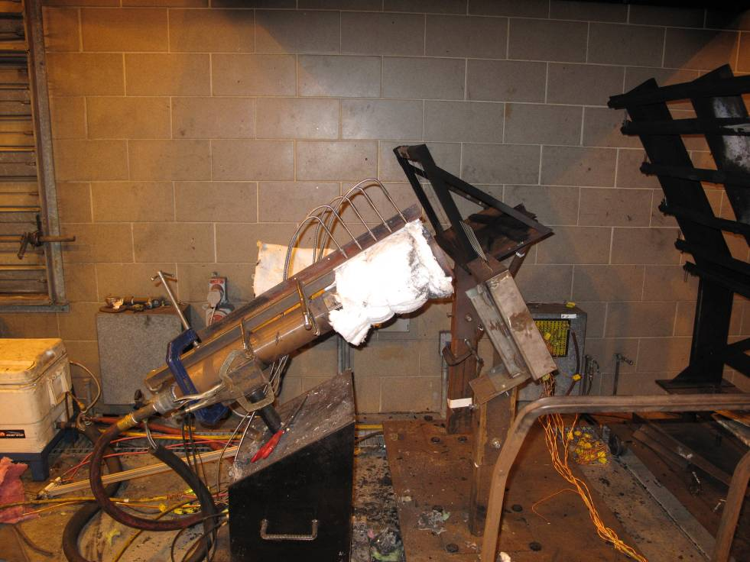
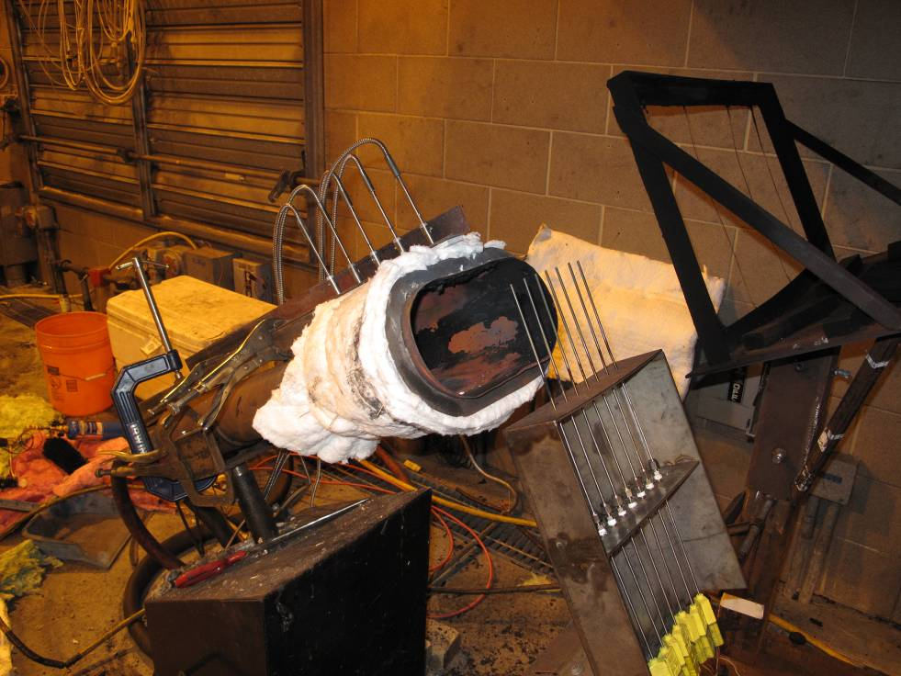
Insulated Cone

Slide 16
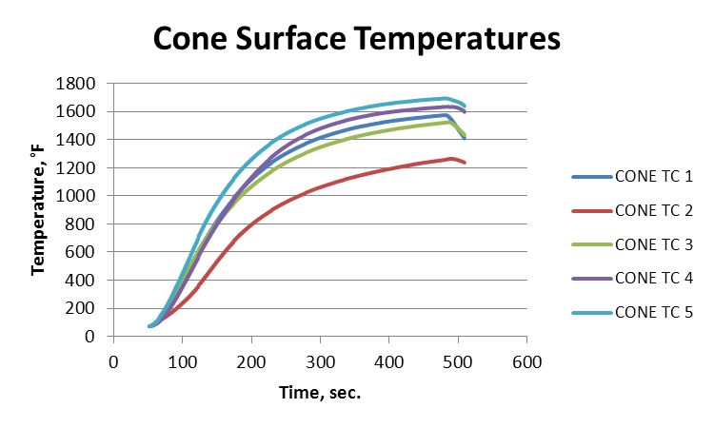
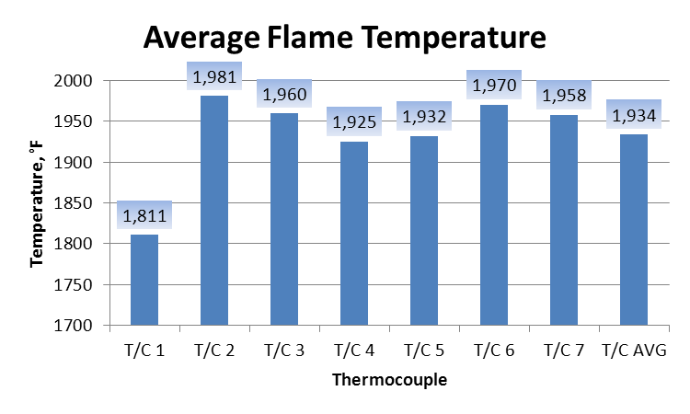
Insulated Cone

Slide 17
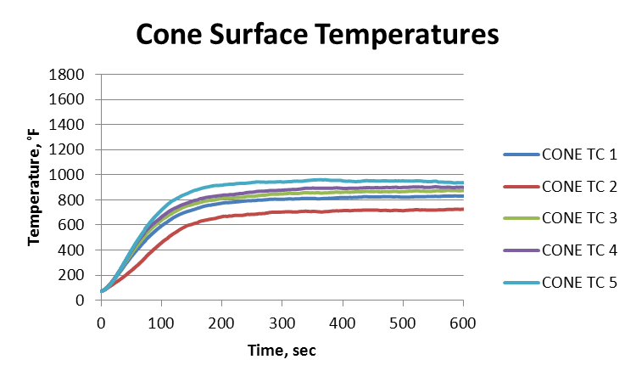
Cone Surface Temperature Comparison
Un-Insulated Cone
Insulated Cone

Slide 18
Flame Temperature Comparison
Un-Insulated Cone
Insulated Cone

Slide 19
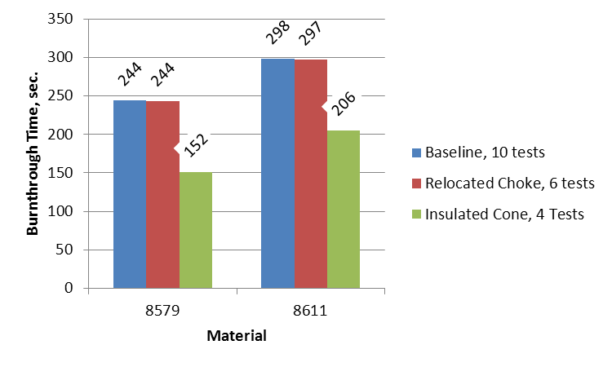
Burnthrough Times

Slide 20
Summary - Insulated Cone
Insulating the cone increases the average flame temperature by about 85°F
Insulation increased the cone surface temperatures by 500-600°F
The insulated cone burned through the PAN material significantly quicker than the un-insulated cone
  8579: 92 sec. quicker
  8611: 92 sec. quicker
Cone insulation used as an extreme example to determine how heat loss from cone can affect burnthrough results

Slide 21
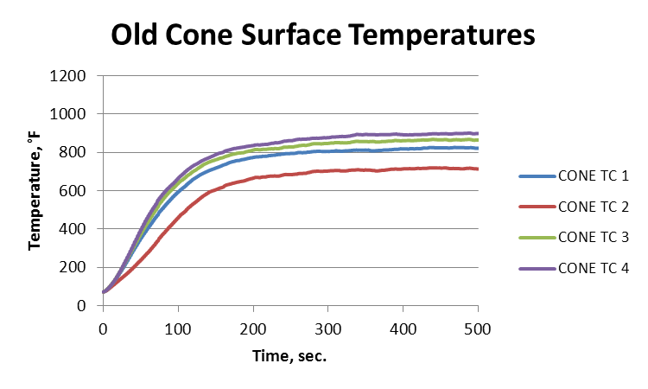
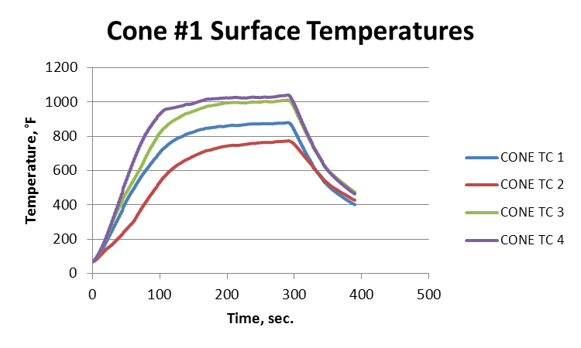
Installed Cone #1
0.048” thickness 18 gauge 310 Stainless Steel

Slide 22
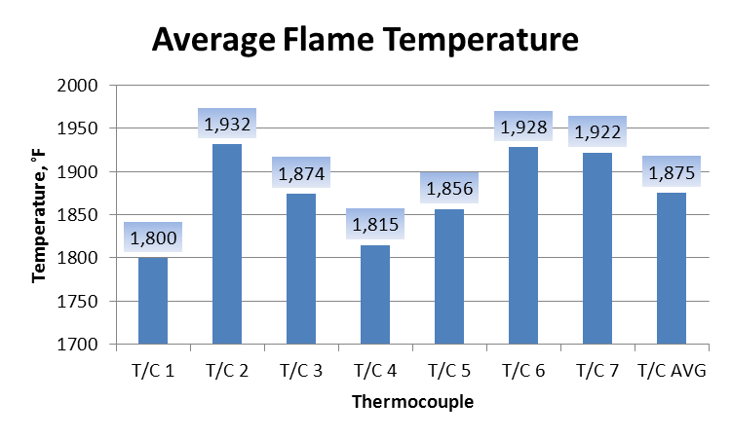
Installed Cone #1
0.048” thickness 18 gauge 310 Stainless Steel
Baseline Cone
Cone #1

Slide 23
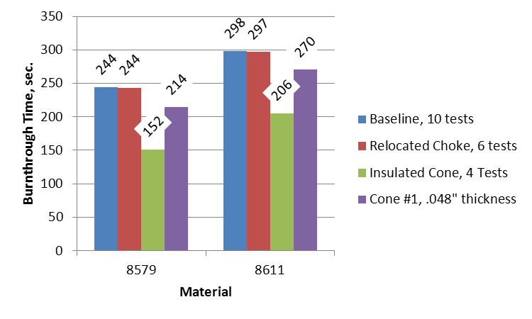
Installed Cone #1
0.048” thickness 18 gauge 310 Stainless Steel

Slide 24
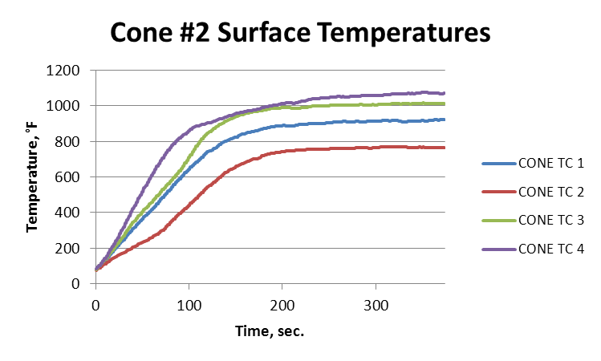
Installed Cone #2
0.061” thickness 321h Stainless Steel

Slide 25
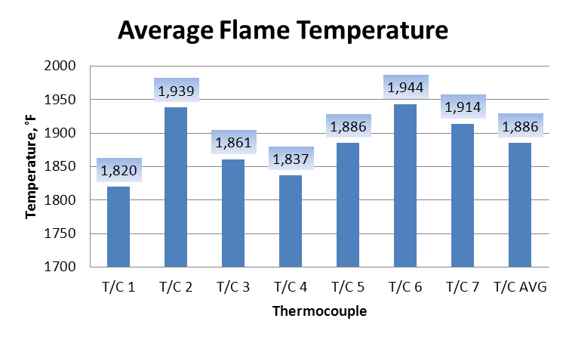
Installed Cone #2
0.061” thickness 321h Stainless Steel
Baseline Cone
Cone #2

Slide 26
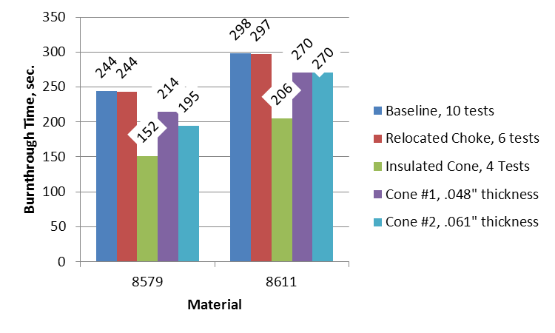
Installed Cone #2
0.061” thickness 321h Stainless Steel

Slide 27
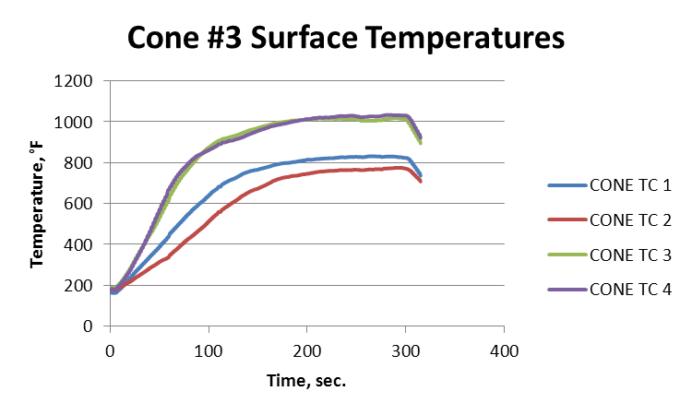
Installed Cone #3
Same as Cone #1 with 1” flange welded on exit plane

Slide 28
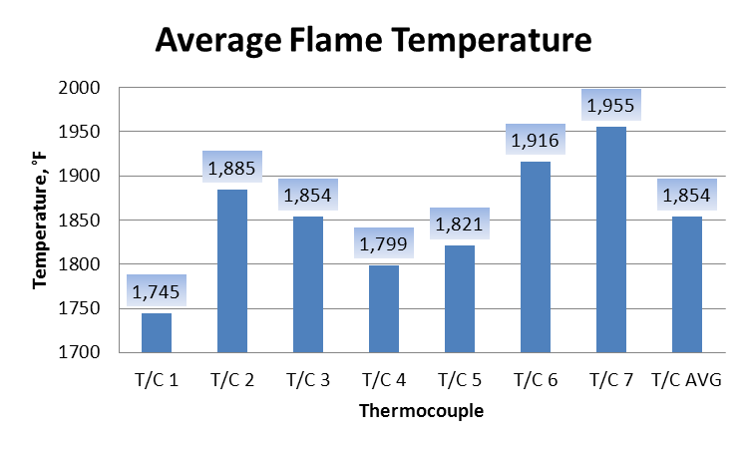
Installed Cone #3
Same as Cone #1 with 1” flange welded on exit plane
Baseline Cone
Cone #3

Slide 29
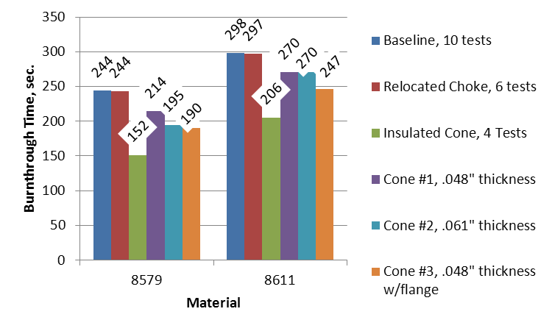
Installed Cone #3
Same as Cone #1 with 1” flange welded on exit plane

Slide 30
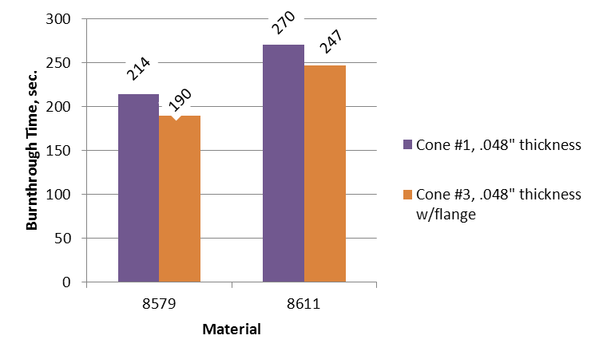
Cones #1 vs. #3 – Effect of Flange

Slide 31
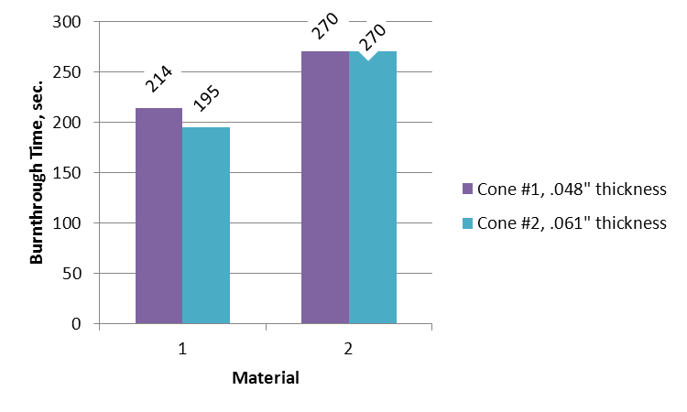
Cones #1 vs. #2 – Effect of Thickness

Slide 32
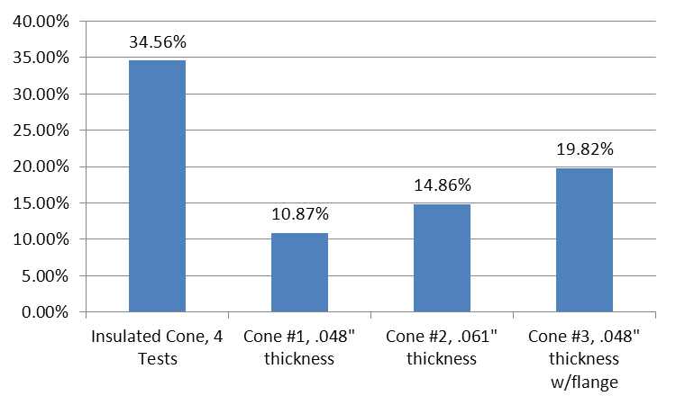
Average % Change from Baseline

Slide 33
Cone Comparison - Summary
All cases tested reduced the burnthrough time of both 8579 and 8611 from the baseline case
In order of impact on burnthrough severity
  Insulating outer cone surface to prevent heat loss
  1” flange on end of cone
  Slightly thicker cone material
  New cone

Slide 34
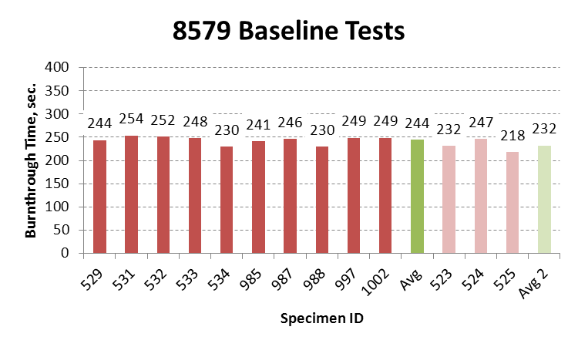
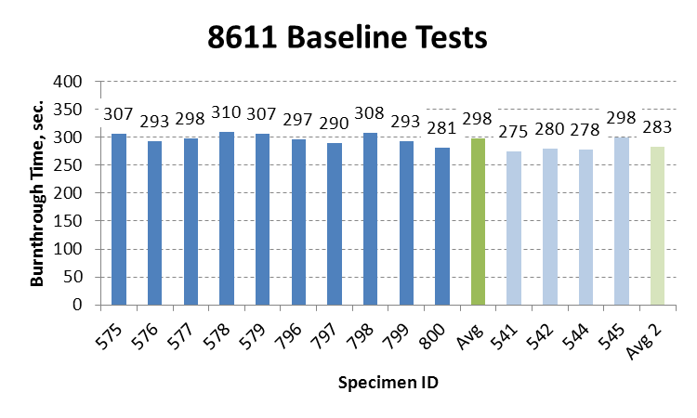
Re-run Baseline Tests
244 ± 5%
231.8<x<256.2
298 ± 5%
283<x<313

Slide 35
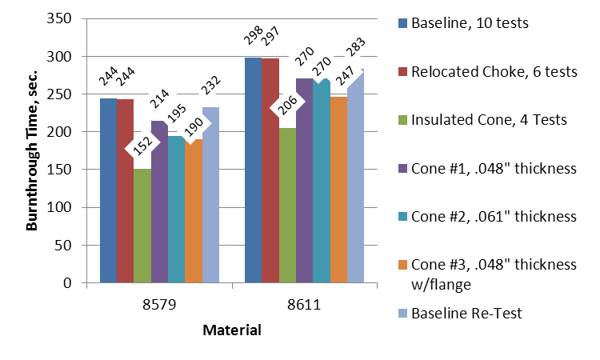
Re-run Baseline Tests

Slide 36
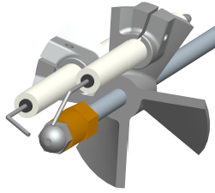
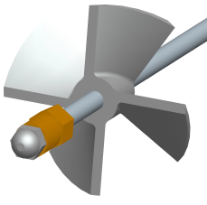
Test Series #3 - Stator
Definitions
“Old Stator”
Marlin Engineering CNC-machined reproduction of original Monarch H-215
“New Stator”
Marlin Engineering, symmetric, CNC-machined

Slide 37
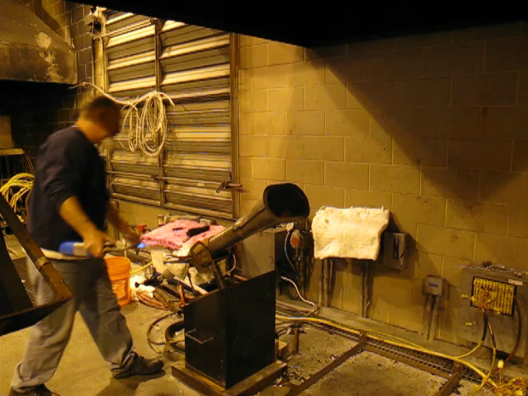
New Stator – External Ignition

Slide 38
New Stator
Initially new stator was put in exact position as old stator
  4” back from nozzle tip
  Centerline between vanes aligned 35° from vertical
Ignition wires were removed from burner completely

Slide 39
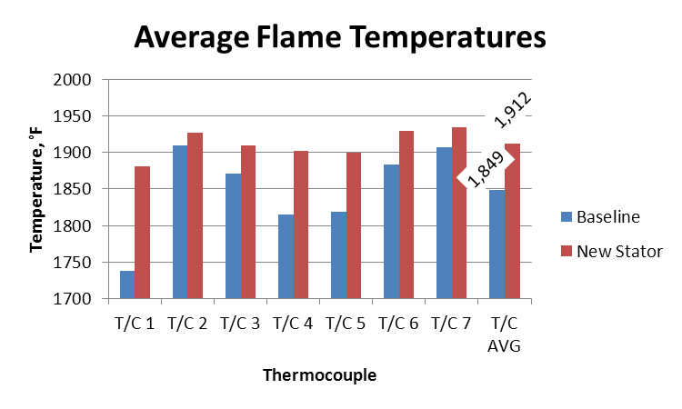
New Stator – Temperature Comparison

Slide 40
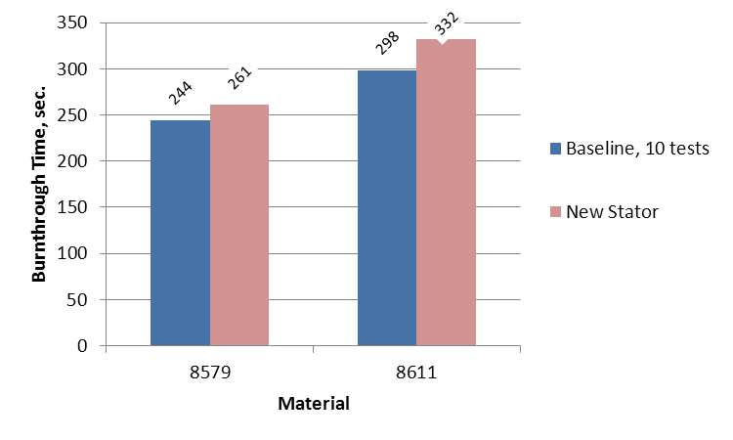
New Stator - Burnthrough

Slide 41
Summary of Initial New Stator Results
New Stator – Flame Temperature Measurement
  More uniform flame temperature profile
  Significant improvement on #1 T/C
  Over 50°F increase in average flame temperature
New Stator – Burnthrough Tests
  Longer overall burnthrough times for both 8579 and 8611 material
    8579 – 16.45 sec. longer
    8611 – 33.60 sec. longer

Slide 42

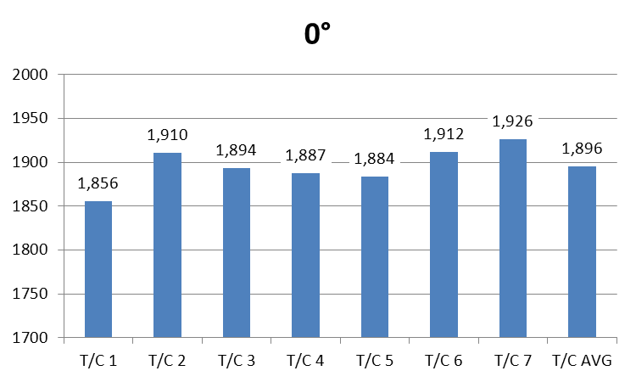
Measured Flame Temperatures - Rotation

Slide 43
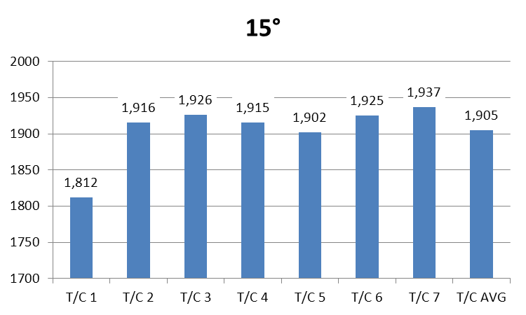
Measured Flame Temperatures - Rotation

Slide 44

Measured Flame Temperatures - Rotation

Slide 45
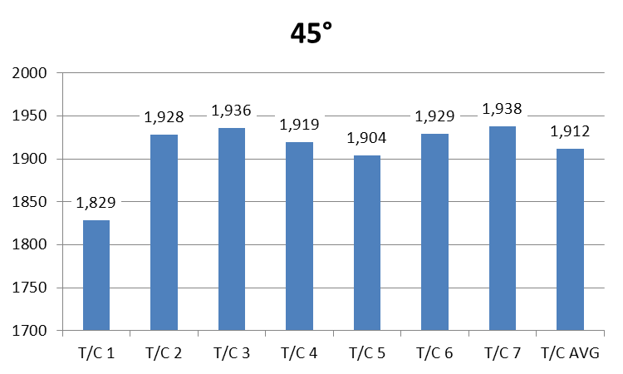
Measured Flame Temperatures - Rotation

Slide 46

Measured Flame Temperatures - Rotation

Slide 47

Measured Flame Temperatures - Rotation

Slide 48

Measured Flame Temperatures - Rotation

Slide 49

Stator Rotation: ΔT=T_{max}-T_{min}
ΔT is used to determine the uniformity of the flame temperature measurement, smaller ΔT, more uniform profile

Slide 50
Stator Rotation - Summary
Rotating the stator over 90° in 15° increments resulted in slightly different flame temperature profiles
The uniformity of the flame was assessed by subtracting the minimum temperature from the maximum temperature
The best uniformity was found at 0°, with a spread of 70.36°F

Slide 51


Axial Position
4”

Slide 52


Axial Position
5”

Slide 53


Axial Position
6”

Slide 54


Axial Position
3”

Slide 55


Axial Position
2”

Slide 56

Stator Axial Location: ΔT=T_{max}-T_{min}

Slide 57
Axial Translation – Summary
Translating the stator on the axis of the burner over a range of 4 inches in 1 inch increments resulted in slightly different flame temperature profiles
The overall temperatures increased as the stator was translated closer to the fuel nozzle
The highest overall flame temperature and best uniformity was found at 2 inches back from the nozzle tip
  T_{avg}=1942°F
  ΔT=28°F

Slide 58

New Stator, 0°, 2” from nozzle tip

Slide 59
Rotation and Translation Burnthrough
The most uniform flame temperature profile and the highest overall measured flame temperature resulted in the longest burnthrough for both 8579 and 8611
  8579: 271.50
  8611: 368.25
These burnthrough times are longer than the baseline test
  8579: 27.20 sec. longer
  8611: 69.85 sec. longer

Slide 60

Old Stator, same position as new stator, no wires

Slide 61

Old Stator, same position as new stator, no wires

Slide 62

Burnthrough Times

Slide 63
Old stator @ 2” from nozzle tip - Summary
The old stator and igniters placed in the same position as the new stator resulted in lower flame temperatures with less uniformity
  New Stator: T_{avg} =1942°F, ΔT=28°F
  Old Stator: T_{avg} =1865°F, ΔT=151°F
The old stator and igniters resulted in significantly faster burnthrough times than the new stator and the original baseline
  8579: 56.75 sec. quicker than new stator
  8611: 89 sec. quicker than new stator
These tests are proof that the magnitude of the measured flame temperature is not indicative of burner severity

Slide 64

New Stator @ 75psig sonic choke inlet pressure

Slide 65

New Stator @ 75psig sonic choke inlet pressure

Slide 66
New Stator @ 75psig sonic choke inlet pressure
Summary
Increasing the air pressure from 60 psig to 75 psig resulted in the 8579 being closer to the baseline, but the 8611 was still significantly longer
  8579: 5.95 sec longer
  8611: 44.6 sec longer

Slide 67

Flame Retention Heads (FRH)
F-12
F-22
F-31
Beckett flame retention heads were purchased from local supply store
These heads are used on modern oil burners for more efficient burning
The heads can be used to create inefficient fuel rich burning that we are looking for by mismatching the air flow and the fuel firing rate
Benefits of Flame Retention Heads
  One component replaces both the stator and turbulator
  Reduces the amount of specification required for burner
  Rotationally symmetric

Slide 68

Nozzle Depth
Note: All FRH tests were run without
Igniters or wires in the draft tube

Slide 69

Flame Retention Heads

Slide 70

Flame Retention Heads

Slide 71
Flame Retention Heads - Summary
The flame retention heads give different temperature profiles depending on the size of the coflow air passages
Overall the flame temperatures were higher with flame retention heads than with stator and turbulator
A wide range of burnthrough times were obtained for the different heads, generally the larger the coflow air passages, the longer the burnthrough time
The F-22 head seems to give the closest burnthrough time to the baseline nexgen burner configuration

Slide 72
FRH for Cargo Liner and Seat Burners

Slide 73

Flame Retention Head: Description
Eliminates the need for a stator or turbulator
Fits on end of burner draft tube
Initial testing shows good potential

Slide 74
Flame Retention Head: Calibration
Calibration readings are significantly higher using the flame retention head compared to sonic readings using the standard stator
Readings also seemed more consistant from one calibration to the next

Slide 75
Flame Retention Head: Test Results

Slide 76
Flame Retention Head: Test Results

Slide 77
Cargo Liner Flame Retention Head: Conclusion
Simplify setup and adjustments by eliminating stator and turbulator
Capable of producing higher temperatures
Flame temperature can be tailored by changing size of holes in flame retention head
Head tested produced temperatures higher than the Park or sonic burner, as well as decreased burn-through time

Slide 78
FRH for Seat Cushion Burner
Extremely low variation of temperature
Less than 1°F variation of averaged temperatures
78

Slide 79
FRH for Seat Cushion Burner

