Slide 1
Development of a Laboratory Scale Flame Propagation Test Method for Structural Composites

Slide 2
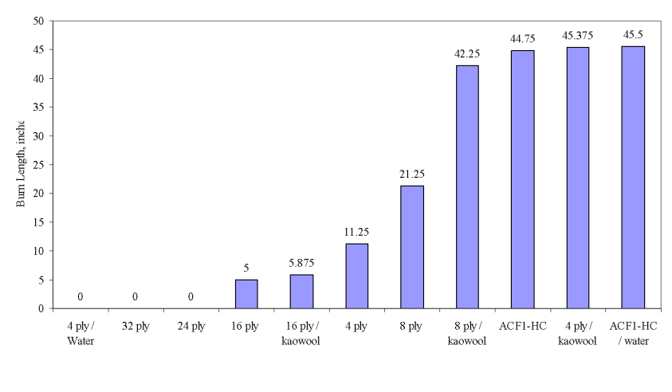
Review from Singapore
Intermediate scale tests were performed on aerospace grade structural composite material of varying thickness
  4, 8, 16, 24, 32 plies and a honeycomb sandwich panel
  Various configurations were tested
    Exposed backside
    Insulated backside
    Water-cooled backside
  Backside heat loss found to have a significant effect on inboard-side burning

Slide 3
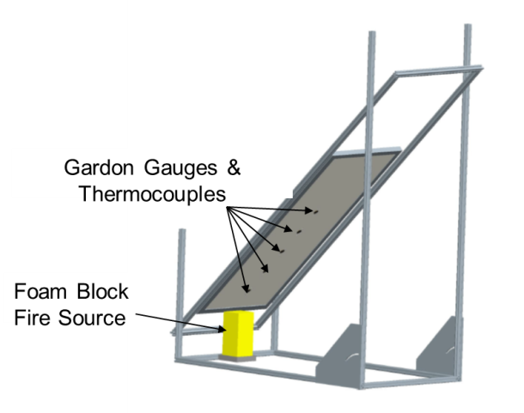
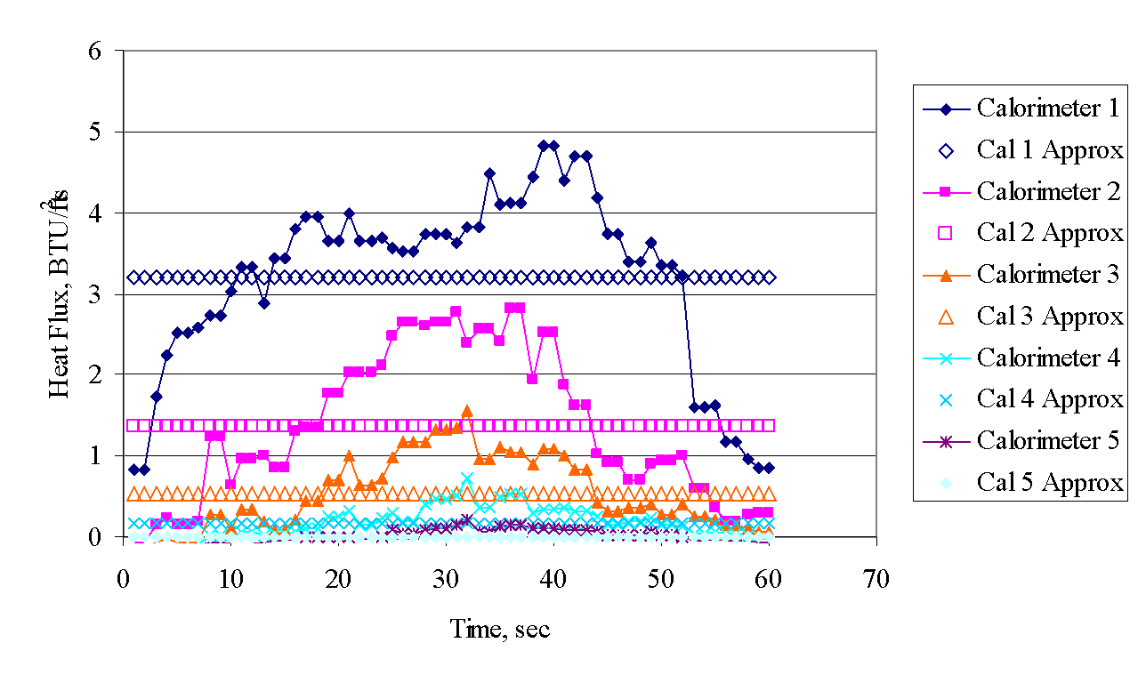
Lab-Scale Test Method Development
The foam block fire source was characterized by measuring the heat flux gradient along an insulated board for the duration of the foam burning event
This heat flux gradient will then be used to impose a similar heat flux on a smaller sample in a lab-scale test apparatus

Slide 4
Heat Flux Gradient – Intermediate Scale

Slide 5
Vertical Radiant Panel (VRP) Development
Objective: to develop a “new” radiant panel type test that will:
  Simulate conditions of a foam block test
    Incident heat flux on sample
    Duration
    Geometry
  Correlate results from foam block test
    Use current database of materials already tested
      Aerospace/non-aerospace grade composites (1/8” thick)
      Aerospace grade carbon epoxy, varying thicknesses
      Cargo liners and floor panels, varying thicknesses

Slide 6
.18
Calorimeter Board
.54
Radiant Panel Heater
1.36
3.2

Slide 7
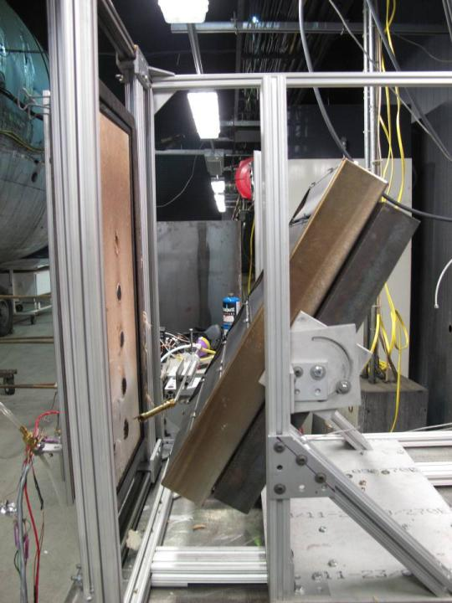
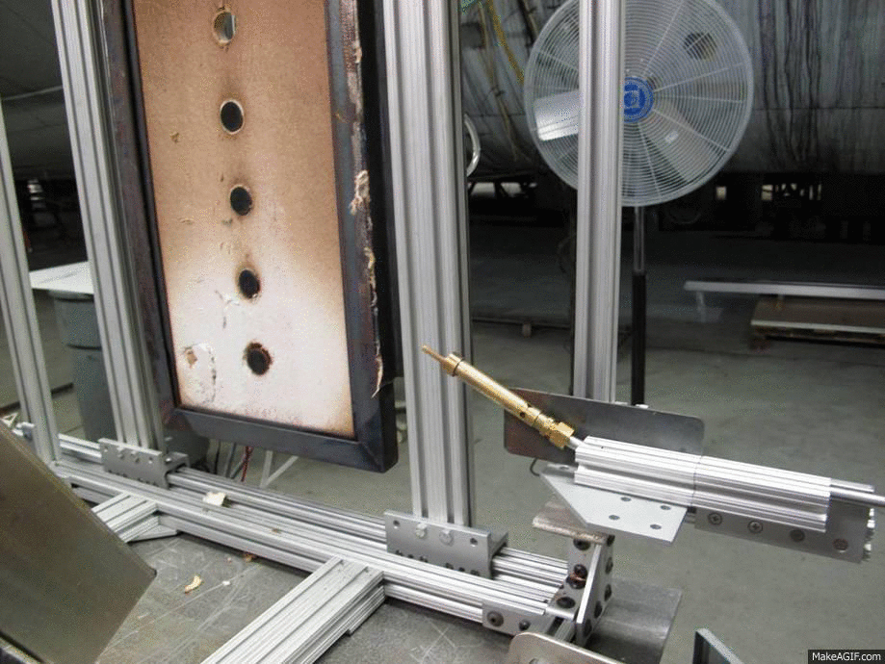
Heat flux gradient
  A tilted panel was used to attempt to achieve the same measured gradient as the foam block test
  Furthest backward tilt (70°) could not achieve steep enough gradient
  Zero position heat flux too low
Next attempt:
  Separate emitter strips into 3 individually controlled pairs to control the heat flux gradient
VRP Configuration

Slide 8
Current Configuration
New Configuration
Leg 1
Leg 2
Leg 3
Temp
Controller
Temp
Controller 1
Temp
Controller 2
Temp
Controller 3
Relay
3-Phase 208V in
Relay 1
Relay 2
Relay 3

Slide 9
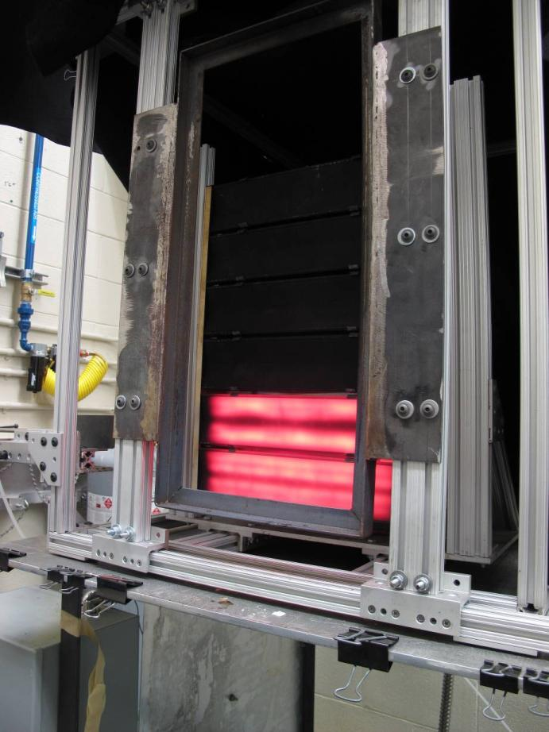

Slide 10
.18
Calorimeter Board
Radiant Panel Heater
Radiant Panel Heater
Radiant Panel Heater
.54
1.36
3.2

Slide 11
Bottom 2 Strips Only

Slide 12
Recent research

Slide 13
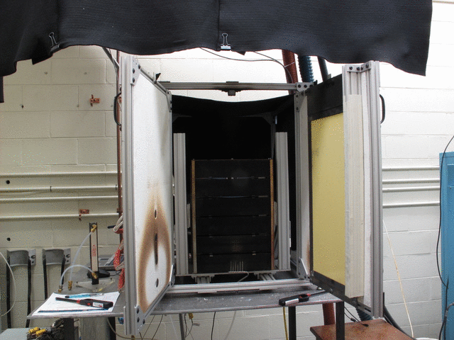
Modifications to VRP
Swivel doors added to make switching between calibration and testing quick and easy

Slide 14
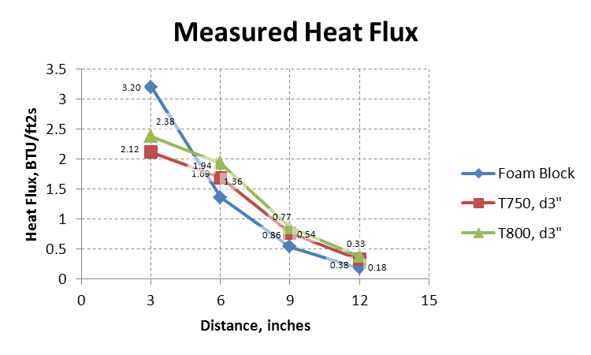
Original Pilot Burner

Slide 15

Original Radiant Panel Pilot Burner

Slide 16
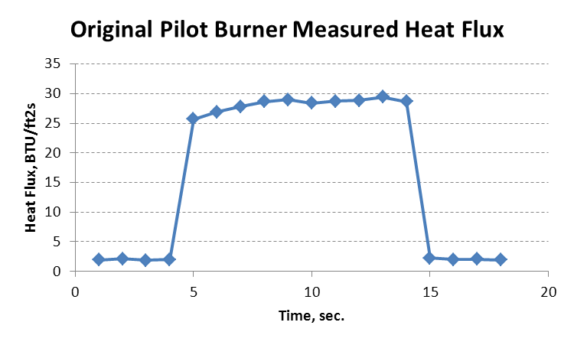

Slide 17
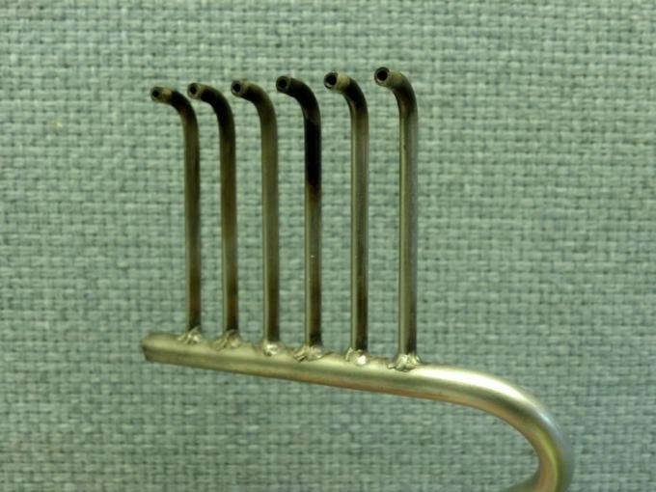
Unidirectional NBS Chamber Pilot Burner
2”

Slide 18
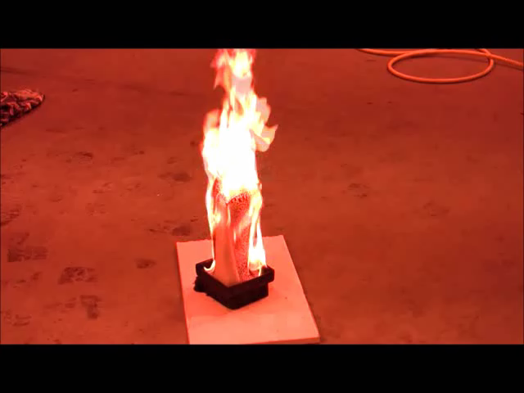
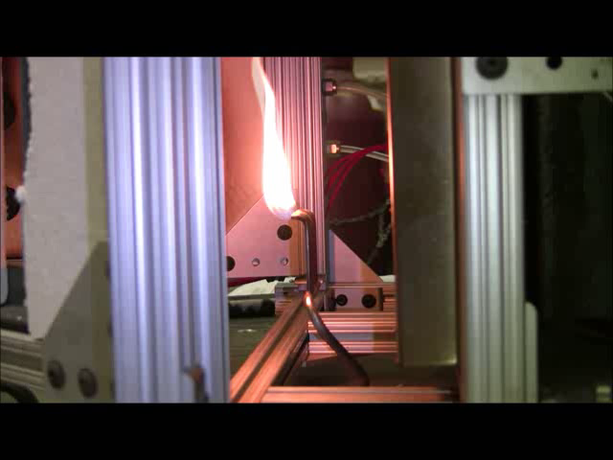
Foam Block
Multiple Flamelet Burner

Slide 19
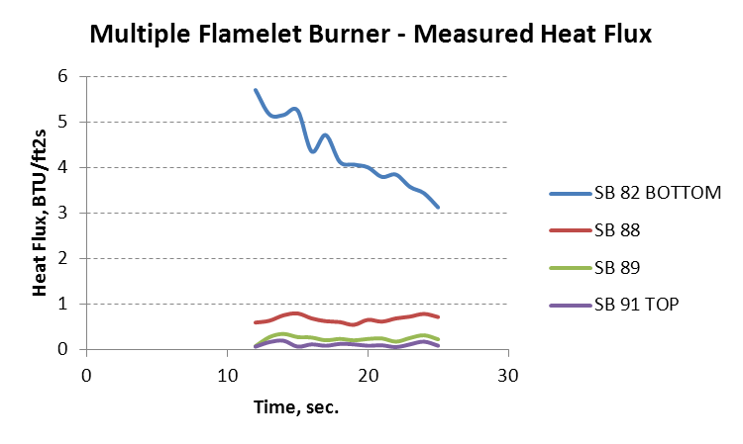

Slide 20
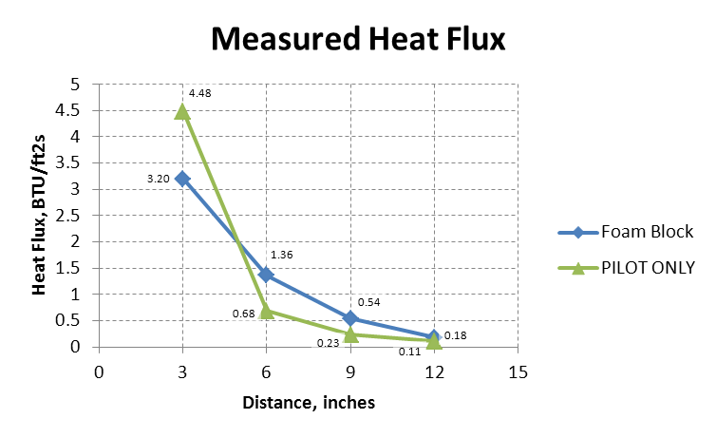

Slide 21
16 ply ACF1

Slide 22
Observations
16 ply ACF1 performed very well in all foam block tests with minimal evidence of burning
Pilot flame gas flow rate for this test produced a tall flame with a large footprint
Reduce flow rate and re-test

Slide 23
16 ply ACF1 – smaller flame

Slide 24
Observations
Reducing the gas flow rate resulted in a much smaller flame with smaller footprint, making it easier to observe flame propagation from the ignition point
Under these test conditions, 16 ply ACF1 still burned more than the foam block tests indicated
Panel heat flux should be changed to get closer to measured foam block heat flux

Slide 25
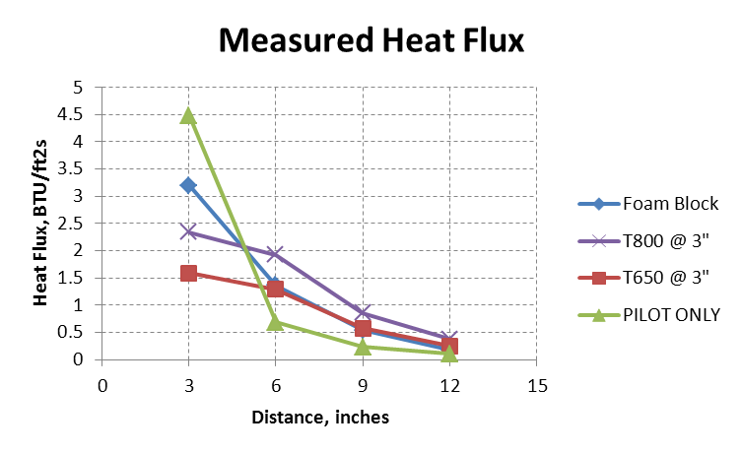

Slide 26
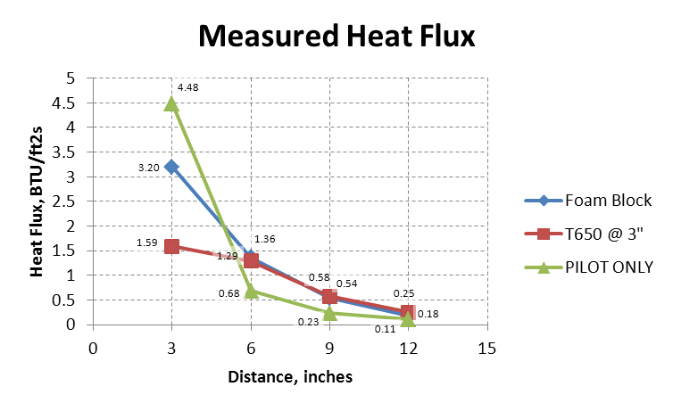
Multiple Flamelet Burner

Slide 27
16 ply ACF1 – smaller flame, lower heat flux

Slide 28
ACF1-HC

Slide 29
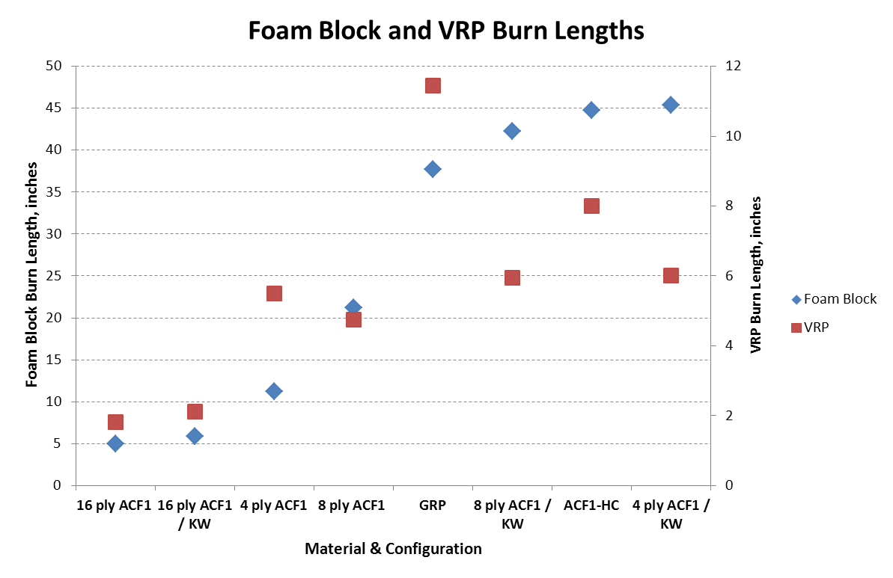

Slide 30
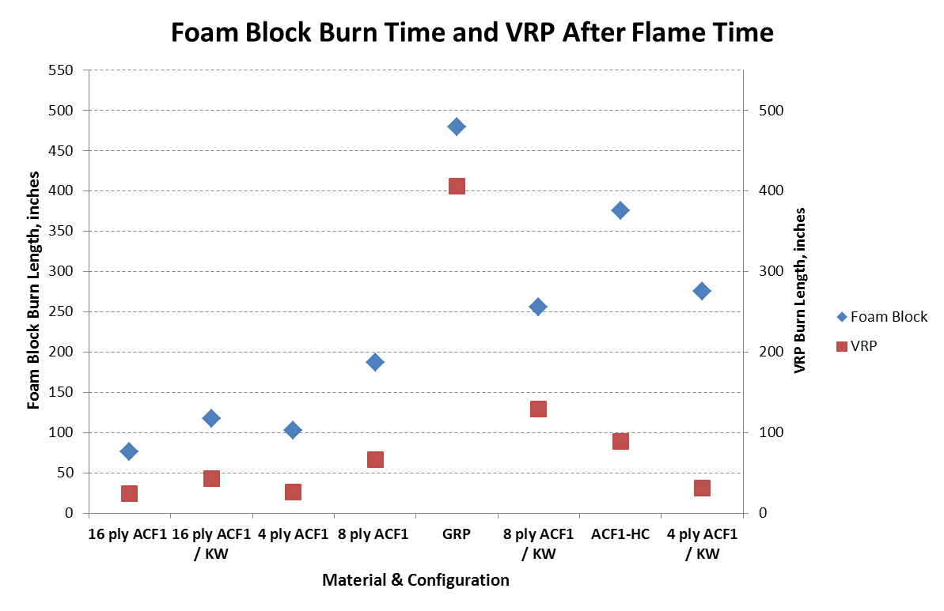

Slide 31
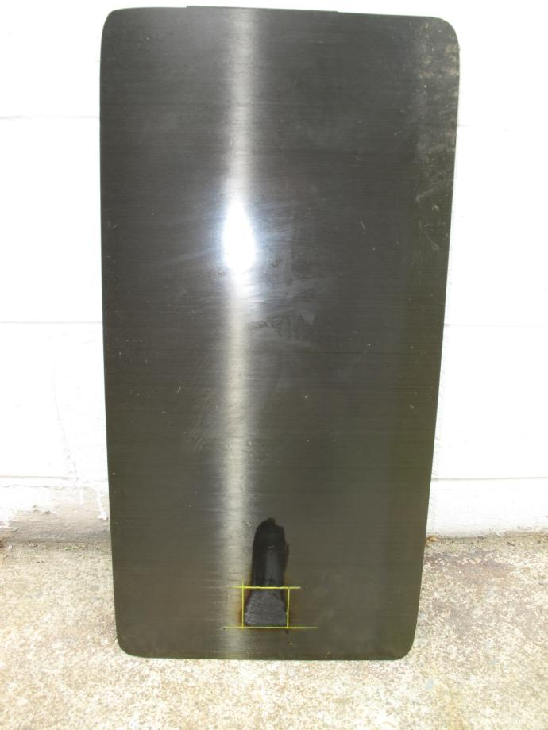
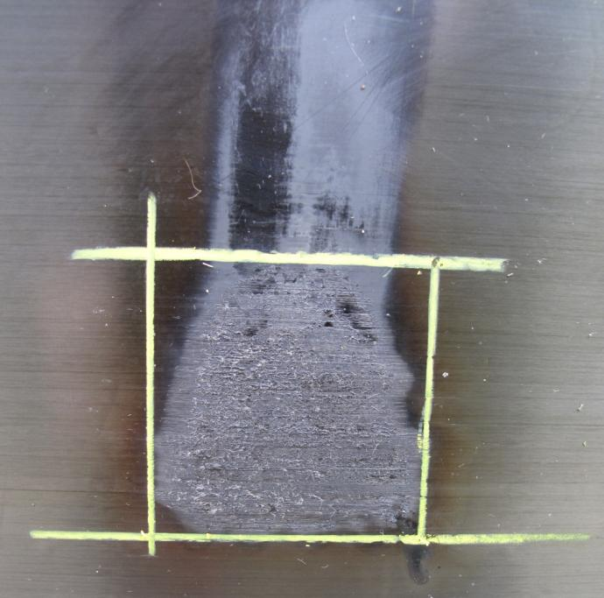
16 Ply ACF1
24”
1 13/16”
1 13/16”
12”

Slide 32
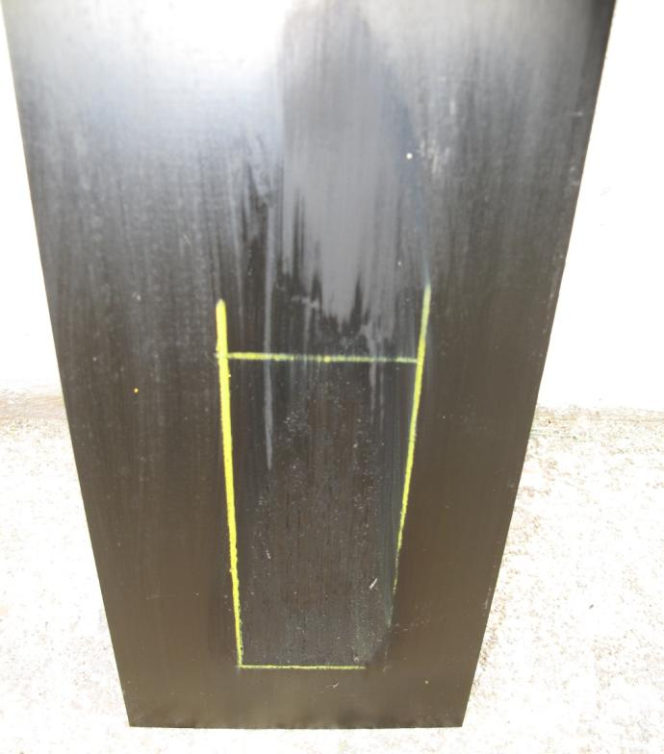
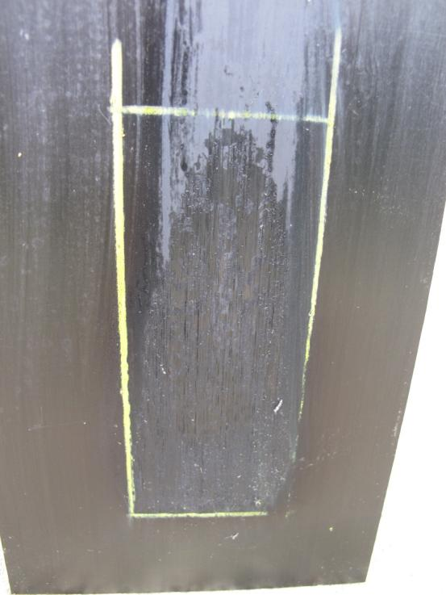
8 Ply ACF1
4 3/4”
2”
6”

Slide 33
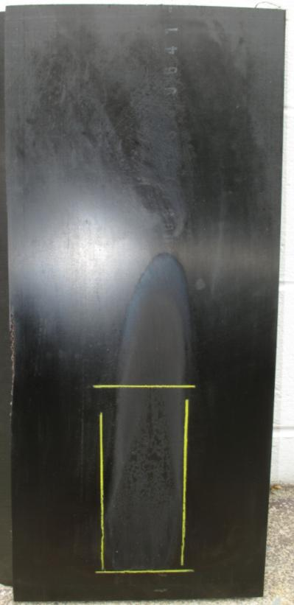
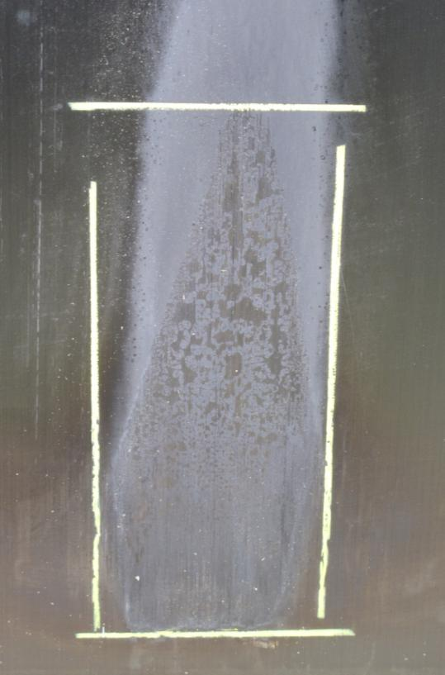
ACF1-HC
24”
8”
3 5/16”
12”

Slide 34
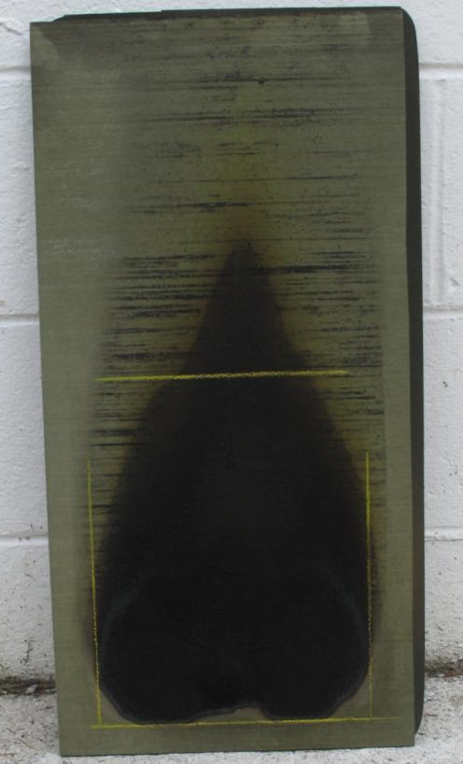
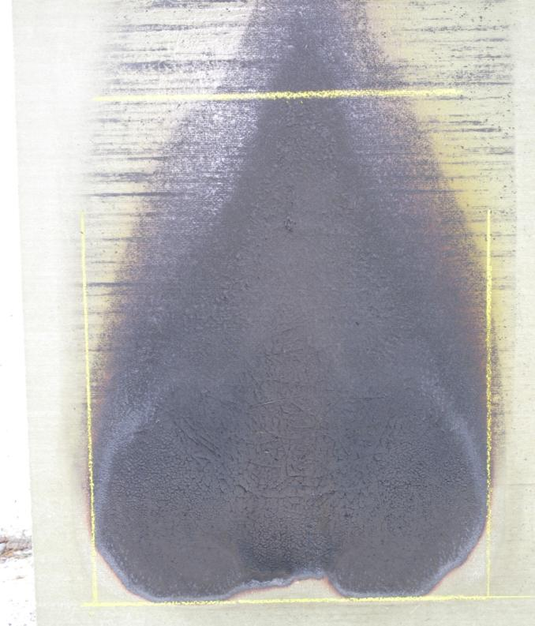
GRP
24”
11 7/16 ”
8 5/16”
12”

Slide 35
Observations
The smaller flame and lower heat flux settings correlate reasonably well with foam block test for the materials tested
More materials are to be tested in both foam block and VRP

