Slide 1
Radiant Panel Update

Slide 2
Since the October Meeting
Sent out survey to all labs to get their radiant panel dimensions and comments on Workbook
13 Responses
Training Video
First draft is completed
Round Robin
Get started as soon as possible

Slide 3
Survey Results

Slide 4
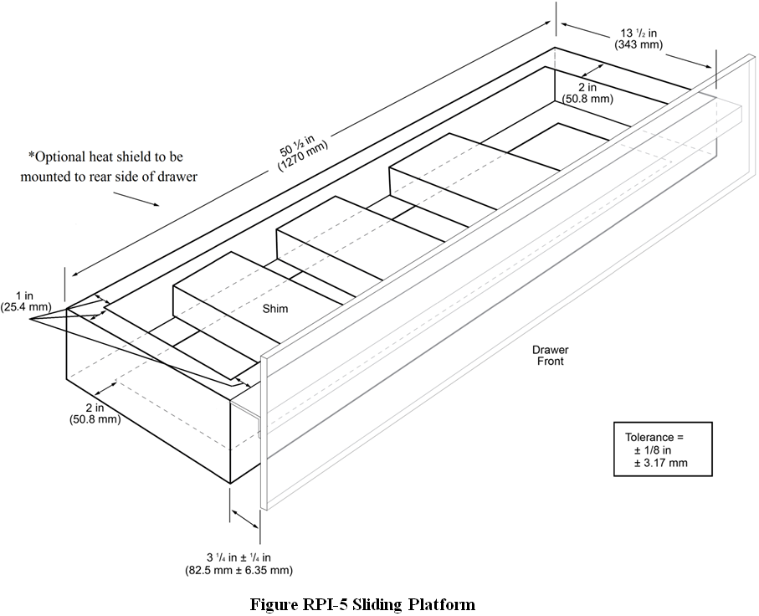
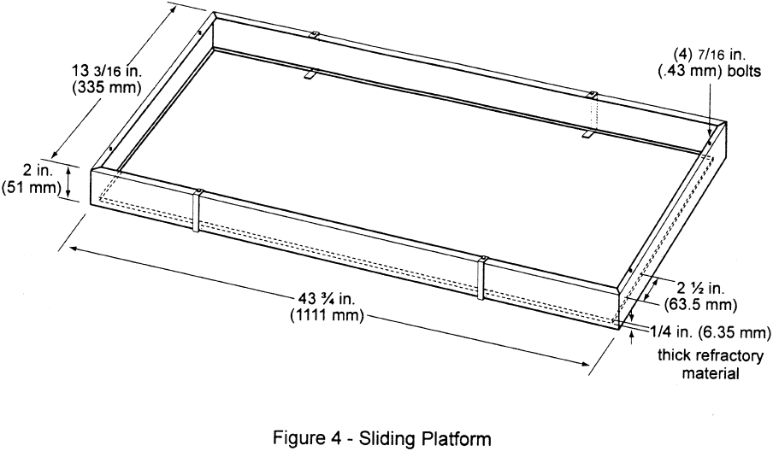
Drawer Change
New Drawer
Old Drawer
New drawer fills out entire width of the chamber
Doesn’t allow air-flow around drawer while testing

Slide 5
Drawer Change
Smaller drawer would leave a bigger gap and could allow air to flow through
FAA has observed skewed flame in certain labs with air flow problems

Slide 6
Training Video
Based on the new Workbook
Purpose of the video is to help make the test procedure more consistent across all testing labs and to help new labs
First draft is completed
Revisions are currently in progress
Re-shoots and final revisions planned for after this meeting

Slide 7
Training Video

Slide 8
Round Robin
Request for participants
Certain materials already selected
Request for “borderline” materials
Set points and chamber temperature along with calibration and test data
Start as soon as possible

Slide 9
Questions?

