Slide 1
Vertical Flame Propagation (VFP) Test
IAMFTF Virtual
Tina Emami
April 19, 2021

Slide 2
Vertical Flame Propagation (VFP)
Objective
Proposed new test method for non-metallic, extensively used materials located in inaccessible areas, i.e.:
Composite skin, structure, and sub-components
Wires (insulations/jackets/sleeving)
Duct materials
What is it?
A way of evaluating the performance of a material against a realistic fire threat using a methane/air flame and radiant heat source.

Slide 3
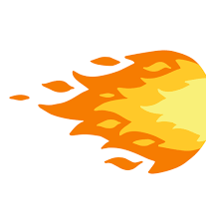
Basic Components of the Test
An electric coil radiant heater is mounted vertically and opposite a 6-inch by 12-inch sample
A methane/air ribbon burner impinges on the lower portion of the test sample, initiating material combustion while continuously exposed to the radiant heat flux from the heater
The burner flame is translated away from the test sample after 30 seconds
The test is allowed to continue until all material combustion has ceased
The sample is then removed from the test frame and a post test burn length measurement is made
Test
Sample
Radiant Heater
Ribbon Burner

Slide 4
What We Know Today
Flow Rate of Gases to the Ribbon Burner
Distance of the Ribbon Burner to the Sample Face
Heat Flux from the Radiant Heater
Room Temperature and its Effects on the Test
Air Exhaust Speeds

Slide 5
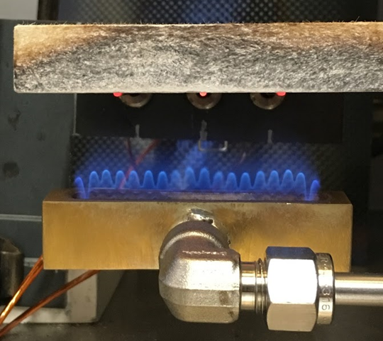
What We Know Today
Flow Rates For Ribbon Burner
The methane to air mixture of flame is set to be:
0.660 slpm methane
3.6 slpm air
This is controlled through mass flow controllers that are calibrated to 14.7 PSIA and 25 C
If the mass flow controllers being used are calibrated to different conditions, they must be accounted for

Slide 6
New Flow Rate Calculation

Slide 7
Flow Rate Effects
Correct Flow Rate
For MFC Calibrated to 20 C
Incorrect Flow Rate
Used numbers for MFC Calibrated to 21 C

Slide 8
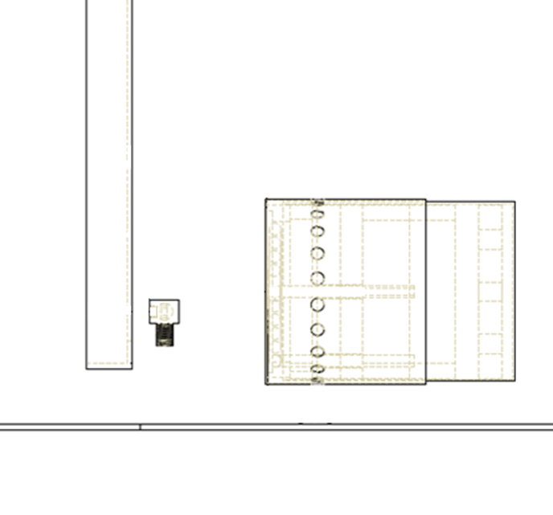
Flame Distance Effects
Incorrect Distance of Flame to Sample
0.4 inches
From burner face to sample face
Correct Distance of Flame to Sample
0.5 inches
From burner face to sample face

Slide 9
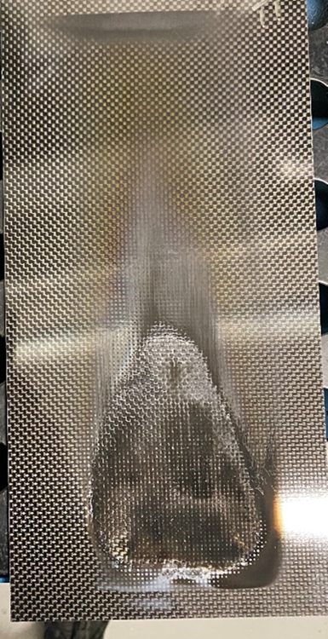
Changing to a New Ribbon Burner
Old Ribbon Burner
New Ribbon Burner

Slide 10
Measuring the Flame Temperature
6 inch x 6 inch x 1/8 inch steel plate
Type K thermocouple embedded in the center
The Burns Plate

Slide 11
Changing to a New Ribbon Burner

Slide 12
Ribbon Burner in the VFP Review
Calculating for Flow Rate is extremely important based on your calibration temperature and pressure of your mass flow controllers
The distance of the ribbon burner face to the sample face is important
Changing to a new ribbon burner is important

Slide 13
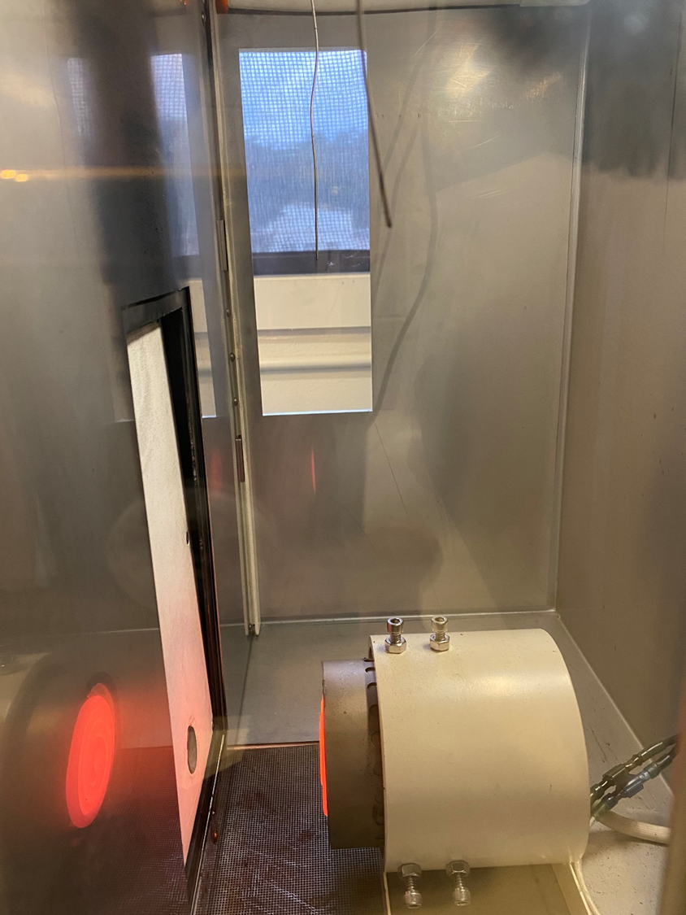
What We Know Today (Cont.)
A heat flux vs. burn length study was performed (reference VFP presentation from March 2020 for details)
Here we learned that if the heat flux varies more than ± 0.08 Watts/cm2 that it will effect the test results.
VFP Manufacturers agreed that a heat flux range of 1.8 ± 0.05 Watts/cm2 is practical

Slide 14
What We Know Today (Cont.)
In that same study we varied chamber temperature and room temperature
Chamber temperature showed to have no effect on burn length but room temperature did have an effect on burn length
The allowable room temperature is able to vary by ± 4 ℉

Slide 15
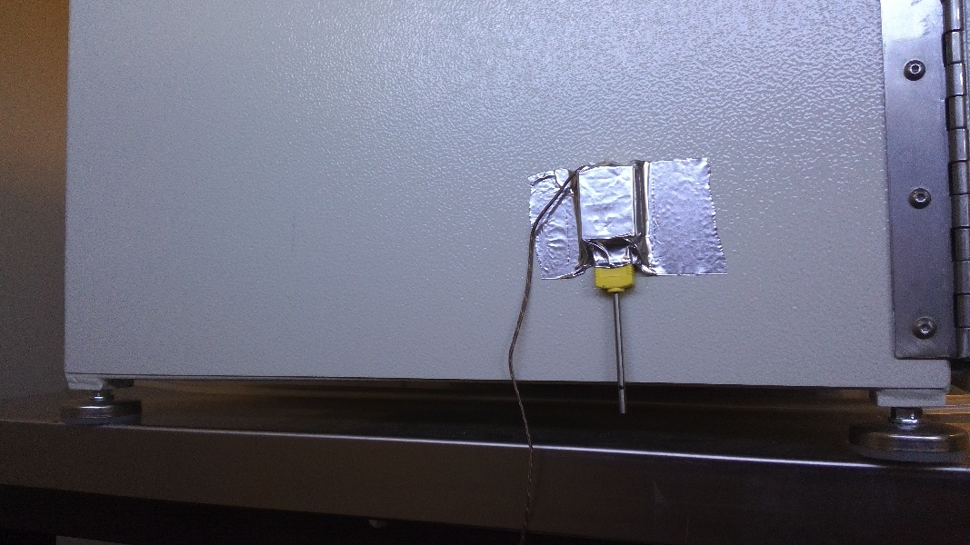
Room Temperature Thermocouple Location
The requirement for this location is 74 ± 4℉
The thermocouple is centered with the air intake grate and placed ½ inch below the base of the unit

Slide 16
Room Temp Effect on Flame Temp

Slide 17
Air Exhaust Speed Measurement

Slide 18
Air Exhaust Speeds
We’re not looking for a specific speed here
We’re looking for the difference between the exhaust speed with your lab fan off and with your lab fan on
Your lab’s fan shouldn’t be pulling too much and should be kept at the lowest setting
Testing to come to understand the threshold of “too much”

Slide 19
Inter-Lab Study (Round Robin)
This inter-lab study is done to confirm that the machines all running with similar results
This has brought up different adjustments that need to be made
Currently 6 labs participated – waiting for 1 more lab results
Materials Used for Inter-lab Study
Material A
½ inch thick
¼ inch thick
Material B
1/8 inch thick
1/16 inch thick
1/32 inch thick
Material C

Slide 20
Round Robin Results Material A

Slide 21
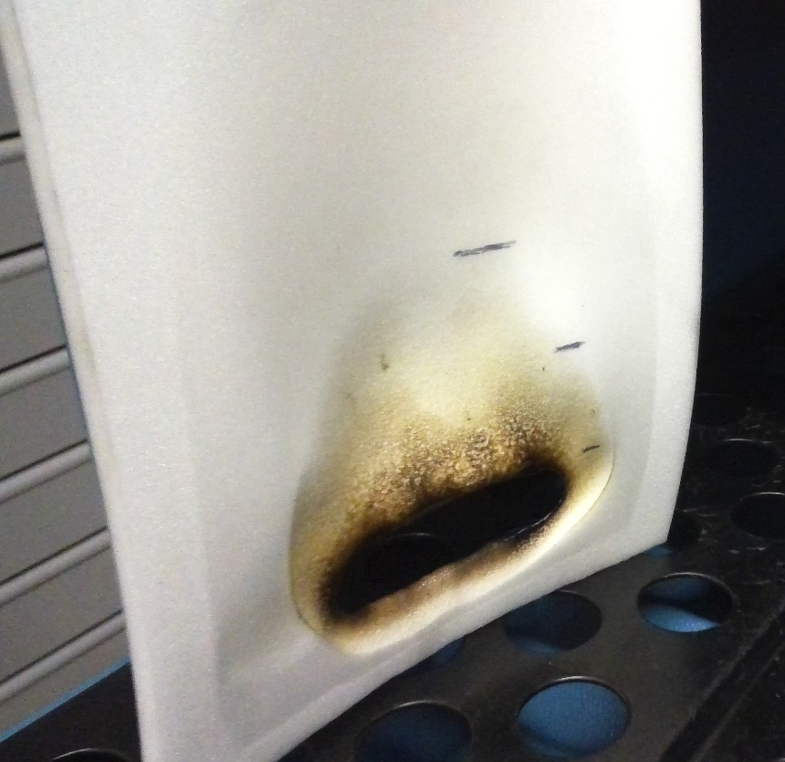
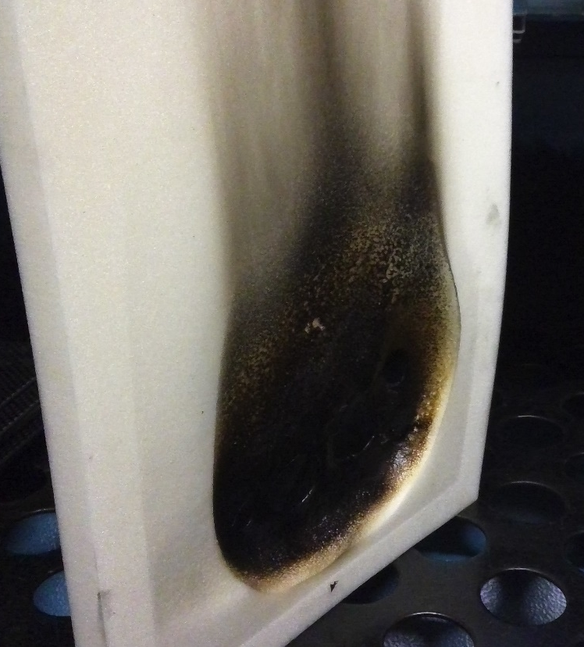
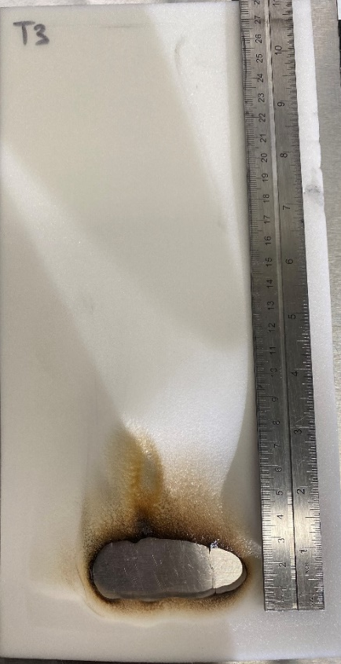
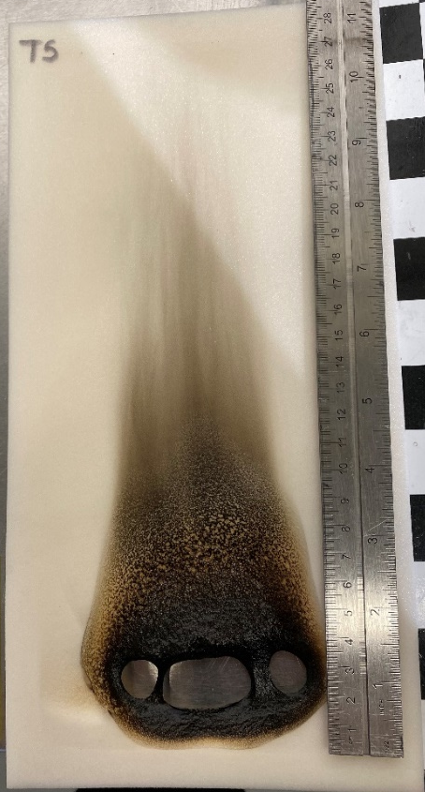
Round Robin Results – Material A
Material A was highly subjective to the user’s definition of burn length
Material A
¼ inch thick
Material A
½ inch thick

Slide 22
Round Robin Material A – ½ inch Thick

Slide 23
Round Robin Results – Material B – Before Adjustments
10% Standard Deviation of the average of each lab

Slide 24
Round Robin Results – Material B
5.7% Standard Deviation of the average of each lab

Slide 25
Round Robin Results – Material C
17.8% Standard Deviation of the average of each lab

Slide 26
Round Robin Adjustments to be Aware of
The height of the VFP base to the lab table should be 1.25 inches
The methane and air flow rates should be accounted for the MFC’s calibration temperature and pressure
Confirm the height and location of your ribbon burner before testing
Confirm the location of your heater while testing
Confirm all calibration dates for equipment including MFC and heat flux gauges
Confirm room temperature thermocouple is in the correct new location
Observe the room temperature before each test

Slide 27
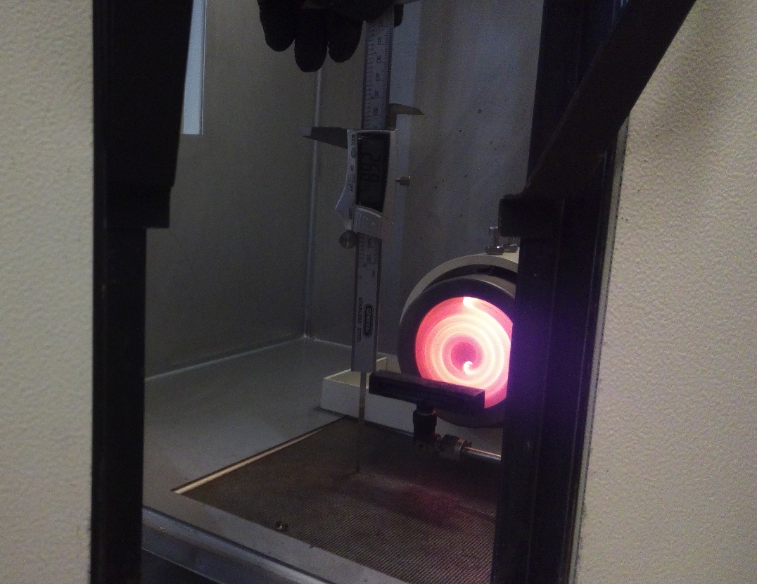
Round Robin – Future Results
The first labs have completed their machine adjustments and are re-doing the test
2 more labs will be sending in data to compare as well

Slide 28
Deatak VFP at Technical Center

Slide 29
Ducting
The materials used in the testing thus far have been comprehensive and representative of materials currently in use, the FAA would like to expand this effort to include additional materials if possible.
If you have materials that have not been tested against this proposed standard, which may be affected by the implementation of a new Rule, the FAA would like to test them at the Technical Center.
The results of this expanded effort will ensure proper representation of the materials likely to be impacted, so that your materials aren’t excluded during final developmental stages.
If you would like to send your materials, please contact Tina Emami at tina.emami@faa.gov.

Slide 30
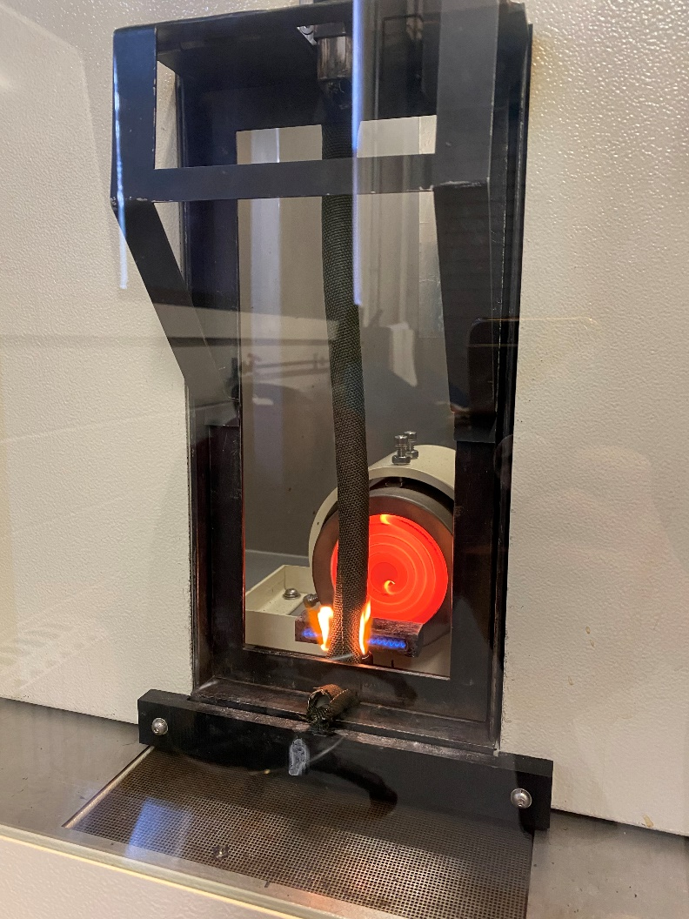
Wire Sleeving
Around Non-Conductive Rod
Alone in Front of Marinite Board
Alone in Sample Holder

Slide 31
Wire Sleeving
With Non-Conductive Rod in Free air
Avg Burn Length = 1.06 inch
Material in Free Air
Avg Burn Length = 1.37 inch
Material With Marinite Board
Avg Burn Length = 2.28 inch
Looking to test more material types

Slide 32
Wire Insulation Testing – What We Know
Testing has been completed to understand that testing 3 wires is more repeatable than testing 5. This is also desirable by industry.
Using Marinite as a backing board produces a significant difference in the burn length of the material, and is required here
Many wires actually have 0 inch burn length or less than 1 inch burn length with this method still. It is not an impossible test this way.
Reference VFP Presentation of June 2018 and October 2017 for details

Slide 33
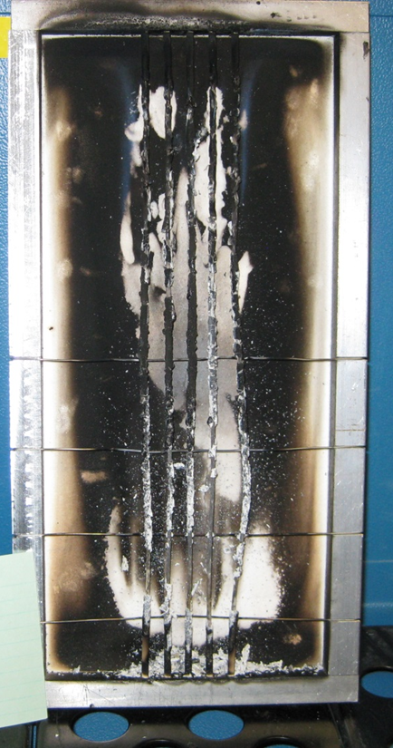
Wire Insulation Testing and VFP
Current development to test various gauge wires at various distances
This will help solidify the development of a universal wire holder

Slide 34
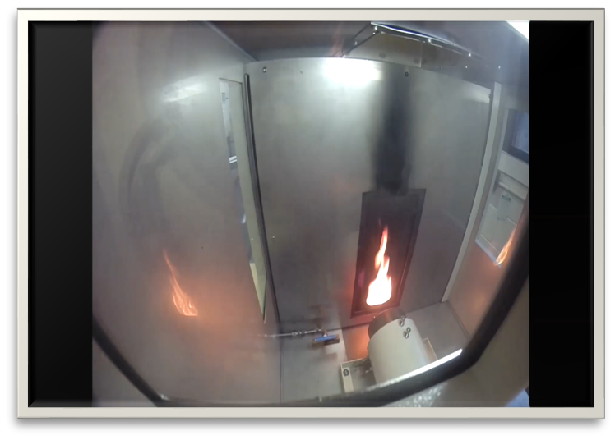
Questions?
Tina Emami
Fire Safety Branch
Bldg275, ANG-E212
William J. Hughes Technical Center
Atlantic City, NJ 08405
(609) 485-4277
Tina.Emami@faa.gov

