Slide 1
New Burning Behavior Identification Approach Using Computer Vision
Ahmed Ben Sidhom¹ , Richard Walters²
Giuseppina Carannante¹ and Nidhal C. Bouaynaya¹
¹ Department of Electrical and Computer Engineering, Rowan University, Glassboro, NJ
² Federal Aviation Administration, Fire Safety Branch ANG-E211, Atlantic City, NJ 08405

Slide 2
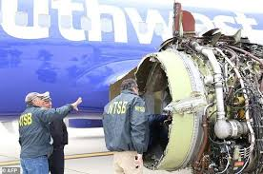
Problem
The Flammability tests results and classification of the FAA agent rely on an analysis based on estimation , exposed to human error and lack standard measurement
Approach
Enhance operator decision-making by leveraging ML/AI object detection algorithms and image processing to extract valuable information from videos and generate insightful measurements.

Slide 3
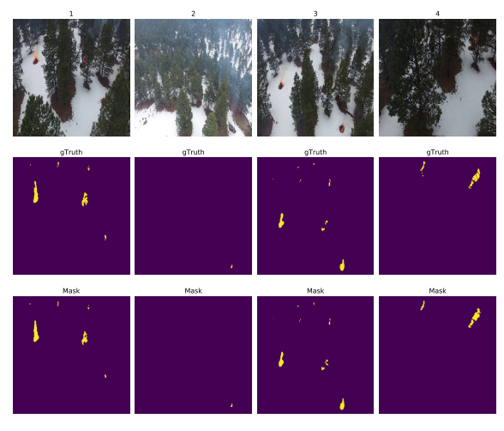
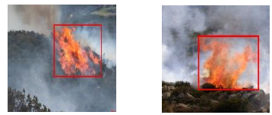
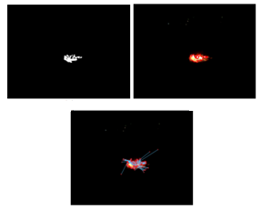
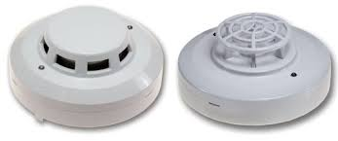
Background
Computer Vision Based Fire Detection Algorithms
Fire Detection Technologies
Heat Detectors
Smoke Detectors
Flame Detectors
Gas Sensors

Slide 4
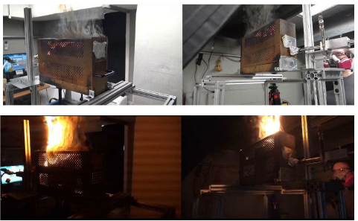
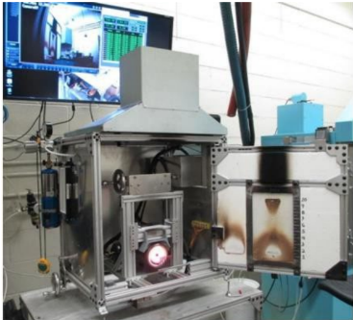
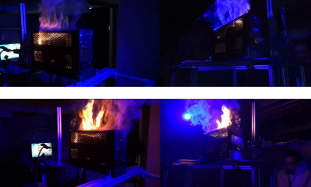
Data
RTCA Box Test
FAA Vertical Flame Propagation Test - VFP

Slide 5
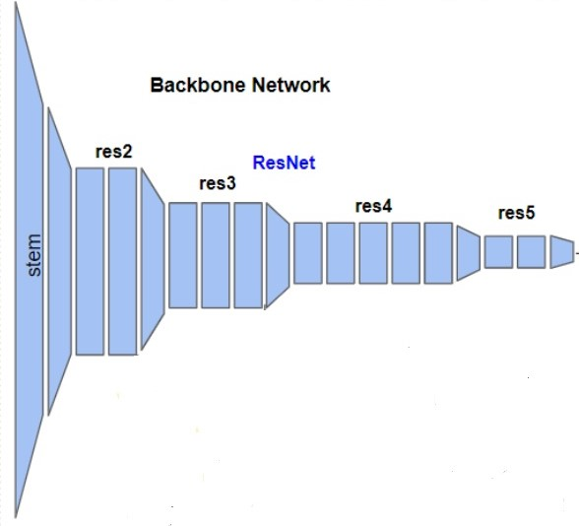
Approach
Notes:
Faster-RCNN
Two-stage methods achieve the highest detection accuracy but are typically slower
Object detection (Faster R-CNN Resnet50_FPN): using Transfer Learning from the famous COCO-dataset and applying data augmentation with the Blur filter we got a mAP= 96.44%
The results of the object detection model were very promising , highlighting the reliability and robustness of our strategy and enable us to proceed for the feature extraction step.

Slide 6
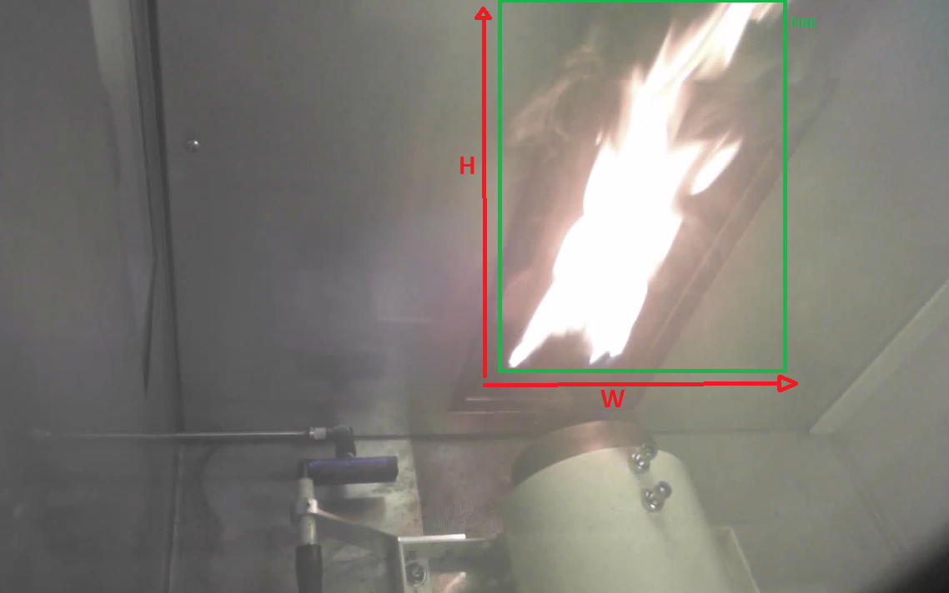
Feature extraction: Object Detection
Time of burning:
Is the time of detection of the first frame with the bounding box of fire.
Burn length:
Is the number of frames with bounding boxes multiplies by the frame rate FPS.
Nbr of Droplets:
Is the number of bounding boxes in the frame with the most boxes in the video.
Burn scale:
The surface of the biggest bounding box with fire. Multiply the Width and Hight of that bounding box.
7
300
L=[0,0,0,0,0,0,1,1,1,1,2,2,2,2,2,2,3,3,3,3,3,3,3,3,3,4,3,………..1,1,1,1,1,1,1,1,0,0,0,0,0,0,0,0,0,]
L: list of the nbr of Bboxes in each frame in the video

Slide 7
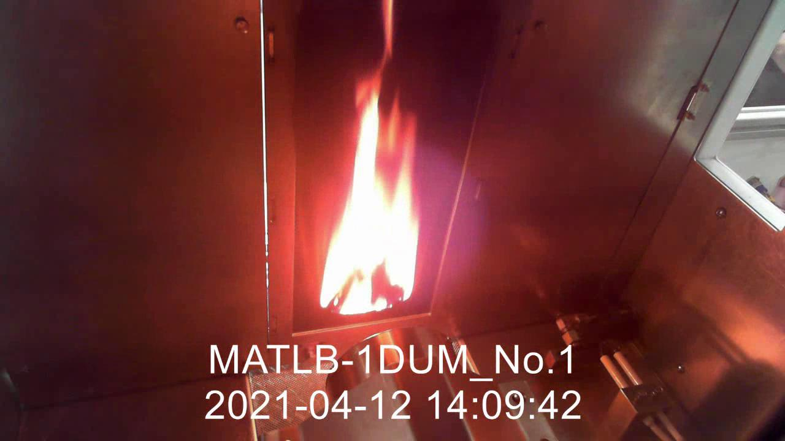
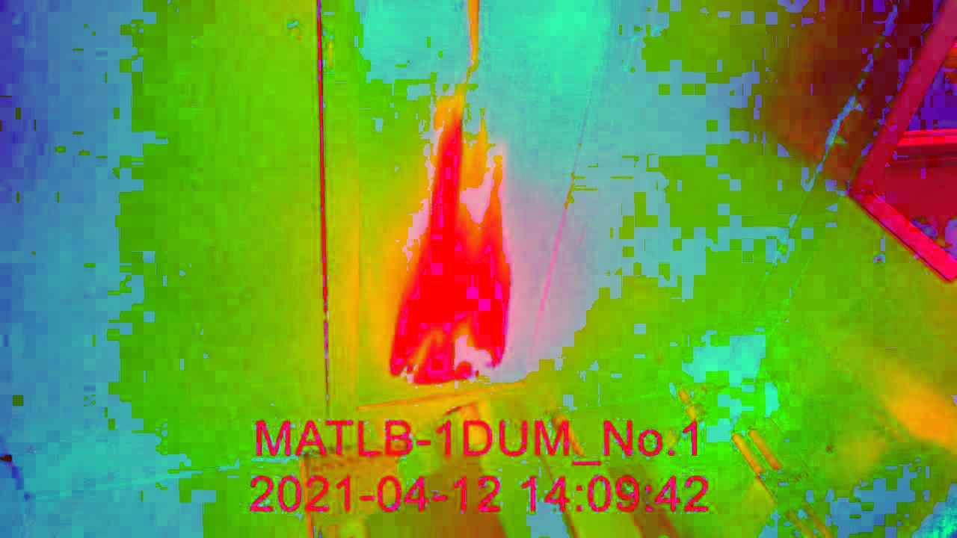
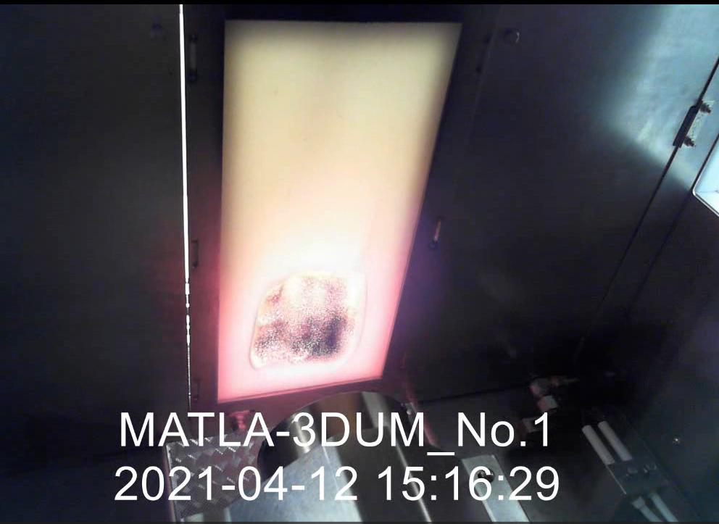
Feature extraction: Image processing
Flame intensity:
Convert frames from RGB to HSV and extract the frame with the max value in the video. The max value is the Flame intensity
Charring area:
Convert the last frames from RGB to GreyScale and crop it. Apply a threshold on the cropped frame, the Nbr of black pixels is the charring area

Slide 8
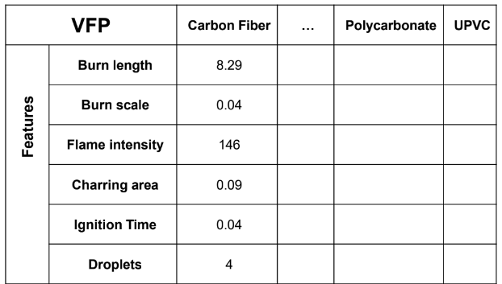
VFP Results Example
Flame Intensity and Burn Lenght are trusted results, and with an FPS= 30 for example we have time measurement with 0.03s precesion.
Nbr of Droplets and Egnition Time can be missleading because of the False positives specially for the Egnition Time.
Burn Scale and Charring Area are trusted results but we can only compare the videos that have identical camera settings
Notes:
Far objects appear small
Close objects appear big
Impact the measurement

Slide 9
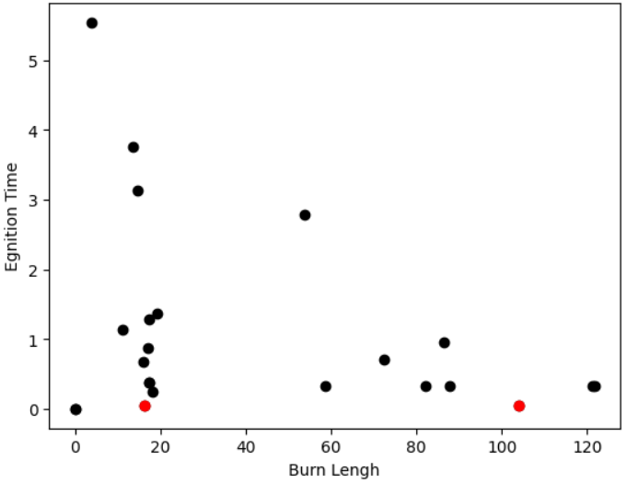
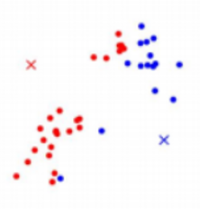
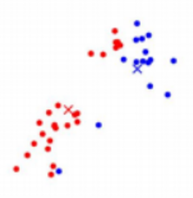
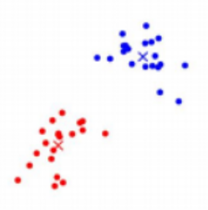
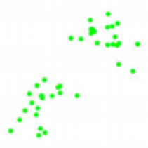
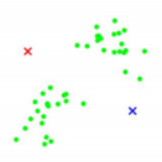
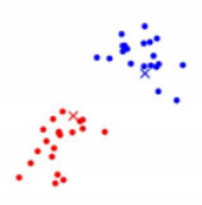
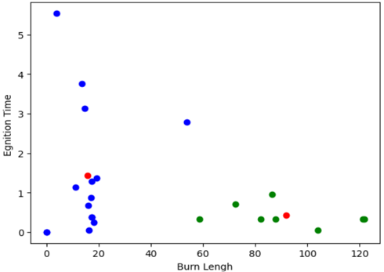
Clustering: K-means
Our Data
Random centroids position
First iterarion
New centoids position
Second iteration
New centoids position
Notes:
The K-means algorithm identifies k number of centroids, and then allocates every data point to the nearest cluster.

Slide 10
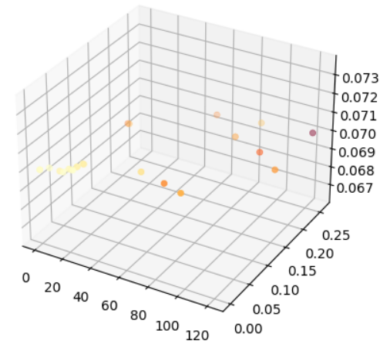
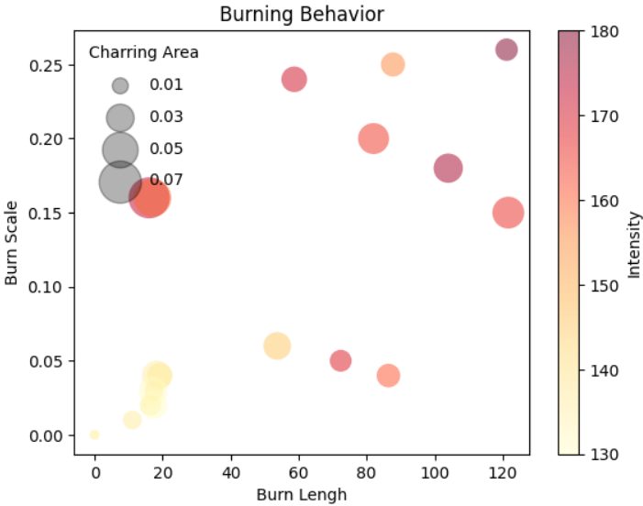
Clustering Results
Despite the limited data (23 videos containing 9 different materials), we were able to regroupe them into 5 clusters with only 1 missmatch.
GF Carbon Fiber Epoxy Resin test 3
Bmaterials
wireC
FKM
Layup3
PTFE
fabric reinforced
GF Carbon Fiber
polycarbonate
materialA
Notes:
Exlude some features
Charring area: can’t measured for black materials.
Ignition time: can be missleading if the flammability test doesn’t start in the beginning of the video.
Nbr of droplets: always between 0 and 4 so can’t generalize and can be irrelivant.

Slide 11
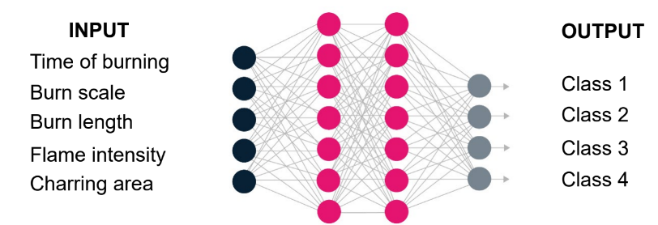
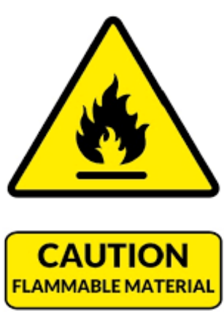
Next: Classification
Binary classification:
Safe to implement onboard or not
Storage indoor or outdoor
…
2. Multi class classsification:
Classification to identify the burned material.
Classification to identify the source of the burning:
-Wood, Tissue….. ; Water
-Iron, Electrical… ; CO2
-Oil, petrol…........ ; Pouder
…

Slide 12
Future Work
Systematic Study with Optimized Conditions:
Set of Materials
Camera Angles
Lighting / Wavelengths
Fixed Focal Point
Minimize Interferences
Additional Parameter Entries & Extractions
Test Methods
FAA Bunsen Burner Pass/Fail Tests Based on Operator Observations
UL-94
Other Test Methods?

Slide 13
Thank you for your attention! Questions?
richard.walters@faa.gov
bensid28@students.rowan.edu

